Slide 1
Soldering Station
Project ontwerpen

Slide 2

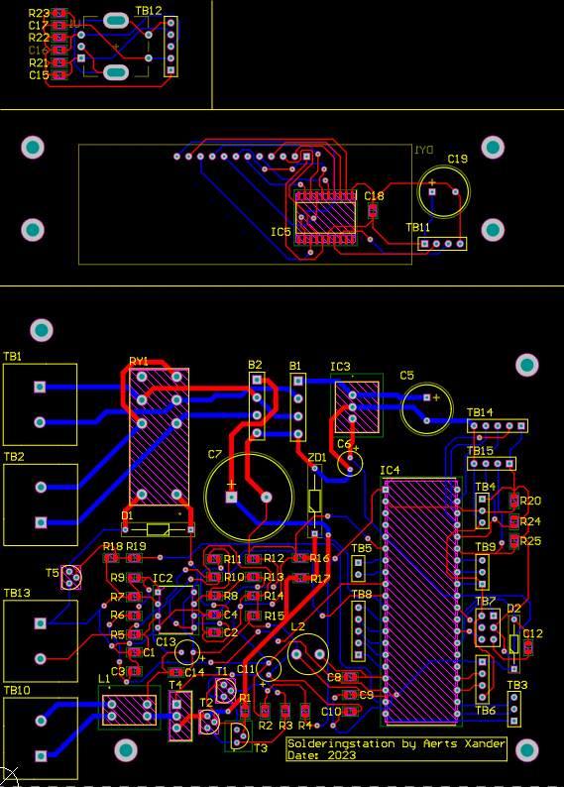
PCB design
Through hole components:
Advantages
Disadvantages

Slide 3
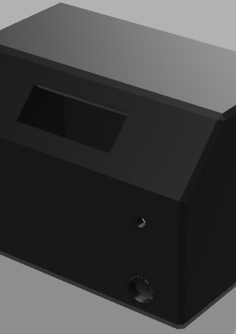
Case Design
Design challenges
3D printer

Slide 4

Demo

Slide 5
Q&a

