Slide 1
Soldering Station
Project ontwerpen

Slide 2

Introduction

Slide 3

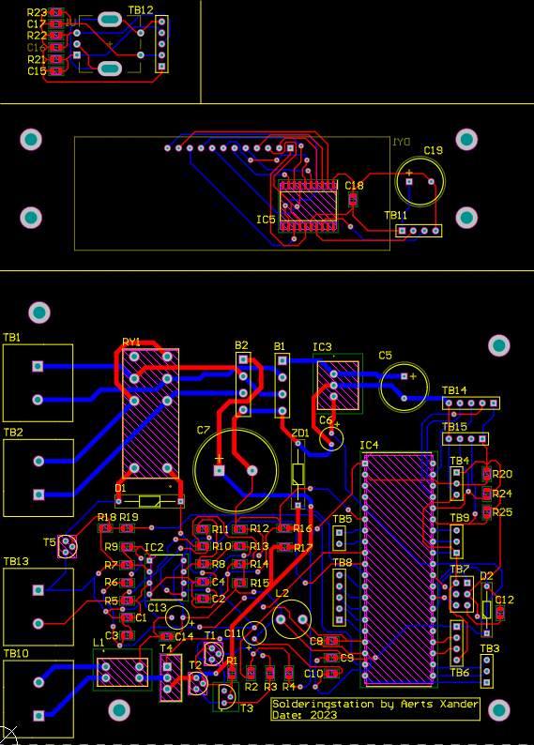
PCB design
Through hole components:
Advantages
Disadvantages

Slide 4
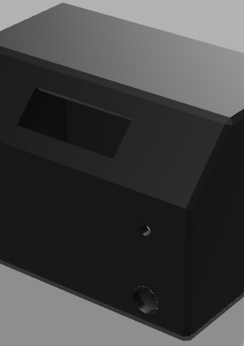
Case Design

Slide 5
Demo

Slide 6
Q&a

