Slide 1
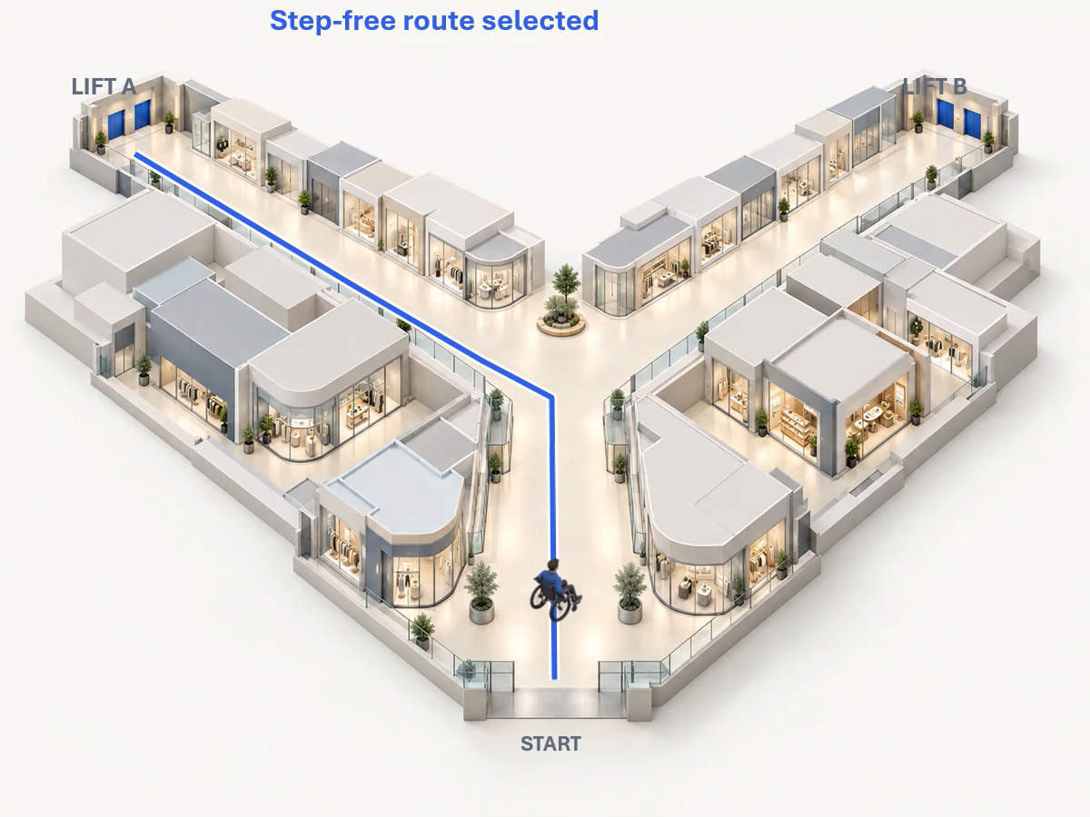
TEAM 1022 / HUMANROUTE
AccessRoute HK
A journey that
should be simple
Personalised navigation for people with different mobility needs
GREEN TRANSPORT & SMART MOBILITY
CONCEPT VISUALIZATION · SIMULATED MOVEMENT
Leader: Li Tong Bo (HKUST)
Zhou Yi Xi (HKBU)
Leung Tsun Hin Brian (HKUST)
PENG Yang Han (LingU)
Fan Zhen Zhen (HKBU)
Zhang Jian Ming (HKBU)
Notes:
Opening concept visualization. The mall is an original fictional scene, not a verified map of Hysan Place. Wheelchair motion and Lift A outage are scripted, not live positioning or live facility data. The actual working prototype should be demonstrated later in the deck. Team details retained from the provided cover. Generated mall prompt: premium isometric cutaway fictional mall with ivory shops, broad corridors and two blue elevator alcoves. Generated avatar prompt: miniature human in manual wheelchair, blue jacket, high rear three-quarter view, transparent background. Built-in image generation used.

Slide 2
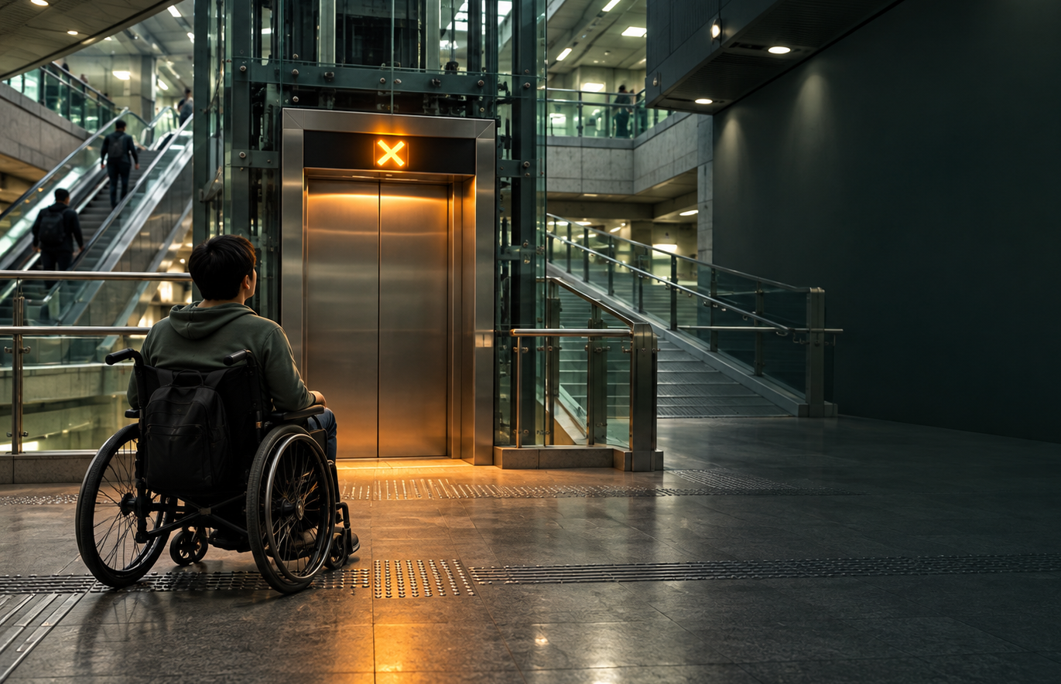
Invisible barriers in a vertical city
Three recurring barriers can invalidate an otherwise usable route.
110
responses in a preliminary needs and preferences survey
CONCEPT SCENE
66.4%
A failed lift can end the journey, even when the map still shows a route.
Survey scope: broad preliminary sample. Results show needs and preferences, not product effectiveness.
INTERNAL SURVEY · N = 110
02
Notes:
Preliminary survey, N=110. The slide highlights three problem indicators: lift failure or construction 73/110 (66.36%); inaccurate indoor GPS 70/110 (63.64%); uncertain floor level 59/110 (53.64%). Multiple responses were allowed. These findings support needs research, not usability or product-effectiveness claims.

Slide 3


Slide 4
Why existing solutions fall short
The gap appears when the journey moves indoors or the planned route becomes unavailable.
Capability | Mainstream maps | Venue information | AccessRoute HK demo
Outdoor route | Strong | Local only | Available in demo scenes
Floor and lift context | Limited | Often static | Floor-aware interface
Disruption recovery | Rare | Staff dependent | Simulated lift closure reroutes
Accessibility evidence | Incomplete | Fragmented | Unknown segments disclosed
Positioning
AccessRoute adds three missing layers: personal mobility constraints, indoor floor context, and recovery when a lift or route becomes unavailable.
HUMANROUTE · ACCESSROUTE HK
04
Notes:
Existing maps can show that a route exists, while users still lack the floor, lift and disruption information needed to complete it. AccessRoute focuses on personal constraints, indoor context and recovery. The comparison remains a product-positioning summary rather than a verified benchmark of named competitors.

Slide 5
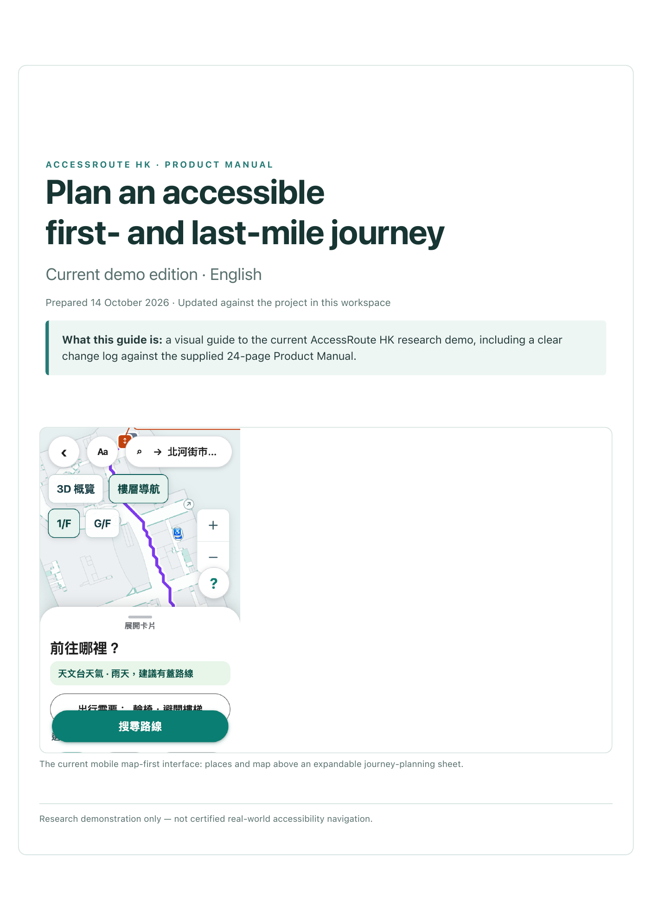
Introducing AccessRoute HK
PROTOTYPE & DESIGN SCOPE
Accessible journeys
across Hong Kong’s
vertical city
Users select their mobility needs before planning. Stair access, lift requirements and shelter preferences shape the route to the same destination.
Five connected capabilities
Mobility profiles
Vertical route planning
Cantonese preference parsing
Visual location checks
Obstacle reporting and rerouting
Landmark voice guidance
Walking
Wheelchair
Elderly
Stroller
Heavy luggage
Current prototype interface
HUMANROUTE · ACCESSROUTE HK
05
Notes:
Implementation sources: accessroute-hk/shared/session/contracts.ts and shared/routing/preferences.ts. Current objectives include balanced, shortest, sheltered, indoor, least_effort and fastest. The implementation does not expose a public-transport transfer-tolerance objective.

Slide 6
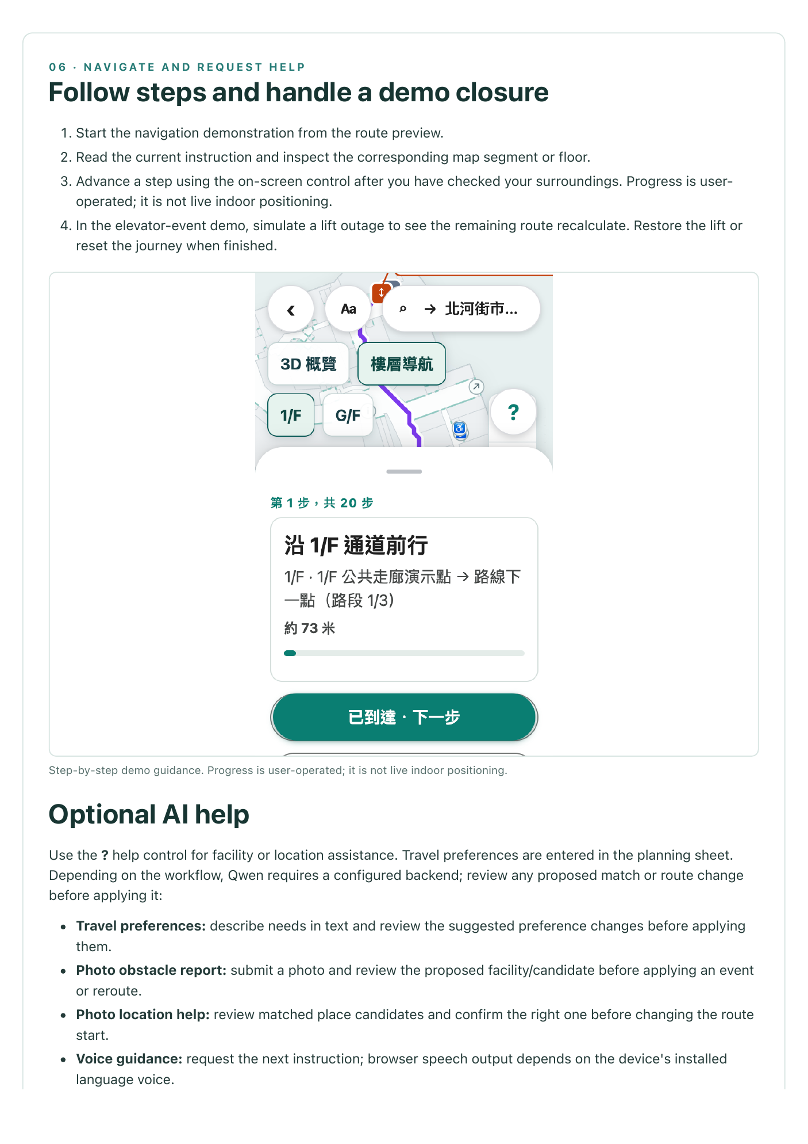
CORE DEMO · 75s
AccessRoute in action
An accessible journey
PRESET DEMO / LIVE API
01
State your needs
Describe needs by voice or text, then confirm
02
Choose a route
Apply stair, lift and shelter preferences
03
Confirm your location
Match photo landmarks to map candidates
04
Report a blocked lift
Confirm the facility and apply a closure event
05
Continue on the revised route
Replan from the current point with text or speech
PHOTO CANDIDATES / USER CONFIRMATION / REMAINING-ROUTE UPDATES
06
Notes:
Implementation sources: accessroute-hk/backend/providers/session-assistance.ts, backend/session/service.ts, backend/workflows/localization.ts and backend/workflows/obstacle.ts. The product supports preset assistance and live Qwen workflows. Preset materials demonstrate the confirmation flow and must not be presented as a live model result. Live requests require a working provider configuration. Progress is updated at discrete step anchors. The closure in this presentation is simulated.

Slide 7
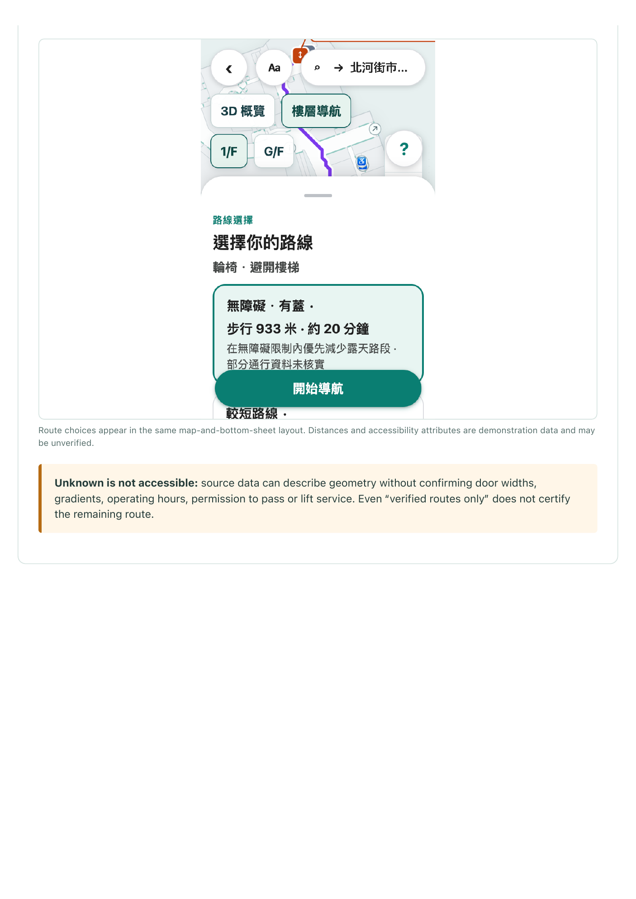
What makes us different
Three design choices connect route planning with recovery when location or access changes.
01
Vertical route intelligence
One graph connects floors, lifts and outdoor paths. Mobility constraints and shelter preferences determine feasible routes.
02
Voice and photo assistance
AI parses needs and observes photos. Map retrieval matches evidence to known nodes or facilities for user confirmation.
03
Cantonese landmark guidance
Cantonese guidance describes planned route steps and mapped landmarks. Browser speech reads the text using a device voice.
Routing rule: every path follows mobility constraints and active facility or path events.
HUMANROUTE · ACCESSROUTE HK
07
Notes:
Implementation sources: accessroute-hk/shared/routing/route.ts, shared/routing/policies.ts, backend/workflows/matching.ts, backend/agents/guidance.ts and frontend/src/genai/speech.ts. Voice input and speech playback depend on browser and device support. The current product uses confirmation forms and location candidates. It does not implement a conversational positioning dialogue or fully hands-free navigation.

Slide 8
IMPLEMENTED ARCHITECTURE
Hybrid multi-agent architecture
Qwen models parse needs and observe photos. Map retrieval checks candidates before user confirmation and route updates.
Preference agent
Vision agent
Map-matching agent
Guidance agent
Needs to routing preferences
Photo text, landmarks and barriers
Nearby candidates and checked IDs
Route facts to Cantonese text
Deterministic routing and rerouting
Hard constraints first, then Dijkstra on the current graph
Official maps, floor graphs and field anchors
Timed events overlay an unchanged base graph
HUMANROUTE · ACCESSROUTE HK
08
Notes:
Architecture sources: accessroute-hk/docs/genai-architecture.md; backend/agents/preferences.ts, vision.ts, map-matcher.ts and guidance.ts; backend/retrieval/map-index.ts and rank.ts; shared/routing/route.ts and policies.ts. Four product workflows (preferences, obstacle, localization, guidance) reuse these specialist roles. For a photo, vision extracts visible evidence, spatial/floor retrieval selects known candidates, the matching agent compares evidence, and ranking returns map candidates. Product users confirm candidates before application. Confirmed obstacles create timed facility/edge events, localization updates the start anchor, and the same routing core replans the remaining route. Guidance consumes route facts. The diagram groups roles and shared components; connecting lines indicate integration, not a parallel sequence. Qwen text and vision model names are configurable. Implemented source code does not establish live-provider availability or model accuracy.

Slide 9
Prototype implementation and validation
Implemented navigation workflows and the measures planned for a target-user pilot.
Test item | Implemented capability | Planned pilot measure
Route calculation | 12 scenes with shared routing policies | Named-route journey completion rate
Lift outage reroute | Closure events trigger remaining-route updates | Median reroute time after a simulated closure
Photo localisation | Photo upload, map matching and confirmation | Top-1 match accuracy on a labelled test set
GenAI assistance | Four workflows and browser Cantonese speech | Latency, success rate and cost per task
Pilot: Kowloon Tong F exit to Cornwall Street, with one simulated lift closure.
IMPLEMENTED WORKFLOWS / USER-PILOT MEASURES PENDING
09
Notes:
Evidence sources: accessroute-hk/data/scenes/index.json registers 12 scenes; shared/routing and backend/session implement policy-based routing and confirmed event/position updates; backend/workflows implements four AI workflows; frontend/src/genai/speech.ts implements browser speech. Kowloon Tong field route sources: data/field/kowloon-tong-festival-walk/field-evidence.json and demo/九龙塘实地路线验证.pdf. Capabilities in the middle column describe implementation, not measured effectiveness. Pilot completion, reroute timing, labelled-photo accuracy, model latency, success rate and cost remain measurements to collect. No numerical accuracy or latency result is claimed. The named pilot route uses the public interchange near Cornwall Street, not an entrance inside the CityU residence.

Slide 10
Sustainable business model
Users receive free access. Venues, public agencies and sponsored programmes can fund deployment
and support.
B2C
B2B
B2G
SPONSORED ACCESS
USERS
VENUE PARTNERS
GOVERNMENT
NGOS & CHARITIES
Free access
Personalised journey planning
Report barriers for review
Shopping centres, campuses, hospitals and transport hubs
Setup and service support
Accessible public services
Cross-venue standards
District route coverage
Procurement or grants
Sponsor access programmes
Recruit target users
Co-design and outreach
Community feedback
Funding logic
Venue licences, public projects and charity-sponsored programmes fund route setup, verification and service support.
B2B2C / B2G / NGO-SPONSORED ACCESS
10
Notes:
Business model hypothesis, not confirmed contracts. Individual users access the service free. Venue partners may fund setup and support. Government can support accessible public services, cross-venue standards and district coverage through procurement or grants. NGOs and charities can sponsor access programmes, recruit target users and support co-design and outreach. Do not present any stakeholder as a current partner.

Slide 11
Inclusive mobility, equal access
Inclusive access depends on responsible AI, location privacy and clear uncertainty.
Where AI is used
Risks and safeguards
01
Voice and text preferences
AI misinterpretation
Interprets language, mobility needs and route preferences.
Users confirm needs, locations and affected facilities before applying route changes.
02
Photo and landmark matching
Matches photo landmarks to nearby map nodes for user confirmation.
Location and photo privacy
Limit photo and location collection to the task. Define consent and retention before a user pilot.
03
Obstacle report classification
Maps an obstacle report to a facility or path for user confirmation.
Outdated facility information
04
Plain-language guidance
Timed reports expire. Unknown access attributes stay unknown, and strict mode excludes them.
Turns route facts into Cantonese text for browser speech playback.
AI interprets and explains. Deterministic rules control safety-critical routing.
RESPONSIBLE AI / PRIVACY / DATA UNCERTAINTY
11
Notes:
Implementation sources: accessroute-hk/backend/session/service.ts, backend/workflows/obstacle.ts, backend/retrieval/rank.ts and shared/routing/policies.ts. Matching scores are evidence-ranking scores, not calibrated probabilities. Product users confirm needs and map candidates. Events have validity intervals. Unknown access attributes remain unknown; strict accessibility excludes unverified edges. Uploaded photos may be stored with local session state. Consent, data minimisation and retention are safeguards to define before the target-user pilot, not claims of an audited privacy implementation.

Slide 12
Social impact and next proof point
The prototype shows the journey logic. The next step is to test whether real users can complete it with confidence.
SDG 10
Reduced inequalities
SDG 11
Accessible transport
Next proof point
One target user completes one verified route, recovers from one simulated disruption and understands system uncertainty.
Intended social value
Fewer journeys blocked by missing floor and lift information
More confidence when a route changes unexpectedly
Clearer access to transport, healthcare and community life
Planned measures
Journey completion
Reroute time after a simulated closure
User confidence and understanding
AccessRoute helps people choose a journey they can actually complete.
PLANNED VALIDATION / NO USABILITY RESULTS CLAIMED
12
Notes:
Closing slide. The stated social value is an intended contribution, not measured impact. The next proof point is a future validation goal: one target user completes one verified route, recovers from one simulated disruption and understands the system's uncertainty. Suggested measures are journey completion, reroute time and user confidence.

