Slide 1



SMART INDIA HACKATHON 2026
Team: TerraVision
  Problem Statement ID – SIH26187
  Problem Statement Title- AI-Based Intelligent Video Analytics Platform for Border Surveillance.
  Theme- Blockchain & Cybersecurity
  PS Category- Software
  Team ID-
  Team Name- TerraVision

Slide 2

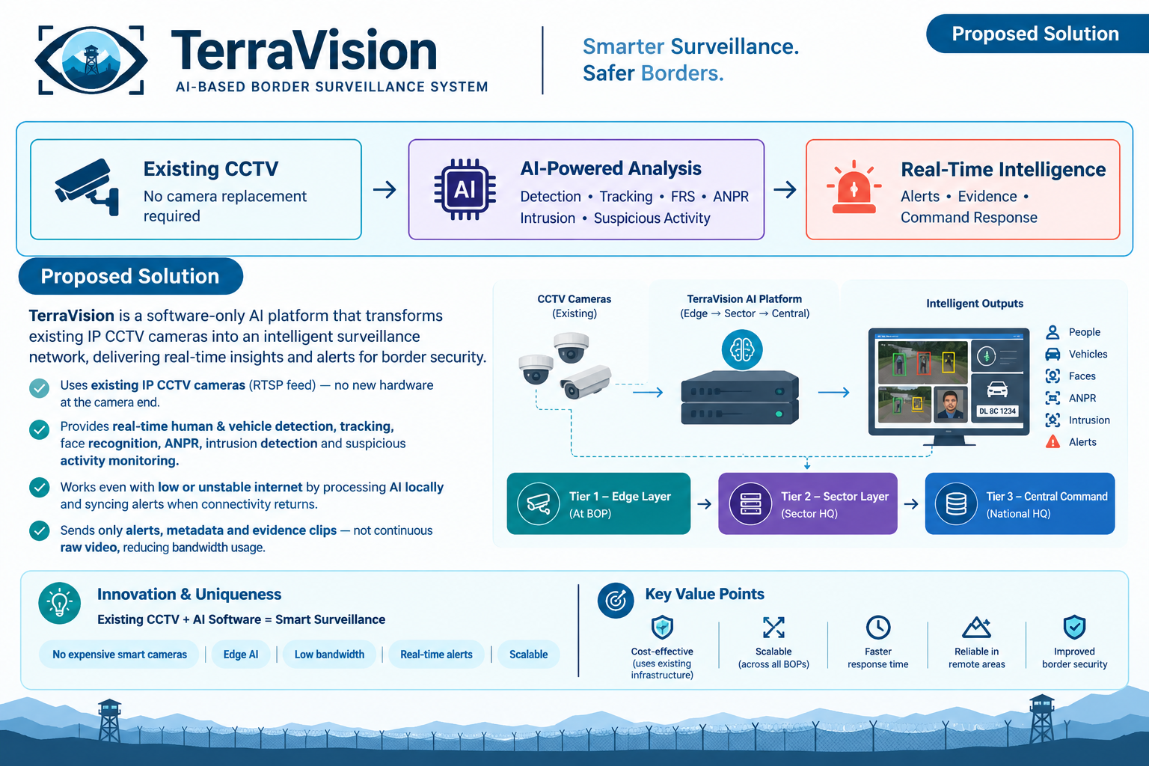
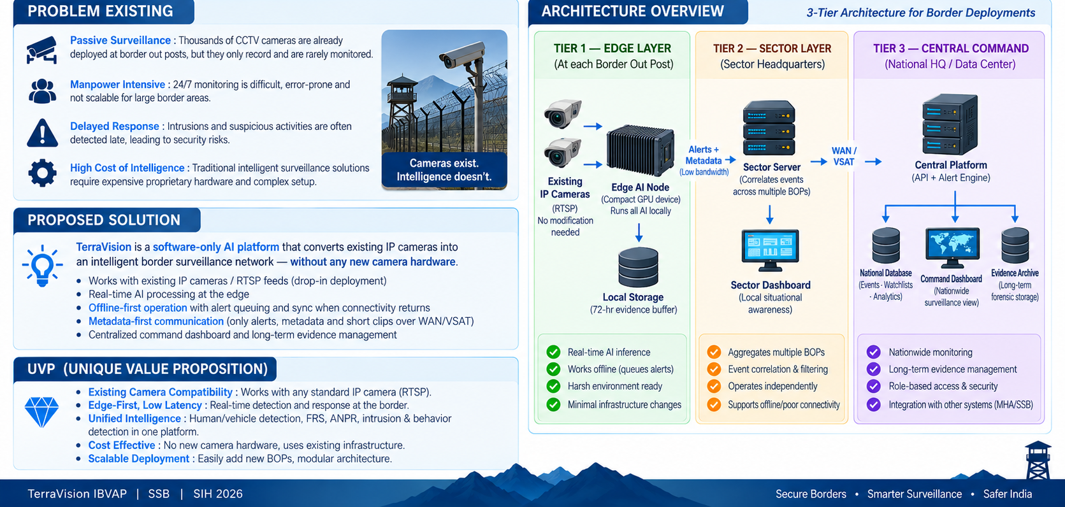
Intelligent Border Video Analytics Platform (IBVAP)
@SIH2026-TerraVision
2

Slide 3

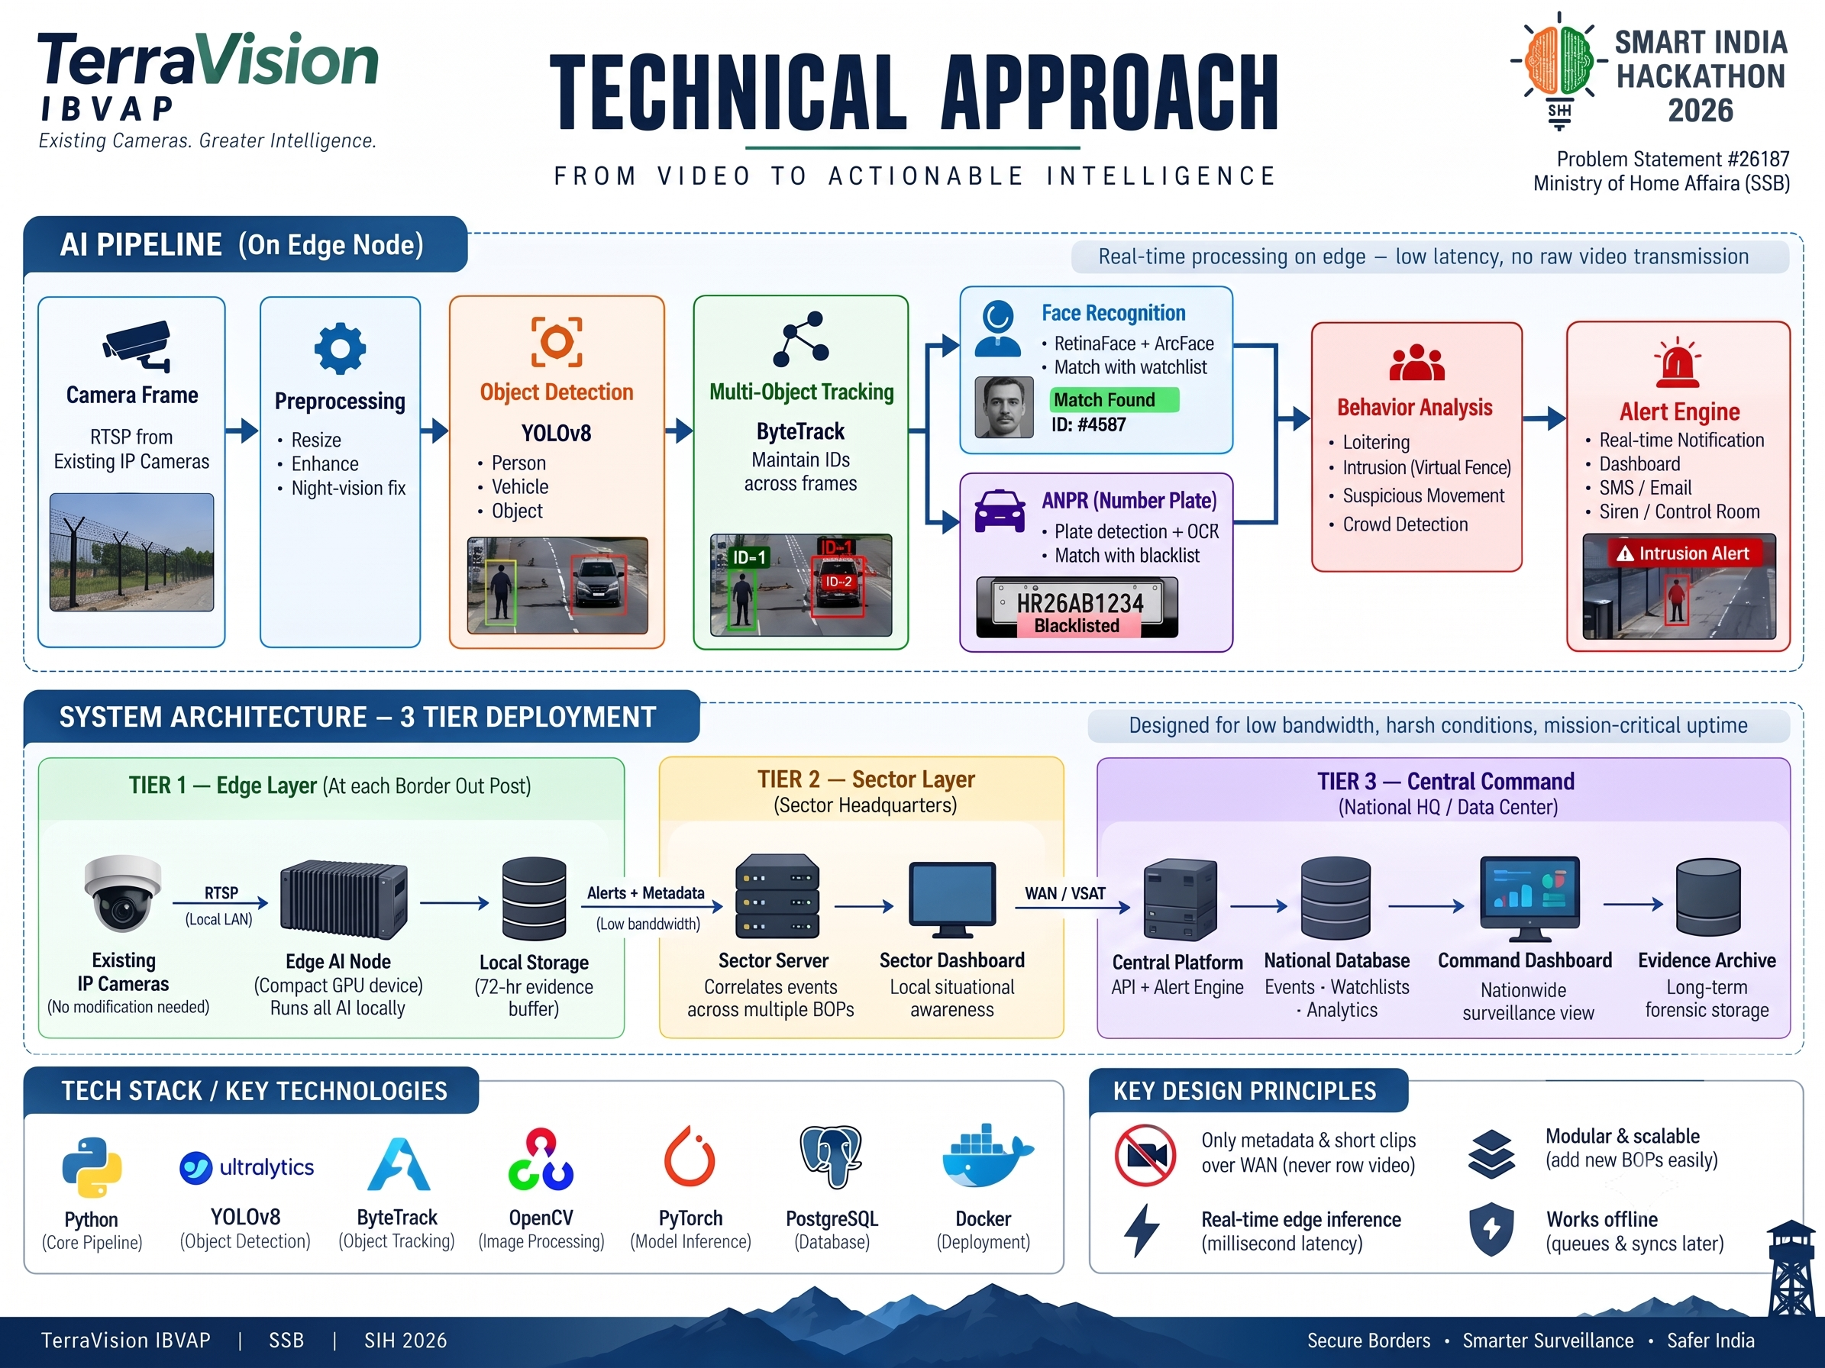

TECHNICAL APPROACH
3

Slide 4
FEASIBILITY AND VIABILITY
Challenges
Feasibility
Border posts often run on unreliable, low-bandwidth VSAT links
System must stay operational even if a central/sector server goes down
Zones need to be reconfigurable fast, without new hardware
All models (YOLOv8, ByteTrack, ArcFace, PaddleOCR) are proven, production-grade - not experimental
Works on existing cameras no new hardware needed
Same architecture scales edge → sector/regional → central
Strategies
Each tier (edge, sector, central) works Independently, so one failure doesn't cascade
Virtual fencing = geometry check on existing detections zero extra AI cost
Scaling just means adding edge nodes, not Redesigning the system

Slide 5
IMPACT AND BENEFITS
Benefits
Impact
1. Social: Strengthens border security and builds public trust in surveillance governance
2. Economic: Reuses existing camera infrastructure avoids cost of proprietary FRS/ANPR hardware
3. Security: Tamper-proof blockchain evidence trail supports forensic and legal accountability
Converts passive CCTV into real-time threat detection - closes the core problem gap
Cuts alert response time from minutes to milliseconds via edge-based AI
Scalability Implementation Plan
Enables 24/7 monitoring without increasing manpower
  Same architecture works from a single BOP pilot to a national deployment no redesign needed between phases, just more edge nodes
  Works over VSAT/low-bandwidth links because only metadata travels upstream viable in genuinely remote terrain, not just well-connected posts
Reduces operator fatigue and error from manual screen monitoring
@SIH2026-TerraVision
5

Slide 6


RESEARCH AND REFERENCES
Object Detection & Tracking
Text & License Plate Recognition (ANPR)
  Ultralytics YOLO
  ByteTrack Tracking Algorithm
  PaddleOCR Toolkit
Face Analysis & Biometrics
🔒 Network Security & Communication Architecture
  InsightFace Framework
  ArcFace Embedding Model
  Meta FAISS Vector Database
  NIST Zero Trust Architecture
@SIH2026-TerraVision
6

