Slide 1
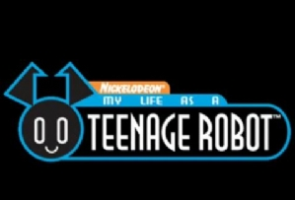
My Life As A Teenage Robot Video Review

Slide 2
Jenny Review Page 1/2
Jenny is the robot which the title is talking about. She's a superhero, which in some cases is quite impressive. She talks to other robots, like her sisters, and says that she shall not be dismantled. She can do many things, but her Mom keeps her from doing so.

Slide 3
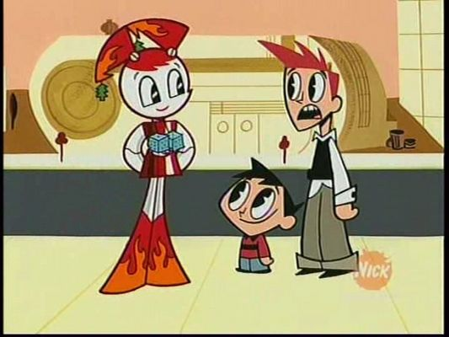
Jenny Review Page 2/2
The main point of the show is Jenny. From left to right, the characters in the picture, from left to right, are: Jenny, Tuck, and Brad. The show's pretty good. Except for certain parts... Like Jenny, her Mom is one big mess. She should just get a life. My Life As A Teenage Robot is pretty good... Please wait to see the results, that is, if you dare!

Slide 4
-Results-
The Ratings are as follows:
It's...
Awesome!

