Slide 1
Code Sharing Strategies and implementations

Slide 2



Name: Hristiyan Hristov
Position: FE Developer
<3: BJJ, JS, Coffee, Shishaa
github.com/Xapuu
xapu.Ivanov@gmail.com

Slide 3

When should we care
We have multiple teams
We want to enforce code quality rules
We want to migrate developers between teams efficiently
We have multiple applications
We are developing multiple applications with similar UI
We are developing multiple application with similar structure
We are developing multiple application depending on common service
We are continuously satisfying new business requirements
Notes:
Multiple teams
Code quality rules, like typescript + specific ts.config
Migrating developers between teams that are building applications the same way
Multiple teams
UI components sharing
Easier onboarding when switching teams
Common modules for implementing a requirement, like authentication module

Slide 4

Why should we care
100 KB
500 KB
1 MB
Notes:
When working in a company consisting of development teams, where new features are implemented on daily basis, there is high possibility, if you had not integrated some kind of code sharing system/process, that huge chunk of your development hours is rediscovering the wheel, that some of your colleagues had discovered last week, or maybe multiple people might be trying to solve the same task in parallel.
If you are familiar with the code base of your neighbor teams, you might be able to `copy` => `paste` some code, which also does not solves the copying problem at all.
In long therm the differences that occur, will stack upon each other, which will lead to serious mismatches in the products delivered by the different teams, which often is not the desired result.

Slide 5

DéjàVu: a map of code duplicates on GitHub
70% of the code on github consists of clones of previously created files
DéjàVu: a map of code duplicates on Git Hub

Slide 6

WTF should we do now

Slide 7
Subrepositoriess
Monorepositories
Nx
Vanila ng

Slide 8
Git Submodules
What are git Submodules
Main repository
Submodule 1
Sub-Submodule
Submodule 2
Notes:
Submodule might be looked upon as a subdirectory of git repository, which is actually a whole separate git repository with it's own git history, ignores and so on.

Slide 9
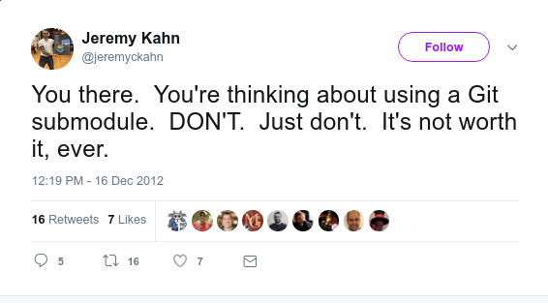
Git Submodules
A programmer had a version control problem and said, “I know, I’ll use submodules.” Now they have two problems.
Notes:
When I found out about github submodules and guess what was among the first results.

Slide 10
Git Submodules
Pros
Share code across multiple git projects
Separate git history per submodule/repository
Cons
Requires high level of discipline
Requires high level of git knowledge
Notes:
Every time you add a submodule, change its remote’s URL, or change the referenced commit for it, you demand a manual update by every collaborator.
Forgetting this explicit update can result in silent regressions of the submodule’s referenced commit.
Commands such as status and diff display precious little info about submodules by default.
Removing a submodule requires several commands and tweaks, some of which are manual and unassisted.
Requires high level of git knowledge, or in other words the "git add . + git commit" user will have hard time adjusting to this strategy and might introduce some risks to the repositority
When using submodule update without pushing the submodules changes, they will be lost (the changes inside the submodule)

Slide 11



Monorepo
What is Monorepo
Monorepo ≠ Monolith
Piper
Mercurial
Git GVFS
Notes:
# Intro
"Monorepo" or "Molonolithic repository" is a software development strategy where multiple projects are stored in single repository
# Piper: Custom monorepo implementation
# Mercurial: Facebook extends Mercurial, which is a free, distributed source control management tool
# GVFS: Git Virtual File System, Microsoft extends git

Slide 12
Monorepo
Pros
Atomic commit possibility
Ease of code reuse
Single source of true
Simplified dependency management
Collaborations across teams / Flexible code ownership
Easier integration of tools
Cons
Common git version history
Loss of version information
Tight coupling
Lock per-project security
Increased build complexity
Size limitations

