Slide 1



Name: Hristiyan Hristov
<3: BJJ, JS, Coffee, Shishaa
github.com/Xapuu
xapu.Ivanov@gmail.com

Slide 2
Code Sharing Strategies and Implementations

Slide 3


Why should we care
DéjàVu: a map of code duplicates on GitHub
70% of the code on github consists of clones of previously created files
Programs, Life Cycles, and Laws of Software Evolution
Continuing Change
Increasing Complexity
Self Regulation
Conservation of Organisational Stability
Conservation of Familiarity
Continuing Growth
Declining Quality
Feedback System
Notes:
When working in a company consisting of development teams, where new features are implemented on daily basis, there is high possibility, if you had not integrated some kind of code sharing system/process, that huge chunk of your development hours is rediscovering the wheel, that some of your colleagues had discovered last week, or maybe multiple people might be trying to solve the same task in parallel.
If you are familiar with the code base of your neighbor teams, you might be able to `copy` => `paste` some code, which also does not solves the copying problem at all.
In long therm the differences that occur, will stack upon each other, which will lead to serious mismatches in the products delivered by the different teams, which often is not the desired result.
IEEE 1980 Volume 9 Lheman Laws

Slide 4

When should we bother
We have multiple teams
We want to enforce code quality rules
We want to migrate developers between teams efficiently
We have multiple applications
We are developing multiple applications with similar UI
We are developing multiple application with similar structure
We are developing multiple application depending on common service
We are continuously satisfying new business requirements
Notes:
Multiple teams
A lot of developers in the company – 10 people an enforce them themselves but what about 500
Code quality rules, like typescript + specific ts.config
Migrating developers between teams that are building applications the same way – decrease cost per developer transfer because he will work in the same code enviroment
Multiple applications
UI components sharing
Easier onboarding when switching teams
Common modules for implementing a requirement, like authentication module

Slide 5
Git Submodules
Monorepo
Angular CLI
Nx
Packages
Topic
Notes:
Look at some code sharing strategies
Look at angular specific implementations / where Nx is applicable for js projects overall

Slide 6
git Submodules
Main repository
Submodule 1
Sub-Submodule
Submodule 2
Git
Notes:
Submodule might be looked upon as a subdirectory of git repository, which is actually a whole separate git repository with it's own git history, ignores and so on.
If the technological context allows for packaging and formal dependency management, you should absolutely go this route.
Therefore be mindful of your current directory when reading your prompt or typing commands:

Slide 7
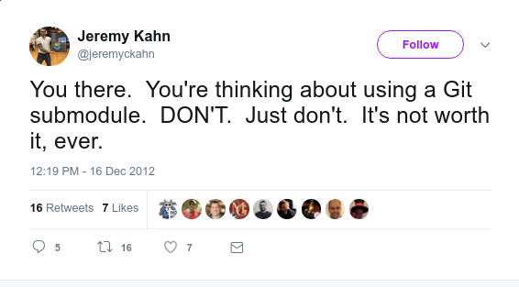
A programmer had a version control problem and said, “I know, I’ll use submodules.” Now they have two problems.
Git
Notes:
When I found out about github submodules and guess what was among the first results.

Slide 8
Pros
Share code across multiple git projects
Cons
Requires high level of discipline
Separate git history per submodule/repository
Requires high level of git knowledge
Git Native
Detailed docs
Git
Notes:
Every time you add a submodule, change its remote’s URL, or change the referenced commit for it, you demand a manual update by every collaborator.
Forgetting this explicit update can result in silent regressions of the submodule’s referenced commit.
Commands such as status and diff display precious little info about submodules by default.
Removing a submodule requires several commands and tweaks, some of which are manual and unassisted.
Requires high level of git knowledge, or in other words the "git add . + git commit" user will have hard time adjusting to this strategy and might introduce some risks to the repositority
When using submodule update without pushing the submodules changes, they will be lost (the changes inside the submodule)
Because constant vigilance does not work. Ever.

Slide 9



Monorepo
Monorepo ≠ Monolith
Monorepo
Piper
Mercurial
Git GVFS
Notes:
# Intro
"Monorepo" or "Molonolithic repository" is a software development strategy where multiple projects/packages are stored in single repository in a non coupled way
# Piper: Custom monorepo implementation
# Mercurial: Facebook extends Mercurial, which is a free, distributed source control management tool
# GVFS: Git Virtual File System, Microsoft extends git

Slide 10
Pros
Possibility for atomic commits
Reuse code with ease
Single source of true
Simplified dependency management
Collaborations across teams / Flexible code ownership
Easier tool integration
Cons
Common git version history
Loss of version information
Lock per-project security
Increased build complexity
Size limitations
Single lint, build, test and release process
Monorepo
Notes:
+ pros
Single place to report issues
Tests across modules are run together
Cross-project changes

Slide 11

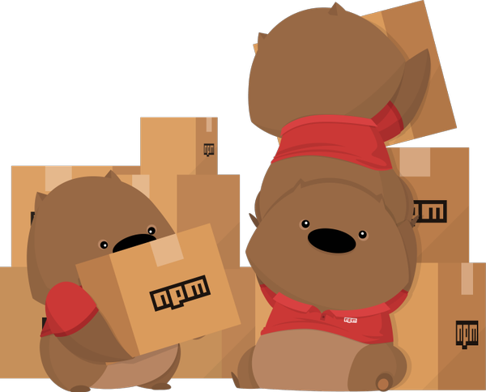
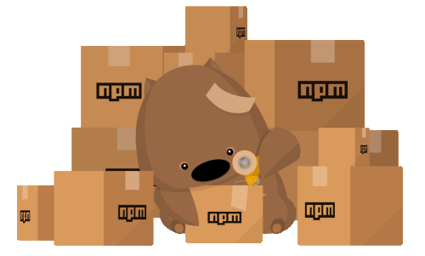
Packages
Packages
Notes:
Packages are basically a way of code sharing, which purpose is to share already written code that tackles common problems
Clojure has Clojars, Erlang has Hex, Go has GoDoc, Haskell has Hackage, Java has Maven Central, JavaScript has npm and Bower (and others, too), NET has nuget, Objective-C has CocoaPods, Perl has CPAN, PHP has Composer, Python has PyPI, Ruby has Bundler and Rubygems, Rust has Crates

Slide 12
Pros
Reuse code with ease
Single source of true
Loose coupling
Possibility to have multiple versions
Cons
Another repository that must be maintained
Delays when multiple teams depend on new features from future releases
Building adequate library usually takes a lot of effort
Avoid unnecessary development effort
Packages

Slide 13

Angular CLI
6+
ng Cli
Notes:
If you haven't already tried the latest cli you've missed a lot
Version 6 supports workspace and lib generation(trough ngPackagr) out of the box.
What is the CLI ?
The cli is Command-line interface that helps with initializing, developing, scaffolding and maintaining Angular application
Now we will explore how can the CLI aids in sharing code across projects

Slide 14


How it works
ngPackagr
ng Cli
import {} …
npm publish
Notes:
Download the angular CLI
Create lib (with the help of the ngPackagr internally)
- The lib will automatically follow the APF (Angular package format), which is google defined format, which is npm publishable
3. Publish the package to whatever host you like
4. Use it inside your repository any way you like

Slide 15
Demo
d:\> npm install –g @angular/cli
d:\> ng new meetupApp –createApplication=false
d:\> cd meetupApp
d:\> npm install scss-bundle
d:\> ng g library mLib –prefix=ml –style=scss
–viewEncapsulation=none
d:\> ng g application meetupApp –prefix=ma –style=scss
ng Cli

Slide 16
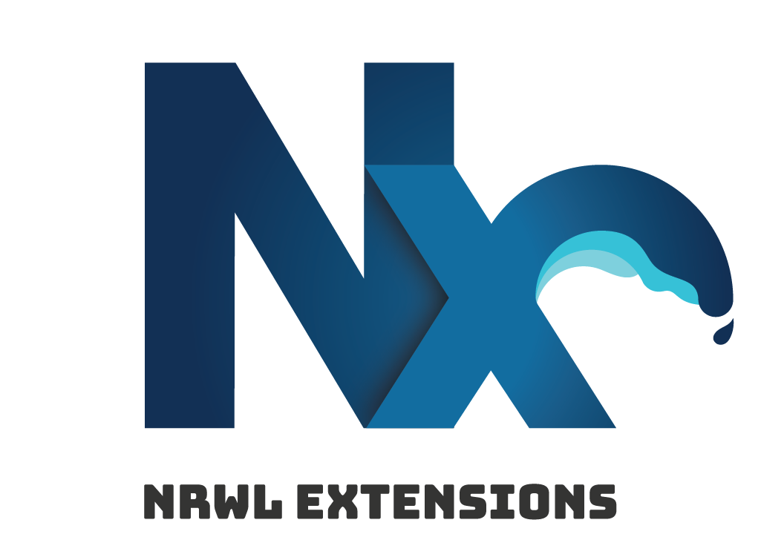

Nrwl && Nx
Nrwl
Notes:
What is nrwl
Nrwl is consultancy company founded by
Victor Savkin
Angular and NgRx core contributor
Dependency injection
Change detection
Form module
Router module
Jeff Cross
- Angular mobile team lead
Http module
AngularFire2
RxJs contributor
What is Nx
Nx are set of angular @schematics, which provides the user with the opportunity to build nx-workspace and few more perks that will discuss in the next slides

Slide 17
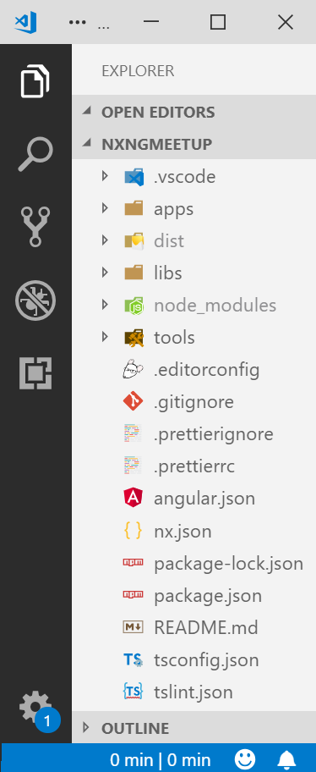
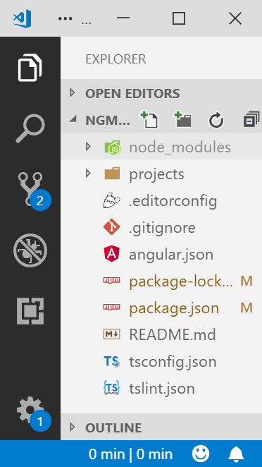
Vanilla vs Nx workspace
Nrwl

Slide 18
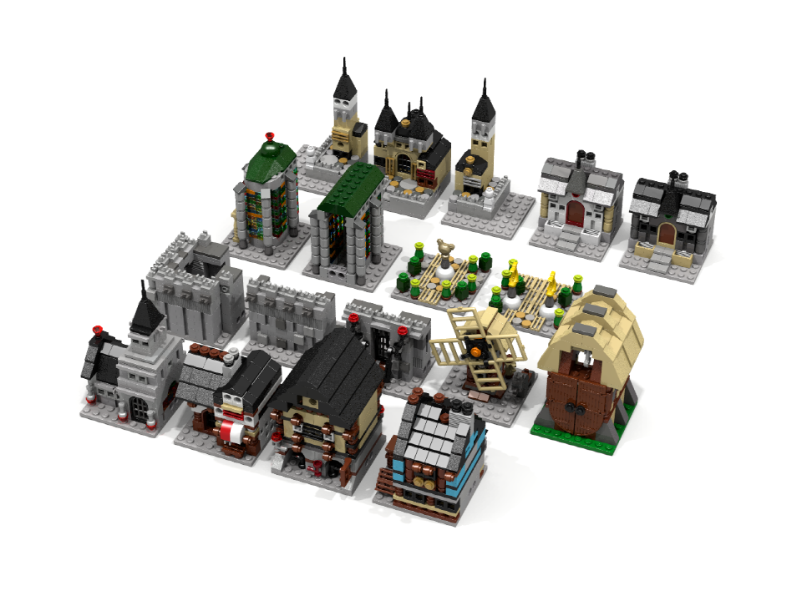
Nx libs
Nrwl

Slide 19
Lib types
Feature
Data-access
UI
Nx
Utility

Slide 20

Nx apps
Nx

Slide 21
Nx apps
Cart
doggy dog
kitty cat
Common UI
Common Utilities
Common
Services
Dog Adoption
Cat meetup
Registration
Cart
Registration
Cart
Registration
Common UI
Common Utilities
Common
Services
Nrwl
Dog Adoption
Cat meetup
Common Utilities
Dog specific
UI
Common Utilities
Cat specific
UI
Common UI
Dog specific
Services
Common UI
Cat specific
Services

Slide 22

Q&A in a minute
?

Slide 23

Code Sharing Strategies and implementations
Q&A
Q&A
github.com/Xapuu
Name: Hristiyan Hristov
xapu.Ivanov@gmail.com

