Slide 1
Website Defacing Incident

Slide 2
Incident Timeline
Port Scanning
Fuzzing
Gained access to: cnt-apache2.services.dom
Performed changes to Apache settings
Notes:
Timeline of Incident Events
Around 12:40 AM, our system detected an IP addressed port scanning our network
They were able to see that port 22 was open on cnt-apache2 which is the server hosting the Ogani website
The attacker was then able to gain access to the server running Apache by fuzzing
Then they performed some file manipulations and downloaded an archive
After modifying the homepage of the Ogani website they left
Our security team was unable to detect the changes until a few hours later
The attacker was only in the system for about 10 minutes

Slide 3
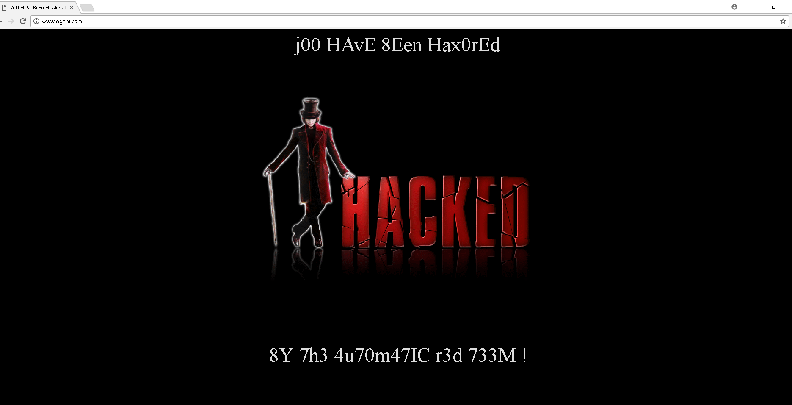
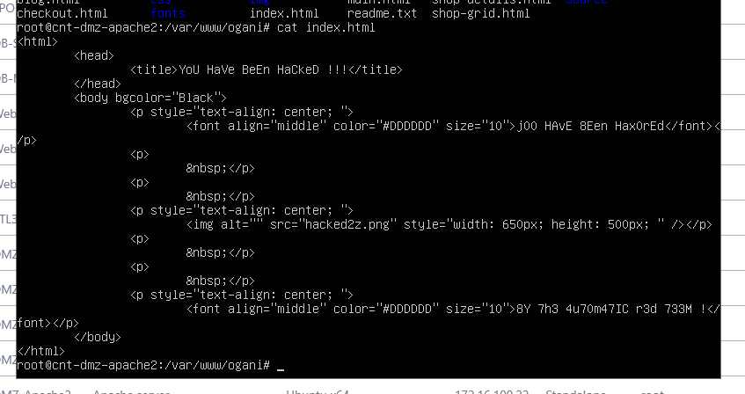
Incident Example
Notes:
Above you can see that changes that the attacker was able to make to the Ogani webpage
The other screenshot you can see is the modifications that the attacker did to the Apache configuration file

Slide 4
Mitigation

Slide 5
Impact Assessment

Slide 6
Lessons Learned

