Slide 1
Artificial Intelligence and Spatial Modeling to Estimate Traffic Volume Measures on Local Roadways
by
Mahmuda Sultana Mimi
Thesis Committee
Chair of the Committee: Dr. Subasish Das, Assistant Professor
Committee Member: Dr. Anandi Dutta, Assistant Professor
Committee Member: Dr. Yihong Yuan, Associate Professor
June 23, 2025
Notes:
Today I am going to present for my thesis defense, titled

Slide 2
Outline
Background
Problem statement and research questions
Literature review
Data description
Non-Spatial RF Modeling
Spatial RF Modeling
Conclusion

Slide 3
AADT on Local Roads
Background
Annual Average Daily Traffic (AADT) is a fundamental metric used in transportation planning, safety assessments, and infrastructure development (Baffoe-Twum et al., 2022).
Defined as the total traffic volume on a roadway divided by 365 days (FHWA, 2022).
Essential for:
Traffic forecasting 📈
Roadway capacity analysis 🚗
Environmental impact assessments 🌍

Slide 4
Background
FHWA made AADT a key input for decision-making in transportation agencies (FHWA, 2022).
Mandatory for State Departments of Transportation (DOTs) to report AADT annually to the Highway Performance Monitoring System (HPMS) for all Federal-aid roadways (FHWA, 2016).
Accurate AADT estimation is essential for pavement design, roadway geometry analysis, and identifying high-risk crash locations (Jin et al., 2008; Zhao and Park, 2004).

Slide 5
Problem Statement
Conventional AADT estimation methods:
rely on permanent traffic count stations, short-term manual counts, and expansion factor methods.
often costly, time-consuming, and lack coverage for local roads (Drusch, 1966; Hartgen and Lemmerman, 1983; Xia et al., 1999).
Traditional traffic data collection is expensive and logistically challenging, particularly for local roads (Sharma et al., 2000).

Slide 6
What is the Problem?
Accuracy Issues: Expansion factor methods assume consistent seasonal and daily variations, which do not always hold true for local roads (Pan, 2008; Sharma and Leng, 1994).
Conventional Regression-Based Models:
While regression models incorporate roadway characteristics, land use, and socioeconomic factors, they often assume linear relationships, limiting predictive power (Mohamad et al., 1998; Zhao and Chung, 2001).
Often fail to capture spatial dependencies, leading to biased estimates in spatially heterogeneous contexts.
More recent research has demonstrated the effectiveness of machine learning models in capturing nonlinear relationships and improving estimation accuracy (Castro-Neto et al., 2009; Sharma et al., 1999).
Notes:
There are several problems that appear for local road AADT estimation. The first is the accuracy issue.

Slide 7
AADT Estimation in Previous Studies
Literature Review
Methods used:
Traditional Methods (Factor-Based Adjustment, Regression-Based Methods, Traffic Count Optimization),
Classification and Clustering Techniques,
Spatial Models (Geographically Weighted Regression, Kriging-Based Interpolation),
ML and DL Approaches, Hybrid and Advanced Models (Smoothly Clipped Absolute Deviation regression)

Slide 8
AADT Estimation in Previous Studies
Data used:
Manual short-term traffic counts, Continuous Count Stations (CCS) data, Satellite imagery and remote sensing data, Socioeconomic datasets from census or surveys, Employment and land use datasets
Most common variables included:
Roadway and Infrastructure Variables (functional class, Number of lanes, Road geometry and design attributes, Accessibility to employment centers)
Socioeconomic and Demographic Variables (population and employment density, income level, land use types)
Temporal and Seasonal Variables (monthly or day-of-week adjustment factor)

Slide 9
Review of previous studies
Table: Summary of methods used for AADT Estimation.
Category | Methods Used | Findings | Sources
Regression-Based Models | Linear regression, spatial regression, multiple linear regression, GWR, CART | Socio-economic, roadway characteristics, and spatial trends significantly impact AADT estimation. Conventional regression may overlook spatial dependencies. | Ritchie (1986), Mohamad et al. (1998), Xia et al. (1999), Zhao & Park (2004), Pan (2008), Eom et al. (2006), Lowry (2014)
Machine Learning & Deep Learning (ML/DL) Models | Random Forest (RF), Support Vector Regression (SVR), ANN, Fuzzy Basis Function Networks (FBFN), collaborative filtering, coefficient of variation (COV), fuzzy decision trees | ML/DL models improve AADT estimation; neural networks perform well with sufficient input; data-driven techniques improve assignment and accuracy. | Sharma et al. (1999), Sharma et al. (2001), Jin et al. (2008), Castro-Neto et al. (2009), Zhong et al. (2012), Wu & Zhang (2009)
Spatial Models | GIS-based geostatistics, stress centrality, connectivity indices, Kriging, image-based density estimation | Spatial tools help interpolate AADT in uncounted segments; account for spatial dependencies; satellite-based estimates improve with ground data. | Wang & Kockelman (2009), Selby & Kockelman (2011), Lowry & Dixon (2012), McCord et al. (2003), McCord & Goel (2009), Jiang et al. (2007)

Slide 10
Review of previous studies
Table: Summary of methods used for AADT Estimation.
Category | Methods Used | Findings | Sources
Other Methods (Grouping, Temporal, Assignment) | Factor grouping, hierarchical clustering, k-means, fuzzy c-means, Bayesian methods, seasonal adjustment factors, short-term count durations (24, 48, 72 hours), advanced assignment methods (DA, fuzzy decision trees) | Grouping improves homogeneity; clustering improves accuracy but varies by method; seasonal factors reduce errors; longer counts improve AADT; advanced assignment outperforms functional classification. | Garber and Bayat-Mokhtari (1986), Flaherty (1993), Rossi et al. (2012), Gecchele et al. (2011)

Slide 11
Review of previous studies
Table: Summary of Spatial Random Forest (SRF) Applications.
Study / Model | Methodological Innovation / Application | Domain | Key Contribution
Hengl et al. (2018) | RF for Spatial Prediction (RFsp) using buffer distances as covariates | Geoscience, Environmental Modeling | Showed RFsp performs comparably to kriging while being more flexible
Talebi et al. (2022) | Truly spatial RF using higher-order spatial statistics | Geoscience | Improved prediction of complex spatial patterns; outperformed standard RF and kriging
Georganos et al. (2021) | Geographical RF (GRF) localized RF models capturing spatial heterogeneity | Urban Modeling, Remote Sensing | Reduced residual spatial autocorrelation and enhanced local interpretability
Fouedjio (2020) | Spatial RF with Bayes-linear-Gauss conditioning for exact value matching at sample sites | Geoscience | Addressed prediction fidelity for applications like mineral and ore body mapping
Labib (2024) | SRF to model combined effects of greenness, pollution, and temperature on health outcomes | Environmental Health | Improved accuracy over non-spatial RF and revealed nonlinear, synergistic effects
Hengl et al. (2018) (2nd mention) | RFsp applied for spatio-temporal air quality (e.g., PM10) prediction | Environmental Exposure Modeling | Validated RFsp’s effectiveness in temporal-spatial prediction
Notes:
The studies collectively show that Spatial RF approaches enhance prediction accuracy and reduce spatial autocorrelation compared to standard RF and kriging. They have been successfully applied across geoscience, environmental, urban, and health domains, offering improved spatial pattern detection, better interpretability, and the ability to model nonlinear, synergistic effects.

Slide 12
Limitations and Research Gaps
Data Availability Constraints:
Traditional methods rely on limited traffic count stations and lack coverage for local roads.
Data scarcity affects the accuracy of AADT estimation, especially in low-volume networks.
Limitations of Traditional Models:
Factor-based and some regression models assume linear relationships between predictors and traffic volume.
Often fail to capture spatial dependencies.
These models struggle with irregular traffic patterns found in local roadways.

Slide 13
Limitations and Research Gaps
Challenges in Machine Learning Approaches:
Neural Networks, SVR, and Gradient Boosting improve predictions but fail to account for spatial dependencies.
Lack of effective spatial integration leads to estimation errors in unmonitored locations.
Limitations of Spatial Models:
GWR and kriging models require extensive calibration and fail in data-scarce environments.
Poor performance on local roads due to spatial variability and irregular flow patterns.
No prior studies applied the Spatial Random Forest (SRF) model specifically for the prediction of AADT.

Slide 14
What is the contribution of this study?
Application of Spatial Random Forest (SRF) Model
Incorporates spatial dependencies to enhance traffic volume predictions.
Addresses estimation challenges in low-volume and unmonitored road networks.
Investigates how roadway characteristics, socioeconomic variables, and geospatial factors impact AADT.
Includes unique composite Indicators (entropy, Walkability Index, Accessibility Index, Centrality Index) from Smart Location Database (SLD).
Compares results from Non-Spatial RF and Spatial RF models.
Provides insights into model effectiveness, error reduction, and scalability.
Enhances policy decisions for local road monitoring.
Notes:
Considering all these limitations, the contribution of this study is to combine both AI and Spatial modeling frameworks together in AADT estimation.

Slide 15
Research questions?
RQ1: How can artificial intelligence and spatial modeling be integrated to improve the accuracy of AADT estimation on local roadways where traffic count data is sparse?
RQ2: What are the key roadway, socioeconomic, and geospatial factors that influence AADT estimation?
RQ3: What are the limitations and challenges of using AI-driven spatial modeling techniques for AADT estimation, particularly for roads with highly variable or low-volume traffic patterns?

Slide 16
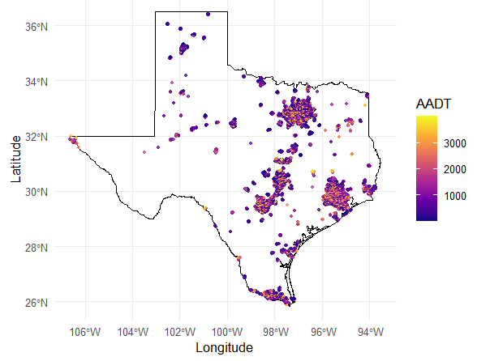
Overview of the dataset
Data Description
Data Source: Smart Location Database (SLD), 200 Variables.
SLD provides built environment, demographic, and transportation characteristics at the Census Block Group level across the U.S.
Figure: Location of local road AADT datapoints across Texas.
Notes:
The data used for this study is taken from SLD which is short for Smart Location Database that contains 200 variables.

Slide 17
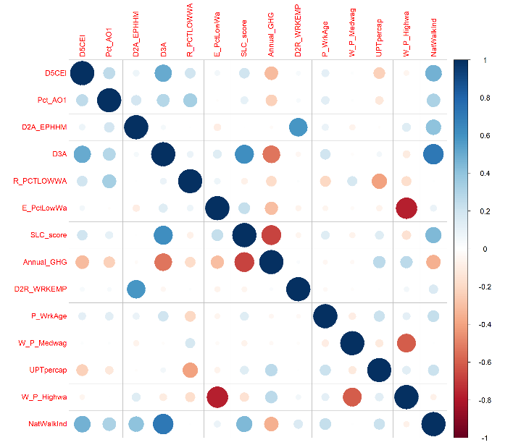
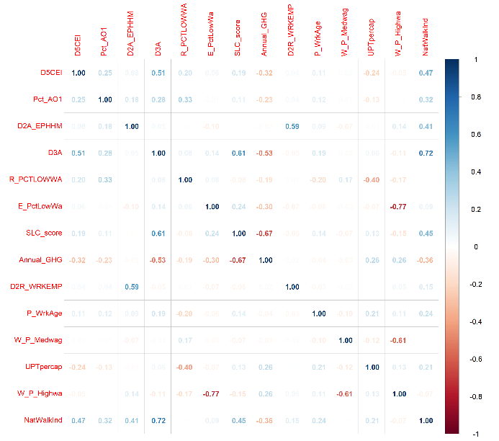
Variable Selection
Figure: Correlation plot of finally selected variables.

Slide 18
Overview of the dataset
Data Description
Variables | Definition
AADT | Annual Average Daily Traffic
Annual_GHG | Annual Greenhouse Gas Emission
D2A_EPHHM | Employment and household entropy
D2R_WRKEMP | Household Workers per Job, as compared to the region: Deviation of Census Block Group (CBG) ratio of household workers/job from regional average ratio of household workers/job
D3A | Total road network density
D5CEI | Regional Centrality Index – Auto: CBG [D5ce] score relative to max CBSA [D5ce] score
E_PctLowWa | % LowWageWk of total #workers in a CBG (work location), 2017
NatWalkInd | Walkability index
P_WrkAge | Percent of population that is working aged 18 to 64 years, 2018
Pct_AO1 | Percent of one-car households in CBG, 2018
R_PCTLOWWA | Percent of low wage workers in a CBG (home location), 2017
SLC_score | Composite measure that evaluates how well a location supports sustainable transportation and land use.
W_P_Highwa | Percent of high wage workers (workplace)
W_P_Medwag | Percent of medium wage workers (workplace)
UPTpercap | Unlinked passenger trips per capita for the CBSA
Notes:
This table summarizes the definitions of the final variables. Some of these variables are composite variables that are derived from multiple single variables, such as

Slide 19
Variable Description
Employment and Household Entropy (D2A_EPHHM):
Measures land-use diversity within a CBG, evaluating the balance between residential housing and employment types.
Higher entropy values indicate mixed-use development, which is associated with increased pedestrian activity, reduced vehicular dependence, and greater accessibility to jobs and services.
Computed using the Shannon entropy equation, where the diversity score accounts for different employment categories and residential distribution.
$$D2A_{EPHHM}= − \sum_{i=1}^{N}{\left(\frac{{Activity}_{i}}{Total Activities} ×\ln\left.\frac{{Activity}_{i}}{Total Activities}\right)\right.}$$ | Total Activities represent the sum of total employment and household units, and N refers to the number of distinct activity categories with nonzero values.
Household Workers per Job Index (D2R_WRKEMP):
Measures the balance between workers and employment opportunities within a CBG.
Quantifies the deviation of the ratio of household workers to jobs from the regional average.
A value close to 1 suggests a well-balanced job-to-worker ratio, while deviations indicate spatial mismatches in employment accessibility.
$$D2R_WRKEMP=1−|\frac{b×\left(Workers−Total Employement\right)}{b×\left(Workers+ Total Employement\right)}|$$ | Where b represents the regional workforce-to-employment ratio at the Core-Based Statistical Area (CBSA) level.

Slide 20
Variable Description
National Walkability Index (NatWalkInd):
A composite index that evaluates the walkability of a location.
Integrates multiple factors, including intersection density (street connectivity), proximity to public transit, employment mix (diversity of job types), and household-employment mix (residential-commercial balance).
Higher values indicate greater pedestrian accessibility, promoting active transportation and multimodal travel behavior.
$$NatWalkInd=0.25\left(W\right)+0.25\left(X\right)+0.25\left(Y\right)+0.25(Z)$$ | Where W, X, Y, and Z represent ranked scores for intersection density, transit proximity, employment mix, and household-employment mix.
Smart Location Choice Score (SLC_score):
A composite index derived from the Environmental Protection Agency (EPA) Smart Location Database.
Evaluates the sustainability of transportation and land use decisions.
Higher values indicate better accessibility to jobs, services, and transit, promoting multimodal travel behavior.

Slide 21
Descriptive Statistics
Variables | Definition | Mean | Standard Deviation | Minimum | Maximum
AADT | Annual Average Daily Traffic | 1344.212 | 1085.388 | 2 | 4000
Annual_GHG | Annual Greenhouse Gas Emission | 5796.925 | 1685.271 | 1936.721 | 19121.66
D2A_EPHHM | Employment and Household Entropy | 0.546 | 0.223 | 0 | 0.993
D2R_WRKEMP | Household Workers Per Job Index | 0.462 | 0.295 | 0 | 1
D3A | Total Road Network Density | 16.647 | 8.894 | 0.405 | 49.388
D5CEI | Regional Centrality Index | 0.566 | 0.262 | 0 | 1
E_PctLowWa | % LowWageWk of total #workers in a CBG (work location) | 0.268 | 0.146 | 0 | 1
NatWalkInd | Walkability Index | 9.343 | 3.725 | 1.833 | 20
P_WrkAge | Percent of the population that is working aged 18 to 64 years | 0.599 | 0.094 | 0 | 0.970
Pct_AO1 | Percent of one-car households in CBG | 0.328 | 0.152 | 0 | 0.901
R_PCTLOWWA | Percent of low wage workers in a CBG (home location) | 0.228 | 0.057 | 0.078 | 0.473
SLC_score | Smart Location Choice Score | 72.652 | 16.308 | 0 | 100
W_P_Highwa | Percent of high wage workers (workplace) | 0.364 | 0.181 | 0 | 1
W_P_Medwag | Percent of medium wage workers (workplace) | 0.367 | 0.114 | 0 | 1
UPTpercap | Unlinked passenger trips per capita for the CBSA | 9.873 | 5.844 | 0 | 18

Slide 22
Non-Spatial Modeling
Notes:
Today I am going to present for my thesis defense, titled

Slide 23
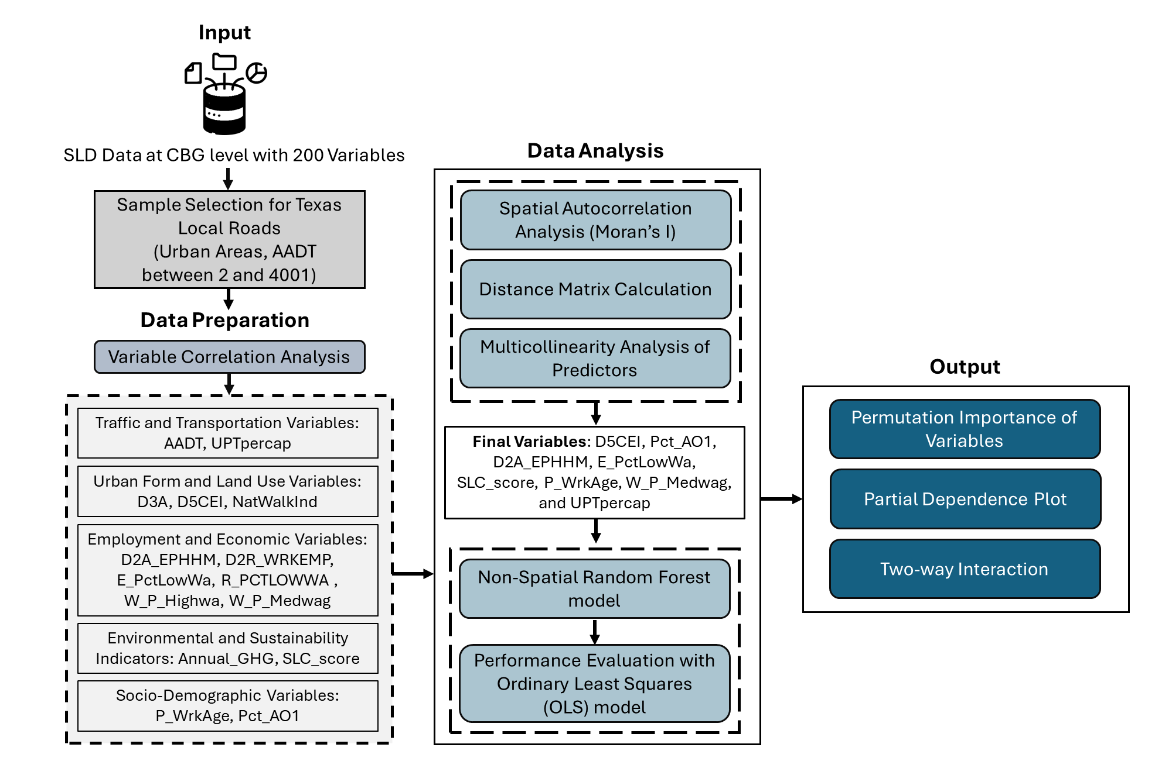
Study Design
Non-Spatial RF Modeling

Slide 24
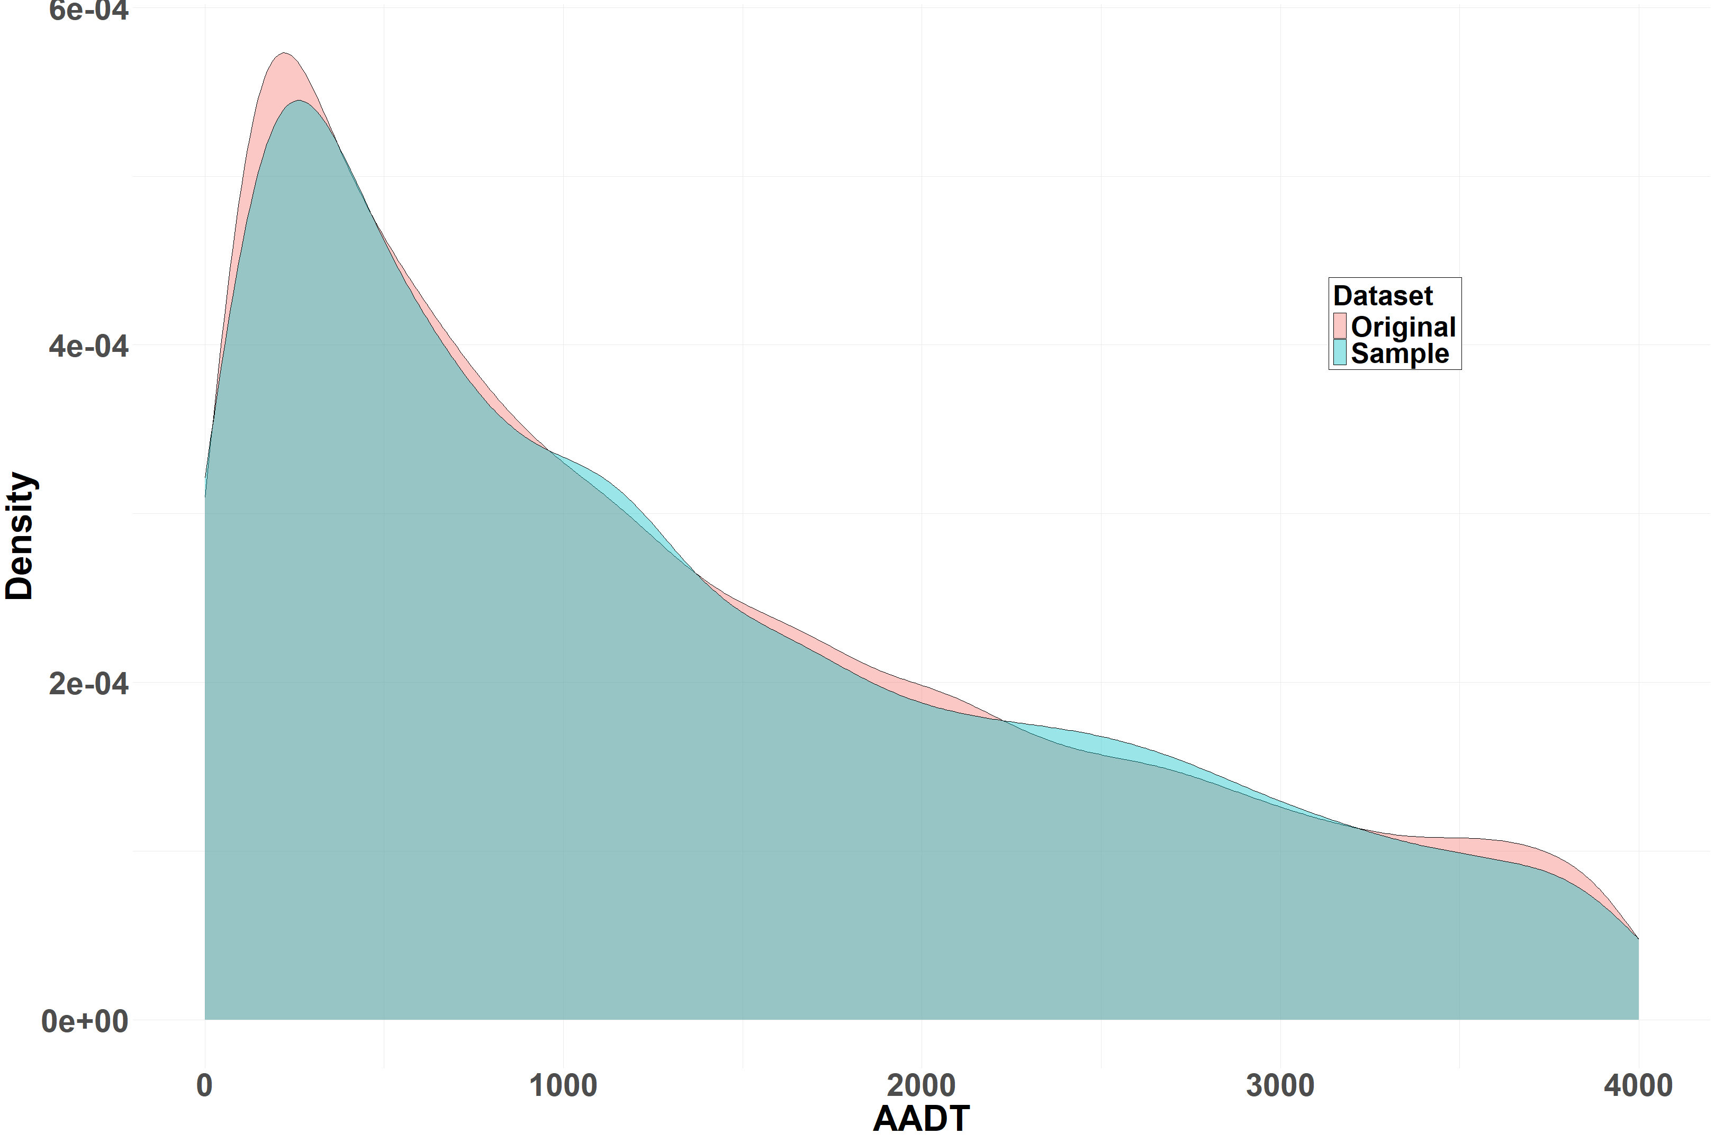
Sample Selection
AADT from 2019 to 2023 (Total 48470 data points).
For local roads: 2 < AADT <4001 (Total 22984 data points).
Chosen sample size: 5000 from all over Texas.
The sample dataset retains the key characteristics of the original dataset, with slight variations in density across different AADT ranges.
This comparison validates the representativeness of the sample in preserving the overall AADT distribution.
Figure: Distribution of AADT in Original and Sample Datasets.
Notes:
This is the distribution plot of the sample chosen for the non-spatial RF model.

Slide 25
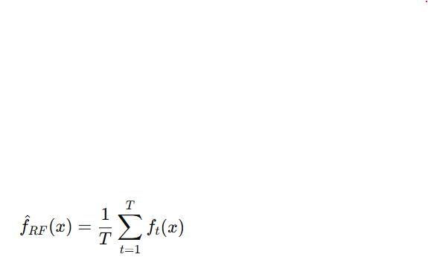

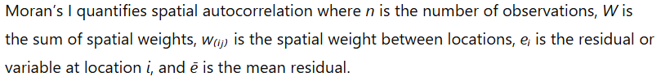
Method Used
Non-Spatial RF Model:
Ensemble of decision trees built on bootstrap samples
Random subset of predictors at each split for diversity
Final prediction:
Does not model spatial autocorrelation directly, but Moran’s I used post hoc:

Slide 26
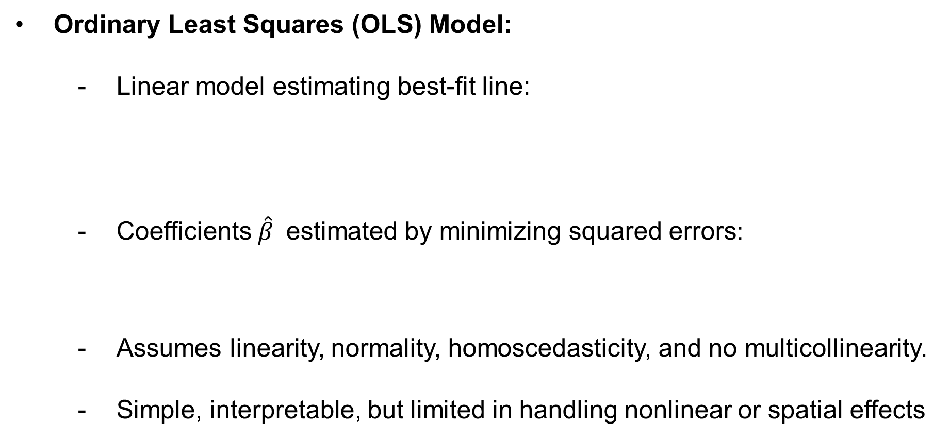
Method Used
Ordinary Least Squares (OLS) Model:
Linear model estimating best-fit line:
Coefficients $\hat{β}$ estimated by minimizing squared errors:
Assumes linearity, normality, homoscedasticity, and no multicollinearity.
Simple, interpretable, but limited in handling nonlinear or spatial effects
$$Y=Xβ+ ε$$ | Where, Y is n ×1 vector of observed values, X is n ×p matrix of predictors (including a column of 1s for the intercept), β is p ×1 vector of coefficients, ε is the n ×1 vector of error terms.
$$\hat{β}= {(X^{T} X)}^{−1} X^{T} Y$$ | Where b represents the regional workforce-to-employment ratio at the Core-Based Statistical Area (CBSA) level.

Slide 27
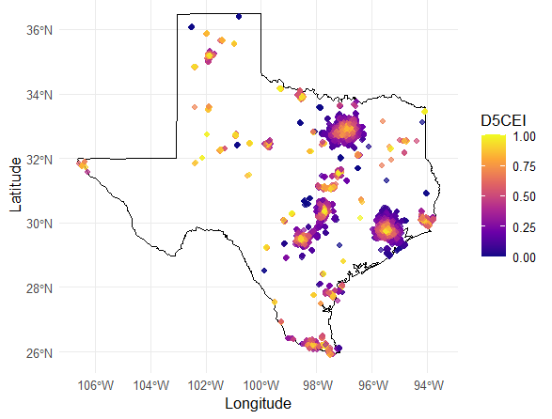
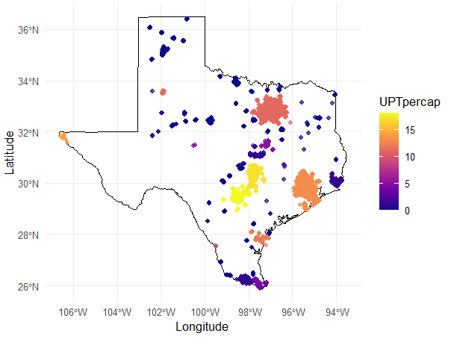
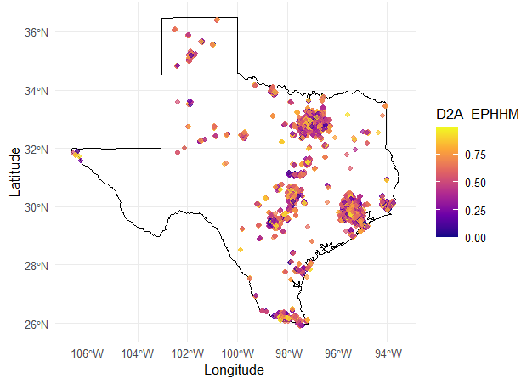
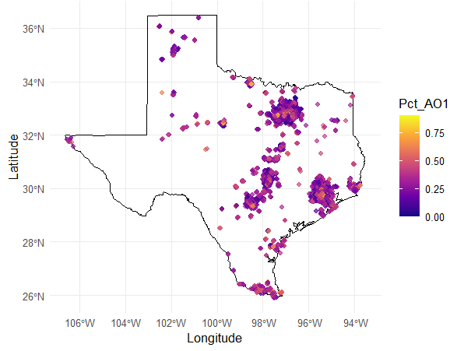
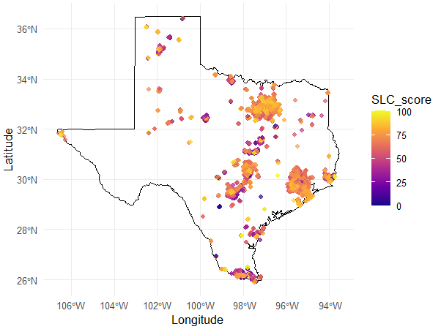
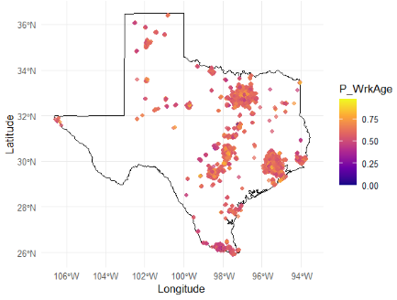
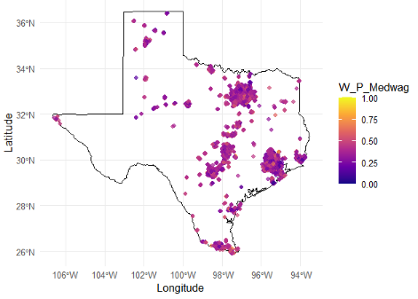
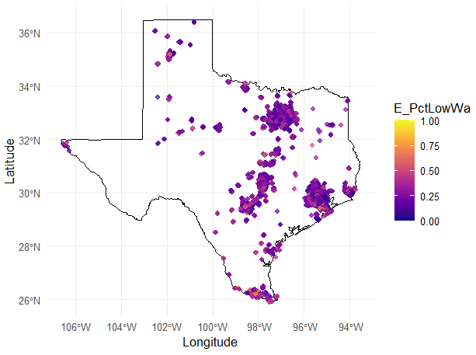
Multicollinearity Analysis
Pairwise correlation (threshold = 0.8) and Variance Inflation Factor (VIF) filtering (threshold = 1.2) eliminated multicollinear predictors.
8 out of 14 variables were retained after the two-step process.
Figure: Spatial distribution of all variables considered in the non-spatial RF model.

Slide 28
Model Performance
Non-Spatial RF Model Setup
Trained on 5,000 samples and eight predictors.
Built using Ranger with 500 trees and node size = 5.
Key Takeaway
Both OLS models failed Breusch-Pagan tests → significant heteroskedasticity.
Polynomial terms slightly improved OLS, but performance remained weak.
RF handled local spatial effects better than OLS.
RF model outperforms OLS in accuracy, residual behavior.
Model | R² | RMSE | Heteroskedasticity (BP test p-value)
OLS (Linear) | 0.0319 | 1069 | 0.0057
OLS (with Nonlinear Terms) | 0.0393 | 1065 | 5.91e-05
Non-Spatial RF (ranger) | 0.7207 | 627.99 | Not Applicable
Notes:
After the variable selection, the Non-Spatial RF and OLS models were implemented. Two different OLS models were performed, one with linear terms and another with non-linear terms of the variables. Non spatial RF model has an R² of 0.721 → Explains ~72% of variance in AADT

Slide 29
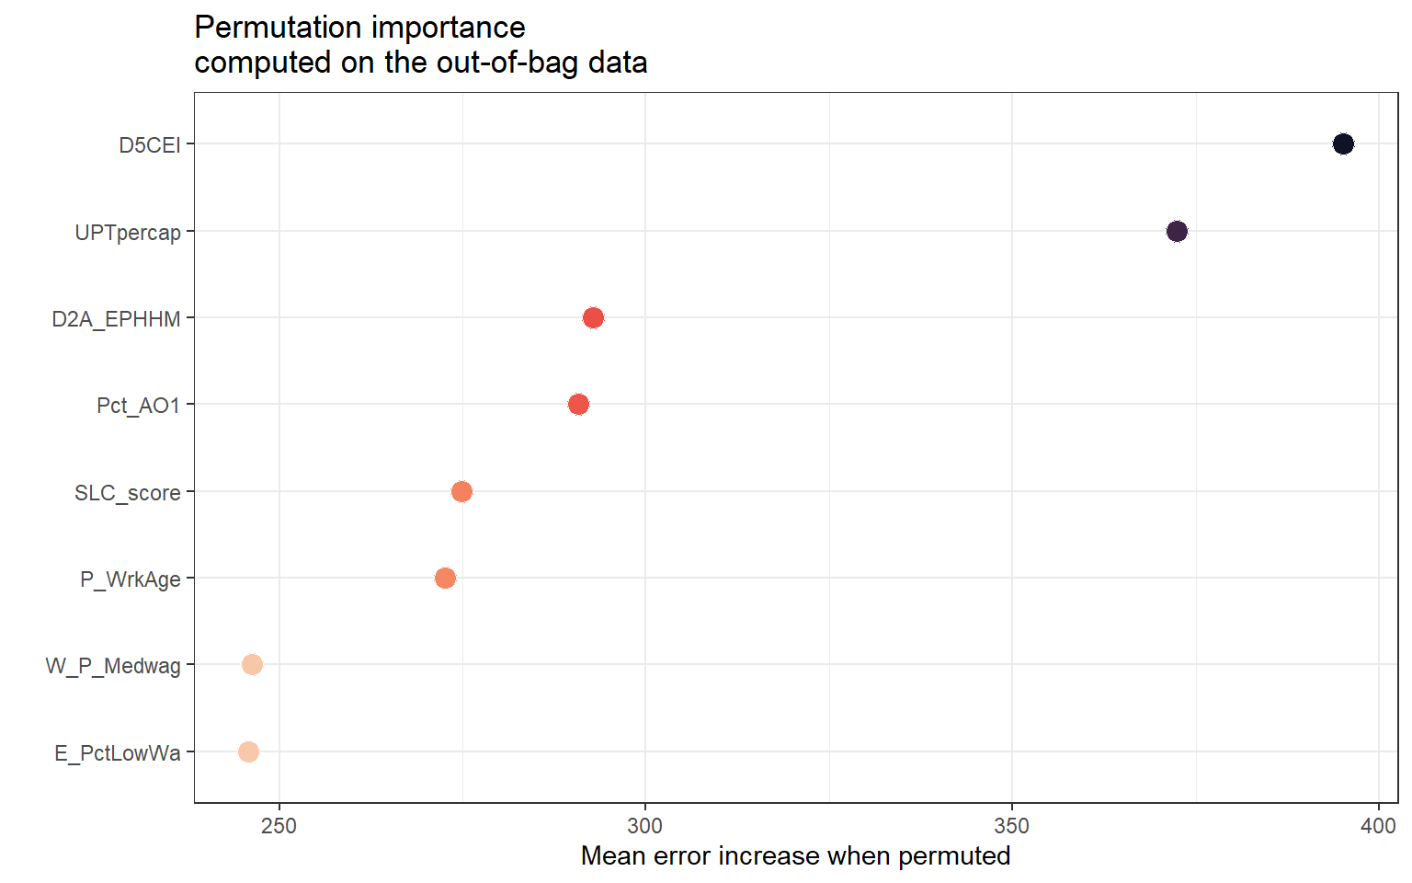
Variable Importance from Non-Spatial RF
RQ2
Regional Centrality Index (D5CEI): Strongest predictor of AADT.
Transit Ridership per Capita (UPTpercap): Multimodal environments have higher overall traffic volumes.
Economic and demographic workforce characteristics play a comparatively smaller role in predicting AADT.
Variables | Importance
D5CEI | 395.161
UPTpercap | 372.416
D2A_EPHHM | 292.866
Pct_AO1 | 290.848
SLC_score | 274.852
P_WrkAge | 272.619
W_P_Medwag | 246.341
E_PctLowWa | 245.805
Notes:
D5CEI (Centrality Index) was the most influential predictor, highlighting that well-connected urban cores experience higher traffic volumes. UPTpercap (Transit Ridership per Capita) ranked highly, indicating areas with more transit usage also attract significant vehicular traffic, likely due to multimodal travel behavior. Workforce-related variables like P_WrkAge and D2R_WRKEMP had low importance, showing that socioeconomic demographics have a weaker direct impact on traffic volume.

Slide 30
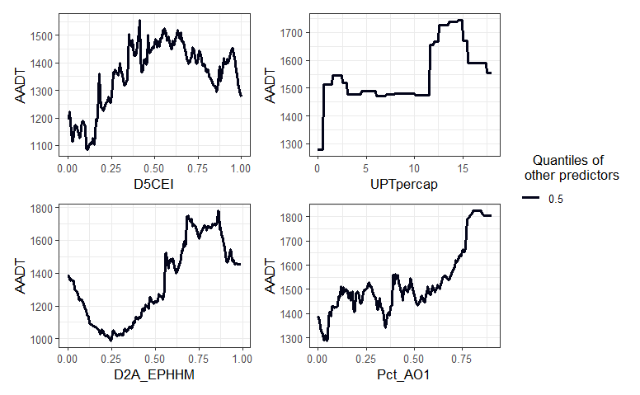
Non-linear Impacts of AADT Predictors
Partial Dependence Plots (PDPs) capture how AADT varies with each predictor while holding all other variables at their median values.
D5CEI (Regional Centrality): AADT increases rapidly initially and then stabilizes, showing that traffic peaks in moderately to highly central areas, likely due to better access and trip density (Cui et al. 2022; Wang et al. 2020).
UPTpercap (Transit Usage per Capita): AADT increases with high transit usage, indicating that multimodal urban zones generate more traffic (Verbavatz and Barthelemy, 2019).

Slide 31
Non-linear Impacts of AADT Predictors
D2A_EPHHM (Employment and Household Entropy): reduced AADT at mid-range values and elevated traffic at both extremes, indicating that highly mixed-use areas experience higher traffic (Ewing et al., 2011).
Pct_AO1 (Percent of one-car households): indicates a steady rise in AADT, indicating greater vehicle dependency in areas with limited travel alternatives.

Slide 32
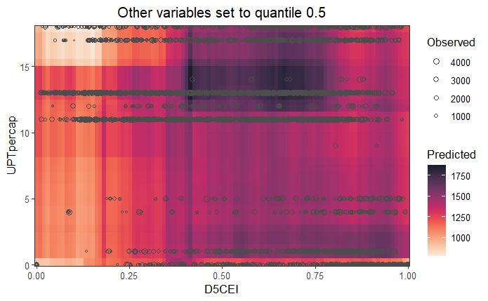
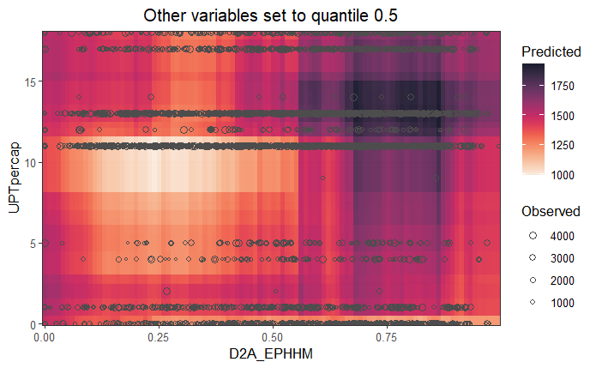
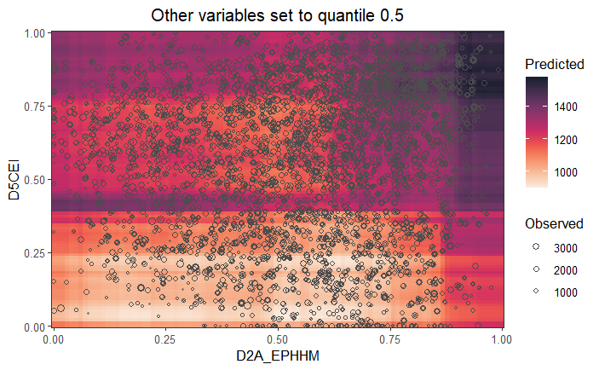
Two-way Interaction Effects
Interaction Pair | Effect on AADT | Key Findings
D5CEI × UPTpercap | AADT is highest when both D5CEI and UPTpercap are high. | Central areas consistently drive traffic; transit usage further amplifies this effect.
D2A_EPHHM × UPTpercap | High AADT in areas with strong employment-household entropy and high transit use. | The impact of employment-household entropy on AADT becomes stronger when public transit usage is higher.
D2A_EPHHM × D5CEI | The combination of high centrality and job-housing balance results in the strongest traffic levels. | These two planning factors reinforce each other in generating traffic demand.

Slide 33
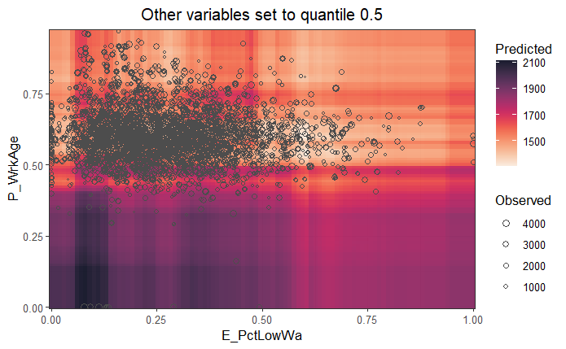
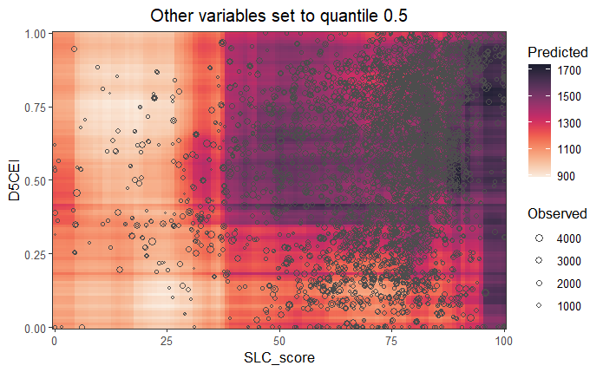
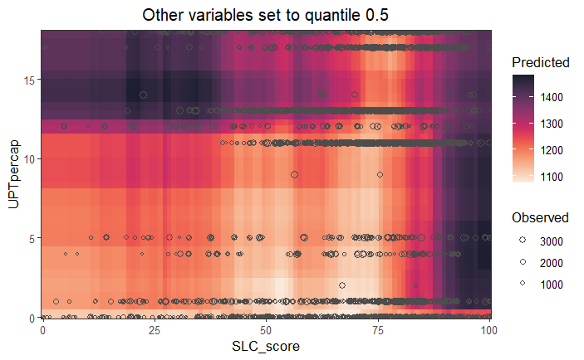
Two-way Interaction Effects
Interaction Pair | Effect on AADT | Key Findings
P_WrkAge × E_PctLowWa | Moderate AADT where the working-age share is high and the low-wage percentage is moderate to low. | The percentage of the working-age population increases traffic with lower concentrations of low-wage workers.
D5CEI × SLC_score | Areas with high sustainability scores and strong centrality show the highest AADT. | Central, walkable, mixed-use areas still attract high traffic volumes.
UPTpercap × SLC_score | AADT increases with sustainability and transit usage, but growth slows at higher values. | Suggests multimodal shift: beyond a point, better transit + sustainable planning no longer raise traffic.

Slide 34
Key Findings from Non-Spatial RF Model
Regional Accessibility Index and Transit Ridership per Capita emerged as the strongest predictors.
Socioeconomic and workforce variables showed weaker influence compared to built environment factors.
Weaker importance for income-related variables → Non-Spatial RF may overlook how traffic dynamics differ across income groups geographically.
Interaction effects identified, but limited in capturing deeper spatial dependencies
Residuals displayed some spatial clustering, indicating unexplained spatial variation
Notes:
Weaker importance for income-related variables like low-wage workforce share or median wages, which indicates that non-Spatial RF may overlook how traffic dynamics differ across income groups geographically.

Slide 35
Spatial AI Modeling
Notes:
Today I am going to present for my thesis defense, titled

Slide 36
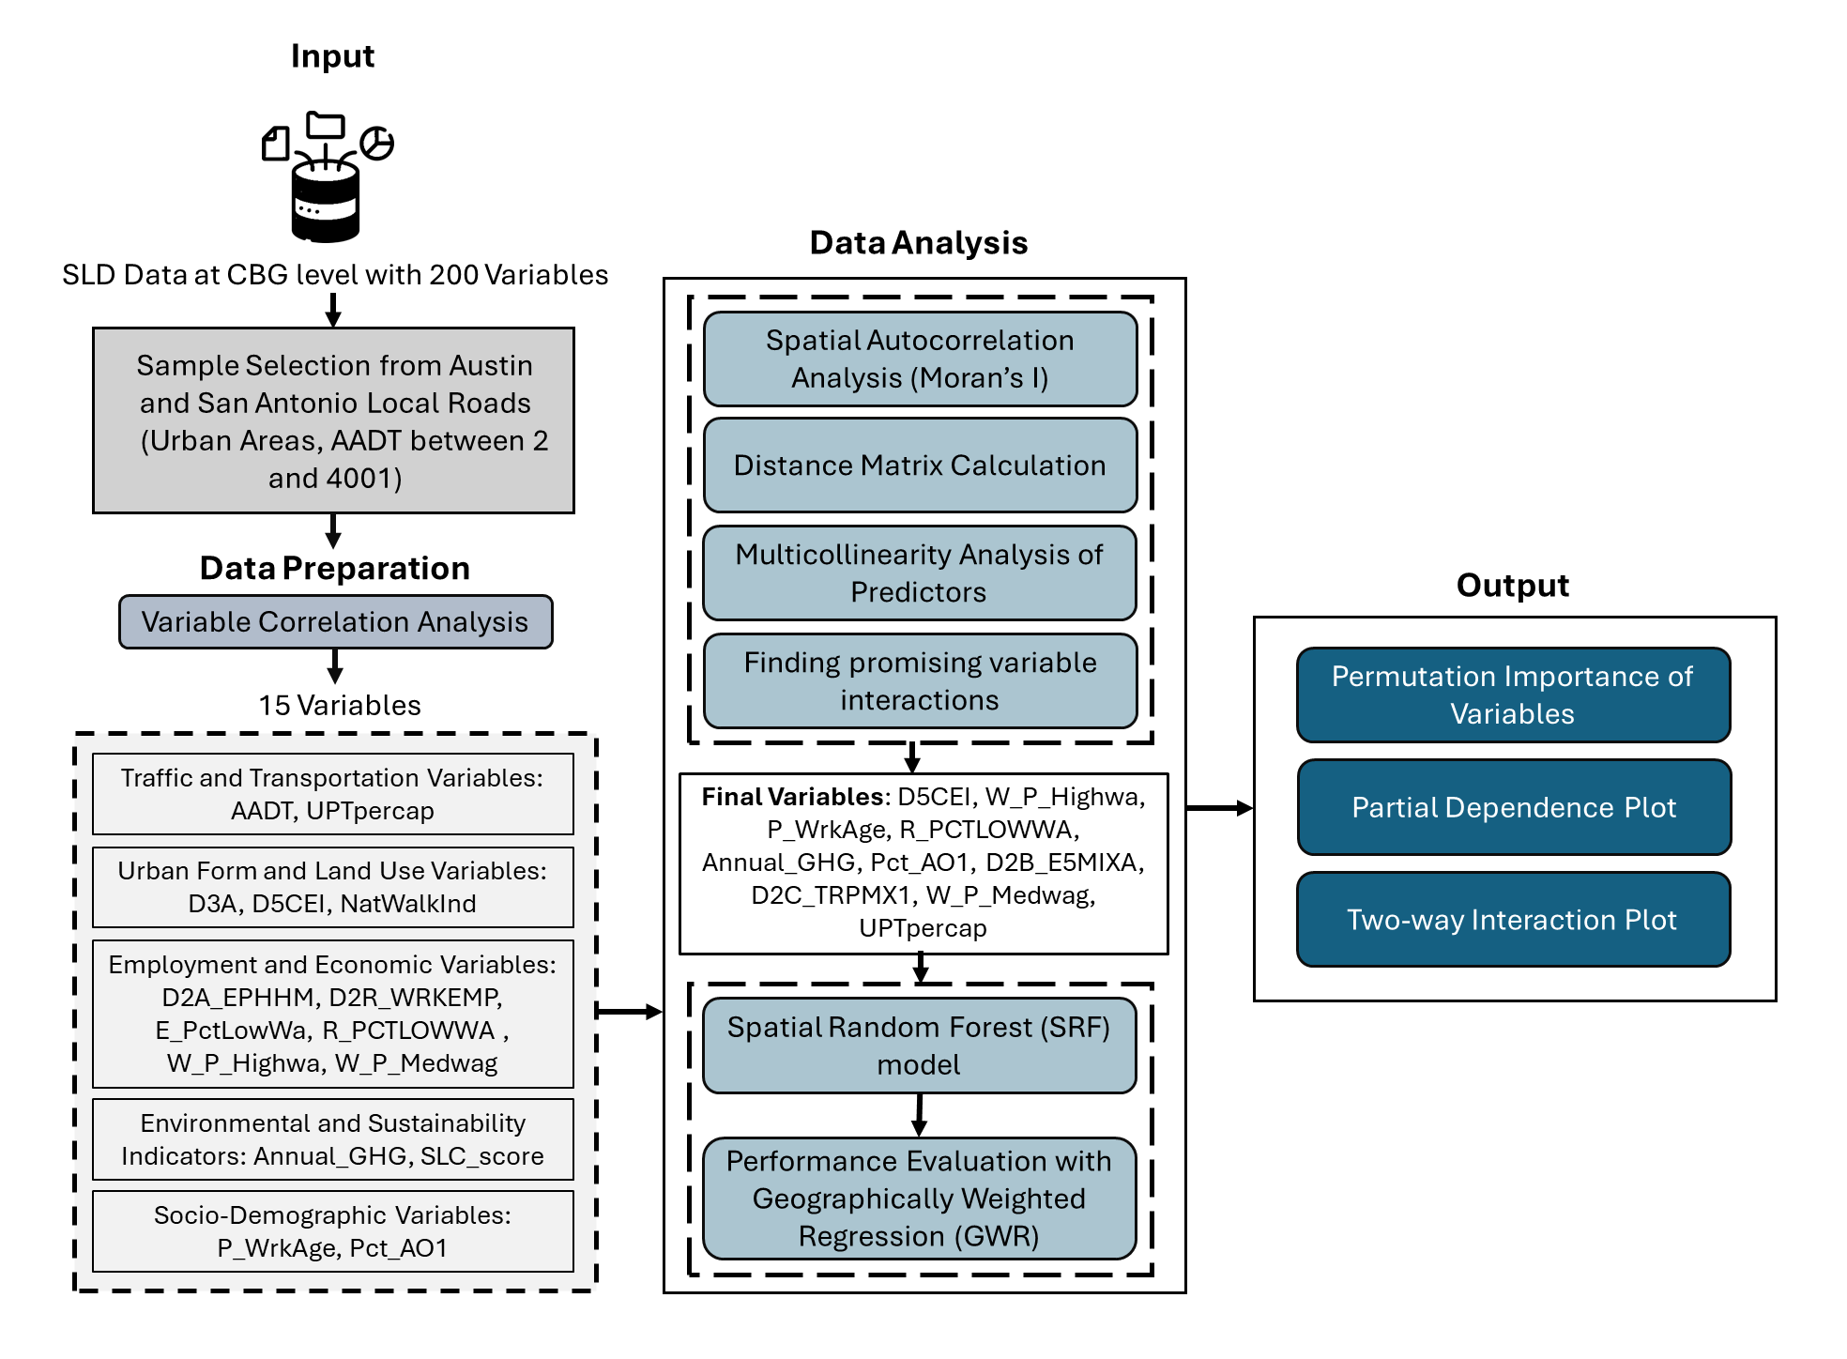
Study Design
Spatial RF Modeling

Slide 37
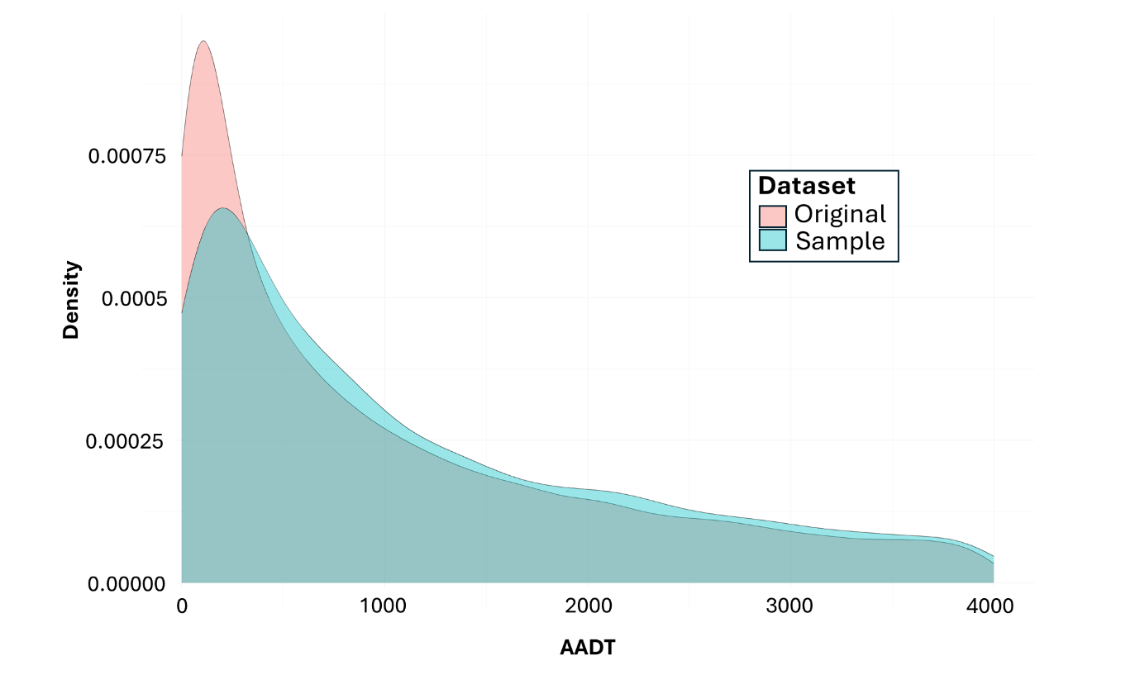
Sample Selection
AADT from 2019 to 2023 (Total 48470 data points).
For local roads: 2 < AADT <4001 (Total 22984 data points).
At Austin and San Antonio: 6116
Chosen sample size: 5000 from Austin and San Antonio.
The sample dataset retains the key characteristics of the original dataset, with slight variations in density across different AADT ranges.
This comparison validates the representativeness of the sample in preserving the overall AADT distribution.
Figure: Distribution of AADT in Original and Sample Datasets.

Slide 38
Method Used
Methodology
Spatial Random Forest (SRF) Model:
Traditional Random Forest (RF) models assume independence among observations (Breiman, 2001).
Spatial dependencies violate this assumption due to autocorrelation among geographically close observations.
SRF incorporates higher-order spatial statistics to model spatial structure (Talebi et al., 2022).

Slide 39
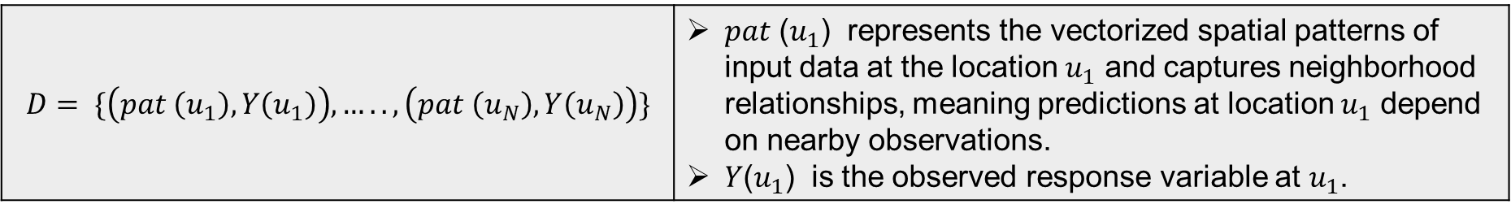
Method Used
Core Components of SRF Model:
Vectorized Spatial Patterns: Captures spatial dependencies by treating input data as location-aware feature vectors (Talebi et al., 2022).
Spatial Splitting Criteria:
Regression: Minimizes within-node variance.
Classification: Uses Gini impurity index to optimize class separation (Talebi et al., 2022).
$$D= \{\left(pat \left(u_{1}\right), Y\left(u_{1}\right)\right), ….., \left(pat \left(u_{N}\right), Y\left(u_{N}\right)\right)\}$$ | 𝑝𝑎𝑡 ($u_{1}$) represents the vectorized spatial patterns of input data at the location $u_{1}$ and captures neighborhood relationships, meaning predictions at location $u_{1}$ depend on nearby observations. 𝑌($u_{1}$) is the observed response variable at $u_{1}$​.

Slide 40
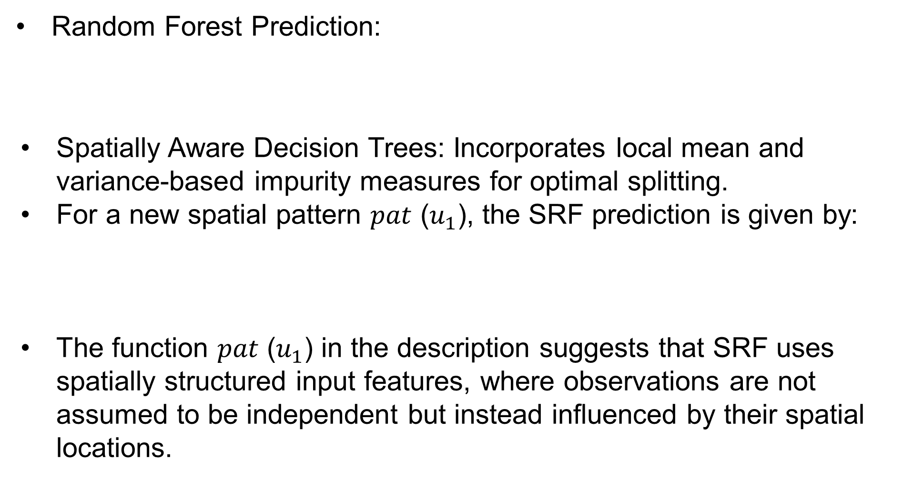

Mathematical Formulation of SRF
Random Forest Prediction:
Spatially Aware Decision Trees: Incorporates local mean and variance-based impurity measures for optimal splitting.
For a new spatial pattern 𝑝𝑎𝑡 ($u_{1}$), the SRF prediction is given by:
The function 𝑝𝑎𝑡 ($u_{1}$) in the description suggests that SRF uses spatially structured input features, where observations are not assumed to be independent but instead influenced by their spatial locations.
$$\hat{f}\left(X\right)=\frac{1}{J}\sum_{J=1}^{J}{h_{j} (X)}$$ | where $h_{j} (X)$ is the prediction from the 𝑗-th tree.
$$\hat{f}\left(X(u)\right)=\frac{1}{J}\sum_{J=1}^{J}{h_{j} (X(u))}$$ | The notation $X(u)$introduces a spatial component, meaning that predictions are made while incorporating spatially aware decision trees.

Slide 41
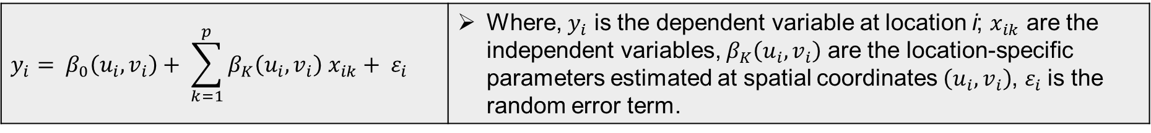
Method Used
Geographically Weighted Regression (GWR):
Allows regression coefficients to vary by location, capturing spatial non-stationarity.
Each observation gets its own local regression equation using spatial weights based on proximity. Core formula:
Bandwidth controls smoothing; selected by Akaike Information Criterion (AIC) or cross-validation.
Strength: reveals local patterns in data.
Limitations: slow for large data, may overfit, and sensitive to bandwidth.
$$y_{i}= β_{0}\left(u_{i}, v_{i}\right)+ \sum_{k=1}^{p}{β_{K}\left(u_{i}, v_{i}\right) x_{ik}+ ε_{i}}$$ | Where, $y_{i}$ is the dependent variable at location i; $x_{ik}$​ are the independent variables, $β_{K}\left(u_{i}, v_{i}\right)$ are the location-specific parameters estimated at spatial coordinates $\left(u_{i}, v_{i}\right)$, $ε_{i}$is the random error term.

Slide 42
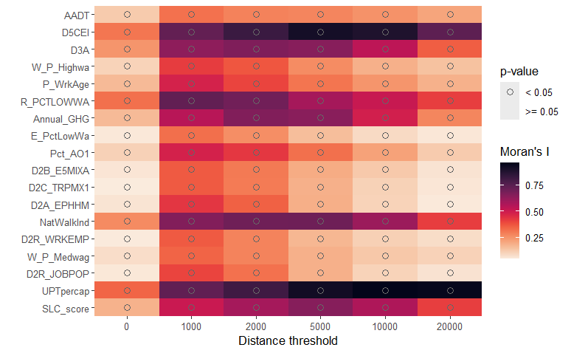
Spatial Autocorrelation Analysis
Strong spatial clustering observed in AADT starting from 1,000 meters, with Moran’s I > 0.5 at several thresholds.
D5CEI and UPTpercap show high and statistically significant Moran’s I across all medium to large distances (5,000–20,000 m).
Annual_GHG and R_PCTLOWWA also show strong and significant spatial autocorrelation, particularly in the 1,000–10,000 meter range, with Moran’s I peaking above 0.6.
In contrast, D2B_E5MIXA and P_WrkAge show weak spatial autocorrelation.
Figure: Spatial Autocorrelation Analysis Results.
Notes:
Here are the results of the spatial autocorrelation analysis.

Slide 43
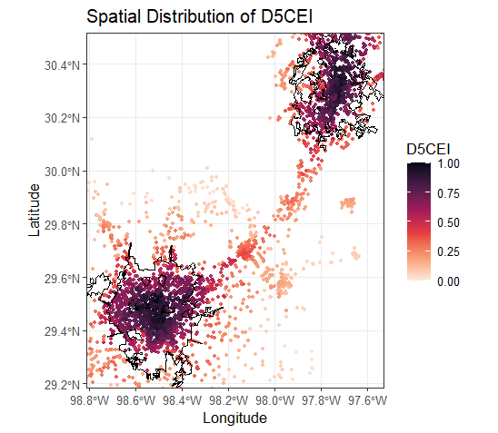
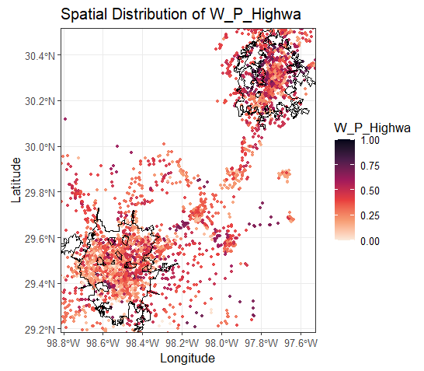
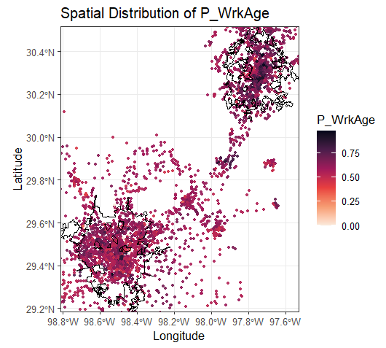
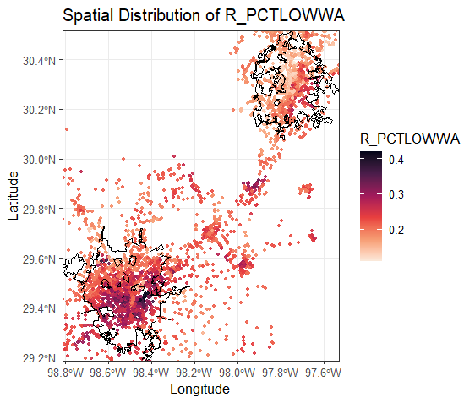
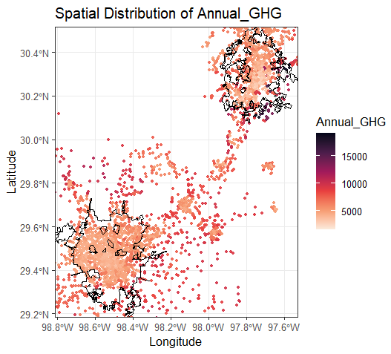
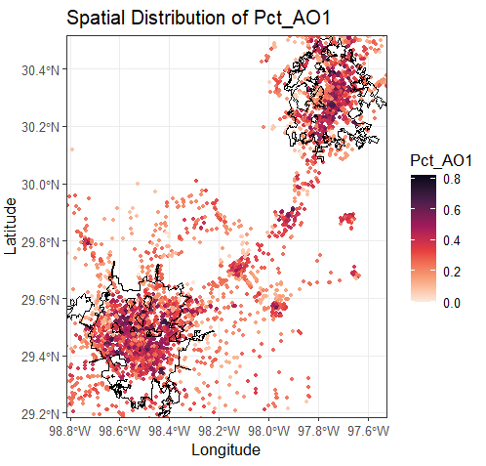
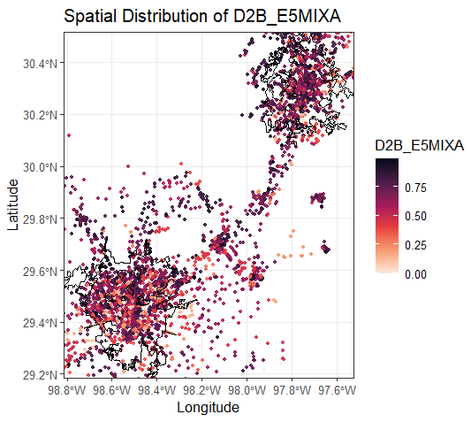
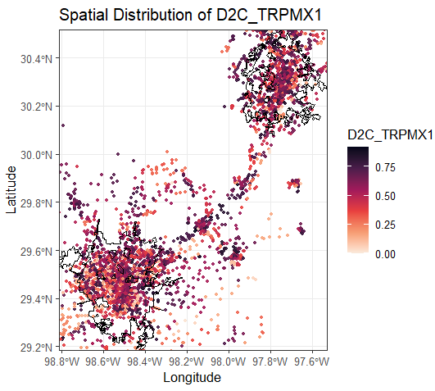
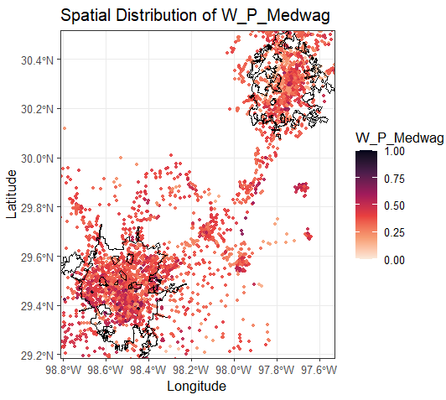
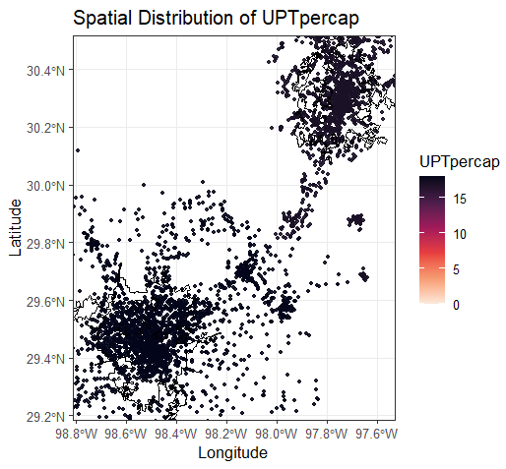
Multicollinearity Analysis
10 variables were retained after the two-step process.
Figure: Spatial distribution of all variables considered in the spatial RF model.

Slide 44
Promising Variable Interactions
An interaction means the influence of one variable is modified by the presence or level of another.
Most influential interaction → UPTpercap × D5CEI (100% importance) → Indicates higher AADT in transit-rich, centrally located areas
D5CEI × R_PCTLOWWA → Suggests that central areas with more low-wage workers experience higher traffic.
Promising Variable Interactions Identified for AADT Estimation Using Spatial RF
Interaction | Importance (% of max) | R-squared improvement | Max correlation with predictors
UPTpercap..x..D5CEI | 100.0 | 0.0240 | 0.840
D5CEI..x..R_PCTLOWWA | 94.5 | 0.0180 | 0.760
UPTpercap..pca..Pct_AO1 | 75.4 | 0.0110 | 0.720
D5CEI..x..Annual_GHG | 70.5 | 0.0155 | 0.667

Slide 45
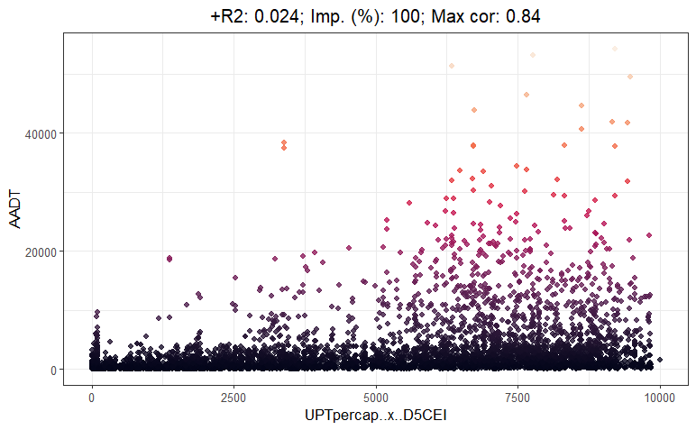
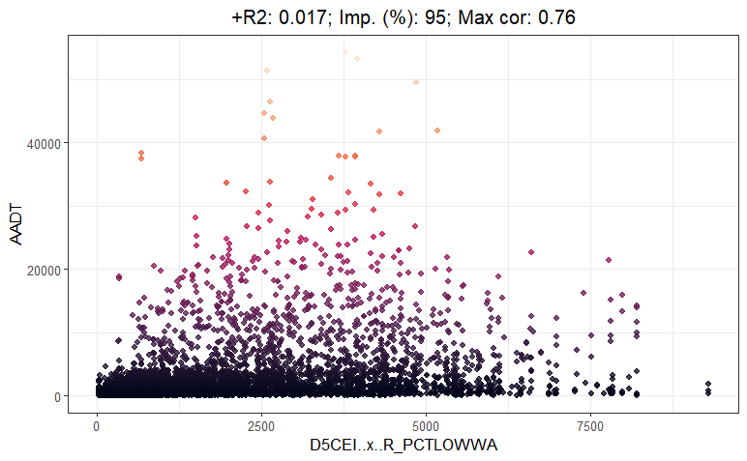
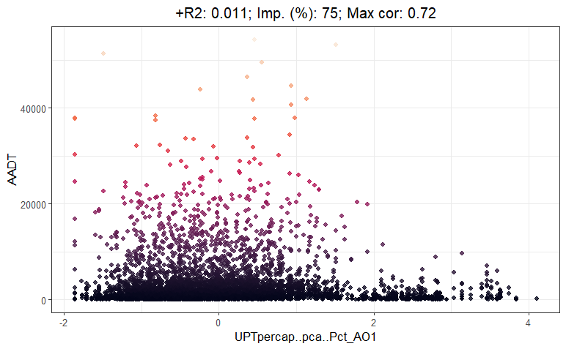
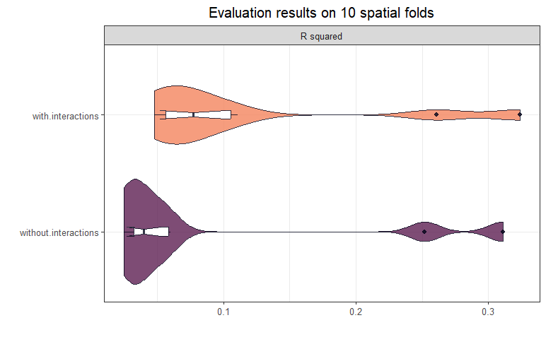
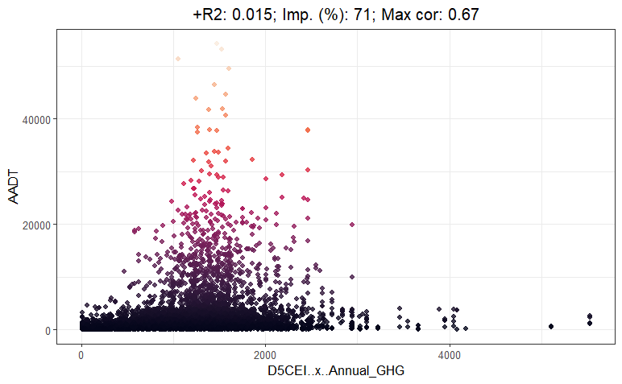
Promising Variable Interactions
Figure: Top Variable interactions and their impact on AADT prediction performance in the Spatial RF model.

Slide 46
Model Performance
Spatial RF model:
Captures 61.5% of the variance in AADT.
Captures nonlinear relationships and shows less spatial clustering in residuals.
Indicates better spatial generalization.
GWR Model:
Gives a weaker fit (R² = 0.138)
Models linear relationships only.
but allows for spatially varying coefficients
Model | R² | RMSE | Interpretation
Spatial RF | 0.615 | 3,211.70 | Stronger fit to data, nonlinear, less residual clustering
GWR | 0.138 | 4,784.67 | Weaker fit, linear, spatial coefficients
Notes:
SpatialRF provides a stronger fit to the data (R² = 0.615), captures nonlinear relationships, and shows less spatial clustering in residuals, indicating better spatial generalization. GWR gives a weaker fit (R² = 0.138), models linear relationships only, but allows for spatially varying coefficients, which can be useful for understanding how predictor effects change across space even if predictive power is limited. The residuals show minimal spatial autocorrelation beyond the smallest distances, as indicated by insignificant Moran’s I values at 10,000 meters and beyond. This indicates the model recognizes spatial patterns in the data. Note: If a model fails to capture spatial patterns, the residuals will still show spatial clustering, which indicates the model is missing something. But if residuals show minimal spatial autocorrelation, it means the model has already explained most of the spatial structure.

Slide 47
Model Performance of Spatial RF
If a model fails to capture spatial patterns, the residuals will still show spatial clustering.
Minimal residual spatial autocorrelation → Insignificant Moran’s I beyond 10,000 meters.
No strong spatial clustering remains in the residuals, indicating:
The model has already explained most of the spatial structure.
What's left (the residuals) is mostly random and not spatially patterned.
The Spatial RF model effectively learned and accounted for spatial patterns, without leaving behind spatially structured prediction errors.
RQ1
The Spatial RF model effectively learned and accounted for spatial patterns, without leaving behind spatially structured prediction errors
Moran’s I for Residual Spatial Autocorrelation
Distance (meters) | Moran’s I | P-value | Interpretation
0 | -0.004 | 0.001 | Negative spatial correlation
10,000 | -0.003 | 0.349 | No spatial correlation
40,000 | -0.001 | 0.673 | No spatial correlation
80,000 | -0.000 | 0.771 | No spatial correlation
Notes:
In this slide, the table summarizes the Moran’s I for residual spatial autocorrelation. Here, the concept is that, if a model fails to capture the spatial patterns, the residuals will still show spatial clustering. The results here indicate that the residuals show minimal spatial autocorrelation beyond the smallest distances, as indicated by insignificant Moran’s I values at 10,000 meters and beyond. Which means that there is no strong spatial clustering remaining in the residuals. This indicates the model recognizes most of the spatial patterns in the data. Note: If a model fails to capture spatial patterns, the residuals will still show spatial clustering, which indicates the model is missing something. But if residuals show minimal spatial autocorrelation, it means the model has already explained most of the spatial structure.

Slide 48
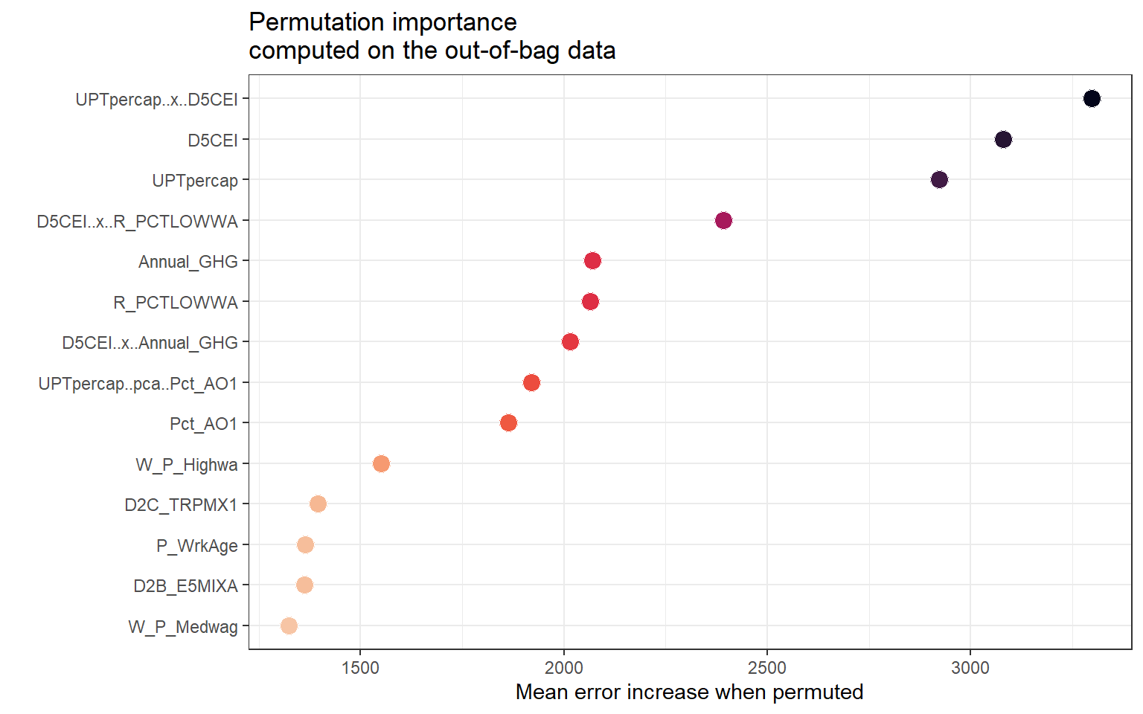
Variable Importance from Spatial RF
UPTpercap × D5CEI was the most important predictor of AADT.
Pct_AO1, employment entropy, and wage-related variables had less impact.
RQ2
Variables | Importance
UPTpercap × D5CEI | 3297.166
D5CEI | 3079.507
UPTpercap | 2922.533
D5CEI × R_PCTLOWWA | 2391.889
Annual_GHG | 2069.174
R_PCTLOWWA | 2065.101
D5CEI × Annual_GHG | 2014.849
UPTpercap (PCA) × Pct_AO1 | 1920.701
Pct_AO1 | 1864.137
W_P_Highwa | 1551.263
D2C_TRPMX1 | 1395.051
P_WrkAge | 1363.609
D2B_E5MIXA | 1362.251
W_P_Medwag | 1322.853

Slide 49
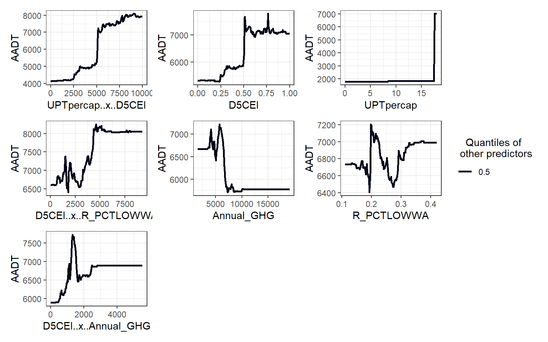
Non-linear Impacts of AADT Predictors
UPTpercap × D5CEI Interaction: Sharp increase of AADT in areas with both high transit usage and strong accessibility.
D5CEI shows increasing AADT up to a plateau, suggesting saturation at high centrality.
R_PCTLOWWA: Sharp drop in AADT as the percentage of low-wage workers increases from 0.2 to 0.3.
D5CEI × R_PCTLOWWA: Higher traffic in areas with both high accessibility and low-wage populations.
D5CEI × Annual_GHG: Moderately high accessibility paired with moderate emissions leads to higher traffic.

Slide 50
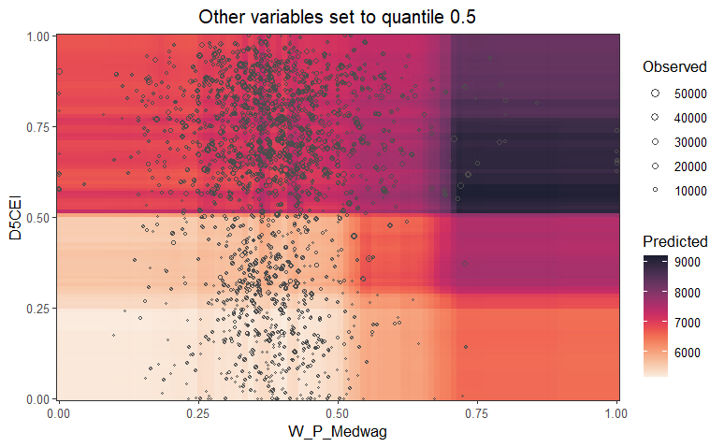
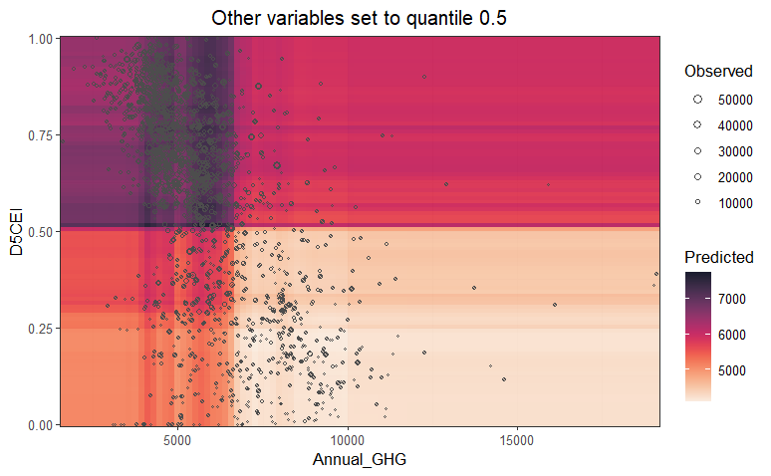
Two-way Interaction Effects
Interaction Pair | Effect on AADT | Key Findings
D5CEI × W_P_Medwag | High AADT when D5CEI is high and W_P_Medwag is low | Central areas with fewer medium-wage workers see the highest traffic volumes
D5CEI × Annual_GHG | AADT peaks with high D5CEI and low GHG | High emissions don’t lead to more traffic unless the area is also highly accessible.
Notes:
High centrality indicates Higher transit use, walking, or cycling reducing per capita emissions, Despite lower emissions, total traffic volumes (AADT) can still be high in these regions because accessibility encourages movement, but the emissions intensity per trip may be lower.

Slide 51
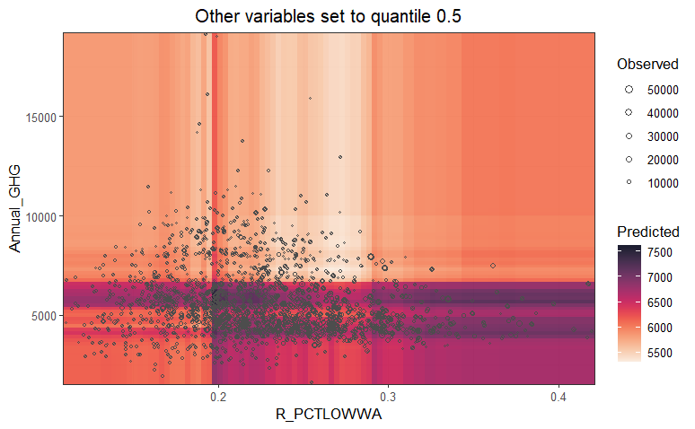

Two-way Interaction Effects
Interaction Pair | Effect on AADT | Key Findings
R_PCTLOWWA × Annual_GHG | Nonlinear AADT pattern with dips and rises | Low-income areas show moderate AADT; high GHG + less low-wage population = less traffic
D5CEI × R_PCTLOWWA | Highest AADT in high D5CEI, high R_PCTLOWWA zones | Centrality boosts AADT even in low-wage areas due to urban activity

Slide 52
Key Findings from Spatial RF Model
UPTpercap × D5CEI interaction was the most influential, highlighting the combined impact of accessibility and transit use → also supported by non-spatial RF.
Spatial RF elevated the importance of income-related variables (e.g., R_PCTLOWWA, W_P_Medwag) and emissions indicators.
Spatial dependencies strengthened the role of socioeconomic and environmental variables compared to the Non-Spatial RF.
Land use entropy and multimodal factors gained importance in the spatial context
Notes:
Spatial RF revealed that socioeconomic factors gain influence when spatial heterogeneity is explicitly modeled while non-spatial RF model showed weaker importance for income-related variables.

Slide 53
Conclusion
Overall Key Findings
Non-Spatial RF Performance: Explained 72% of AADT variance, outperforming OLS.
Spatial RF Performance: more accurate estimation of AADT than traditional GWR, capturing 61.5% of its variance.
Most influential predictors of traffic volume: Regional accessibility and transit ridership
Income-AADT Pattern: AADT decreased as the share of low-wage workers increased.
Two-way Interaction Effects: Built environment, socioeconomic, and environmental interactions played a crucial role in explaining traffic patterns.
Notes:
High traffic volumes were observed in areas with both high accessibility and high public transit usage.

Slide 54
Conclusion
Limitations
Relies on static, cross-sectional data, does not capture seasonal or temporal variation.
Spatial RF model accounts for geographic variability, but it does not produce interpretable spatial coefficients.
Lack of behavioral or trip-purpose-specific data reduces the model’s ability to distinguish between different traffic patterns (e.g., commuting vs. leisure travel).
Future Scope
Incorporate longitudinal data to model traffic changes over time.
Expand to multimodal travel (e.g., walking, biking, shared mobility) for broader insight.
Incorporate parcel-level or street-level data for finer traffic prediction.
RQ3

Slide 55
References
AASHTO, 2019. Guidelines for Geometric Design of Low-Volume Roads, 2nd Edition.
Apronti, D., Ksaibati, K., Gerow, K., Hepner, J.J., 2016. Estimating traffic volume on Wyoming low volume roads using linear and logistic regression methods. Journal of Traffic and Transportation Engineering (English Edition) 3, 493–506. https://doi.org/10.1016/j.jtte.2016.02.004
Baffoe-Twum, E., Asa, E., Awuku, B., 2022. Estimation of annual average daily traffic (AADT) data for low-volume roads: a systematic literature review and meta-analysis. Emerald Open Research 1. https://doi.org/10.1108/EOR-05-2023-0010
Benito, B., 2023. spatialRF: Easy Spatial Modeling with Random Forest in R.
Breiman, L., 2001a. Random Forests. Machine Learning 45, 5–32. https://doi.org/10.1023/A:1010933404324
Brunsdon, C., Fotheringham, A.S., Charlton, M.E., 1996. Geographically Weighted Regression: A Method for Exploring Spatial Nonstationarity. Geographical Analysis 28, 281–298. https://doi.org/10.1111/j.1538-4632.1996.tb00936.x

Slide 56
References
Castro-Neto, M., Jeong, Y., Jeong, M.K., Han, L.D., 2009. AADT prediction using support vector regression with data-dependent parameters. Expert Systems with Applications 36, 2979–2986.
Chang Chien, Y.-M., Carver, S., Comber, A., 2020. Using geographically weighted models to explore how crowdsourced landscape perceptions relate to landscape physical characteristics. Landscape and Urban Planning 203, 103904. https://doi.org/10.1016/j.landurbplan.2020.103904
Chatterjee, S., Hadi, A.S., 2015. Regression analysis by example. John Wiley & Sons.
Cui, Y., Yu, Y., Cai, Z., Wang, D., 2022. Optimizing Road Network Density Considering Automobile Traffic Efficiency: Theoretical Approach. Journal of Urban Planning and Development 148, 04021062. https://doi.org/10.1061/(ASCE)UP.1943-5444.0000780
Cutler, D.R., Edwards Jr., T.C., Beard, K.H., Cutler, A., Hess, K.T., Gibson, J., Lawler, J.J., 2007. Random Forests for Classification in Ecology. Ecology 88, 2783–2792. https://doi.org/10.1890/07-0539.1

Slide 57
References
Das, S., 2021. Traffic volume prediction on low-volume roadways: a Cubist approach. Transportation Planning and Technology 44, pp-93-110. https://doi.org/10.1080/03081060.2020.1851452
Das, S., Tsapakis, I., 2020. Interpretable Machine Learning Approach in Estimating Traffic Volume on Low-volume Roadways. International Journal of Transportation Science and Technology 9, pp-76-88. https://doi.org/10.1016/j.ijtst.2019.09.004
Davis, G.A., Guan, Y., 1996. Bayesian Assignment of Coverage Count Locations to Factor Groups and Estimation of Mean Daily Traffic. Transportation Research Record 1542, 30–37. https://doi.org/10.1177/0361198196154200105
Desai, H., Cunagin, W., Cunagin, K., Hoyt, D., Reel Jr, R.L., Bentz, S., 2014. Application of Seasonal Adjustment Factors to Subsequent Year Data. Transportation Research Record 2443, 143–147.
Drusch, R.L., 1966a. Estimating Annual Average Daily Traffic from Short-Term Traffic Counts.

Slide 58
References
Eom, J.K., Park, M.S., Heo, T.-Y., Huntsinger, L.F., 2006. Improving the prediction of annual average daily traffic for nonfreeway facilities by applying a spatial statistical method. Transportation research record 1968, 20–29.
Erhunmwunsee, P.O., 1991. Estimating average annual daily traffic flow from short period counts. ITE journal 61.
Ewing, R., Greenwald, M., Zhang, M., Walters, J., Feldman, M., Cervero, R., Frank, L., Thomas, J., 2011. Traffic Generated by Mixed-Use Developments—Six-Region Study Using Consistent Built Environmental Measures. Journal of Urban Planning and Development 137, 248–261. https://doi.org/10.1061/(ASCE)UP.1943-5444.0000068
FHWA, 2022. Traffic monitoring guide. U.S. Department of Transportation.
FHWA, 2016. Highway Performance Monitoring System Field Manual.
Flaherty, J., 1993. Cluster analysis of Arizona automatic traffic recorder data. Transportation Research Record 1410, 93–99.
Fotheringham, A.S., Brunsdon, C., Charlton, M., 2002. Geographically Weighted Regression: The Analysis of Spatially Varying Relationships. Wiley, Chichester, UK.

Slide 59
References
Fouedjio, F., 2020. Exact Conditioning of Regression Random Forest for Spatial Prediction. Artificial Intelligence in Geosciences 1, 11–23. https://doi.org/10.1016/j.aiig.2021.01.001
Fricker, J.D., Xu, C., Jin, L., 2008. Comparison of annual average daily traffic estimates: Traditional factor, statistical, artificial neural network, and fuzzy basis neural network approach.
Garber, N.J., Bayat-Mokhtari, F., 1986. A Computerized Highway Link Classification System for Traffic Volume Counts.
Gastaldi, M., Rossi, R., Gecchele, G., Della Lucia, L., 2013. Annual average daily traffic estimation from seasonal traffic counts. Procedia-Social and Behavioral Sciences 87, 279–291.
Gecchele, G., Rossi, R., Gastaldi, M., Caprini, A., 2011. Data mining methods for traffic monitoring data analysis: A case study. Procedia-Social and Behavioral Sciences 20, 455–464.

Slide 60
References
Georganos, S., Grippa, T., Niang Gadiaga, A., Linard, C., Lennert, M., Vanhuysse, S., Mboga, N., Wolff, E., Kalogirou, S., 2021b. Geographical random forests: a spatial extension of the random forest algorithm to address spatial heterogeneity in remote sensing and population modelling. Geocarto International 36, 121–136. https://doi.org/10.1080/10106049.2019.1595177
Goel, P.K., McCord, M.R., Ruan, S., O’Kelly, M., 2006. Bayesian estimation of statewide OD flows using link volumes estimated from combined information in remotely sensed data and ground counts, in: Applications of Advanced Technology in Transportation. pp. 418–423.
Granato, S., Linn County Regional Planning Commission, 1998. The impact of factoring traffic counts for daily and monthly variation in reducing sample counting error.
Hartgen, D.T., Lemmerman, J.H., 1983. Streamlining collection and processing of traffic count statistics. Transportation research record 928, 11–20.
Hengl, T., Nussbaum, M., Wright, M.N., Heuvelink, G.B.M., Gräler, B., 2018a. Random forest as a generic framework for predictive modeling of spatial and spatio-temporal variables. PeerJ 6, e5518. https://doi.org/10.7717/peerj.5518

Slide 61
References
Jessberger, S., Krile, R., Schroeder, J., Todt, F., Feng, J., 2016. Improved Annual Average Daily Traffic Estimation Processes. Transportation Research Record: Journal of the Transportation Research Board pp 103-109. https://doi.org/10.3141/2593-13
Jiang, Z., McCord, M.R., Goel, P.K., 2007. Empirical Validation of Improved AADT Estimates from Image-based Information on Coverage Count Segments.
Jin, L., Fricker, J.D., 2008. Applying K-nearest neighbor algorithm for statewide annual average daily traffic estimates.
Labib, S.M., 2024. Greenness, air pollution, and temperature exposure effects in predicting premature mortality and morbidity: A small-area study using spatial random forest model. Science of The Total Environment 928, 172387. https://doi.org/10.1016/j.scitotenv.2024.172387
Lämmer, S., Gehlsen, B., Helbing, D., 2006. Scaling laws in the spatial structure of urban road networks. Physica A: Statistical Mechanics and its Applications 363, 89–95. https://doi.org/10.1016/j.physa.2006.01.051

Slide 62
References
Li, M.-T., Zhao, F., Chow, L.-F., 2006. Assignment of seasonal factor categories to urban coverage count stations using a fuzzy decision tree. Journal of Transportation Engineering 132, 654–662.
Lowry, M., 2014. Spatial interpolation of traffic counts based on origin–destination centrality. Journal of Transport Geography 36, 98–105.
Lowry, M., Dixon, M., 2012. GIS tools to estimate average annual daily traffic. National Institute for Advanced Transportation Technology (US).
Lu, C., Yang, R., Yang, S., Zhao, F., 2013. Seasonal factor assignment based on the similarity of hourly traffic patterns and influential variables. Journal of Software 8.
McCord, M.R., Goel, P., 2009. Estimating AADT from combined air photos and ground based data : system design, prototyping, and testing. (No. 002OY01).
McCord, M.R., Yang, Y., Jiang, Z., Coifman, B., Goel, P.K., 2003. Estimating annual average daily traffic from satellite imagery and air photos: Empirical results. Transportation Research Record 1855, 136–142.

Slide 63
References
Meyer, H., Reudenbach, C., Hengl, T., Katurji, M., Nauss, T., 2018. Improving performance of spatio-temporal machine learning models using forward feature selection and target-oriented validation. Environmental Modelling and Software 101, 1–9. https://doi.org/10.1016/j.envsoft.2017.12.001
Mohamad, D., Sinha, K.C., Kuczek, T., Scholer, C.F., 1998. Annual average daily traffic prediction model for county roads. Transportation research record 1617, 69–77.
Moran, P.A.P., 1950. Notes on Continuous Stochastic Phenomena. Biometrika 37, 17–23. https://doi.org/10.1093/biomet/37.1-2.17
Pan, T., 2008. Assignment of estimated average annual daily traffic volumes on all roads in Florida.
PennDOT Traffic, 2014. Dirt, Gravel, and Low Volume Road Maintenance Program (DGLVRP) Traffic Count Policy. Pennsylvania Department of Transportation.
Ritchie, S.G., 1986. A statistical approach to statewide traffic counting.

Slide 64
References
Rossi, R., Gastaldi, M., Gecchele, G., Kikuchi, S., 2012. Estimation of Annual Average Daily Truck Traffic Volume. Uncertainty Treatment and Data Collection Requirements. Presented at the Procedia - Social and Behavioral Sciences, Elsevier, p. pp 845-856. https://doi.org/10.1016/j.sbspro.2012.09.800
Schneider, W.H., Tsapakis, I., 2009. Review of traffic monitoring factor groupings and the determination of seasonal adjustment factors for cars and trucks. Ohio. Dept. of Transportation. Office of Research and Development.
Selby, B., Kockelman, K., 2011. Spatial prediction of AADT in unmeasured locations by universal kriging.
Shamo, B., Asa, E., Membah, J., 2015. Linear Spatial Interpolation and Analysis of Annual Average Daily Traffic Data. Journal of Computing in Civil Engineering 29, 04014022. https://doi.org/10.1061/(ASCE)CP.1943-5487.0000281
Sharma, S., Leng, Y., 1994. Seasonal traffic counts for a precise estimation of AADT. ITE Journal 64.

Slide 65
References
Sharma, S., Lingras, P., Xu, F., Kilburn, P., 2001. Application of Neural Networks to Estimate AADT on Low-Volume Roads. Journal of Transportation Engineering 127, 426–432. https://doi.org/10.1061/(ASCE)0733-947X(2001)127:5(426)
Sharma, S.C., Allipuram, R.R., 1993. Duration and frequency of seasonal traffic counts. Journal of Transportation Engineering 119, 344–359.
Sharma, S.C., Lingras, P., Liu, G.X., Xu, F., 2000. Estimation of Annual Average Daily Traffic on Low-Volume Roads: Factor Approach Versus Neural Networks. Transportation Research Record 1719, 103–111. https://doi.org/10.3141/1719-13
Sharma, S.C., Lingras, P., Xu, F., Liu, G.X., 1999. Neural Networks as Alternative to Traditional Factor Approach of Annual Average Daily Traffic Estimation from Traffic Counts. Transportation Research Record 1660, 24–31. https://doi.org/10.3141/1660-04
Sun, X., Das, S., 2019. Estimating Annual Average Daily Traffic for Low-Volume Roadways: A Case Study in Louisiana. Presented at the Transportation Research Circular, Transportation Research Board, p. pp 190-201.

Slide 66
References
Sun, X., Das, S., 2015. Developing a Method for Estimating AADT on all Louisiana Roads (Digital/other). Federal Highway Administration.
Talebi, H., Peeters, L.J.M., Otto, A., Tolosana-Delgado, R., 2022a. A Truly Spatial Random Forests Algorithm for Geoscience Data Analysis and Modelling. Math Geosci 54, 1–22. https://doi.org/10.1007/s11004-021-09946-w
Talebi, H., Peeters, L.J.M., Otto, A., Tolosana-Delgado, R., 2022b. A Truly Spatial Random Forests Algorithm for Geoscience Data Analysis and Modelling. Math Geosci 54, 1–22. https://doi.org/10.1007/s11004-021-09946-w
Tsapakis, I., Holik, W., Das, S., Kraus, E., Anderson, P., 2020. Data Collection and Annual Average Daily Traffic (AADT) Estimation for Non-Federal Aid System (NFAS) Roads (No. FHWA-SA-20-064). FHWA, Washington, DC.
Tsapakis, I., Schneider IV, W.H., Nichols, A.P., 2011. Improving the estimation of total and direction-based heavy-duty vehicle annual average daily traffic. Transportation planning and technology 34, 155–166.
Verbavatz, V., Barthelemy, M., 2019. Critical factors for mitigating car traffic in cities. PLoS ONE 14, e0219559. https://doi.org/10.1371/journal.pone.0219559

Slide 67
References
Wang, S., Yu, D., Kwan, M.-P., Zheng, L., Miao, H., Li, Y., 2020. The impacts of road network density on motor vehicle travel: An empirical study of Chinese cities based on network theory. Transportation Research Part A: Policy and Practice 132, 144–156. https://doi.org/10.1016/j.tra.2019.11.012
Wang, X., Kockelman, K.M., 2009. Forecasting network data: Spatial interpolation of traffic counts from texas data. Transportation Research Record 2105, 100–108.
Wheeler, D., Tiefelsdorf, M., 2005. Multicollinearity and correlation among local regression coefficients in geographically weighted regression. Journal of Geographical Systems 7, 161–187.
Wright, M.N., Ziegler, A., 2017. ranger: A Fast Implementation of Random Forests for High Dimensional Data in C++ and R. J. Stat. Soft. 77. https://doi.org/10.18637/jss.v077.i01
Wu, H., Zhang, Z., 2009. Framework for estimating AADT using coclustering-based collaborative filtering.

Slide 68
References
Xia, Q., Zhao, F., Chen, Z., Shen, L.D., Ospina, D., 1999. Estimation of annual average daily traffic for nonstate roads in a Florida county. Transportation research record 1660, 32–40.
Yang, B., Wang, S.-G., Bao, Y., 2011. Efficient local AADT estimation via SCAD variable selection based on regression models. IEEE, pp. 1898–1902.
Zhao, F., Chung, S., 2001a. Contributing Factors of Annual Average Daily Traffic in a Florida County: Exploration with Geographic Information System and Regression Models. Transportation Research Record 1769, 113–122. https://doi.org/10.3141/1769-14
Zhao, F., Chung, S., 2001b. Contributing factors of annual average daily traffic in a Florida county: exploration with geographic information system and regression models. Transportation research record 1769, 113–122.
Zhao, F., Li, M.-T., Chow, L.-F., 2004. Alternatives for estimating seasonal factors on rural and urban roads in Florida.

Slide 69
References
Zhao, F., Park, N., 2004a. Using geographically weighted regression models to estimate annual average daily traffic. Transportation research record 1879, 99–107.
Zhong, M., Bagheri, E., Christie, J., 2012. Improving group assignment and AADT estimation accuracy of short-term traffic counts using historical seasonal patterns & Bayesian statistics. Procedia-Social and Behavioral Sciences 43, 607–617.

Slide 70
Thank You

Slide 71
Any comments or questions?

