Slide 1
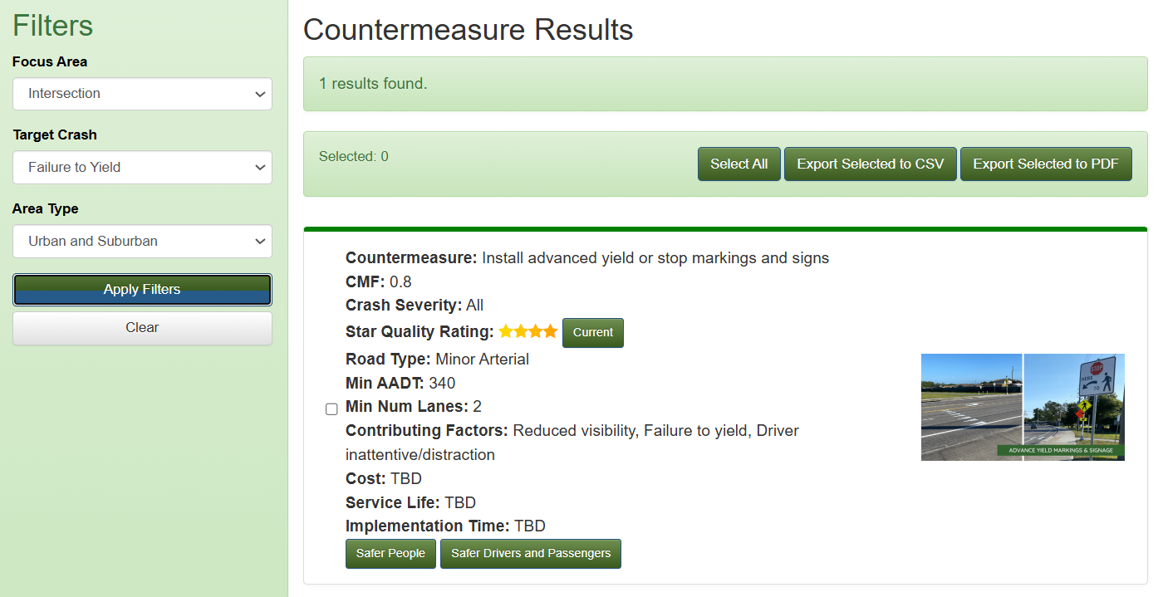

Slide 2

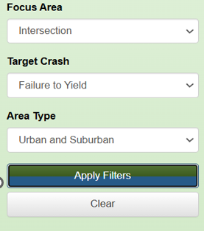
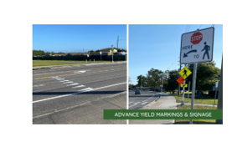

Search SSA Pillars
SSA Hierarchy
Countermeasure: Install advanced Yield
Type: Current / New / Emerging
SSA Pillar: Safer Road Users
TZD: Safer Drivers and Passengers
SSA Hierarchy: Tier 1 (Remove severe conflicts)
Focus Area: Intersection
Equity
Target Crashes: Failure to Yield
Contributing Factors: X, Y, Z
Equity Consideration: Yes
(Note: This is guidance only. States can select their own countermeasures.)
CMF: [0.67- 1.03]
CMF Clearinghouse
Knowledge Base
Countermeasure Fact sheet
Other Countermeasures
Countermeaure 1 (Link to Countermeasure)
Countermeaure 2 (Link to Countermeasure)
Countermeaure 3 (Link to Countermeasure)

Slide 3
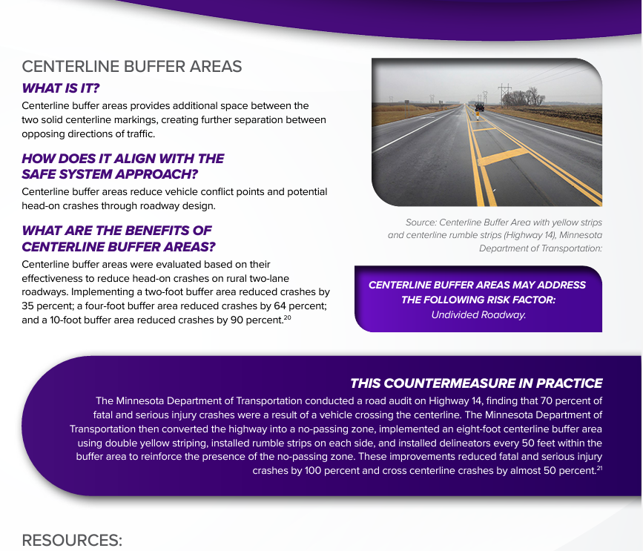

Slide 4
Link to Countermeasure
Knowledge Base
Provided in Phase II
Cost
Service Life
Implementation Period
List of other countermeasures

