Slide 1
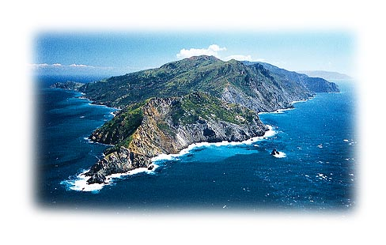
A Tiered Approach for the Identification of a Human Fecal Pollution Source at a Recreational Beach
Alexandria Boehm
Stanford University
Image from www.catalina.com

Slide 2
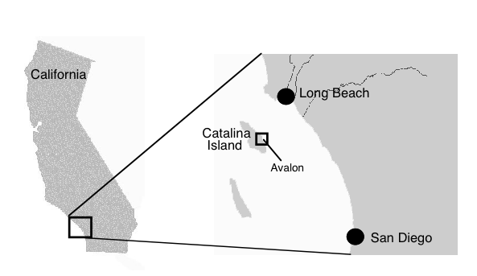
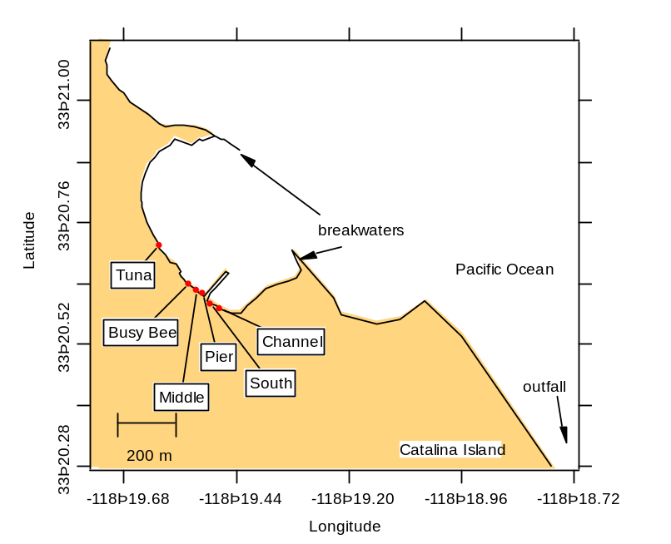
The Problem
Avalon Beach had high levels of fecal indicator bacteria (FIB), especially enterococci (ENT)
City officials could not readily identify and remediate the problem.
Possible sources
  treated sewage effluent
  nuisance runoff
  bird and wild animal feces
  leaking sewer pipes
  boat sewage collection tanks

Slide 3
Our Approach
Tier 1. Use FIB analyses to document spatiotemporal variability and identify hot spots
  Nearshore bay survey: conducted during a flood tide, at night
  Cross-shore transect: sediment and water tested
  24 hour study: document sunlight and tide effects
  Month long, twice daily shoreline survey
Tier 2: Use FIB analyses to document potential sources
  Grab samples of runoff, feces, subsurface waters, cooling water discharge, leaking pipes under pier and wharf
  Intensive sampling of subsurface waters
Tier 3: Use novel, human-specific indicators to determine if human sewage contributes to FIB.
  Hot spots and sources assayed for Bacteroides/Prevotella DNA (Bernhard and Fields) and enterovirus genomic RNA (Monpoeho et al.)

Slide 4
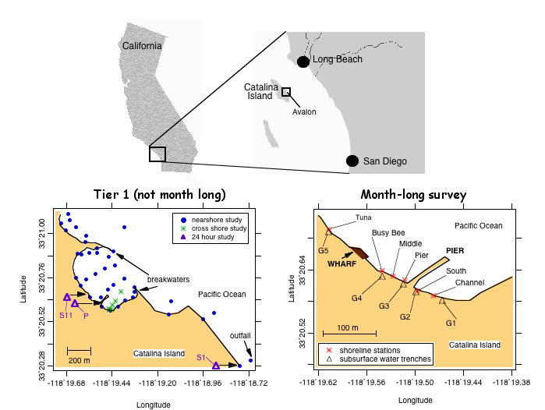

Slide 5
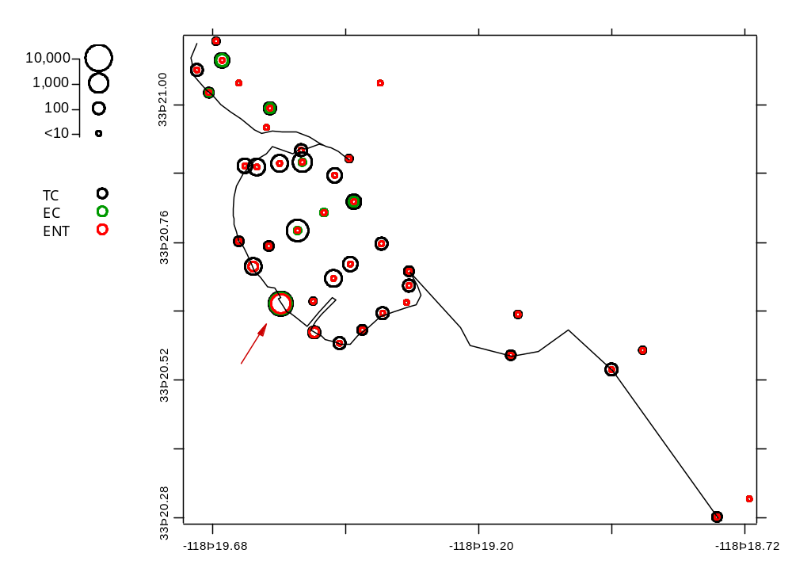
Tier 1: Nearshore bay survey
MPN/100 mL
1900 to 2100 h 19 Sept 2001

Slide 6
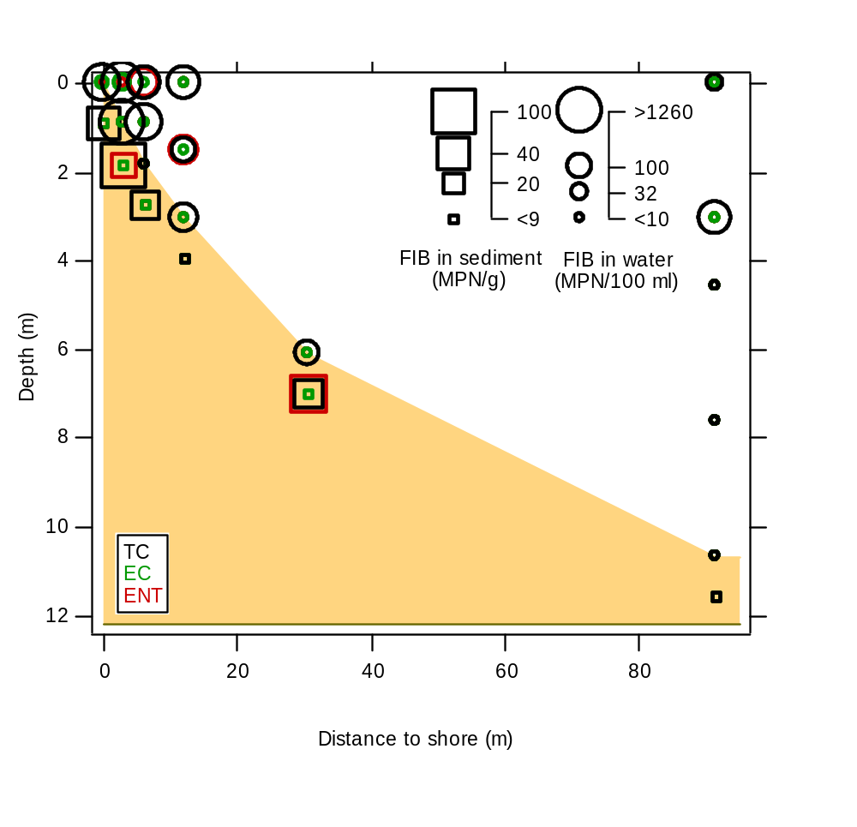
Tier 1: Cross shore survey

Slide 7
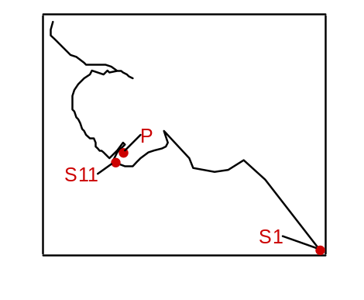
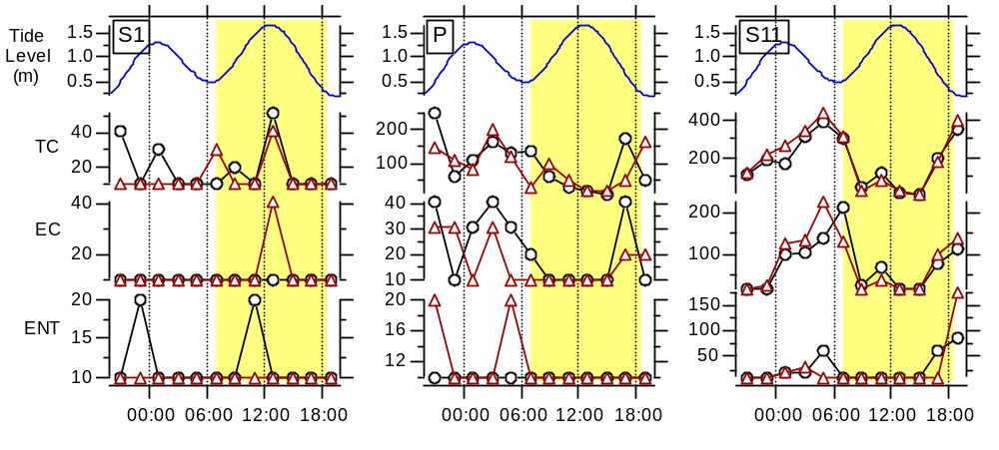

Tier 1: 24 h survey
MPN/100 mL
Distinct diurnal/semi-diurnal signal at S11

Slide 8
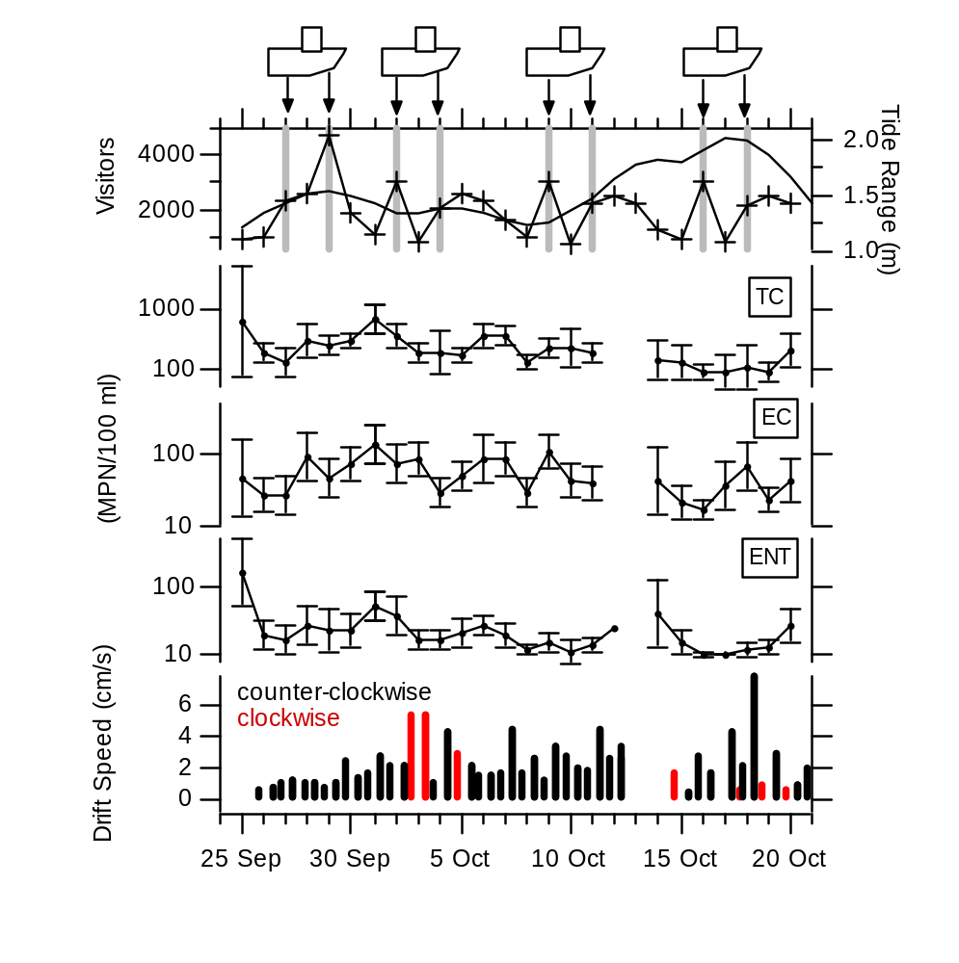
Tier 1: Month long survey (1)
 | Visitors | Tide Range | Littoral current
Log mean TC | 0.19 | -0.43 | -0.19
Log mean EC | 0.25 | -0.34 | 0.03
Log mean ENT | 0.23 | -0.11 | -0.26
None significant at 95%

Slide 9
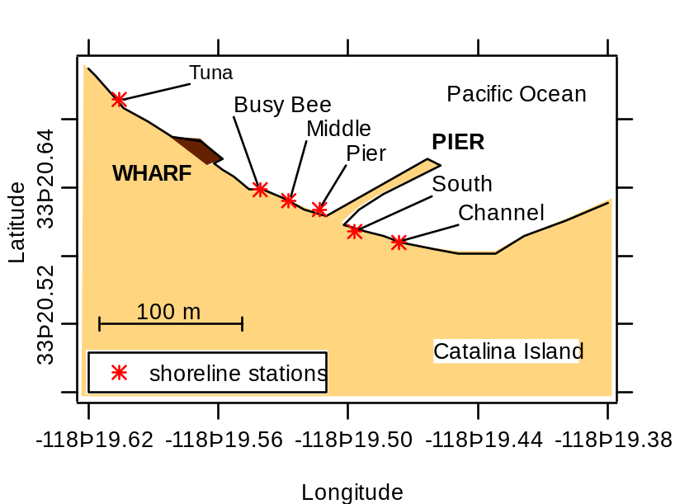
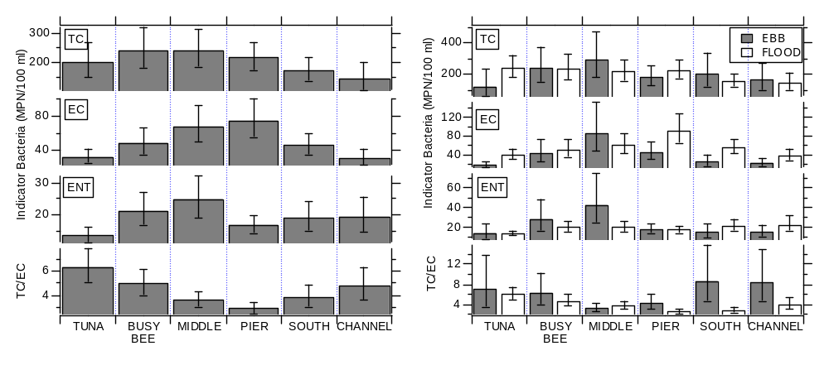
Tier 1: Month
Long Survey (2)

Slide 10
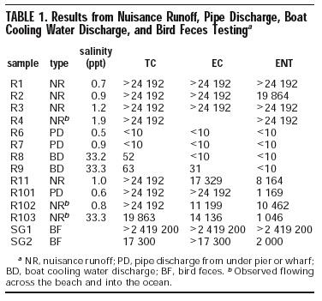
Tier 2: Source investigations-runoff, bird feces, pipe discharge
MPN/100 mL

Slide 11
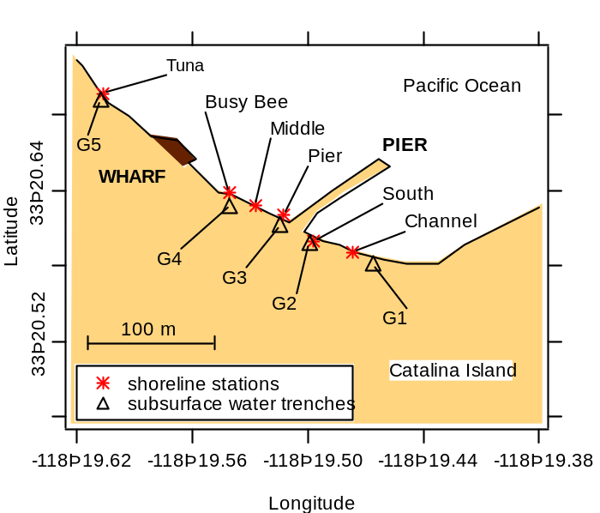
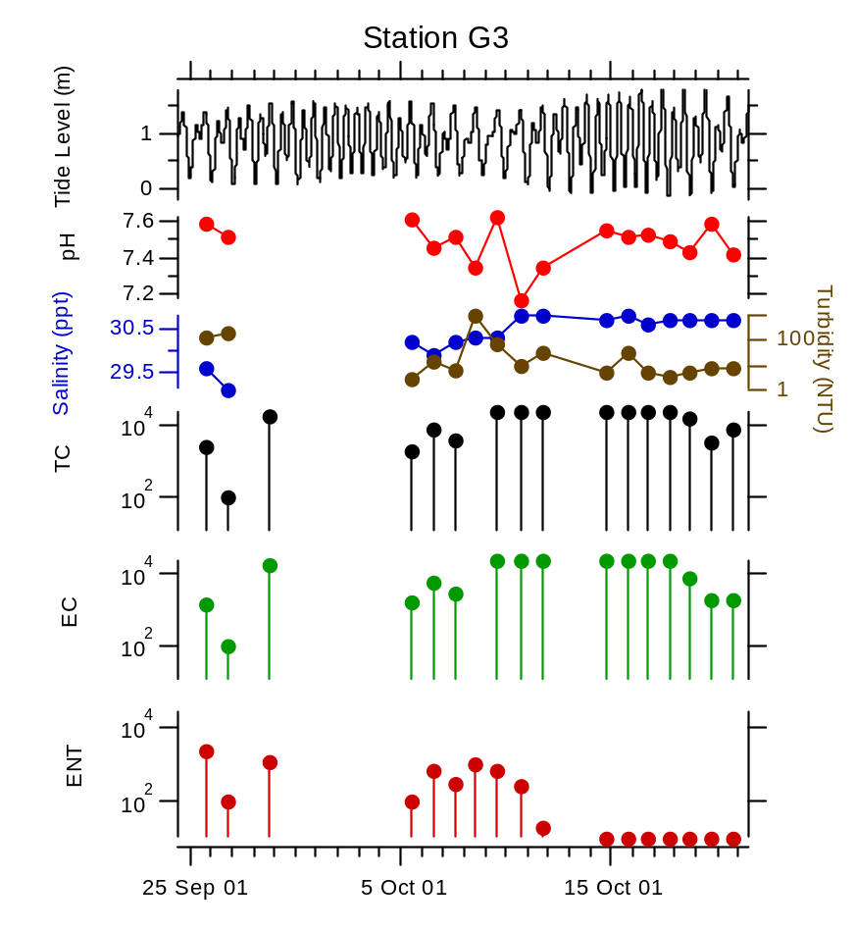
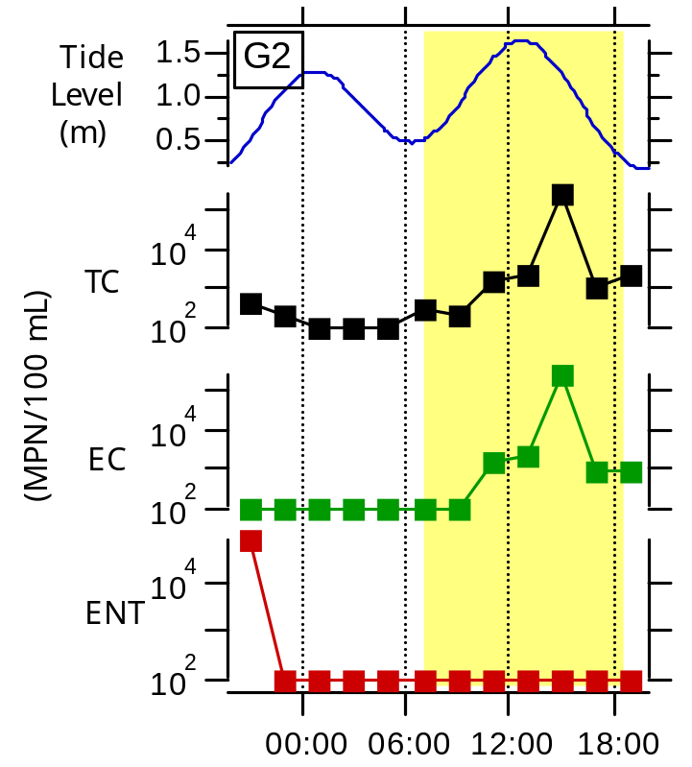
Tier 2: Source investigations -subsurface waters
MPN/100 mL

Slide 12
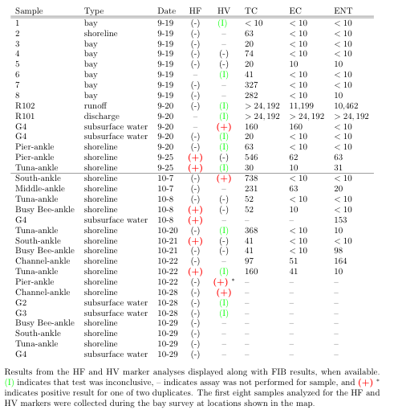
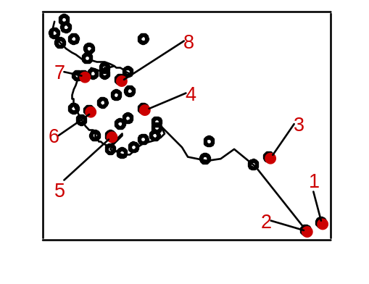
Tier 3: Bacteroides/Prevotella (HF) & Enterovirus (HV) testing
Detection Limits
HV: 1 pfu per volume filtered (2-20 L)
HF: 1 µg fecal matter per volume filtered (1-4 L)

Slide 13
Interpreting negative results…
“Because DNA tests have positively ruled out humans
as the source of bacteria in the bay, we suspect that
large populations of birds around our bay are the
probable source.”
--Avalon Bay Water Quality pamphlet handed out to tourists exiting boats prior to our study.

Slide 14
Implications
FIB at Avalon Beach are from sources inside the bay, from the land side of the beach.
  Nearshore bay survey, cross shore survey, ebb tide signal (24 hour study, month long survey)
At least a portion of the pollution is from human sewage
  Extraordinarily high levels of FIB in groundwater
  HF and HV markers found at every shoreline site (except middle) and in a groundwater sample
City of Avalon slip-lined their sewer lines adjacent to the beach in the winter of 2001/2002

Slide 15
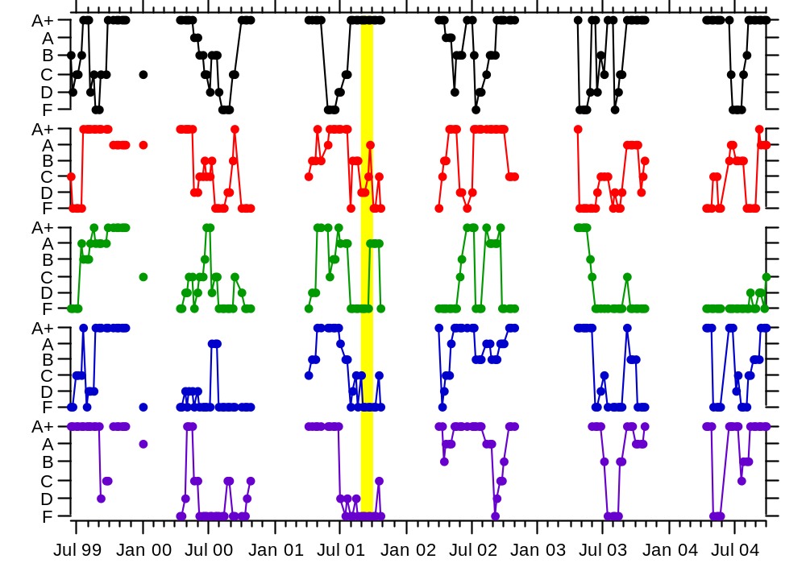
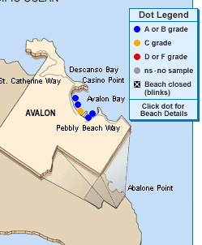
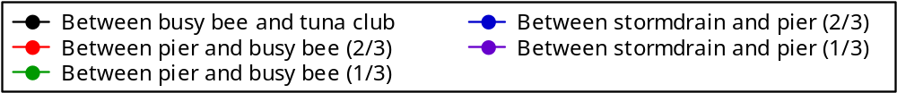
Has water quality improved?
www.healthebay.org

Slide 16
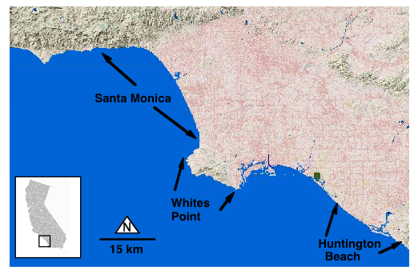
Are polluted sediments/groundwater impacting water quality at other locations?
61 beaches examined to determine if influenced by tides

Slide 17
Data & Method
Location | Data Duration | Frequency of data | Number of stations | Data
Santa Monica (I) | 9/1/87 -7/4/94 | Daily | 17 | ENT & tide level / range
Santa Monica (II) | 7/5/94 -12/31/99 | Daily to weekly | 18 | ENT & tide level / range
Whites Point | 12/1/91 -12/28/99 | Daily to weekly | 18 | ENT & tide level / range
Huntington Beach | 6/1/98 -8/30/01 | 5 d per wk | 8 | ENT & tide level / range
Compare ENT levels at each station measured during
• ebb vs. flood
• spring vs. neap

Slide 18
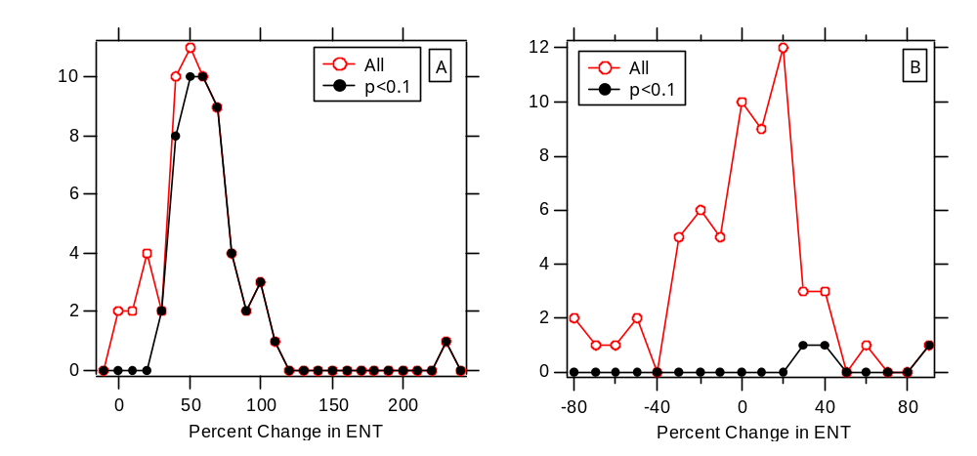
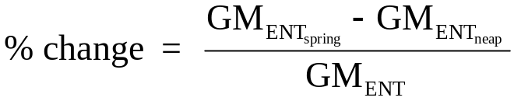
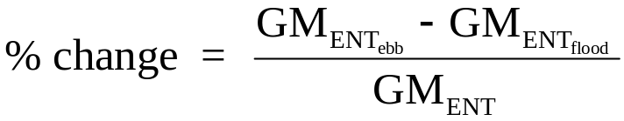
Difference in ENT between tidal conditions

Slide 19
Which beaches have strongest tidal signal?
Not related to proximity to a surficial watershed outlet, slope of input, beach slope, or beach direction
Tidal signals wide-spread at beaches away from watershed outlets
Results suggests that tidally-forced sources other than land-based surficial runoff are widespread. Potential sources include:
  Sand
  bird feces
  wrack near the high water line
  groundwater within the beach aquifer

Slide 20
Acknowledgements
Funding from
  The City of Avalon
  Los Angeles Regional Water Quality Control Board
  State of California Clean Beaches Initiative Prop 13
  UPS Foundation
  Clare Boothe Luce Professorship
Colleagues
  Steve Weisberg, Stanley Grant, Jed Fuhrman, Robert Mrse, Ryan Reeves, Cynthia Jensen-McMullin, Mark Bachman, Lisa Gilbane, Burt Jones

Slide 21
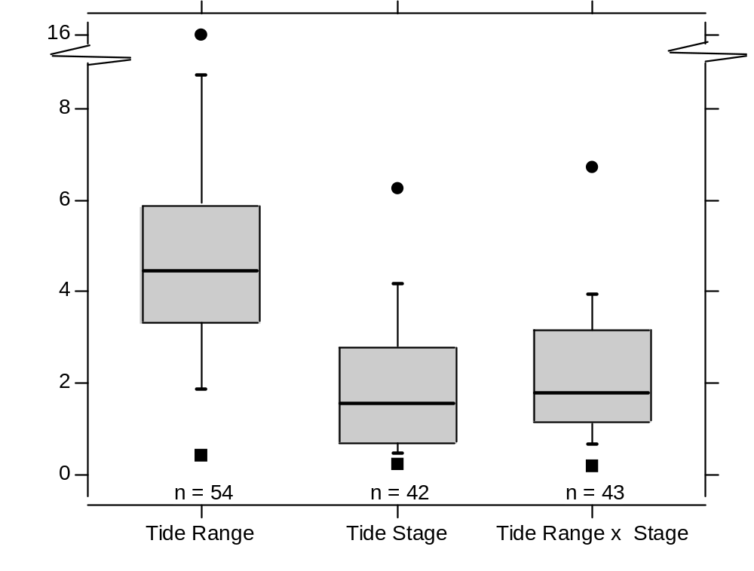
Tide range and stage both important at most beaches

