Slide 1
SPASE and the VxOs
Jim Thieman
Todd King
Aaron Roberts

Slide 2
What is SPASE?
Space Physics Archive Search and Extract (SPASE)
An International, community-based standards organization with the goals of:
  Defining a data model for Space Physics
  Demonstrate its viability
  Enabling interoperability in a federated environment
Initiated in late 2002 as a discussion among a few individuals.
Organized as a consortium with an open invitation for anyone to participate in early 2003.
U.S. participants funded by NASA in July 2005.
The VxOs can think of SPASE as:
  A group devoted to providing a common approach for spanning the differences among VxOs in data search and retrieval

Slide 3











Current Participants
• CNES/CNRS Plasma Physics (CDPP) Data Archive
• NASA/Goddard Space Flight Center
• NOAA/National Geophysical Data Center
• Planetary Data System- UCLA Plasma Physics Interactions Node
• Rutherford Appleton Laboratory
• Southwest Research Institute
• Applied Physics Laboratory
• Jet Propulsion Laboratory
• Augsburg College
• European Grid of Solar Observations (EGSO)
• Institute of Space and Astronautical Science (ISAS/JAXA)

Slide 4
What is the
SPASE Data Model?
The SPASE Data Model is a set of terms, definitions, naming conventions and relationships intended for use in describing space physics data resources
A data model must also include at least one representative form of the model (XML, data schema, etc)
The SPASE Data Model defines a metadata standard for space physics data search and retrieval
• Why create a new Data Model? No existing data model had all that was needed by the Space Physics community

Slide 5
Why a Data Model
To enable interoperability between systems.
  Each system may be implemented differently, but when they "speak" to each other its in the same language.
  You might think in French or German or Russian, but always speak English.
To provide across the board functionality.
  Single point of query.
  Value added services.
  Collection and packaging.

Slide 6
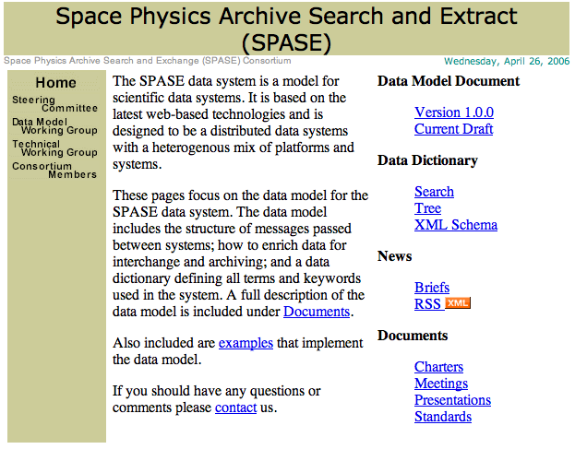
SPASE Data Model and SPASE Home Page
The SPASE Data Model Version 1.0.0 and the Current Draft can be found on the SPASE Home Page at UCLA as well as much other information about SPASE
http://www.igpp.ucla.edu/spase/

Slide 7
Status of the Data Model
Version 1.0 released November 22, 2005
Currently undergoing revisions to improve methods for describing physical regions and parameter attributes.
Will be maintained as a living Data Model
Version 1.1 to be released after current revisions are finalized (June)
  Version 1.1 will remain stable for initial VxO implementations.

Slide 8
Tools for Data Model Use
The SPASE data model is available as an XML schema. Existing XML-based tools can be used.
Other tools will help in the use of SPASE - as the community develops tools (we anticipate some from SPASE members and some from VxO efforts) they will be posted at the SPASE web site.
Tool categories might be:
  Validator - Determines compliance with SPASE data model.
  Generator – Creates SPASE descriptions using external sources of information.
  Harvester – Extracts information from SPASE resource descriptions (or registries)
  Wrapper – Converts or embeds SPASE metadata in other descriptions or forms (i.e., OAI)

Slide 9
Proposed Plan for Working with SPASE (and for Model Feedback)
Each VxO would have a registry of some form.
The registries would have a common set of core functions (to be defined) to test the model.
Proposed method for making changes to the SPASE Data Model:
  Submit a Request For Action (RFA - describing the suggested change)
  SPASE will consider the change and its community wide implications.
  SPASE may either adopt the suggested changes or suggest alternatives.
  SPASE will be responsive to each RFA and will avoid impacting VxO development schedules.
  Changes will become a part of the next release of the model.
Become an active part of the SPASE consortium (if you're not already) to directly influence the updates

Slide 10
The OAI Framework
OAI – Open Archives Initiative
http://www.openarchives.org/
Key Features:
Dublin Core Metadata (bibliographic)
  Dublin core is required
  Allows other metadata formats
REST implementation (URL request, XML response)
Supported "verbs":
  GetRecord: Retrieve an individual metadata record .
  Identify: Retrieve information about a repository.
  ListIdentifiers: Retrieve record headers.
  ListMetadataFormats: Retrieve available metadata formats
  ListRecords: Harvest records from a repository
  ListSets: Retrieve the set structure of a repository
A variety of implementations (http://www.openarchives.org/tools/tools.html)
Suitable for the VxO?

Slide 11
Open Discussion
Plans and Questions
SPASE is intended to be the inter-lingua for the VxOs
What protocol and framework should exist for VxO interoperability?
How much should SPASE also focus on technology demonstrations (prototypes) and implementations?
What tools would be useful for the VxOs in working with SPASE?
What tools are most needed by the VxOs?

