Slide 1
Status Report at ICFA-SCIC
- recent developments in networking interconnectivity at KEK/Japan/Asia -
at CERN on 8 December 2001
Yukio.Karita@kek.jp
http://www-nwg.kek.jp/~karita/icfascic-dec01.ppt

Slide 2
Outline
Changes within Japan
  SuperSINET
Changes in international connectivity
  NII’s US/Europe link upgrade
  Links within Asia
    HEP links
    APAN
Security AdHoc meeting

Slide 3
Changes within Japan
SuperSINET will start its service in January 2002
  Intended to be fully photonic
    10 λ’s from KEK
      One for 10Gbps IP backbone
      Seven for direct GbE (or 10GbE) to university HEP
  HEP VPN (or APN) within SuperSINET
    MPLS-VPN for HEPnet-J
    GbE’s to extend Workgroup VLAN’s in KEK to university HEP

Slide 4
SuperSINET
As of 2002.1.1
IP
NIFS
WDM path
Nagoya U
NIG
IP router
OXC
Nagoya Hub
Tohoku U
Osaka Hub
Tokyo Hub
KEK
Osaka U
NII Chiba
Kyoto U
NII
Hitotsubashi
ICR
Kyoto-U
ISAS
U Tokyo
Internet
IMS
NAO
U-Tokyo

Slide 5
MPLS-VPN for HEP
Nagoya U
GbE
MPLS
IP
SuperSINET
MPLS router
HEPnet-J
IP router
SuperSINET
OXC
Nagoya Hub
Osaka Hub
Tokyo Hub
KEK
OC48c’s
Osaka U
GbE
Kyoto U
GbE
U Tokyo
GbE
Tohoku U
GbE

Slide 6
Changes in international connectivity

Slide 7
NII’s US/Europe link
SuperSINET’s plan (Jan. 2003)
  Two λ’s to US Westcoast (λ≈2.5Gbps?)
    One is for IP backbone
    One is for direct GbE’s
      to be used for KEK-CERN Grid Testbed
        Canarie can bridge SuperSINET’s λ and DataTAG’s λ?
Minor upgrade in Jan. 2002
  Five OC3 POS’s for the default IP traffic
  Three 75Mbps ATM-PVC’s for mission-oriented traffic
    One is to connect with Abilene
    One is to connect with Esnet
    One is to connect with Geant
      75Mbps is to fullfill NII’s contribution for the NII-Dante OC3 connection proposed by Dante last year

Slide 8
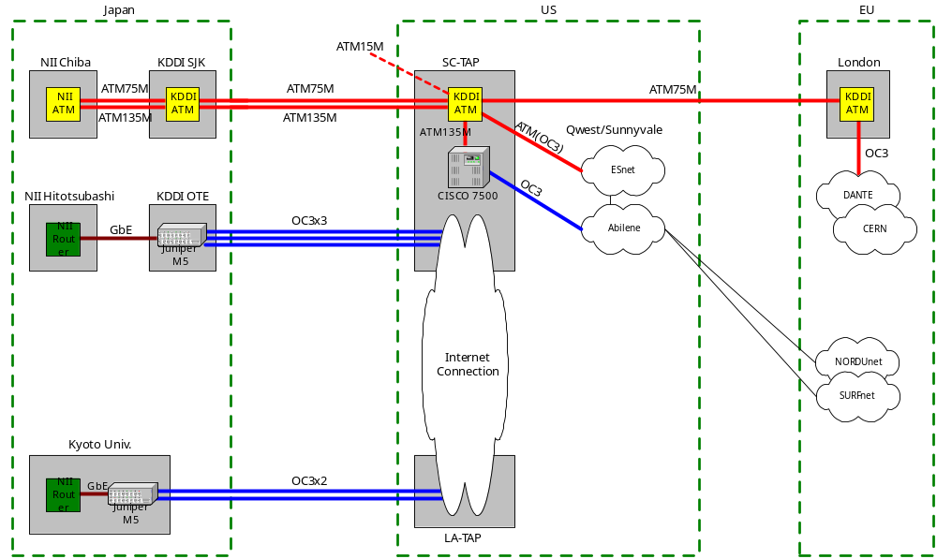
NII’s US/Europe link as from Jan. 2002

Slide 9
Bandwidth for HEP in NII’s US/Europe link
Bandwidth as from Jan. 2002
  KEK-Esnet 20Mbps (← current 10Mbps)
  KEK-CERN 20Mbps (← current 4Mbps)
  KEK-DESY 10Mbps (← current 2Mbps)
How shall we do in Geant?
  MBS (Managed Bandwidth Service supported in TEN-155) is not supported in Geant for the present.
  So the both PVC (to CERN and to DESY) are currently terminated at Geant router at London.
  Can we expect MPLS-VPN support or something else in Geant?

Slide 10
Links within Asia
HEP links
  KEK-AcademiaSinica (TW) 1.5Mbps FrameRelay
    To be merged into AcademiaSinica-APAN 45Mbps (coming).
    HEP traffic will have priority there.
  KEK-BINP (RU) 128Kbps → 512Kbps
    Its Japanese half circuit has been ready for the upgrade since early 2001.
    Waiting for US’s support for its Russian half circuit.
  KEK-IHEP (CN) 128Kbps
    Once said to be merged into CAS (Chinese Academy of Science)’s international link, but may continue to exist even after IHEP is connected to CAS.
    IHEP-CAS 2Mbps link is being delayed.
APAN
  Expected to provide the intra-regional connectivity for HEP within Asia, especially to Korea.
  “ACFA network”

Slide 11
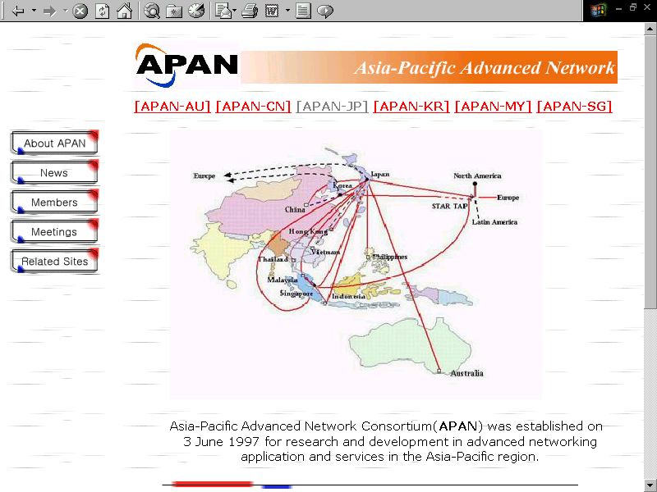
APAN
http://www.apan.net/

Slide 12
Intra-regional APAN lines
Countries
JP-AU
JP-CN
JP-HK
JP-ID
JP-KR
JP-LK
JP-MY
JP-PH
JP-SG
JP-TH
JP-TW
JP-VN
KR-SG
MY-SG
Network
RWCP-ACSys
AI3(CSTNET)
CERNET
AI3(HKUST)
AI3(ITB)
APII
GENKAI
AI3(UC)
AI3(USM)
MAFFIN(PHNET)
AI3(SICU)
APII
AI3
AI3(AIT)
SINET(NECTEC)
AcademiaSinica
AI3(IIT)
APII
TEMAN (SingaREN)
Bandwidth(Mbps)
1.5
1.5
10
1.5
1.5
8
1000
1.5
1.5
0.75
1.5
2
1.5
1.5
2
45
1.5
2
2
Availability
Now
1999-2000
Now
Now
Now
Now
2002(?)
2000(?)
1999-2000
Now
2000(?)
Now
1999-2000
Now
Now
2002
1999-2000
Now
Now
AUP
Research & Education
Research & Education
Research & Education
Research & Education
Research & Education
APII Project
?
Research & Education
Research & Education
Research & Education
Research & Education
APII Project
Research & Education
Research & Education
Research & Education
Research & Education
Research & Education
APII Project
Research

Slide 13
APII Asia Pacific Information Infrastructure
a project initiated by APEC
      http://www.crl.go.jp/t/team1/APII
AI3 Asian Internet Interconnection Initiative
      http://www.ai3.wide.ad.jp
GENKAI
      http://genkai.info

Slide 14
APAN is not automatically open to all the A&R community.
Its use is granted per project base.
“ACFA network” project
Abstract of project
  ACFA stands for Asian Committee for Future Accelerators. Under ACFA, many institutes in the Asia Pacific region are collaborating in research with accelerators. A quality computer network is crucial for this collaboration, and is expected to be provided by APAN.
Expected result
  The infrastructure for the well collaboration in ACFA is established.
Special feature of traffic
    Collaborative tools including the video conferencing
    Access to large databases

Slide 15
Countries in Asia(-Pacific) requiring connectivity for the ACFA collaboration
  JP, KR, CN, TW, PH, SG, IN, ID, VN, TH, RU, MY, AU,...
HENP lines
  KEK to CN, RU, TW
APAN lines
  APAN_Tokyo to KR, CN, PH, TH, SG, AU (now)
  to TW, VN, MY, ID (coming)

Slide 16
Security AdHoc meeting
Held at KEK on 5-6 December 2001 with participants from SLAC, FNAL, BNL, CERN, DESY, and KEK.
Had valuable information exchange and discussions on VPN, mobile PC support, video conferencing, high speed data transfer bypassing the firewall, …. from the security’s point of view.
Next meeting will be held at US EastCoast in autumn 2002.

