Slide 1
Toward Middle East Cooperation
Drug Abuse and Infectious Disease among
Former Soviet Union Immigrants
Richard Isralowitz, Ph.D.
Director
Alex Reznik, Ph.D.
Senior Research Associate
Regional Alcohol & Drug Abuse Resources Center
Ben Gurion University
USAID-MERC Program

Slide 2
Background
Little is known about drug abuse among Former Soviet Union (FSU) immigrants.
The health needs of FSU immigrants are still in the early stage of assessment.
Among Russian speaking immigrants in Israel, there is a relatively high level of poverty, especially among single parents and the elderly who immigrated after 1989.

Slide 3
Background (con’t)
Since 1989, nearly 1 million people immigrated to Israel from the FSU. Among the country's estimated 25,000-28,000 drug abusers, about 25% are Russian-speaking.
It appears that FSU immigrants have a high rate of drug abuse compared to other immigrants and possibly even native born populations

Slide 4
Research in Israel
FSU Drug Abusers in Treatment (152)
Background Characteristics
  Most were addicted (about 80%) before immigration.
  44% reported a history of FSU imprisonment.
  21% had been in a psychiatric hospital primarily for detoxification.
  Physical abuse as a child was reported by 46% of the female and 37% of the male drug abusers. Sexual abuse as a child was reported by 36% of the women and 5% of the men.
  50% said their family relationships had deteriorated since immigration.

Slide 5
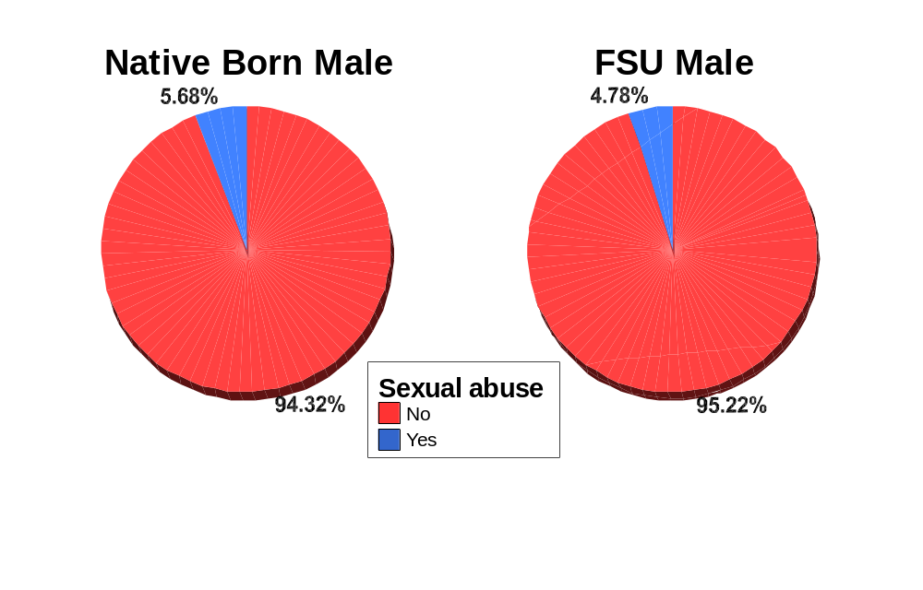
Sexual Abuse
(Lifetime)
Native Born & FSU Males

Slide 6
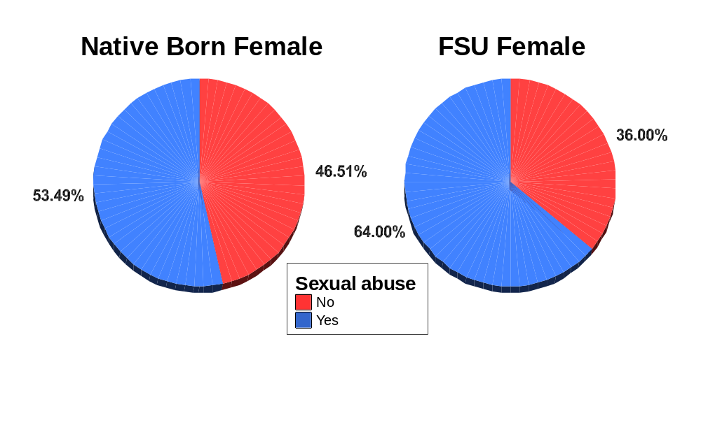
Sexual Abuse
(Lifetime)
Native Born & FSU Females

Slide 7
Research (con’t)
  Alcohol Use
  Heavy alcohol use among parents was reported by 33% of the male and 40% of the female FSU drug abusers.
  Drug use among parents was reported by 18% of the male and 38% of the female FSU drug abusers.
  Females had almost three times as many heavy alcohol using mothers as did males (14% vs. 5%).
  Older drug abusers tend to be more heavy users of alcohol.

Slide 8
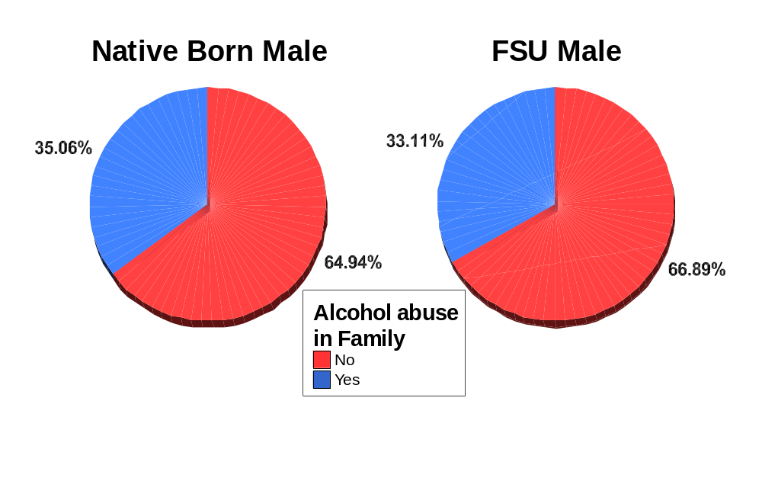
Family History: Alcohol Abuse
Native Born & FSU Males

Slide 9
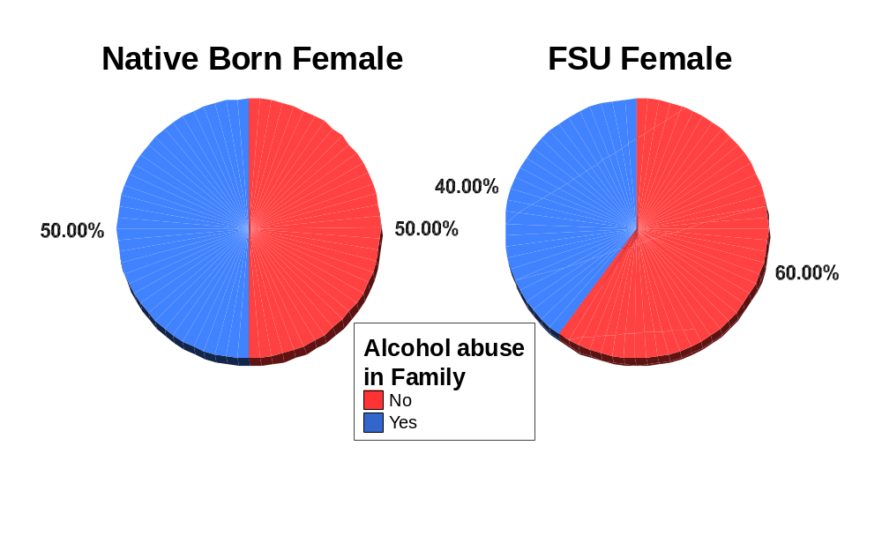
Family History: Alcohol Abuse
Native Born & FSU Females

Slide 10
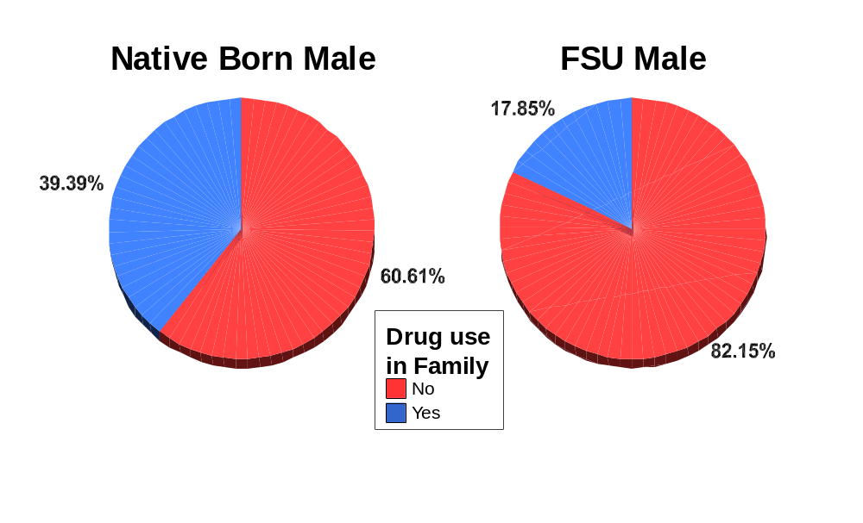
Family History: Drug Use
Native Born & FSU Males
(p≤.001)

Slide 11
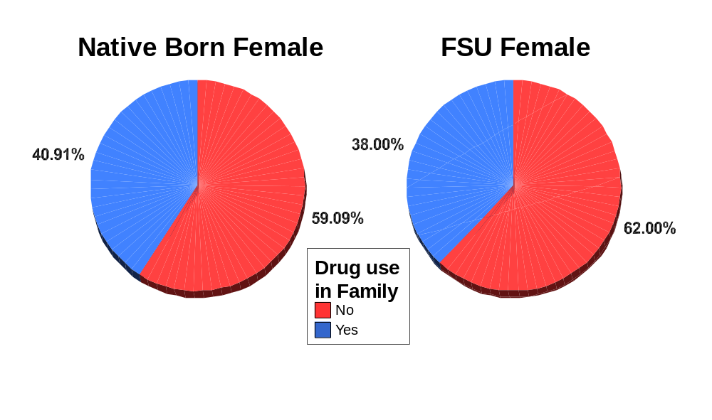
Family History: Drug Use
Native Born & FSU Females

Slide 12
Research (con’t)
  Treatment Factors
  Many drug abusers seek a medical fix for their addiction. It appears that many tend to use treatment to reduce their level of drug abuse, not to eliminate the problem.
  44% of the those in drug treatment claimed to be "clean" of heroin but using alcohol or other drugs such as amphetamines, benzodiazepines, marijuana and hashish; only 17% reported to be free of any licit or illicit substance use.
  39% reported using heroin or opiate type drugs while in treatment; the majority of this group (72%) were using such substance(s) in combination with alcohol.

Slide 13
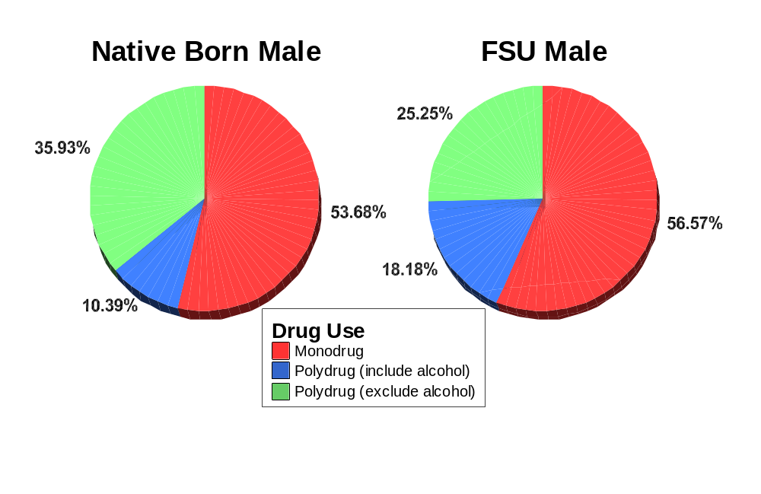
Drug/Alcohol Use
Native Born & FSU Males
(p≤.01)

Slide 14
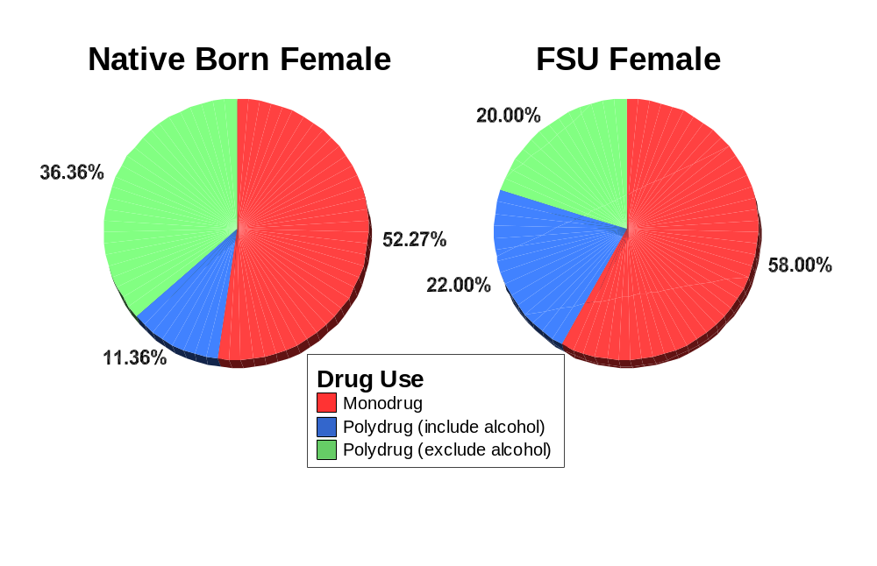
Drug/Alcohol Use
Native Born & FSU Females

Slide 15
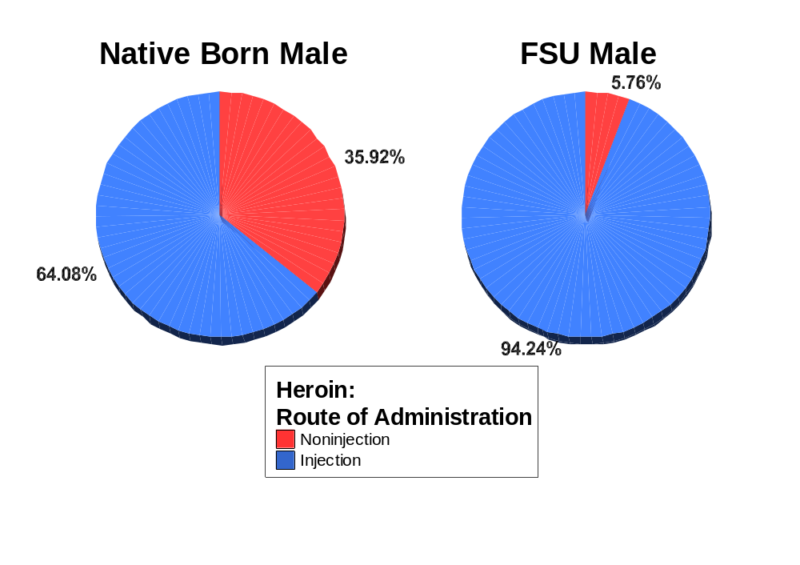
Route of Administration
Native Born & FSU Males
Heroin
(p≤.001)

Slide 16
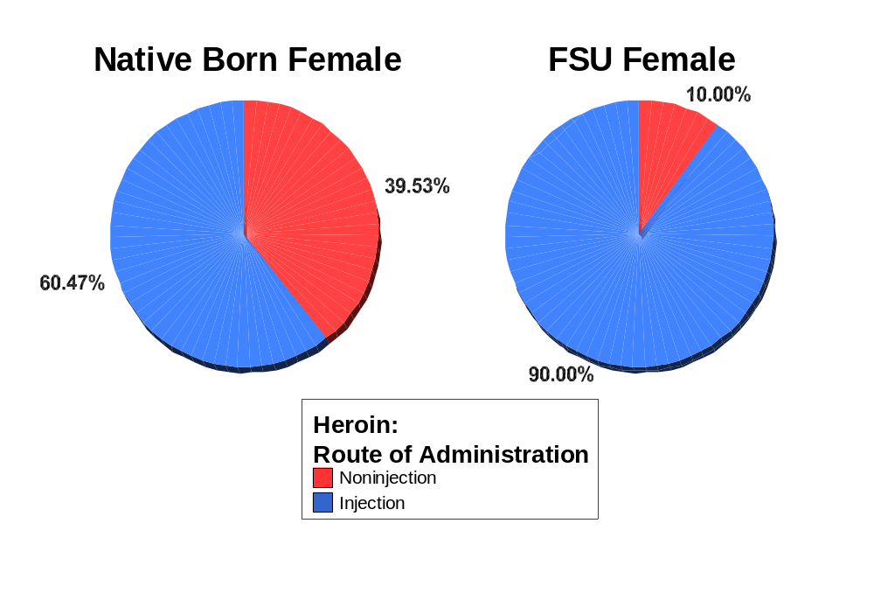
Route of Administration
Native Born & FSU Females
Heroin
(p≤.001)

Slide 17
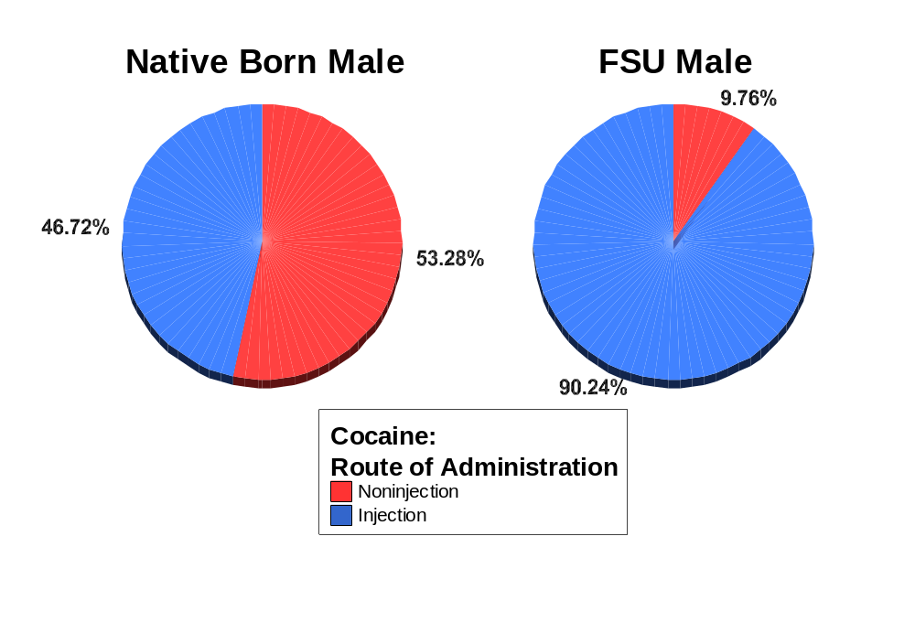
Route of Administration
Native Born & FSU Males
Cocaine
(p≤.001)

Slide 18
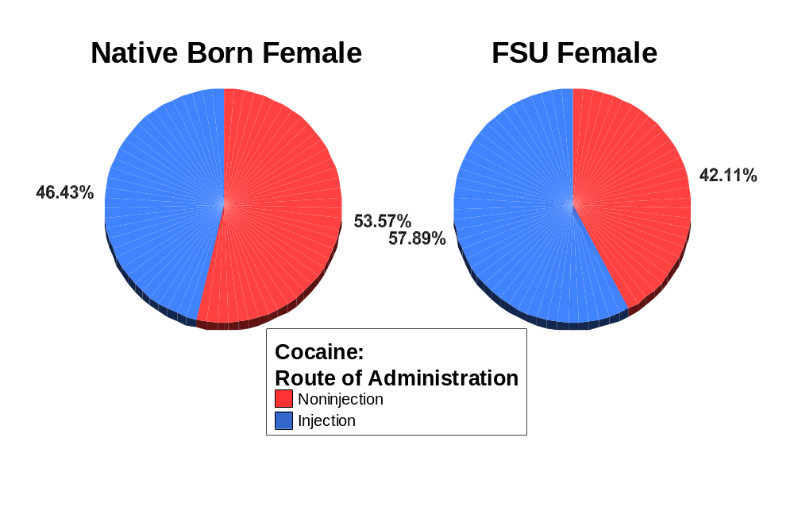
Route of Administration
Native Born & FSU Females
Cocaine

Slide 19
Research (con’t)
  Female FSU (53) & Native–Born Drug Abusers (61)
  FSU female drug abusers tend to be better educated and have a greater concern about their personal health and custody of their children.

Slide 20
Research (con’t)
  Other Factors - religion, acculturation, drug use patterns, and work
  Religious affiliation (i.e., being Jewish) does not appear to influence the attitudes and behavior of FSU drug abusers - a comparison of 70 Jewish and 29 non-Jewish drug abusers (Isralowitz, 2002).
  Acculturation does not appear to influence drug use attitudes and behavior among FSU drug abusers. Numerous factors tend to differentiate FSU and Israeli-born drug abusers including patterns of injection heroin use; heroin use in combination with other substances (e.g., alcohol), and work behavior- a comparison of 114 FSU and 93 native-born Israeli drug users (Isralowitz, 2004a).

Slide 21
Research (con’t)
  Current research shows younger FSU drug abusers are more inclined to use heroin than older FSU drug abusers whose problem behavior is mostly related to a combination of heroin and alcohol (Isralowitz, et al., 2004b).
  Unlike native born Israeli drug abusers, those from the FSU tend to be employed and less likely to have a family member who is also using drugs (Isralowitz, et al., 2004b).

Slide 22
Research (con’t)
Infectious Diseases
HIV/HCV/TB rates among FSU male (269) and female drug abusers (46) (Isralowitz, et al., 2004b).
FSU Males FSU Females
HIV/AIDS* 5% 15%
Hepatitis C 66% 72%
Tuberculosis 4% 2%
* Most HIV infected FSU persons (about 80%) are younger than 30 years old compared with about 30% in the US (Field, 2004:118). In Germany or the UK the number of newly identified IDU related HIV infection was 2 persons per million inhabitants in 2002, the corresponding figures were 129 in Russia and 94 in the Ukraine (UNODC, 2004:85-86).

Slide 23
Research (con’t)
HIV/HCV/TB rates among FSU (269) and Israeli-born (210) male drug abusers (46) (Isralowitz, et al., 2004b).
FSU Males Israeli-Born Males
HIV/AIDS 5% <1%
Hepatitis C* 66% 35%
Tuberculosis 4% <1%
* In Europe including the FSU, it has been reported that depending on location, between 40-90 percent of the IDU populations are HCV infected (WHO, 2000).

Slide 24
Research (con’t)
HIV/HCV/TB rates among FSU (46) and Israeli-born (37) female drug abusers (Isralowitz, et al., 2004b).
FSU Females Israeli-Born Females
HIV/AIDS 15% <1%
Hepatitis C 72% 41%
Tuberculosis 2% <1%

Slide 25
Future Research Recommendations
  Regular monitoring (e.g., CEWG) of drug use and infectious disease (i.e., HIV/AIDS, HCV and TB) is needed among high risk populations including drug abusers and family members - women and children.
  Research of drug treatment personnel is needed to understand their knowledge about drug use and infectious disease (i.e., HIV/AIDS, HCV and TB). Such information should provide the basis for content specific training that needs to be evaluated in terms of its impact on treatment service provision and the attitudes and behavior among high risk populations.

Slide 26
Recommendations (con’t)
  Research is needed about the obstacles encountered by FSU immigrants that restrict access to treatment services.
  Information is needed to inform, not alarm, the FSU population (and general population) about HCV and other infectious diseases. Such information should be evaluated to determine its impact on the attitudes and behavior among high risk populations as well as its impact on service use.

Slide 27
Recommendations (con’t)
  The issue of drug abuse and infectious disease (i.e., HIV, HCV and TB) prevention should become a theme used to promote communication and cooperation between Israel and its neighbors in the Middle East region.

Slide 28
References
Field, M. (2004). HIV and AIDS in the Former Soviet Bloc. New England Journal of Medicine 35, 1/2, July 8
Isralowitz, R. (2001). Toward an understanding of Russian speaking heroin addicts and
drug treatment services, Journal of Social Work Practice in the Addictions, 1(2), 33-44.
Isralowitz, R. (2002). Religious affiliation of Russian speaking heroin addicts in Israel,
Journal of Social Psychology, 142(6), 791-793.
Isralowitz, R., & Bar Hamburger, R. (2002a). Characteristics of heroin using immigrant
and native born women: Implications for policy and program development, Journal
of Psychoactive Drugs, 34(1), 97-103.
Isralowitz, R., & Borkin, S. (2002b). Russian-speaking immigrants: Factors associated with
heroin use. In Isralowitz, R. Afifi, M. & Rawson, R. (Eds.). Drug problems: Cross-cultural policy and program development, 89-112. Westport, CT: Auburn House.
Isralowitz, R., Straussner, L., Vogt, I., & Chtenguelov, V. (2002c). Toward an understanding of
Russian speaking drug addicts in Israel, Germany and the United States, Journal of Social Work Practice in the Addictions, 2(3/4), 119-136.
Isralowitz, R. (2003). Female heroin addicts in Israel. Psychiatric Times, Global Watch
Special Edition, XX, 11, 25-27.

Slide 29
References (con’t)
Isralowitz, R. (2004). Drug Use: A Resources Handbook, ABC-CLIO, Denver, Co.
Isralowitz, R. (2004a). Cultural identification and substance use: Immigrant and native heroin addicts in Israel, Journal of Social Psychology, 144(2), 222-224.
Isralowitz, R., et al. (2005). Diseases and service utilization among Former Soviet Union Immigrants: A view from New York City. Journal of Ethnicity in Substance Abuse, forthcoming
United Nations Office on Drugs and Crime (2004). World Drug Report, Vol. 1: Analysis, Vienna.
World Health Organization, “Fact Sheet No. 164: Hepatitis C” (revised October 2000).
Thank you

