Slide 1

Tropical Cyclone Winds in IFPS in Pacific Region
IFPS Methodology Workshop
April 2004
Ken Waters

Slide 2
Outline
Pacific Region ORD
TCM Tools
Rankin Vortex Work
What’s Next?

Slide 3
Pacific Region ORD
ORD August 3rd to September 15th
IOC October 15th
TCM grids
  Appropriate 3 hourly TCM grids required
  OB3 required for TPC TCM solution
  Test grids prior to ORD
  TCM Grids within GFE 30 minutes after issuance from Centers
IFPS 16.0 timing
  National implementation immediately after ORD
  Backup Issues
    WFO MTR, WFO HFO & WFO GUM
  VTEC Issues???

Slide 4
Pacific Region ORD
BOTTOM LINE
  Pacific Region stated our #1 most important issue and potential IOC-breaker was…..
  THE NEED FOR TROPICAL CYCLONE INITIALIZATION WIND GRIDS:
    In a timely manner
    Sufficient resolution
    Reasonably representative of the structure of the tropical cyclone as best as we know

Slide 5
Pacific Region ORD
Initial Results appear very promising
  Communication tests sending TPC grids to PR mostly successful
  FSL tool successfully run at WFO Guam, PRH, and WFO Honolulu
    Can only be fully evaluated using a real storm when it comes into either Guam’s or Honolulu’s domain
  Both tools seem to show good potential to be used
  One big drawback to the TPC tool is the 6-hour resolution

Slide 6
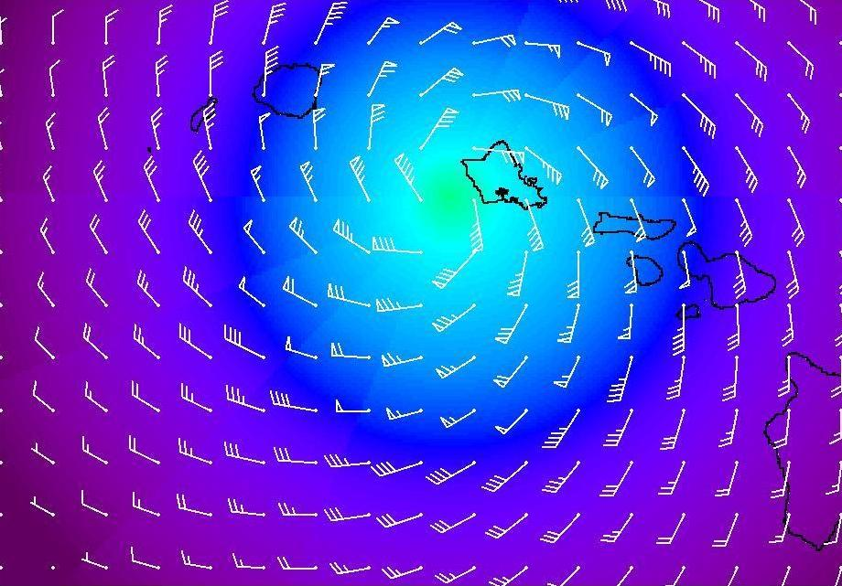
FSL TCM Solution

Slide 7
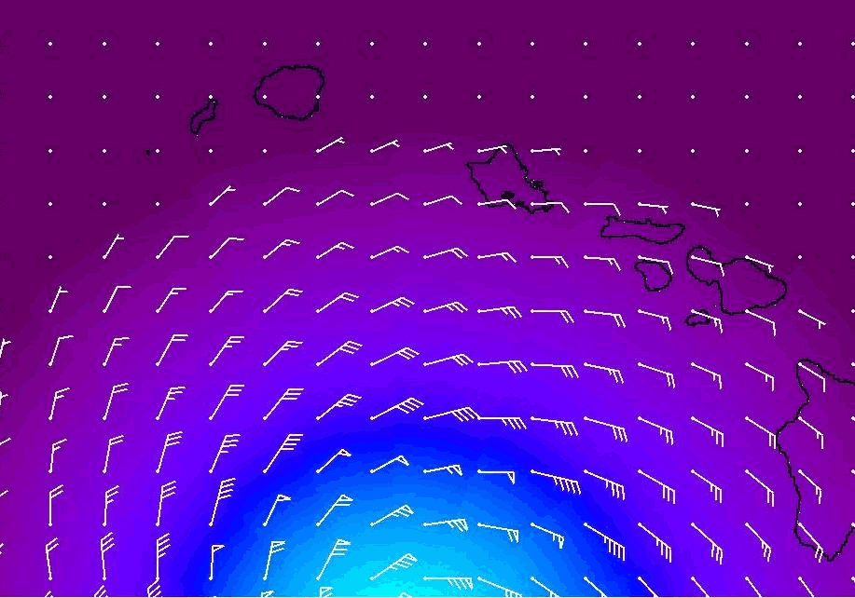

Slide 8
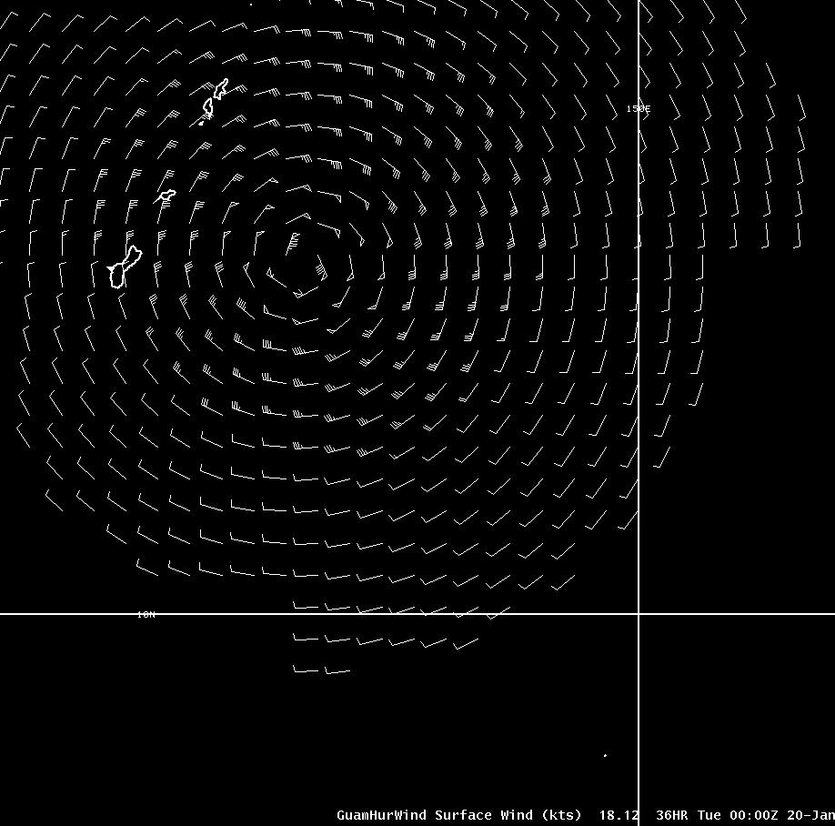
TPC TCM Solution

Slide 9
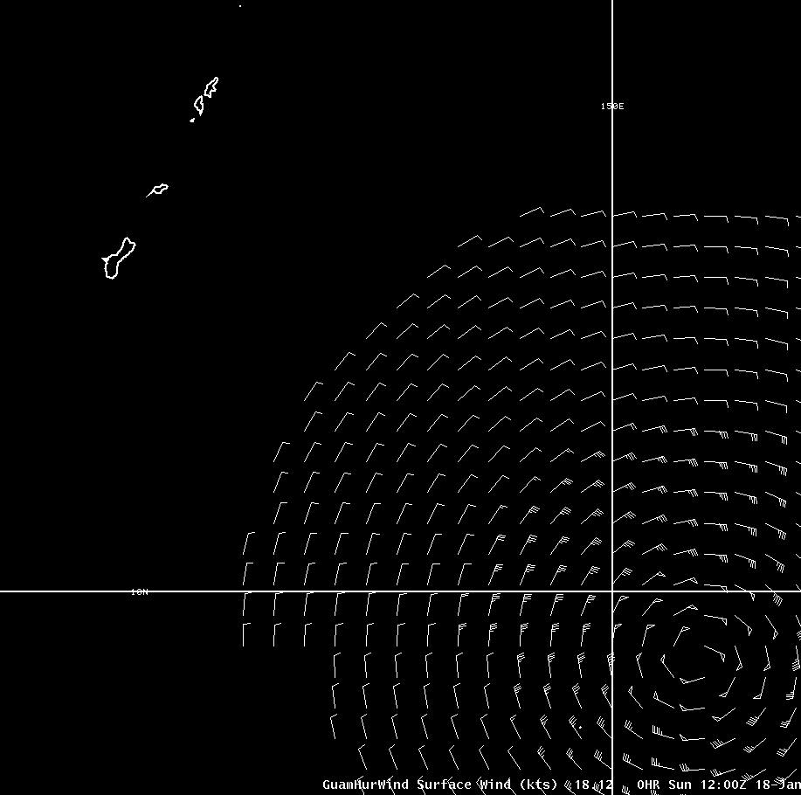

Slide 10
Rankin Vortex Work
Work started in 1997 at WFO Guam
  The Original Goal: To give forecasters aid to translating text warnings into hourly forecast for point locations for use in TAFs and determining temporal “breakpoints” for determining periods of destructive winds
  WFO Guam had 31 warning points/islands and frequently had more than one tropical cyclone to warn on in their coverage area

Slide 11
Rankin Vortex Work
Basic Concept
  Start with the warning positions (lat/long/max wind)
  Interpolate hourly position and intensity
  Develop a Rankin vortex centered on each interpolated hourly position
  Using this model calculate wind speeds for both points (islands) and at regularly-spaced gridpoints
  Adjust wind speeds/directions by adding/subtracting vector storm movement

Slide 12
Rankin Vortex Work
Issues
  Determination of Radius of Maximum Wind (RMW) --- not part of forecast but input to the formula
  Determination of the exponential “shape” factor
    How rapidly does wind speed fall off as one moves away from center?
    Variances include spectrum from huge storm down to “midget” typhoons
  Inherent dangers with using a highly deterministic approach to describe difficult-to-predict tropical cyclone movement and intensity

Slide 13
Typhoon Sudal Apr 9, 2004
HOURLY POSITION/CLOSEST POINT:
# Lat Lon Wind Mvmt Dstnc/Dirctn from (naut mi)
0 8.8 138.5 110.0 282 8 55 SSE Yap
1 8.8 138.4 110.4 282 8 50 SSE Yap
2 8.9 138.3 110.8 282 8 45 SSE Yap
3 8.9 138.2 111.2 282 8 42 S Yap
4 8.9 138.0 111.7 282 8 40 S Yap
5 8.9 137.9 112.1 282 8 40 SSW Yap
6 8.9 137.8 112.5 282 8 42 SSW Yap
7 9.0 137.7 112.9 282 8 44 SW Yap
8 9.0 137.6 113.3 282 8 48 SW Yap
9 9.0 137.4 113.8 282 8 50 N Ngulu
10 9.1 137.3 114.2 282 8 53 N Ngulu
11 9.1 137.2 114.6 282 8 56 NNW Ngulu
12 9.1 137.1 115.0 282 8 61 NNW Ngulu
13 9.2 137.0 115.4 305 9 69 NNW Ngulu
14 9.2 136.9 115.8 305 9 77 NNW Ngulu
15 9.3 136.8 116.2 305 9 86 NW Ngulu
16 9.4 136.7 116.7 305 9 94 NW Ngulu
17 9.5 136.6 117.1 305 9 103 NW Ngulu
18 9.6 136.4 117.5 305 9 111 W Yap
SYMMETRIC MODEL PREDICTED WINDS FOR:
Koror Ngulu Yap Taipei Hong Kong
0 340 25 334 56 59 69 47 9 33 8
1 339 26 330 59 66 73 47 9 33 8
2 338 26 325 62 74 77 47 9 33 8
3 337 27 319 66 84 81 48 9 33 8
4 336 27 312 69 95 84 48 9 33 8
5 335 28 304 72 106 84 48 9 33 9
6 334 28 296 74 118 83 48 9 33 9
7 333 29 286 76 128 80 48 10 33 9
8 332 29 277 76 136 76 48 10 33 9
9 330 30 267 75 144 72 49 10 34 9
10 329 31 259 73 150 68 49 10 34 9
11 327 31 251 70 154 64 49 10 34 9
12 326 32 245 67 158 61 49 10 34 9
13 324 32 241 63 164 59 49 10 34 9
14 321 33 238 59 169 56 49 10 34 9
15 319 33 236 56 173 54 49 10 34 9
16 316 33 234 53 176 52 49 10 34 9
17 314 34 232 50 180 50 49 10 34 9
18 311 34 231 48 182 48 49 10 34 9
19 309 34 230 46 185 46 49 10 34 9
20 306 34 229 44 187 45 49 10 34 9
21 303 34 228 43 188 43 50 11 34 9
22 301 34 227 41 190 42 50 11 33 10
23 298 34 226 40 191 41 50 11 33 10
24 296 34 226 39 193 40 50 11 33 10
Paper to be presented May 2004 at AMS Tropical Conference

Slide 14
What’s Next?
Direct Comparison in Pacific Region
  Same storm
  Same warning
Analyze effect of difference in temporal resolution (e.g., interpolated 6 hr TPC grids to 3 hr vs. FSL 3 hr)
Analyze effect of differences in spatial resolution

Slide 15
What’s Next?
Decision by wind team on which tool to use
  Not efficient to support two tools other than in a test environment
Possible enhancements?
  Asymmetric wind structure (moving storm)
  Environmental blending (e.g., SW monsoon flow)
  Verification (using…? QuikSCAT? Recon?)

Slide 16

Questions?

