Slide 1

Infection Control Preparedness Planning for SARS
Linda A. Chiarello, RN, MS

Slide 2

Planning Goal
Protect the healthcare community from SARS
  Patients
  Healthcare Workers (HCWs)
  Visitors

Slide 3
SARS Preparedness Planning
Preparedness Plan Elements
  Organizational infrastructure
  Logistics of patient care
  Staffing
  Durable and consumable resources
  Exposure management
Patient focused pre-event planning
  Lessons learned
  Fix the weaknesses in the system

Slide 4
Lessons Learned:
Case Study #1
Toronto Hospital Emergency Department
Patient contacts as SARS transmission risks
Evidence for close contact/droplet spread
Implement precautions at point of first encounter

Slide 5


Friday, March 7th
SGH
Index Case
Patient A
(Mother)
(Son)
Admitted to SGH

Slide 6
Night of March 7th
Observation Unit ER SGH
Patient A
Patient B
Patient C

Slide 7
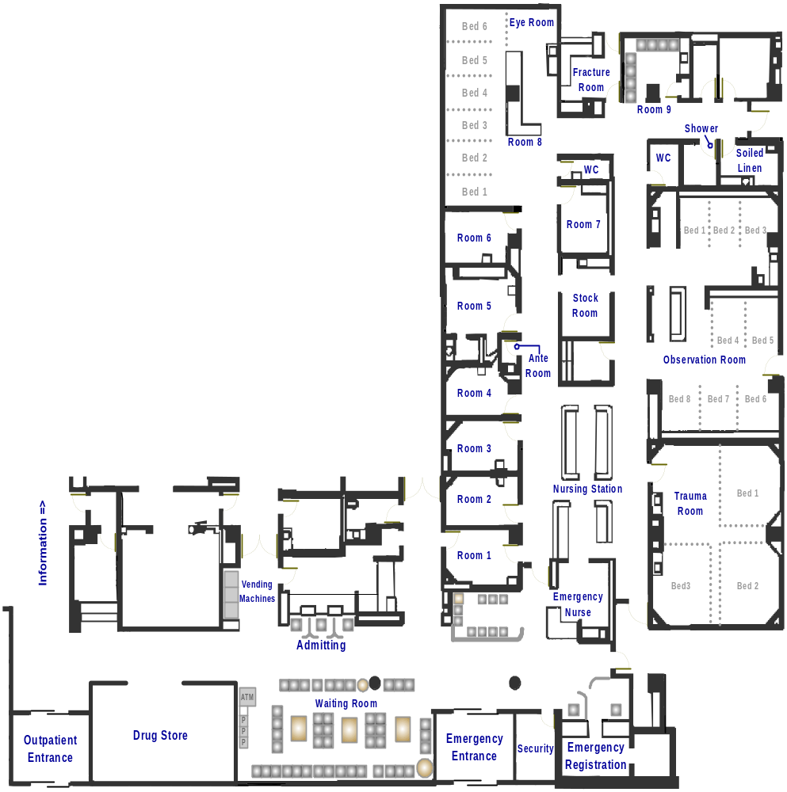
Toronto Hospital
Emergency Department
March 16; 22:45-23:30

Slide 8
Lessons Learned:
Case Study #2
Toronto Outbreak: Phase II
Barrier precautions are protective
Maintain vigilance after outbreak is “over”

Slide 9

SARS 2 - NYGH

Slide 10
Lessons Learned:
Case Study # 3
SARS Transmission During
Aerosol-Generating Procedures
Risk of transmission may be heightened during aerosol-generating procedures
Importance of using full barrier precautions and careful use of PPE

Slide 11
Communicability is heterogeneous: aerosol-generating medical procedures
Cluster of Severe Acute Respiratory Syndrome Cases Among Protected Healthcare Workers --- Toronto, Canada, April 2003
  Canadian family physician
  April 4: Onset of symptoms
  April 13: ICU
    Non-invasive positive pressure ventilation (BiPAP)
    Intubation (assist-control ventilation)
    Frothy secretions that obstructed ventilator tubing, requiring disconnection and drainage
    Switched to high-frequency oscillatory ventilation for 7 days

Slide 12
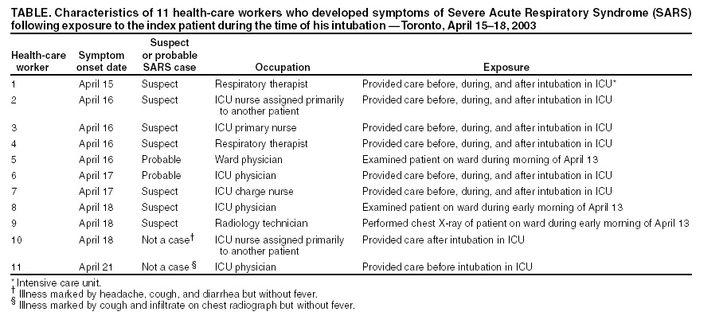

Slide 13
What have we learned?
SARS transmission
  Primarily through close contact with infected persons
  Droplet spread most likely
  Cannot rule out fomites and possibility of airborne spread
  Intensity of exposure during aerosol-generating procedures may increase transmission risks

Slide 14
What have we learned?
SARS transmission risks are primarily from:
  Unprotected exposures to unrecognized cases in both inpatient and outpatient settings.
We must look beyond the patient … contacts may be infectious too.
Prevention begins when a patient or visitor walks through the door of an Emergency Department or outpatient office.

Slide 15
What have we learned?
Use of PPE prevents transmission…however,
  Healthcare personnel need instruction on how to don, use and remove PPE
  Wearing PPE for extended periods of time is a burden and can lead to breaches in technique

Slide 16
What have we learned?
Cohorting groups of patients that require airborne isolation is challenging but can be done
Advance planning is necessary to ensure the protection of HCWs, patients and visitors

Slide 17
What should be our immediate priorities?
Improve recognition and prevention of transmission at the initial point of patient encounter
Improve PPE use practices
Review precautions for aerosol-generating procedures

Slide 18
Act Now!
Address Prevention Planning Priorities in Emergency Departments and Outpatient Offices

Slide 19
What would happen today if a patient with symptoms of SARS presented to your Emergency Department or outpatient office?

Slide 20
Opportunities for Prevention Intervention in Emergency Departments and Outpatient Offices
Triage and reception encounter
Waiting room encounter
Evaluation by the healthcare provider
Transport (e.g., to radiology)
Respiratory treatment
Hospital admission process

Slide 21
Prepare to make changes at the first point of patient encounter
Examine your triage, reception and appointment procedures
  Are patients queried about respiratory symptoms?
  Are personnel trained to observe for respiratory symptoms in patients and visitors?
  What instructions are provided to patients who are symptomatic?

Slide 22
Prepare to make changes at the first point of patient encounter
Consider ways to prevent exposures….
  Visual alerts with instructions at entrances
  Designate “sick” and “well” waiting areas
  Create physical barriers between patients and triage/reception personnel
  Promote “Respiratory Etiquette”

Slide 23
Promote “Respiratory Hygiene”
Instruct ALL patients with respiratory symptoms to cover nose/mouth with tissue when coughing or sneezing
Make hand hygiene products and tissues available in waiting areas
Offer masks to symptomatic persons

Slide 24
Patient-Focused Pre-Event Planning: Emergency Departments and Outpatient Offices
Patient examination by the healthcare provider
  Where will the patient with respiratory symptoms be examined?
  What PPE will the provider wear?

Slide 25
Assess Airborne Isolation Capacity in Emergency Departments and Outpatient Areas
Is there an airborne isolation room available for the initial patient examination?
If not, what room or area would be appropriate for the initial examination of a patient with symptoms of SARS?
  Distance from other examination rooms
  Ability to redirect air flow

Slide 26
Assess Current PPE Practices in Emergency Departments and Outpatient Offices
Assess availability of PPE
  Are gowns, gloves, respirators or surgical masks, and face/eye protection available?
  Are N95 respirators available and have staff been fit-tested?
Review PPE use with healthcare providers
Reinforce importance of hand hygiene

Slide 27
Patient-Focused Pre-Event Planning:
Emergency Departments and Outpatient Offices
Transport of patient for diagnostic procedures, treatment, admission
  How will the patient be transported?
  Who will be responsible?
Hospital admission (if necessary)
  Who needs to be notified?
    Infection Control
    Health Department
    Receiving patient care unit

Slide 28
Act Now!
Address Prevention Planning Priorities in Hospitals

Slide 29
What would happen today if a SARS patient is admitted to my hospital?

Slide 30
Patient-Focused Pre-Event Planning:Hospitals
Where will the patient be isolated?
How will we move the patient through the admissions process to the isolation room?
Who will care for the patient? Have they been trained?

Slide 31
Patient-Focused Pre-Event Planning:Hospitals
What if the patient needs to be placed on a ventilator?
  Who will do it?
  Where will it be done?
  What PPE will be worn?
How will family members and other contacts be managed?
Who needs to be in the communication loop?
What if there is an exposure?
Is there a procedure that tells me what to do?

Slide 32
What would happen today if I learned that a patient who has been hospitalized for one week has been diagnosed with SARS?

Slide 33
Patient-Focused Pre-Event Planning: Hospitals
Is the patient isolated? If not, where should he/she be placed?
Does anyone else have symptoms of SARS? How would I find out?
Who has been exposed? How would I find out?
  HCWs?
  Other Patients?
  Visitors?
What should we do with exposed persons?

Slide 34
Act Now!!!
Test the System!
Develop “SARS Patient” scenarios for your work area
Test them out to identify and correct problems

Slide 35
Organizational Planning:
Create the Infrastructure to Detect and Respond to SARS

Slide 36
SARS Preparedness Planning:
Areas of Overlap with Disaster, Bioterrorism and Pandemic Influenza Planning
Preparedness Plan Elements
  Organizational infrastructure
  Logistics of patient care
  Staffing
  Durable and consumable resources
  Exposure management

Slide 37
Creating the Organizational Infrastructure
Multi-disciplinary team
  Scientific leadership – healthcare epidemiology/infection control
  Administrative leadership
  Clinical representation
  Engineering/Environmental Services
  Communications/public relations
  Safety/security
  Other

Slide 38
Creating the Organizational Infrastructure
Collaboration with community and public health planning groups
  State and local health department
  Disaster preparedness planning groups
  Healthcare facility planning groups

Slide 39
Creating the Organizational Infrastructure
Creation of internal and external communication channels…solidify these NOW!!
  Health department contacts
  Chain of internal communication
  Responsibility for media communications
  Scientific spokesperson

Slide 40
Patient Admission Planning
Identify areas that will be used for the care of SARS patients
Decide how patients will be cohorted
  Consider the need to segregate suspect from probable cases
  Exposed asymptomatic patients
Involve engineering personnel in determining optimal locations for cohorting

Slide 41
Evaluate Existing Facility Design and Functioning
Identify all airborne isolation rooms in facility - ensure proper functioning
Identify area(s) that can be converted for airborne isolation…should be able to:
  Seal off from other patient areas
  Establish negative pressure relative to surrounding areas
  Exhaust directly outside (>25 ft from intake) or pass through HEPA filter
  Supplement with portable HEPA or UV

Slide 42
Patient Admission Planning:
Configuration of SARS Units
Designate locations for:
  PPE and other isolation supplies
  Waste and linen receptacles
  Soiled equipment/PPE receptacles
Assign responsibility for restocking isolation units and removing waste/ linen
Assign responsibility for reprocessing reusable PPE (e.g., goggles)

Slide 43
Patient Admission Planning:
Configuration of SARS Units
Determine how to restrict traffic flow
  Consider placing physical barriers and visual alerts
Establish designated work patterns when moving within unit to limit contamination
Train personnel on these procedures!

Slide 44
Environmental Cleaning and Disinfection
Assess staffing needs to meet requirements for daily and terminal cleaning of SARS patient rooms or units
Consider dedicating specially trained staff for this assignment
Review current room cleaning protocols

Slide 45
Develop Plans for Educating and Training Healthcare Personnel
“SARS 101” for clinical and support staff
Training on Isolation practices
  PPE use -demonstration of competency?
  Isolation practices in a SARS unit
Plan for caring for SARS patients
Specialized training?
  Designated SARS care teams
  Aerosol-generating procedures teams
  Designated environmental services personnel
Respirator fit-testing and training

Slide 46
Provide Informational and Instructional Materials
Posters on PPE use and Hand Hygiene
Patient and visitor information

Slide 47
Surveillance Planning
Develop systems for:
  Monitoring patient contacts
  Surveillance for transmission to patients and personnel
  Exposure reporting
  HCW exposure management
    Symptom monitoring
    Work furlough

Slide 48
Planning for Surge Capacity
What is “Surge Capacity” for SARS?

Slide 49
Surge Capacity Planning
Assessment of human resource needs
Assessment of durable and consumable resource needs
Logistics of patient triage, evaluation, admission, discharge, transfer

Slide 50
Surge Capacity Planning
Control of traffic into and out of facility
Ramp up of education and training

Slide 51
Surge Capacity Planning:
Human Resource Needs
Number and categories of healthcare personnel required to provide SARS care for multiple patients
  Establish policies regarding students and trainees
  Consider need for “PPE breaks”
  Consider how temporary staffing needs will be met if existing resources are exceeded

Slide 52
Surge Capacity Planning:
Consumable and Durable Resources
Consumable resources
  PPE supply needs per patient/day
  Mechanisms for meeting increased demand for supplies
  Contingency plans for limited resources
Durable resources
  Respiratory support equipment
  Patient-dedicated equipment

Slide 53
Surge Capacity Planning:
Limiting Hospital Contact
Restricted entrances
  Fever screening on entry
Visitor limitations
Segregated areas for SARS and non-SARS staff?
  Is it necessary?
  What are the implications?

Slide 54
Surge Capacity Planning:
Mental/Social Service Support for Staff
Mental health counseling
Family services
  Child care
  Shopping services (food, pharmacy, etc
  Transportation
Lodging
Economic support

Slide 55
Is the plan working?

Slide 56
Monitor for Adherence
Identify criteria and methods for measuring adherence and effectiveness of interventions
Areas to monitor
  Patient placement
  Surveillance for transmission
  Use of PPE

Slide 57
Final Thoughts
SARS transmission can be prevented!
Begin NOW to prepare for SARS
  Shore up procedures for triage and evaluation
  Review use of PPE
  Review precautions for aerosol-generating procedures
  Solidify relationships with health departments
  Engage your colleagues in preparedness planning

Slide 58
Infection control is EVERYONE’s responsibility!

