Slide 1
The Commissioning of the Technical Systems of LHC
The final validation that all the collider components/systems perform as specified.
All the tests are performed without beam.
The sectors under test are fully installed but installation is going on in other sectors.
Also, tests are going on in other sectors.
Félix Rodríguez-Mateos, CERN-TS

Slide 2
the mandate
◆
After the qualification for operation of the individual systems of a sector (vacuum, cryogenics, quench protection, interlocks, powering, etc.),
operation
& controls
groups
individual system tests
commissioning
coordination
beam
transfer
cooling &
ventilation
❖
each sector will be commissioned as a whole up to the powering to nominal current of all the circuits.
collimators
quench
protection
equipment
groups
infrastructure
groups
hardware commissioning
cryogenics
rf
access
control
& safety
⬥
Validation and specific studies will be carried-out on the first commissioned sector.
instrumentation
magnet
electricity
interlocks

Slide 3
the logic
Sytem owners
define and carry-out
individual
system tests
Hardware Commissioning Coordination with System Owners define and carry-out
hardware
commissioning
subsystems ready
Short
Circuit
Tests
all systems ready for
machine check out
RF
Collimator
System
Injection
System
Superconducting
Circuits

Slide 4
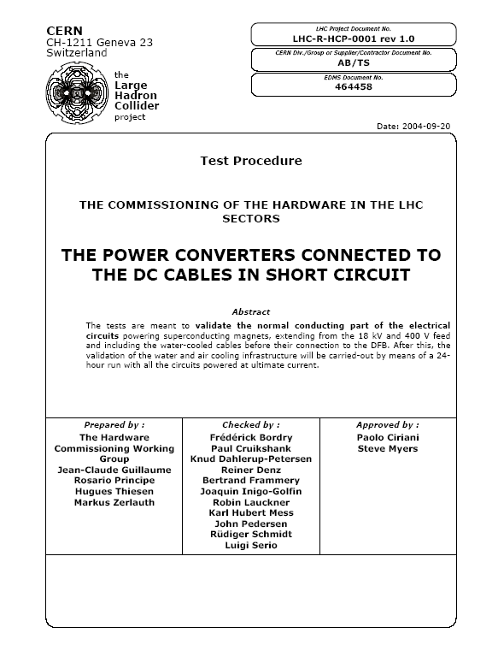
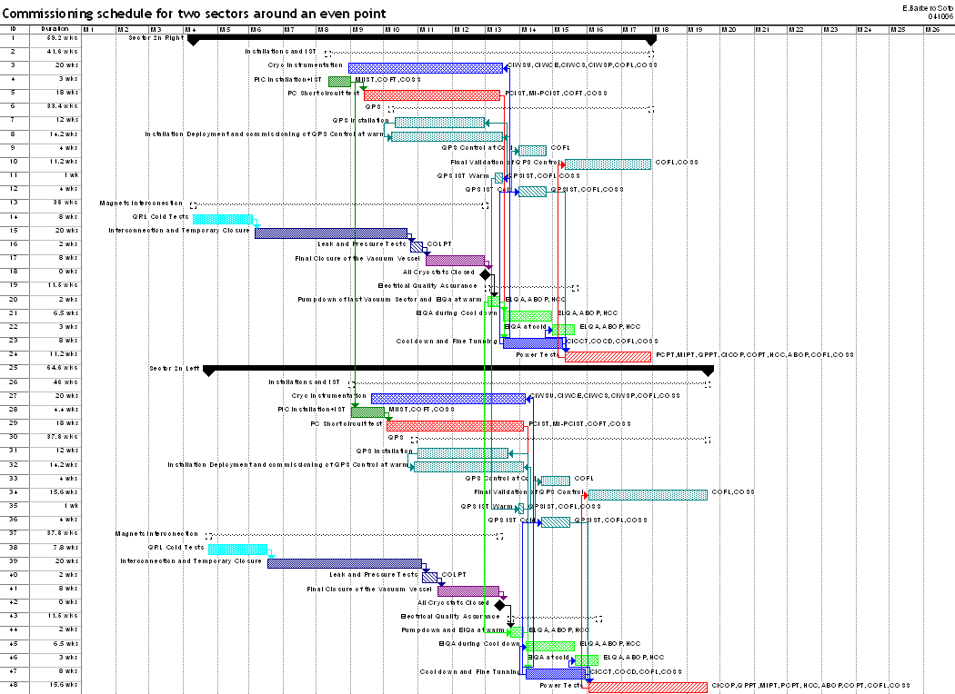
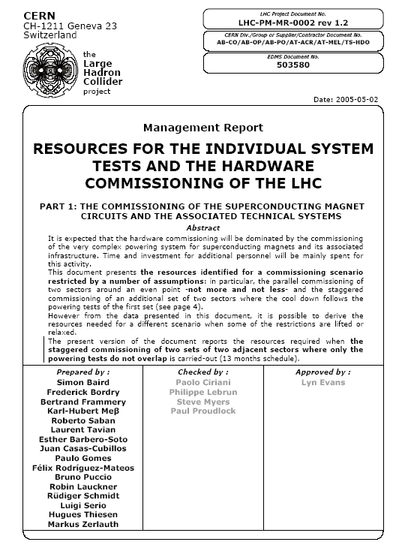
preparation
the scope
  all the accelerator systems in the LHC tunnel with particular emphasis to superconducting circuits
individual system tests
commissioning
failure scenarios
x 65
  documentation
  the program
  the schedule
  the manpower

Slide 5
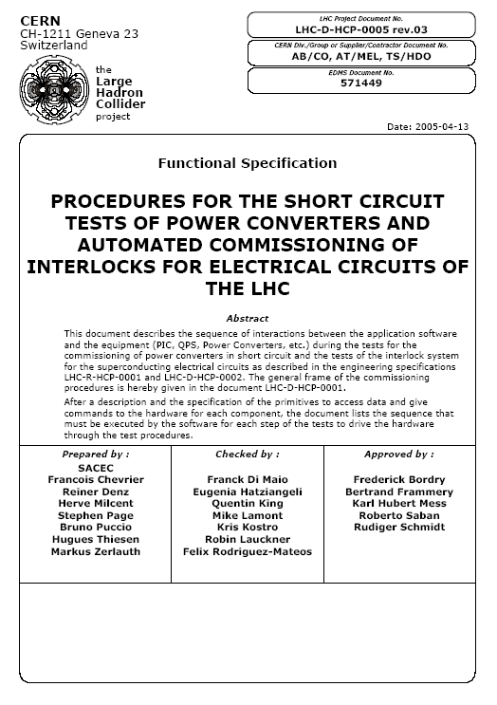
preparation : software
sacec : software applications for the commissioning of the electrical circuits
QPS
Power Converters
Powering Interlock
AT/MEL
procedures
commissioning scenario
AB/PO
AT/ACR
x 15
AB/CO
AB/CO
HCC
requirements
prototypes
Documents on PMA tools
requirements being prepared
at present

Slide 6
the number of simultaneous work fronts
front = instance of the sequencer running
FCR1 FCR2 UJ or RR CCC
1 SCT
1 SCT
1 front
1 SCT
August 2006
2 PT 1 SCT
2 PT 1 SCT
5 fronts
2 PT 1 SCT
February 2007
2 PT 2 PT 1 SCT
2 PT 2 PT + 1 SCT
9 fronts
2 PT + 2 PT + 1 SCT
2 PT = powering tests in two adjacent sectors
1 SCT = short circuit tests of one powering area

Slide 7
the as designed documentation
defines the pre-requisites to start the tests in terms of conditions and availability of systems
specifies the objective of the test and either describes each step or summarizes the test procedure
subsystems ready
all systems ready for
machine check out
EDMS
describes in what conditions the system should be delivered to the next step

Slide 8
HCP in circulation for engineering check
LHC-D-HCP-0004 | The Commissioning of the Inner Triplet Region
Esther Barbero Soto Davide Bozzini Paul Cruikshank Reiner Denz Bruno Puccio Félix Rodríguez Mateos Rüdiger Schmidt Luigi Serio Hugues Thiesen Markus Zerlauth | This document describes the sequence of the steps which lead to the commissioning of the complete inner triplet. It gives the backbone of the general procedures and refers to more detailed documents associated to the different systems, which in turn describe the individual system tests and the hardware commissioning procedures.

Slide 9
the as tested documentation
contains the sequence of the tests
includes the data gathered during the tests
describes the eventual non conformities
subsystems ready
all systems ready for
machine check out
MTF

Slide 10
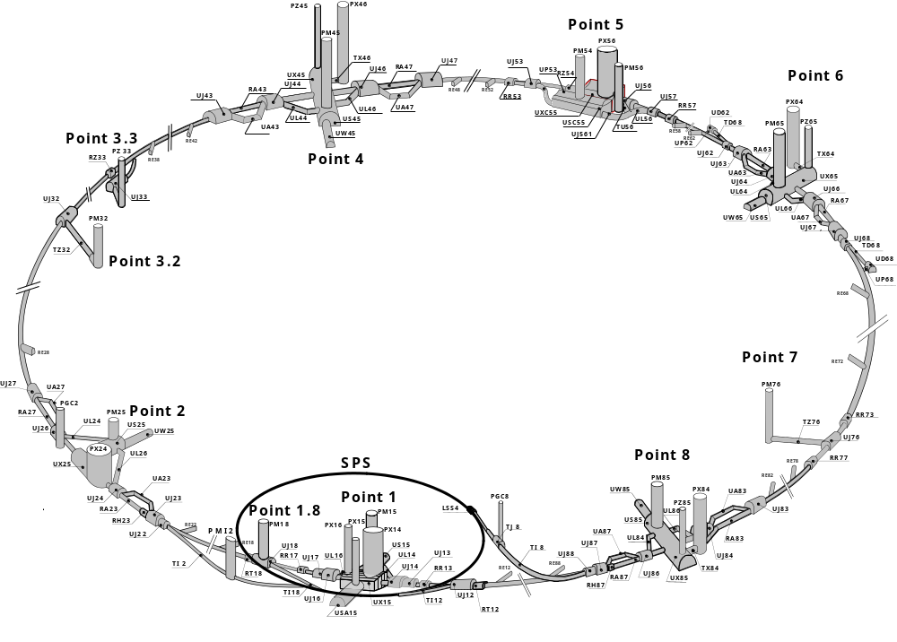
the sequence
2
3
4
1

Slide 11
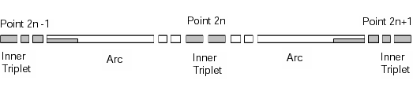
personnel underground
two shifts = 15 hour days
resources deployed for the powering tests
Left
Right
Front 1 arc and the matching section on the even side
Front 2 arc, the matching section on the odd side and the inner triplets on both sides
Front 2
Front 1
Front 1
Front 2
6.6 km
in the field on call
cryogenics operation
cryogenics instrumentation
quench protection
machine interlocks
power converters
coordination
controls
operation
o operator
x expert
e engineer
t technician
22 present in the field

Slide 12
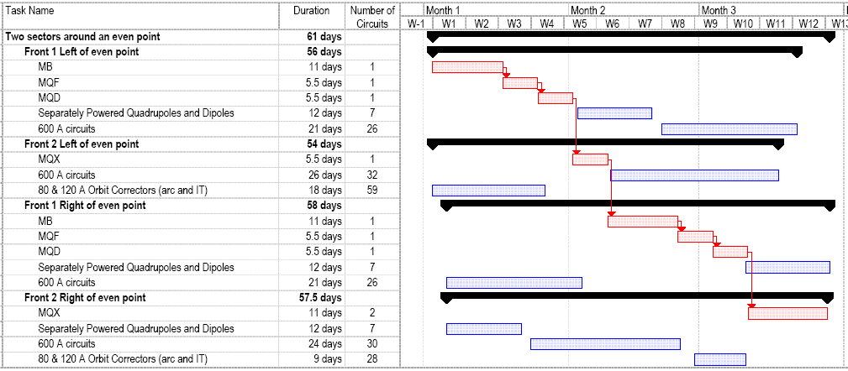
the sequence of tests around an even point
Powering Tests

Slide 13
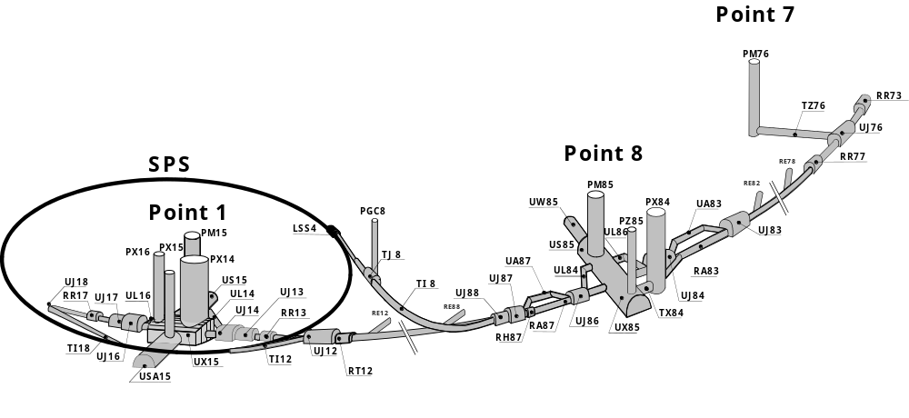
the field
field control room
minor control centres
arc and even matching section
inner triplets and odd matching section
~210 cold circuits
190 orbit corrector circuits
~10 warm circuits
warm magnets

Slide 14
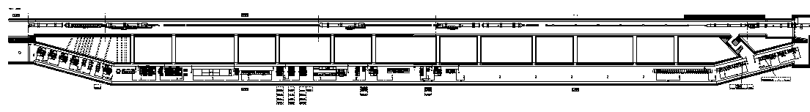






the field control room
UA 83 – Left of Point 8
DFBs
Energy
Extraction
Systems
Field control room
Power
Converters
cryogenics
powering tests
interlocks
post-mortem
+ wi-fi coverage of the UA
+ printer
+ desks
+ meeting table
+ lockable closets
+ social corner
+ water fountain

Slide 15
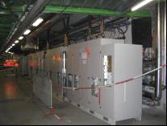
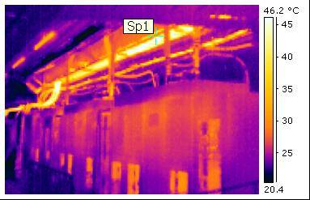
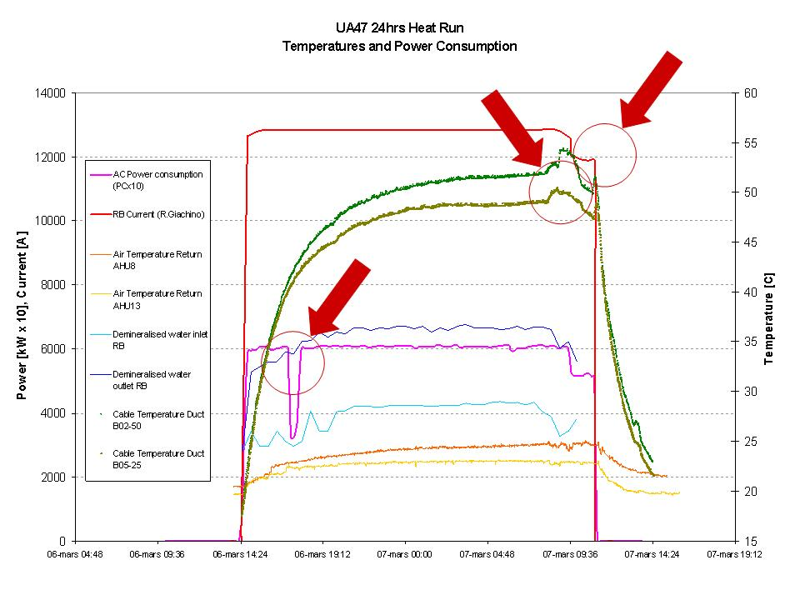
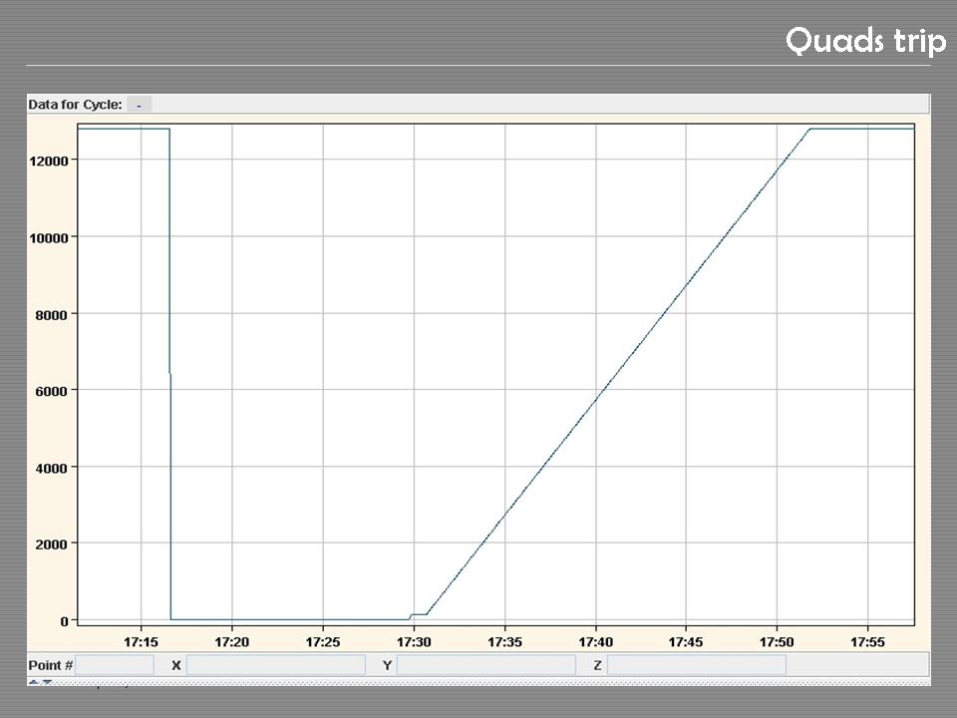
the first commissioning

Slide 16
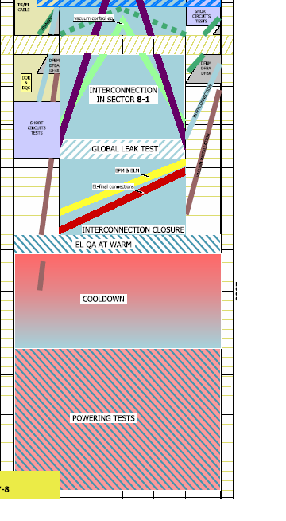
the phases
W:SCT short circuit tests
W:LT leak test
W: PT pressure test
W:ISTs all sorts of system tests at warm
W
W:ELQA electrical quality assurance at warm
CD:1 cool down from 300 to 80 K
CD
CD:2 cool down from 80 to 4.5 K
CD:3 cool down from 4.5 to 1.9 K
C
C:ELQA electrical quality assurance at cold
C:ISTs system tests at cold
C:PT powering tests

Slide 17
superconducting magnet circuits
Individual System Tests of Powering Interlock Control
300 K
Test of power converters connected to the DC cables in short circuit, including controls for powering, ramp, monitoring
Individual System Tests of the Quench Protection and Energy Extraction Systems
90 K
Electrical Quality Assurance
Power Converters
not connected to Magnets
1.9 K
Post-Mortem System tests
Interlock tests of a powering subsector prior and after connection of the power cables to the DFB leads
connexion of power cables
to the current leads
Power Converters
connected to Magnets
Commissioning of the electrical circuits one by one or in groups at low, intermediate and nominal currents
Commissioning of all the electrical circuits of the sector powered in unison to nominal current with nominal ramp rates

Slide 18
powering of the superconducting magnet circuits
1/2
HCA:PIC2 | Stand-by current | to commission the protection functionalities of the powering interlock controllers and all its connected systems with current through the circuits to verify the compatibility of the switch-on and switch-off processes of the converters with the sensitivity of the protection systems (namely QPS)
HCA:PLI1 HCA:PLI2 HCA:PLI3 HCA:PLI4 | Injection level 20% of I_{nom} 50% of I_{nom} 80% of I_{nom} | to set up the power converter current loops to verify the cooling control of the current leads to validate the protection mechanisms under real powering conditions and with limited amount of energy in the circuits to validate quench-related procedures, e.g. cryogenic recovery procedures to validate the sensitivity and compatibility during ramps of the systems susceptible to noise pick-up, couplings, etc to perform a last check on the polarities of the circuits by verifying voltages across current leads (at low current using QPS signals)





Slide 19
powering of the superconducting magnet circuits
2/2
HCA:PNO | Nominal current | to verify that the power converters work correctly during the ramp of the current to verify the cooling control of the current leads to calibrate the DCCTs for the main power converters and the Inner Triplet power converters and to verify that the calibration systems work correctly to validate the protection mechanisms under real powering conditions and with nominal energy in the circuits to verify the quench current level of each circuit to validate quench-related procedures, e.g. cryogenic recovery procedures
HCA:PAC | Nominal current (all circuits of a sector) | to verify the tracking of the current to verify thermal performance of the ventilation and water cooling systems in underground areas to have a 24-h reliability run in order to detect premature failures due to wrong settings or possible assembly errors


Slide 20
HCP in circulation for approval
LHC-D-HCP-0003 | Powering of the Superconducting Circuits of a Sector up to Nominal Current
Amalia Ballarino, Davide Bozzini Knud Dahlerup-Petersen Reiner Denz, Robin Lauckner Bruno Puccio, Félix Rodríguez-Mateos Roberto Saban, Rüdiger Schmidt Luigi Serio, Hugues Thiesen Antonio Vergara, Markus Zerlauth | This document describes the sequence of the steps which lead to the powering of the superconducting circuits of a powering sub-sector to nominal current. It covers the phases after the connection of the power cables to the current leads up to the powering in unison of all the circuits of a sector to nominal current.

Slide 21
failure scenarios
failure scenarios during the commissioning were studied
the objective was to define strategies for at least a few case studies per major system in order to gain in reactivity at the time of failures
  evaluate the impact on the program and
  define alternatives to carry-on
six sessions of the HCWG were devoted to this study:
  Superconducting Electrical Circuits
  Cooling and Ventilation System
  Cryogenic System
  Vacuum System & Leak Tests
  Electrical Power Distribution
  Power Interlock Controllers
failure
can it be
circumvented
yes
apply
diagnostic
protocols
apply
diagnostic
protocols
do it
according
to defined
procedures
clear
diagnostic
yes
decision
decision
crash
programme

Slide 22
HCP in circulation for engineering check
LHC-D-HCP-0006 | Failure Scenarios for the Electrical Circuits
Davide Bozzini Reiner Denz Knud Dahlerup-Petersen Hugues Thiesen Antonio Vergara Markus Zerlauth | This document describes the failure scenarios for the Electrical Circuits which are relevant during the Hardware Commissioning. The objective is to identify show stoppers and define the strategies to repair, recover or do with them.

Slide 23
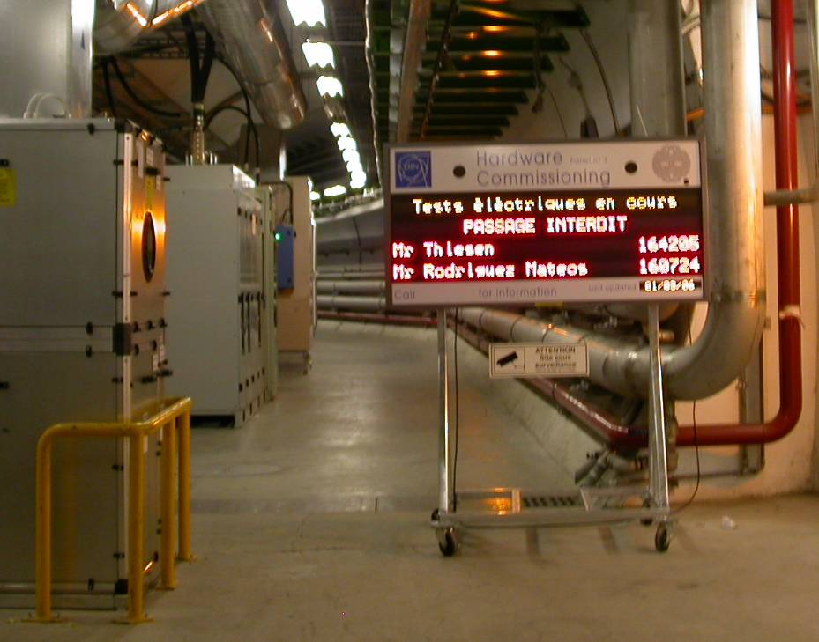
Thanks for your attention…

