Slide 1
PSI digital power supply controller
T. Korhonen
Credits & contact persons:
EPICS interface, drivers:Andreas Luedeke (andreas.luedeke@psi.ch)
Power supply controller: Felix Jenni (felix.jenni@psi.ch) & the PSI Power Supply group
PS-link Industry Pack design:Guido Janser (guido.janser@psi.ch)
Fast Orbit feedback: Thomas Schilcher et.al. (thomas.schilcher@psi.ch)

Slide 2
Contents
Introduction to “digital regulated power supplies”
Controllers and control link
Particularities of the EPICS Interface
Applications at PSI and elsewhere

Slide 3
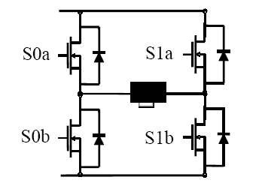
Introduction: “Digital Regulation”
Regulation by “pulse width modulation” (PWM)
Digital “set-value” (switch U0 on or off )
No analogue outputs (for control), regulation quality determined by system bandwidth (switch & control loop performance)
Controller
PWM
I
low-pass
U0
Load

Slide 4
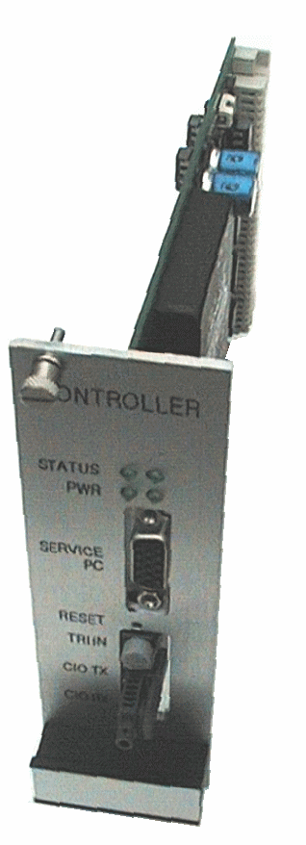
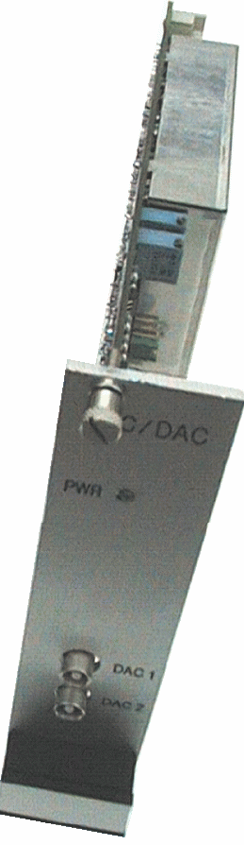
Introduction: Digital PS Controller
The PSI type “digital” controller
  To be built into power supply
  FPGA to generate PWM signal
  DSP to run 50 kHz regulation loop
  Fast optical fibre + RS232 service IF
ADC card for digitizing output-current
  Two ADC 16 bit, 50 kHz
  High-precision voltage reference

Slide 5
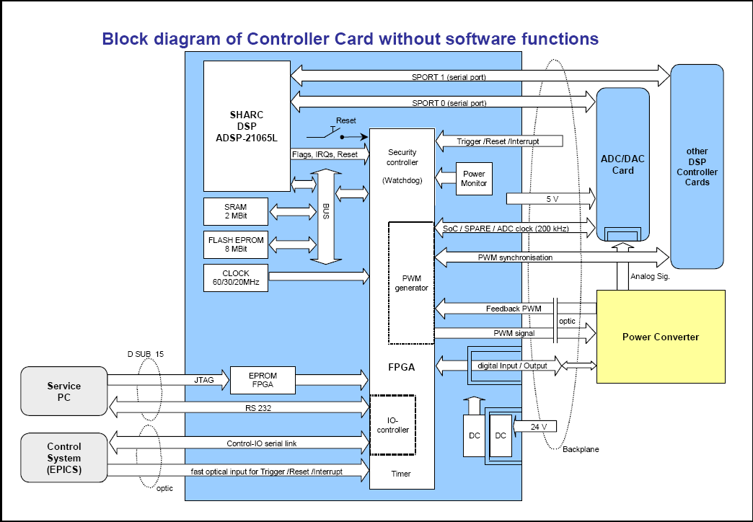
PS controller structure
1) DSP for the feedback control loop
2) FPGA to generate the PWM switching pulses
3) Control system interface (optical link): POF, 5 MHz
4) Service PC interface: full control of the power supply/controller card with a service program, used in commissioning and debugging
The controller software has to be parameterized for each load (=magnet): impedance, inductance, max. current, etc. Done when commissioning the power supply (transparent to control system.)
1
2
4
3

Slide 6
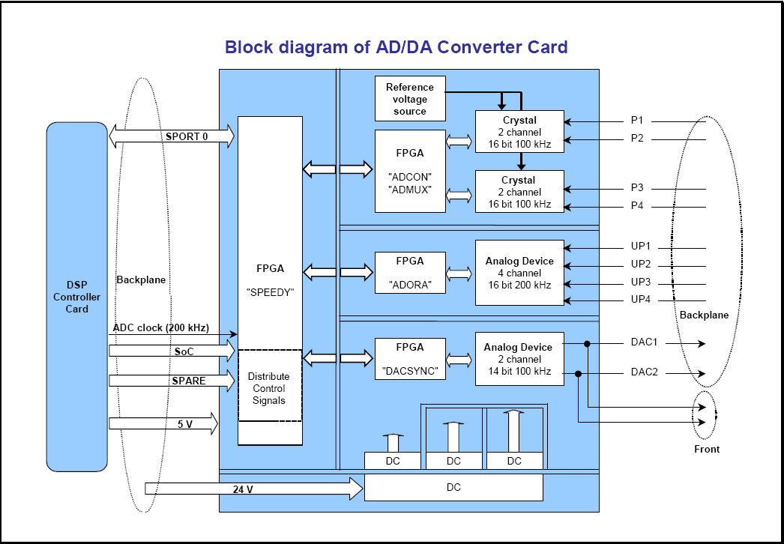
Controller ADC Card
2x precise 2-channel ADC with high stability voltage reference
4 channels less precise ADC
2 x DAC for utility (debugging) purposes

Slide 7
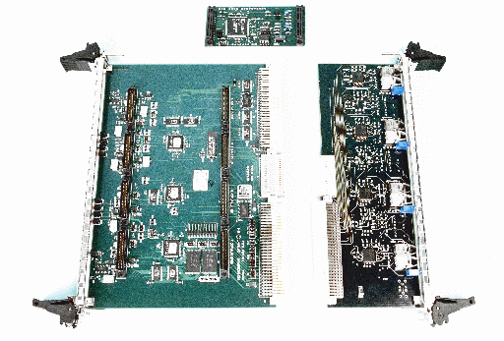
VME Hardware
Industry Pack Carrier
VME64x 4 slot boards
“off-the-shelf”:
Greenspring
Vipc664
Hytec 8002
Carriers available
for many different
busses (PCI, …)
IP Module for 2 PS
VME64x
Transition module
for 8 PS
(optolink drivers)

Slide 8
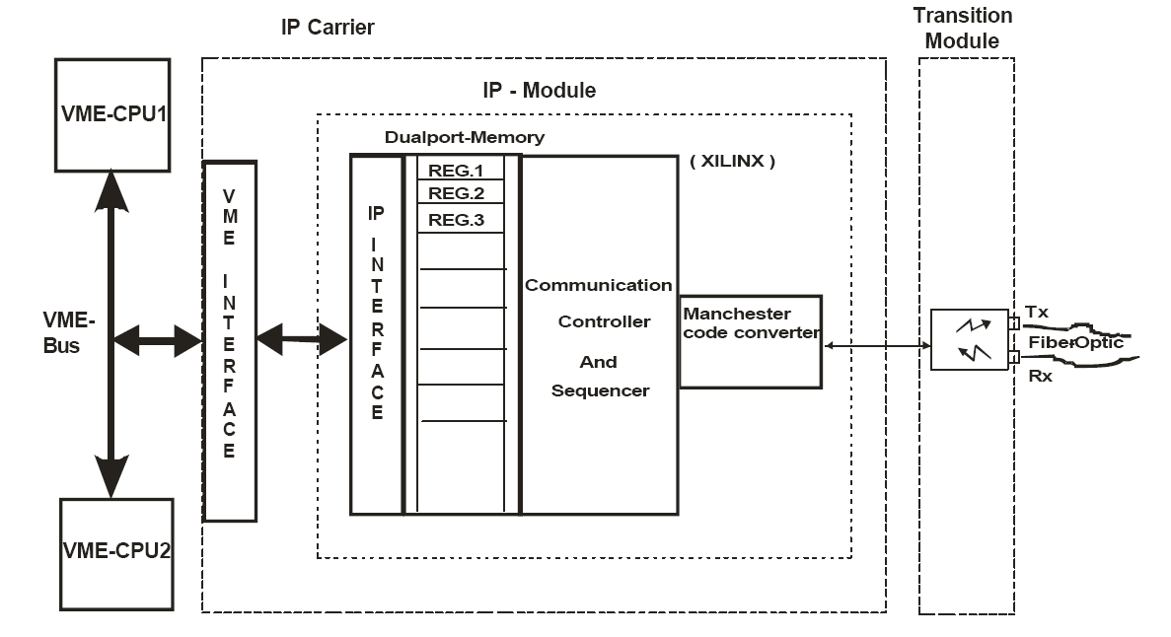
Link operation
The IP module has (for each PS):
-6 register groups (3*16 bit) for communicating with the PS
  High-priority write (fast feedback, etc.)
  Write (setpoint)
  Read (current, etc.)
  Waveform write
  Waveform read
  FPGA status (error handling)
Concurrent access automatically prioritized (order as above)
-2-byte status register
Link presence/absence is automatically detected
-IRQ vector register
Communication registers are write-sensitive:
Writing to these registers (lowest word) triggers a communication cycle
-Communication is handled by FPGA: serial protocol is transparent to the card.
-response from PSC appears automatically in the registers (signaled by an interrupt)

Slide 9

Link protocol & performance
-Communication frame (command + data), 66 bits
command (8 bits), address (8 bits), data(32 bits)
“overhead”: start, stop, parity bits (6*3 = 18 bits)
-13 us for pure transfer at 5 MHz
transfer rate limited to 10 kHz in firmware
one data request cycle takes about 60 us (request + reply)

Slide 10
EPICS Interface: Scope
A power supply an “intelligent device”
  Freely programmable: RAM & flash memory
  Sending and receiving waveforms
  Communication via 256 read/write registers (attributes)
  Reacts to trigger inputs and digital I/O
  Each PS has an unique ID (PSI convention)
Fast interface
  5 MHz optical fibre link
  Extra trigger input

Slide 11
EPICS Interface: Features
Serializes record access to the IP registers
Reading and writing of parameters & status
Waveform (ramp) download & upload
Enhanced fault diagnostics
  Currently 135 different error messages from PS
  Check of Controller ID ⇒ cabling ok?
  Detailed link communication diagnostics
Allow for parallel VME bus access

Slide 12
EPICS Interface: Device / Driver
“high priority write”
register, used by fast orbit feedback
VME
read
task
ao
ai
bo
write
task
0
VME_IO:
#C$(card) S$(slot)
@$(link)$(function)
IP
mbbo
1
bi
2
mbbi
down
load
3
longout
4
longin
~400 functions
waveform
up
load
stringin
PS Controller

Slide 13
Applications at PSI
About 600 magnet power supplies at SLS
  Ring dipole PS: 440 kW, 15 ppm stability
  Booster dipole PS: 1 MW, 10 ppm, DC+3 Hz
  Correctors: 1 kHz BW, +18 bits, 4 kHz setpoints
Planned to use some for the SLS RF plants
PSI proton cyclotron facilities will replace old magnet power supplies with digital ones

Slide 14
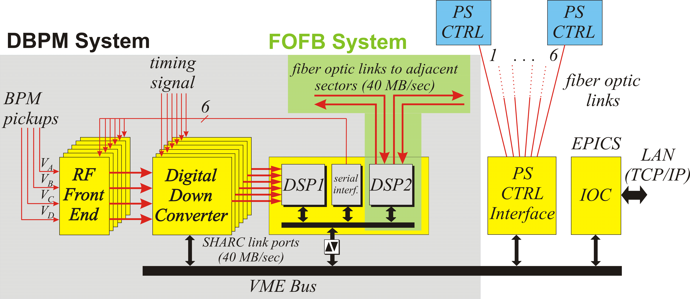
Application in Fast Orbit Feedback
“high priority write”
register, used by fast orbit feedback

Slide 15
Applications at PSI
In PSI Proton Cyclotron, an intelligent IP carrier board (Hytec8003) is used
  The board communicates autonomously with the PS (up to 6 PS/carrier plus interlock channels)
  Monitors the operating conditions and current; generates an interlock if problems detected (2 mA proton beam!)
  Reduces IOC load, faster response, simpler interface to the control system

Slide 16
Applications elsewhere
Diamond will have ~1500 digital PS
  PSI facility license fee: manufacturer can use hard- and software for Diamond orders
Several PS manufacturer bought PSI license
  Just ask your favourite PS manufacturer

