Slide 1

On the Quality of Pre-Advisory Model Guidance
Mike Fiorino
michael.fiorino@noaa.gov
Techniques Development and Applications Unit
National Hurricane Center
Miami, FL
5 March 2008

Slide 2
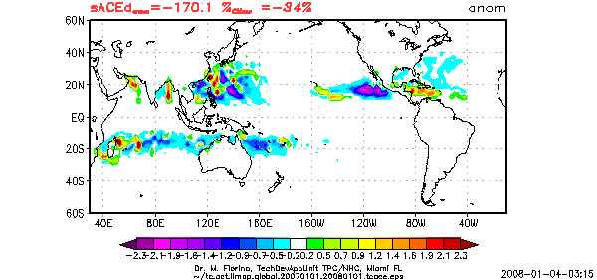
We don’t know why…
two cat5 TCs in the NIO -- 02A (Gonu) and 06B (Sidr)
Global TC Activity 2007 - 34% below normal, lowest since…

Slide 3
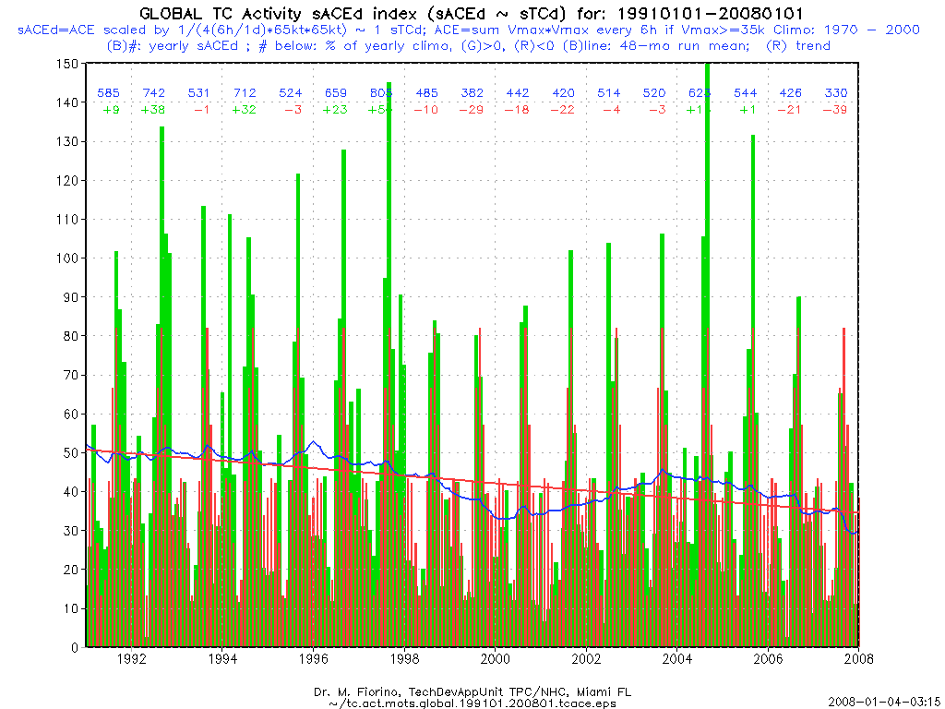
“crash of 1999”
“crash of 2007?”

Slide 4
Motivations
Forecasting as a data assimilation problem – update previous forecast with new information. The first forecast jump starts the process and because forecast-to-forecast consistency is a (strong) constraint, a good initialization is desirable. Guidance on the guidance in particular CON_
Many models are first influenced by the first advisory. The transition from an INVEST (9?B) to a numbered system ([0-4]?B and from non-TC (LO, WV, DB, EX) to TC (TD,TS,HU,SD,SS). Diagnosis of the models
Focus on medium-range track (72-h FE):
  Extend warning time → 72 h (Jack Hayes), MRT still first-order foreast problem
  83% of major hurricanes have 1 or more Rapid Intensity events and 60% occur as the TC first reaches hurricane state (~ 3d), e.g., FELIX - 06L.2007
Answer the mail – availability of 9X trackers from NCEP for JTWC

Slide 5
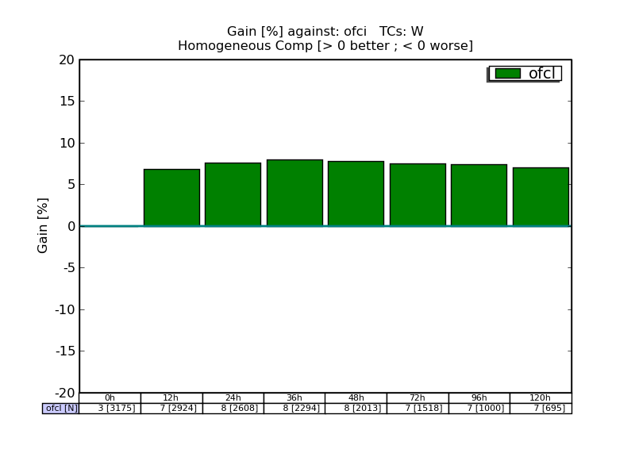
Error growth OFCL (analysis) v OFCI (background)
WPAC/EPAC/LANT 2005-2007
~8% / 6 h ; highest 36-48

Slide 6
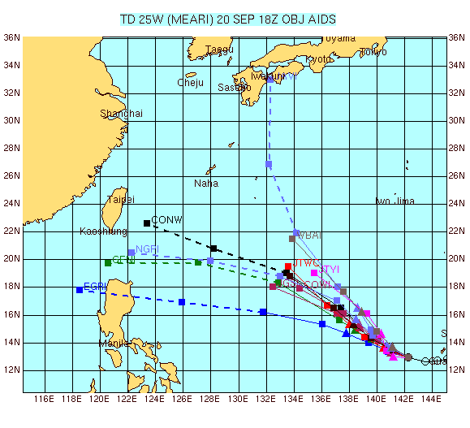
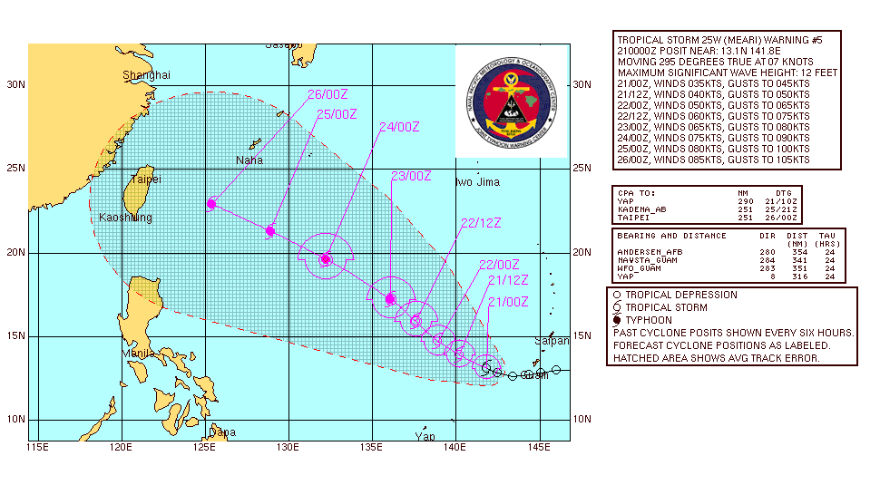


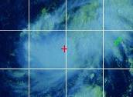
25W.2004 MEARI – my first WPAC forecast, first JTWC 72-h
120 h
90 kts
72 h
115 kts

Slide 7
Mike’s Lessons Learned from 25W.2004
first advisory jump starts the 6-h forecast cycle of OFCL correcting OFCI with new data and guidance
Know CONW is best aid...but wanted some guidance on what models were part of the consensus, should I do an SCON? (RYOC), favor one model?
Intensity forecast at 72-h was very bad (50 kt), based on synoptic reasoning. did not account for the “flavor” of the TC development in WESTPAC (generally look for reasons NOT to intensify T# / day) – character of TC activity on seasonal time scales a factor (weak constraint)
  OFCL 72-h intensity forecasts in the LANT: -17% bias in 2005, +27% bias in 2006, -5% in 2007 – TC development on seasonal time scales a factor?

Slide 8
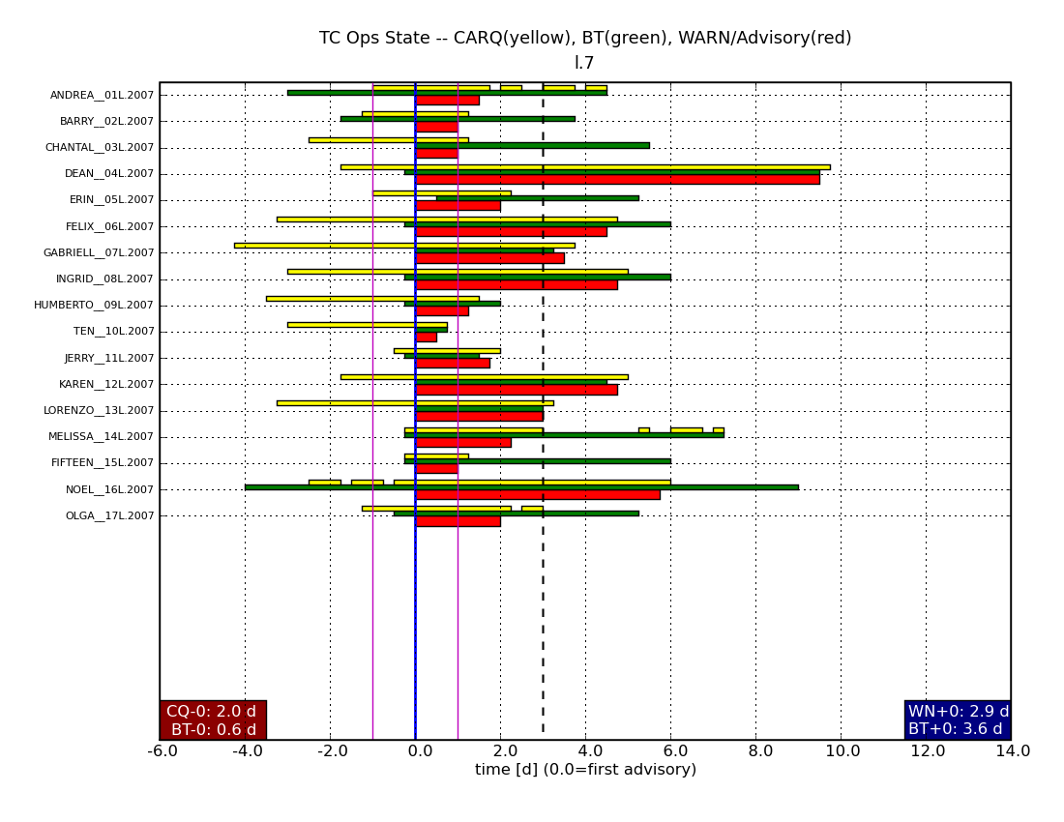
TC Operational State – Pre/Post Advisory 2007 LANT
CARQ
BT (best track)
Advisories
time axis (d): 0.0 = time of first advisory

Slide 9
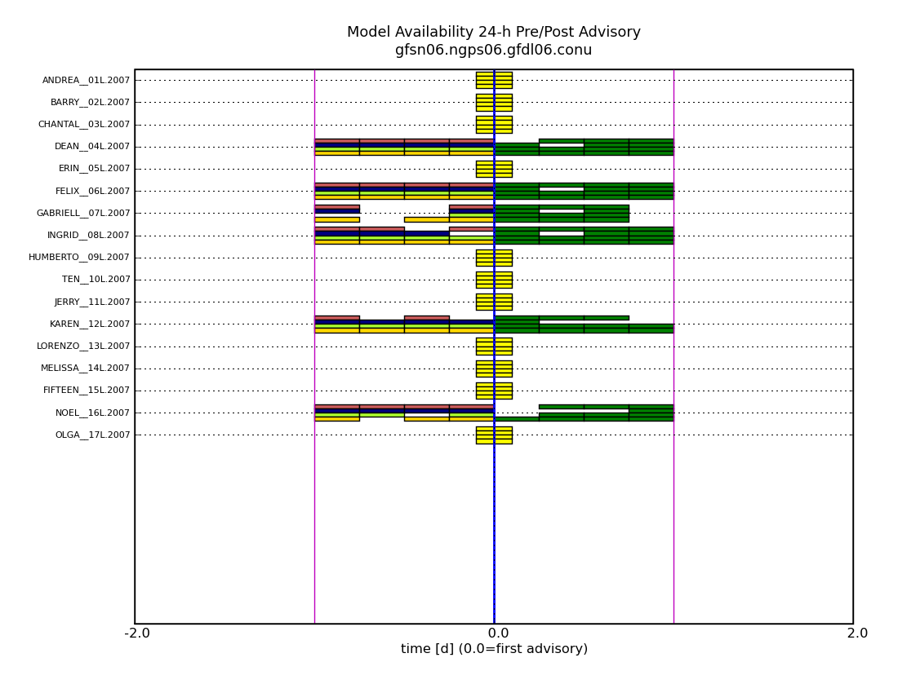
Model Availability: -24 h – +24 h :: 2007 LANT
GFSN06
NGPN06
GFDL06
CONU
no 72-h forecast to verify

Slide 10

04L.2007 DEAN
GFSN06
missing
+0 h
NGPS06
missing +6h
GFSN06
NGPN06
GFDL06
CONU
all models available -24 h

Slide 11
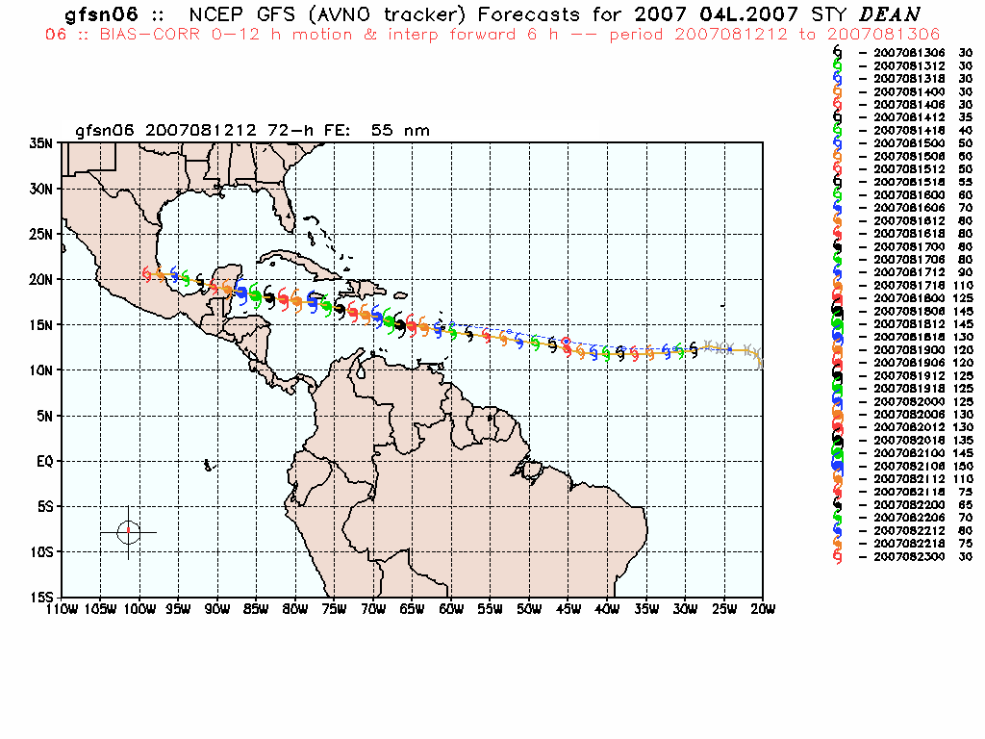
GFSN06 (~AVNI) 04L.2007 DEAN :: -24 h (pre-adv)
MEAN FE ~ 50 nm

Slide 12
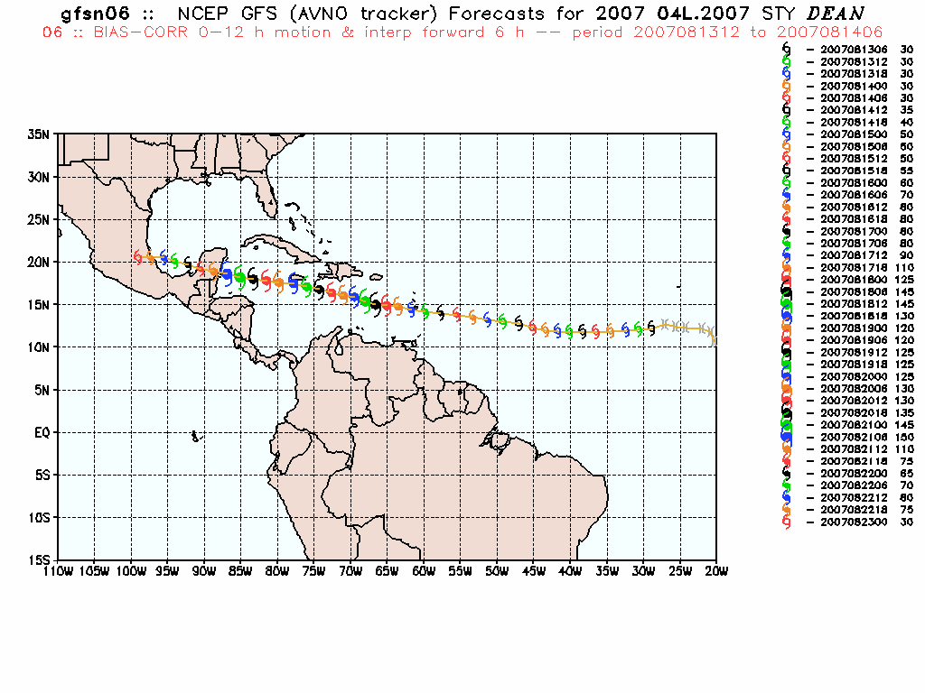
GFSN06 04L.2007 DEAN :: +24 h (POST-adv)
MEAN FE ~ 290 nm

Slide 13
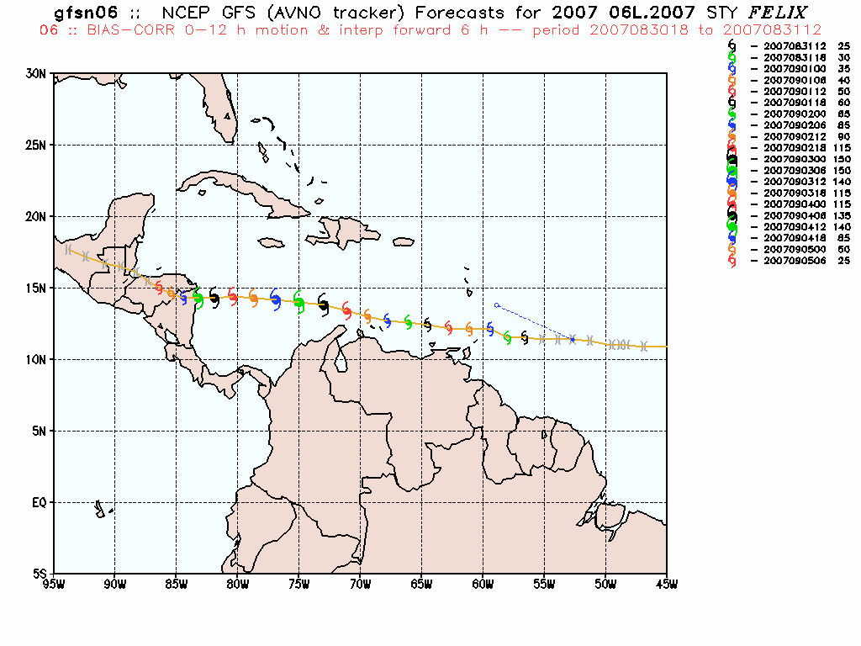
GFSN06 06L.2007 FELIX :: -24 h (pre-adv)
model run at all times, but only one verifiable 72-h forecast
Notes:
initialization….

Slide 14
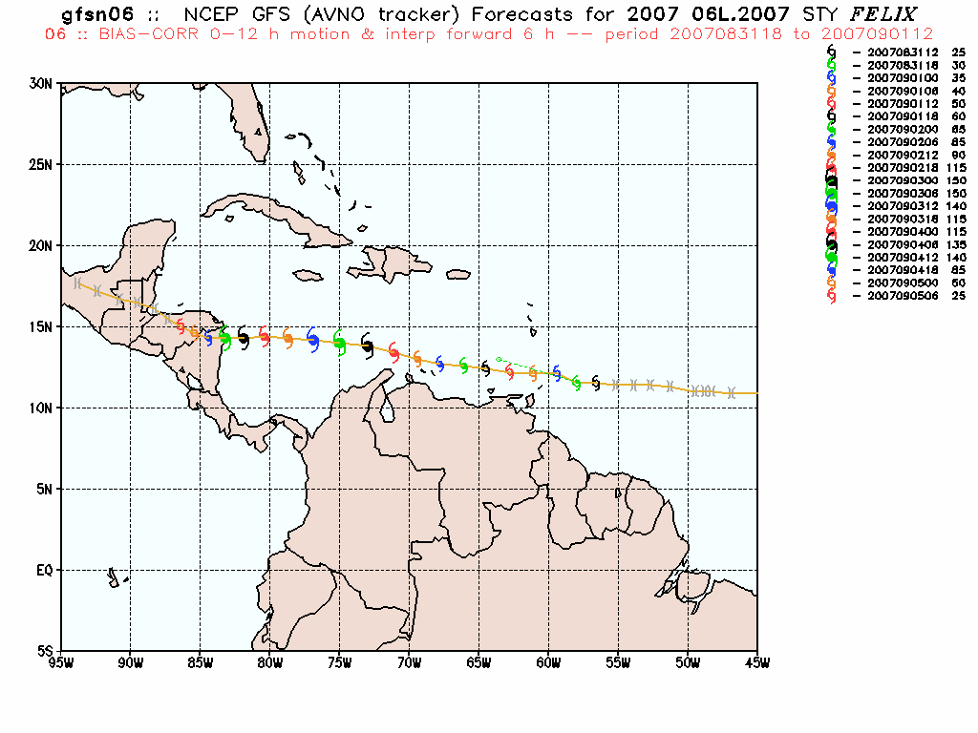
GFSN06 06L.2007 FELIX :: -24 h (pre-adv)
model run at all times, three made verifiable 72-h forecasts
72-h FE MEAN ~ 75 nm
Notes:
initialization….

Slide 15
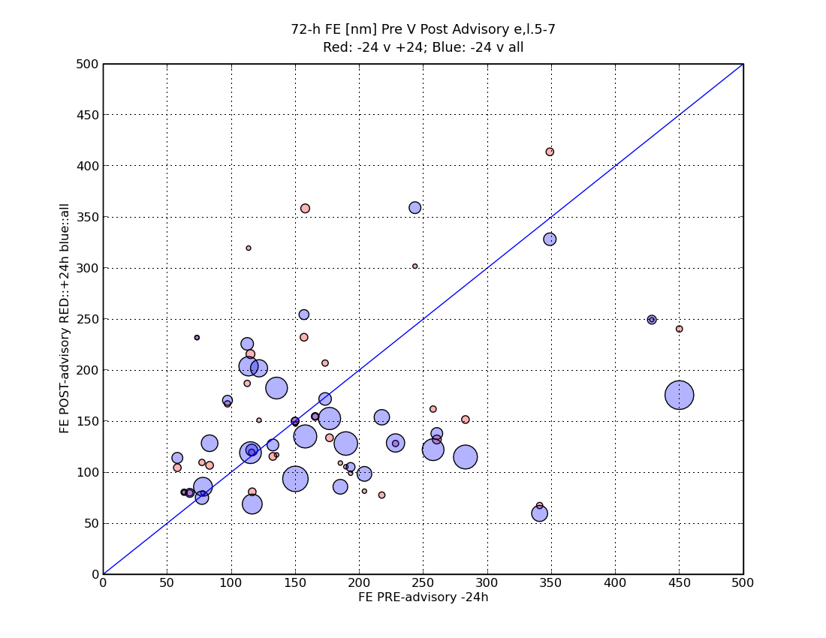
72-h mean FE Pre v Post (red); Pre v ALL (blue)
EASTPAC/LANT 2005-2007
blue circles scaled by # of postitions
PRE
>
post
POST
>
Pre

Slide 16
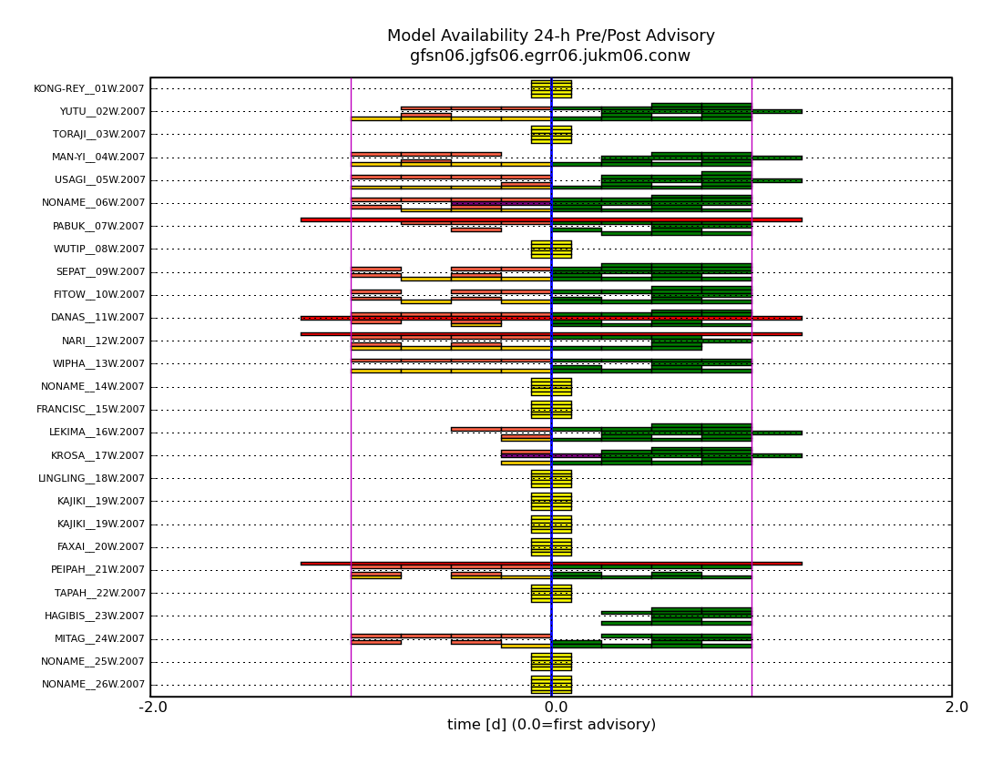
Model (un)availability in WESTPAC 2007
GFSN06
JGFS06
EGRR06
JUKM06
CONW

Slide 17
Summary
Pre-advisory MRT guidance does have value…
  dependence on initial vortex not strong
  pre-adv GFS (before relocation) error much lower than post-adv for FELIX (after relocation)
    HWRF/GFDL pre- and post- skill impacted similarly
    more diagnostics of the model TC vortex analysis
  diagnostics of CON
  local trackers can fill gaps and should be run based on “bdecks” (working best track) in addition to the CARQ
Next steps…
  comm of CARQ to NCEP, monitor running of the NCEP trackers
  improve my local tracker – when all else fails
  diagnostics of initial TC in the models

