Slide 1

KOJAK and SCALASCA
Jack Dongarra, Shirley Moore,
Farzona Pulatova, and Fengguang Song
University of Tennessee and Oak Ridge National Laboratory
Markus Geimer, Marc-André Hermanns, Bernd Mohr, Felix Wolf, and Brian Wylie
Forschungszentrum Jülich, Germany

Slide 2

KOJAK Project
Software package for automatic performance analysis of parallel applications
  Message passing and multi-threading (MPI, OpenMP, SHMEM , CAF)
  Parallel performance
  CPU and memory performance
Collaborative research project between
  Forschungszentrum Jülich, Germany
  University of Tennessee, USA
URLs
http://www.fz-juelich.de/zam/kojak/
http://icl.cs.utk.edu/kojak/

Slide 3
Automatic Off-Line Trace Analysis
Idea:
  Automatic search for patterns of inefficient behavior
  Quantification of significance
Low-level
event trace
Problem
Call tree
Reduction
High-level
profile
≡
System
Data distillation
Guaranteed to cover the entire trace

Slide 4
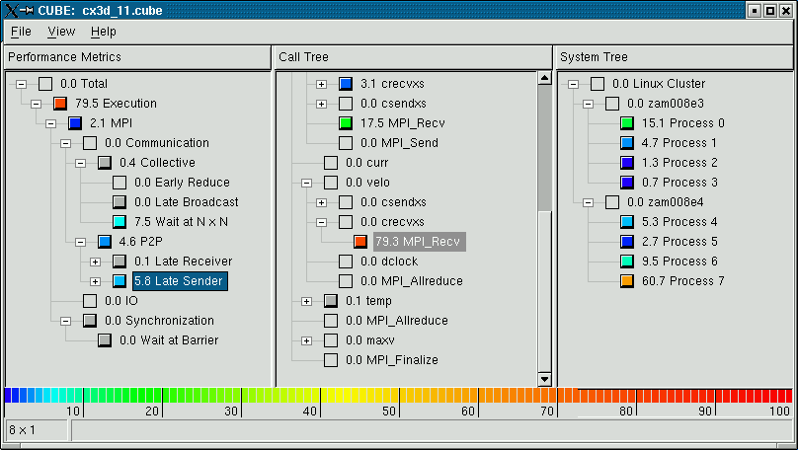
Analysis Report
Which type of
problem?
Where in the source code?
Which call path?
Which process /
thread ?

Slide 5
Extended MPI-2 Pattern Hierarchy
MPI
Synchronization
Barrier
Wait at Barrier
Barrier Completion
RMA Sync.
Window Mngt.
Wait at Create
Wait at Free
Fence
Wait at Fence
Locks
Active Target
Early Wait
Late Complete
Late Post

Slide 6
SCALASCA
Major re-design of KOJAK
Funded by German Helmholtz Association
Specifically addresses scalability
Basic idea: Parallelization of analysis
Current focus: Single-threaded MPI-1 applications
URL
  http://www.scalasca.org/

Slide 7
Current SCALASCA Prototype
Instrumentation
Source code
Automatic Multilevel
Instrumentation
Executable
Measurement
Local
Trace Files
Execution on
Parallel Machine
Local
Definition Files
Analysis
ID Mapping
Tables
Unification
Parallel Analyzer
Local Results
Combine
Global CUBE
File

Slide 8
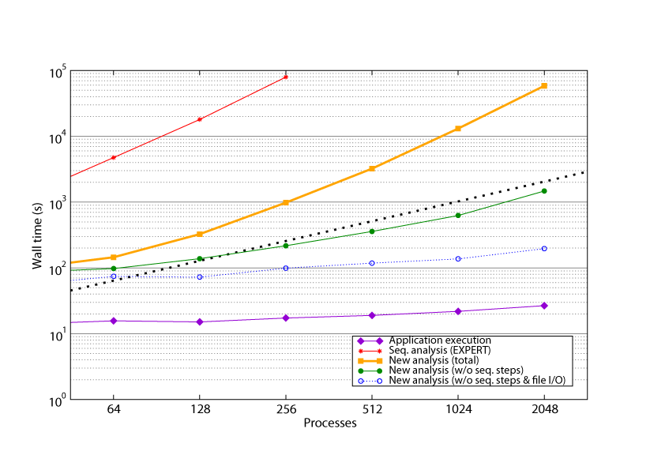
Results: SMG2000

Slide 9
Contacts
Jack Dongarra
Shirley Moore
Farzona Pulatova
Fengguang Song
Markus Geimer
Marc-André Hermanns
Bernd Mohr
Felix Wolf
Brian Wylie

