Slide 1
Measurement of Invariant Differential Cross Sections of Identified Charged Hadrons in p+p Collisions at RHIC
Mark Harvey
Brookhaven National Laboratory
July 18-24, 2004
Hot Quarks 2004 Workshop
Taos Valley, New Mexico, USA

Slide 2
Physics Motivation
Differential Invariant Cross Section in p+p Collisions
  fundamental for understanding the particle production in
  p+p collisions
  baseline measurement for disentangling nuclear effects which arise in d+Au and Au+Au collisions
  Hard-scattered partons give rise to hadronic sprays; i.e., jets
Physics implications:
  Careful examination of the Nuclear Modification factors; e.g., R_{dAu} and R_{AuAu}
  Initial state multiple scattering “broadens” the momentum distribution and enhances the high p_{T} yield compared to point-like scaling from p+p collisions
  Lack of high momentum enhancement → jet suppression

Slide 3
Differential Invariant Cross Section
Experimental Definition:
  Measurement of Luminosity (L) in p+p collisions → Beam-Beam Counter (BBC) triggered events
      Edσ/d³p = 1/2π 1/p_{T} 1/L dN/dydp_{T}
    where L = N_{eventsBBC}/σ^{pp}_{BBC}
Application to A+A collisions:
  The differential invariant yield in A+A collisions may be decomposed into a soft phenomenological piece and a hard pQCD component
    EdN_{AB}/d³p = N_{part} EdN_{soft}/dyd²p_{T} + N_{coll} 1/σ^{pp}_{in} EdN_{hard}/dyd²p_{T}
Cross section sensitive to two important pieces of physics!
  yields described in a two component model → Soft and hard production mechanisms

Slide 4
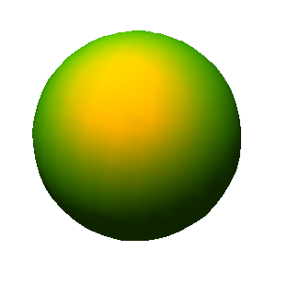







Hadronic Collisions
Nuclear
System A
D
D
D
U
D
Spectators
U
U
U
U
D
U
D
D
D
D
D
D
D
D
D
D
D
U
U
U
U
U
U
U
U
D
D
D
D
D
D
D
D
U
U
U
U
U
U
D
D
D
b
D
D
D
D
D
D
D
D
D
U
Participants
U
U
U
D
D
D
D
D
D
D
D
D
D
D
D
U
U
U
D
U
D
D
D
D
D
D
D
D
D
D
D
U
U
U
U
U
U
U
U
D
D
D
D
D
D
D
D
U
U
U
U
U
U
D
D
D
z
D
D
D
D
Spectators
D
U
U
D
D
D
D
D
D
D
D
D
D
D
D
x
Nuclear
System A
b: Impact Parameter
U
U
U
U
U
U
U
N_{part}: No. of nucleons participating
inelastically in interaction process
p
U
U
U
U
U
U
U
U
U
U
U
U
U
U
U
p
U
D
U
D
D
D
D
D
D
D
D
D
D
D
D
D
D
D
The number of spectator nucleons
may be expressed as
N_{spect}= 2A – N_{part}
N_{coll}: Binary collisions
two particle interactions

Slide 5
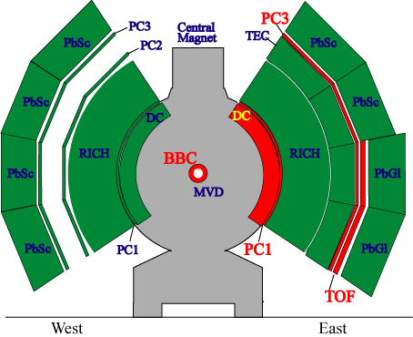


PHENIX Detector
Identified Charged Hadron Analysis Detection Elements:
Beam-Beam Counter (BBC)
Trigger, timing and collision
information
Drift Chamber (DC)
Charged particle tracking
and momentum information
Pad Chambers (PC1-PC3;
in analysis, use only PC1)
3D space-point information
on charged particles
Time-Of-Flight (TOF)
Detector
Timing information
and charged hadron
identification

Slide 6
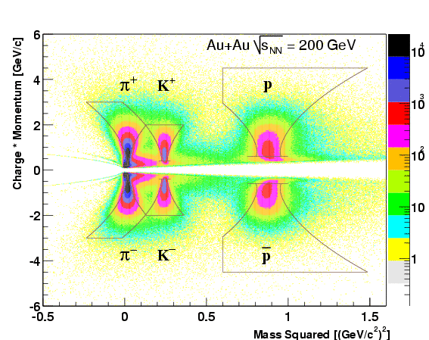
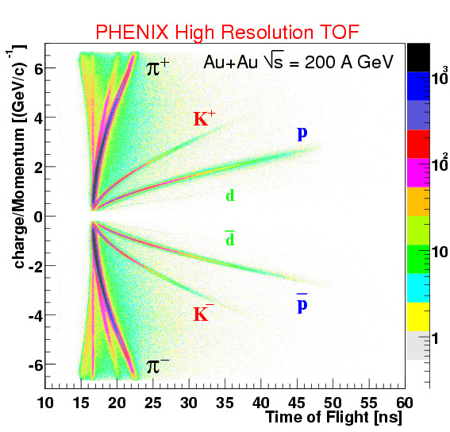
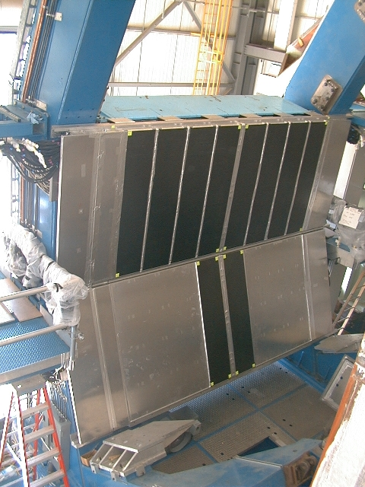
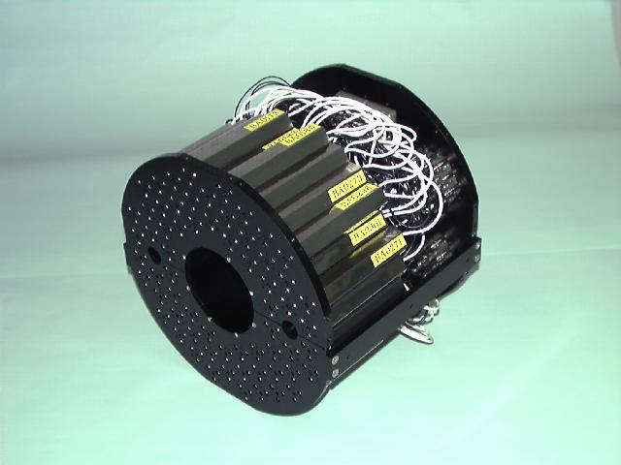
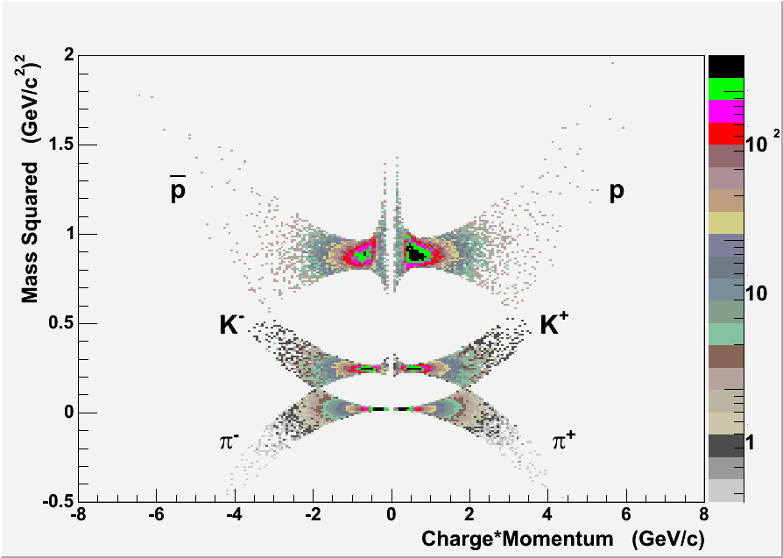
Particle Detection and Measurement
    High Resolution Time-of-Flight (TOF)
  detector – TOF time resolution in Au+Au is 115 ps, relative to 2σ cut in m²; K/π separation up to 2 GeV/c; p/K separation extends up to p_{T} = 4 GeV/c… Beam-Beam Counter (BBC) provides start clock trigger
TOF
BBC
m² vs. momentum
p+p @ √200 GeV
In p+p, clean pion and kaon separation out to |p| ~ 1.8 GeV/c; p/K separation
beyond 3 GeV/c -- TOF timing resolution ~135 ps

Slide 7
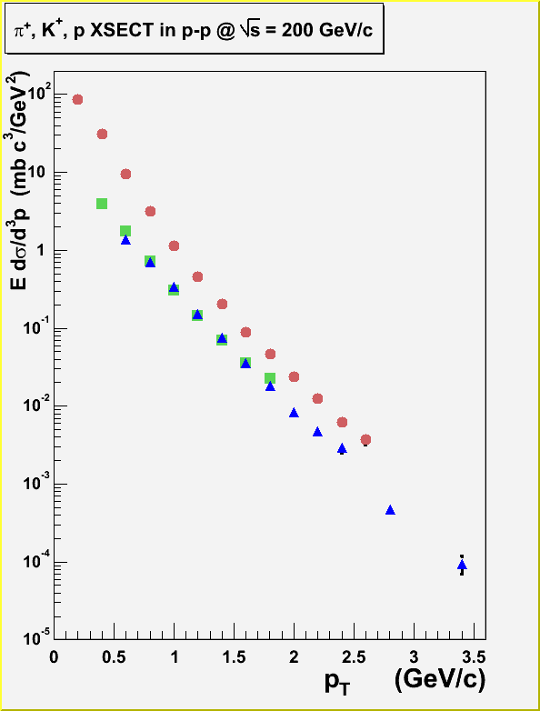
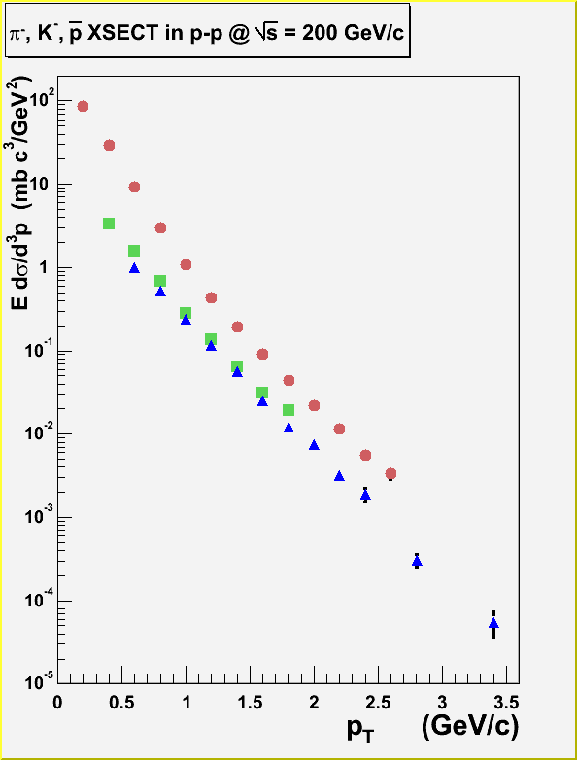

Differential Invariant
Cross Section in p+p collisions
Pion spectra,
exhibit concave
shape well
described by
gamma-type
function;
“Ap_{T} ^{2-λ}e^{-pT/T}”
PHENIX Preliminary
PHENIX Preliminary
π⁺, K⁺, p
π⁻, K⁻, p
Kaon spectra,
Fall-off
exponentially
in p_{T}
Proton spectra,
Characterized
by gamma
function
At low p_{T} (< 1.2 GeV/c), each particle species goes like f(p_{T}) = e^{-bpT} (b=6); similar
to behavior observed at ISR energies

Slide 8
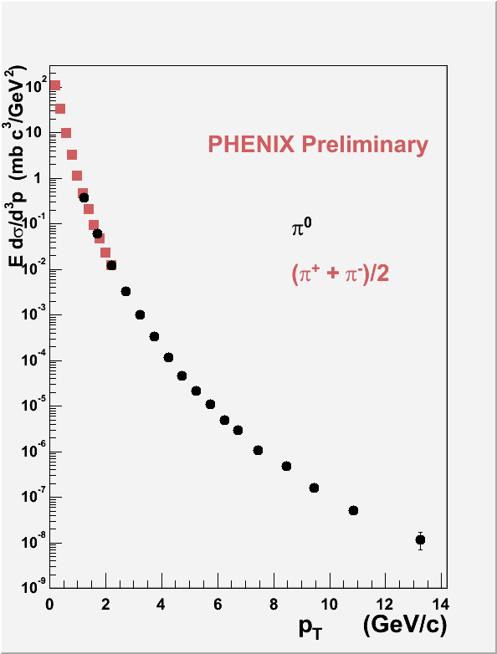
Differential Invariant Cross Section
Magnitude of the
charged pion average
cross section is in
excellent agreement
with published pi zero
work
The p+p XSECT for
pions measured
out to 10 orders of
magnitude as a
function of p_{T}!
Phys. Rev. Lett. 91, 241803 (2003)

Slide 9
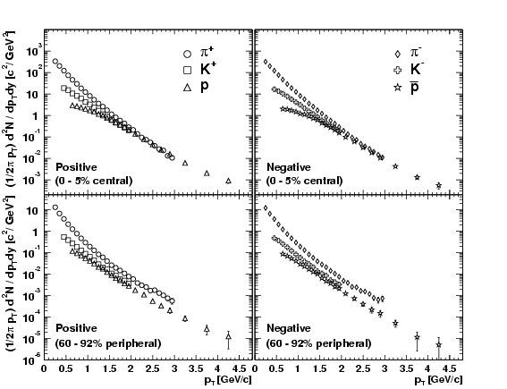
Au+Au p_{T} Spectra @ √s = 200 GeV
(central vs. peripheral)
Central
low p_{T}; slopes vary
w.r.t. mass
at higher p_{T}, produced (anti) proton yield equivalent to pion yield
Peripheral
dependence in mass is less pronounced
particle production yield similar to p+p
Phys.Rev.C69:034909,2004

Slide 10
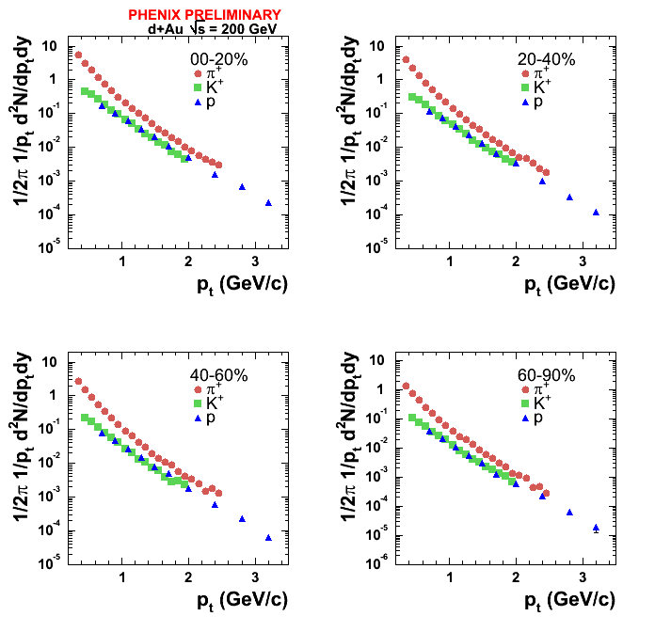
d+Au p_{T} Spectra @ √s = 200 GeV
(4 centrality classes)
particle production
yield decreases with
increasing centrality
pions; power law
for all centralities
kaons and protons; p_{T}
exponential in each
centrality class

Slide 11
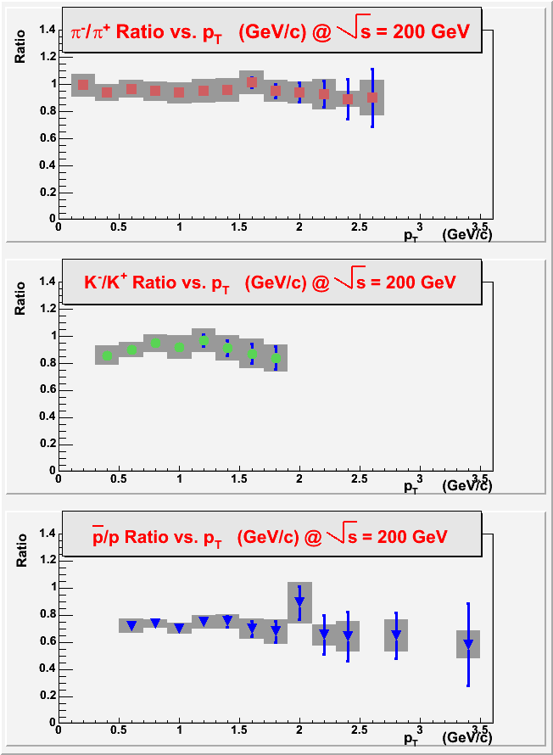
p+p Particle Ratios
pion, Kaon and proton ratios are flat in p_{T}
PHENIX Preliminary
π⁻/π⁺; 0.97 ± 0.001 ± 0.02
K⁻/K⁺; 0.90 ± 0.01 ± 0.03
PHENIX Preliminary
p/p; 0.72 ± 0.01 ± 0. 02
Shaded boxes
represent systematic
error estimates
PHENIX Preliminary

Slide 12
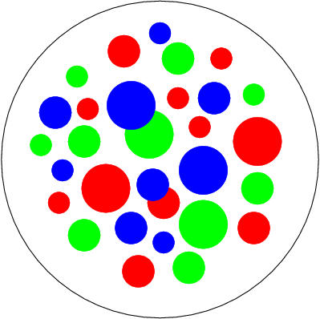
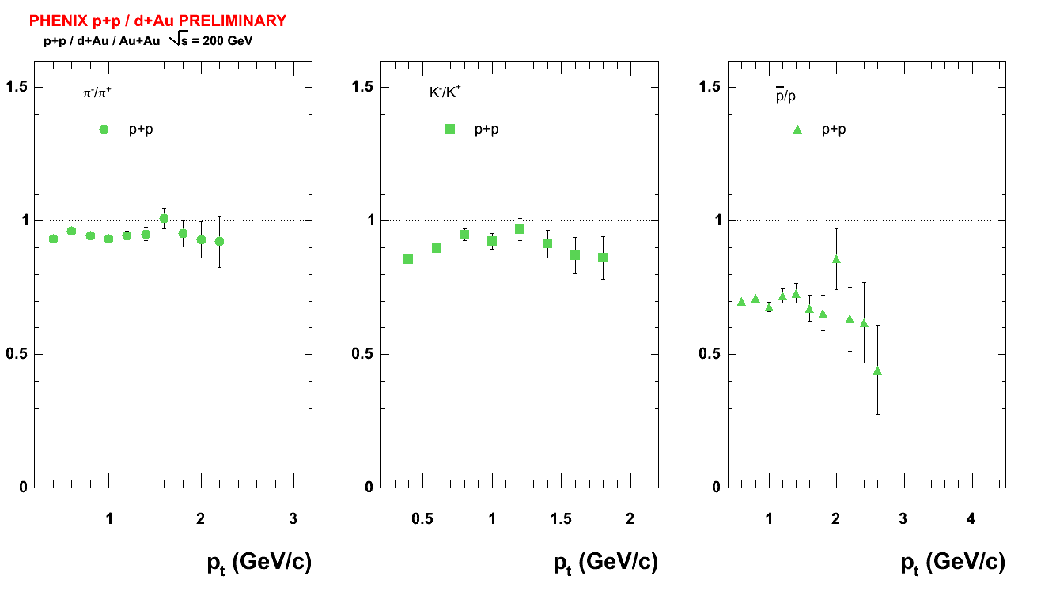
Particle Ratios for
three Collision Systems
p
p
π⁻/π⁺ K⁻/K⁺ p/p
slide prepared by Felix Matathias

Slide 13
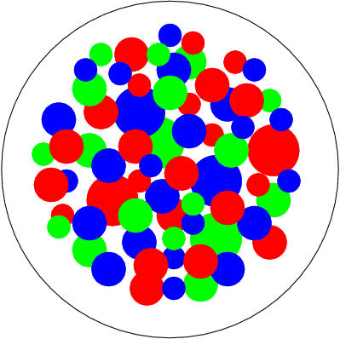
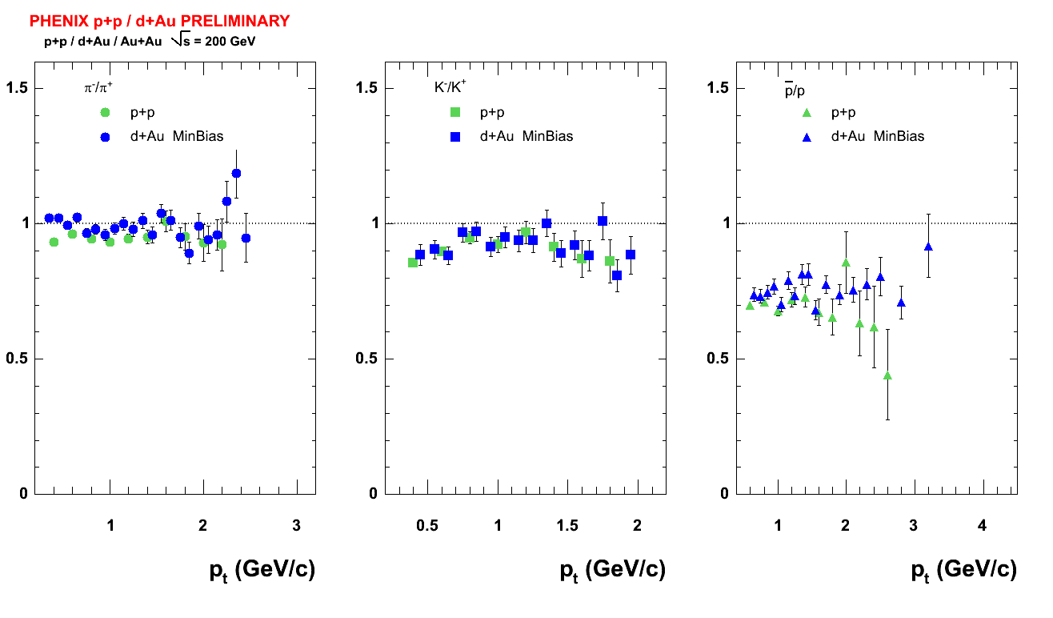
Particle Ratios for
three Collision Systems
Au
d
π⁻/π⁺ K⁻/K⁺ p/p
slide prepared by Felix Matathias

Slide 14
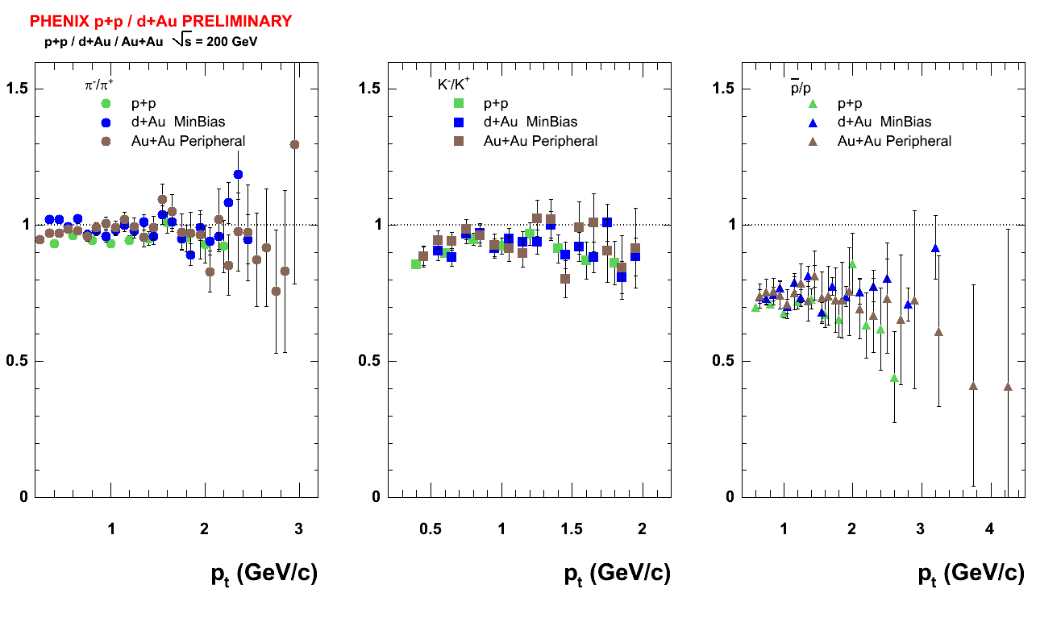
Particle Ratios for
three Collision Systems
Au
Au
π⁻/π⁺ K⁻/K⁺ p/p
slide prepared by Felix Matathias

Slide 15
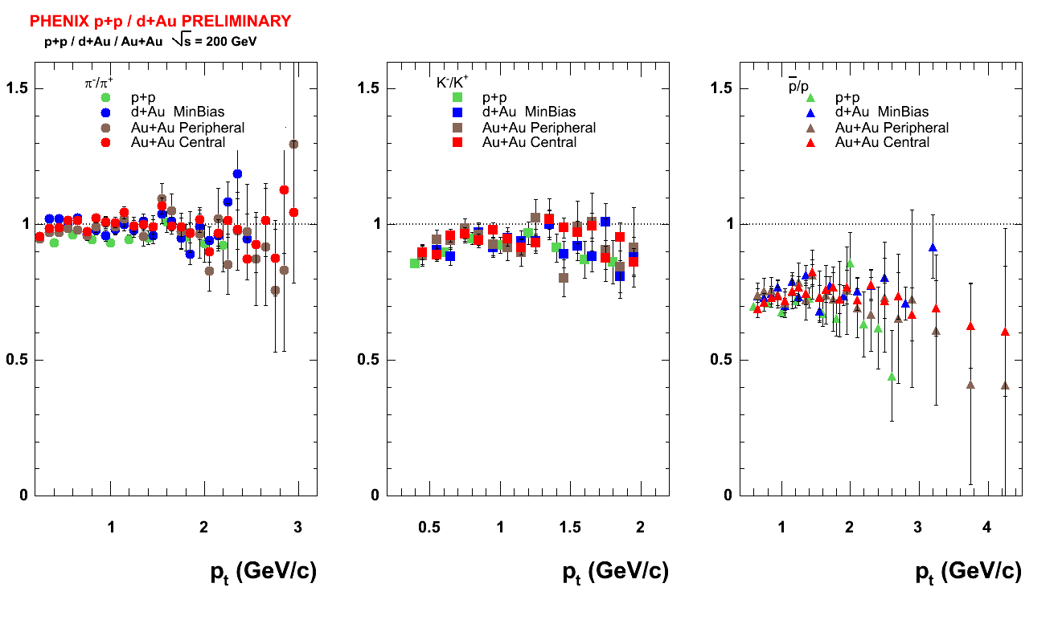
Particle Ratios for
three Collision Systems
Au
Au
Like particle ratios: agree very well independent of collision system
π⁻/π⁺ K⁻/K⁺ p/p
slide prepared by Felix Matathias

Slide 16
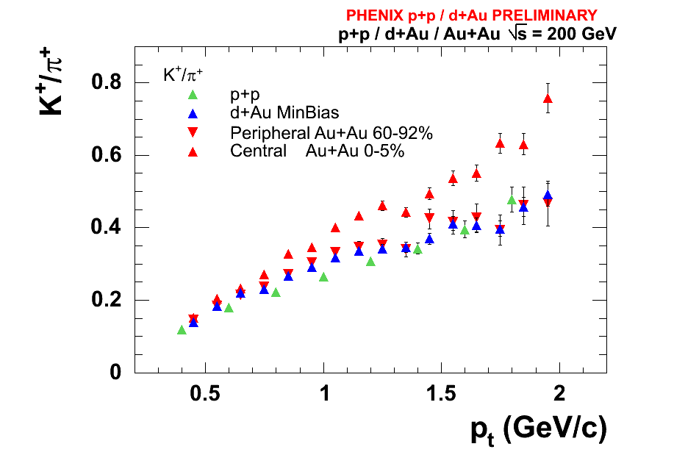
K⁺/π⁺ Ratios; 3 Collision systems
K/π Ratios increase
steadily with
increasing p_{T}
No apparent
indication of
saturation in this
limited p_{T} range
All three systems
have comparable
magnitudes –
somewhat enhanced
for most central
Au+Au collisions
slide prepared by Felix Matathias

Slide 17
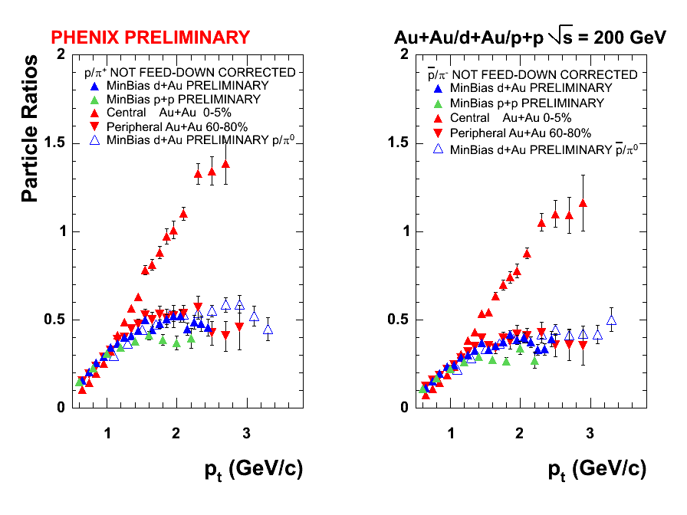
p/π Ratios for three
Collision Systems
p+p, min bias
d+Au and
peripheral Au+Au
are directly
comparable
In p+p, p/π Ratios
increase rapidly for
p_{T} < 1.4 GeV/c –
flattens around
0.4 (0.3) for the
positive (negative)
particles at higher p_{T}
slide prepared by Felix Matathias
Central Au+Au dramatically higher
for p_{T} > 1.4 GeV/c → New Physics!

Slide 18
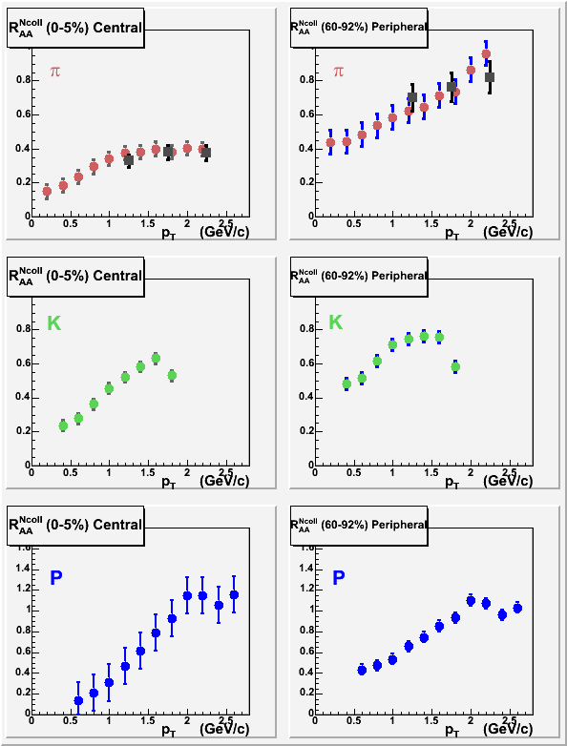
A look at R_{AA}
R_{AA} was computed in the following way:
R_{AA}^{Ncoll} = Y_{AA}/(Ncoll(Y_{pp}*(σ_{BBC}/σ_{inelpp})))
π’s are suppressed in central
collisions; seem to be
approaching unity for increasing
p_{T} in peripheral collisions
Work in Progress
K’s appear to flatten out within limited p_{T} window in both central and peripheral collisions, respectively
p’s increase fairly rapidly at low p_{T} ; however, the protons are different and are consistent with no suppression!
R_{AA} considerably less than 1 for
π’s; implication → jet quenching
due to hard scattered parton
absorption in hot medium; p’s
and K’s indicate other new physics.

Slide 19
Summary
Differential invariant cross section of identified charged hadrons in p+p collisions (paper preparation for publication in process)
  baseline for d+Au and Au+Au
  Excellent agreement between charged pion average and published pi zero result
  High precision measurement of pions out to 10 orders of magnitude!
Particle Ratios:
  Like particles; agree very well, independent of collision system
  K/π ratios rise steadily in limited p_{T} range
  p/π ratios saturate for all systems except Au+Au central – may be viewed as flow effect since protons are much heavier than pions; ergo, flow contribution to their slope ~ m <u_{t}>² ; see Phys.Rev.C69:034909,2004

Slide 20
Summary Continued
Essentially, R_{AA} pions are suppressed in central collisions – rising steadily peripheral… magnitude slightly increased for Kaons; however, they saturate in limited p_{T} window; Protons are not suppressed at higher p_{T} -- very different from pions!
  Particle production mechanisms may be described with similar source in soft domain (p_{T} < 1.5 GeV/c) for π±, K± and p (pbar), respectively – difference in production probably limited to large p_{T} regime.
More work to be done on R_{dAu} and R_{AuAu} before physics result is ready for “prime time”

