Slide 1
Connect Four
Xaver Buttinger Stefan Habringer

Slide 2
Recap
Tree Based representation of game, nodes have utility representing how good state is for the player, either maximizers or minimizer, propagation of values only upward in the tree
MinMax
Two competing player try to maximize their utility and minimize the opposing one
Recursive evaluation – depth-first-search
Alpha-Beta Pruning
Extension – propagate information about bounds in subtrees (α/β)
Cut subtree if value is outside of interval [α, β]

Slide 3
Application - Connect 4 Game
Aim is to get 4 pieces in a row either vertical, horizontal or diagonal
State of the board evaluates to relative strength for each player
Aim for moves that maximize own strength
Avoid moves that improve the opposing strength

Slide 4
Program and Setup
Java Applet
GameMaster.java – management of game, turns, scores, restarts
C4Board.java – representation of board, possible moves for players, event listeners on rows
MinmaxPlayer.java –minmax and pruning logic, recursive expansion of minimizer and maximizer nodes, recursion depth adjustable by lookup depth – difficulty of minmax player
DEMONSTRATION

Slide 5
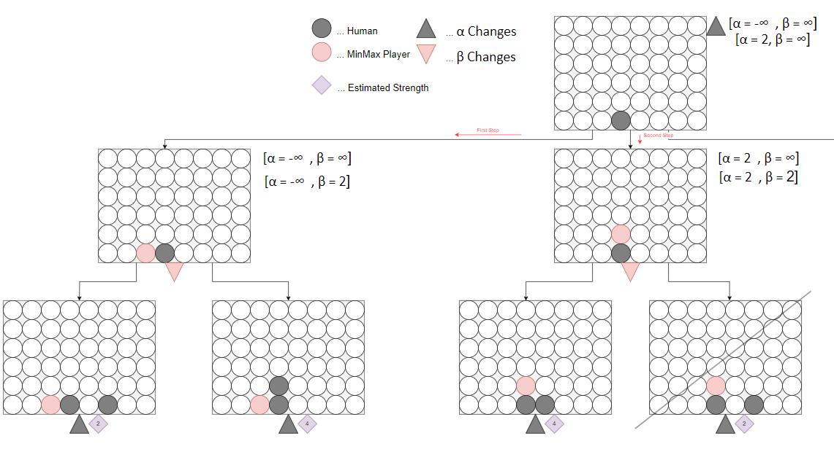
Tree Based representation of Game

Slide 6
Task 1 - Measurements
Observe number of evaluated moves for each turn
Moves/Task | 1 | 2 | 3 | 4 | 5a | 5b | Combined
1 | 1 426 | 4 680 | 1 208 | 993 | 4 680 | 302 | 302
2 | 925 | 4 680 | 771 | 642 | 4 680 | 457 | 457
3 | 867 | 4 680 | 817 | 676 | 4 568 | 649 | 649
4 | 1 657 | 4 623 | 1 337 | 1 145 | 4 624 | 310 | 310
5 | 1 249 | 4 623 | 1 068 | 916 | 4 608 | 226 | 226

Slide 7
Task 2 – Pure Minmax
Remove pruning functionality
Minmax.java – only evaluated strength of move without consideration of parent nodes in evaluation of min and max nodes
All possible moves are always evaluated, eg. for the first move with lookup depth 4:
8 ^1 = 8 possible positions to put first piece (rows)
8 ^ 2 = 64 possible positions for second piece
8 ^ 3 = 512 possible positions for third piece
8 ^ 4 = 4096 possible positions for fourth picece
Evaluated total moves is sum = 4680
// FH: Disable Pruning
// if (strength > parentMinimum) {
// board.undoLastMove();
// return strength;
// }
if (strength > maxStrength) {
maxStrength = strength;
}

Slide 8
Task 3 – Adjust Pruning Condition
Evaluation of parent strength must include equality in the condition
Draws and other moves are not considerd on strict evaluation (scenarios where α == β)
// FH: change condition from > to >= to enable correct pruning in maxNode (< to <= for minNode)
if (strength >= parentMinimum) {
board.undoLastMove();
return strength;
}

Slide 9
Task 4 – Deep Alpha-Beta Pruning
Adjust interfaces to not only incorporate parent information but subtree interval [α,β]
private int expandMaxNode(int depth, int alpha, int beta) {
...
// int strength = expandMinNode(depth -1, maxStrength);
int strength = expandMinNode(depth - 1, alpha, beta);
...
}
private int expandMinNode(int depth, int alpha, int beta){
...
// int strength = expandMaxNode(depth -1, maxStrength);
int strength = expandMaxNode(depth - 1, alpha, beta);
...
}

Slide 10
Task 5 – Heuristic ordering of moves
Previously, moves were evaluated from left of the board to right – higher number of evaluated moves
In Connect4 usually moves closer to the boards center are stronger
Changes to C4Board.java prefer central moves
private int[] PREFERED_ORDER_OF_MOVES = {3,4,2,5,1,6,0,7};

Slide 11
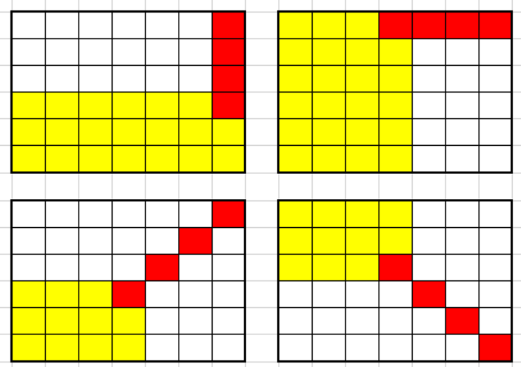
Task 6 – Adjust Board Dimensions
Initial board has 8 rows, traditionally Connect4 board has 7 (UI is not changed but game logic)
Board dimension determines the number of possible positions from where to win the game
// FH: vector of the capacity of win conditions
// Offset of 3 is necessary to get all positions were 4 pieces can be next to each other
int horizontalWins = NUMBER_OF_ROWS * (NUMBER_OF_COLUMNS - 3);
int verticalWins = NUMBER_OF_COLUMNS * (NUMBER_OF_ROWS - 3);
// For diagonal wins we must get all possible positions from
which
// we can achieve a diagonal line and multiply it by 2 since we can
// either get it right/left diagonal
int diagonalWins = 2 * ((NUMBER_OF_COLUMNS -3) * (NUMBER_OF_ROWS-3));
int allPossibleWins = horizontalWins + verticalWins + diagonalWins;
https://roboticsproject.readthedocs.io/en/latest/ConnectFourAlgorithm

Slide 12
Task 7 – Board Evaluation Heuristic
Strength of the position of each player cannot be determined deterministically – use heuristic estimation
Player strength is weighted sum of number of occurrences of 3, 2 and 1 pieces in any row combination
3 pieces are weighted with factor 64, 2 pieces with 16, 1 pieces with 1, multiplication is done via bitshifting
return
(p1_2InARow << SHIFT_2_IN_A_ROW) +
(p1_3InARow << SHIFT_3_IN_A_ROW) +
p1_1InARow;

Slide 13
Task 8 – Why not always win?
TODO
Early pruning if nodes are pruned away due to the current state of the subtree interval
Ressource constraints – if a thread that does computation is interrupted not the entire tree is evaluated

