Slide 1
Connect Four
Xaver Buttinger Stefan Habringer

Slide 2
Recap
Tree Based representation of game, nodes have utility representing how good state is for the player, either maximizers or minimizer, propagation of values only upward in the tree
MinMax
Two competing player try to maximize their utility and minimize the opposing one
Recursive evaluation – depth-first-search
Alpha-Beta Pruning
Extension – propagate information about bounds in subtrees (α/β)
Cut subtree if value is outside of interval [α, β]

Slide 3
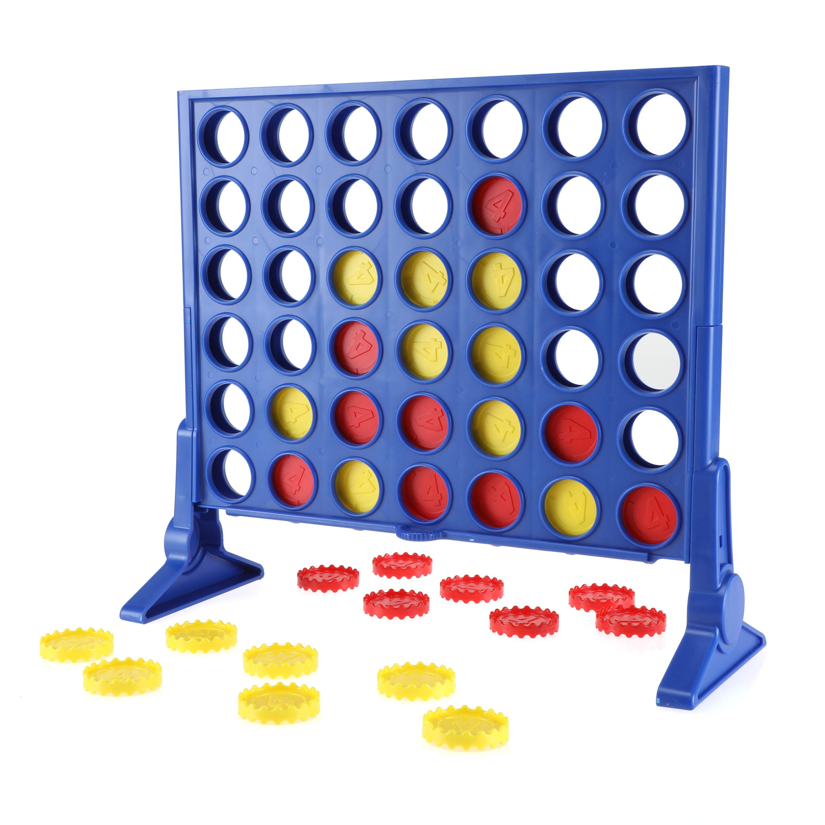
Application - Connect 4 Game
Aim is to get 4 pieces in a row either vertical, horizontal or diagonal
State of the board evaluates to relative strength for each player
Aim for moves that maximize own strength
Avoid moves that improve the opposing strength

Slide 4

Program and Setup
Java Applet
DevContainers, JDK 8 (full Applet Support), X-Server VCXSRV
GameMaster.java – management of game, turns, scores, restarts
C4Board.java – representation of board, possible moves for players, event listeners on rows
MinmaxPlayer.java –minmax and pruning logic, recursive expansion of minimizer and maximizer nodes, recursion depth adjustable by lookup depth – difficulty of minmax player
DEMONSTRATION

Slide 5
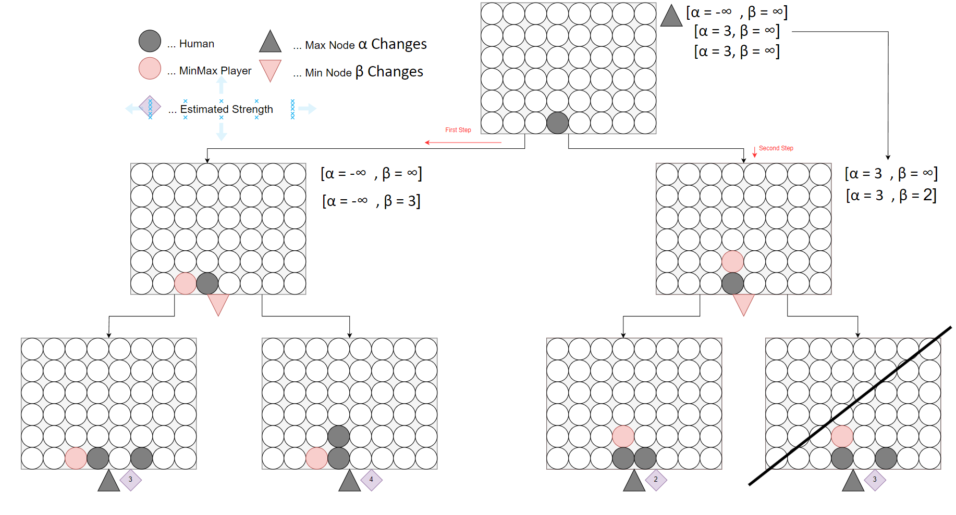
Tree Based Representation
Notes:
Parameters are only propagated upward (α/β), 8 follow up gamestate after every move
Order of moves matters – depends on how likely a move is
α … best score the max player can currently achieve
Β … best score the min player can currently achieve
Condition is only explore trees were α >= β – if it is fullfilled we do not evaluate following subtrees
Alpha only changes on first and third level Beta only on second level
Since in the second step our condition is fullfilled we propagate the values back to the top
In this instance we immediatly prune the branch that is not yet evaluated
So for our example the first branch is evaluated as follows:
For the first tree branch The Min Player will chose the branch with the lowest output which is 3 – this means the beta value is updated
Than this is propagated upward and sind 3 >= -inf the Max Player updates the α value For the second tree branch
The value of α = 3 is now propagated down the tree to determin the cutoff condition Now again, the Min Player will choose the leftmost branch 2 – this already fullfills α >= β (3 >= 2) and we can cut the remaining branch
After these steps the current Max Player will choose the left branching tree and never the right

Slide 6
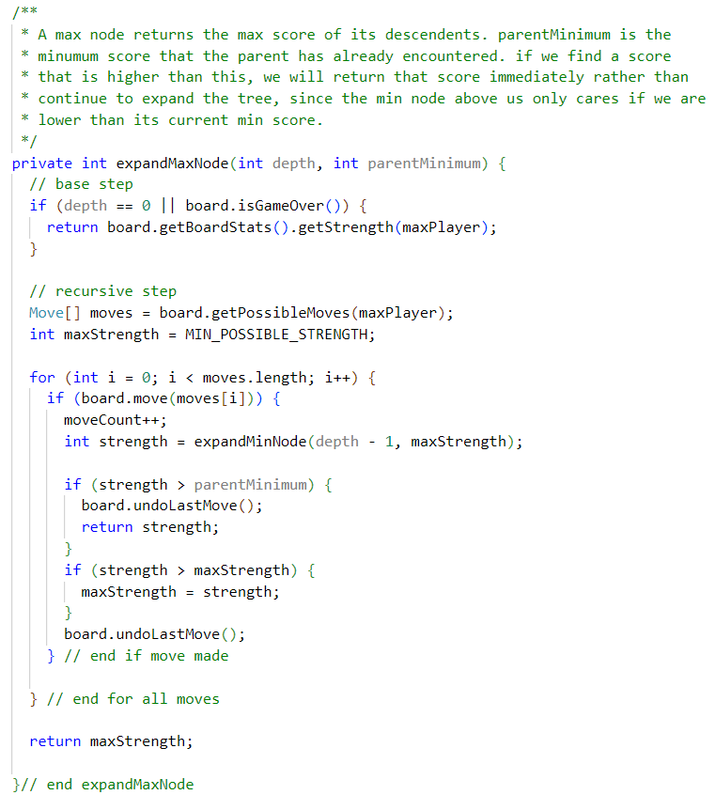

Task 2 – Pure Minmax
Can you spot the pruning?

Slide 7
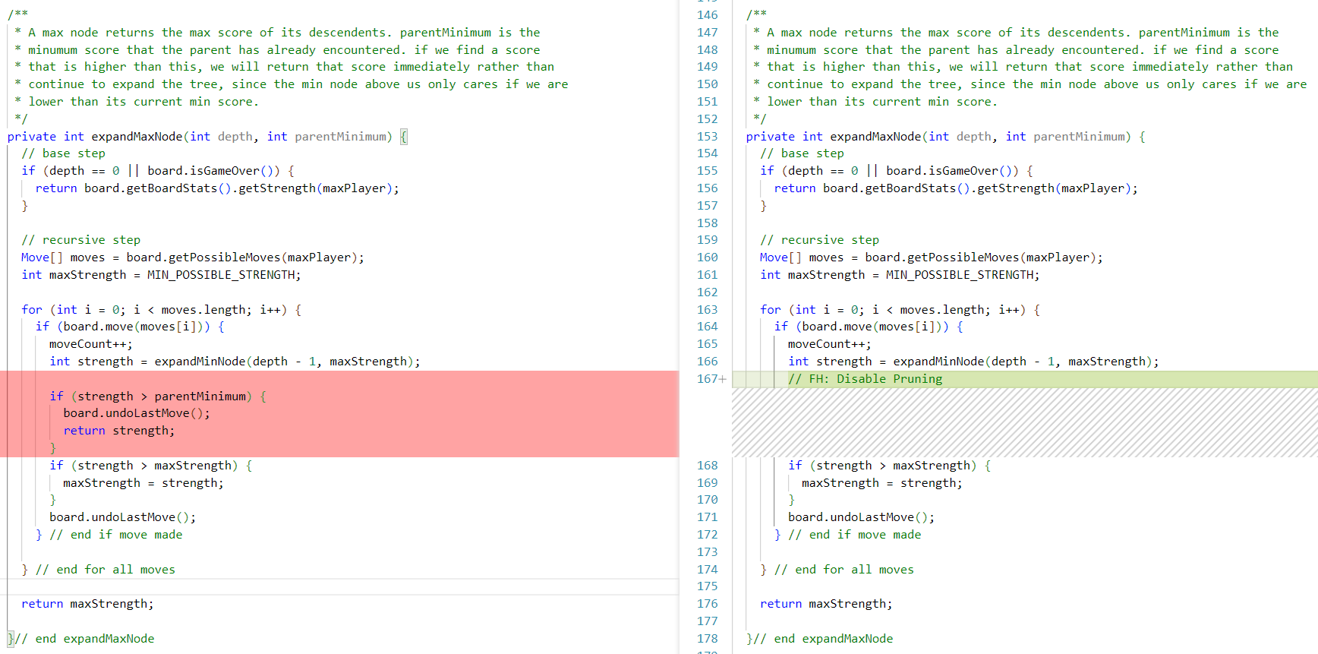
Task 2 – Pure Minmax

Slide 8
Task 2 – Pure Minmax
Remove pruning functionality
Minmax.java – only evaluated strength of move without consideration of parent nodes in evaluation of min and max nodes
All possible moves are always evaluated, eg. for the first move with lookup depth 4:
8 ^1 = 8 possible positions to put first piece (rows)
8 ^ 2 = 64 possible positions for second piece
8 ^ 3 = 512 possible positions for third piece
8 ^ 4 = 4096 possible positions for fourth picece
Evaluated total moves is sum = 4680
// FH: Disable Pruning
// if (strength > parentMinimum) {
// board.undoLastMove();
// return strength;
// }
if (strength > maxStrength) {
maxStrength = strength;
}

Slide 9

Task 3 – Adjust Pruning Condition
Can you spot the pruning condition?

Slide 10
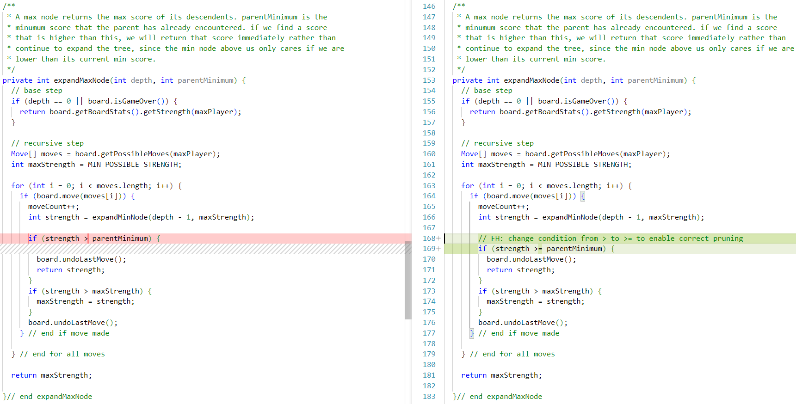
Task 3 – Adjust Pruning Condition

Slide 11
Task 3 – Adjust Pruning Condition
Evaluation of parent strength must include equality in the condition
Draws and other moves are not considerd on strict evaluation (scenarios where α == β)
< and > could miss pruning opportunities
// FH: change condition from > to >= to enable correct pruning in maxNode (< to <= for minNode)
if (strength >= parentMinimum) {
board.undoLastMove();
return strength;
}
Notes:
By using the `>=` condition in the maxNode and the `<=` condition in the minNode, the algorithm correctly prunes the subtrees that are guaranteed not to affect the final outcome, thereby improving the efficiency of the search.
If the strict `>` condition were used in the maxNode, it would potentially miss some pruning opportunities, as a child node with a utility value exactly equal to the current beta value could still be relevant for the minimizer player's decision. Similarly, using the strict `<` condition in the minNode could miss pruning opportunities when a child node's utility value is equal to the current alpha value.
Therefore, using the `>=` and `<=` conditions in the maxNode and minNode, respectively, ensures that the alpha-beta pruning algorithm correctly identifies and prunes all unnecessary subtrees, leading to an optimal and efficient search process.

Slide 12
Task 4 – Deep Alpha-Beta Pruning
Adjust interfaces to not only incorporate parent information but subtree interval [α,β]
private int expandMaxNode(int depth, int alpha, int beta) {
...
// int strength = expandMinNode(depth -1, maxStrength);
int strength = expandMinNode(depth - 1, alpha, beta);
...
}
private int expandMinNode(int depth, int alpha, int beta){
...
// int strength = expandMaxNode(depth -1, maxStrength);
int strength = expandMaxNode(depth - 1, alpha, beta);
...
}

Slide 13
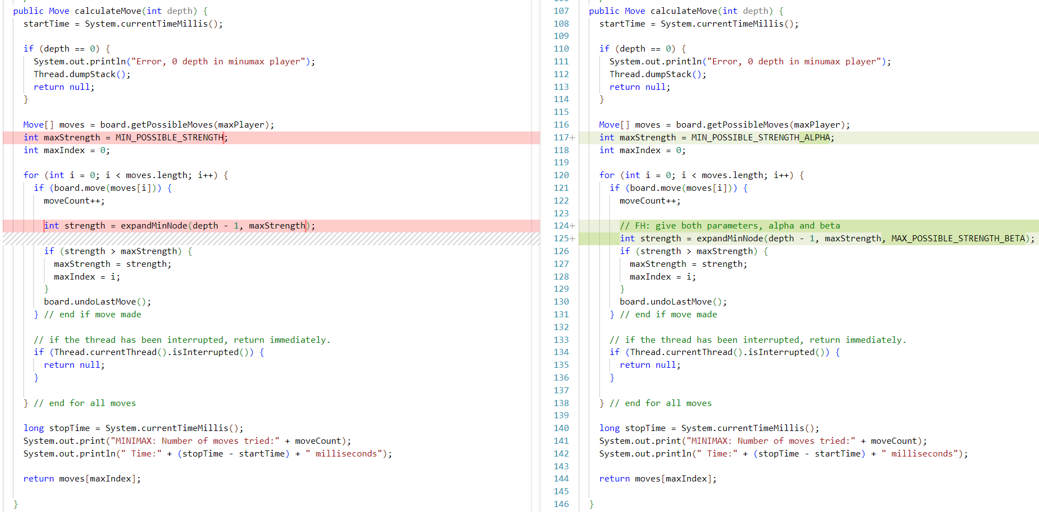
Notes:
- The `maxStrength` variable is initialized with `MIN_POSSIBLE_STRENGTH_ALPHA` instead of `MIN_POSSIBLE_STRENGTH`. This is done to track the alpha value for the maximizer node.
- The `expandMinNode` function is now called with three parameters: `depth`, `maxStrength` (alpha), and `MAX_POSSIBLE_STRENGTH_BETA` (beta). This is to incorporate alpha-beta pruning.

Slide 14
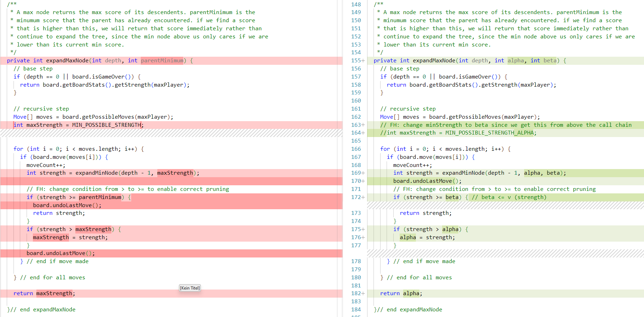
Notes:
- The `expandMaxNode` function is modified to accept three parameters: `depth`, `alpha`, and `beta`.
- The `maxStrength` variable is initialized with `MIN_POSSIBLE_STRENGTH_ALPHA` to track the alpha value from the call chain.
- The condition for pruning is changed from `if (strength >= parentMinimum)` to `if (strength >= beta)`. This checks if the current strength is greater than or equal to the beta value, which represents the minimum value the minimizer player is assured of getting. If true, the subtree can be pruned as the minimizer will never choose a move that leads to a value greater than or equal to beta.
- If pruning occurs, the function returns the strength directly.
- If the strength is greater than the current alpha value, the alpha value is updated to the new strength.
- The function returns the updated alpha value instead of the maximum strength.

Slide 15
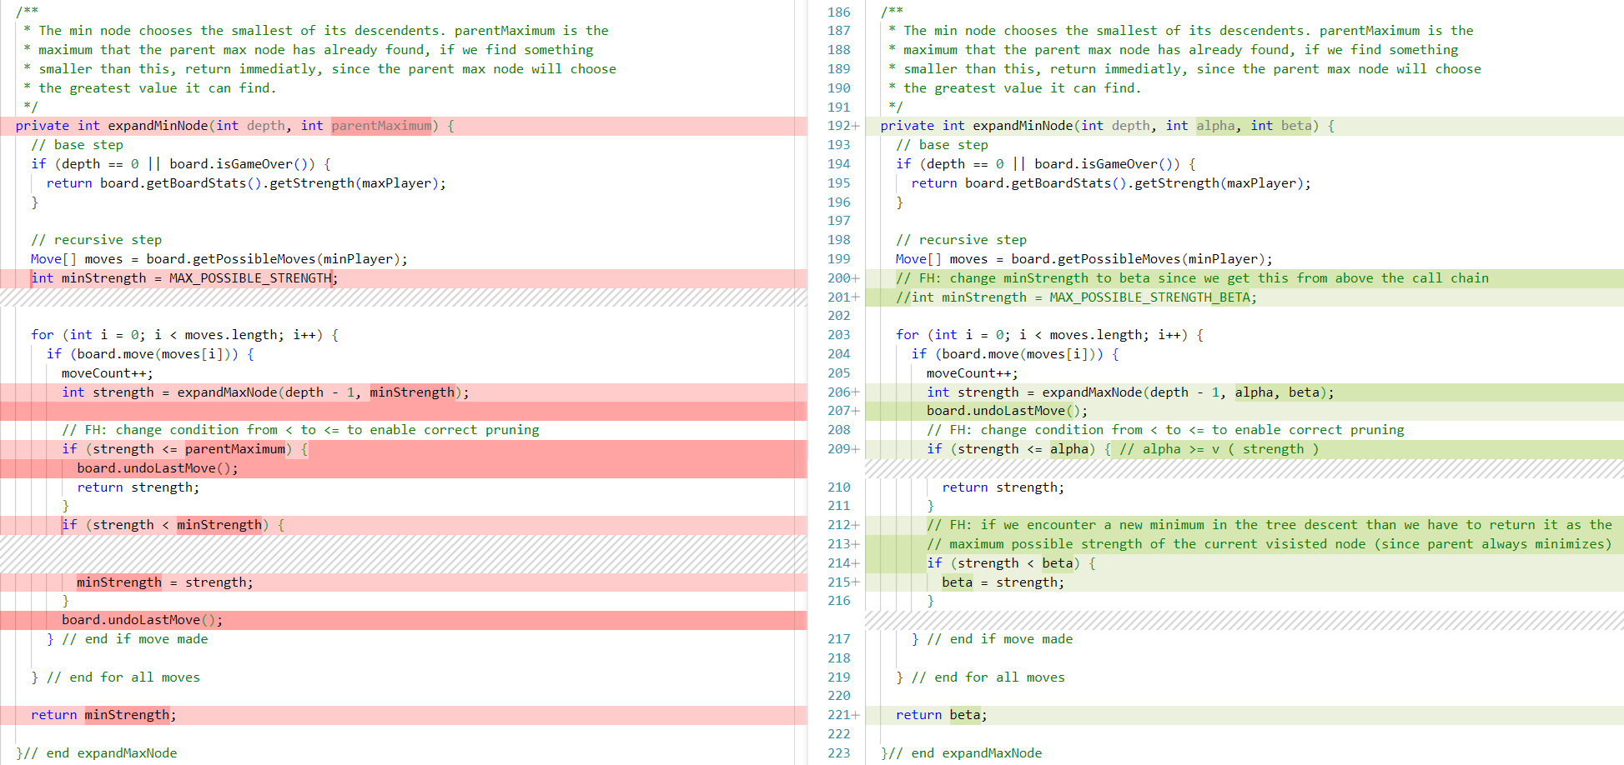
Notes:
- The `expandMinNode` function is modified to accept three parameters: `depth`, `alpha`, and `beta`.
- The `minStrength` variable is initialized with `MAX_POSSIBLE_STRENGTH_BETA` to track the beta value from the call chain.
- The condition for pruning is changed from `if (strength <= parentMaximum)` to `if (strength <= alpha)`. This checks if the current strength is less than or equal to the alpha value, which represents the maximum value the maximizer player is assured of getting. If true, the subtree can be pruned as the maximizer will never choose a move that leads to a value less than or equal to alpha.
- If pruning occurs, the function returns the strength directly.
- If a new minimum strength is encountered during the tree descent, the beta value is updated to this new minimum strength. This is done by checking `if (strength < beta)` and updating `beta = strength`.
- The function returns the updated beta value instead of the minimum strength.
These changes incorporate alpha-beta pruning into the minimax algorithm by keeping track of the alpha and beta values during the tree traversal. Subtrees are pruned if their values lie outside the [alpha, beta] interval, as they cannot influence the final decision. This optimization significantly reduces the search space and improves the efficiency of the algorithm, especially in larger game trees.

Slide 16
Task 5 – Heuristic ordering of moves
Previously, moves were evaluated from left of the board to right – higher number of evaluated moves
In Connect4 usually moves closer to the boards center are stronger
Changes to C4Board.java prefer central moves
private int[] PREFERED_ORDER_OF_MOVES = {3,4,2,5,1,6,0,7};

Slide 17
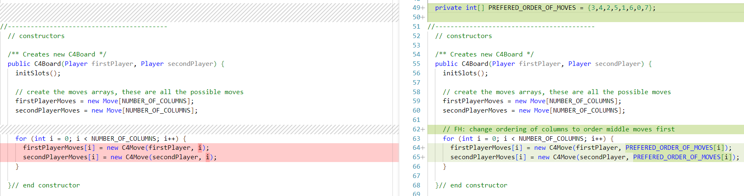

Slide 18
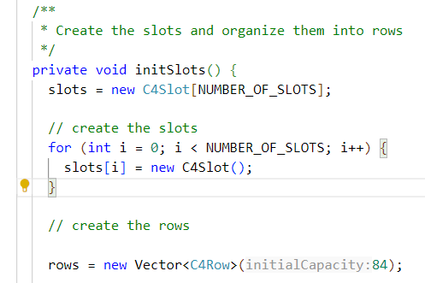
Task 6 – Adjust Board Dimensions
// C4Board.java
Can you guess what’s this magic number?
Rows = 8
Cols = 7

Slide 19
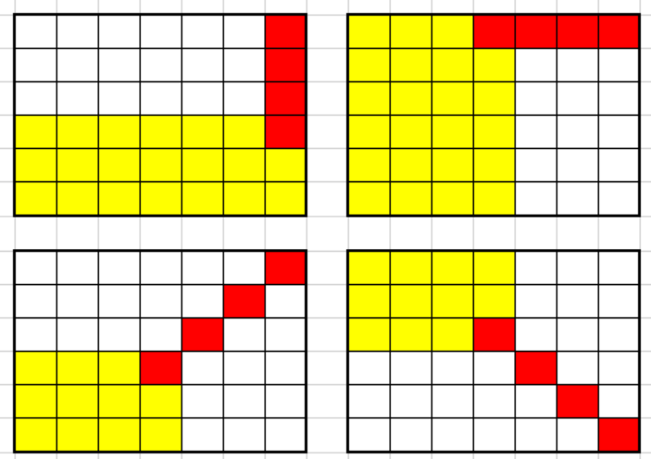
Task 6 – Adjust Board Dimensions
Initial board has 8 rows, traditionally Connect4 board has 7 (UI is not changed but game logic)
Board dimension determines the number of possible positions from where to win the game
// FH: vector of the capacity of win conditions
// Offset of 3 is necessary to get all positions were 4 pieces can be next to each other
int horizontalWins = NUMBER_OF_ROWS * (NUMBER_OF_COLUMNS - 3);
int verticalWins = NUMBER_OF_COLUMNS * (NUMBER_OF_ROWS - 3);
// For diagonal wins we must get all possible positions from
which
// we can achieve a diagonal line and multiply it by 2 since we can
// either get it right/left diagonal
int diagonalWins = 2 * ((NUMBER_OF_COLUMNS -3) * (NUMBER_OF_ROWS-3));
int allPossibleWins = horizontalWins + verticalWins + diagonalWins;
https://roboticsproject.readthedocs.io/en/latest/ConnectFourAlgorithm

Slide 20
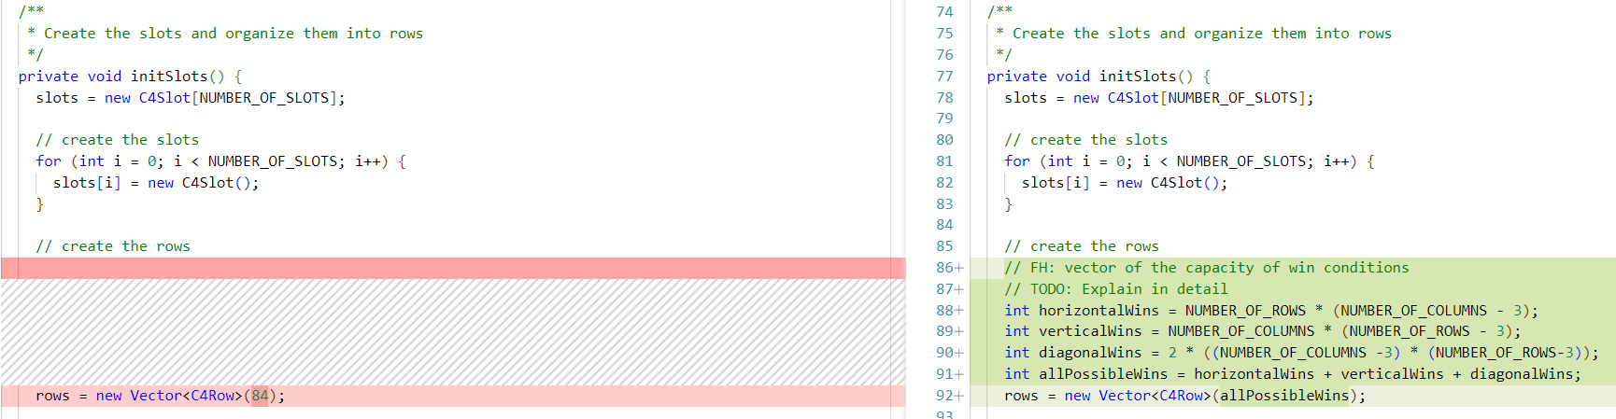

Slide 21
Task 7 – Board Evaluation Heuristic
Strength of the position of each player cannot be determined deterministically – use heuristic estimation
Player strength is weighted sum of number of occurrences of 3, 2 and 1 pieces in any row combination
3 pieces are weighted with factor 64, 2 pieces with 16, 1 pieces with 1, multiplication is done via bitshifting (speed)
return
(p1_2InARow << SHIFT_2_IN_A_ROW) +
(p1_3InARow << SHIFT_3_IN_A_ROW) +
p1_1InARow;

Slide 22
Task 8 – Why not always win?
Early Pruning can occasionally lead to missing the optimal move
The pruning mechanism optimizes search by avoiding suboptimal branches (efficiency)
However, it may prune a winning move if a "good enough" move is found first
Notes:
Original Code: The issue you described where the computer could win in one move but doesn't do so can be attributed to the pruning mechanism in the Minimax algorithm with Alpha-Beta pruning.
In the given code, the `expandMaxNode` and `expandMinNode` methods implement the pruning logic. The pruning is based on the `parentMinimum` and `parentMaximum` values, which represent the best scores found so far by the parent nodes.
The pruning works as follows:
- In the `expandMaxNode` method, if a child node returns a score greater than `parentMinimum`, the method immediately returns that score without exploring further moves. This is because the parent min node will not choose any score greater than its current minimum.
- Similarly, in the `expandMinNode` method, if a child node returns a score less than `parentMaximum`, the method immediately returns that score without exploring further moves. This is because the parent max node will not choose any score less than its current maximum.
The pruning mechanism is designed to optimize the search by avoiding the exploration of branches that are guaranteed to be suboptimal. However, this can sometimes lead to situations where the algorithm prunes a winning move because it has already found a "good enough" move.
For example, let's say the computer is the max player and has two possible moves: Move A leads to a guaranteed win in one move, while Move B leads to a winning position but requires more moves. If the algorithm explores Move B first and finds a score that is greater than the initial `parentMinimum`, it will prune the remaining moves, including Move A. As a result, the computer may choose Move B instead of the immediate winning Move A.
To mitigate this issue, you can consider the following approaches:
1. Increase the depth of the search: By increasing the search depth, the algorithm will explore more moves and have a higher chance of finding the optimal winning move.
2. Adjust the pruning threshold: Instead of pruning based on strict inequality, you can introduce a small threshold value. For example, in the `expandMaxNode` method, you can modify the condition to `if (strength > parentMinimum + threshold)` to allow the exploration of moves that are slightly better than the current best move.
3. Implement additional heuristics: You can incorporate additional heuristics or rules to prioritize certain moves, such as checking for immediate winning moves before applying the Minimax algorithm.
Keep in mind that the effectiveness of these approaches may depend on the specific characteristics of the game and the trade-off between search depth, computational resources, and the desired level of play. The flowchart highlights the pruning mechanism where moves are undone and strengths are returned if they exceed the parentMinimum (in the Max node) or fall below the parentMaximum (in the Min node). This pruning can lead to missing winning moves if a "good enough" move is found early in the search. Updated Code: The provided code includes the implementation of the Minimax algorithm with Alpha-Beta pruning for a Connect Four game. The code has been modified to address the issue mentioned in the previous question.
The main changes made to the code are:
1. In the `expandMaxNode` method:
- The `parentMinimum` parameter has been renamed to `alpha` to align with the standard terminology used in Alpha-Beta pruning.
- The condition for pruning has been changed from `if (strength > parentMinimum)` to `if (strength >= beta)`. This ensures that the pruning occurs when the current node's strength is greater than or equal to the beta value received from the parent.
- The `maxStrength` variable has been replaced with `alpha`, and it is updated whenever a better score is found.
2. In the `expandMinNode` method:
- The `parentMaximum` parameter has been renamed to `beta` to align with the standard terminology used in Alpha-Beta pruning.
- The condition for pruning has been changed from `if (strength < parentMaximum)` to `if (strength <= alpha)`. This ensures that the pruning occurs when the current node's strength is less than or equal to the alpha value received from the parent.
- The `minStrength` variable has been replaced with `beta`, and it is updated whenever a better score is found.
With these changes, the pruning mechanism in the Alpha-Beta algorithm has been corrected. The algorithm will now properly prune branches that are guaranteed to be suboptimal, considering both the alpha and beta values.
The question "Sometimes the computer can win in one move, but does not do so. Can you explain why?" is no longer applicable to this updated code. The modified Alpha-Beta pruning implementation should now correctly identify and choose the winning move whenever possible, as long as the search depth is sufficient and the heuristic evaluation function is accurate.
The updated code addresses the pruning issue and should improve the computer player's decision-making, reducing the chances of missing an immediate winning move. In the Max node, if the strength is greater than or equal to beta, the move is pruned. In the Min node, if the strength is less than or equal to alpha, the move is pruned.

Slide 23
Task 8 – Example
Computer is the max player with two possible moves
Move A: Guaranteed win in one move
Move B: Winning position, but requires more moves
If Move B is explored first and its score exceeds the initial parentMinimum
The algorithm prunes remaining moves, including the optimal Move A
Resulting in the computer choosing Move B instead of the immediate win (Move A)

Slide 24
Task 1 - Measurements
Observe number of evaluated moves for each turn
Moves/Task | 1 | 2 | 3 | 4 | 5a | 5b | Combined
1 | 1 426 | 4 680 | 1 208 | 993 | 4 680 | 302 | 302
2 | 925 | 4 680 | 771 | 642 | 4 680 | 457 | 457
3 | 867 | 4 680 | 817 | 676 | 4 568 | 649 | 649
4 | 1 657 | 4 623 | 1 337 | 1 145 | 4 624 | 310 | 310
5 | 1 249 | 4 623 | 1 068 | 916 | 4 608 | 226 | 226
Notes:
Original
Without pruning
Equal to pruning limit
Deep pruning
Order of moves
Without pruning
With pruning

Slide 25
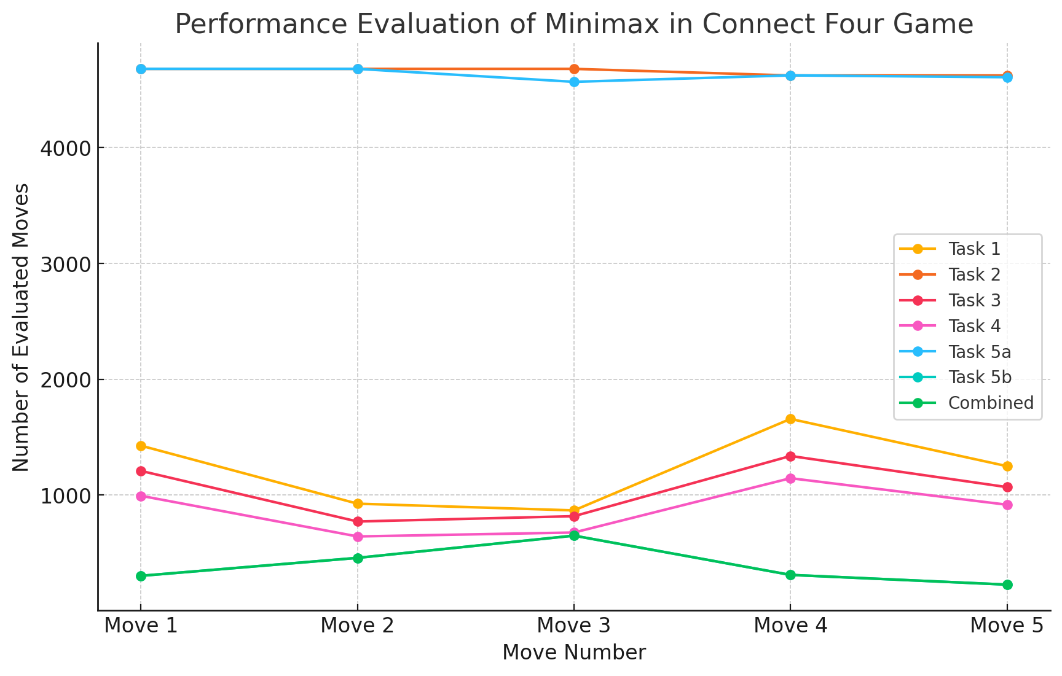
Notes:
Original
Without pruning
Equal to pruning limit
Deep pruning
Order of moves
Without pruning
With pruning

Slide 26
Source
https://github.com/XaverB/connect-four

