Slide 1

beer
Gudic Emrah and Buttinger Xaver
DMML

Slide 2
Beer Recommendation Engine
Notes:
Mustermann likes beer X
Beer X is in cluster C
Find best rated beer in cluster C

Slide 3
Beer Recommendation Engine
Cluster beer by aroma type
Join overall score of beer

Slide 4
Data Investigation
Reading paper
Investigate data sets (especially data set 7)
Remove attributes that accumulate others
Notes:
A_malt_grain ,A_malt_bread ,A_malt_cara ,A_malt_burn ,A_hops_citrus ,A_hops_tropical ,A_hops_noble ,A_hops_woody ,A_esters_ethac ,A_esters_isoaa ,A_esters_flower ,A_esters_fruity ,F_malt_grain ,F_malt_bread ,F_malt_cara ,F_malt_burn ,F_hops_citrus ,F_hops_tropical ,F_hops_noble ,F_hops_woody ,F_esters_ethac ,F_esters_isoaa ,F_esters_flower ,F_esters_fruity ,acidity ,bitternes ,sweetness ,X4vg ,diacetyl ,dms ,metallic ,stale_hops ,t2n ,orange ,coriander ,clove ,lactic ,acetic ,barnyard ,aftertaste ,co2

Slide 5
Clustering
Initially created some basic clusters with our target variable
How to determine the right cluster-size?
Elbow Method
Notes:
Elbow Method:
Run k-means clustering on the data for a range of k values (e.g., 1 to 10).
For each k, calculate the sum of squared distances between data points and their cluster centroid (inertia or within-cluster sum of squares).
Plot the inertia against the number of clusters k.
Look for the "elbow point" in the plot where the rate of decrease in inertia slows down significantly.
Choose the k value at the elbow point as the optimal number of clusters.

Slide 6
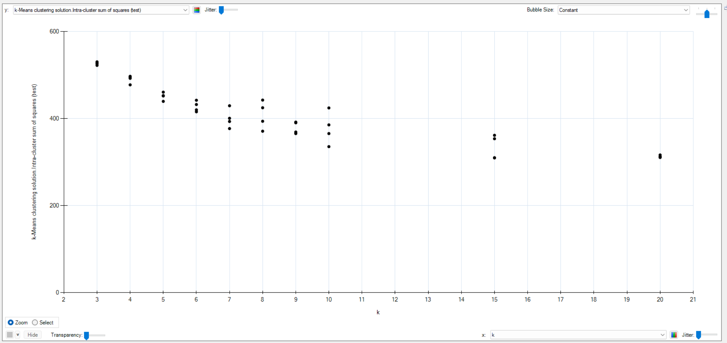
Clustering
The results of multiple runs (statistic relevance) are plotted with heuristic lab:

Slide 7
Cluster Analysis
To calculate the percentage of beer types that are in the same cluster, we can follow these steps:
1. For each cluster, we count the number of beers per beer type.
2. We determine the most common beer type in each cluster.
3. We sum the number of beers of the most common type across all clusters and divide it by the total number of beers.

Slide 8
Cluster Analysis
Cluster | Beer Types | Most Common Type
1 | 1 Brut (100%) | Brut (100%)
2 | 7 Kriek, 4 Lambic, 4 West Flanders ale, 3 Flanders old brown, 2 Faro, 1 Fruitbeer | Kriek (33%)
3 | 4 Hoppy, 1 Saison, 1 Blond, 1 Strong ale | Hoppy (57%)
4 | 6 Fruitbeer, 4 Kriek, 3 Lambic, 2 Christmas, 2 West Flanders ale, 2 Scotch, 1 Low/No alcohol, 1 Wheat, 1 Saison, 1 Faro, 1 Stout/Porter, 1 Brown, 1 Strong ale, 1 Brut, 1 Blond, 1 Tripel | Fruitbeer (23%)
5 | 13 Blond, 10 Tripel, 8 Hoppy, 6 Strong ale, 5 Saison, 5 Stout/Porter, 4 Brown, 3 Brett/cofermented, 3 Amber, 2 Wheat, 1 Flanders old brown, 1 Brut, 1 Pils/Lager, 1 Christmas | Blond (21%)
6 | 10 Strong ale, 4 Stout/Porter, 3 Christmas, 2 Hoppy, 2 Scotch, 2 Brown, 2 Tripel, 1 Dubbel, 1 Amber, 1 Brut | Strong ale (36%)
7 | 19 Blond, 15 Tripel, 8 Amber, 8 Wheat, 6 Pils/Lager, 6 Low/No alcohol, 6 Dubbel, 4 Brown, 2 Stout/Porter, 2 Christmas, 1 West Flanders ale, 1 Saison | Blond (21%)

Slide 9
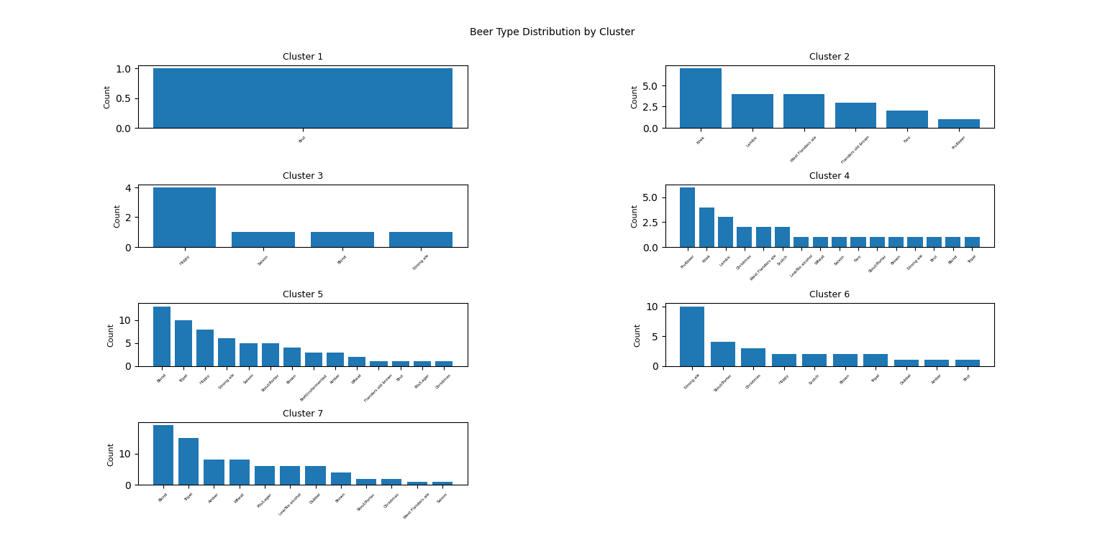

Slide 10
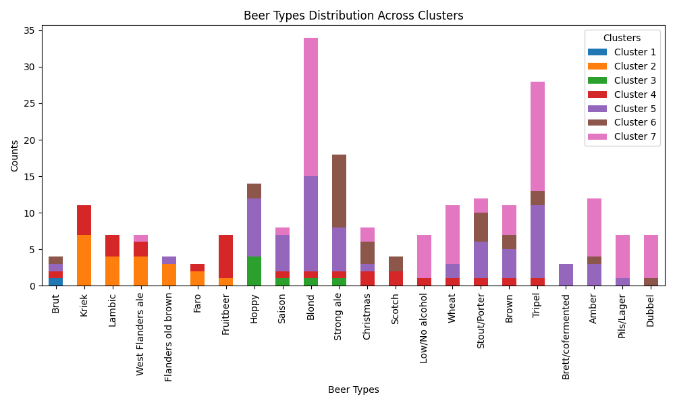

Slide 11
Clustering Question
Does clustering by aroma correlate to the type of beer (like pale ale etc.)?
In total, 84 out of 250 beers (34%) are of the most common type in their respective cluster.
The calculation shows that the same beer types tend to be in different clusters. Only about one-third of the beers are of the most common type in their cluster. The clustering does not seem to strongly correlate with the beer types.

Slide 12
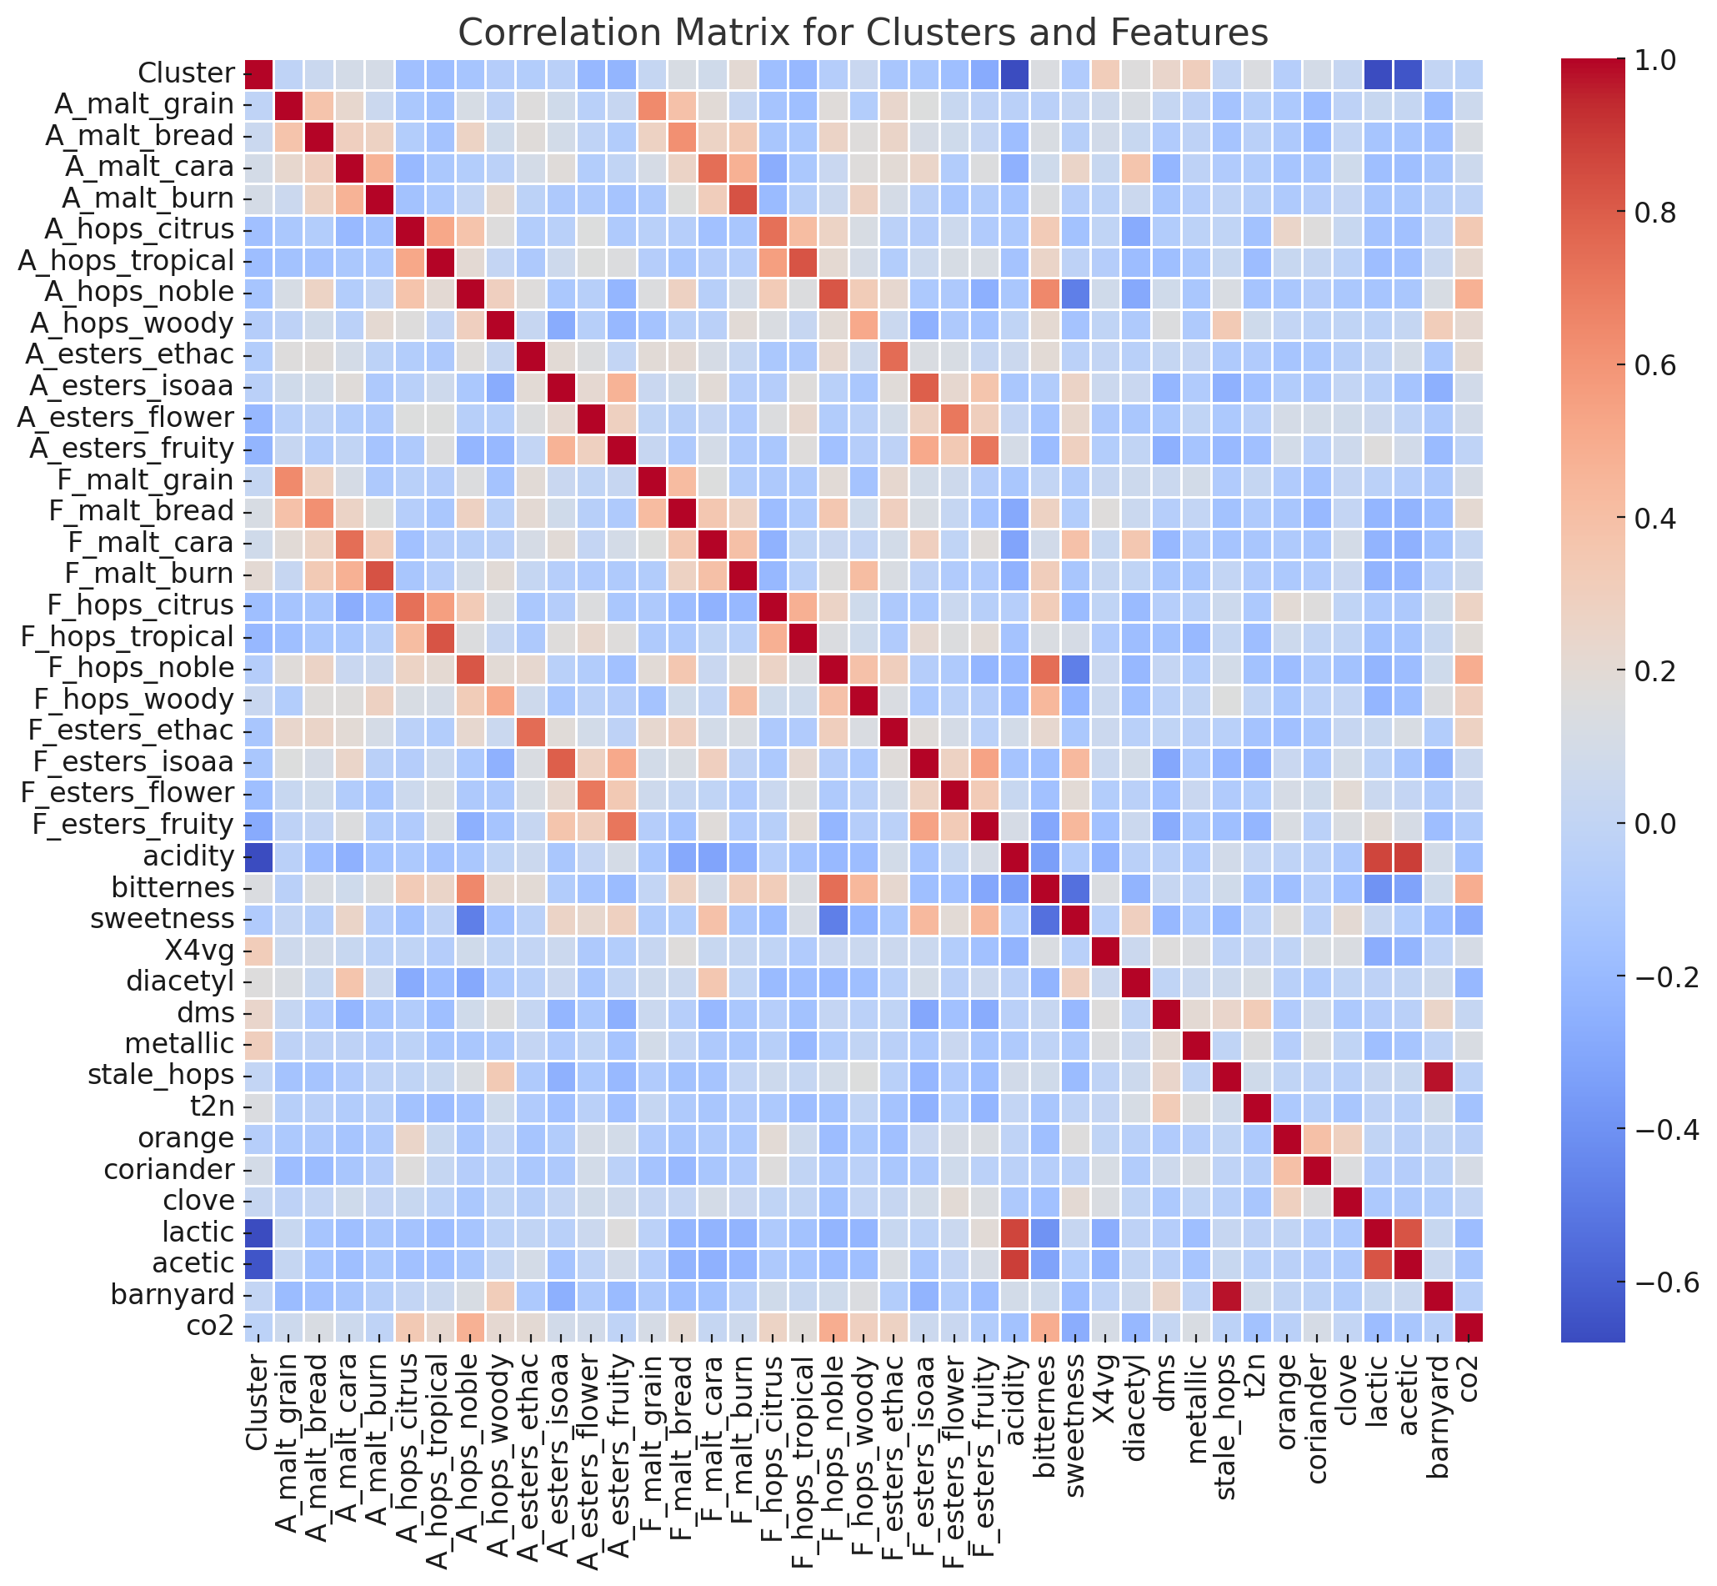

Slide 13
Feature Analysis
Feature Selection aroma per beer type
Which aroma has the most impact regarding the beer type classification?

Slide 14
Learnings
Questions on unknown data sets are pretty hard to formulate
Analyzing data takes a lot of time
Some questions might not be answered

Slide 15
Pitfalls

Slide 16
Conclusio

