Slide 1
Continuous Improvement Pipeline
Group 6

Slide 2
CI Pipeline
Example of a CI pipeline with relevant software examples
Talk about a few specific software and how and where it can be integrated into our example.

Slide 3
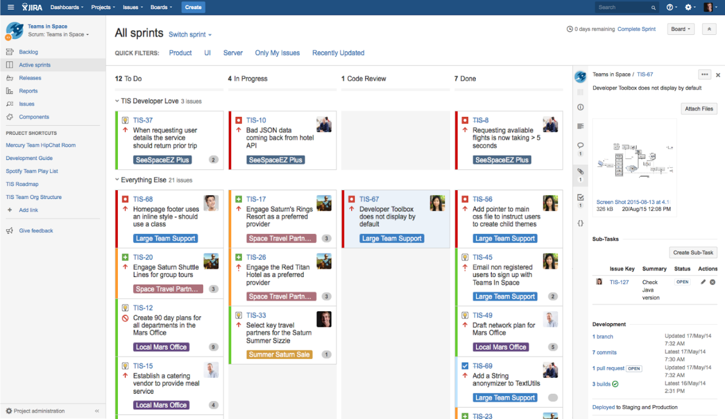
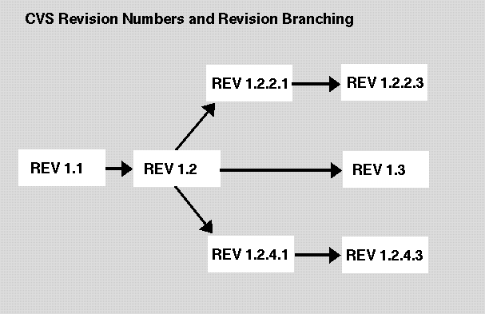

Developers
Push
Update Work
Source Code
Version Control System
Project Tracking
Pull
Get Work
CI PIPELINE

Slide 4

Developers
Push
Update Work
Source Code
Version Control System
Project Tracking
Pull
Get Work
Pull Code
Poll Code
CI PIPELINE
DevOps
Build Results
Email server
CI Server
Build Tool
Build Report
Send code
Artefact Repository
Run Tests
Test Results
Send Artefact
Automated Testing

Slide 5

Developers
Push
Update Work
Source Code
Version Control System
Project Tracking
Pull
Get Work
Pull Code
Poll Code
CI PIPELINE
DevOps
Build Results
Email server
CI Server
Build Tool
Build Report
Send code
Artefact Repository
Run Tests
Test Results
Send Artefact
Automated Testing
Testers
Test Artefact
Testing Environment
Staging Environment
Live Environment
Environment Testing Done
Staging Passed

Slide 6
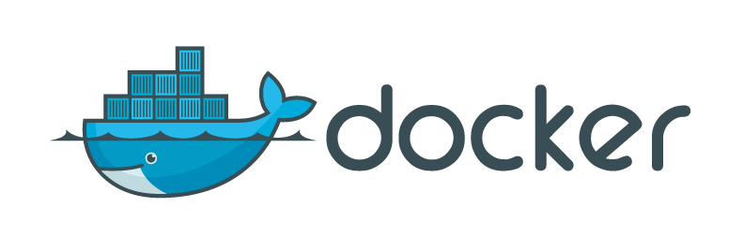
Developers
Push
Update Work
Source Code
Version Control System
Project Tracking
Pull
Get Work
Pull Code
Poll Code
CI PIPELINE
DevOps
Saves Code and packages as an docker.image
These Images can be ran on any machine with the docker Engine installed
Docker Engine effectively sits on top of the OS
Build Results
Email server
CI Server
Build Tool
Build Report
Send code
Artefact Repository
Run Tests
Test Results
Send Artefact
Automated Testing
Testers
Test Artefact
Testing Environment
Staging Environment
Live Environment
Environment Testing Done
Staging Passed

Slide 7

Developers
Push
Update Work
Source Code
Version Control System
Project Tracking
Pull
Get Work
Pull Code
Poll Code
CI PIPELINE
DevOps
Build Results
Email server
CI Server
Build Tool
Build Report
Send code
Artefact Repository
Run Tests
Test Results
Send Artefact
Automated Testing
Testers
Test Artefact
Testing Environment
Staging Environment
Live Environment
Environment Testing Done
Staging Passed

Slide 8

Developers
Push
Update Work
Source Code
Version Control System
Project Tracking
Pull
Get Work
Pull Code
Poll Code
CI PIPELINE
DevOps
Build Results
Email server
CI Server
Build Tool
Build Report
Send code
Artefact Repository
Run Tests
Test Results
Send Artefact
Automated Testing
Testers
Test Artefact
Testing Environment
Staging Environment
Live Environment
Environment Testing Done
Staging Passed

Slide 9

Developers
Push
Update Work
Source Code
Version Control System
Project Tracking
Pull
Get Work
Pull Code
Poll Code
CI PIPELINE
DevOps
Build Results
Email server
CI Server
Build Tool
Build Report
Send code
Artefact Repository
Run Tests
Test Results
Send Artefact
Automated Testing
Testers
Test Artefact
Testing Environment
Staging Environment
Live Environment
Environment Testing Done
Staging Passed

Slide 10

Developers
Push
Update Work
Source Code
Version Control System
Project Tracking
Pull
Get Work
Pull Code
Poll Code
CI PIPELINE
DevOps
Build Results
Email server
CI Server
Build Tool
Build Report
Send code
Artefact Repository
Run Tests
Test Results
Send Artefact
Automated Testing
Testers
Test Artefact
Testing Environment
Staging Environment
Live Environment
Environment Testing Done
Staging Passed

Slide 11
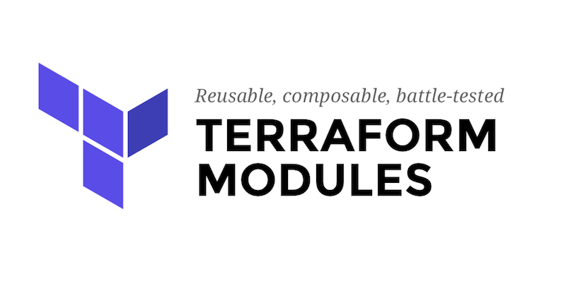
Developers
Push
Update Work
Source Code
Version Control System
Project Tracking
Pull
Get Work
Pull Code
Poll Code
CI PIPELINE
DevOps
Build Results
Email server
CI Server
Build Tool
Build Report
Send code
Artefact Repository
Run Tests
Test Results
Send Artefact
Automated Testing
Testers
Test Artefact
Testing Environment
Staging Environment
Live Environment
Environment Testing Done
Staging Passed

Slide 12
Developers
Questions?
CI PIPELINE
DevOps
Testers

