Slide 1

TRACKING PERSON USING INTELLIGENT SURVEILLANCE
Under the Guidance of
Dr. Pritam Dhumale
HOD & Associate Professor
Project Team Members
Abubakar Momin 2JR18CS001
Shreya Hukkerikar 2JR19CS072
Xavier Dias 2JR19CS098
Yunus Ilkal 2JR20CS428

Slide 2
CONTENTS
INRODUCTION
LITERATURE SURVEY
HARDWARE & SOFTWARE REQURIMENTS
METHODOLOGY
SCREENSHOTS
CONCLUSION
REFERENCES

Slide 3
INTRODUCTION
Reports of missing persons worldwide have increased significantly in the past recent years, from roughly 4,50,000 in 2018 to about 10,00,000 this year.
The currently available Manual System for finding missing person have very long procedure and takes more time. More time is require for launching an FIR (First Information Report) in police station.
Out of the reported number,40% are located after a long period of search while 30% are left untraced. Only 30% of the reported victims are found within a reasonably short period of up to 3 months.
The aim here is to build a project to find missing person, which will be very convenient to common people so that they can find their loved ones within short span of time.
The goal was to come up with a prototype of a solution for finding missing persons fast enough within short span of time.

Slide 4
LITERATURE SURVEY
[1] "Finding missing persons using Ml,Ai",Neha Gholape,Ashish Gour,Shivam Mourya, 2021.
The purpose was to make system which will help to find missing persons by their face recognition using Machine Learning, Deep Learning and Artificial Intelligence.The aim here was to make a dynamic system which will be having the prediction outcome probability higher even if change in image.
[2] “Real Time Face Detection using CCTV Camera",Nirmal Kumar Saraswat, Arvinda Kushwaha, 2019
Closed Circuit Television i.e. CCTV are widely for security purposes getting the opportunity to be useful with time.Using smart CCTV technology face recognition is possible that filter out the POI from the human face image.
[3] "Crime Reporter and Missing Person Finder",Pranay Thali, Dhiraj Mujmule, Ankit Bhingarde, Prof. Yogesh Salve,2018
The idea was about how interface should be for adding new complaint (How add complaint form user) from this android application.The method used is Agile software development.

Slide 5
LITERATURE SURVEY
[4] "MISSING INFANT FINDER ANDROID APPLICATION" Vivek C Shet, Mr.Srinivasulu M, 2018
It uses an Android mobile device to take pictures, submit them to the application, and then receive results based on face detection.The SWF-SIFT techniques are used.
[5] "CCTV-Based Surveillance System with Face Recognition Feature"Michael Bryan P. Lumaban, Giged T. Battung,2017
The study explored the application of the thee face recognition algorithms, namely Local Binary Pattern Histogram, Eigenface, and Fisherface. The LBPH algorithm was determined to have the highest face recognition rate, with a 95.92% accuracy rate.

Slide 6
HARDWARE AND SOFTWARE REQIREMENTS
These requirements include the minimum processor speed, memory, and disk space required to install Windows.
Laptop / Computer
Processor : Any processor above 1GHz
RAM : Above 512 Mb
ROM : 4Gb
A condition or capability needed by a user to solve a problem or achieve an objective.
Operating System : Windows 7+
Server side Script : Python 3.7+
IDE : PyCharm/ visual studio code

Slide 7
Register the target person
METHODOLOGY
Analyze the image
CNN Classifier
Track the person
Fetching the Details

Slide 8
REGISTER THE TARGET PERSON
Collect personal information
Verify identity
Record the information
Ensure data security and privacy
Analyze the image
Register the target person
CNN Classifier
Track the person
Fetching the Details

Slide 9
ANALYZE THE IMAGE
Image acquisition: The first step is to acquire an image or a set of images through various sources, such as cameras, scanners, satellites, or drones.
Image segmentation: The image is then segmented or partitioned into regions of interest based on certain characteristics, such as color, texture, shape, or intensity. This step helps to isolate the relevant parts of the image for further analysis.
Feature extraction: Features or attributes of the image are then extracted, such as edges, corners, lines, curves, shapes, or textures. This step helps to quantify the visual information in the image and represent it in a more meaningful and useful way.
Register the target person
CNN Classifier
Track the person
Analyze the image
Fetching the Details

Slide 10
FACE RECOGNITION
Face detection
Face alignment
Feature extraction
Face matching
Register the target person
CNN Classifier
Analyze the image
Fetching the Details
Face Recognition

Slide 11
CNN Classifier
Data Collection
Data Preprocessing
Face Detection
Train a CNN
Evaluation
Fine-tuning
Feature Matching
Classification or Verification
Performance Optimization
Deployment
CNN Classifier
Register the target person
Analyze the image
Fetching the Details
Face Recognition

Slide 12
FETCHING THE DETAILS
Identify the relevant details
Extract the details
Store the details
Automate the process
Register the target person
Face Recognition
Analyze the image
Track the person
Fetching the Details

Slide 13
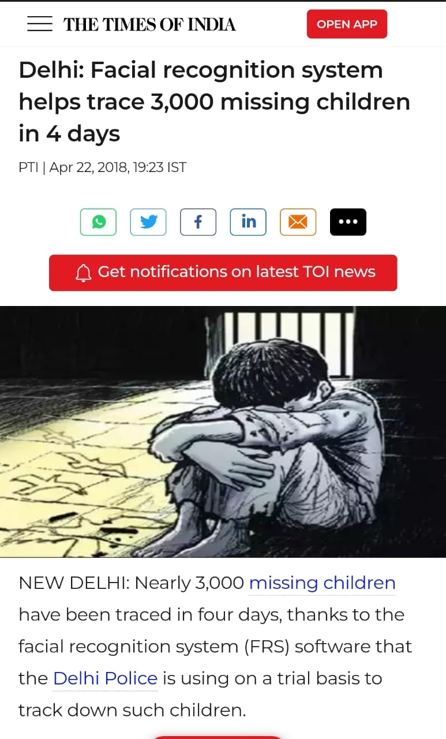
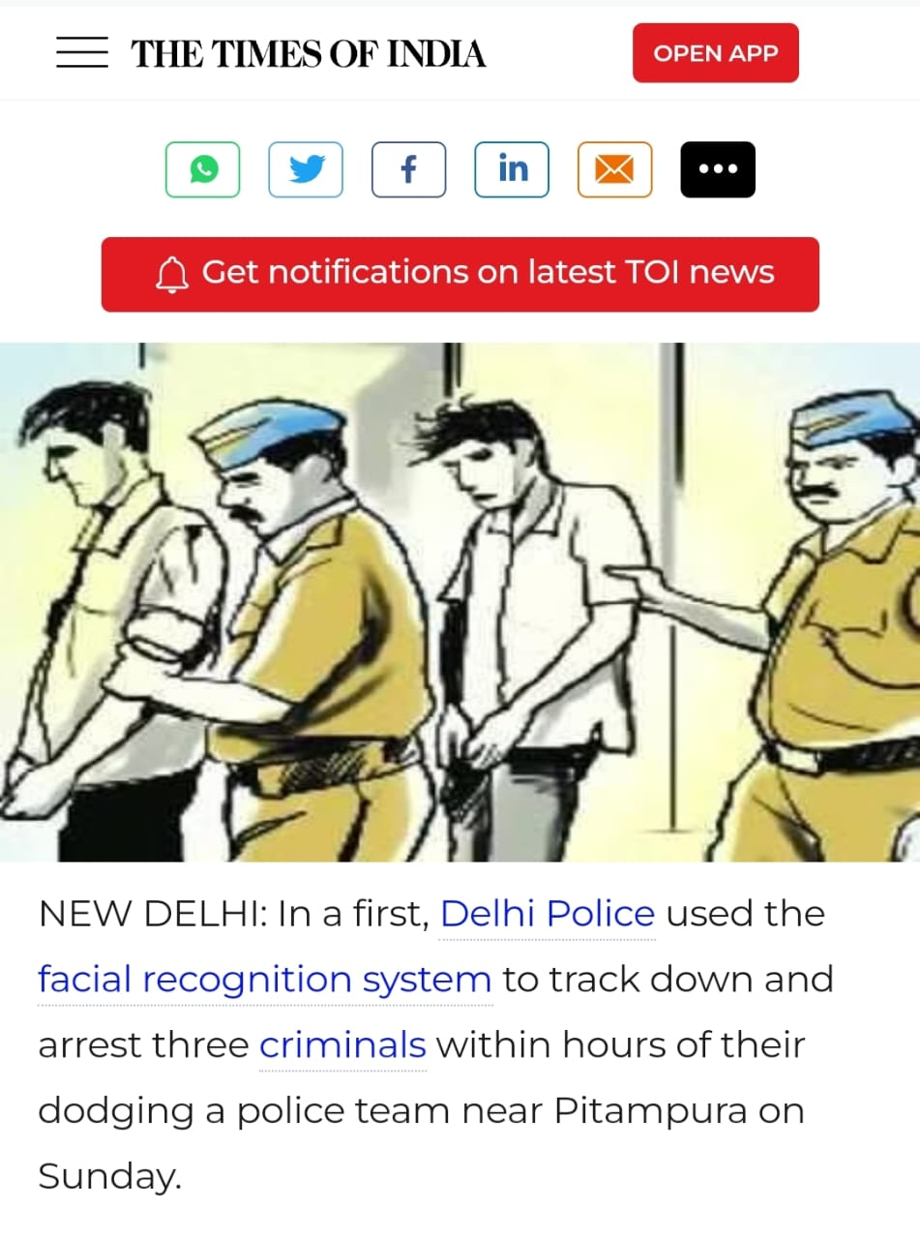
NEWS REPORTS

Slide 14
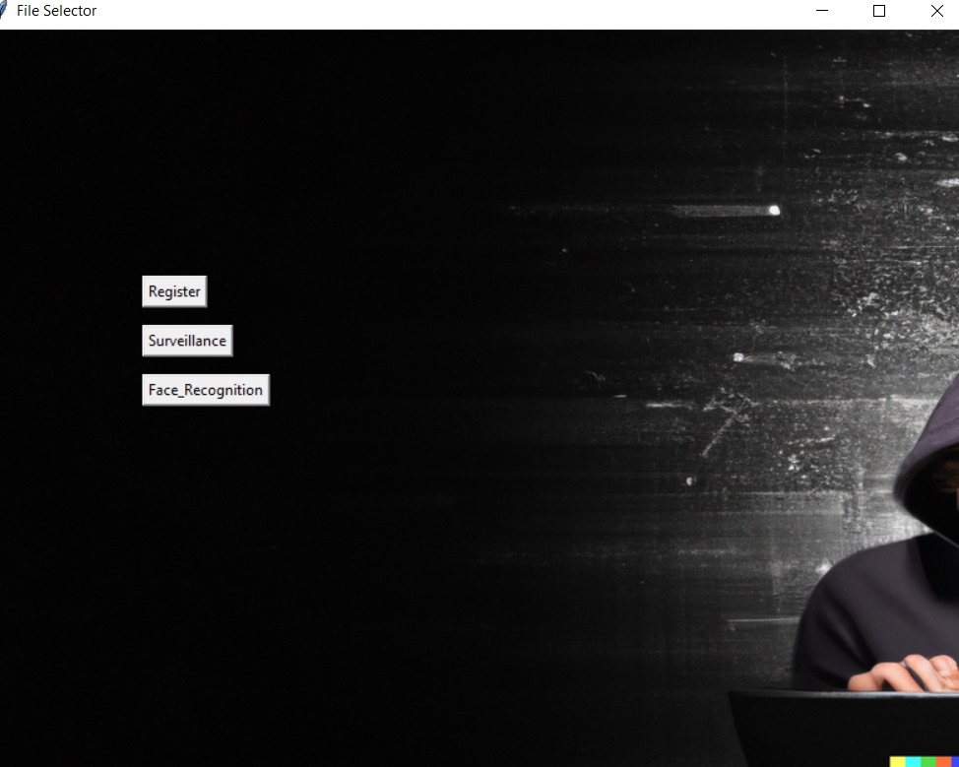
SCREENSHOTS

Slide 15
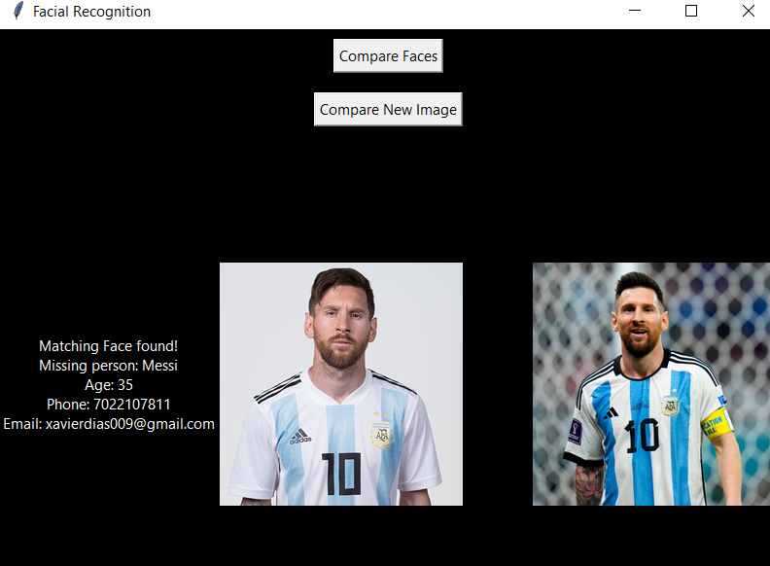
SCREENSHOTS

Slide 16
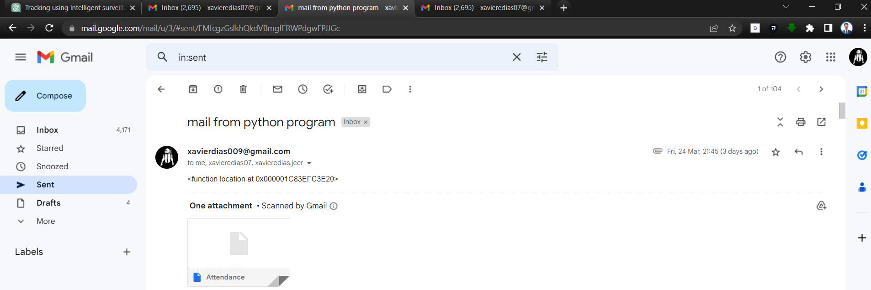
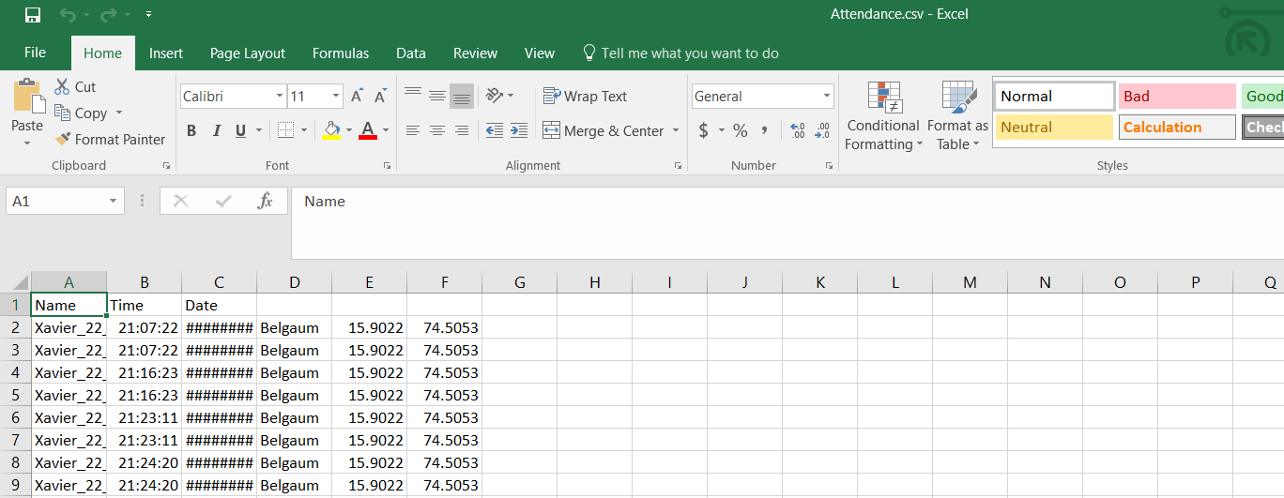
SCREENSHOTS

Slide 17
CONCLUSION
The face recognition model in our system will try to find a match in the database. If a match is found, it will redirect user to that person’s profile is found.
It will be useful to get exact location of the person if match detected with the Google maps integration which makes the police job easy.
Process of identifying the missing people is fastened. Our system replaces the manual scanning process through the databases for each picture to check the match, by an efficient face recognition method which finishes the work in no time.

