Slide 1
RJ12 cable – load cell connection
Cut the blue wire
E+
A+
A-
E-
Shield
Load cell wires

Slide 2
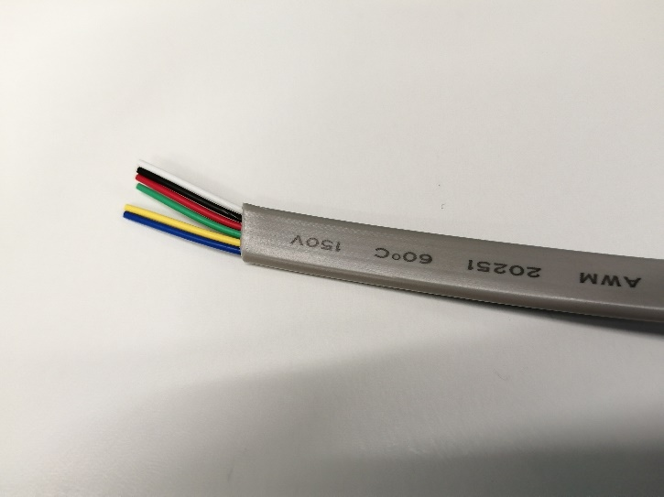
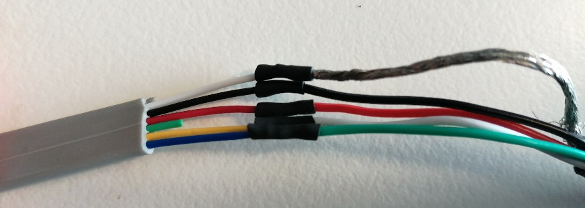

Slide 3
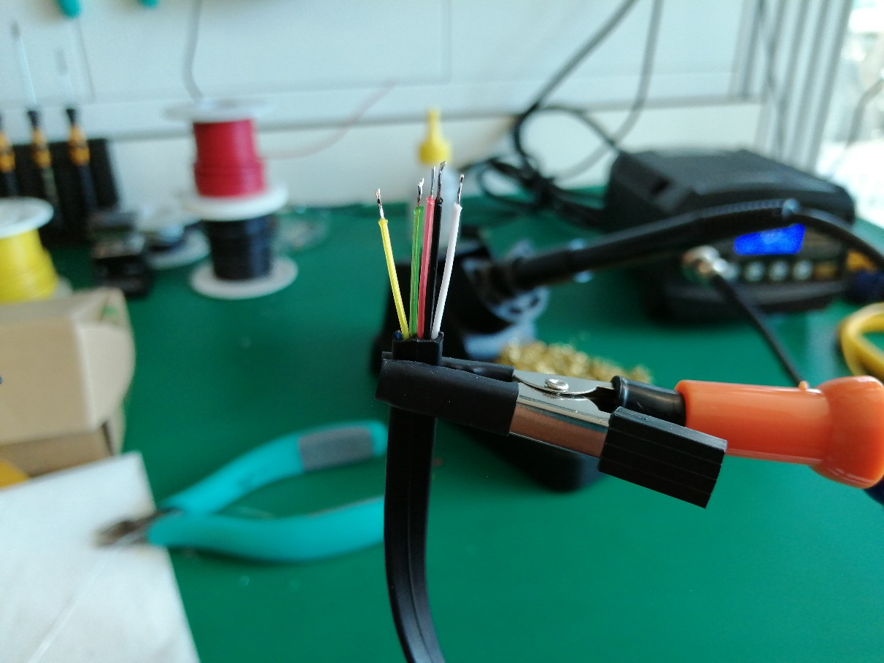
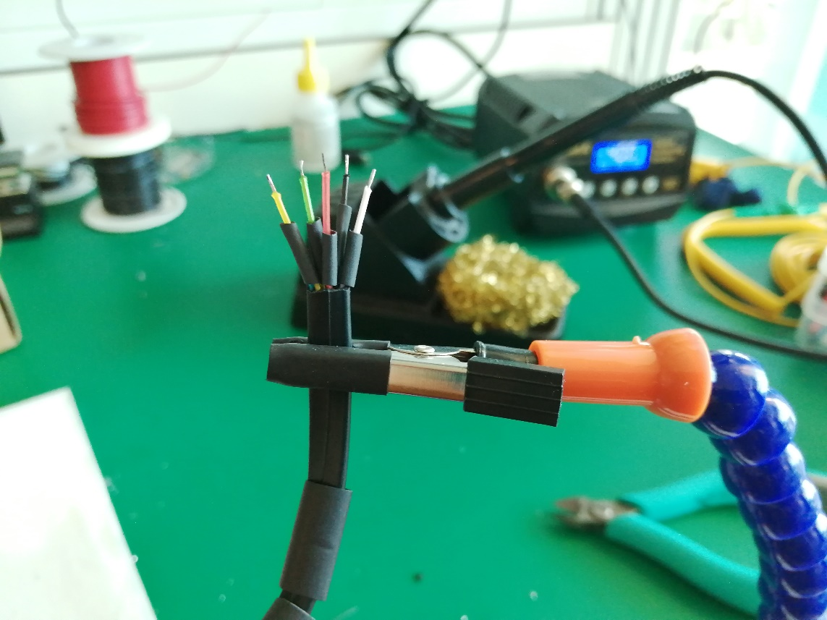
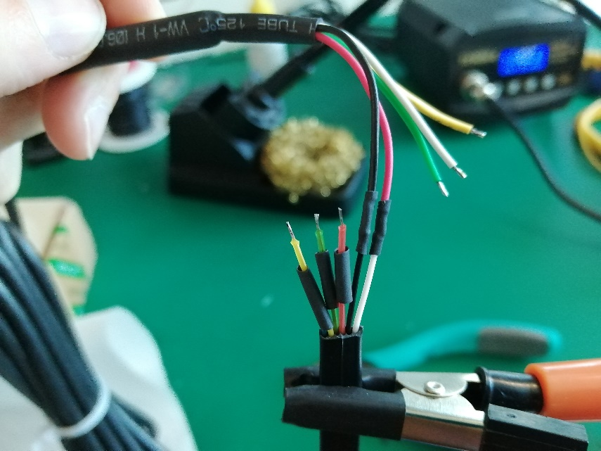
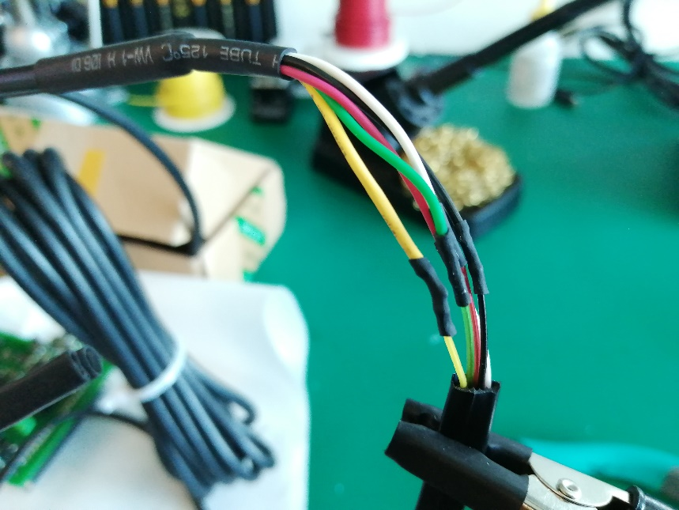
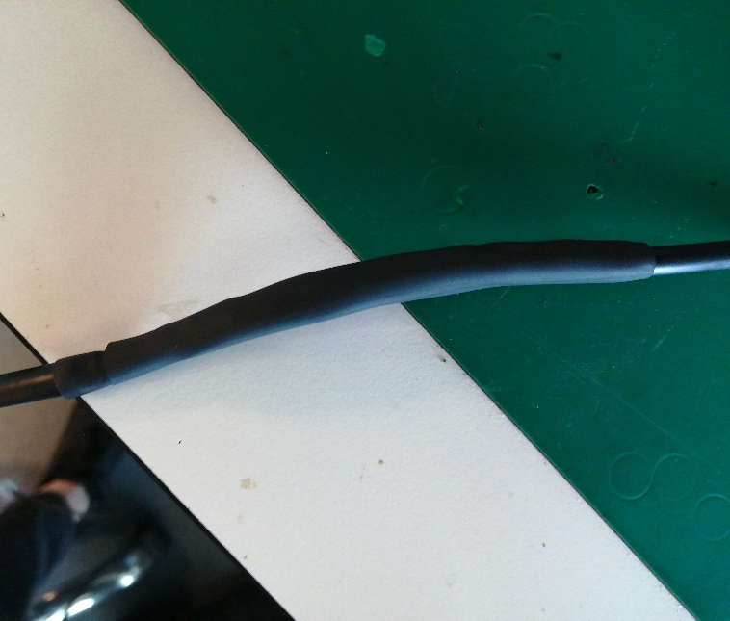
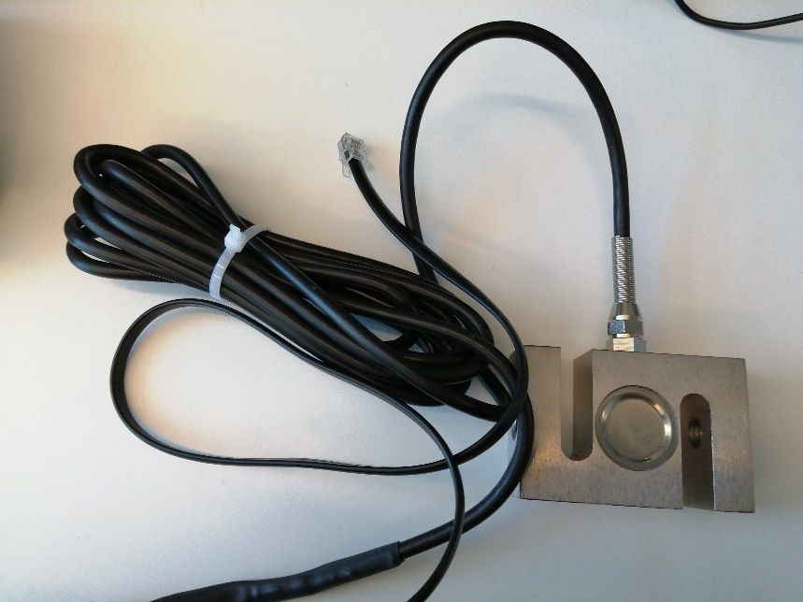
1
2
3
4
5
6

Slide 4
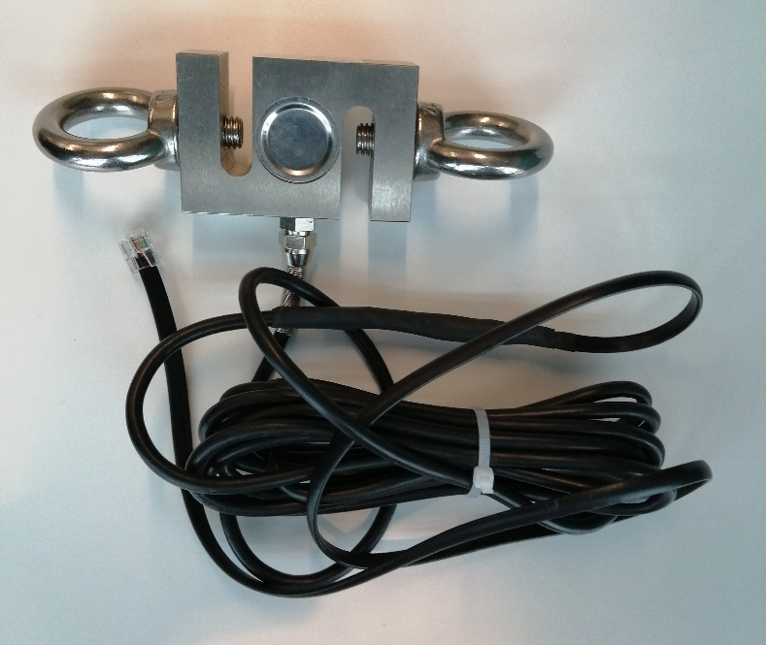
1
2
3
4
5
6

Slide 5
RJ12 cable – optical encoder connection
Cut the green wire
5V
B
A
GND
Shield
Encoder wires

Slide 6
RJ12 cable – load cell connection
RJ12 cable – optical encoder connection
Cut the blue wire
Cut the green wire
E+
A+
A-
E-
5V
B
A
GND
Shield
Shield
Load cell wires
Encoder wires

Slide 7
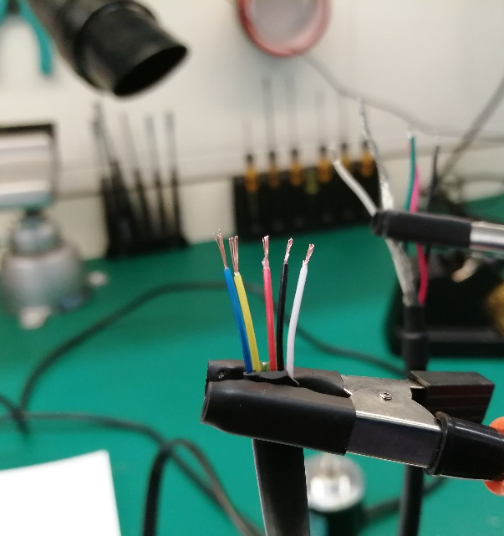
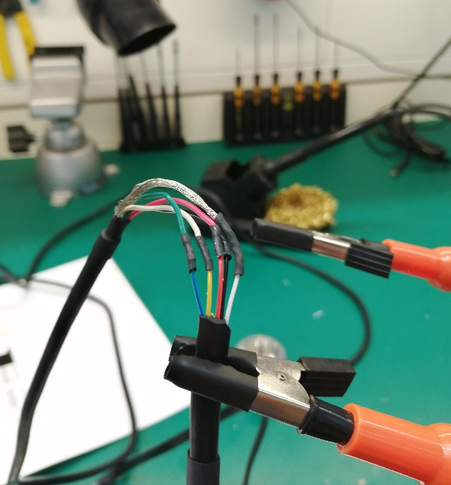
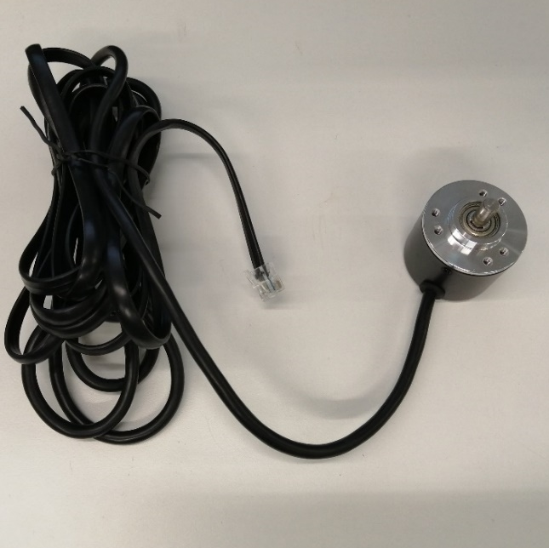
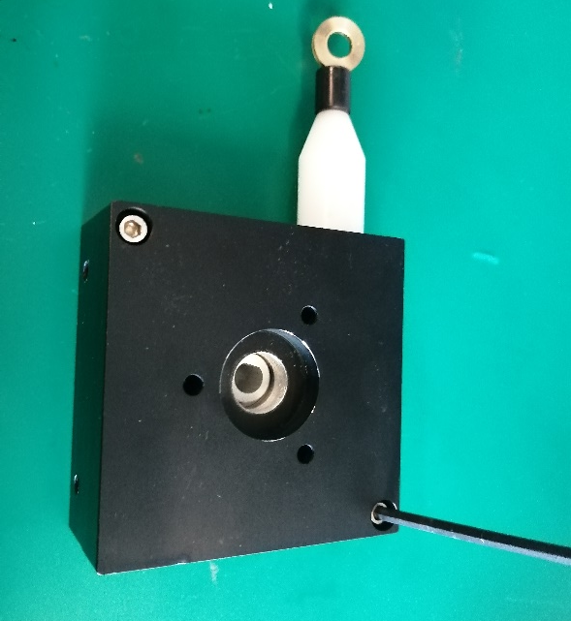
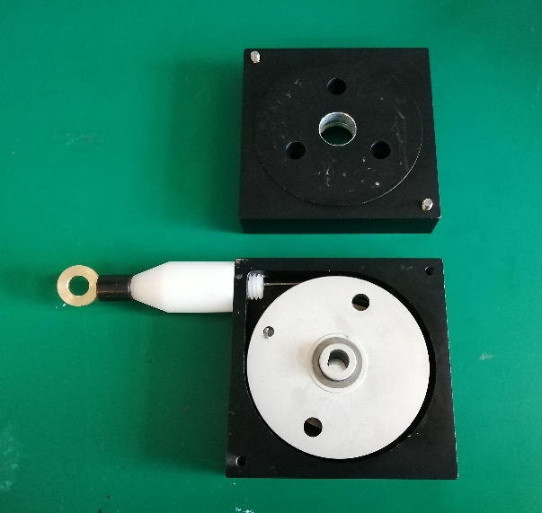
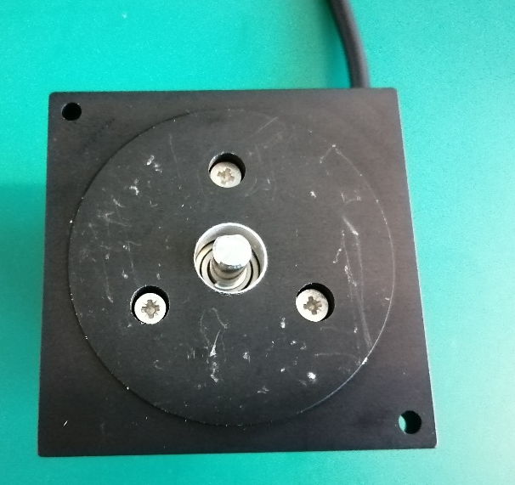
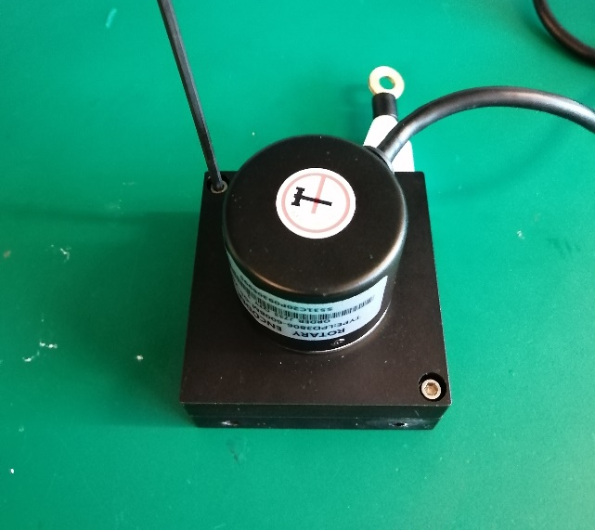
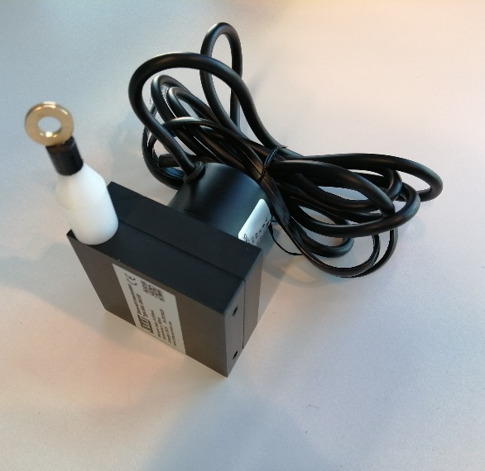
1
2
3
4
5
6
7
8

Slide 8
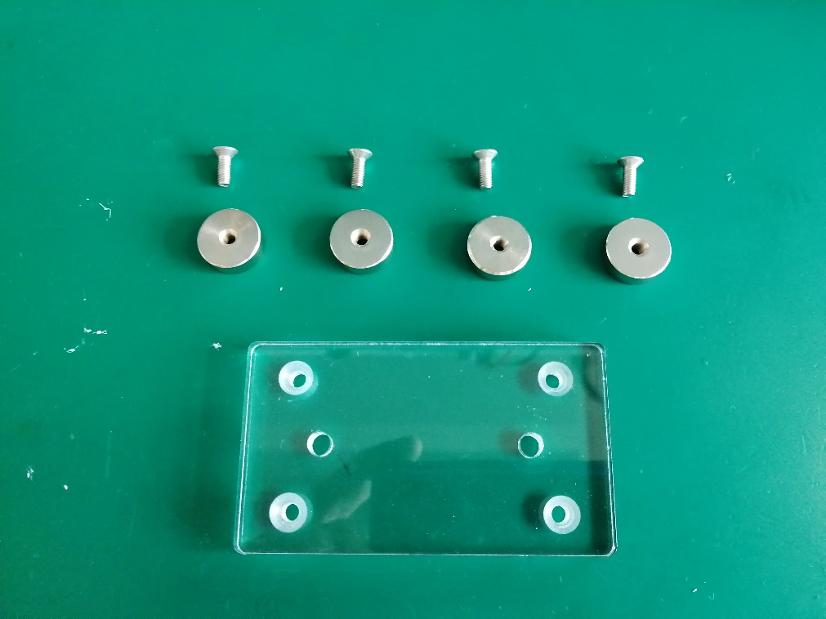
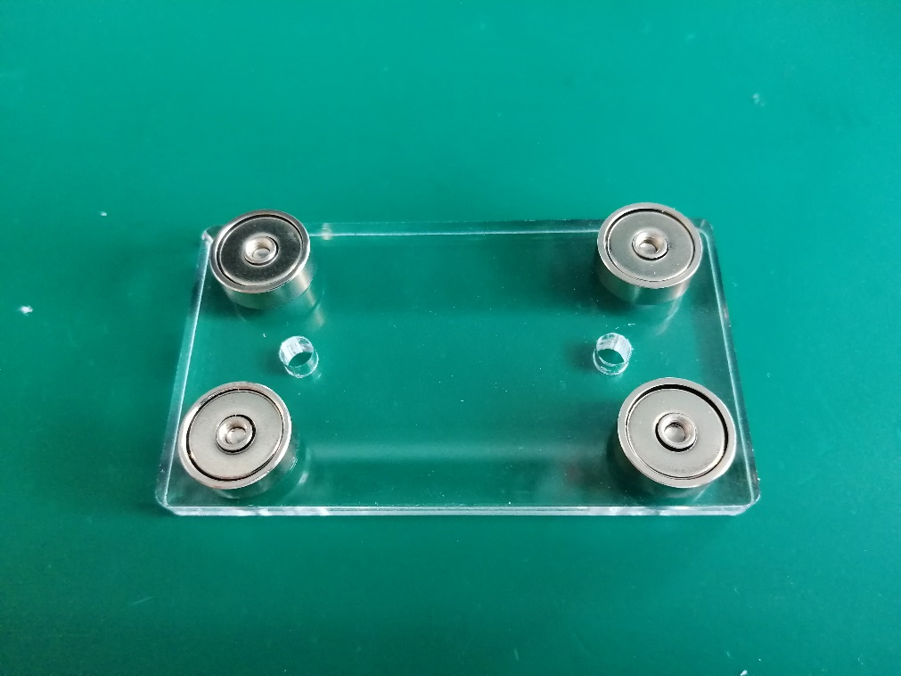
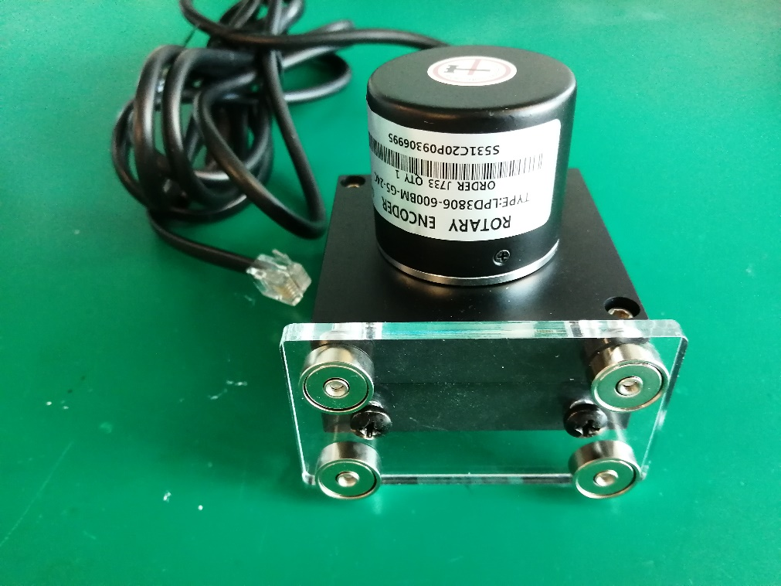
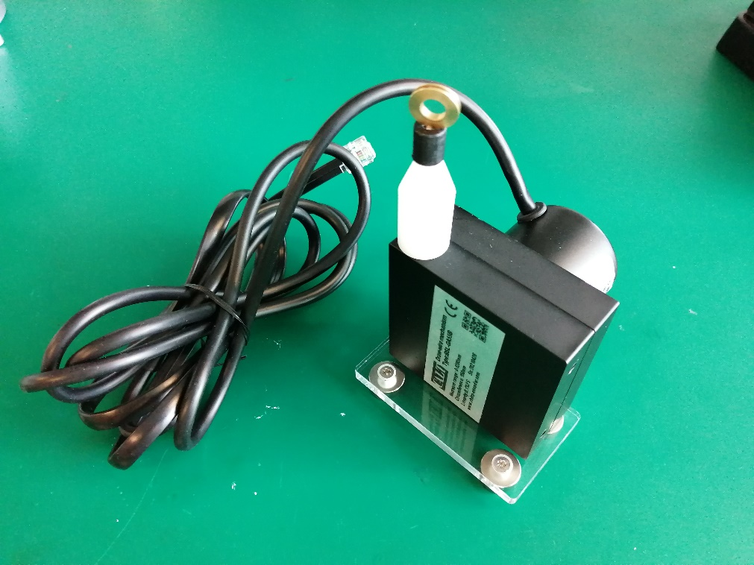
1
2
3
4

Slide 9
RJ12 cable – resistive sensor connection
Cut the blue, yellow and white wires
5V
GND
Signal
Resistive sensor wires

Slide 10
RJ12 cable – load cell connection
RJ12 cable – optical encoder connection
RJ12 cable – electrogoniometer connection
Cut the blue wire
Cut the green wire
Cut the blue, yellow and white wires
A+
5V
B
A
5V
E+
A-
GND
E-
GND
Shield
Shield
Signal
Load cell wires
Encoder wires
Electrogoniometer
sensor wires

