Slide 1
EECS4030: Computer Architecture Memory Hierarchy (III)
Prof. Chung-Ta King
Department of Computer Science
National Tsing Hua University, Taiwan
(Adapted from textbook slides https://www.elsevier.com/books-and-journals/book-companion/9780128122754/lecture-slides)

Slide 2
Outline
Introduction to memory hierarchy (Sec. 5.1)
Memory technologies (Sec. 5.2, 5.5)
Caches (Sec. 5.3, 5.4, 5.9)
Virtual memory (Sec. 5.7)
Framework for memory hierarchy (Sec. 5.8)
Virtual machines (Sec. 5.6)
Parallelism and memory hierarchies: cache coherence, redundant arrays of inexpensive disks (Sec. 5.10, 5.11)

Slide 3
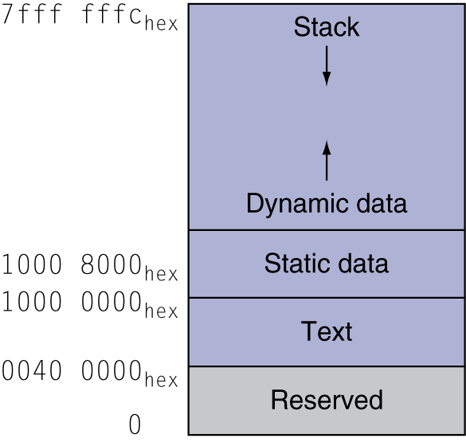
Virtual Memory (VM)
Provide each running program an illusion of a large, private main memory that can be accessed at the speed of physical memory (cache+DRAM)
Each program has own address space (virtual address space) accessible to itself only
Physical memory may be much smaller
Virtual

Slide 4
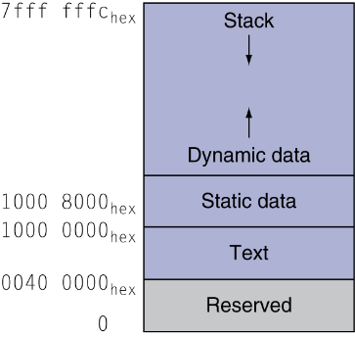
Virtual Memory (VM)
Allow many such programs to run at once with protection and sharing (of physical memory)
Running Program 1
Physical Memory
$
…
Running Program n

Slide 5
Virtual Memory
Such an illusion is supported by the memory hierarchy between physical main memory (DRAM) and secondary storage (disk)
Main memory acts as a “cache” for disk and takes care of speed
Disk provides the large space
Virtual memory is managed by the operating system (OS) with assistance from CPU hardware
A program in execution is called a process in OS
CPU
Registers
Instr. operands
Cache (SRAM)
Blocks
Memory (DRAM)
Pages
Disk

Slide 6
Basic Virtual Memory Organization
Virtual address space of a process exists in disk and is partitioned into blocks of equal size called pages
OS creates space on disk for “all” the pages in swap space
Physical address space in main memory is partitioned into blocks of the same size called page frames
Actively accessed pages are loaded into empty page frames in main memory and accessed at DRAM speed
Program (and CPU) only sees virtual address space
Thus, ld and sd generate virtual addresses
But cache and memory are accessed by physical addresses
Virtual memory needs to implement address translation from virtual address space to physical address space

Slide 7
RISC-V Virtual Memory
RISC-V supports a variety of VM configurations
Although RISC-V has a 64-bit address, it supports 39-bit, 48-bit, and 57-bit virtual address spaces
All of these configurations use a page size of 4 Kbytes
For 48-bit virtual address scheme:
Size of a page = 4 Kbytes = 2¹² bytes
Size of virtual address space = 2⁴⁸ bytes = 256 Tbytes
Max. number of pages of a process = 2³⁶ pages
Assume size of physical memory = 1 Tbytes = 2⁴⁰ bytes → 40-bit physical address → number of page frames in physical memory = 2²⁸

Slide 8
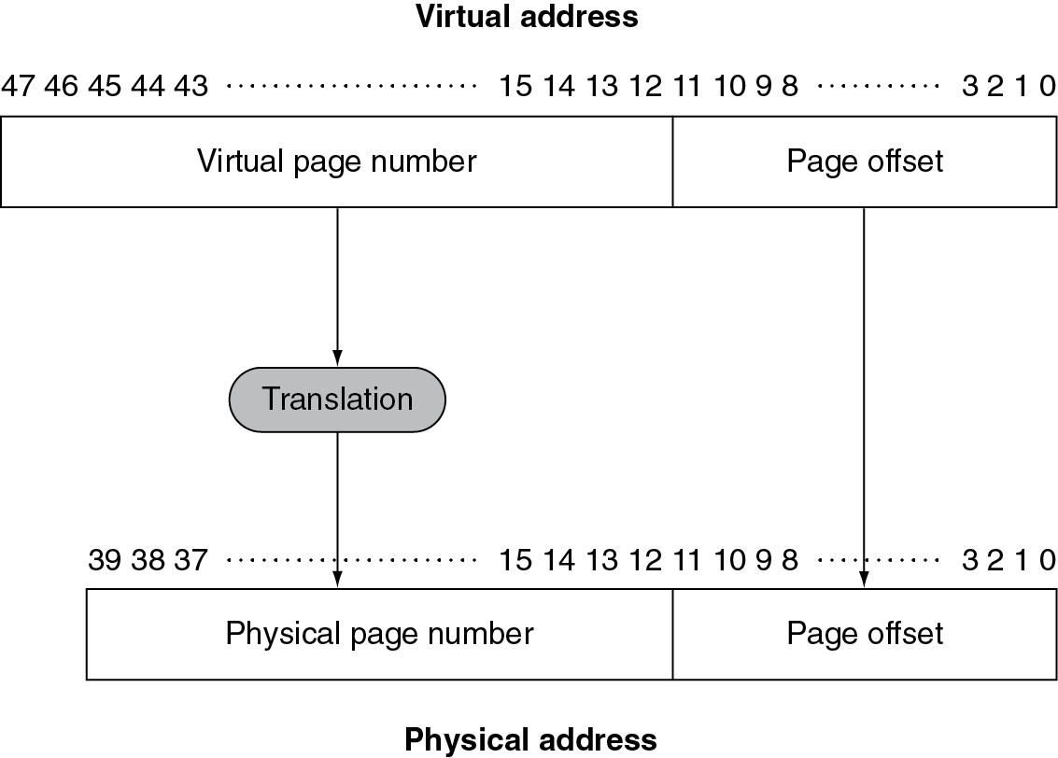
Address Translation
CPU
Fixed-size pages (e.g., 4KB)
Registers
ld x11,0(x20)
48-bit virtual address
From CPU
40-bit physical address
Cache (SRAM)
Memory (DRAM)
No need to translate!
Disk
Who will do address translation?
Fig. 5.26
To cache + memory

Slide 9
Virtual Memory Design Issues
Again, 4 questions for virtual memory design:
Q1: block placement
Q2: block identification
Q3: block replacement
Q4: write policy
But need to add another: → how to do address translation?

Slide 10
Key Factors Affecting Design Choices
Huge miss penalty: millions of cycles for disk access → can be and should be handled by OS
Large blocks (e.g., 4KB) to amortize the high access time
Reducing misses is critical to reduce disk accesses
Can handle misses by sophisticated software in OS instead of hardware, because handling time is much smaller compared to disk access
Write-through expensive → use write-back
Note: VM hit to service cache miss
Address translation is in critical path from CPU to cache
Need hardware support
CPU
Registers
Instr. operands
Cache (SRAM)
Blocks
Memory (DRAM)
Pages
Disk

Slide 11
Q1: Block Placement
Where can a block be placed in upper level (memory)?
For virtual memory: fully associative
That is, a page can be placed in any free page frames in main memory
Why?
Fully associative placement has the lowest miss rate!
Can minimize disk accesses due to misses
Even though fully associative placement is complex and the handling is by software, the handling time is still much smaller than disk access time

Slide 12
Q2: Block Identification
How is a block found if it is in the upper level?
Instead of tag comparison or indexing as in cache, use a page table to store placement information
Consisting of an array of page table entries (PTEs), indexed by virtual page number
Page table register in CPU points to page table, which is stored in physical memory
If page is present in memory
PTE stores the physical page frame number of that page
Plus other status bits, e.g., referenced, dirty, …
If page is not present
PTE can refer to its location in swap space on disk

Slide 13
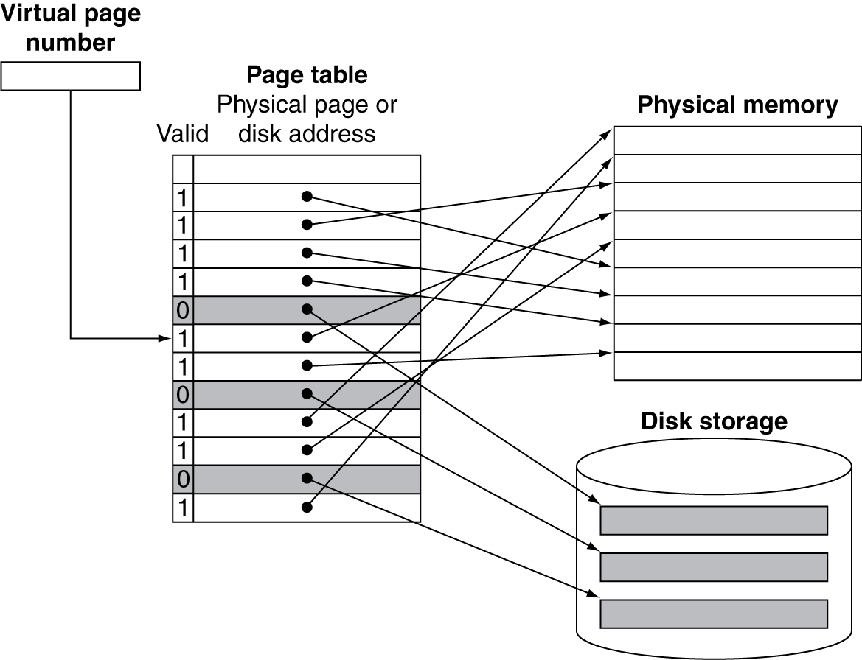
Page Table to Map Pages to Storage
From CPU
e.g., 4KB each
ld x11,0(x20)
$
Memory (DRAM)
Block identification +
address translation
Pages
Disk
In physical memory (huge!)
Fig. 5.28

Slide 14
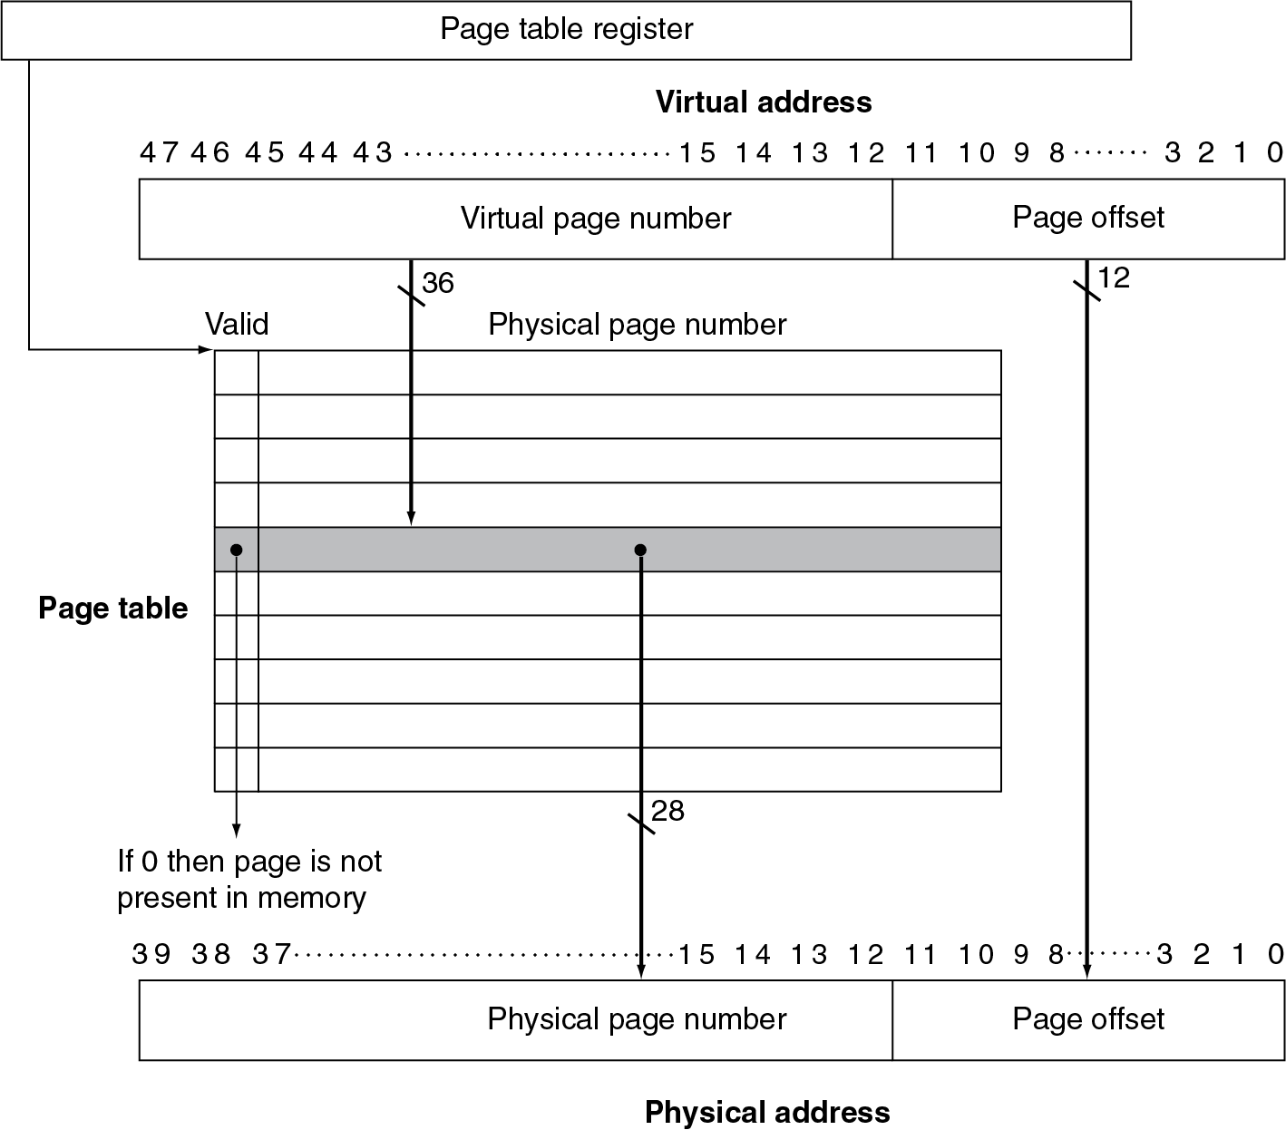
Translation Using Page Table (Conceptual)
From CPU
ld x11,0(x20)
How many memory references for each address translation?
Who will do this?
In physical memory (or cache)
Fig. 5.27
To cache
Physical address space 2⁴⁰ bytes

Slide 15
Fast Translation
Address translation using page table would require extra memory references
One to access the PTE
Then the actual memory access
Basically double number of memory operations
Unfortunately, each memory operation (instruction fetch, ld, sd) requires a page-table access!
If address translation is implemented in software, then CPU has to do these operations by executing some instructions for each memory operation

Slide 16
Fast Translation Using a TLB
Since access to page tables has good locality
So use a fast cache of PTEs within the CPU called Translation Lookaside Buffer (TLB)
Typical: 16~512 PTEs, 0.5~1 cycle for hit, 10~100 cycles for miss, 0.01%~1% miss rate
VA
hit
miss
CPU
TLB
PA
Cache
Main
Memory
Translation
with a TLB
miss
hit
OS
(ISR)
CPU interrupt
data
1/2 t
t
20 t

Slide 17
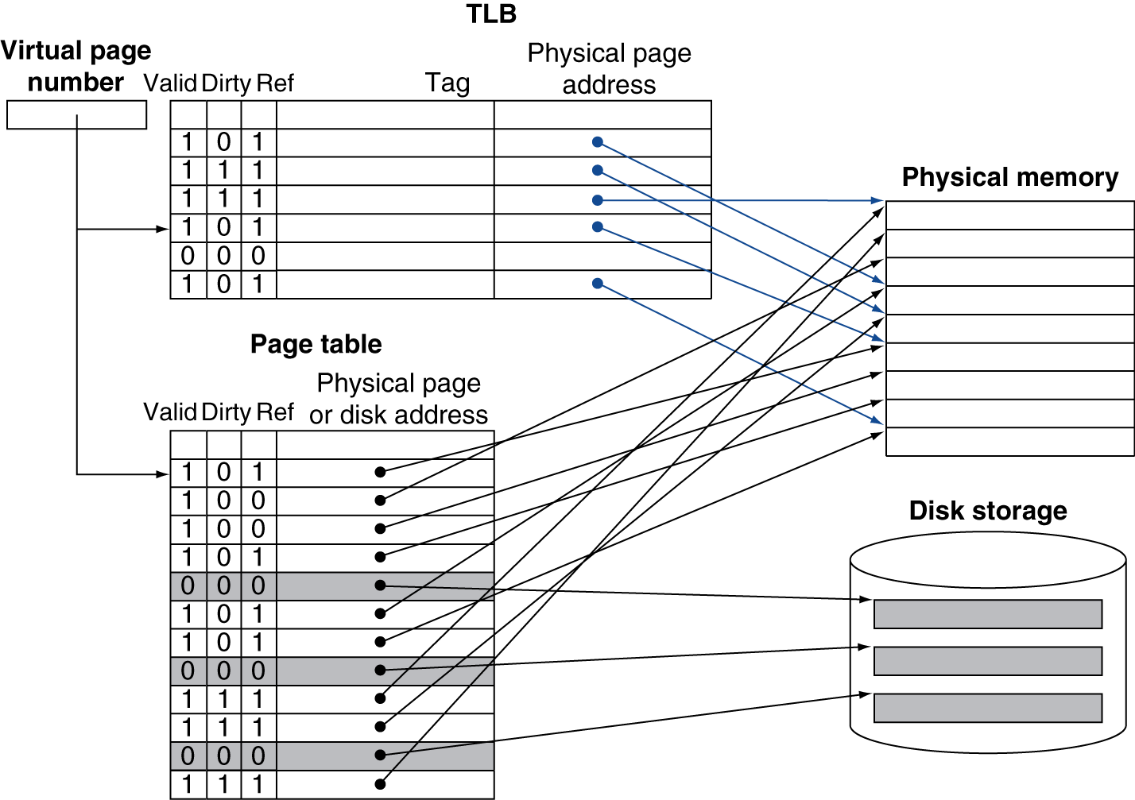
Fast Translation Using a TLB
TLB
Hardware in CPU
Fig. 5.30
Notes:
OS has to keep TLB valid on context switch
• Flush TLB when new process runs (x86)
• Store process id (MIPs)

Slide 18
What Happens When You Miss?
TLB miss (PTE not in TBL) but page is in memory
Load the PTE from page table in memory into TLB and retry
By hardware: may be complex
By software: (around 13 cycles in Intrinsity FastMATH)
Raise an exception before destination register overwritten
CPU jumps to TLB miss routine to find PTE and uses a special set of system instructions to load physical address into TLB
Rerestart the faulting instruction
Notes:
MIPS traditionally handles a TLB miss in software. It brings in the page table entry from memory and then re-executes the instruction that caused the TLB miss. Upon re-executing, it will get a TLB hit. If the page table entry indicates the page is not in memory, this time it will get a page fault exception.
TLB traps to OS on page fault: This is the general address for exception, where OS uses the exception Cause register to diagnose the cause of the exception. Because the exception is a page fault, OS knows that extensive processing will be required. Thus, it saves the entire state of the active process, including all the general-purpose registers, the page table address register, the EPC, and the exception Cause register.

Slide 19
What Happens When You Miss?
Page not in memory is called page fault
Can handle page faults in software instead of hardware, because handling time is small compared to disk access
The software can be very smart and complex
The faulting process can be context-switched to yield CPU
Page fault handler (in OS):
Choose a page to replace if needed (if dirty, write to disk)
Use faulting virtual address to find PTE in page table
Locate page on disk and read page into memory (may cause context switch to allow CPU to run other processes)
Update page table
Schedule the process to restart from the faulting instruction

Slide 20
TLB Misses
If page is not in memory (page fault)
TLB traps to OS, which saves whole process state
OS fetches page from disk
Uses faulting virtual address to find PTE
Locates page on disk from PTE
Chooses page to replace if necessary, and if the page to be replaced is dirty, write to disk first (may cause context switch)
Reads page into memory
Updates page table in memory
Makes process runnable again and restarts from the faulting instruction
Notes:
MIPS traditionally handles a TLB miss in software. It brings in the page table entry from memory and then re-executes the instruction that caused the TLB miss. Upon re-executing, it will get a TLB hit. If the page table entry indicates the page is not in memory, this time it will get a page fault exception.
TLB traps to OS on page fault: This is the general address for exception, where OS uses the exception Cause register to diagnose the cause of the exception. Because the exception is a page fault, OS knows that extensive processing will be required. Thus, it saves the entire state of the active process, including all the general-purpose registers, the page table address register, the
EPC, and the exception Cause register.

Slide 21
Q3: Block Replacement
Which block should be replaced on a miss?
To reduce page fault rate, prefer least-recently used (LRU) replacement, e.g., a 1-bit LRU scheme:
Reference bit (or used bit) in PTE set to 1 on access to page
Periodically cleared to 0 by OS or reset on scan
A page with reference bit = 0 has not been used recently and can be replaced
dirty
used
1
page table entry
Last replaced pointer (LRP)
Page Table
1
1
0
0

Slide 22
Q4: Write Policy
What happens on a write (e.g., sw)?
For virtual memory: write-back with write-allocate
Because disk writes take millions of cycles and thus write through is impractical
Dirty bit in PTE is set when page is written
On replacement, a dirty page is written back to disk, but a clean page is discarded and needs not be written back to disk
Review the operations of virtual memory
Virtual memory hit, virtual memory miss

Slide 23
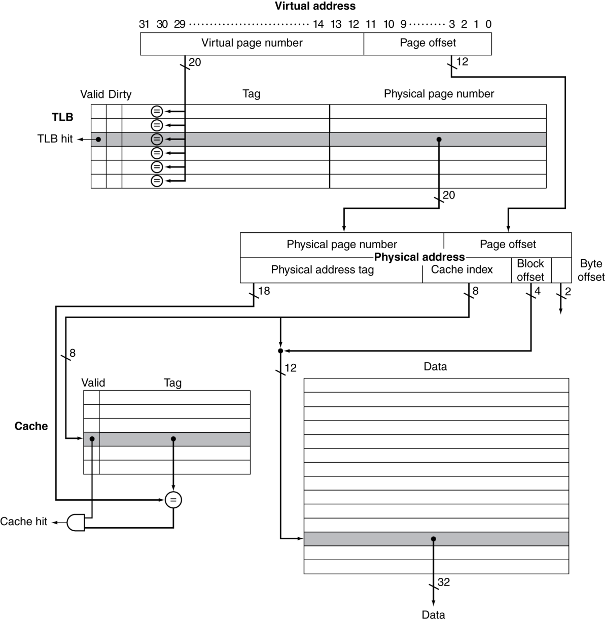
TLB and Cache Interaction in FastMATH
If cache tag uses physical address
Need to translate before cache lookup
Alternative: use virtual address tag
Problem due to aliasing: different virtual addresses used for a shared physical address
If cache index needs not be translated …
256 blocks,
16 words/block, direct mapped
Fig. 5.31
Notes:
FastMATH: 16KB cache (256 blocks, 16 words/block), direct mapped
The tag and data RAMs are split. By addressing the long but narrow data RAM with the cache index concatenated with the block offset, we select the desired word in the block without a 16:1 multiplexor.
4 KB pages → 12-bit page offset, 20-bit page number
TLB: 16 entries, fully associative, shared instruction and data, 64-bit/entry (20-bit tag, 20-bit physical page number, valid, dirty, others)
software to handle TLB miss
If pages are 16 KB instead of 4 KB, then virtual page offset is the same as physical page offset → can access cache data RAM while TLB finds physical page number

Slide 24
Possible Combinations of Events
Provide data
Provide address

Slide 25
Design Optimization: Right Page Size
Want to minimize wasted storage:
Small page minimizes internal fragmentation
Small page increases size of page table
Want to minimize transfer time:
Large page amortizes disk access cost
Large page tends to transfer unnecessary data
Large page sometimes prefetches useful data
Large page sometimes discards data early
A trend toward larger pages because
Big cheap DRAM
Increasing memory/disk performance gap
Larger address spaces

Slide 26
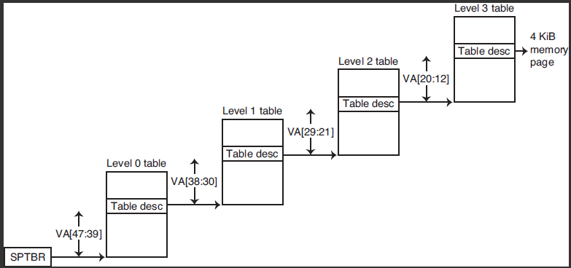
Design Optimization: Huge Page Table
Page table occupies storage
48-bit virtual address, 4KB (2¹²) page, 4bytes/PTE ➔ 2³⁶ PTEs , 2³⁸ bytes = 256 Gbytes in page table
Possible solutions:
Use bounds register to limit table size; add more if exceed
Let pages grow in both directions → 2 tables (hash, stack)
Use hashing → page table same size as physical pages
Multiple levels of page tables:
Fig. 5.29
SPTBR: Supervisor Page Table Base Register
Each step translates 9 bits in virtual address, and each PTE has 8 bytes → one page/table

Slide 27
Memory Protection with Virtual Memory
Allow sharing of main memory by multiple processes, while protecting memory among them and OS
Must protect the memory of a user process and the OS from reading and writing by another user process
How?
A process has its own virtual address space → only need to protect page table from itself and other user processes
Solution: put page tables in the addressing space of OS
OS can change the page tables while preventing a user process from changing them
But, need support from CPU hardware
Notes:
Example: consider memory contents if there are several processes running at the same time, e.g. Hello World!, FB, Browser

Slide 28
Memory Protection with Virtual Memory
Hardware support to allow protection by OS in VM:
Support at least two modes: user and kernel (supervisor)
User process runs in user mode, can read but not write some portion of CPU state, e.g., mode bit, page table pointer, TLB
OS runs in kernel mode and can use privileged instructions only available in kernel mode to update those elements
Allow CPU to go from user to kernel mode and vice versa
User → kernel: by a system call, implemented as a special instruction (e.g., ecall in RISC-V ISA) that transfers control to a dedicated location in kernel code space and saves return address in supervisor exception program counter (SEPC)
Kernel → user: by supervisor exception return (sret) instruction, which resets to user mode and jumps to the address in SEPC

Slide 29
Memory Protection with Virtual Memory
Support for sharing between user processes:
User processes can share parts of virtual address spaces via page frames, but need to protect against errant access
Require OS assistance, e.g., P2 asks OS to create a PTE for a virtual page in P1’s address space that points to the same physical page frame that P2 wants to share
PT of P1
Physical
Memory
P1
OS
PT of P2
P2

Slide 30
Memory Protection with Virtual Memory
Protection problem with TLB:
On context switch from P1 to P2, TLB may leave behind PTEs of P1 for P2 to access → compromising protection
Clear TLB on context switch
Add process identifier (PID) tag field of TLB, and TLB hit needs to match both page number and PID

Slide 31
Summary: Memory Protection
Different tasks can share parts of their virtual address spaces
But need to protect against errant access
Requires OS assistance
Hardware support for OS protection
Privileged supervisor mode (aka kernel mode)
Privileged instructions
Page tables and other state information only accessible in supervisor mode
System call exception (e.g., ecall in RISC-V)

Slide 32
Outline
Introduction to memory hierarchy (Sec. 5.1)
Memory technologies (Sec. 5.2, 5.5)
Caches (Sec. 5.3, 5.4, 5.9)
Virtual memory (Sec. 5.7)
Framework for memory hierarchy (Sec. 5.8)
Virtual machines (Sec. 5.6)
Parallelism and memory hierarchies: cache coherence, redundant arrays of inexpensive disks (Sec. 5.10, 5.11)

Slide 33
Framework for Memory Hierarchy
Common principles apply at all levels of the memory hierarchy
Based on notions of caching
At each level in the hierarchy, 4 questions to ask
Q1: Block placement
Where can a block be placed in the upper level?
Q2: Finding a block
How is a block found if it is in the upper level?
Q3: Replacement on a miss
Which block should be replaced on a miss?
Q4: Write policy
What happens on a write?

Slide 34
Block Placement
Determined by associativity
Direct mapped (1-way associative)
One choice for placement
n-way set associative
n choices within a set
Fully associative
Any location
Higher associativity reduces miss rate (conflict miss)
But, increases complexity, cost, and access time

Slide 35
Finding a Block
Hardware caches
Reduce comparisons to reduce cost
Virtual memory
Full table lookup (page table) for full associativity
Benefit in reduced miss rate
Associativity | Location method | Tag comparisons
Direct mapped | Index | 1
n-way set associative | Set index, then search entries within the set | n
Fully associative | Search all entries | #entries
 | Full lookup table | 0

Slide 36
Replacement
Choice of entry to replace on a miss
Least recently used (LRU)
Complex and costly hardware for high associativity
Random
Close to LRU, easier to implement
LRU approximation with hardware support

Slide 37
Write Policy
Write-through
Update both upper and lower levels
Simplifies replacement, but may require write buffer
Write-back
Update upper level only
Update lower level when block is replaced
Need to keep more state and extra overhead on replace
Write allocate and no allocate on write miss
Virtual memory
Only write-back is feasible, given disk write latency

Slide 38
Outline
Introduction to memory hierarchy (Sec. 5.1)
Memory technologies (Sec. 5.2, 5.5)
Caches (Sec. 5.3, 5.4, 5.9)
Virtual memory (Sec. 5.7)
Framework for memory hierarchy (Sec. 5.8)
Virtual machines (Sec. 5.6)
Parallelism and memory hierarchies: cache coherence, redundant arrays of inexpensive disks (Sec. 5.10, 5.11)

Slide 39
Protection by Virtual Memory
Virtual memory provides protection among processes
By supporting a separate address space to each process
Accomplished by OS and CPU hardware, e.g., page fault handling, TLB, etc.
So, OS must be able to do something that normal user processes cannot do, e.g., run privileged instructions
Nevertheless, in virtual memory, multiple processes are still managed by a single OS
Stronger protection can be provided if users have the entire computer to themselves, including a copy of OS
A single computer hardware can provide such an illusion through a technique called virtual machines

Slide 40
Protection by Virtual Machines
Virtual machine (also abbreviated as VM!):
A software implementation of a computer that executes programs like a physical computer
First developed in the mid-1960s
Two types of virtual machines:
Process virtual machine: provides a virtual computer system to run a single user process, e.g., Java virtual machine
System virtual machine: provides a virtual computer that can run an OS and all its user processes, e.g., VMware, Xen
Bare metal vs. hosted (on top of hardware vs. OS)
Emulation vs. virtualization (SW emulates HW with guest code as input vs. CPU runs guest and host code → same ISA)
QEMU
http://www.cs.nthu.edu.tw/~ychung/syllabus/Virtualization.htm

Slide 41
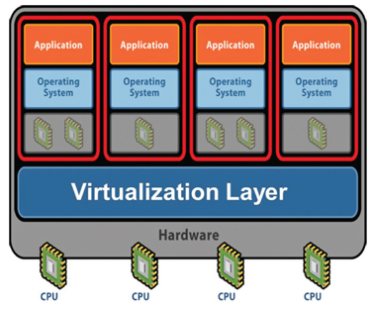
System Virtual Machine
Controlled by hypervisor or Virtual Machine Monitor (VMM)
Host: underlying platform
Guest VMs with same ISA
Why VMs?
Share resources
Improve protection, isolation, security
Migrate running VMs
Run applications in compatible OS
Run complete software stacks of different versions
https://www.isa.org/standards-and-publications/isa-publications/intech-magazine/2011/august/system-integration-virtualization-101-understanding-how-to-do-more-with-less/

Slide 42
Virtual Machine Monitor (VMM)
The software to manage resource and provide protection among different guest OSes
Presents a hardware view in software to guest VMs
Isolates state of guest OSes from each other and from itself
Maps virtual resources of guest OSes to shared physical resources, e.g., CPU, memory, I/O,
VMM ←→ guest OS vs. OS ←→ user processes
Challenge:
To execute guest OS directly in VMs without modification → full virtualization → need hardware-assisted virtualization
How to do?

Slide 43
SW/HW Interface of a Typical OS
CPU normally runs user process in user mode and will “trap” into OS to handle special events in kernel mode
Many OSes have their core part (kernel) taking part of user processes’ virtual address space
System calls: invoked by user process to request OS services (e.g., do IO) by jumping to specific routines in OS kernel
Hardware interrupts: invoked by HW events (e.g., mouse click) to interrupt CPU execution and jump to interrupt service routine in OS kernel
Exception: invoked when user process performs illegal operations or causes errors, e.g., executing privilege instructions, page faults, overflows, similar to system call
Proc
1
Proc
2
User
mode
4GB
OS kernel
Kernel
mode
Hardware

Slide 44
Ideal SW/HW Interface of a VMM
To “virtualize” CPUs, VMM must have full control, e.g., run privilege instr., I/O, exceptions, interrupts
VMM in kernel mode and virtual machines (OS + user processes) in user mode
System calls/exceptions: (example scenario)
When P12 calls a system call or causes an exception, CPU will trap to OS1
When OS1 executes a privilege instruction, since OS1 executes it in user mode, an exception occurs, causing CPU traps to VMM and enters kernel mode
VMM emulates the instruction for OS1 and then jumps back
Hardware interrupts:
Make CPU trap to interrupt handler of VMM
VMM jumps to corresponding interrupt handler of guest OS
P11
P12
P21
P22
User
mode
OS1
OS2
Legacy processors (e.g., x86, ARM) are adapting to support VMs
VMM
Kernel
mode
Hardware

Slide 45
Example: Timer Virtualization
In native machine, on timer interrupt
OS suspends current process, handles interrupt, selects and resumes next process
With Virtual Machine Monitor
VMM suspends current VM, handles interrupt, selects and resumes next VM
If a VM requires timer interrupts
VMM emulates a virtual timer
Emulates interrupt for VM when physical timer interrupt occurs

Slide 46
Pitfalls
Ignoring memory system effects when writing or generating code
Example: iterating over rows vs. columns of arrays
Large strides result in poor locality
Implementing a VMM on an ISA not designed for virtualization
e.g., non-privileged instructions accessing hardware resources
Either extend ISA, or require guest OS not to use problematic instructions (paravirtualization)

Slide 47
Concluding Remarks
Fast memories are small, large memories are slow
We really want fast, large memories ☹
Memory hierarchy leveraging caching gives an illusion of a fast and large memory ☺
Principle of locality to make memory hierarchy works
Programs use a small part of their memory space frequently
Memory hierarchy
L1 cache ↔ L2 cache ↔ … ↔ DRAM memory ↔ disk
Block placement: direct mapped, set-associative
Block identification: tag comparison, page table
Block replacement: LRU, random
Write policy: write-through with write buffer, write-back
Protection by virtual memory and virtual machine

