Slide 1
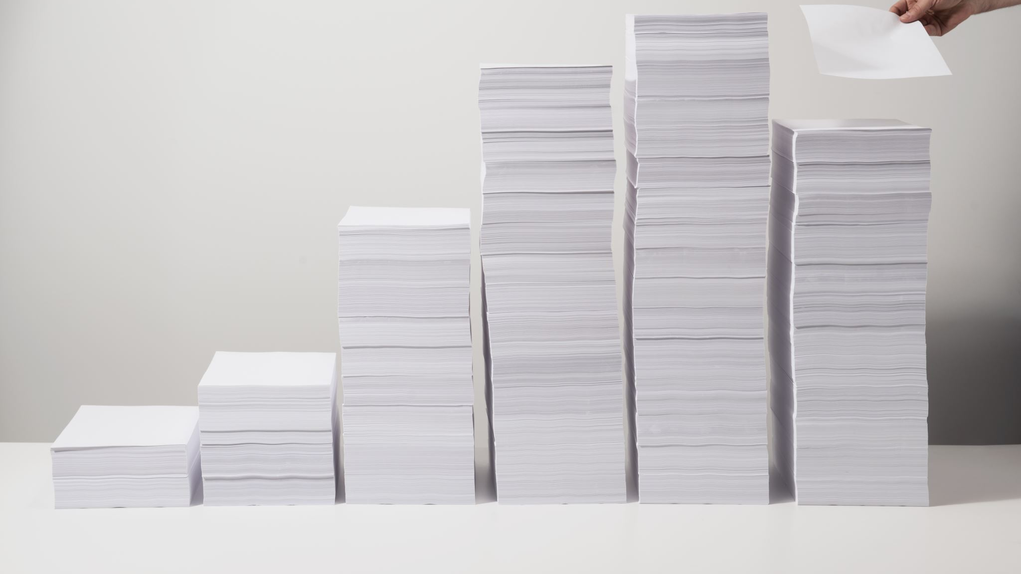
Heap
chchiang

Slide 2
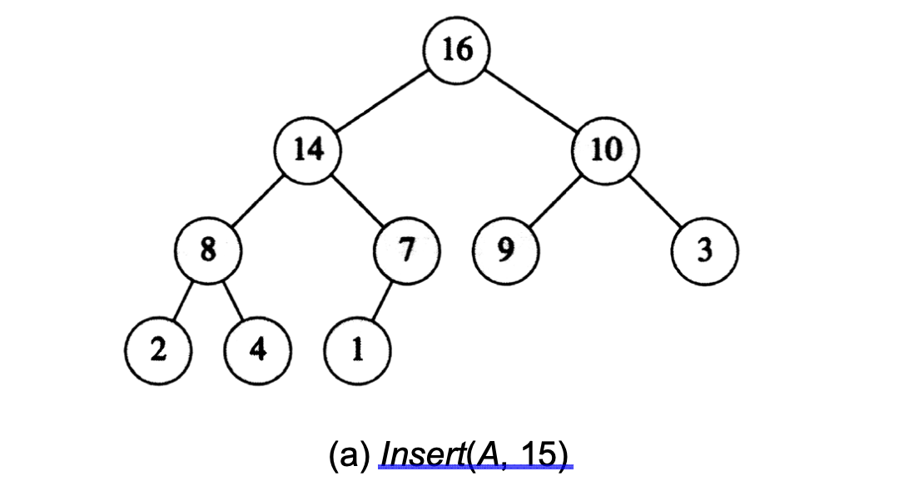
Insert element into a max heap

Slide 3
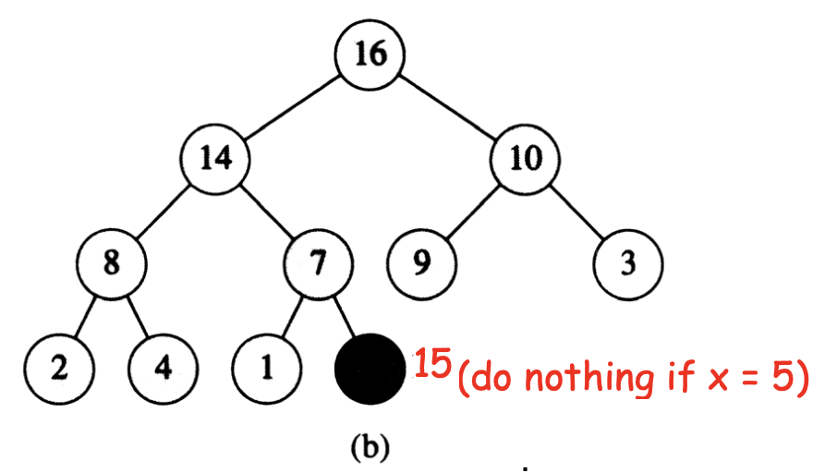
Insert element into a max heap

Slide 4
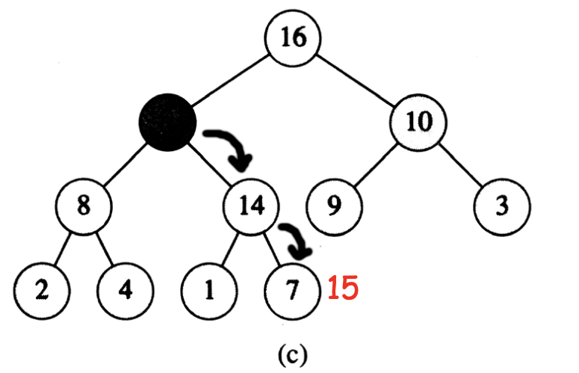
Insert element into a max heap

Slide 5
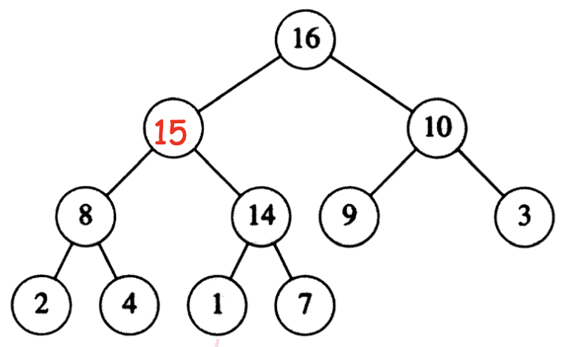
Insert element into a max heap

Slide 6

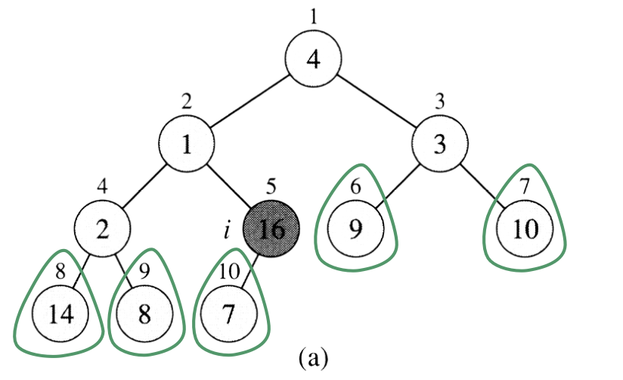
Build a max heap

Slide 7
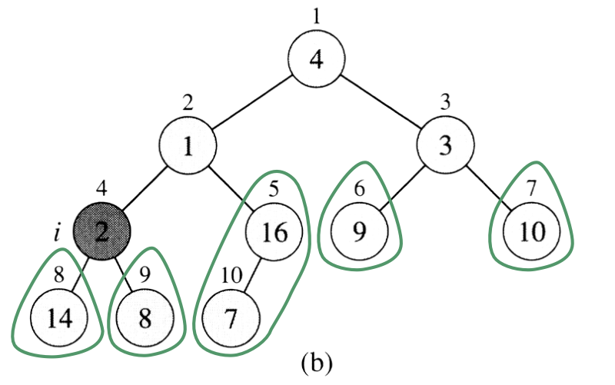
Build a max heap

Slide 8
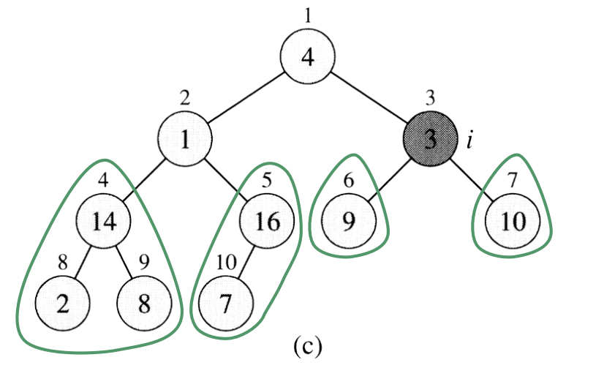
Build a max heap
14
2

Slide 9
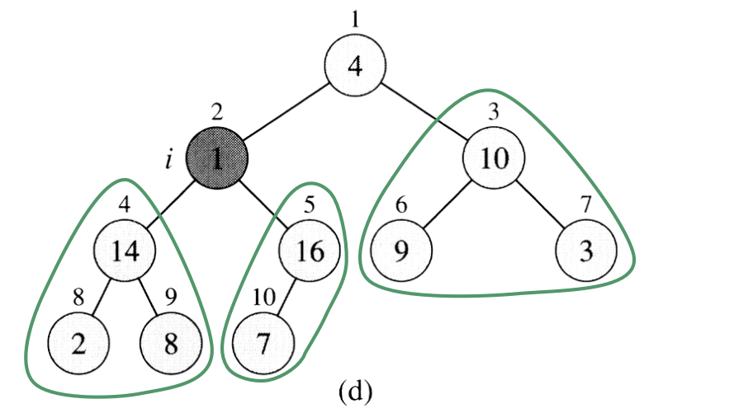
Build a max heap
10
14
3
2

Slide 10
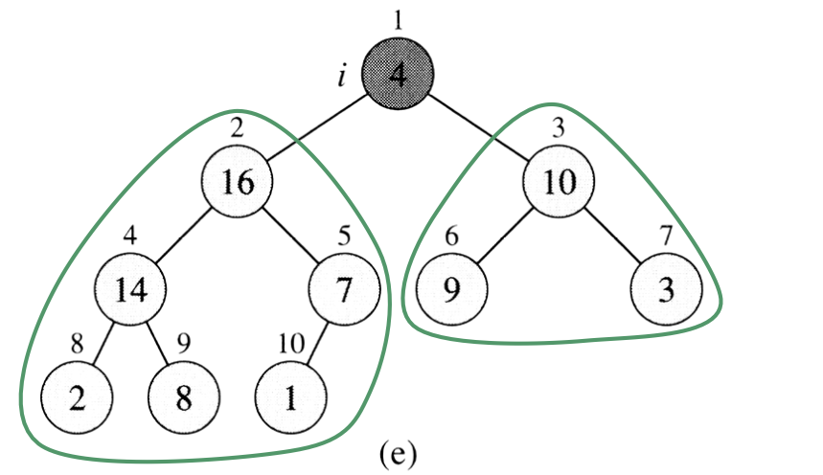
Build a max heap
16
10
14
7
3
2
1

Slide 11
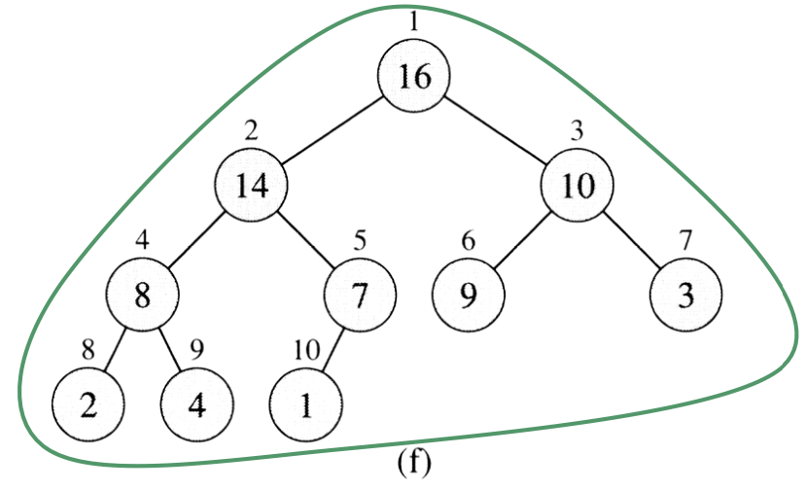
Build a max heap
16
14
10
14
7
8
3
2
4
1
This procedure is called “Heapify”.

Slide 12
Extract an element from a max heap
Output A[1]
Move the last element of the array to A[1]
Heapify!

Slide 13
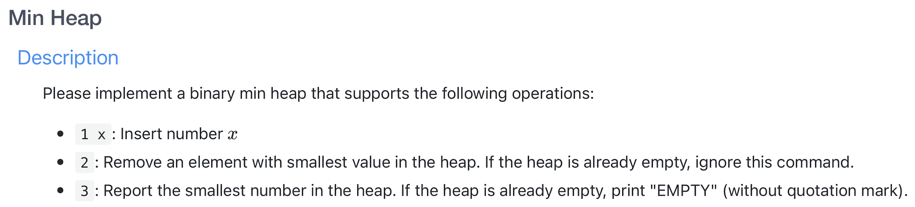
Lab 4

Slide 14
Sample Codes
C++ sample code: http://codepad.org/mGfUD3YM
C sample code: http://codepad.org/YjAGXMGz

Slide 15
Left and Right shift
7 = 00000111₍₂₎
7 << 1 = 00001110₍₂₎ = 14
7 << 3 = 00111000₍₂₎ = 56
7 >> 1 = 00000011₍₂₎ = 3
7 >> 2 = 00000001₍₂₎ = 1

Slide 16
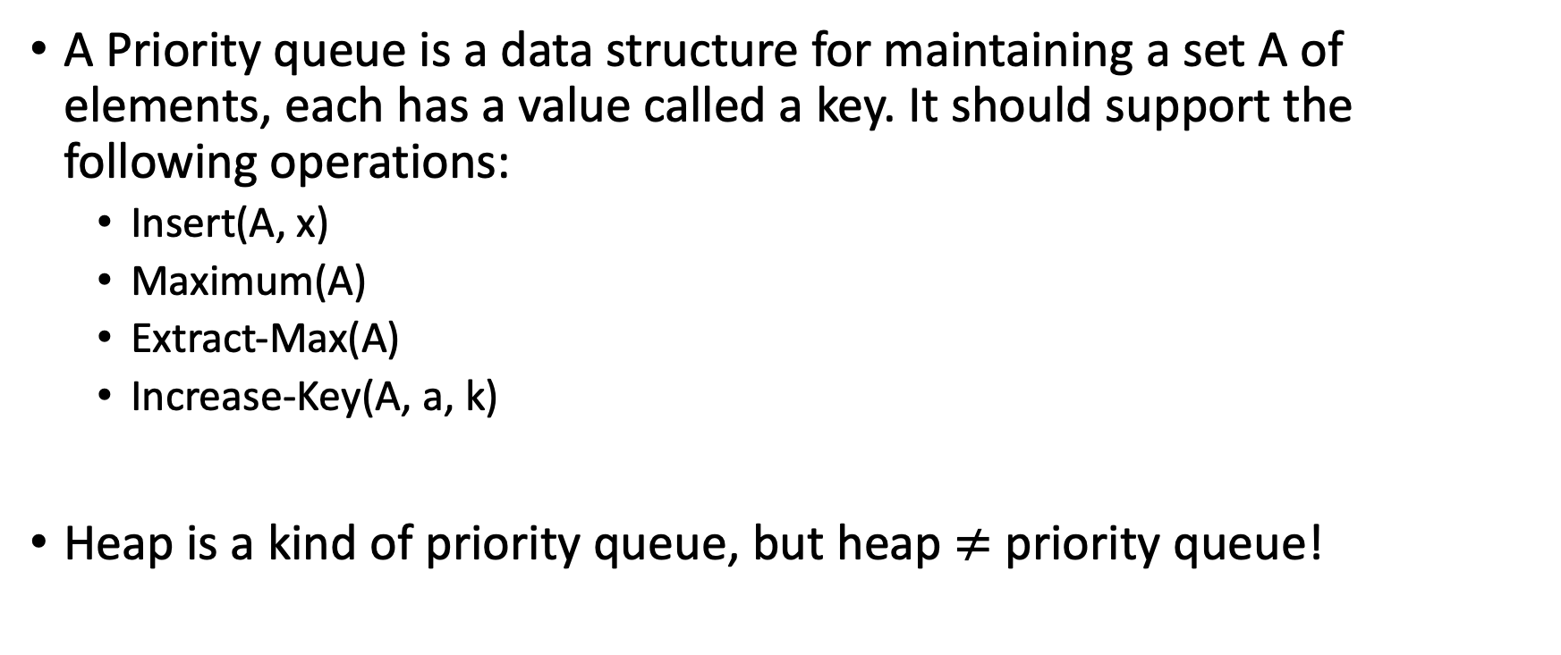
Priority queue

Slide 17
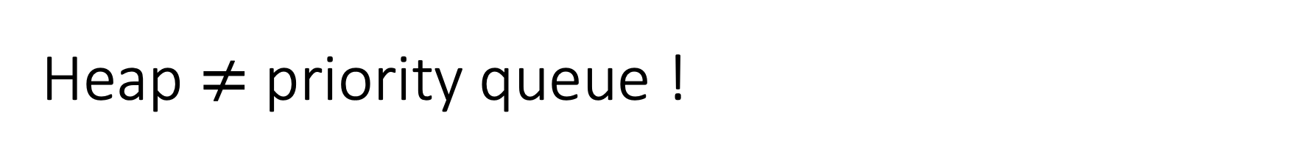
Priority queues | Binary heap | Pure array
Build | O(n) | O(n)
Insert | O(lg n) | O(1)
Maximum | O(1) | O(n)
Increase-Key | O(lg n) | O(1)
Extract-Max | O(lg n) | O(n)

Slide 18
Lab 4

Slide 19
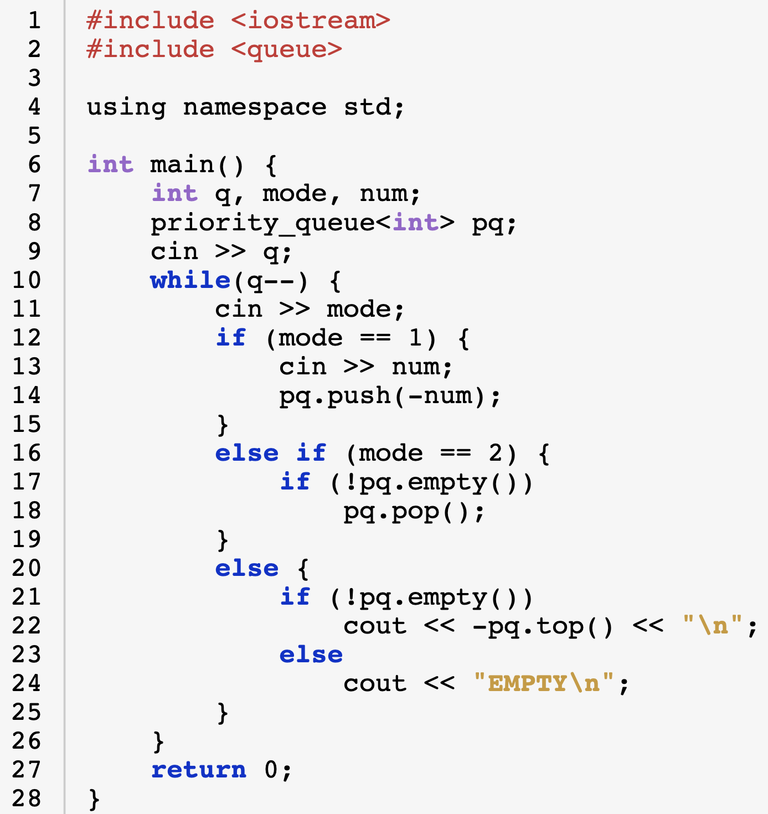
priority_queue in <queue>

Slide 20
References
The following declaration works without changing the sign of elements
priority_queue<int, vector<int>, greater<int>> pq;
See more in
https://cplusplus.com/reference/queue/priority_queue/

