Slide 1
Binary Search Tree (BST)
chchiang

Slide 2
Lab 8: Integer ordered set
Maintain an integer set, which supports the following operations:
I x: Insert x
D x: Delete x
S x: Search x
L x: Lower bound of x
U x: Upper bound of x

Slide 3
Insert x
If x is NOT in the set, insert x into the set.
Otherwise, do nothing.
Print the number of integers in the set when the operation ends.

Slide 4
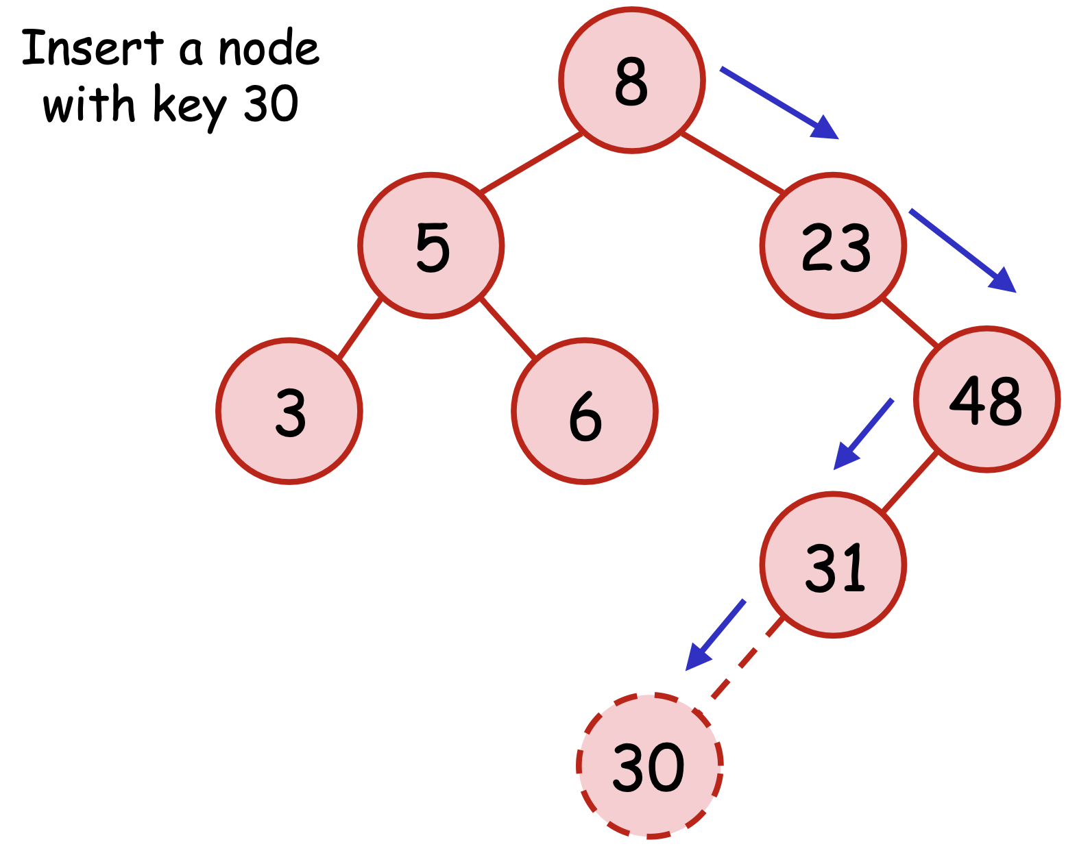
Insert x
I 31: print “7”
I 30: print “8”

Slide 5
Delete x
If x is in the set, delete x from the integer set.
Otherwise, don't do anything.
Print the number of integers in the set when the operation ends.

Slide 6
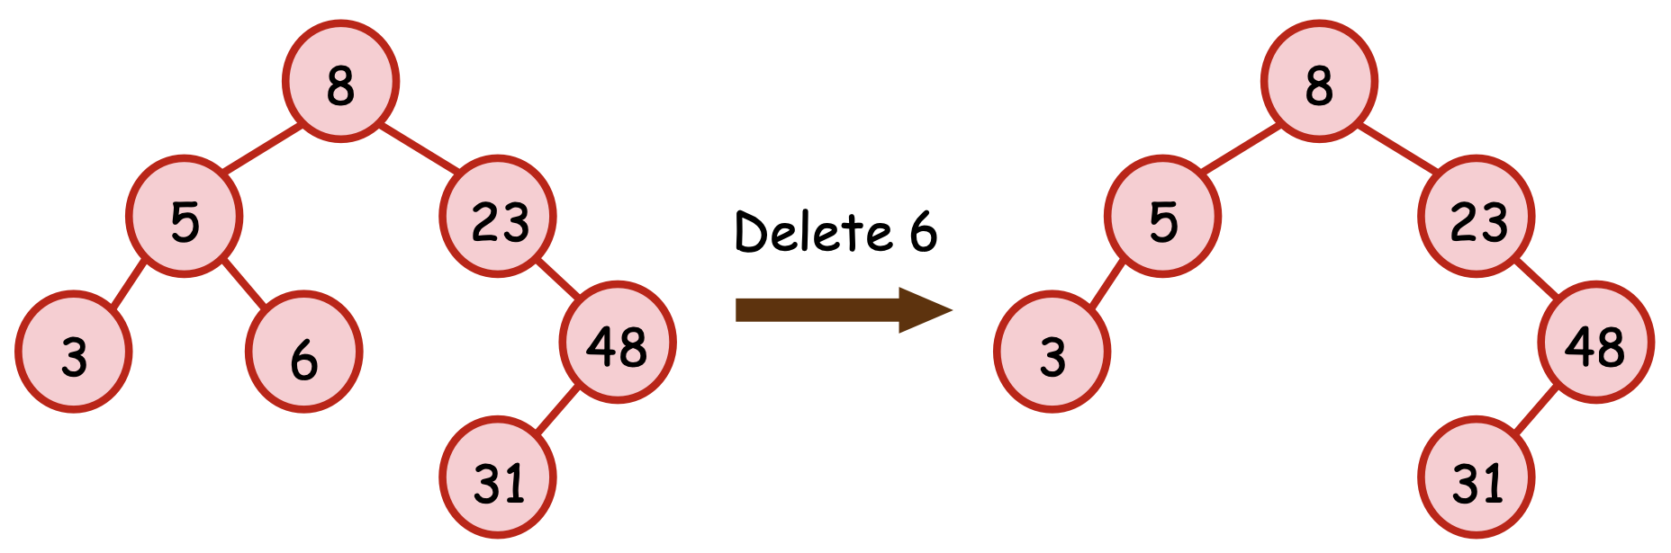
Delete x
D 6: print “6”

Slide 7
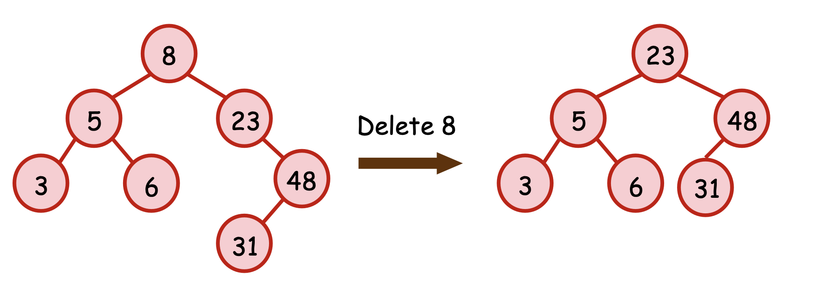
Delete x
D 8: print “6”

Slide 8
Search x
If x is in the set, print "YES".
Otherwise, print "NO".

Slide 9
Lower bound of x
Print the smallest element greater than or equal to x in the set.
If the element doesn't exist, print "-1".

Slide 10
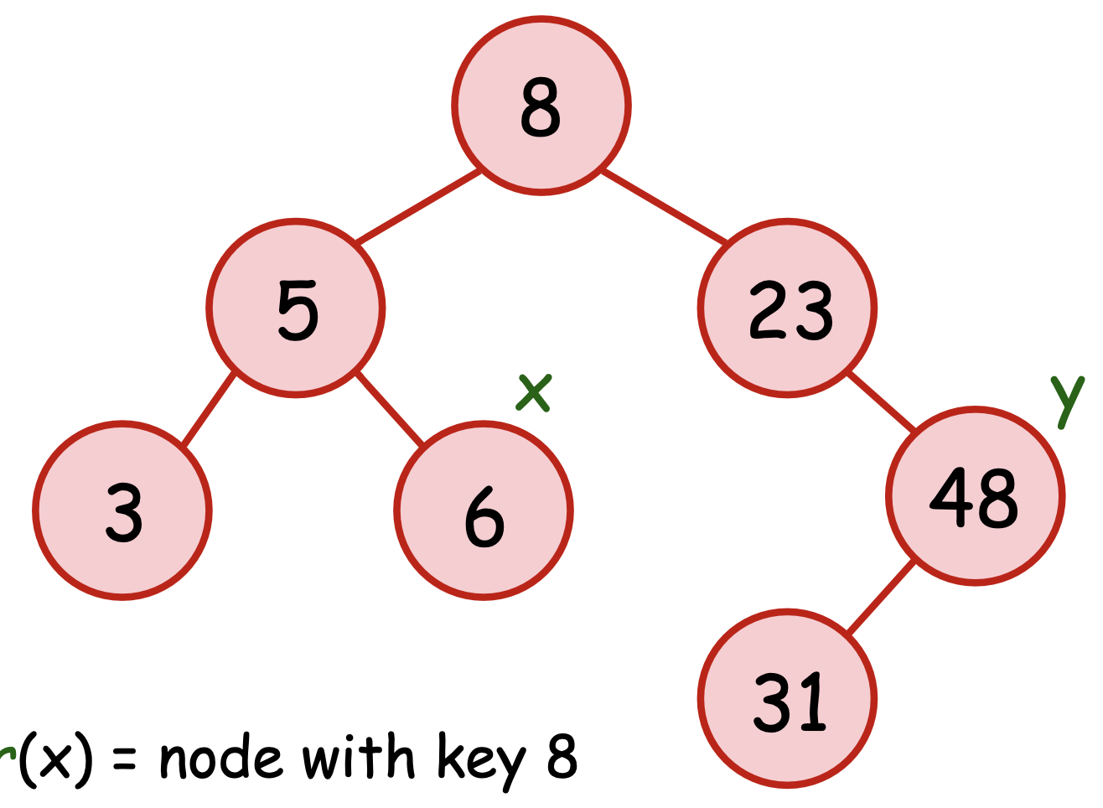
Lower bound of x
L 31: print “31”
L 47: print “48”
L 50: print “-1”

Slide 11
Upper bound of x
Print the smallest element greater than x in the set.
If the element doesn't exist, print "-1".

Slide 12
Upper bound of x
U 31: print “48”
U 48: print “-1”
U 20: print “23”

Slide 13
Implementation
Write a BST
http://codepad.org/yQD4UJA7
Using set<int>
http://codepad.org/dO9VJ82R

Slide 14
Think about it (recommended)
V x: Print the second smallest element greater than x in the set.
W x: Print the third smallest element greater than x in the set.
Hint: If y = U x, then U y = V x

Slide 15
Think about it
Y x: Print the largest element smaller than x in the set.
Z x: Print the second largest element smaller than x in the set.
Hint: Build a negative-value BST. Then Y x = -(U (-x))

Slide 16
Build two trees and the same time

Slide 17
References
Binary Search Tree, Kai’s teaching material
http://www.cs.nthu.edu.tw/~wkhon/ds/ds12/lecture/lecture13.pdf
set
https://cplusplus.com/reference/set/set/?kw=set
map
https://cplusplus.com/reference/map/map/?kw=map

