Slide 1
Preorder, Inorder, Postorder
Han
(2023 spring TA)

Slide 2
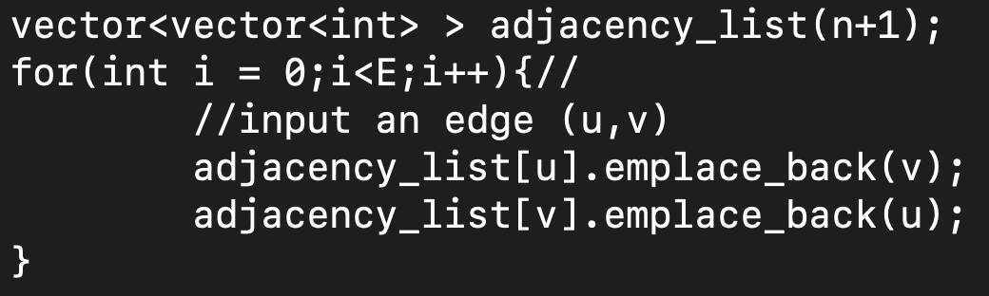
Tree Implementation
Previously, we’ve taught you how to save a graphs.
We can save general trees as graphs.

Slide 3
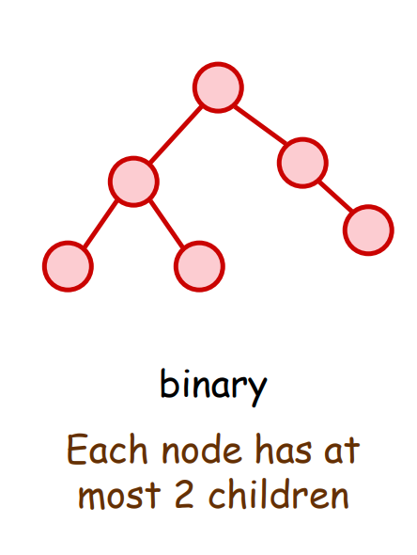
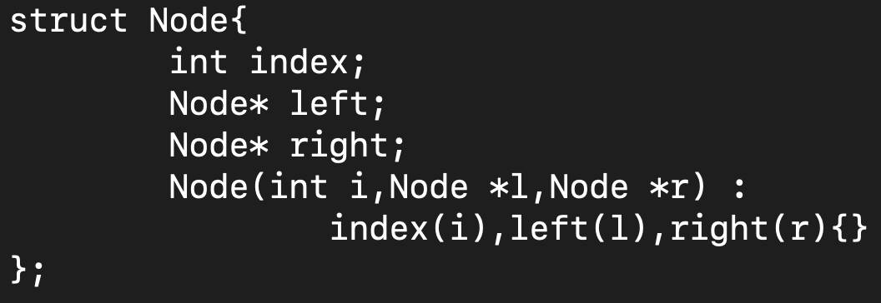
Tree Implementation
But when we are dealing with special trees. There are other ways to store them.

Slide 4
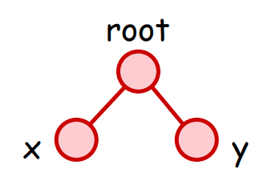
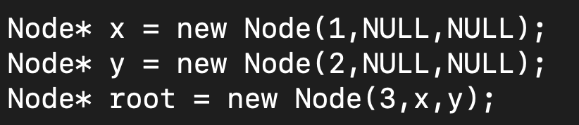
Tree Implementation

Slide 5
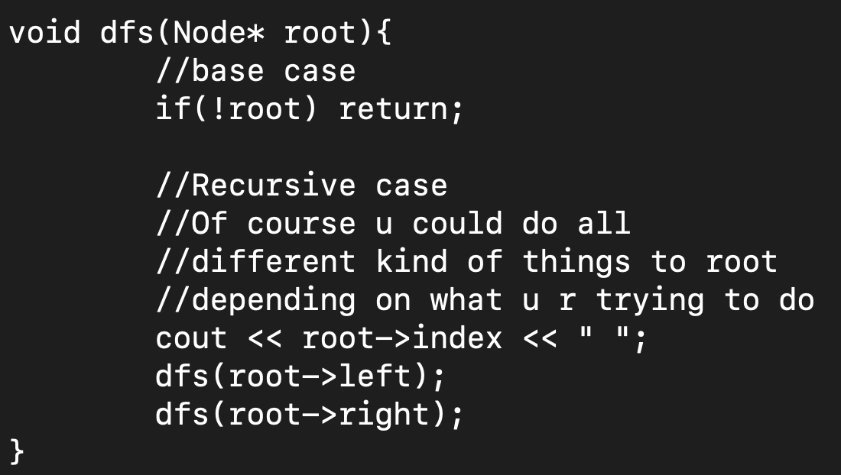
Tree Implementation - Preorder
x
L
R
Output: x dfs(L) dfs(R)

Slide 6
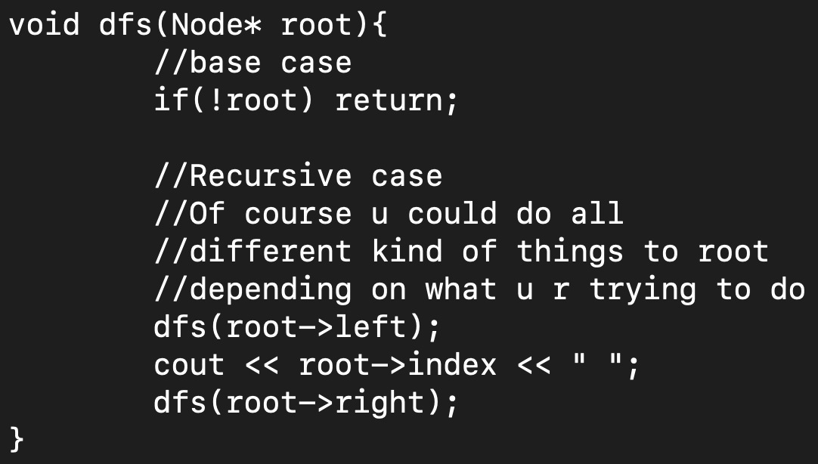
Tree Implementation - Inorder
x
L
R
Output: dfs(L) x dfs(R)

Slide 7
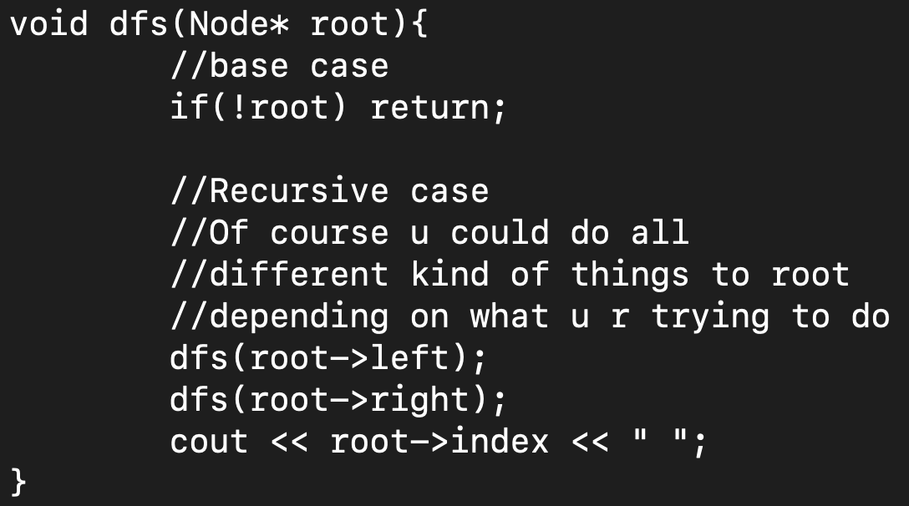
Tree Implementation - Postorder
x
L
R
Output: dfs(L) dfs(R) x

Slide 8
Lab practice 1
Sample code: https://paste.ofcode.org/UYmRVYPLwP9n4uwewbQr5z

Slide 9
Determining a unique tree with preorder
Is it possible for us to obtain a unique tree by a preorder traversal?

Slide 10
Determining a unique tree with preorder
Is it possible for us to obtain a unique tree by a preorder traversal?
1
1
2
2
3
3

Slide 11
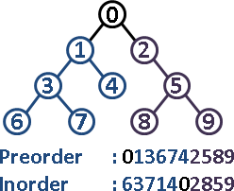
Determining a unique tree from preorder and inorder
However, when we have both preorder and inorder traversal, we can obtain a unique tree.

Slide 12
Tree reconstruction
We can reconstruct the tree by taking the first element of Preorder, search it in Inorder, everything before the searched element belongs to the left subtree, everything after the searched element belongs to the right subtree.

Slide 13
Tree reconstruction
Time complexity = O(?)

Slide 14
Tree reconstruction- Time complexity
Naively, we could search through the Inorder array for our vertex. This would take O(n^2)
With a little preprocessing, we could lower the search time in each iteration to O(1). Resulting the total time complexity to O(n)

Slide 15
Lab practice 2
Sample code: https://paste.ofcode.org/dRfazUtXHFN5SZYnjKCDMY

Slide 16
References
演算法筆記
Geeksforgeeks: Tree Traversals (Inorder, Preorder and Postorder)

