Slide 1


Group 9
May 16th 2024
ANOVA ANALYSIS
Analysis of Data Science Engineer’s Salary
110060012
109021226
109011214
110071014
徐竣霆
呂柏緯
陳姿穎
蘇哲正
Team Leader:
Team Members:

Slide 2
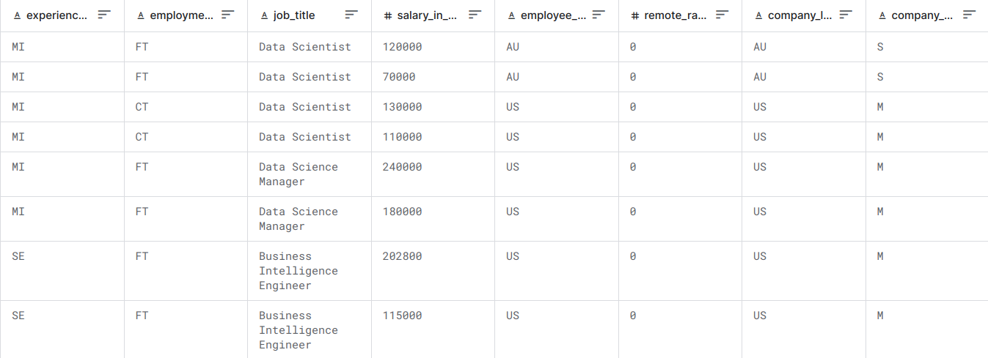
Introduction
This dataset represents salary information for Machine Learning(Data Science) engineers.
For each entry, contains 11 columns, including details such as the level of experience, employment type, job title, salary amount, employee residence, remote work ratio, company location, and company size.
This information allows for analysis of salary trends, employment patterns, and other factors affecting machine learning engineer salaries in various locations and company settings.

Slide 3
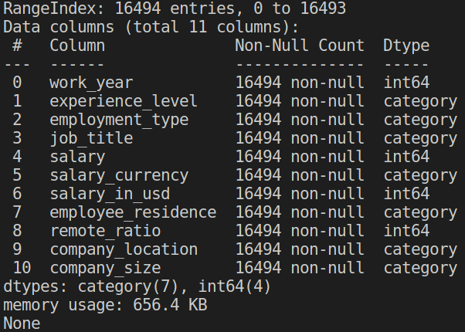
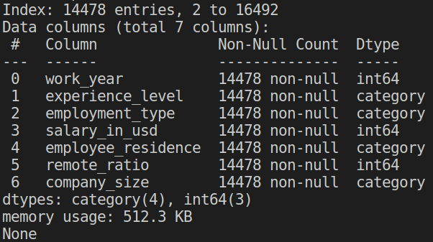
Data Preprocessing
We drop job_title(not important).
We drop salary, salary_currency(USD as measurement).
We drop those entries with company location not in US(US consists of 87.8%).
Total 16494 entries, 7 categorical features.
14478 entries, 4 categorical features.

Slide 4
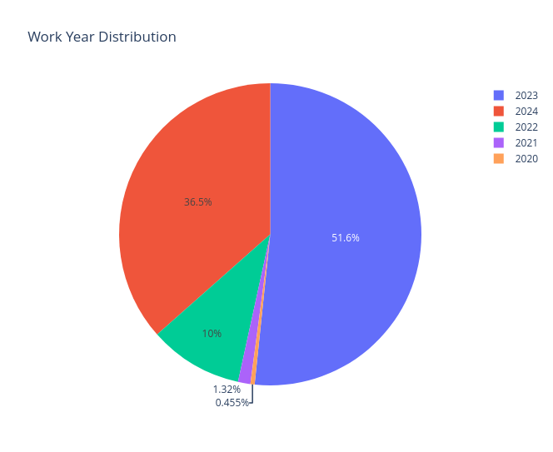
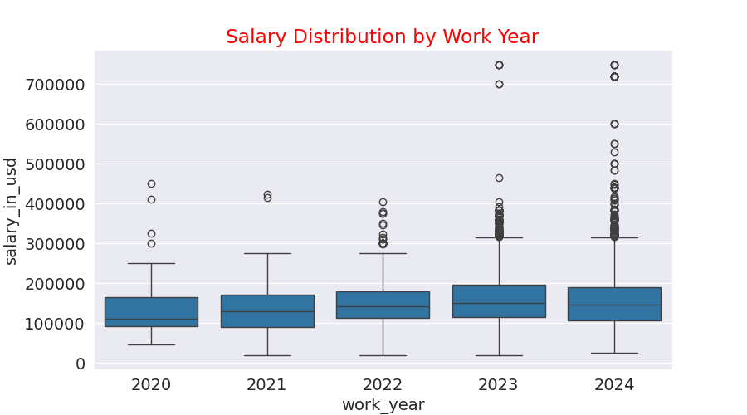
Visualization - Work Year

Slide 5
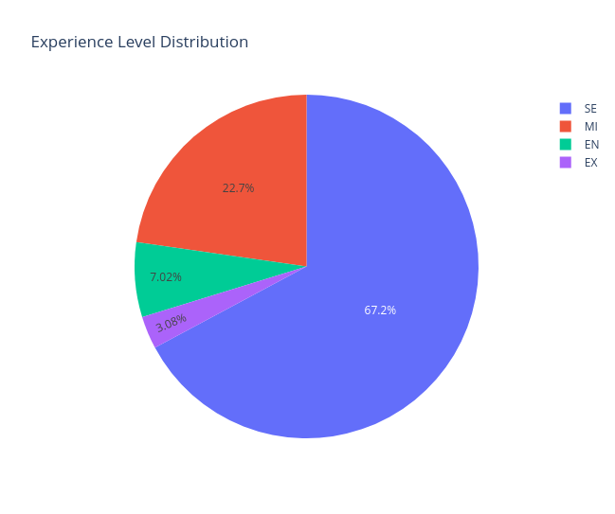
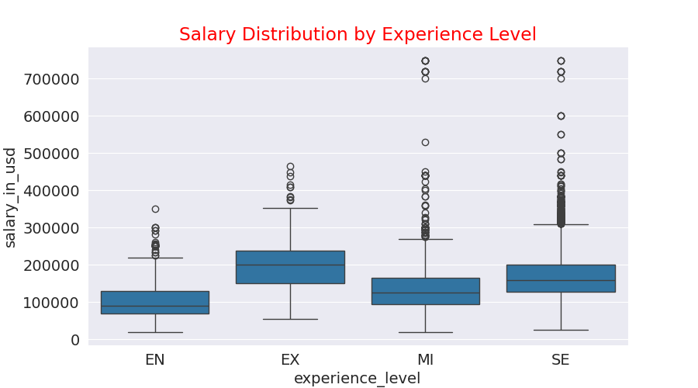
Visualization - Experience Level
EN: Entry Level
MI: Mid Level
SE: Senior Level
EX: Executive Level

Slide 6
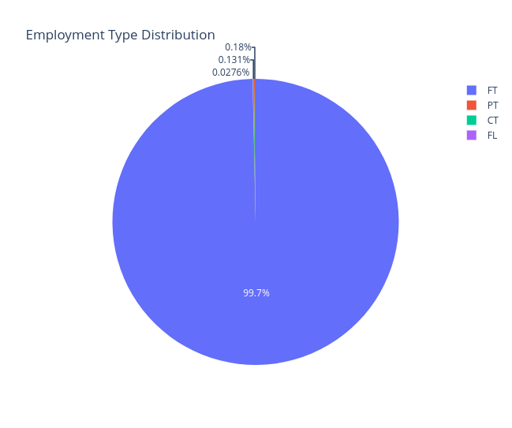
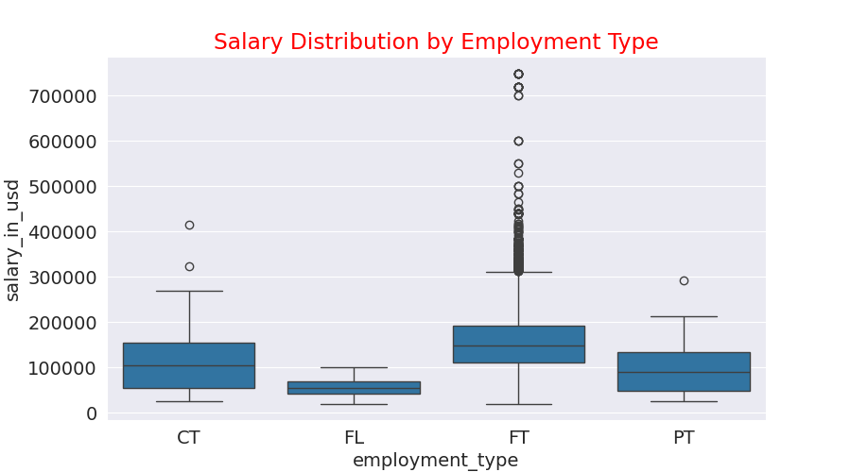
Visualization - Employment Type
FL: Freelancer
CT: Contract basis
PT: Part Time
FT: Full Time

Slide 7
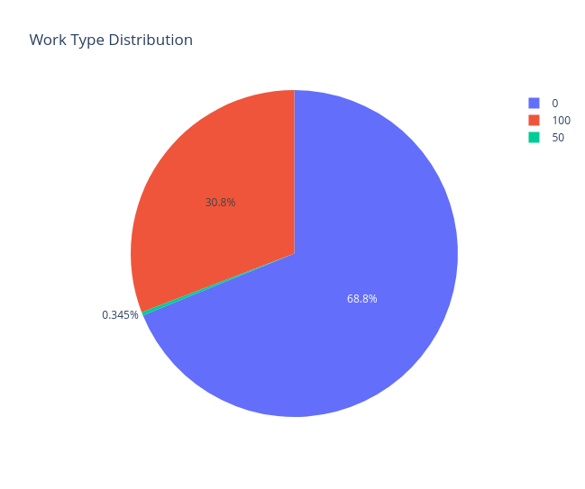
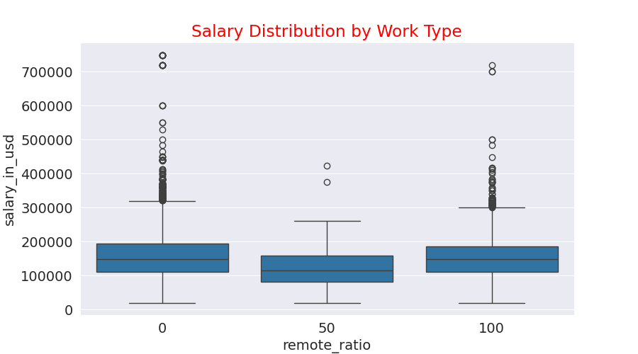
Visualization - Work Type
0: Office Work
50: Hybrid
100: Work from Home

Slide 8
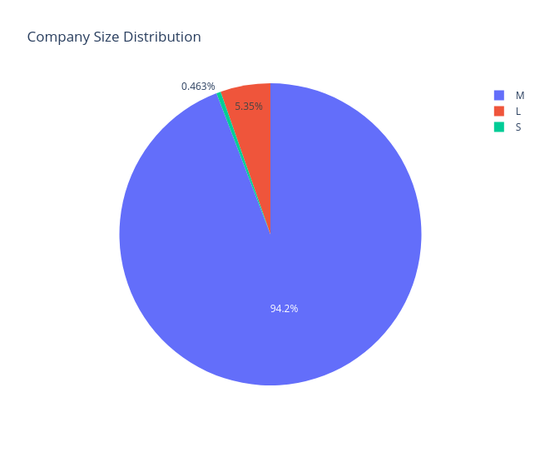
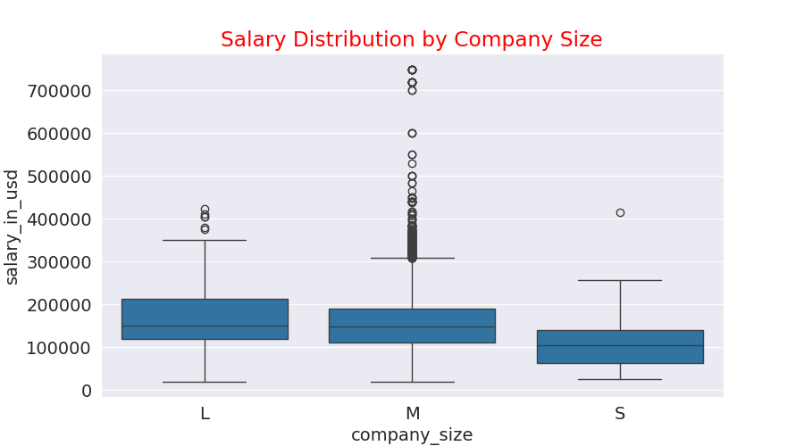
Visualization - Company Size
S: Small
M: Medium
L: Large

Slide 9
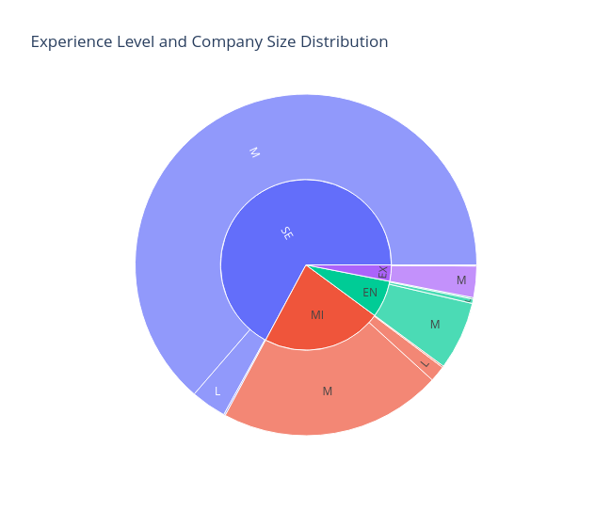
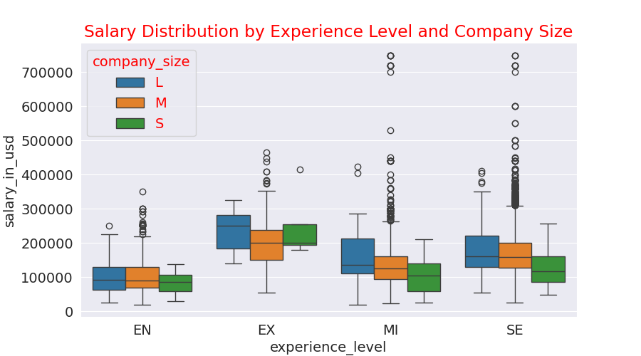
Visualization - Company Size ~ Experience Level

Slide 10
Hypothesis Setting
Want to know that if there is an impact on salary by
company size
experience level
Company size
Set H₀ : µ₁ = µ₂ = µ₃ against H₁ : H₀ is NOT true
Experience level
Set H₀ : µ₁ = µ₂ = µ₃ = µ₄ against H₁ : H₀ is NOT true

Slide 11
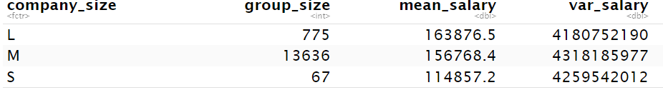
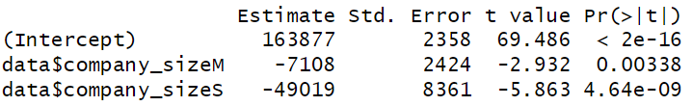
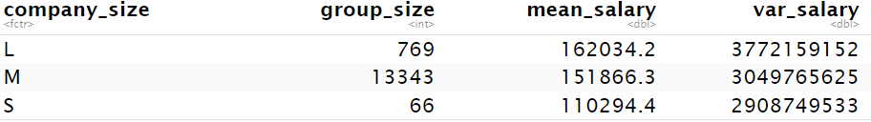
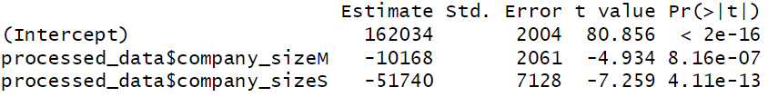
Introduction - Summarization
Company Size
<--- Raw data
<--- Processed data
remove the outlier that outside
[ Q1 - 1.5 IQR , Q3+1.5 IQR ]

Slide 12
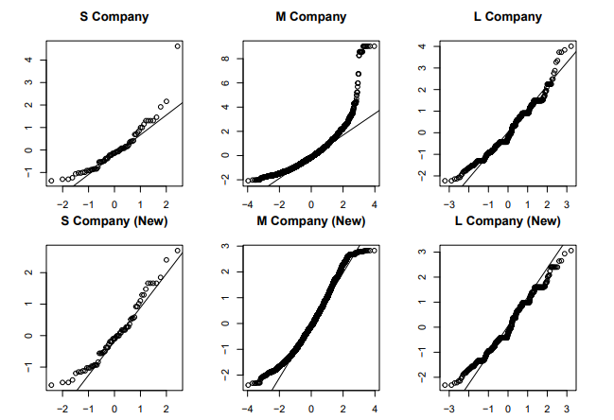
Model Diagnostics - Normality
Company Size
<--- Raw data
<--- Processed data
remove the outlier that outside
[ Q1 - 1.5 IQR , Q3+1.5 IQR ]

Slide 13
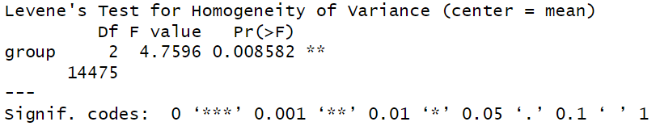
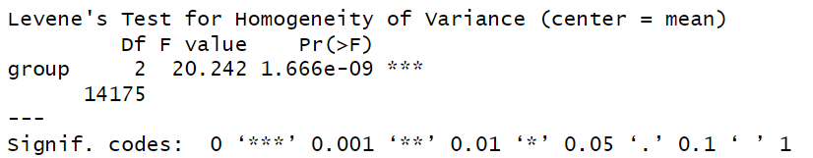
Model Diagnostics - Homogeneity
Company Size
<--- Raw data
<--- Processed data
remove the outlier that outside
[ Q1 - 1.5 IQR , Q3+1.5 IQR ]

Slide 14
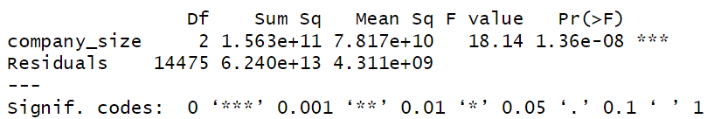
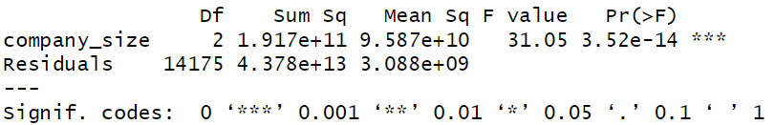
ANOVA
Company Size
<--- Raw data
<--- Processed data
remove the outlier that outside
[ Q1 - 1.5 IQR , Q3+1.5 IQR ]

Slide 15
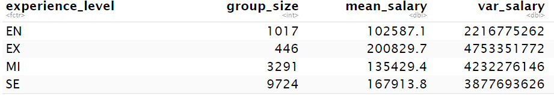
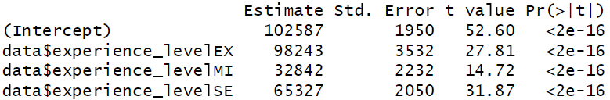
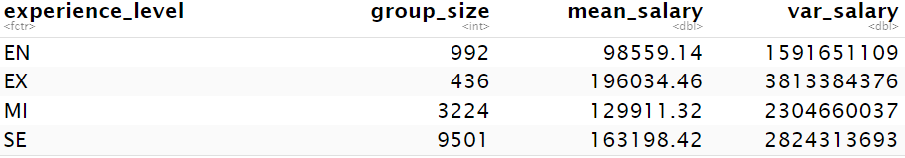
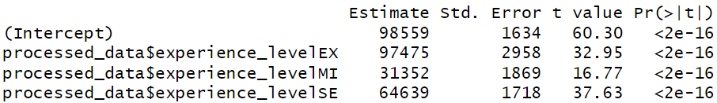
Introduction - Summarization
Experience Level
<--- Raw data
<--- Processed data
remove the outlier that outside
[ Q1 - 1.5 IQR , Q3+1.5 IQR ]

Slide 16
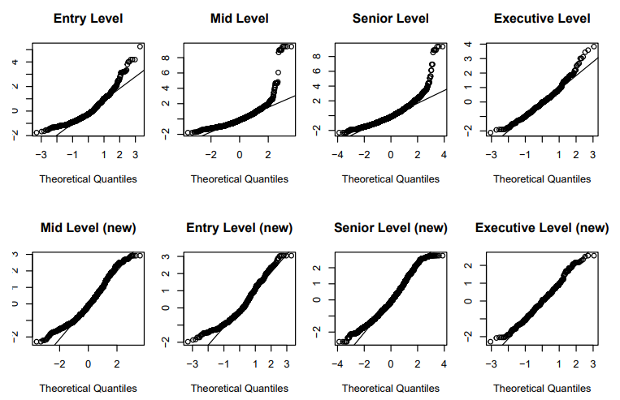
Model Diagnostics - Normality
Experience Level
<--- Raw data
<--- Processed data
remove the outlier that outside
[ Q1 - 1.5 IQR , Q3+1.5 IQR ]

Slide 17
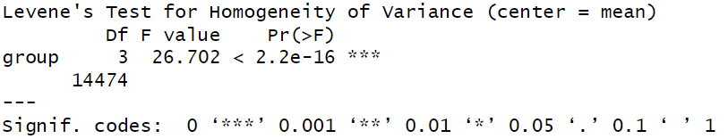
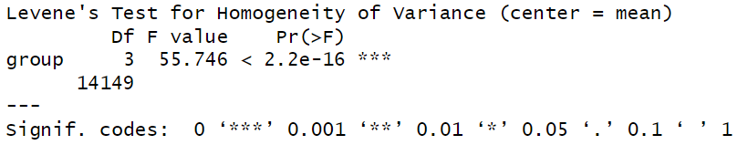
Model Diagnostics - Homogeneity
Experience Level
<--- Raw data
<--- Processed data
remove the outlier that outside
[ Q1 - 1.5 IQR , Q3+1.5 IQR ]

Slide 18
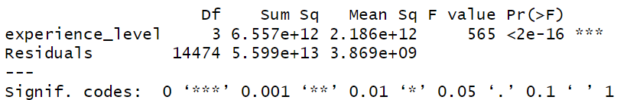
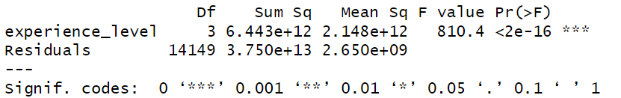
ANOVA
Experience Level
<--- Raw data
<--- Processed data
remove the outlier that outside
[ Q1 - 1.5 IQR , Q3+1.5 IQR ]

Slide 19
Conclusion
The size of a company has an impact on salaries.
The difference between the size “M” and “L” is smaller than the difference between “S” and the others.
The experience level has a significant impact on salaries.
Kick out the outliers may lead to
increase the normality.
worsen the homogeneity of variance.
make the results of ANOVA more significant.

Slide 20
Reference
Dataset: Machine Learning Engineer Salary in 2024
Article reference: Data Scientist Job Salaries Analysis

Slide 21
Group 9
May 16th 2024
THANKS FOR LISTENING

