Slide 1

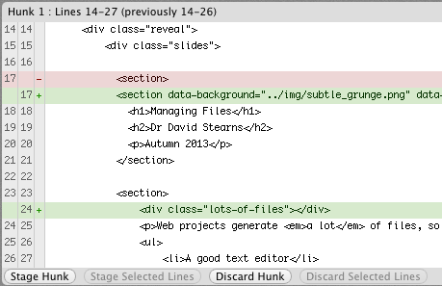
Adding Committed Changes to Your Local Repository
Like inserting a new row into a database
VCS Repository
Stage & Commit

Slide 2
If you make a mistake, or change your mind, you can revert to a previous commit, restoring files to the state they were in when you made that commit
VCS Repository
Checkout commit 1234

Slide 3

Common
Server Repo
Clone
Push & Pull
Clone
Push & Pull
Clone
Push & Pull
Local Repo
Local Repo
Local Repo

Slide 4

Publishing Your Site via Git
Web Server (Dante)
Common
Server Repo
git clone
Clone
Commit
Push
ssh
Local Repo

Slide 5
Updating Your Site via Git
Web Server (Dante)
Common
Server Repo
git pull
Commit
Push
ssh
Local Repo

