Slide 1
Build a Website – Class 1
Xavier Esteve - Volunteer
Broward County – SW Regional Library

Slide 2
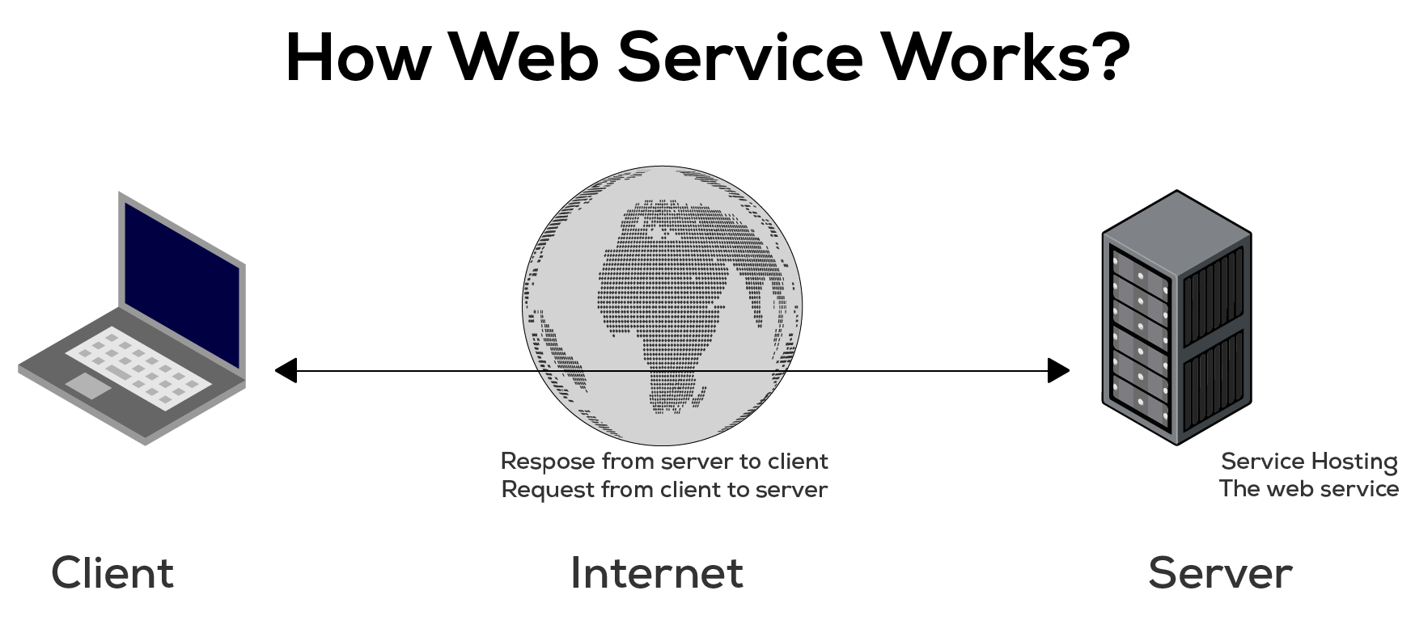
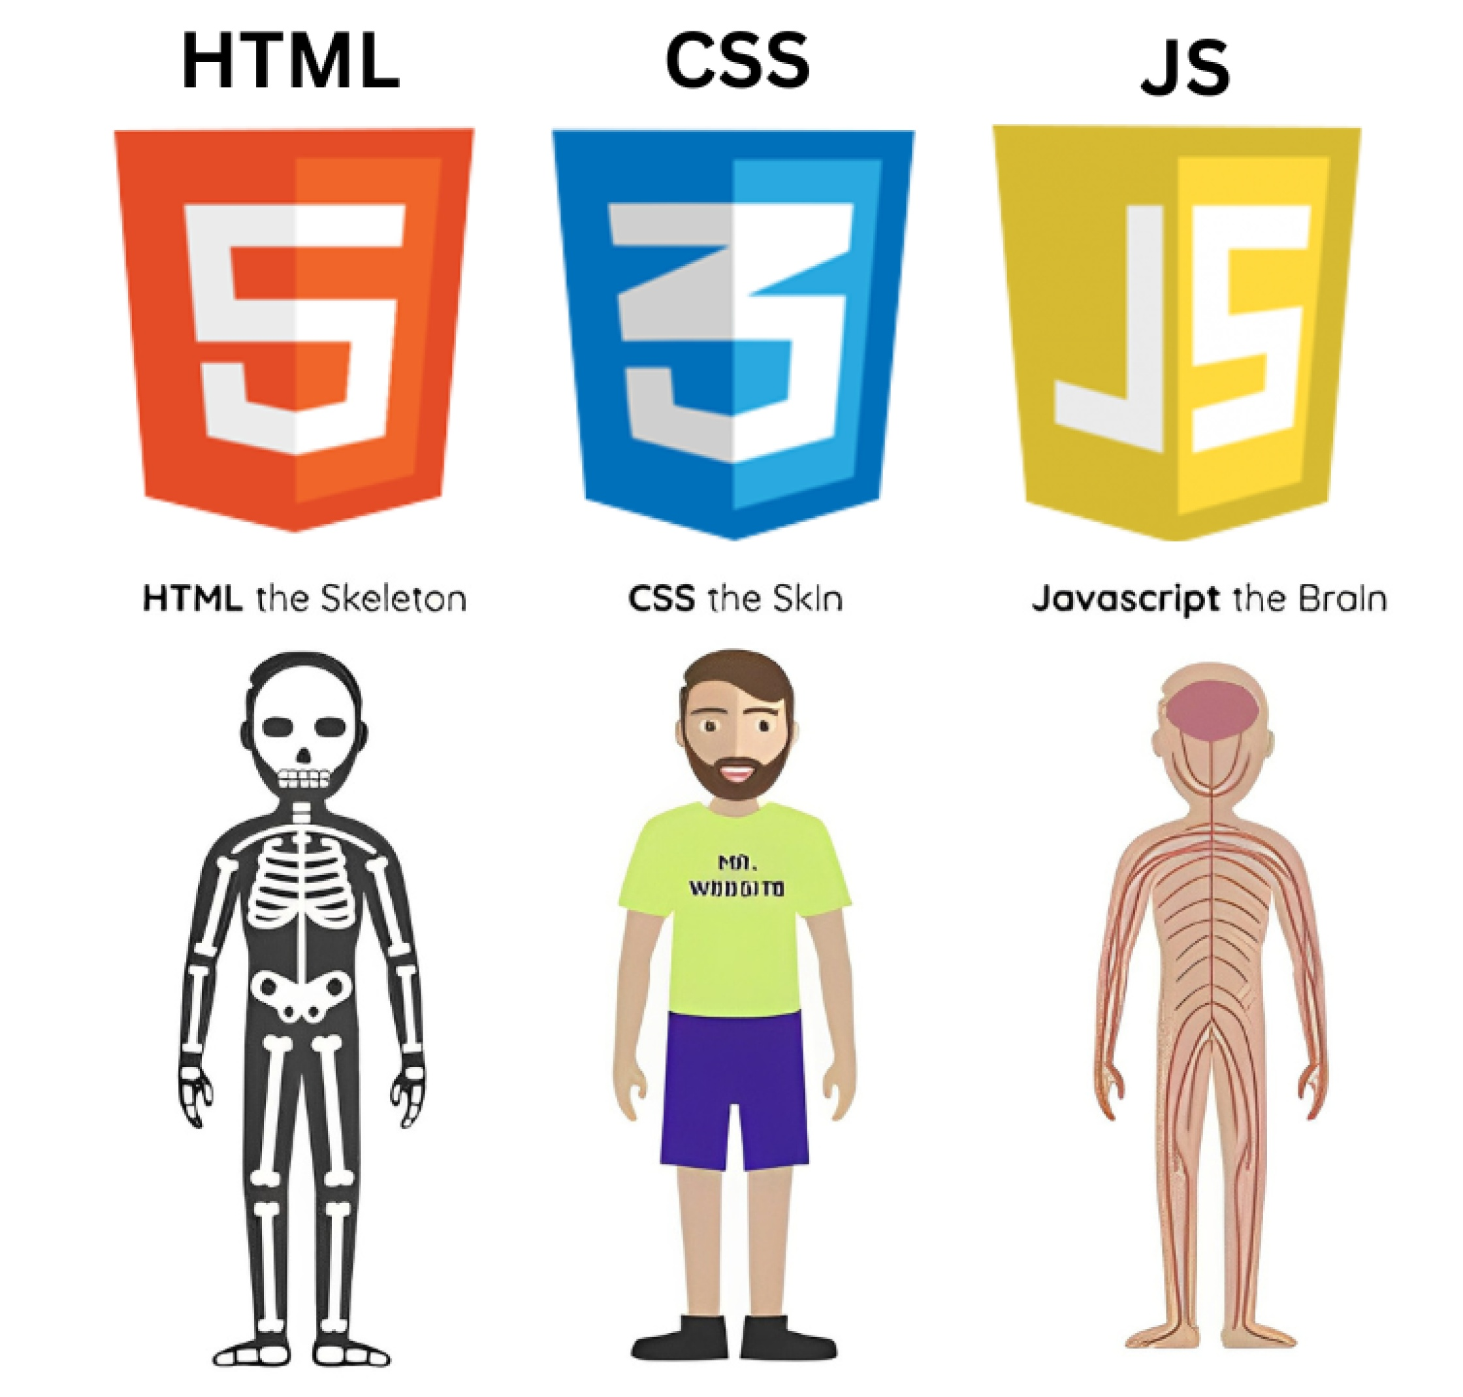
What actually goes into a website?
Websites are meant to show content and provide actions for users.
Media content can take many forms.
Actions like submitting information, purchases, etc.

Slide 3
The focus of this class
Some basic discussion of what kinds of tools are used to build a web-SITE.
Gauging the class
Re-arrange seating?
HTML and CSS

Slide 4
Sites are???
Web servers using the http portocol usually on port 443 as ssl encrypted messages getting and sending information.
Transporting device information, user data, payment information, pictures and videos.
Yes? Kind of?

Slide 5
<Sets look like>?
Text, video, buttons, lists, the list goes on.
Whatever you want
  But there are some nice standards
  Can you describe a website?
All encoded into a single or multiple flat pages.

Slide 6
HTML. Encoded.
Websites are authored by people, mimicked by machines.
Websites can be changed and edited and a text editor.
Edited graphically
AI generated
Look in a browser. You can inspect the HTML.

Slide 7
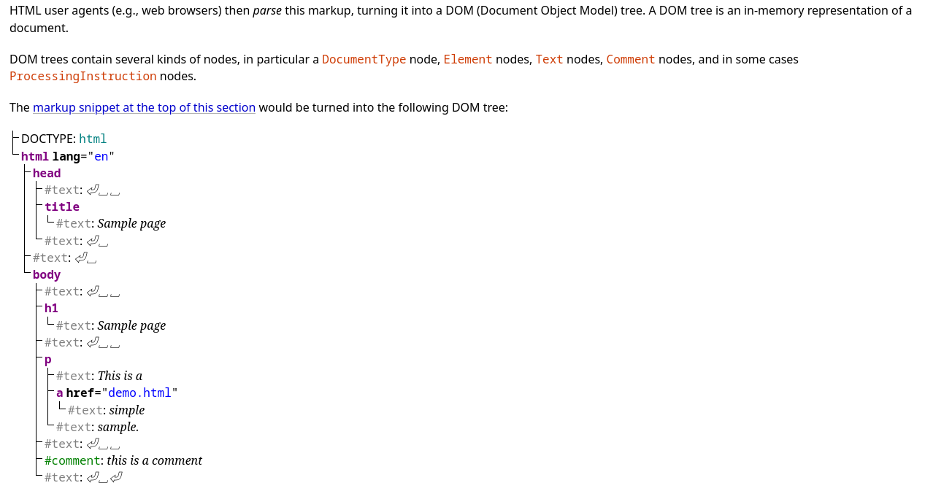

<H1>HTML?</H1>
<html>
<head>
<body>
</body>
/head>
</html>

Slide 8
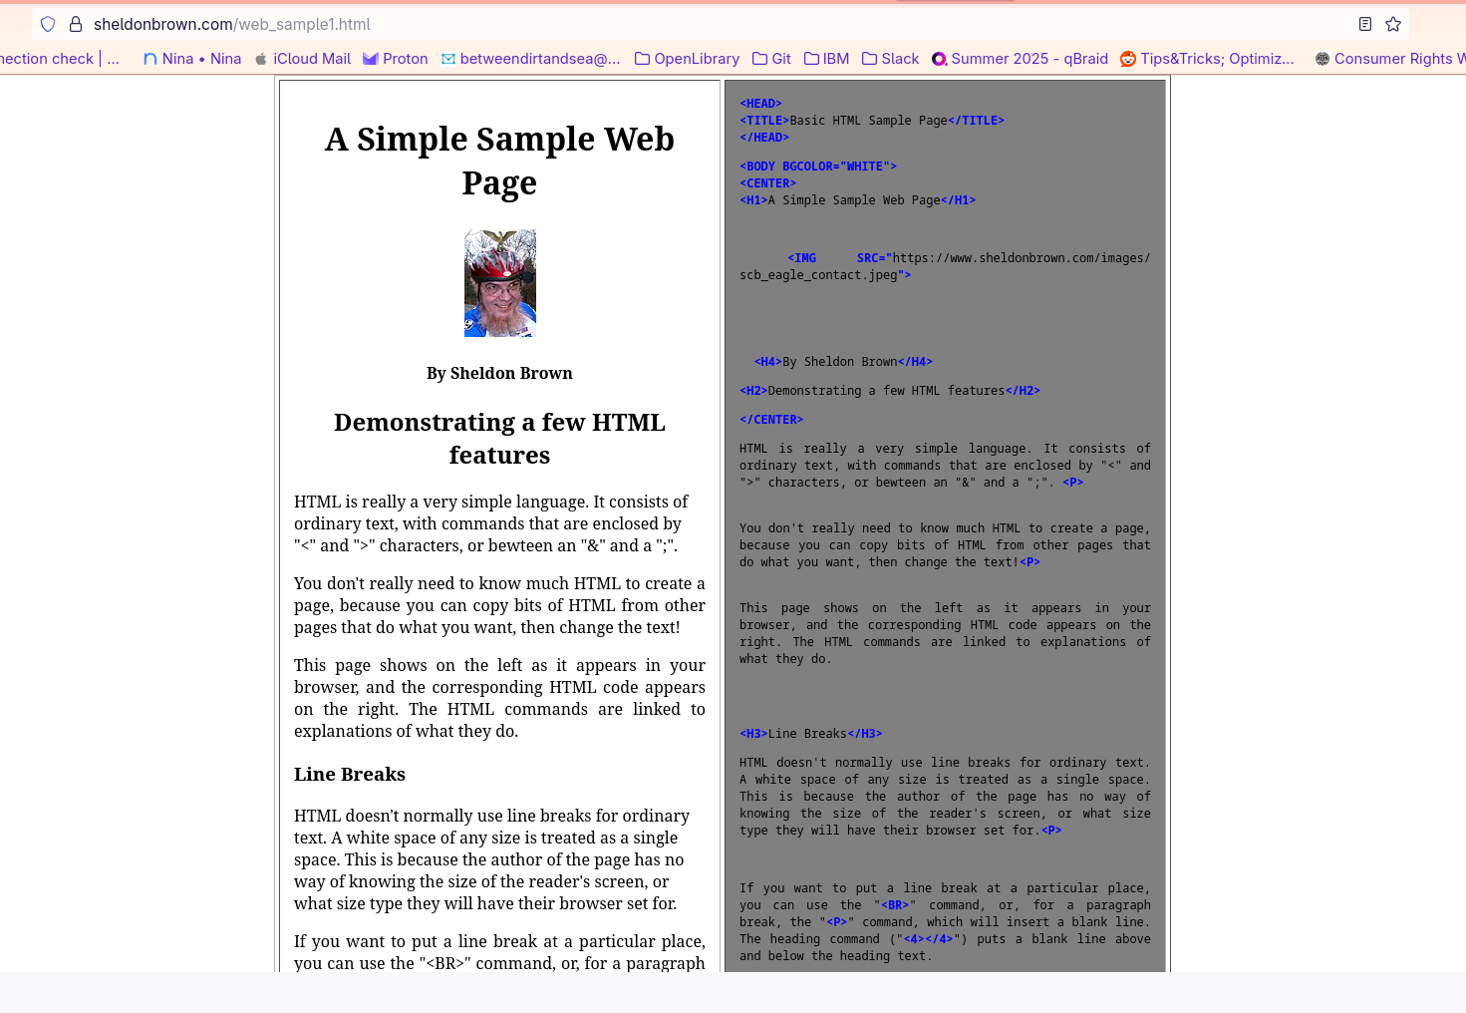
Sheldon’s Website

Slide 9
Time to make a website
- Open any text editor
- Start writing HTML
- Save the file: name.html
- Close the file
- Try opening the html file

Slide 10
Defining a style
- Create a .css file; file.css
- Add entries for the following
  Bold for all listed content
  Borders for all divs
  Blue for all headers

Slide 11
Grid and Flexbox

Slide 12
Finding information
W3 Schools;
  HTML : https://www.w3schools.com/html/default.asp
  CSS : https://www.w3schools.com/cssref/index.php
  Javascript : https://www.w3schools.com/js/default.asp

