Slide 1
Build a Website – Class 2
Xavier Esteve - Volunteer
Broward County SW Regional Library

Slide 2
What we covered previously
HTML Editing
Some Styling with css

Slide 3
What will be covered in this lesson
Using Node.js to run a site in real-time
Some more html editing for page layout and styling with css. Starting with a template.

Slide 4
What is Node.js?
It can handle many connections at once without waiting for one to finish before starting another. Making it great for real-time apps and websites. Here are some examples of what you can build with Node.js:
Web servers and websites
REST APIs
Real-time apps (like chat)
Command-line tools
Working with files and databases

Slide 5
How to start using Node.js
Download and Install Node.js
Go to https://nodejs.org
Download the LTS (Long Term Support) version
Run the installer and follow the instructions
Verify Installation
Open your terminal/cmd and type
  node --version
  npm --version

Slide 6
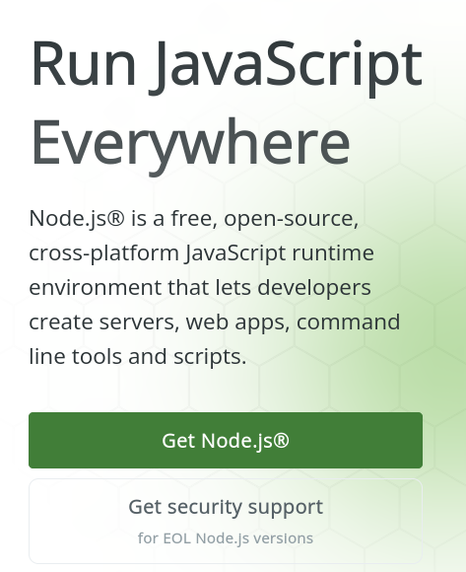
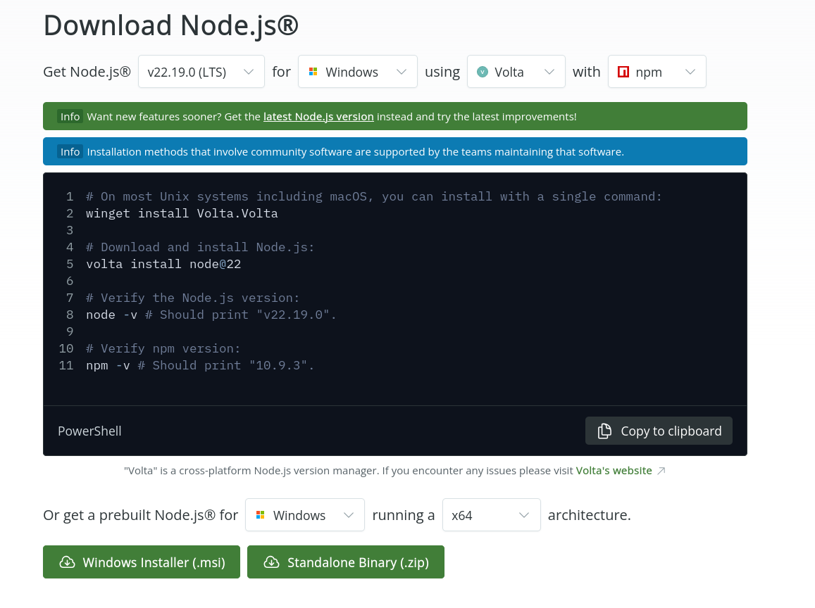
Download

Slide 7
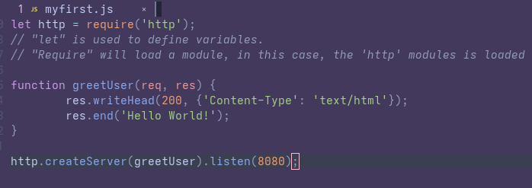
Getting Started
Create a file myfirst.js and add the following code

Slide 8
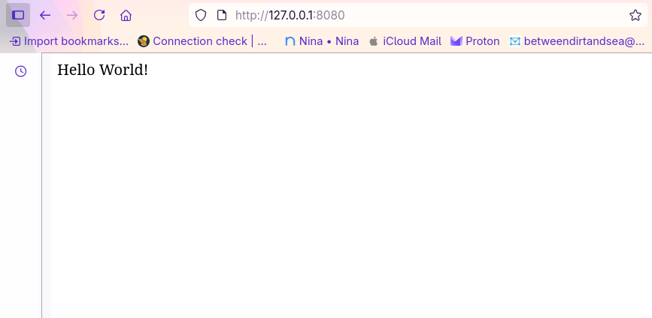
Getting Started Pt. 2
Initiate the Node.js file: `node myfirst.js` and open browser.

Slide 9
Reviewing Javascript
At a high level Javascript applications are made up of statements and expressions.
Statements
A statement is a unit of instruction made up of one or more lines of code that represent an action. For example, you can use the following statement to assign a value to a variable named myVariable:
let myVariable = 4;
myVariable;
> 4
Block statements
A block statement groups any number of statements and declarations inside a pair of braces ({}). It lets you combine statements in places where JavaScript expects only one.
You'll most frequently see block statements alongside control flow statements, such as if:
if ( x === 2 ) {
//some behavior;
}

Slide 10
Reviewing Javascript
Expressions
An expression is a unit of code that results in a value, and can therefore be used wherever a value is expected. 2 + 2 is an expression that results in the value 4:
2 + 2;
> 4

Slide 11
Data types and structures

Slide 12
Data types and structures
Primitives are the simplest types of data in JavaScript. A primitive literal are immutable values, meaning they can't be changed to represent other values in the same way that JavaScript's more complex object-based data structures can.
For example, while the value of a variable named theTruth can be reassigned a value of false, the boolean literal true can never represent any value other than true, in the same way the number literal 5 can never represent the value of another number.
There are seven primitive data types:
Numbers
Strings
Booleans
null
undefined
BigInt
Symbol

Slide 13
Datatypes and structures
null
The null keyword represents an intentionally defined absence of value.
undefined
undefined is a primitive value assigned to variables that have just been declared, or to the resulting value of an operation that doesn't return a meaningful value. For example, this can happen when you declare a function in a browser's developer console:
function myFunction() {}
> undefined

Slide 14
Variables

Slide 15
Variables
A variable's name is called an identifier. A valid identifier must follow these rules:
Identifiers can contain Unicode letters, dollar signs ($), underscore characters (_), digits (0-9), and even some Unicode characters.
Identifiers can't contain whitespace, because the parser uses whitespace to separate input elements. For example, if you try to call a variable my Variable instead of myVariable, the parser sees two identifiers, my and Variable, and throws a syntax error ("unexpected token: identifier").
Identifiers must start with a letter, underscore (_), or dollar sign ($). They can't start with digits, to prevent confusion between numbers and identifiers:
  let 1a = true;
  > Uncaught SyntaxError: Invalid or unexpected token
"Reserved words" that are already syntactically meaningful can't be used as identifiers.

Slide 16
Variables
Declaration
There are multiple ways to make JavaScript aware of an identifier, a process called "declaring" a variable. A variable is declared using the let, const, or var keywords.
Use let instead of var. This is more modern and better supported. Will lead to less issues.
Use the equal ‘=’ sign to assign or reassign a value to a variable.
  let myVariable = 5;
  myVariable + myVariable
  > 10
Undefined example
  let myVariable;
  myVariable;
  > undefined
  myVariable = 5;
  myVariable + myVariable
  > 10

Slide 17
Variables - Scoping
A variable's scope is the part of a script where that variable is available. Outside a variable's scope, it won't be defined—not as an identifier containing an undefined value, but as if it hadn't been declared.
Depending on the keyword you use to declare a variable and the context in which you define it, you can scope variables to block statements (block scope), individual functions (function scope), or the entire JavaScript application (global scope).
https://web.dev/learn/javascript/data-types/variable#scope

Slide 18
Functions

Slide 19
Functions – Introduction
A function is a modular, reusable block of statements used to perform a set of related tasks, such as calculating and returning a value based on arguments provided to the function.
function myFunction() {
console.log( "This is my function." );
};
A function can be assigned to a variable, passed as an argument to other functions, and returned by other functions.

Slide 20
Functions - Calling
Referencing a function
function myFunction() {
console.log( "This is my function." );
};
myFunction;
> myFunction() {
console.log( "This is my function." );
}
Calling a function
function myFunction() {
console.log( "My function has been executed." );
};
myFunction();
> "My function has been executed."

Slide 21
Looking back at our first js file
let http = require('http');
function greetUser(req, res) {
res.writeHead(200, {'Content- Type': 'text/html'});
res.end('Hello World!');
}
http.createServer(greetUser).listen(8080);
Is this clearer now?

