Slide 1
Mercury: Supporting Scalable Multi-Attribute Range Queries
A. Bharambe, M. Agrawal, S. Seshan
In Proceedings of the SIGCOMM’04, USA
Παρουσίαση:
Τζιοβάρα Βίκυ
Τσώτσος Θοδωρής
Χριστοδουλίδου Μαρία

Slide 2
Introduction (1/2)
Mercury is a scalable protocol for supporting
  multi-attribute range-based searches
  explicit load balancing
Achieve its goals of logarithmic-hop routing and near-uniform load balancing

Slide 3
Introduction (2/2)
Main components of Mercury’s design
  Handles multi-attribute queries by creating a routing hub for each attribute in the application schema
    Routing hub: a logical connection of nodes in the system
    Queries are passed to exactly one of the hubs associated with its queried attributes
    A new data item is sent to all associated hubs
  Each routing hub is organized into a circular overlay of nodes
    Data is placed contiguously on this ring, i.e. each node is responsible for a range of values for the particular attribute

Slide 4
Using existing DHTs for range queries
Can we implement range queries using insert and lookup abstractions provided by DHTs???
  DHTs designs use randomizing hash functions for inserting and looking up keys in the hash table
  Thus, the hash of a range is not correlated to the hash of the values within a range.
One way to correlate ranges and values is:
  Partition the value space into buckets. A bucket forms the lookup key for the hash table.
  Then a range query can be satisfied by performing lookups on the corresponding buckets.
  Drawbacks!!!!!!!
    Perform the partitioning of space a priori which is difficult, i.e. partitioning of file names
    Query performance depends on the way partitioning performed.
    The implementation is complicated

Slide 5
Mercury Routing – Data Model
Data item: A list of typed attribute-value pairs, e.g. each field is a tuple of the form (type, attribute, value)
  Type: int, char, float and string.
Query: A conjunction of predicates which are tuples of the form (type, attribute, operator, value)
  Operators: <, >, ≤, ≥, =.
  String operators: prefix (“*n”), postfix (“j*”)
A disjunction is implemented by multiple distinct queries

Slide 6
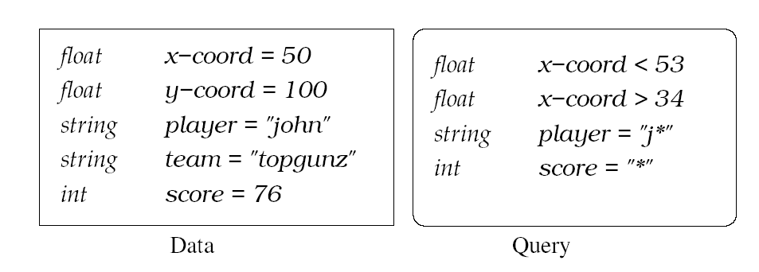
Example of data item and a query

Slide 7
Routing Overview (1/4)
The nodes are partitioned into groups called attribute hubs
  A physical node can be part of multiple logical hubs
Each hub is responsible for a specific attribute in the overall schema
  This mechanism does not scale very well as the number of attributes increases and is suitable only for applications with moderate-sized schemas.

Slide 8
Routing Overview (2/4)
Notation
A: set of attributes in the overall schema
A_{Q}: set of attributes in a query Q
A_{D}: set of attributes in a data-record D
π_{α}: value/range of an attribute α in a data-record/query.
H_{a}: hub for attribute α
r_{a}: a contiguous range of attribute values

Slide 9

Routing Overview (3/4)
A node responsible for a range r_{a}
  resolves all queries Q for which π_{α}(Q)∩r_{a} ≠ {}
  stores all data-records D for which π_{α}(D) r_{a}
    Ranges are assigned to nodes during the join process
A query Q is passed to exactly one hub H_{a} where α is any attribute from the set of query attributes
Within the chosen hub, the query is delivered and processed at all nodes that could have matching values

Slide 10
Routing Overview (4/4)
In order to guarantee that queries locate all the relevant data-records:
  A data-record, when inserted, is sent to all H_{b} where b A_{D}
  Within each hub, the data-record is routed to the node responsible for the record’s value for the hub’s attribute
Alternative method: send a data-record to a single hub in A_{D} and queries to all hubs in A_{Q}
  Queries may be extremely non-selective in some attribute, thereby resort to flooding a particular hub. Thus the network overhead is larger compared to the previous approach.

Slide 11
Replication
It is not necessary to replicate entire data records across hubs.
A node within one of the hubs can hold the data record while the other hubs can hold a pointer to the node
  Reduction of storage requirements
  One additional hop for query resolution

Slide 12
Routing within a hub
Within a hub H_{a}, routing is done as follows:
  for routing a data-record D, we route to the value π_{a}(D).
  for a query Q, π_{a}(Q) is a range. Hence, for routing queries, we route to the first value appearing in the range and then use the contiguity of range values to spread the query along the circle, as needed.

Slide 13

Routing within a hub - Example
Query
d[240, 320)
50 ≤ x ≤ 150
150 ≤ y ≤ 250
e[0, 105)
a[160, 240)
H_{x}
c[0, 80)
H_{y}
Data item
x = 100
y = 200
g[210, 320)
b[80, 160)
f[105, 210)
minimum value=0, maximum value=320 for the x and y attributes
the data-record is sent to both H_{x} and H_{y} and stored at nodes b and f
respectively.
The query enters H_{x} at node d and is routed and processed at nodes b
and c.
Notes:
Explain how histograms can aid in selectivity estimation; how sending a query to only one attribute can make this optimization possible.
We are aiming at really reducing query load here; if we think queries are infrequent, one can turn this around.

Slide 14
Additional requirements for Routing
Each node must have a link to
  the predecessor and successor nodes within its own hub
  each of the other hubs (cross-hub link)
We expect the number of hubs for a particular system to remain low

Slide 15
Design Rationale
The design treats the different attributes in an application schema independently, i.e., routing a data item D within a hub for attribute α is accomplished using only π_{α}(D).
An alternate design would be to route using the values of all attributes present in D
  Since each node in such a design is responsible for a value-range of every attribute, a query that contains a wild-card attribute can get flooded to all nodes
By making the attributes independent, we restrict such flooding to at most one attribute hub.
Furthermore, it is very likely some attribute of the query is more selective. Thus routing the query to that hub, can eliminate flooding.

Slide 16
Constructing Efficient Routes (1/2)
Using only successor and predecessor pointer can result in θ(n) routing delays for routing data-records and queries.
In order to optimize Mercury’s Routing:
  each node stores successor and predecessor links and maintains k long-distance links
  This results to each node having a routing table of size k+2
The routing algorithm is simple:
  let neighbor n_{i} be in charge of the range [l_{i}, r_{i}), and
  d denotes the clockwise distance or value-distance between two nodes
  When a node is asked to route a value v, it chooses the neighbor n_{i} which minimizes d(l_{i},v).

Slide 17
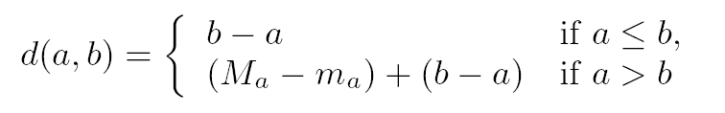
Constructing Efficient Routes (2/2)
Let m_{a} and M_{a} be the minimum and maximum values for attribute a, respectively.
A node selects its k links by using a harmonic probability distribution function
It can be proven that the expected number of routing hops for routing to any value within a hub is O((1/k)*log²n), under the assumption that node ranges are uniform

Slide 18
Node Join and Leave
Each node in Mercury needs to construct and
maintain the following set of links:
  successor and predecessor links within the attribute hub,
  k long-distance links for efficient intra-hub routing and
  one cross-hub link per hub for connecting to other hubs.

Slide 19
Node Join (1/2)
A node needs information about at least one node already in the system
The incoming node queries an existing node and obtains state about the hubs along with a list of representatives for each hub in the system
Then, it randomly chooses a hub to join and contacts a member m of that hub
The incoming node installs itself as a predecessor of m, takes charge of half of m's range of values and becomes a part of the hub

Slide 20
Node Join (2/2)
The new node copies the routing state of its successor m, including its long-distance links as well as links to nodes in other hubs
It initiates two maintenance processes:
  Firstly, it sets up its own long-distance links by routing to newly sampled values generated from the harmonic distribution
  Secondly, it starts random-walks on each of the other hubs to obtain new cross-hub neighbors distinct from his successor's

Slide 21
Node Departure (1/3)
When nodes depart, the successor/predecessor links, the long-distance links and the inter-hub links within Mercury must be repaired
Successor/predecessor links’ repair:
  within a hub, each node maintains a short list of contiguous nodes further clockwise on the ring than its immediate successor
  When a node's successor departs, that node is responsible for finding the next node along the ring and creating a new successor link

Slide 22
Node Departure (2/3)
A node's departure will break the long-distance links of a set of nodes in the hub
Long distance links repair:
  nodes periodically reconstruct their long-distance links using recent estimates of the number of nodes.
  Such repair is initiated only when the number of nodes in the system changes dramatically

Slide 23
Node Departure (3/3)
Broken cross-hub link repair:
A node considers the following three choices:
  it uses a backup cross-hub link for that hub to generate a new cross-hub neighbor (using a random walk within the desired hub), or
  if such a backup is not available, it queries its successor and predecessor for their links to the desired hub, or
  in the worst case, the node contacts the match-making (or bootstrap server) to query the address of a node participating in the desired hub.

Slide 24
Τέλος!!!

