Slide 1
Distributed Avatar Management for Second Life
Matteo Varvello (Eurecom-Thomson)
With Stefano Ferrari (Eurecom-Thomson), Ernst Biersack (Eurecom)
Christophe Diot (Thomson)
  Paris, November 23rd, 2009

Slide 2
Introduction to Second Life
Second Life (SL) is a synthetic world where multiple participants interact via the Internet
  Users meet, communicate, play and trade
  16 million registered users (September 2009)
The virtual world is made of independent regions
  Regions are filled with objects (cars, trees and buildings)
  Users interact through their avatars
Client/Server (C/S) architecture
  One region per server

Slide 3
Motivations
Current Second Life C/S design does not scale
  Maximum 100 concurrent avatars per server
  World simulation is very often “slowed down” [CONEXT’08]
Peer-to-Peer (P2P) can solve scalability issues
  How would Second Life perform in P2P?
  How to design efficiently a P2P virtual world?

Slide 4
Outline
Distributed Avatar Management
The Delaunay Network
Experimental Evaluation
Results
Conclusions and Future Work

Slide 5
Distributed Avatar Management*
Problem
  Neighbor avatar discovery
  Dissemination of avatar state updates
Many candidate solutions
  Distributed Hash Table, Delaunay/Voronoi Network, Multicast Tree, etc.
*Distributed Object Management was presented in [INFOCOM’09]
Notes:
Need to motivate why we use DELAUNAY!!!!

Slide 6
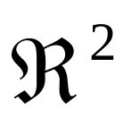
The Delaunay Network
Why?
  Popular design for distributed avatar management
  Convenient for Second Life [CONEXT’08]
  Missing experimental evaluation!!
What?
  P2P network topology based on the Delaunay triangulation
  The Delaunay triangulation of a set of N points in is a triangulation of points DT(N) such that no point p lies inside the circumcircle of any triangle in DT(N).
Notes:
#CHD#: why is weak ☹

Slide 7
The Delaunay Network (cont’d)
Avatar coordinates are used to construct the Delaunay triangulation
E
A
B
X
D
C
  Can we achieve better QoE with Delaunay? (than with C/S)

Slide 8
Experimental Evaluation
Instrument open source SL client [libsecondlife]
Avatar traces
  SL crawler [CONEXT’08]
  207 avatar sessions over one hour
Empty and unpopular SL region as a playground
Planetlab machines as hosts
Notes:
Say we did some analytical results
Re-call the measurement done and that the regions with different object compositions

Slide 9
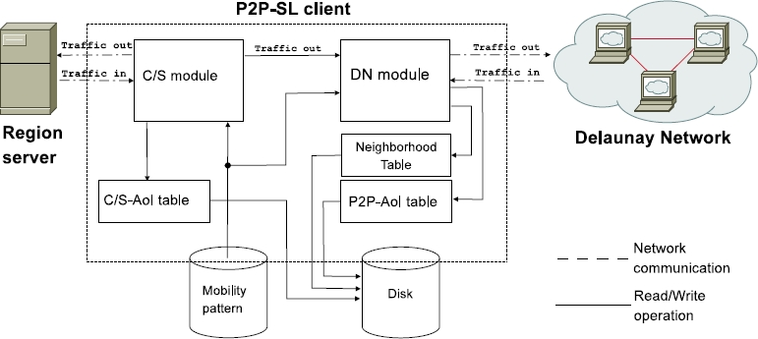
Evaluation – The P2P-SL Client
Notes:
Say we did some analytical results
Re-call the measurement done and that the regions with different object compositions

Slide 10
Evaluation – Metric Definition
Inconsistency
  It is the fraction of wrong avatar information contained within an avatar Area of Interest (AoI)
  It takes values between 0 and 1
Inconsistency Duration
  It is the time an avatar needs to achieve a consistent view of the avatars in its AoI
Notes:
INCONSISTENCY - where 0 means that all the information contained in an avatar AoI is correct, and 1 means that all the information contained in an avatar AoI is wrong.
INC DURATION - We compute the inconsistency duration by starting a timer whenever an inconsistency is detected in an avatar AoI and stopping it as soon as the avatar’s AoI becomes consistent again.

Slide 11
Evaluation – Limitations
Experimenting on empty region is in favor of C/S
We measure user QoE “re-playing” real (monitored) avatar behaviors using bots
  Avatar behavior changes according to factors such as perceived performance
  Lack of human feedback

Slide 12
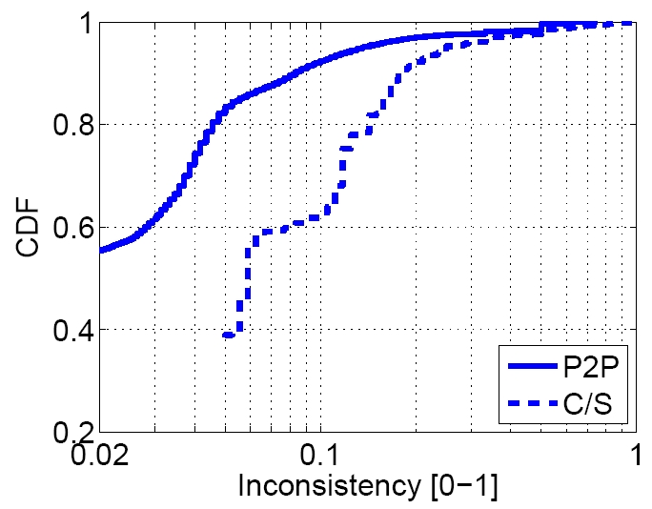
Results – Inconsistency
P2P is more consistent 20-40% of the times
Comparable Inconsistency

Slide 13
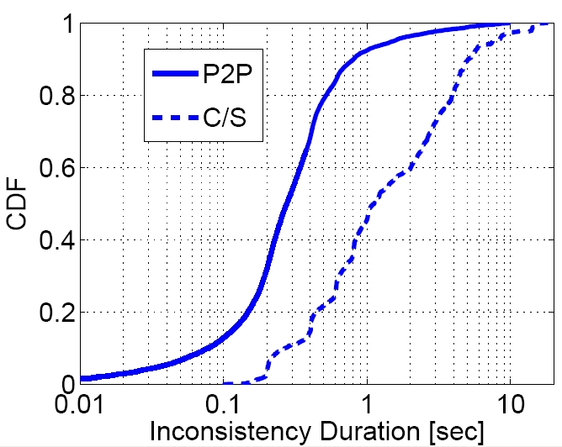


Results – Inconsistency Duration
P2P is about 5 times more responsive than C/S!!
Notes:
P2P makes avatar experience more correct and interactive
Slow responsiveness in presence of churn, fast avatar movements and groups

Slide 14
Conclusions and Future Work
We evaluate P2P versus C/S Second Life
  P2P makes avatar experience more correct and interactive
  Slow responsiveness in presence of churn, fast avatar movements and groups
Future Work
  Improve performance of the Delaunay Network
  Integrate in the P2P-SL client a distributed object management

Slide 15

Questions?

