Slide 1
Scaling Melees in Peer-to-Peer Games with Donnybrook
Jeffrey Pang, Frank Uyeda, John Douceur, Jay Lorch

Slide 2
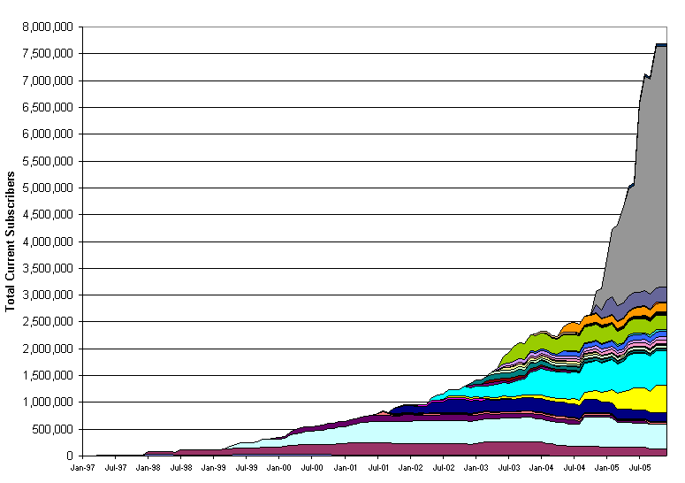
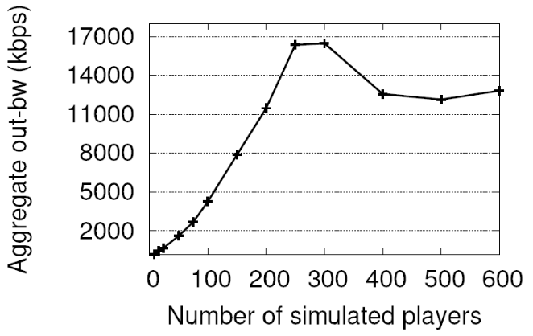
Why P2P Games?
http://www.mmogchart.com/
8 million
Multiplayer games are popular
  Some recent research:
    Colyseus [NSDI ‘06]
    SimMUD [INFOCOM ’04]
Centralized
First Person Shooter games scale poorly
7 million
World of Warcraft
6 million
5 million
Number of subscribers
4 million
Final Fantasy XI
3 million
Everquest
2 million
Ultima Online
1 million
1997
1998
1999
2000
2001
2002
2003
2004
2005
Quake II server
Bandwidth (kbps)
Colyseus [NSDI ’06]

Slide 3
Overview
Limited outbound network capacity constrains scale of peer-to-peer games
  Home users with cable/DSL can’t send frequent game state updates to many others
  Multiplayer melees don’t work – too many to send to
Donnybrook contributions
  Techniques to accommodate limited bandwidth,
  even in melees
  A prototype illustrating these techniques
Our user study shows we greatly increase scalability while preserving fun and fairness

Slide 4
Outline
P2P Games Background
Outbound Capacity Problem
Guidable AI
Evaluation
Summary

Slide 5
Game Execution Model
Game State:
  Collection of distinct objects (players, missiles, items, etc.)
Game Execution:
  Each object has a Think function:
  Think() { ReadPlayerInput(); DoActions(); ... }
  Execute each object once per frame:
  Each 50ms do {
  foreach object do {
  object->Think();
  }
  }

Slide 6



P2P Object Model
Local Object Store
Primary object
updates for
Replica
objects
Primary:
  Execute Think function
  Send state to all peers
Replicas:
  Receive state updates
  Apply state update to replica

Slide 7
Outline
P2P Games Background
Outbound Capacity Problem
Guidable AI
Evaluation
Summary

Slide 8
The Outbound Capacity Problem
128-384kbps up,
1.5-3Mbps down
Residential broadband is asymmetric
In many games, players can see many others
Insufficient capacity to send updates at preferred frequency
⇒ must send updates at lower frequency
Cost per Peer in Quake III:
Update rate = 20 updates/sec
Update size = ~100 bytes
⇒
Bwidth per peer >= 16kbps
⇒
Supportable peers at 128kbps <= 8
Notes:
Large, open map
Very popular region
(social nature of games ⇒
popularity follows power law)

Slide 9
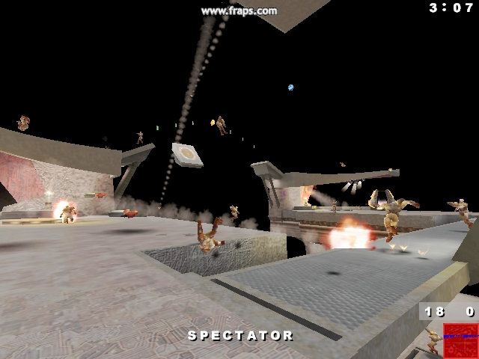
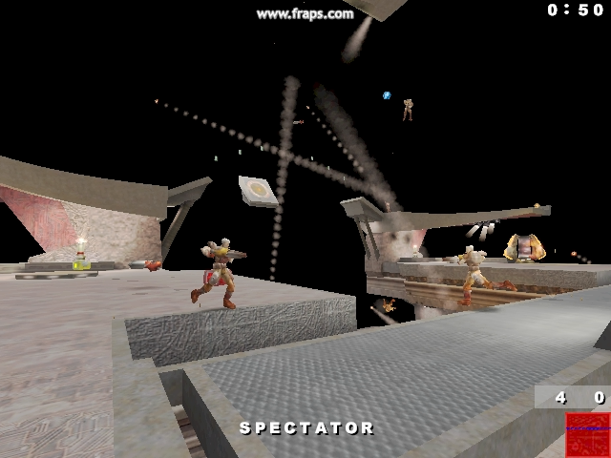
The Outbound Capacity Problem
P2P Quake on a LAN
P2P Quake on a Cable Modem

Slide 10
Outline
P2P Games Background
Outbound Capacity Problem
Guidable AI
Evaluation
Future Work

Slide 11
Guidable AI
Existing P2P game architectures
  Updates are opaque
  (just state snapshots --- “blob of bytes”)
  Secondary replicas can be as stale as the update interval
  Update rate per peer is fixed
Donnybrook’s Solution: Guidable AI
  Updates aggregate information
  (predict continuous behavior)
  Secondary replicas can think for themselves
  (they are “guided” by updates, rather than follow them strictly)
  Update rate per peer is variable (quality of service)

Slide 12
Design Principles
Timely and realistic interaction is most important
  Example: When I shoot you, you should take damage immediately
  Why: Multiplayer games are social; inconsistent interactions are jarring
  Guidable AI Component: Pairwise Rapid Agreement
Player attention is bounded even when in a crowd
  Example: I focus on my current target or important players
  Why: Human cognitive limitations
  Guidable AI Component: Frequent Update Set
For out-of-focus objects, value realism over accuracy
  Example: “warping” to correct location is more jarring than walking
  Why: if player is not focused on an object, should not draw attention
  Guidable AI Component: Prediction/Replica AI

Slide 13
Pairwise Rapid Agreement
Interaction: when player A modifies player B
(i.e. A performs a write on B)
Goal: modification is consistent and applied quickly
Analogous to async RPC
  Player A sends mod to Player B
  Player B checks preconditions locally
  Player B then applies mod
  Optional: Player A gives a deadline to B by when the PRA should be applied (e.g., so B has time to make local preconditions hold)
PRAs required in Quake III:
  Damage, Death, Item Pickup, Door Opening

Slide 14
Frequent Update Set
Each player divides other peers into two classes:
  FU Set: peers get updates every frame
  Best Effort: peers get updates when bandwidth is available
  (using round-robin)
α bandwidth allocated to FU Set, (1- α) to Best Effort
Who goes in my FU Set?
  Compute attention-value for how much I am focused on each player
    Attention based on distance, aiming angle, and PRAs
  Attention-values are sent between peers periodically
  Peers with the highest attention-values on me go in my FU Set

Slide 15
Prediction
Motivation: state snapshots get stale fast
  Example: players can traverse the entire diameter of a map in several seconds in Quake III
  Goal: send prediction of state at the time of the next expected update
  Example: predict the motion path of a player until the next update
Predicted Properties:
  Predict position: use in-game simulation to figure how where physics brings player in next second
  Predict viewing angle: use view angles to estimate the target a player is aiming at
  Predict Events: use number-of-shots-fired to estimate when a player is “shooty”, etc.

Slide 16
Replica AI
Idea: Use AI to make transition between updates appear realistic
Properties smoothed with AI
  Position: use existing path finding code to make replica move smoothly
  Angle: have AI turn smoothly toward predicted targets
  Events: AI can not perform “non-undoable” events (death, etc.)
Convergence
  Motivation: Players in focus should be represented more accurately
  Solution: Converge to actual state when receiving frequent updates
    Focus on player B
    ⇒ in player B’s FU Set
    ⇒ Error(replica of B, actual state of B) decreases with each update
    When Error() < ε, use player B’s update snapshots instead of AI
    Error() is function chosen so transition is smooth

Slide 17
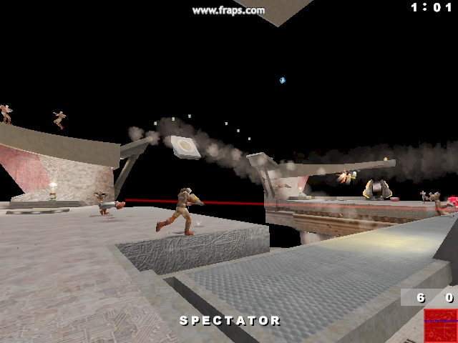
Guidable AI in Action
P2P Quake on a LAN
P2P Quake on a Cable Modem
with Donnybrook Guidable AI

Slide 18
Outline
P2P Games Background
Outbound Capacity Problem
Guidable AI
Evaluation
Summary

Slide 19
Evaluation Overview
Goals
  Determine how much Guidable AI improves playability of P2P Quake III
  Determine how close Guidable AI gets to Quake III on a LAN (i.e., optimal)
Methodology
  User study to evaluate “funness”
  Bot simulation to evaluate “fairness”

Slide 20
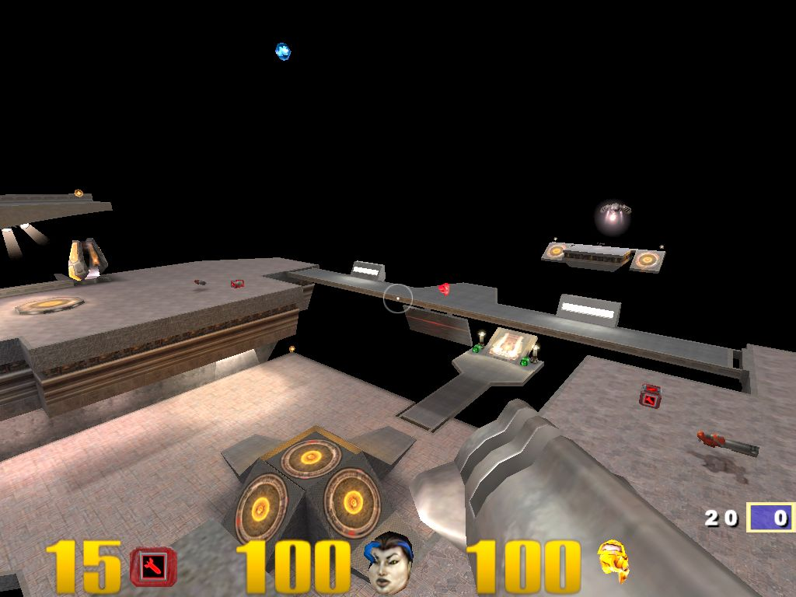
Evaluation Methodology
Compare 3 versions of P2P Quake
  S: Current state-of-the art in P2P setting
  D: Donnybrook Guidable AI in P2P setting
  Q: Quake III in LAN setting (optimal)
Emulate P2P Game
  15 min Quake III game
  32 players
    30 bots
    2 real players
  Focus on player-player interaction
    Player kills worth 10x more
    Winner gets MS Dining coupon
    Encourage trash talk ☺
Parameters:
P2P: 108kbps
LAN: 4Mbps
FU Set α = 0.77
⇒ size = ~4
⇒ ~1 update per sec.

Slide 21
Evaluation Methodology (cont.)
User Study Overview
  Each pair of players told 2 Quake III “servers” exist (A and B)
  Start playing on A, can vote to switch to B, and can vote to switch back and forth
  When both players vote, game continues on other version
  Analog to how players choose servers in existing games
  (if server is good, stay, otherwise leave and try another)
  Play additional 5 min on least-used version so they can compare

Slide 22
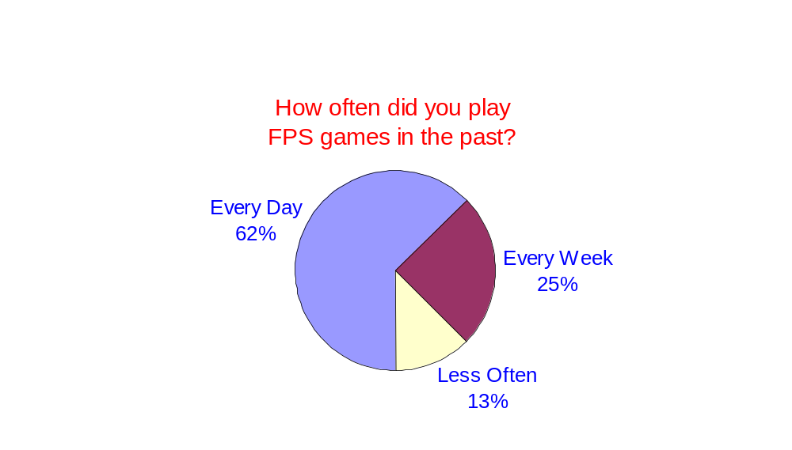
Evaluation Methodology (cont.)
User Study Stats
  D vs. S: 12 pairs (1/2 start on each)
  D vs. Q: 32 pairs (1/2 start on each)
  98 total participants
“Funness” Metrics
  Departure Time: How long before a player wants to switch?
  Total Stay Time: How long does a pair play on each version?
  Self-Reported “Fun Score”: How fun was server A? Server B?
  Self-Reported Preference: Do you prefer A or B?

Slide 23
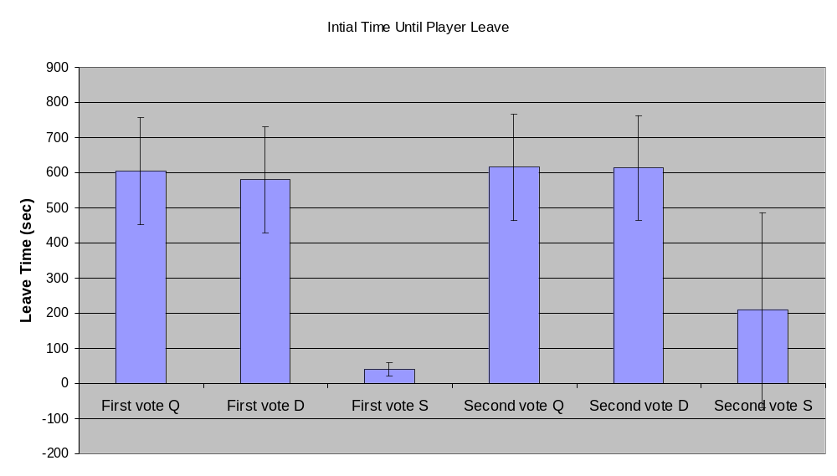
Player Departure Time

Slide 24
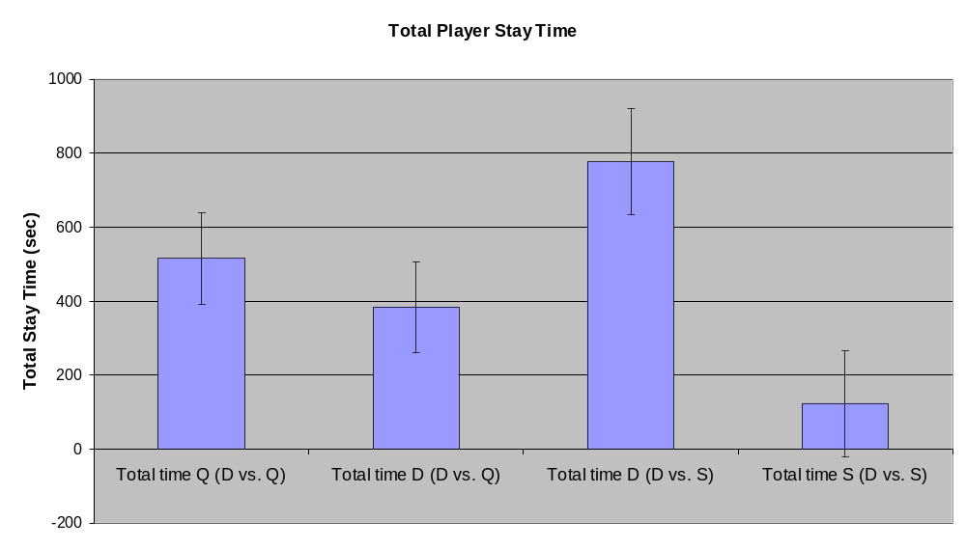
Total Player Stay Time

Slide 25
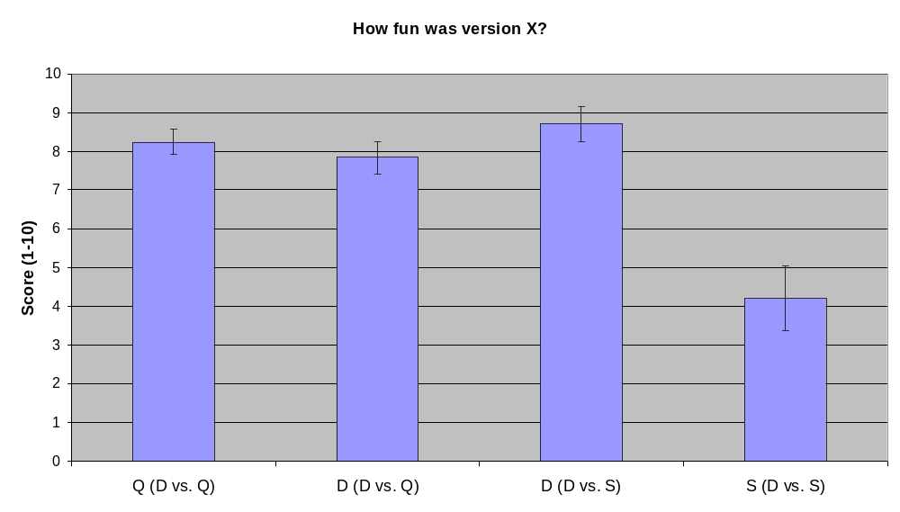
Self-Reported Playability

Slide 26
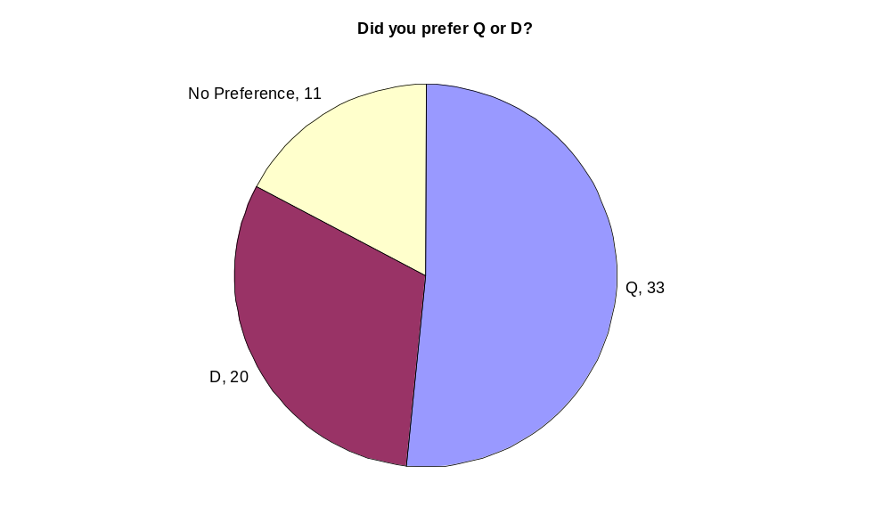
Self-Reported Preference

Slide 27
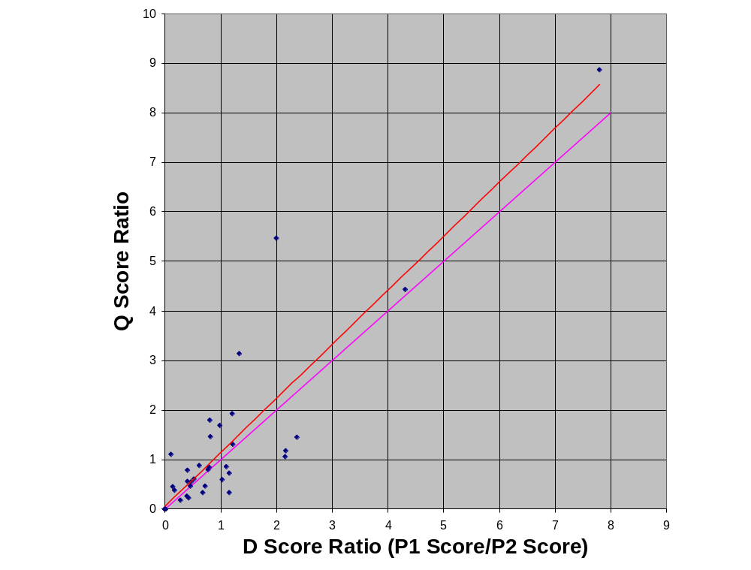
Fairness Preservation

Slide 28
Outline
P2P Games Background
Outbound Capacity Problem
Guidable AI
Evaluation
Summary

Slide 29
Summary
Guidable AIs enable large-scale P2P games in low bandwidth environments
Three key components for Guidable AI
  Pairwise Rapid Agreement
  Frequent Update Set
  Prediction/Replica AI
Initial results are positive
  Players clearly prefer Guidable AIs over existing update techniques
  A low bandwidth game with Guidable AIs is almost as playable as an optimal LAN game

