Slide 1
DS 6306: Case Study on Employment
Xavier Mojica
Notes:
Welcome members of DDSAnalytics

Slide 2
Agenda
What’s the Scope
Possible Reasons for Attrition:
Correlations: Possible Contenders
Job Insights
The 3 Culprits
What this Means for You

Slide 3
Cleanup
There were no errors in any data set.
The Data had high integrity.
Notes:
No Data were harmed in the making of this presentation.

Slide 4
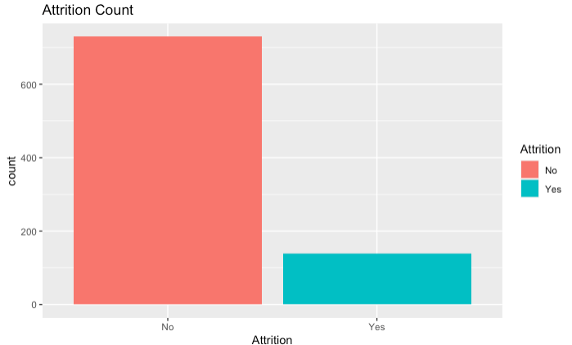
What’s the Scope Looking at Attrition
Notes:
What does this mean? As DDSAnalytics you may be asking yourself, what are we looking for? What is the purpose of this project? It is to predict the amount of attrition here at DDSAnalytics.
You may be wondering how did we define attrition. This refers to the loss of employees due to any life event such as elimination of a position, resignation or retirement. And those positions left vacant will remain unfilled.
From one angel, there are benefits of attrition for your organization such as you may want to reduce turnover bc recruiting and training of new hires is one of the main costs that affect all companies.
Another perspective is to help prevent attrition which will positively affect the organization by minimizing costs thorough incentives such as pay increases or benefits which shows value in your employees or flexibility via flexible hours or telecommuting in order to give everyone work-life balance.
To begin it is important to understand what our base is with the current data that was provided to me. In this graph we can see that the left side’s total amount of No Attrition is 730 and the amount of Yes Attrition is 140. That means there is a 19.18% chance of attrition as our established baseline.

Slide 5
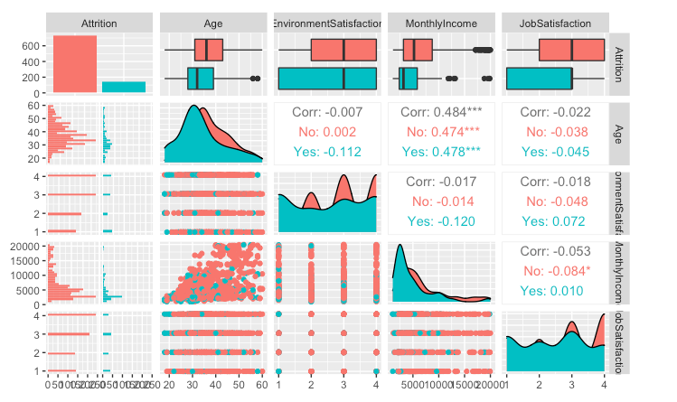
Correlations: Possible Contenders
Notes:
Let’s take a look at the differences of means with respect to Attrition and possible variables. Difference in means measure the absolute difference bw the mean value in two different groups.
Overall, Attrition has some differences in distribution in reference to different variables.

Slide 6
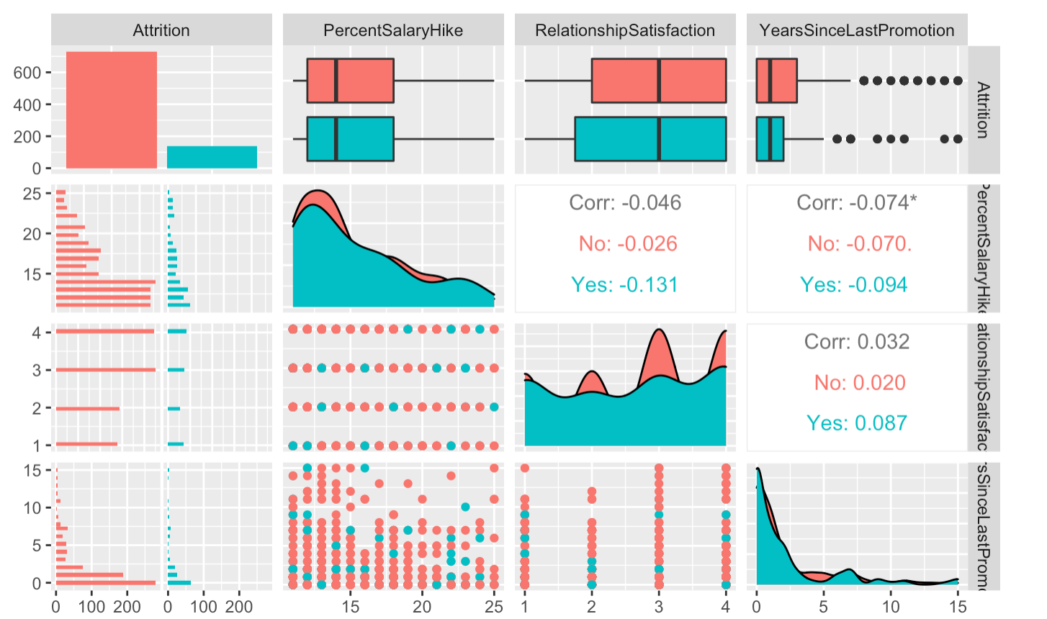
Correlations: Possible Contenders

Slide 7
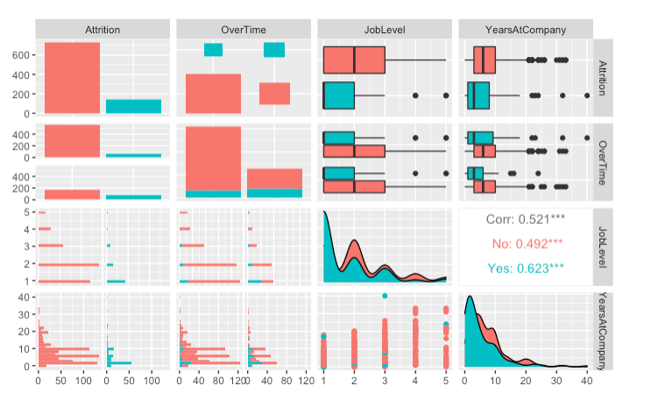
Correlations: Possible Contenders

Slide 8
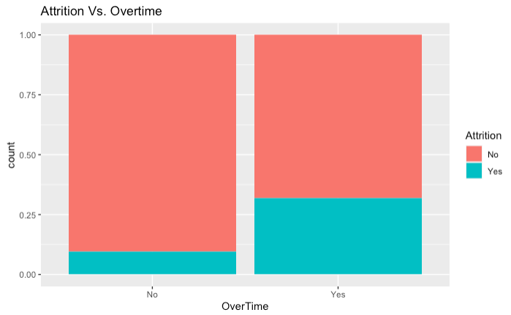
Correlations: Possible Contenders
Notes:
The probability of attrition is higher with overtime

Slide 9
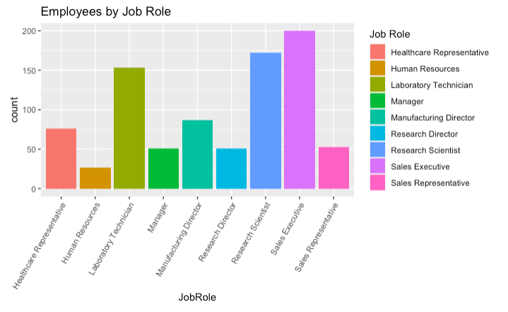
Job Insights: Number of Employees by Job Role
Notes:
Looking at the number of employees by job role we can see that Sales Executives are 200, Research Scientist 172, Laboratory Technician 153 and make up 22.98%, 19.77%and 17.58% of total employment.

Slide 10
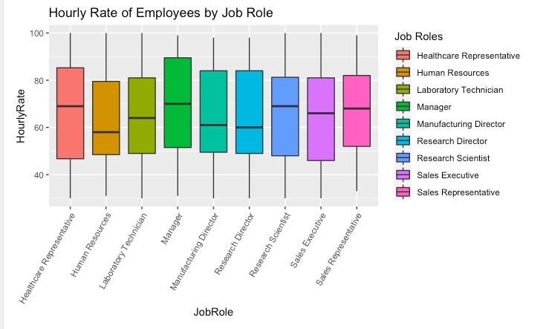
Job Insights: Hourly Rate of Employees by Job Role

Slide 11
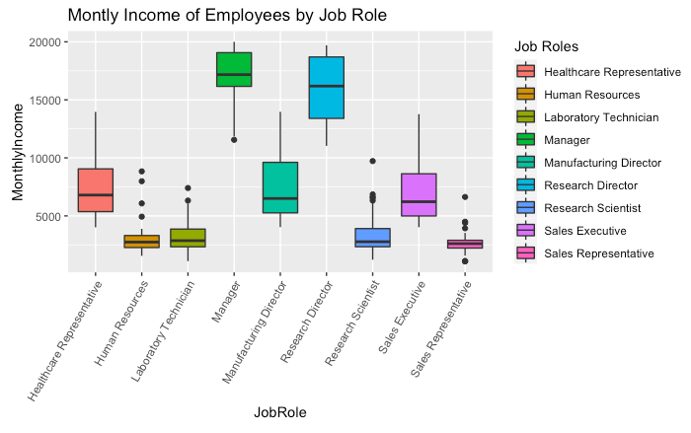
Job Insights: Monthly Income of Employees by Job Role
Notes:
As we can see from this graph, Job Role is related to Income (MonthlyIncome). Research Directors and Managers make the most and they place as the top 2 highest paying job roles within your company while the lowest incomes, which tied to job roles, would be Sales Representatives, Human Resources, Lab Tech and Research Scientist. So which roles are affected by Attrition ??

Slide 12
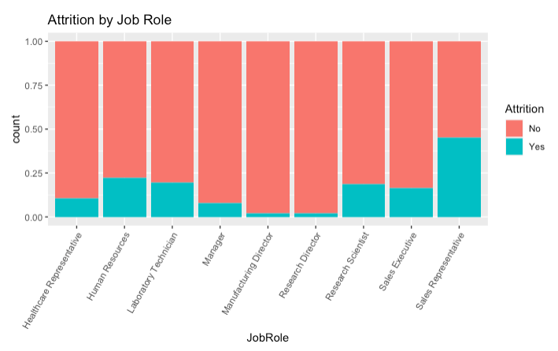
Job Insights: Attrition by Job Role
Notes:
Yes Attrition: With Attrition making up 140 units or 19.18% of the data, Sales Executives make up (33) 23.57% of attrition, Research Scientist (32) 22.85%, and Laboratory Technician (30) with 21.42% of all attrition.

Slide 13
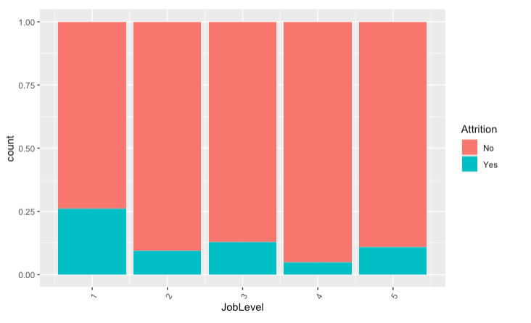
Job Insights: Attrition by Job Level
Notes:
Here we can see that Job Levels that are affected with different levels of attrition.

Slide 14
The 3 Culprits
1. When looking at Overtime. The two distinct groups for No and Yes OverTime are heavily shown to favor the Yes Attrition trait if working overtime.
2. Monthly Income plays a pivotal role as the data show that the differences between means of the two groups, which represent Yes and No Attrition, is significant. This means that for the Yes Attrition group, those individuals with a lower income are more prone to attrition.
3. Finally, looking at the data for JobLevel we can see that numerically lower numbers such as 1,3 and 2 have high amounts of attrition in comparison to job levels that are 4 and 5.
Over Time
Monthly Income
Job Level

Slide 15
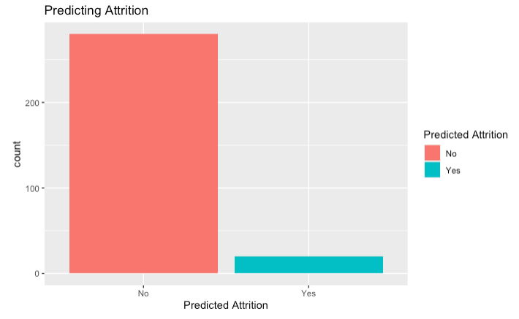
What this Means for You
Predicting Attrition
Notes:
Based on the 3 variables that I choose which were Over Time, Monthly Income, Job Level; I am very confident to say that with a 87.74% Accuracy, 90.68% Sensitivity and a 60% Specificity that my prediction will do very well to help this company minimize attrition if it chooses to do so. High Sensitivity means that there are few false negative results, and thus it is used to correctly identify as Yes to Attrition. On the other hand Specificity refers to the true negative rate, in otherwords No Attrition. From the model it predicted that you will have an estimate of 20 people who will leave, in otherwards that will fall under the Yes to Attrition category

Slide 16
Thank You for Your Time
Notes:
This concludes my presentation. Thank you for your time today. Happy holidays.

