Slide 1
DS 6306 Case Study: Beer
Xavier R. Mojica
Notes:
Greetings everyone and welcome. My name is Xavier Mojica and I’m presetting today a DS Case Study on Beer. Let us begin by talking about our favorite drink, beer .

Slide 2
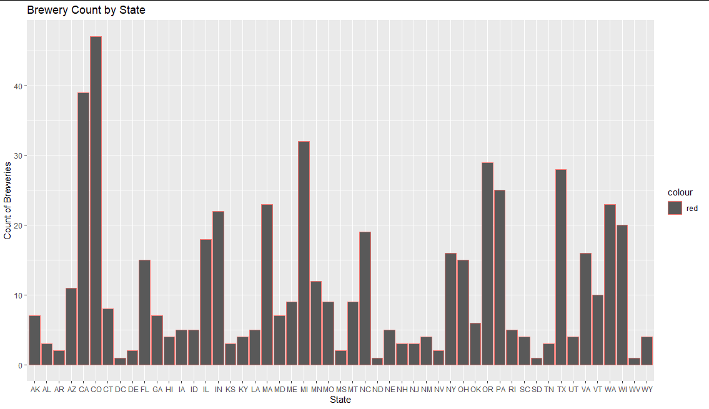
America’s Brewery Market
Notes:
Overal it’s important to look at America’s brewery market. Our first question we should be asking ourselves is how many breweries are there in the USA? There happens to be 558. So,what we can tell from this graph is that CO has the most breweries with 47 in total, followed by CA with 39 and Michigan (MI) with 32.

Slide 3
Cleanup
Before cleaning up there were 2410 entries of data.
Most had missing entries.
After cleanup, there were 1405 entries of data.
This renders the analysis more efficient.
Notes:
Before stating the analysis it’s important to clean the data. You may be asking yourselves Why clean up? It is important to identify ,fix errors and address duplicates and missing data. This insures accuracy and reliable data, that can be presented properly in order to make well informed decisions.

Slide 4
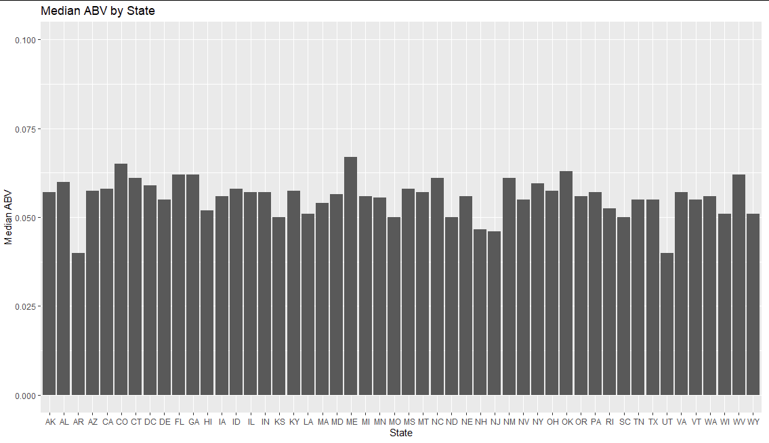
The Distribution of the Dataset
Looking at ABV
Notes:
Looking at ABV, I have arranged the set by the median abv by state. and have taken the median of ABV (alcohol content by volume) for each state. The median is the middle value when a data set is arranged from least to greatest. And why the median? The median provides us a measure of the center of this dataset by each state. I hope that this gives everyone an idea of the overall distribution.

Slide 5
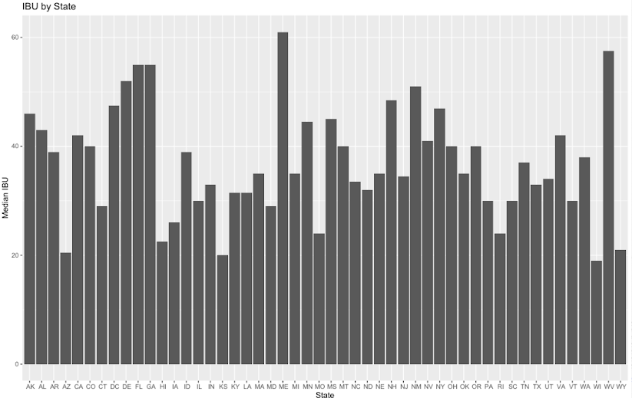
Looking at IBU
Notes:
Here, we have the median of IBU also known as the (international bitterness unit) for each state. Again, the median is the middle value of our data when it is arranged.

Slide 6
Which states have the highest median ABV and IBU?
Notes:
From all those privous differences we want to know …Which states have the heights median ABV and IBU You may be wondering …any guesses ?

Slide 7
The Winner is
Which states have the highest median ABV and IBU?
Maine!
Highest Median of ABV at 0.067.
Highest Median of IBU at 61.
Notes:
Maine is the two time winner of having the highest Alcohol By Volume at 0.067. and the highest International Bitterness Units at 61

Slide 8
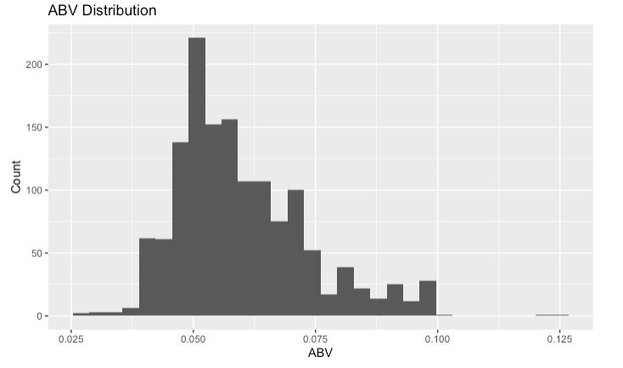
What does this means for ABV?
The Average for ABV is 0.06
Centered at 0.052
This is relatively higher to everyday beers such as Coors Light, Bud Light etc.
Notes:
Our average for ABV is 0.06 which is here and a little to the right of where the center of our graph is , overe here at 0.052. The graph shows that our data has most of the values clustered around the left side, meaning that our distribution is positive. This is relatively higher to everyday beers such as Coors Light, Bud Light etc.

Slide 9
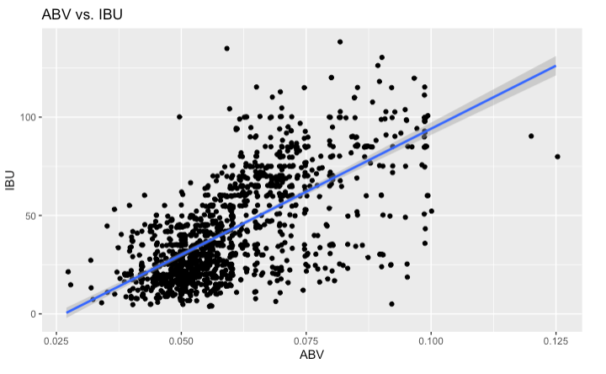
The Trend
There is a positive and strong linear relationship.
The blue line (regression) is a line that best fits our data.
The higher the Alcohol By Volume, the stronger the bitterness is.
It can be more hoppy!
Notes:
Next up lets talk about The Trend. Is there a relationship between the bitterness of beer and its alcoholic content ? Yes, It would seem that the linear approach to this model appears to be linear and positive. As we increase the ABV so does the IBU. Meaning more bitterness in higher alcoholic beers. There also are a lot of outliers but we also have a cluster of values on the lower left side

Slide 10
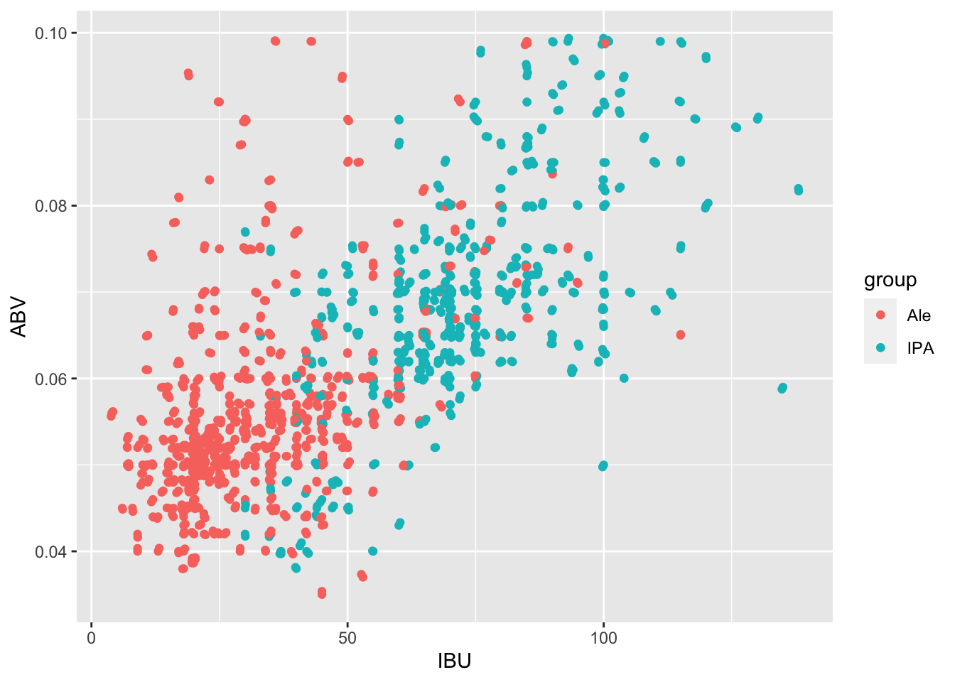
The Investigation
Notes:
After my analysis and filtering out the data for beers that only contain Ale and IPA we get this graph. My first observation is that IPAs have a higher IBU and ABV whilst Ales are lower in IBU and mostly lower in ABV but not all. So my hypothesis is that IPAs are more alcoholic and bitter whilest Ales are less bitter and less alcoholic but not necessarily bc we have some outliers/exceptions

Slide 11
My Hypothesis & Proving It
The model proved my hypothesis with 84.43% Accuracy.
Notes:
So after running my model and analysis I have concluded with 84.43% accuracy that IPAs are indeed more bitter and more alcoholic. SO what does that mean for you ?

Slide 12
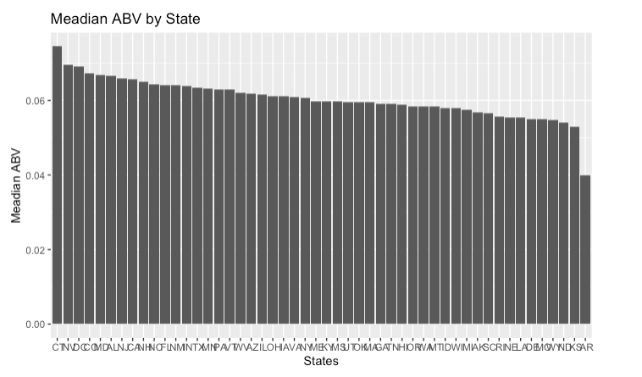
The Target Market
Notes:
Looking for eligible states for appropriate target market using ABV. If you want to make an IPA here are the states Budweiser should invest in.
#These are the top 5 states
#1 " CT" 0.0745 #2 " NV" 0.0695 #3 " DC" 0.069 #4 " CO" 0.0674 #5 " MD" 0.0668

Slide 13
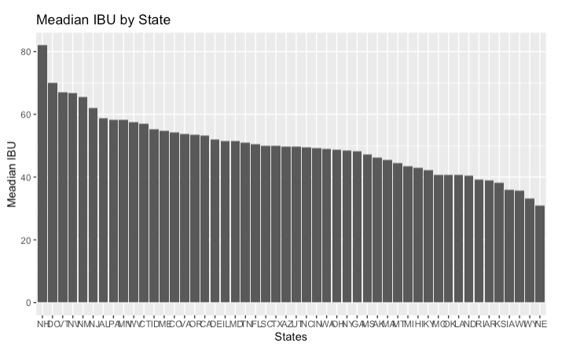
Notes:
If you want to market or make Ale, here are the states Budweiser should look into. #These are the top 5 states
# 1 " AR" 0.04 #2 " KS" 0.0528 #3 " ND" 0.054 #4 " WY" (Wyoming) 0.0547 #5 " MO" Missouri 0.0549

Slide 14

Case study
Challenge
Results
Outcomes
What did all these data mean.
Built statistical and visual
evidence of IBU & ABV’s relationship.
High IBU can mean that the beer is hoppy.
Top 5 Target Markets for each IPA and Ale
Notes:
Though IBU measures parts per million of isohumulone from hops in beer (which gives its bitterness) , not all hoppy beers are bitter yet a high IBU can mean that the beer is hoppy.

Slide 15
Thank you for your time
https://smu-2u-com.zoom.us/rec/share/lIc8D-xNPFT5orn5iwD9XPu5kvpggdIeZkhtmGUH5SgHVIoybbeIYlNU_bjXfbs1.K5a3N0m6z0L4u-nj?startTime=1666486155000
Notes:
In concluding, I want to thank each and every one of you for your time today.

