Slide 1


ECG-BASED HUMAN AUTHENTICATION
DHIRAJ RAMNANI, SHAIL PATIL, DARPEN PATEL, PROF. HETAL GAUDANI
Presented By:
Dhiraj Ramnani
Shail Patil

Slide 2
CONTENTS
Introduction
Purpose
ECG Basics
Steps involved in ECG Processing
Comparison of ECG Processing Methodologies
Challenges
Applications
Future Work

Slide 3
Introduction
The electrocardiogram (ECG) is an emerging novel biometric approach for human identification.
The ECG, being a record of electrical currents generated by the heart, is potentially a distinct human characteristic, since ECG waveforms and other properties of the electrocardiogram depend on the anatomic features of the human heart and body.
Rather than using 'knowledge-based' passwords and PINs, our research analyzes the potential of the ECG to be used for authentication and security.
The ECG is unique to an individual, with benefits such as resilience to replay attacks and spoofing.

Slide 4


Purpose
What are the alternatives available for overcoming the limitations of PIN, Passwords and Biometrics like fingerprints and Iris Scan ?
Which are the useful characteristics of the ECG to work as an authentication parameter?
Which feature extraction technique provides an optimum solution?

Slide 5
Why ECG?
A "perfect" biometric characterization:
Universal - Each individual possesses this characteristic.
Easily Measured - It is quite easy technically and convenient for an individual to obtain the characteristic.
Unique - There are no two individuals with identical characteristics.
Permanent - The characteristic does not change over time.
Performance - It has been shown to provide accurate results for the subset population.

Slide 6
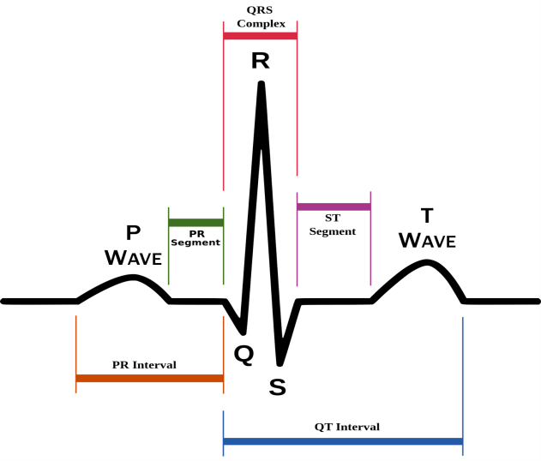
ECG Basics
ECG is a method to measure and record different electrical potentials of the heart. The ECG may roughly be divided into the phases of depolarization and repolarization of the muscle fibers making up the heart.
The depolarization phases correspond to the P-wave (atrial depolarization) and QRS-wave (ventricular depolarization).
The repolarization phases correspond to the T-wave.(ventricular repolarization).

Slide 7
ECG is a graph of voltage vs time.

Slide 8
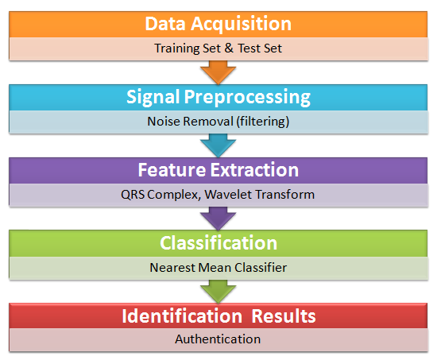
Steps Involved in ECG Processing
Firstly, signals are captured using ECG sensors.
Preprocessing is performed
which includes band-pass filters to reduce noise.
Feature Vector is formed for further classification.
Classification methods are used for pattern recognition/matching.

Slide 9
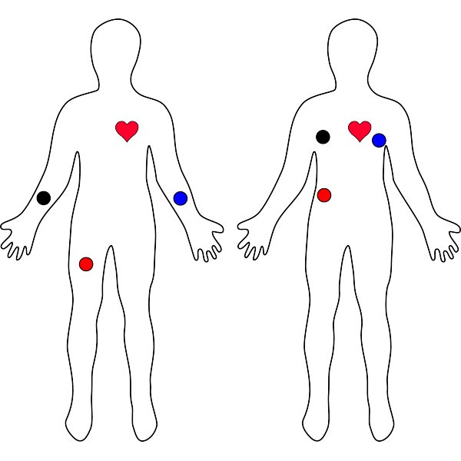
Data Acquisition
The procedure for ECG acquisition should be convenient for individuals and should require interaction with a minimal set of equipment; therefore it was decided to use single-lead ECG.
ECG Sensors like AD8232, ADS1293 can be used to measure heart rate variability.
Electrodes should be positioned closer to heart.

Slide 10
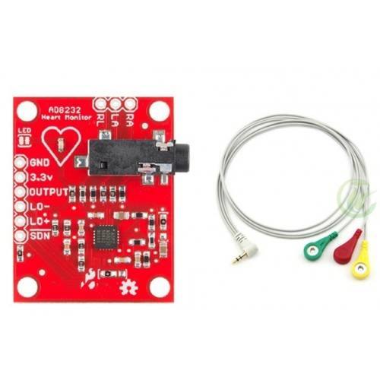
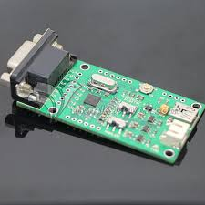
ECG Sensors
AD8232
ADS1293

Slide 11
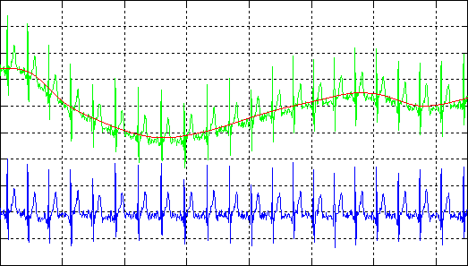
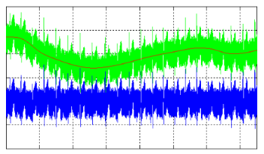
Data Preprocessing
The raw ECG is often rather noisy and contains distortions of various origins.
Visual analysis of noisy ECG shows that the preprocessing stage should perform three major tasks: baseline drift correction, frequency-selective filtering and signal enhancement.

Slide 12
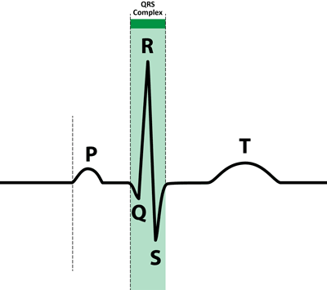
Feature Extraction
The information about cardiac electrical activity is primarily contained in the cardiac cycle fragment containing the QRS complex, P and T waves.
The QRS complex is the most distinctive among them. The value for identification of P and T waves is questionable.
The P wave has a low amplitude and can be greatly distorted by noise. The T wave is rather changeable, since its position depends on heart rate.

Slide 13
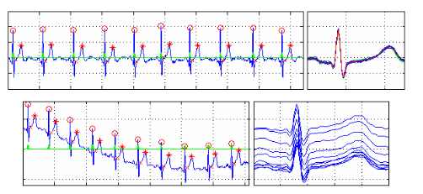
Feature Extraction

Slide 14
Feature Extraction
The process of initial space formation begins with extraction of a set of R peak synchronized PQRST-fragments.
PR, QRS and especially QT intervals have variable length depending on individual physiology and heart rate.
Since feature vectors must have equal length, the PQRST-fragment length was fixed at 0.5 sec or 250 samples.
For each cardiac cycle, regardless of the actual lengths of PR, QRS and QT intervals, 250 samples (80 samples to the left of R-peak and 170 samples to the right) were extracted and analyzed.
Pan-Tompkin’s algorithm provides efficient QRS Complex detection.

Slide 15
Feature Space Formation
There are different approaches to form the feature vector.
For each ECG record, 10 PQRST-fragments were extracted. Since PQRST-fragment samples are used as informative features, extracted PQRST-fragments are processed to enhance their similarity as follows:
From the set of 10 extracted PQRST-fragments, the "mean" PQRST-fragment was estimated using Euclidean distance, only the 6 closest PQRST-fragments were selected for further analysis.
Finally, PCA or Wavelet Transform is performed to reduce the feature vector dimension.

Slide 16
Classification and Identification
As a result of data processing on previous stages, the original ECG record is represented as a set of six PQRST-fragment patterns in the reduced feature space.
At this stage, each PQRST-fragment pattern is classified independently of the others and assigned to some class, and each PQRST-fragment classification result is a vote for the candidate class of the final ECG record identification, which is elected by a majority of votes.
Classifiers used: Nearest Mean Classifier, Linear Discriminant Analysis
Also, the Euclidean distance of the candidate feature vector and the vectors stored can be computed.
Finally, one with minimum value is regarded as the solution.

Slide 17
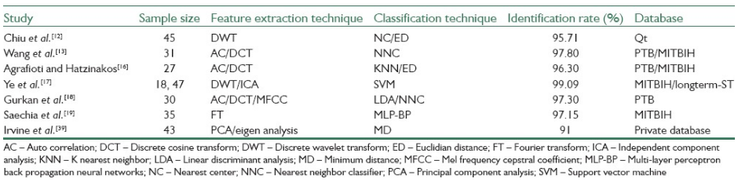
Comparison of Approaches

Slide 18
Challenges
1. Time dependency. With time-varying biosignals there is high risk of instantaneous changes which may endanger biometric security. Recordings of the cardiac potential at the surface of the body are very prone to noise due to movements over a period of time.
2. Collection periods. As opposed to biometrics such as the face, the iris or the fingerprint, where the biometric information is available for capturing at any time instance, this is not the case with the ECG.
3. Privacy implications. When collecting ECG signals a large amount of sensitive information is collected inevitably. The ECG signal may reveal current and past medical conditions as well as hints on the instantaneous emotional activity of the monitored individual.
4. Cardiac Conditions. Although cardiac disorders are not as a frequent damaging factor as injuries for more conventional biometrics (fingerprint, face), they can limit ECG biometric methods.

Slide 19
Applications
Immediate applications of our technology include scenarios of low security and low user throughput, such as recognition in mobile phones, laptop computers, cable TV interfaces, and user-tuned in-game experience.
If combined with other modalities, there are several use cases where the ECG stands as an important add-on.
For example high security applications, we can envision scenarios where user recognition is periodically performed using a hard biometrics such as the fingerprint, ECG data is collected simultaneously with the fingerprint to extract a heartbeat waveform template, and after the initial identity validation using the hard biometric modality, the ECG continues to enable the validation of the user.

Slide 20
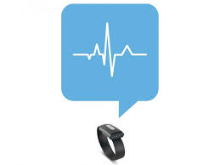
Future Work
We intend to develop a wearable device to perform real time ECG based authentication.

Slide 21
References
Dr. Boo-Ho yang, Prof Haruhiko H. Asada ,Yi Zhang “Cuff-less continuous monitoring of beat-to-beat Blood pressure using a kalman filter and sensor” ,Fusion-first joint IEEE conference of bmes/embs,1999.
L. Goldberger et al., “PhysioBank, PhysioToolkit, and PhysioNet: Components of a new research resource for complex physiologic signals,” Circulation, vol. 101, no. 23, pp. 215-220, 2000.
L. Biel, O. Pettersson, L. Philipson, and P. Wide. " ECG analysis: a new approach in human identification". Proceedings of the 16th Instrumentation and Measurement Technology Conference, IEEE, volume 1,1999.
Julio C.D Conway,Claudionor J.N Coelho ,Luis C.G Andrade, “Wearable computer as a multi-parametric monitor for physiological signals” IEEE international conference on bioinformatics and biomedical engineering, pp-236-242,2000.
M. Sanjeev Dasrao,Yeo Joon Hock,Eugene KW sim, “Diagnostic blood pressure wave analysis and ambulatory monitoring using a novel”, non-invasive portable device-proceeding of international conference on biomedical engineering, pp 267-272, 2001.

Slide 22
References
Peter Varady Benyo ,Balazs, “An open architecture patient monitoring system using Standard technologies”, IEEE transactions on information technology in biomedicine, vol. 6, 2002.
Paul Lucowicz, Urs Anliker, Jamie Ward, Gerhard Troster, “Amon: a wearable medical computer for high risk patients”, IEEE computer society, 6th international symposium on wearable computers (iswc.02), 2002.
Y. Wang, F. Agrafioti, D. Hatzinakos, and K. N. Plataniotis, "Analysis of human electrocardiogram for biometric recognition", EURASIP Journal on Advances in Signal Processing, 2008.
Janani S., Minho S., Tanzeem C., David K., ”Activity-aware ECG-based patient authentication for remote health monitoring”; , International Conference on Mobile Systems,ACM,Nov,2009.
D. C. Chan, M. M. Hamdy, A. Badre, and V. Badee. ”Wavelet distance measure for person identification using electrocardiograms”, Transactions on Instrumentation and Measurement, IEEE, Volume 57, issue 2, 2008.

Slide 23
References
Steven A. Israel, Jhon M.I,Andrew C.,Mark D.W,”ECG to identify individuals”, Virtual reality medical center, USA, Pattern Recognization, Volume 38,issue1,2005.
C. Chiu, C. Chuang, and C. Hsu. “A novel personal identity verification approach using a discrete wavelet transform of the ECG signal”, Proceedings of the International Conference on Multimedia and Ubiquitous Engineering, Volume 6, issue 4,2008.
T. W. Shen, W. J. Tompkins, and Y. H. Hu "One-lead ECG for identity verification",Proceedings of the 24th Annual Conference on Engineering in Medicine and Biology and the Annual Fall Meeting of the Biomedical
Engineering Society, Volume 57, issue 2, 2002.
Arteaga-Falconi, Juan Sebastian, Hussein Al Osman, and Abdulmotaleb El Saddik. "ECG Authentication for Mobile Devices." IEEE Transactions on Instrumentation and Measurement 65.3 (2016): 591-600.
Choudhary, Tilendra, and M. Sabarimalai Manikandan. "A novel unified framework for noise-robust ECG-based biometric authentication." Signal Processing and Integrated Networks (SPIN), 2015 2nd International Conference on. IEEE, 2015.

Slide 24
References
Safie, Sairul, et al. "Multiple pulse K-Nearest Neighbors authentication for Malay ECG based class attendance system." Engineering Technology and Technopreneuship (ICE2T), 2014 4th International Conference on. IEEE, 2014.
Kaul, Amit, A. S. Arora, and Sushil Chauhan. "ECG based human authentication using synthetic ECG template." Signal Processing, Computing and Control (ISPCC), 2012 IEEE International Conference on. IEEE, 2012.
Ye, Can, Miguel Tavares Coimbra, and BVK Vijaya Kumar. "Investigation of human identification using two-lead electrocardiogram (ECG) signals."Biometrics: Theory Applications and Systems (BTAS), 2010 Fourth IEEE International Conference on. IEEE, 2010.
Biel, Lena, et al. "ECG analysis: a new approach in human identification."IEEE Transactions on Instrumentation and Measurement 50.3 (2001): 808-812.
Matos, André Cigarro, André Lourenço, and José Nascimento."Embedded system for individual recognition based on ECG Biometrics." Procedia Technology 17 (2014): 265-272.

Slide 25


