Slide 1

PRODUCT
PROJECT

Slide 2

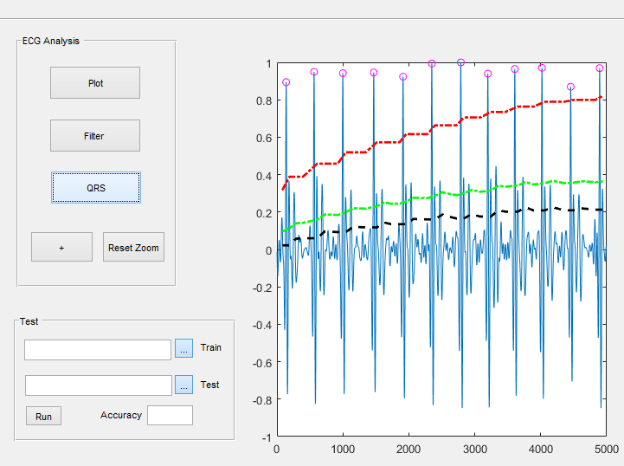
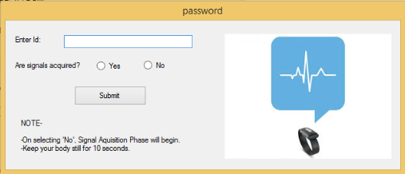
State of the art

Slide 3
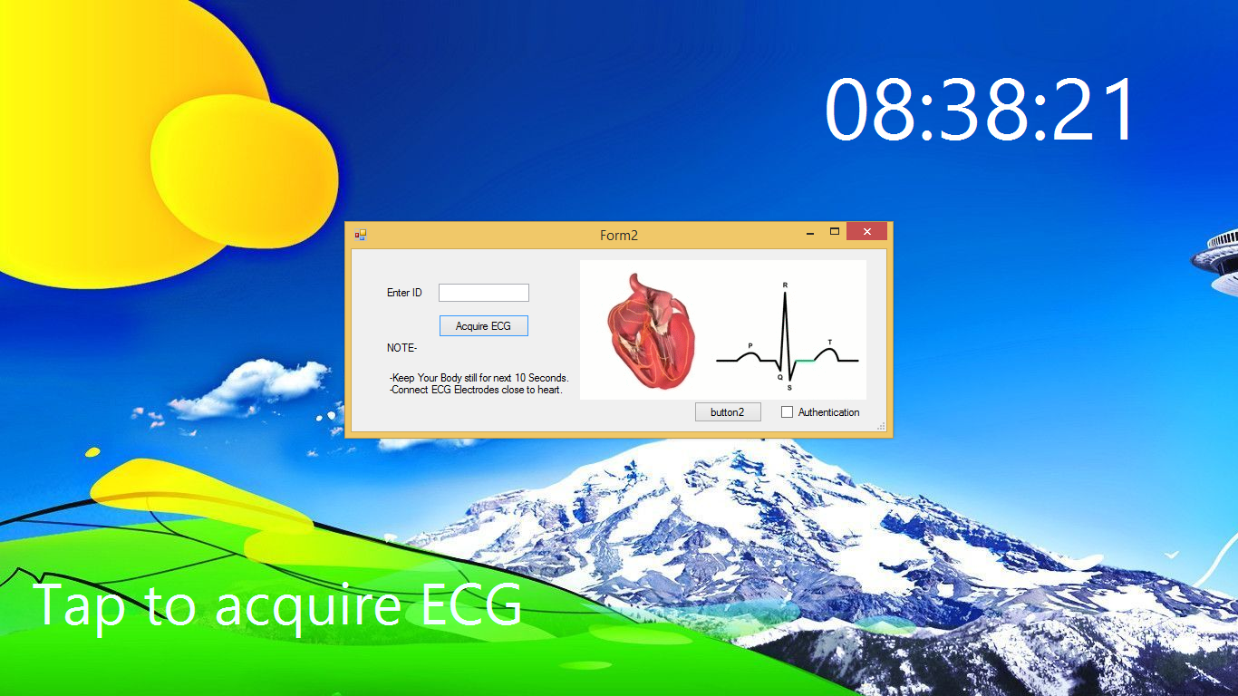
Our Implementation

Slide 4
Challenges faced
ECG Sensor: The ECG sensor AD8232 is the cheapest available sensor. Hence, it possess poor Signal-To-Noise ratio.
Solution: We used a couple of curve fitting algorithms along with band pass filters.
Electrodes: Disposable electrodes. Need to be attached to chest every time, thereby making the signal acquisition tedious.
Solution: Dry electrodes can be used.
Time: Signal Acquisition time of 10 seconds is not feasible.
Solution: Algorithm optimization and efficient feature extraction.
Finally, employing the use of BMD 101 ECG sensor; the hardware size
can be reduced to that of a wearable.

Slide 5
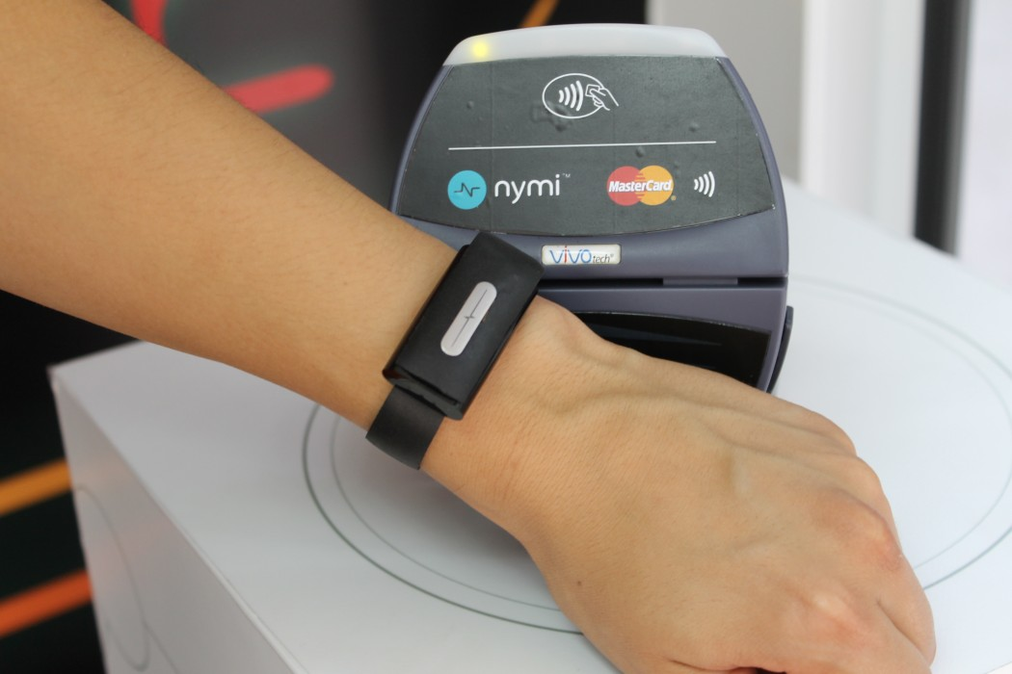
Available alternatives

Slide 6


Slide 7
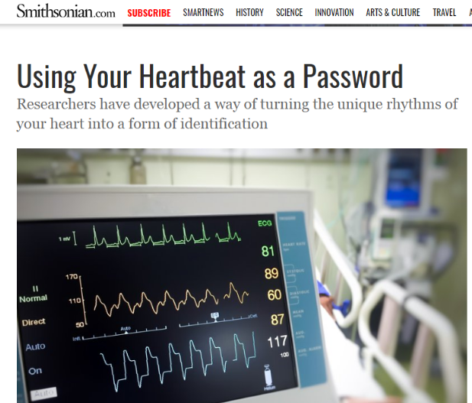
In the News..

Slide 8
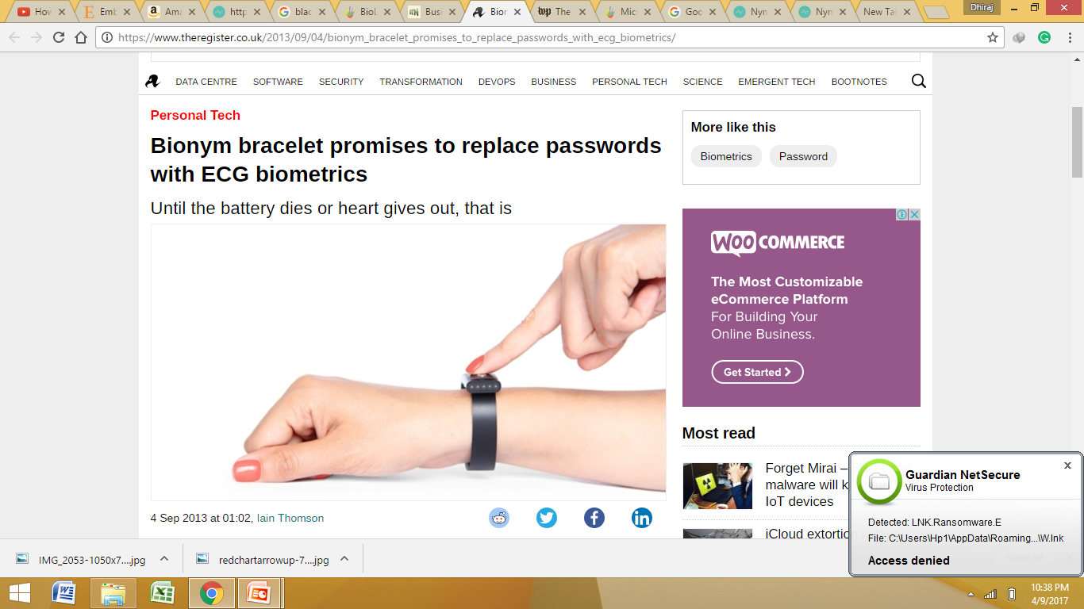

Slide 9


Slide 10

Any Questions?

