Slide 1


BIOMETRIC AUTHENTICATION BASED ON ECG
Presented by: shail patil , Dhiraj ramnani, DARPEN PATEL
Department of computer engineering
g.h.patel college of engineering and technology

Slide 2
TABLE OF CONTENTS
INTRODUCTION
PURPOSE
WHY ECG?
ECG BASICS
STEPS INVOLVED IN ECG PROCESSING
TABULAR COMPARISON

Slide 3
INTRODUCTION
This project investigates the possibility of biometric human identification based on the electrocardiogram (ECG).
The ECG, being a record of electrical currents generated by the beating heart, is potentially a distinctive human characteristic.
ECG waveforms and other properties of the ECG depend on the anatomic features of the human heart and body.
Entity-based: tokens and ID cards or Knowledge-based: PIN numbers and passwords, raises security concerns.
The major benefit of security systems based on biometrics is the full dependency on the individual.

Slide 4

PURPOSE
What are the alternatives available for overcoming the limitations of PIN,Passwords and Biometrics like fingerprints and Iris Scan ?
Which are the useful characteristics of the ECG to work as an authentication parameter?
Which feature extraction technique provides an optimum solution?

Slide 5
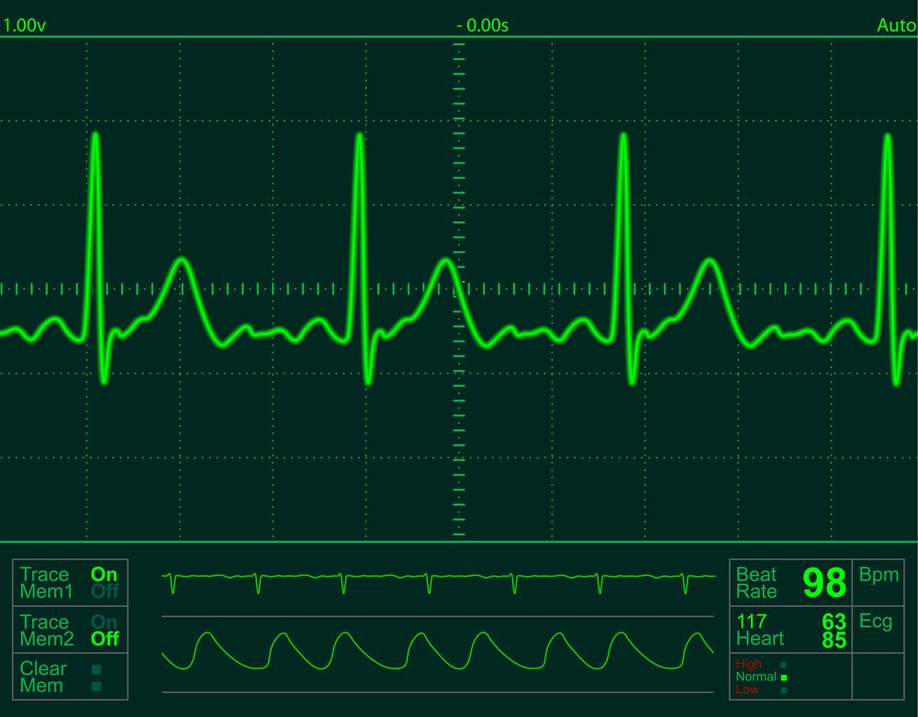
WHY ECG?
A "perfect" biometric characterization:
Universal, i.e., each individual possesses this characteristic,
Easily Measured, i.e., it is quite easy technically and convenient for
an individual to obtain the characteristic,
Unique, i.e., there are no two individuals with identical characteristics,
Permanent, i.e., the characteristic does not change over time.
Performance-it has been shown to provide accurate results for the
subset population.

Slide 6
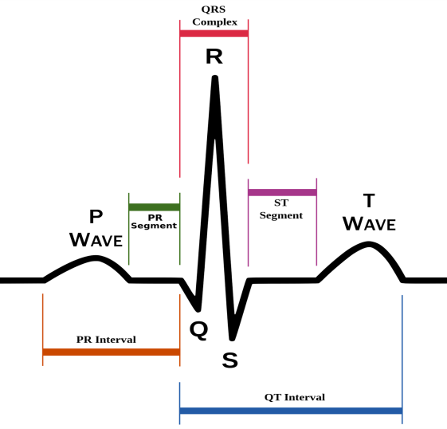
ECG BASICS
ECG is a method to measure and record different electrical potentials of the heart. The ECG may roughly be divided into the phases of depolarization and repolarization of the muscle fibers making up the heart.
The depolarization phases correspond to the P-wave (atrial depolarization) and
QRS-wave (ventricular depolarization).
The repolarization phases correspond to the T-wave.(ventricular repolarization)

Slide 7
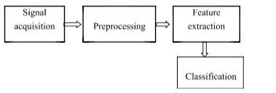
STEPS INVOLVED IN ECG PROCESSING
Firstly, signals are captured
using ECG sensors.
Preprocessing is performed
which includes band-pass
filters to reduce noise.
Feature Vector is formed for further
classification.
Classification methods are used for
pattern recognition/matching.

Slide 8
SIGNAL PROCESSING
The initial step for entire authentication is acquiring the signals using sensors or
other hardware devices.
The data collected is either processed or raw data is stored in the
database which is later used to match the testing dataset for authenticating a
valid user.
PREPROCESSING
The raw ECG is rather noisy and contains distortions which may reduce the
effectiveness of feature extraction and classification and thus lead to decrease
in efficiency of the results produced and also the accuracy.

Slide 9
FEATURE EXTRACTION
After pre-processing, the second stage towards classification is
to detect certain features of ECG signals mostly QRS complex,
P and T waves.
CLASSIFICATION
At this stage, each PQRST-fragment pattern is classified independently of the others and assigned to some class, and each PQRST-fragment classification result is a vote for the candidate class of the final ECG record identification, which is elected by a majority of votes.

Slide 10
FEATURE EXTRACTION
After pre-processing, the second stage towards classification is to detect certain features of ECG signals mostly QRS complex, P and T waves. The features, which represent the classification information contained in the signals, are used as inputs to the classifier used in the classification stage.
The goal of the feature extraction stage is to find the smallest set of features that enables acceptable classification rates to be achieved. In general, the developer cannot estimate the performance of a set of features without training and testing the classification system.
Therefore, a feature selection is an iterative process that involves training different feature sets until acceptable classification performance is achieved.

Slide 11
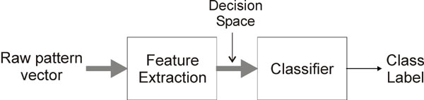
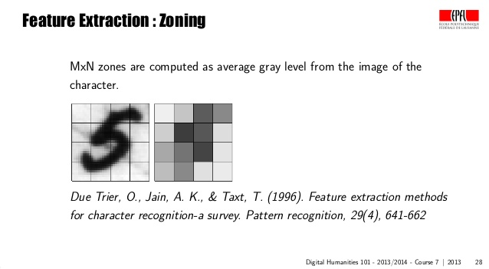
EXAMPLES

Slide 12
Implementation

Slide 13
ECG- Observations
On the figures it is seen that ECG cycles have no significant qualitative or quantitative variations over time, and the configuration of QRS complex and the ratio of amplitudes remain stable.
Variations within an hour are almost identical with variations within six months.
Observed ECG variations are more likely caused by variations in acquisition procedure and filter distortions.
Of course, there are many other natural and artificial, intentional and unintentional causes of ECG variability. For example, taking certain medications may temporarily change the configuration of the cardiac cycle.

Slide 14
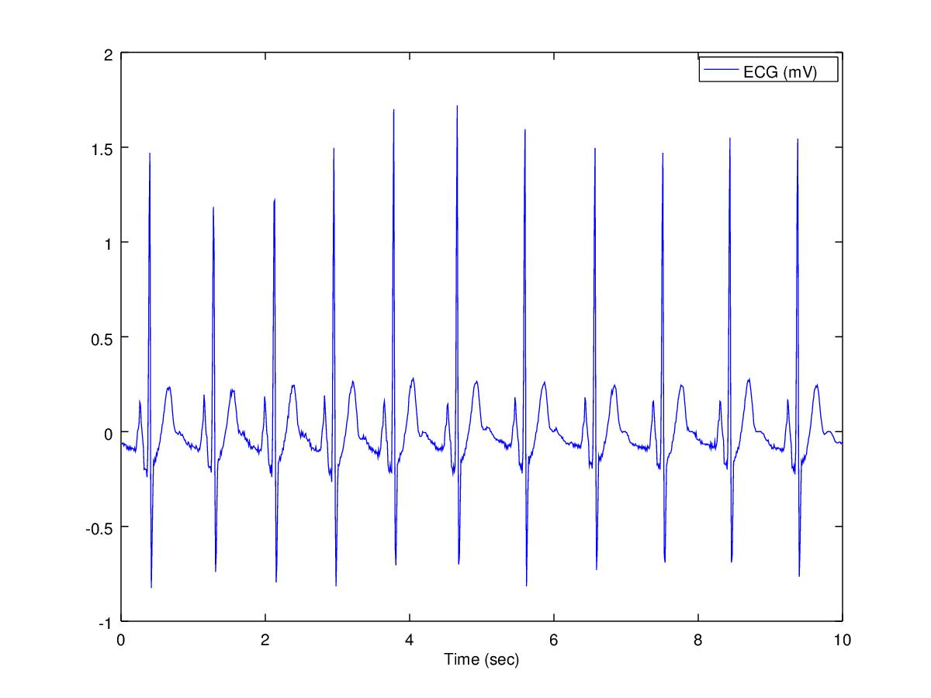
Plotting of ECG from data set

Slide 15
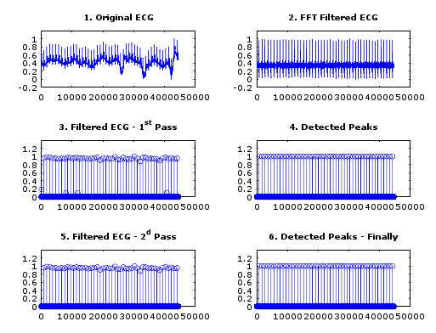
Filtering of ECG Signal

Slide 16
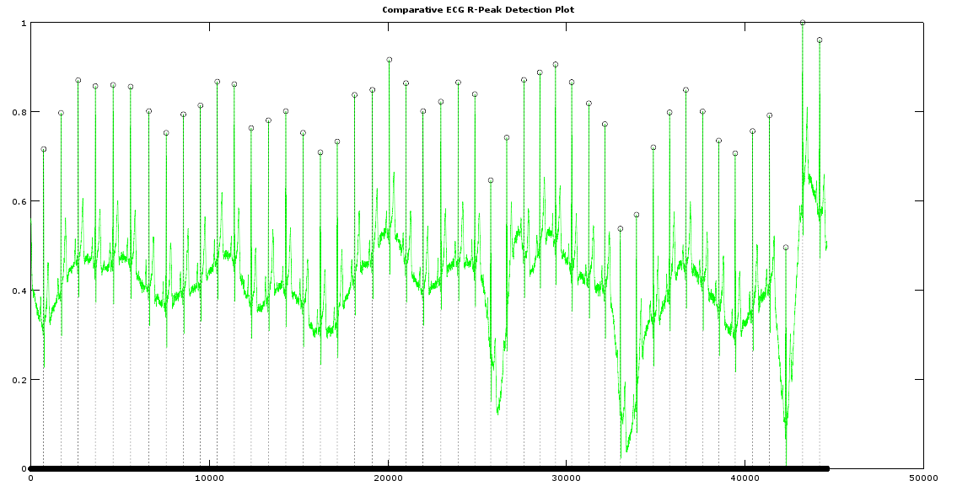
Detecting R-peaks

Slide 17
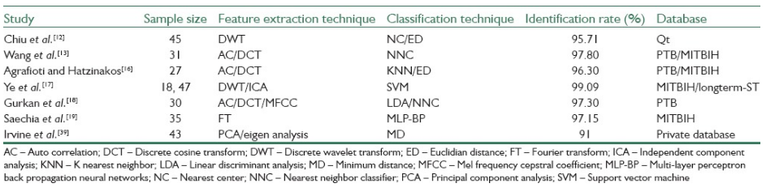
TABULAR COMPARISON

Slide 18
Thank You

