Slide 1
UI/UX AUDIT REPORT: OCBC Precious Metals Module
Comprehensive UI/UX Audit Report
4.5
AUDIT DATE
2026-06-23
PLATFORM
Web desktop — OCBC business/corporate internet banking (OCBC Velocity-style), 1600px; with email (702px) and mobile push (375px) notification mockups
UX Health Score / 10
AUDITOR PERSONA
N/A
URL
https://www.figma.com/design/pJuwdSGBCJvVtx6i77ytzM/Precious-Metal?node-id=1106-21058

Slide 2
Executive Summary
The OCBC Precious Metals module is a competently structured corporate-banking trading flow with several genuine strengths: persistent field labels, a thoughtful amount↔quantity dual-input, well-written and non-punitive error-recovery copy, sensible sell-side guardrails (caps to holdings), proper empty states, and clear cross-channel reference numbers. The bones of a trustworthy trading tool are present. However, for a regulated investment product the audit surfaces serious gaps concentrated in risk disclosure, system feedback, and production polish. There is no investment-risk disclosure, Key Fact Sheet, or suitability check before a customer commits to a five-figure order; the first-time Terms & Conditions modal asks the user to agree to four documents it never lets them open. The displayed "Indicative price" silently differs from the actual execution price (6,581.85 quoted vs 6,128.50 executed in the sample data) with no caveat. Multiple customer-facing surfaces ship unfilled template tokens (`[6:00 AM SGT]`, `<Salutation> <Surname>`, `<7,000.00 SGD/ounce>`, a stale "© 2024"). Price freshness is contradictory across screens with no refresh indicator, there is no loading state on order submission (double-submission risk), and the validation/error states exist only as isolated spec frames rather than on the live trade screen. The experience diverges sharply by persona. The novice is under-served at exactly the high-stakes moments — undefined jargon (XAU/XAG, troy ounce, "Filled", "Credit account"), risk buried in a collapsed FAQ, and cold liability-only copy at the point of commitment. The experienced investor is better served for core trading but is blocked by efficiency gaps (no "place another trade", dead-end trade detail) and a data-integrity bug in the alerts list (count vs rows mismatch). Audit coverage: all 9 usability dimensions plus a banking/investment domain lens (risk disclosure, terminology comprehension, yield/price presentation, regulatory disclosures), across the full buy/sell/alerts journey.
2
11
11
2
CRITICAL
HIGH
MEDIUM
LOW
Total Findings: 26

Slide 3
Findings (1/6)
#
Screen
Severity
Finding
Recommendation
#1
T&C / Confirm
CRITICAL
No investment-risk disclosure, Key Fact Sheet, or suitability check anywhere in the buy flow. The only risk-related artifact before commitment is a liability declaration on Review. The first-time T&C modal lists four agreements by title only ('Platform T&Cs', 'Precious Metal Account T&Cs', 'Investment Module T&Cs', 'Business Account Board Reso T&Cs') with no openable documents, yet requires the user to click 'Agree'.
Add a dedicated risk-disclosure step before 'Confirm buy order': a Key Fact Sheet / risk-warning statement with an explicit 'I understand precious-metal values can fall' acknowledgement, and make the four T&Cs in the modal openable (links or expandable text). Separate liability declaration (protects bank) from risk disclosure (protects customer).
#2
Buy/Sell input / Error specs
CRITICAL
Inline validation and error states exist only as isolated spec frames (insufficient balance, below-minimum, exceed-market-value) and are not rendered on the live Buy/Sell trade screen. No error border, no inline message anchored to a field, and validation timing / CTA-gating cannot be confirmed. For a money-moving flow the on-screen error state is mandatory and appears undesigned/uninstrumented.
Integrate the spec'd error/warning states into the actual trade screen with field-anchored inline messages, on-blur validation, and a CTA that gates with a stated reason. Specify hover/focus/active/loading states too.
#3
Review / Buy input / Trade detail
HIGH
The gap between the displayed 'Indicative price' and the actual execution price is never disclosed. The quoted indicative price is 6,581.85 SGD/ounce, but the completed trade detail shows an actual 'Purchase price 6,128.50 SGD/ounce' — a materially different number. Nothing warns that the price can move between input and settlement.
Add an 'Indicative price' tooltip and an execution caveat at input and review: 'Final price is set at execution and may differ from the indicative price shown.' Show the executed price prominently on confirmation.
#4
Overview / Landing
HIGH
Landing marketing copy is upside-only: 'Buy paper bullion to diversify your portfolio, hedge against inflation, and access a globally recognised store of value.' There is no balancing 'the value of precious metals can fall as well as rise' statement before the call to action.
Add a concise, equally-weighted risk statement adjacent to the value proposition on the landing (not only in a collapsed FAQ).
#5
Overview / Landing
HIGH
The only risk-bearing content ('Things to look out for') is a collapsed FAQ accordion, below the fold, positioned after 'Reason to invest' and after the 'Start trading' CTA, and softened with a euphemistic label.
Rename to 'Risks', surface key risks above the fold or inline near the CTA, and expand by default for first-time users.

Slide 4
Findings (2/6)
#
Screen
Severity
Finding
Recommendation
#6
Maintenance modal / Email / Push
HIGH
Unfilled template artifacts are shipped into customer-facing surfaces: maintenance modal shows '[6:00 AM SGT]' and '[6:00 AM]' bracket tokens (and the two phrasings disagree on timezone); the confirmation email shows 'Dear <Salutation> <Surname>' and a '<Name> / <Designation/rank> / <Department name>' signature plus a stale '© Copyright 2024'; the push notification leaks delimiters '<7,000.00 SGD/ounce>'.
Purge all merge-field/placeholder tokens, fill the maintenance time dynamically with a single consistent timezone format, and correct the copyright year.
#7
Buy input / Overview
HIGH
Price freshness is not communicated for a live-priced commodity. The overview says 'Last updated 23 April 2026, 11:30 AM (UTC+08:00)' while the trade-panel chart says 'Last updated 28 Apr 2026, 2:00 PM SGT' — a ~5-day discrepancy within the same product. There is no auto-refresh, countdown, or 'price expires in / refresh' affordance.
Show a single live timestamp, auto-refresh the indicative price with a visible countdown/refresh control, and reconcile the conflicting timestamps.
#8
Review / Confirmation
HIGH
No loading/processing state exists between 'Confirm buy order' and the success screen. Order submission, price lock, and account creation all involve latency, but there is no spinner, skeleton, or 'Submitting order…' state — risking double submission and user uncertainty at the most critical moment.
Add an explicit processing state that disables the button, shows progress, and prevents resubmission until the server responds.
#9
Review vs Trade detail
HIGH
The Review screen (pre-commit) and the Trade-detail screen (already executed) are near-identical in layout and content; the only differentiators are the small kicker (REVIEW vs TRADE DETAILS) and the buttons. A user landing mid-flow cannot tell whether money has already moved.
Visually differentiate the two: distinct headers, a clear status banner ('Not yet submitted' vs 'Completed · Filled'), and a step indicator. Make the pre-commit state unmistakable.
#10
Buy / Sell input
HIGH
Buy/Sell is differentiated almost entirely by colour (green Buy / red Sell pill) with no icon, arrow, or shape redundancy, and gain/loss values on the Holding-details card rely on green/red with only a weak '+/-' sign. Brand red is simultaneously used for OCBC branding, the Sell state, and loss values — so the most saturated red on the Sell screen is the toggle, not the primary action.
Add non-colour redundancy (directional icons/labels) to Buy/Sell and gain/loss everywhere, and decide a single meaning for red (brand vs action vs sell) so the primary CTA reads unambiguously.

Slide 5
Findings (3/6)
#
Screen
Severity
Finding
Recommendation
#11
Overview / Trade history / Alerts
HIGH
Currency context can shift silently. Overview toggles SGD/ounce vs USD/ounce, trade history mixes SGD, USD and EUR rows, and alerts mix SGD/USD. A user can read a price in one currency and transact in another without noticing the unit change.
Make the active currency a persistent, prominent indicator across all screens; warn on currency switch; align overview, history and alert currencies or label each row's currency unambiguously.
#12
Review
HIGH
At the highest-anxiety moment — confirming a 30,642.50 SGD order — the only copy is a cold liability declaration: 'Declarations which are found to be untrue or inaccurate may result in the delay or rejection of your investment, without recourse to OCBC Bank.' There is no reassurance (e.g. 'funds are only debited on settlement', security signal, or 'you can review before it's final').
Pair the legal declaration with plain-language reassurance about what happens next (debit/settlement timing, security), and keep the legal text secondary.
#13
Manage price alerts
HIGH
The alert list filter counter and the table disagree: the 'All (5)' pill is shown while the table renders 7 rows with different target prices/dates across the two captured states — a correctness/trust bug.
Reconcile the filter counts with the rendered rows; treat as a data-integrity defect, not cosmetic.
#14
Buy/Sell input
MEDIUM
The primary CTA is weak and buried: 'Review buy order' sits bottom-right below a full-width divider, rendered in slate-grey, and when disabled is nearly invisible with no hint of what's missing to enable it. Meanwhile the visually richest element (the line chart) is decision-support, not the task, pulling the eye away from the form.
Elevate the primary CTA (consistent treatment, stronger weight, clear enabled/disabled), and pair the disabled state with a reason ('Enter an amount to continue').
#15
Trade detail / Buy input
MEDIUM
Novice-hostile terms are used without inline explanation: ISO codes 'XAU/XAG' (never expanded on first use), 'ounce' (never stated as troy ounce), 'Indicative price', 'Credit account'/'Debit account' (a buy's 'Credit account - Gold (XAU)' reads as being given credit), 'Order status: Filled', and 'Market value (Indicative)'. The only glossary is the FAQ on the Overview tab — absent from the input, review, detail and sell screens where the jargon actually appears.
Add inline tooltips/glosses on first use ('troy ounce', 'Filled = completed', define XAU/XAG, clarify Credit/Debit account), and carry FAQ definitions onto transactional screens via progressive disclosure so experts aren't slowed.

Slide 6
Findings (4/6)
#
Screen
Severity
Finding
Recommendation
#16
Review / Overview
MEDIUM
The header/eyebrow system is not standardised: the kicker appears inline top-left on some screens, in the left gutter with a red rule on others, and is absent (only an H2) on the overview. There is no consistent page-title anchor and no step indicator ('Step 2 of 3') in a multi-step money flow.
Standardise one eyebrow+H1 pattern across all screens and add a step indicator to the buy/sell flow.
#17
Buy/Sell input
MEDIUM
The amount-to-quantity swap control (the vertical double-arrow between 'Investment amount' and 'Quantity to buy') has no label, button chrome, hover hint, or tooltip. It's unclear it's an interactive control that switches which field drives the calculation.
Give the swap control a button container and tooltip ('Switch between amount and quantity') and a clear active/driver indication.
#18
Buy input / T&C modal
MEDIUM
Account creation is messaged twice and inconsistently: the buy input says 'New Gold (XAU) Account will be created with your order', while a separate first-time modal says 'a Gold (XAU) account will be created for you' — leaving it unclear when the account is actually opened.
Use one clear, consistent account-creation message at a single, well-defined point in the flow.
#19
Error specs
MEDIUM
Blocking errors (e.g. 'Insufficient balance') and soft warnings share an identical amber/triangle treatment, with no visual distinction between a hard block and a caution. Three banner variants also coexist (tight field banner, large padded container banner, and a page-level banner with a close ×).
Introduce distinct error vs warning styles (colour/icon) and consolidate to one banner component with size variants.
#20
Buy input
MEDIUM
Field labels and helper text ('Investment amount', 'Quantity to buy', 'Minimum 24.59 SGD') are light grey inset on light-grey fills, with borderline contrast likely failing WCAG AA at ~11px. The empty-state '0.00' is rendered in the same dark weight a real value would use, so a placeholder is indistinguishable from an actual entered zero.
Raise label/helper contrast to AA and visually distinguish placeholder from entered values (lighter placeholder, clear focus/filled states).

Slide 7
Findings (5/6)
#
Screen
Severity
Finding
Recommendation
#21
Trade detail / Confirmation
MEDIUM
The trade-detail screen is a dead end (only 'Back'), with no 'Sell this holding', 'Download receipt', or 'Set an alert' — the obvious next actions. The success screen offers only 'Back to overview' and 'View order' with no 'Place another trade', despite this being a repeat-action product.
Add contextual next-actions on trade detail (sell, download, set alert) and a 'Place another trade' shortcut on success.
#22
Trade history / multiple
MEDIUM
Number, unit and account formatting drift across screens: 'ounce' (singular) vs 'ounces'; account numbers as '410-212232-201 - XAU' vs 'XAU-410-212232-201' vs '647561400225-SGD' (no hyphens); unit phrasing 'SGD/ounce' vs 'SGD / ounce'; and the card label 'Holdings details' vs 'Holding details'.
Define and enforce one formatting standard for currency units, account numbers, pluralisation, and shared labels.
#23
Review
MEDIUM
The 'Back' button on Review is unlabeled as to consequence — it is unclear whether it discards the order or returns to edit inputs. In a money-moving flow, an ambiguous back action is a trust gap.
Label the intent ('Edit order' vs 'Cancel') and confirm before any destructive discard.
#24
Confirmation / Trade detail
MEDIUM
The primary-button system is not systematised: slate-grey is the de-facto primary while OCBC red is never used for a primary action; the same 'Back' action appears as a blue text-link on the success screen but an outlined button on trade-detail and review. Two near-identical confirmation screens also use different backgrounds (grey page + white card vs white page, no card).
Define one primary, one secondary, and one tertiary button treatment and apply consistently; unify the two confirmation layouts.
#25
Dashboard / global
LOW
Global chrome drifts across captures: the top nav reads 'FX and Investment' on most screens but 'FX and treasury' on a dashboard variant, and some screens show a Search pill and help '?' icon that others lack. Design-spec frames (error banners, alert input) are also mixed into the product set on peach/grey artboards rather than shown integrated.
Reconcile to one nav taxonomy and one header chrome; keep spec frames out of the production flow or render error states in-context.

Slide 8
Findings (6/6)
#
Screen
Severity
Finding
Recommendation
#26
Confirmation
LOW
On the success screen the confirming sentence ('Buy order for Gold (XAU) has been filled successfully') is set in lighter mid-grey, smaller than the figures beneath it; the green check carries all the visual weight. The most important message on a success screen should be its strongest text element.
Promote the success sentence to the strongest text on the screen (size/weight/contrast).

Slide 9
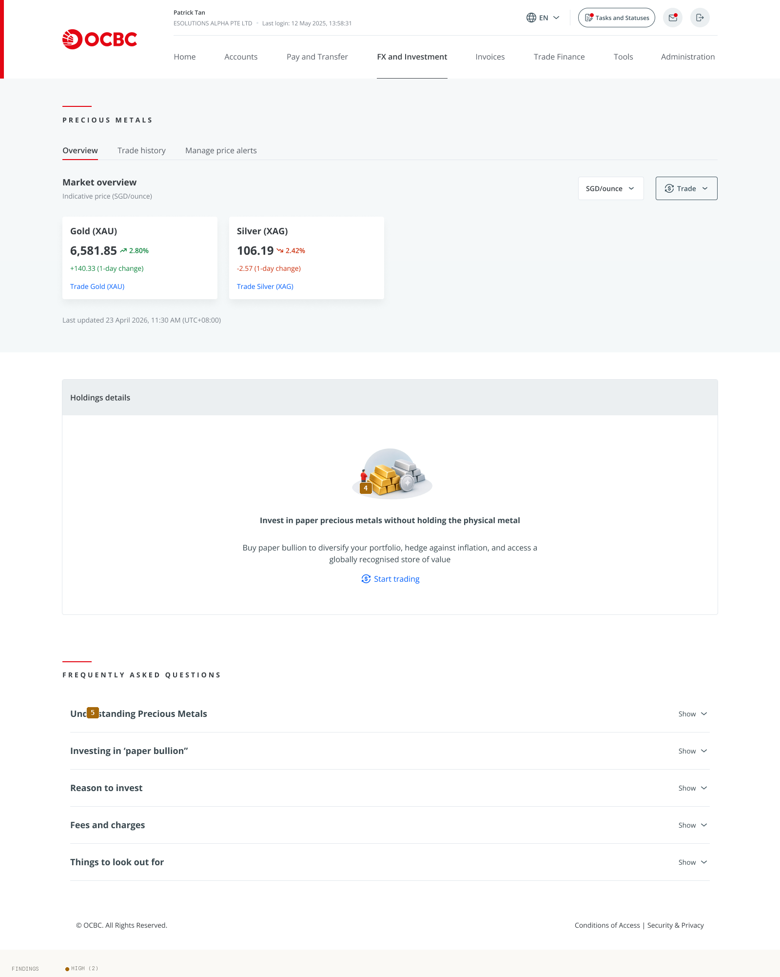
01 Landing Overview Sgd
Findings on this screen:
4
[HIGH] Landing marketing copy is upside-only: 'Buy paper bullion to diversify your portfolio, hedge against inflation, and access a globally recognised store of value.' There is no balancing 'the value of precious metals can fall as well as rise' statement before the call to action.
→ Add a concise, equally-weighted risk statement adjacent to the value proposition on the landing (not only in a collapsed FAQ).
5
[HIGH] The only risk-bearing content ('Things to look out for') is a collapsed FAQ accordion, below the fold, positioned after 'Reason to invest' and after the 'Start trading' CTA, and softened with a euphemistic label.
→ Rename to 'Risks', surface key risks above the fold or inline near the CTA, and expand by default for first-time users.

Slide 10
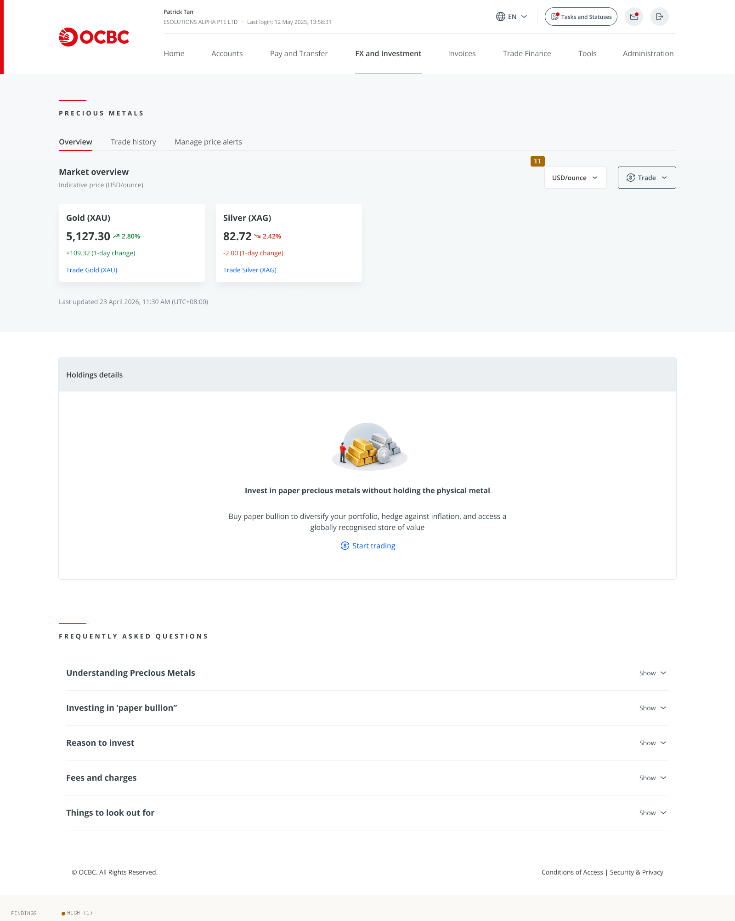
02 Landing Overview Usd
Findings on this screen:
11
[HIGH] Currency context can shift silently. Overview toggles SGD/ounce vs USD/ounce, trade history mixes SGD, USD and EUR rows, and alerts mix SGD/USD. A user can read a price in one currency and transact in another without noticing the unit change.
→ Make the active currency a persistent, prominent indicator across all screens; warn on currency switch; align overview, history and alert currencies or label each row's currency unambiguously.

Slide 11
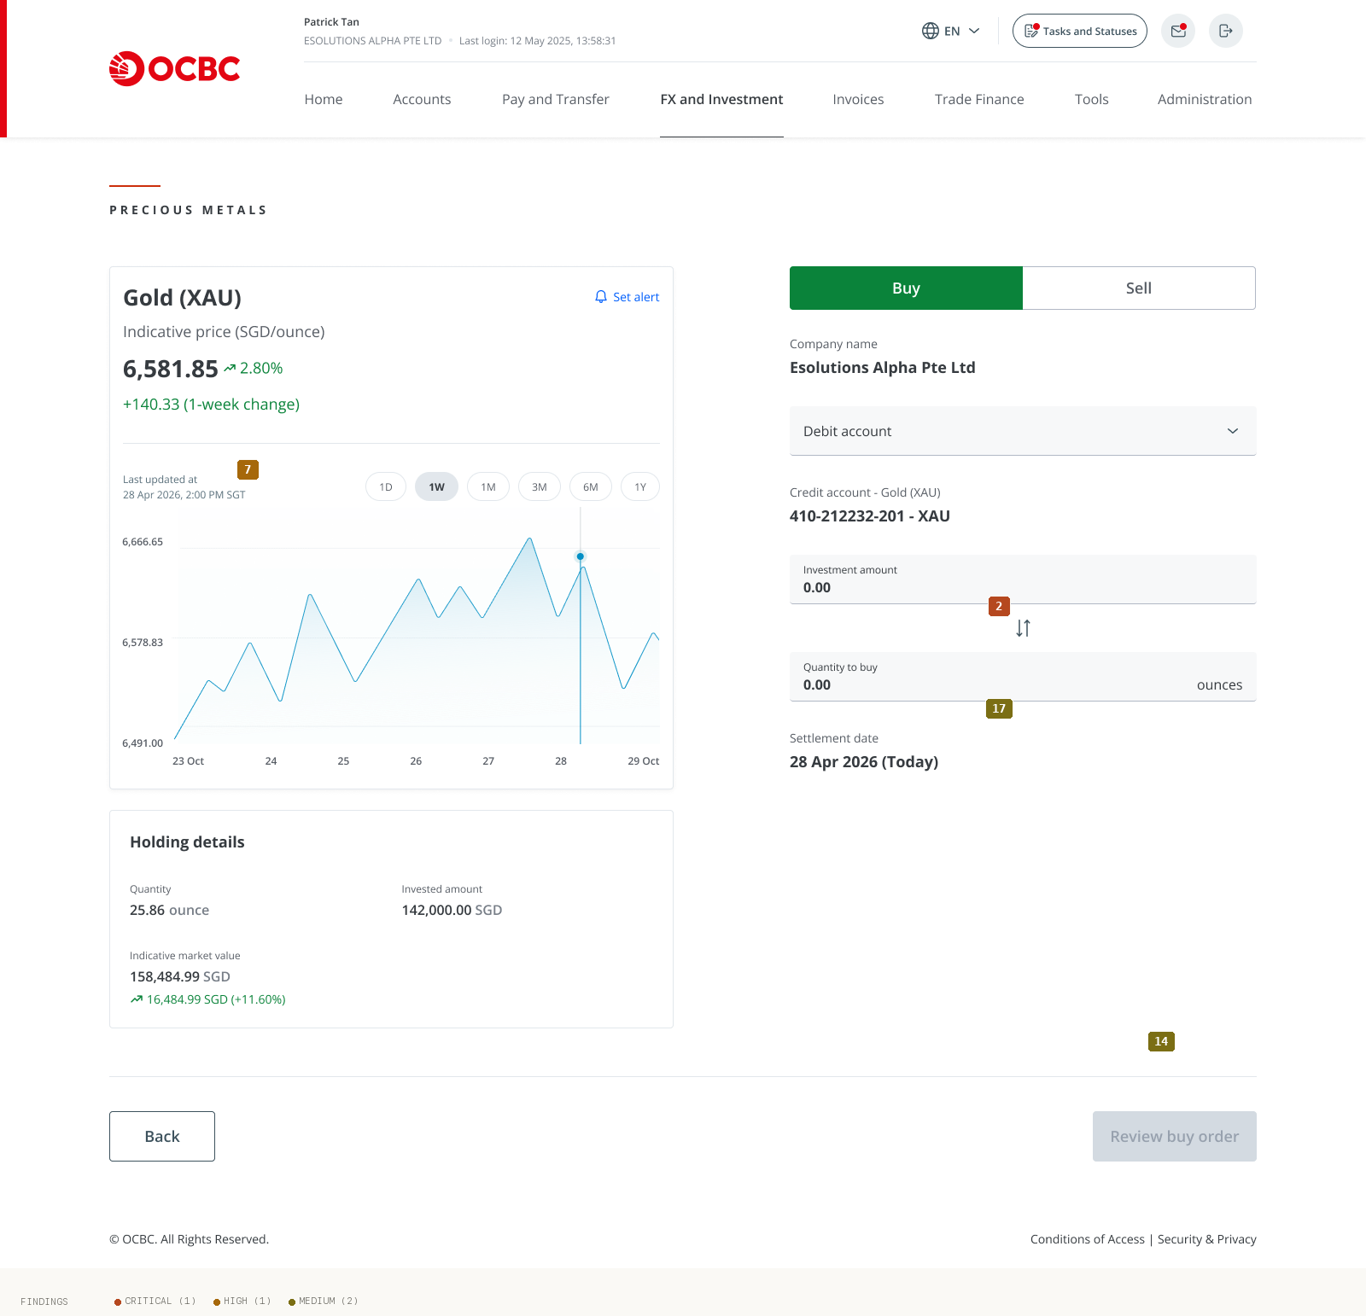
03 Buy Trade Input
Findings on this screen:
2
[CRITICAL] Inline validation and error states exist only as isolated spec frames (insufficient balance, below-minimum, exceed-market-value) and are not rendered on the live Buy/Sell trade screen. No error border, no inline message anchored to a field, and validation timing / CTA-gating cannot be confirmed. For a money-moving flow the on-screen error state is mandatory and appears undesigned/uninstrumented.
→ Integrate the spec'd error/warning states into the actual trade screen with field-anchored inline messages, on-blur validation, and a CTA that gates with a stated reason. Specify hover/focus/active/loading states too.
7
[HIGH] Price freshness is not communicated for a live-priced commodity. The overview says 'Last updated 23 April 2026, 11:30 AM (UTC+08:00)' while the trade-panel chart says 'Last updated 28 Apr 2026, 2:00 PM SGT' — a ~5-day discrepancy within the same product. There is no auto-refresh, countdown, or 'price expires in / refresh' affordance.
→ Show a single live timestamp, auto-refresh the indicative price with a visible countdown/refresh control, and reconcile the conflicting timestamps.
14
[MEDIUM] The primary CTA is weak and buried: 'Review buy order' sits bottom-right below a full-width divider, rendered in slate-grey, and when disabled is nearly invisible with no hint of what's missing to enable it. Meanwhile the visually richest element (the line chart) is decision-support, not the task, pulling the eye away from the form.
→ Elevate the primary CTA (consistent treatment, stronger weight, clear enabled/disabled), and pair the disabled state with a reason ('Enter an amount to continue').
17
[MEDIUM] The amount-to-quantity swap control (the vertical double-arrow between 'Investment amount' and 'Quantity to buy') has no label, button chrome, hover hint, or tooltip. It's unclear it's an interactive control that switches which field drives the calculation.
→ Give the swap control a button container and tooltip ('Switch between amount and quantity') and a clear active/driver indication.

Slide 12
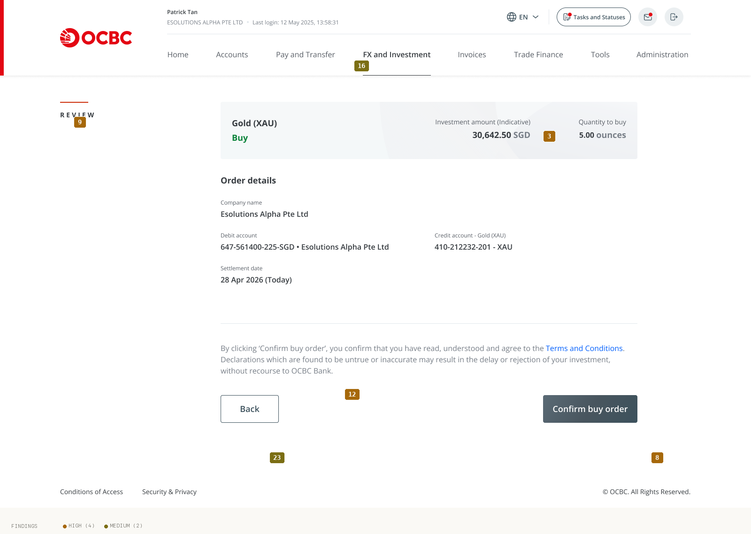
04 Review Buy Order
Findings on this screen:
9
[HIGH] The Review screen (pre-commit) and the Trade-detail screen (already executed) are near-identical in layout and content; the only differentiators are the small kicker (REVIEW vs TRADE DETAILS) and the buttons. A user landing mid-flow cannot tell whether money has already moved.
→ Visually differentiate the two: distinct headers, a clear status banner ('Not yet submitted' vs 'Completed · Filled'), and a step indicator. Make the pre-commit state unmistakable.
3
[HIGH] The gap between the displayed 'Indicative price' and the actual execution price is never disclosed. The quoted indicative price is 6,581.85 SGD/ounce, but the completed trade detail shows an actual 'Purchase price 6,128.50 SGD/ounce' — a materially different number. Nothing warns that the price can move between input and settlement.
→ Add an 'Indicative price' tooltip and an execution caveat at input and review: 'Final price is set at execution and may differ from the indicative price shown.' Show the executed price prominently on confirmation.
12
[HIGH] At the highest-anxiety moment — confirming a 30,642.50 SGD order — the only copy is a cold liability declaration: 'Declarations which are found to be untrue or inaccurate may result in the delay or rejection of your investment, without recourse to OCBC Bank.' There is no reassurance (e.g. 'funds are only debited on settlement', security signal, or 'you can review before it's final').
→ Pair the legal declaration with plain-language reassurance about what happens next (debit/settlement timing, security), and keep the legal text secondary.
8
[HIGH] No loading/processing state exists between 'Confirm buy order' and the success screen. Order submission, price lock, and account creation all involve latency, but there is no spinner, skeleton, or 'Submitting order…' state — risking double submission and user uncertainty at the most critical moment.
→ Add an explicit processing state that disables the button, shows progress, and prevents resubmission until the server responds.
16
[MEDIUM] The header/eyebrow system is not standardised: the kicker appears inline top-left on some screens, in the left gutter with a red rule on others, and is absent (only an H2) on the overview. There is no consistent page-title anchor and no step indicator ('Step 2 of 3') in a multi-step money flow.
→ Standardise one eyebrow+H1 pattern across all screens and add a step indicator to the buy/sell flow.
23
[MEDIUM] The 'Back' button on Review is unlabeled as to consequence — it is unclear whether it discards the order or returns to edit inputs. In a money-moving flow, an ambiguous back action is a trust gap.
→ Label the intent ('Edit order' vs 'Cancel') and confirm before any destructive discard.

Slide 13
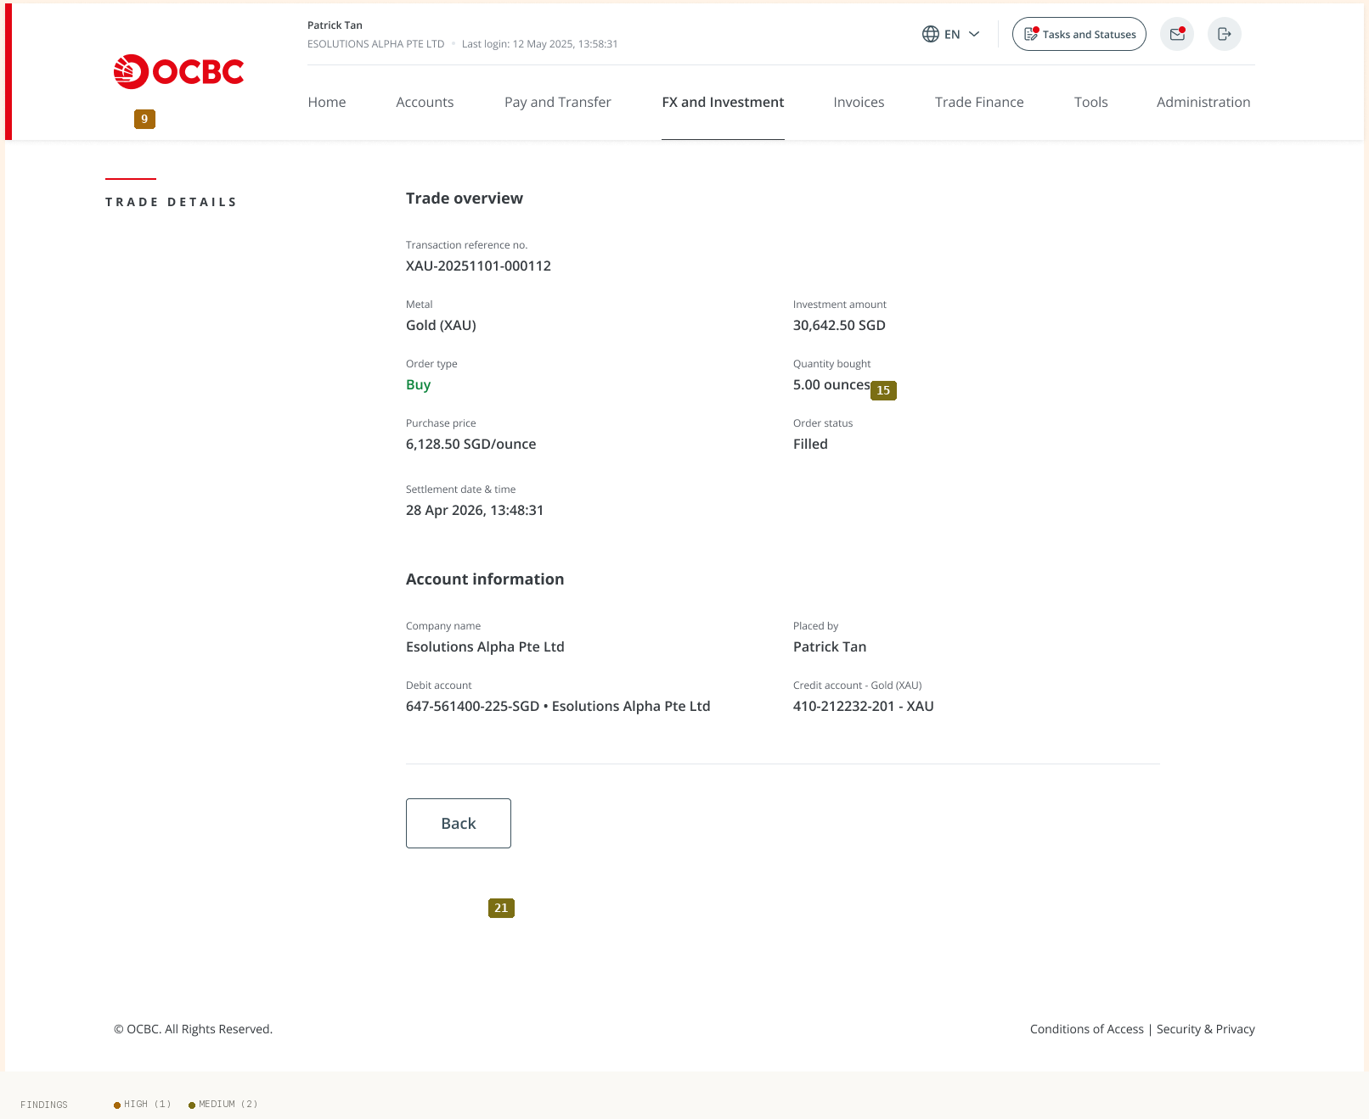
05 Trade Detail Confirmation
Findings on this screen:
9
[HIGH] The Review screen (pre-commit) and the Trade-detail screen (already executed) are near-identical in layout and content; the only differentiators are the small kicker (REVIEW vs TRADE DETAILS) and the buttons. A user landing mid-flow cannot tell whether money has already moved.
→ Visually differentiate the two: distinct headers, a clear status banner ('Not yet submitted' vs 'Completed · Filled'), and a step indicator. Make the pre-commit state unmistakable.
15
[MEDIUM] Novice-hostile terms are used without inline explanation: ISO codes 'XAU/XAG' (never expanded on first use), 'ounce' (never stated as troy ounce), 'Indicative price', 'Credit account'/'Debit account' (a buy's 'Credit account - Gold (XAU)' reads as being given credit), 'Order status: Filled', and 'Market value (Indicative)'. The only glossary is the FAQ on the Overview tab — absent from the input, review, detail and sell screens where the jargon actually appears.
→ Add inline tooltips/glosses on first use ('troy ounce', 'Filled = completed', define XAU/XAG, clarify Credit/Debit account), and carry FAQ definitions onto transactional screens via progressive disclosure so experts aren't slowed.
21
[MEDIUM] The trade-detail screen is a dead end (only 'Back'), with no 'Sell this holding', 'Download receipt', or 'Set an alert' — the obvious next actions. The success screen offers only 'Back to overview' and 'View order' with no 'Place another trade', despite this being a repeat-action product.
→ Add contextual next-actions on trade detail (sell, download, set alert) and a 'Place another trade' shortcut on success.

Slide 14
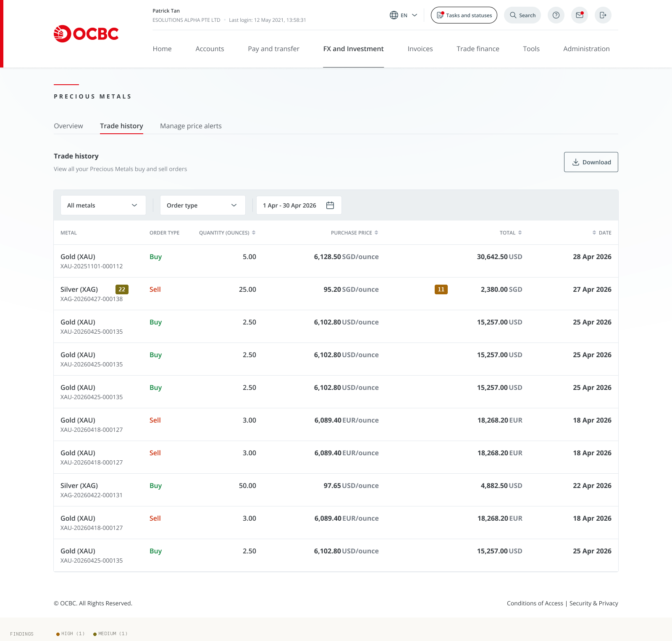
06 Trade History
Findings on this screen:
11
[HIGH] Currency context can shift silently. Overview toggles SGD/ounce vs USD/ounce, trade history mixes SGD, USD and EUR rows, and alerts mix SGD/USD. A user can read a price in one currency and transact in another without noticing the unit change.
→ Make the active currency a persistent, prominent indicator across all screens; warn on currency switch; align overview, history and alert currencies or label each row's currency unambiguously.
22
[MEDIUM] Number, unit and account formatting drift across screens: 'ounce' (singular) vs 'ounces'; account numbers as '410-212232-201 - XAU' vs 'XAU-410-212232-201' vs '647561400225-SGD' (no hyphens); unit phrasing 'SGD/ounce' vs 'SGD / ounce'; and the card label 'Holdings details' vs 'Holding details'.
→ Define and enforce one formatting standard for currency units, account numbers, pluralisation, and shared labels.

Slide 15
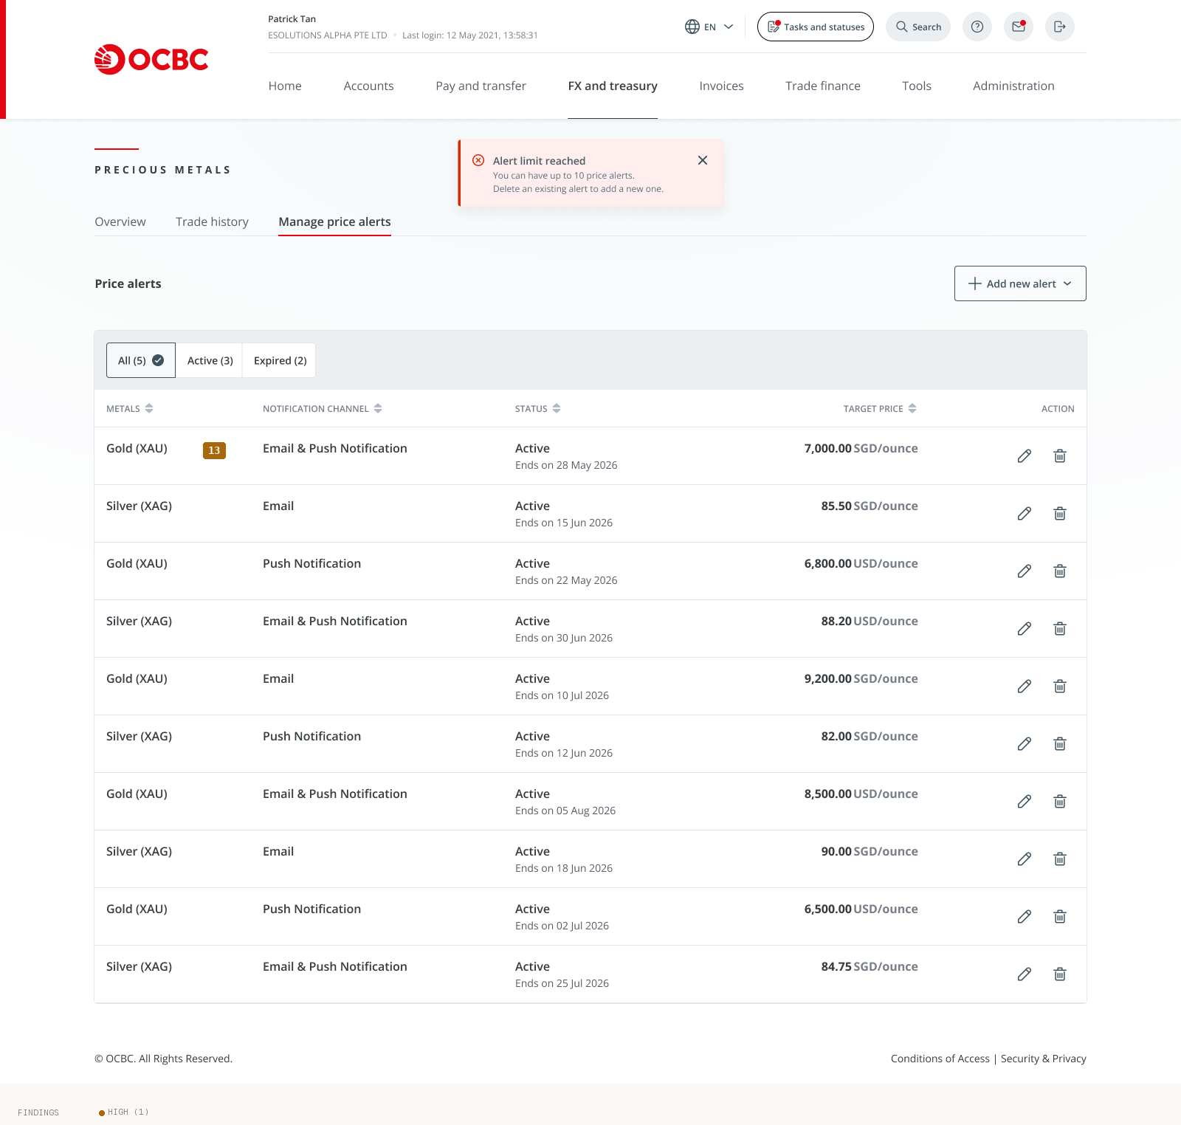
07 Dashboard Holdings
Findings on this screen:
13
[HIGH] The alert list filter counter and the table disagree: the 'All (5)' pill is shown while the table renders 7 rows with different target prices/dates across the two captured states — a correctness/trust bug.
→ Reconcile the filter counts with the rendered rows; treat as a data-integrity defect, not cosmetic.

Slide 16
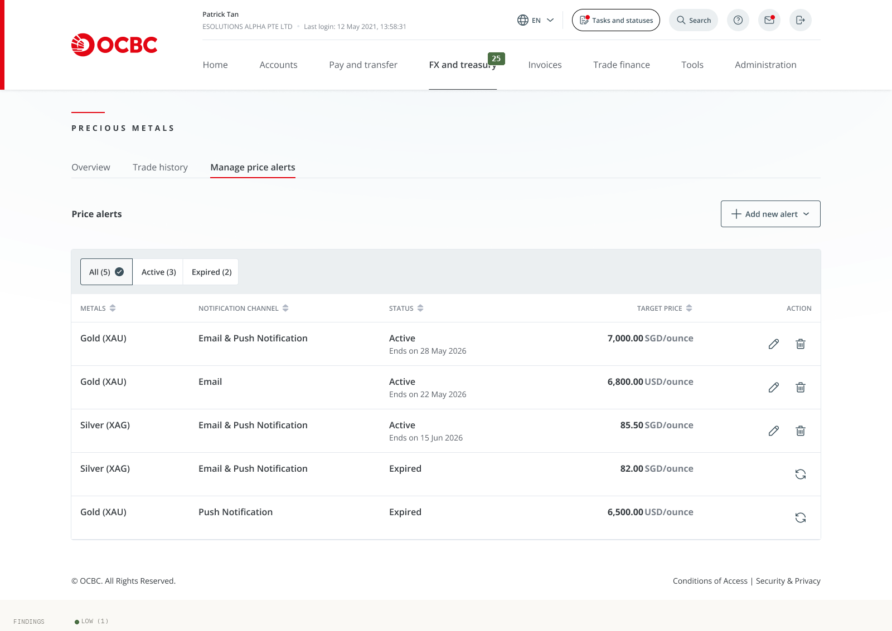
08 Dashboard Default
Findings on this screen:
25
[LOW] Global chrome drifts across captures: the top nav reads 'FX and Investment' on most screens but 'FX and treasury' on a dashboard variant, and some screens show a Search pill and help '?' icon that others lack. Design-spec frames (error banners, alert input) are also mixed into the product set on peach/grey artboards rather than shown integrated.
→ Reconcile to one nav taxonomy and one header chrome; keep spec frames out of the production flow or render error states in-context.

Slide 17
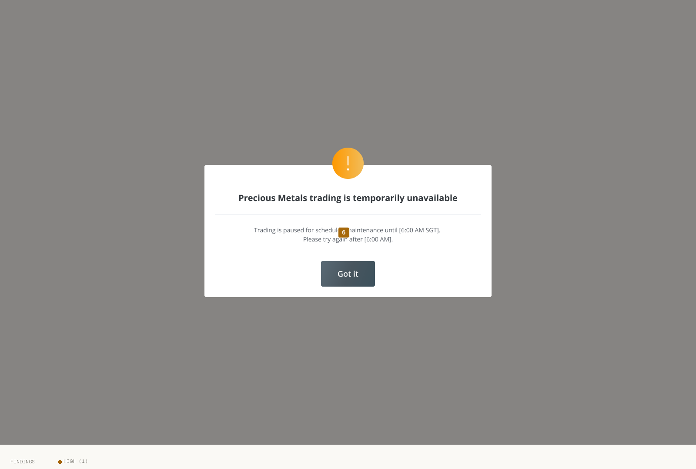
10 Modal Acknowledgement
Findings on this screen:
6
[HIGH] Unfilled template artifacts are shipped into customer-facing surfaces: maintenance modal shows '[6:00 AM SGT]' and '[6:00 AM]' bracket tokens (and the two phrasings disagree on timezone); the confirmation email shows 'Dear <Salutation> <Surname>' and a '<Name> / <Designation/rank> / <Department name>' signature plus a stale '© Copyright 2024'; the push notification leaks delimiters '<7,000.00 SGD/ounce>'.
→ Purge all merge-field/placeholder tokens, fill the maintenance time dynamically with a single consistent timezone format, and correct the copyright year.

Slide 18
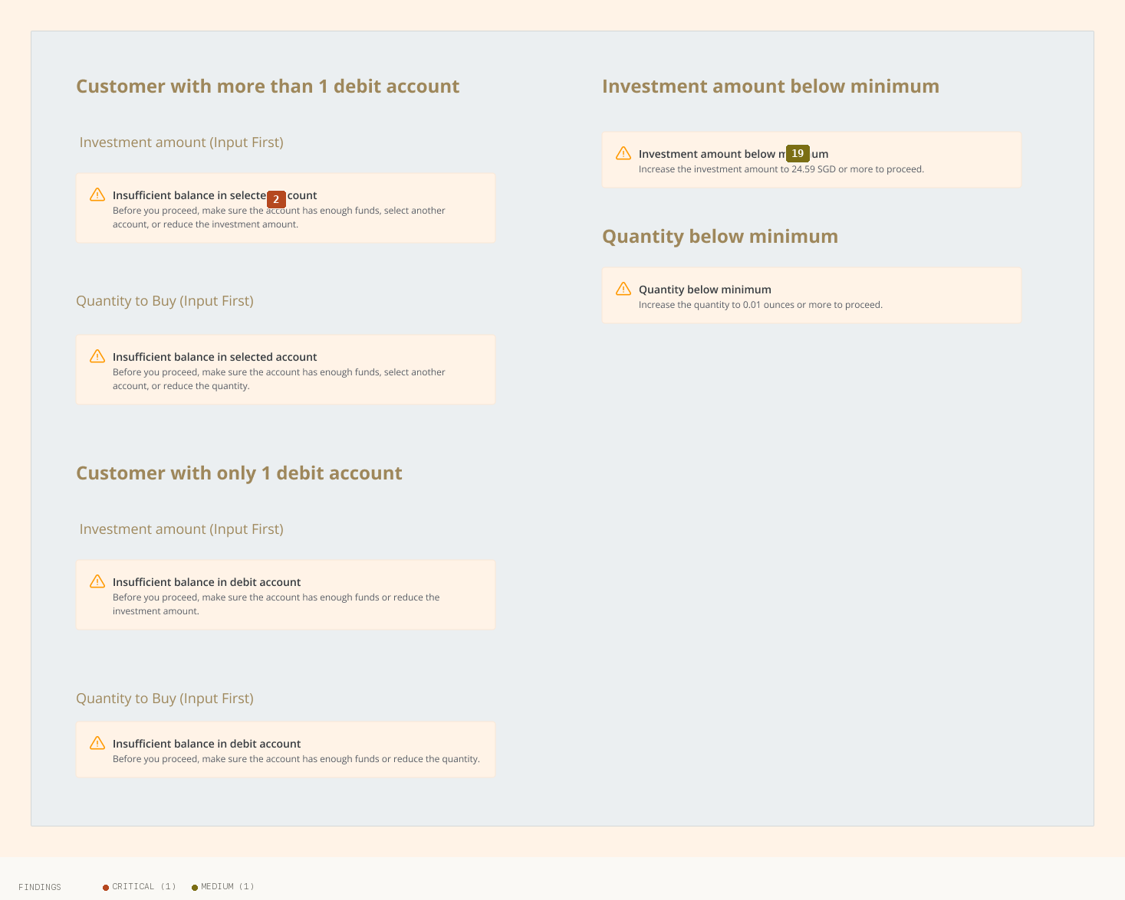
11 Error Banner Specs
Findings on this screen:
2
[CRITICAL] Inline validation and error states exist only as isolated spec frames (insufficient balance, below-minimum, exceed-market-value) and are not rendered on the live Buy/Sell trade screen. No error border, no inline message anchored to a field, and validation timing / CTA-gating cannot be confirmed. For a money-moving flow the on-screen error state is mandatory and appears undesigned/uninstrumented.
→ Integrate the spec'd error/warning states into the actual trade screen with field-anchored inline messages, on-blur validation, and a CTA that gates with a stated reason. Specify hover/focus/active/loading states too.
19
[MEDIUM] Blocking errors (e.g. 'Insufficient balance') and soft warnings share an identical amber/triangle treatment, with no visual distinction between a hard block and a caution. Three banner variants also coexist (tight field banner, large padded container banner, and a page-level banner with a close ×).
→ Introduce distinct error vs warning styles (colour/icon) and consolidate to one banner component with size variants.

Slide 19
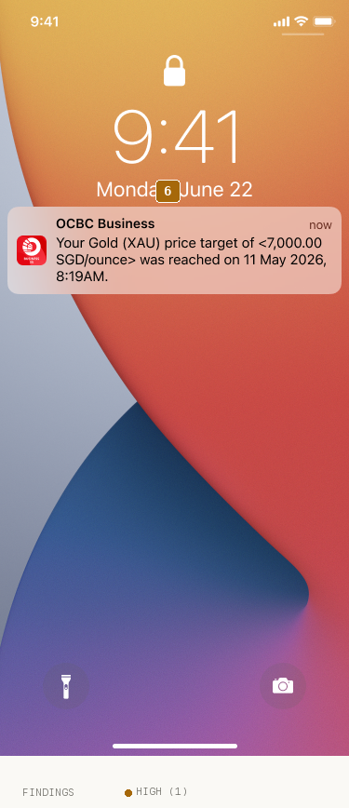
12 Push Noti Rate Reached
Findings on this screen:
6
[HIGH] Unfilled template artifacts are shipped into customer-facing surfaces: maintenance modal shows '[6:00 AM SGT]' and '[6:00 AM]' bracket tokens (and the two phrasings disagree on timezone); the confirmation email shows 'Dear <Salutation> <Surname>' and a '<Name> / <Designation/rank> / <Department name>' signature plus a stale '© Copyright 2024'; the push notification leaks delimiters '<7,000.00 SGD/ounce>'.
→ Purge all merge-field/placeholder tokens, fill the maintenance time dynamically with a single consistent timezone format, and correct the copyright year.

Slide 20
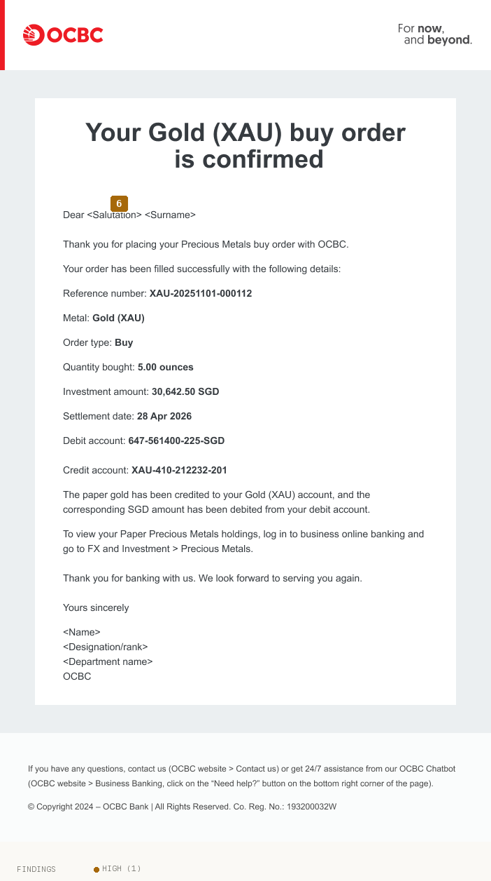
13 Email Noti
Findings on this screen:
6
[HIGH] Unfilled template artifacts are shipped into customer-facing surfaces: maintenance modal shows '[6:00 AM SGT]' and '[6:00 AM]' bracket tokens (and the two phrasings disagree on timezone); the confirmation email shows 'Dear <Salutation> <Surname>' and a '<Name> / <Designation/rank> / <Department name>' signature plus a stale '© Copyright 2024'; the push notification leaks delimiters '<7,000.00 SGD/ounce>'.
→ Purge all merge-field/placeholder tokens, fill the maintenance time dynamically with a single consistent timezone format, and correct the copyright year.

Slide 21
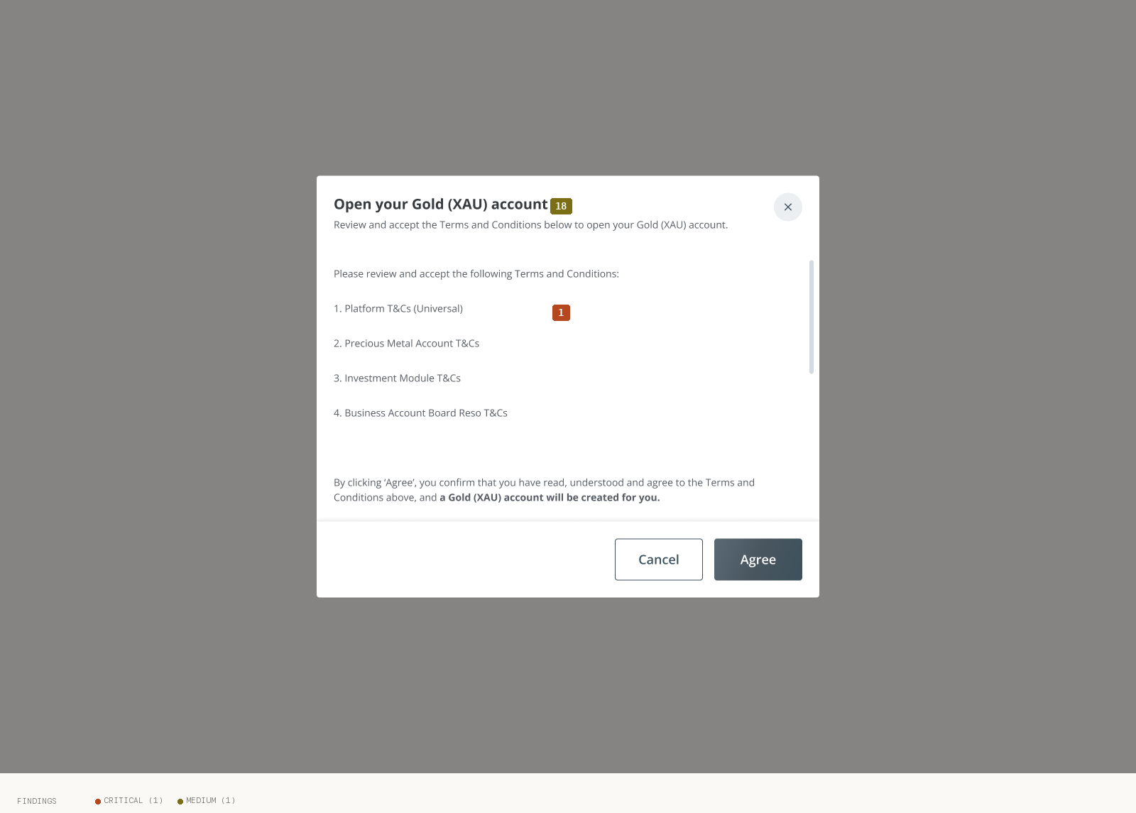
15 Terms And Conditions
Findings on this screen:
1
[CRITICAL] No investment-risk disclosure, Key Fact Sheet, or suitability check anywhere in the buy flow. The only risk-related artifact before commitment is a liability declaration on Review. The first-time T&C modal lists four agreements by title only ('Platform T&Cs', 'Precious Metal Account T&Cs', 'Investment Module T&Cs', 'Business Account Board Reso T&Cs') with no openable documents, yet requires the user to click 'Agree'.
→ Add a dedicated risk-disclosure step before 'Confirm buy order': a Key Fact Sheet / risk-warning statement with an explicit 'I understand precious-metal values can fall' acknowledgement, and make the four T&Cs in the modal openable (links or expandable text). Separate liability declaration (protects bank) from risk disclosure (protects customer).
18
[MEDIUM] Account creation is messaged twice and inconsistently: the buy input says 'New Gold (XAU) Account will be created with your order', while a separate first-time modal says 'a Gold (XAU) account will be created for you' — leaving it unclear when the account is actually opened.
→ Use one clear, consistent account-creation message at a single, well-defined point in the flow.

Slide 22
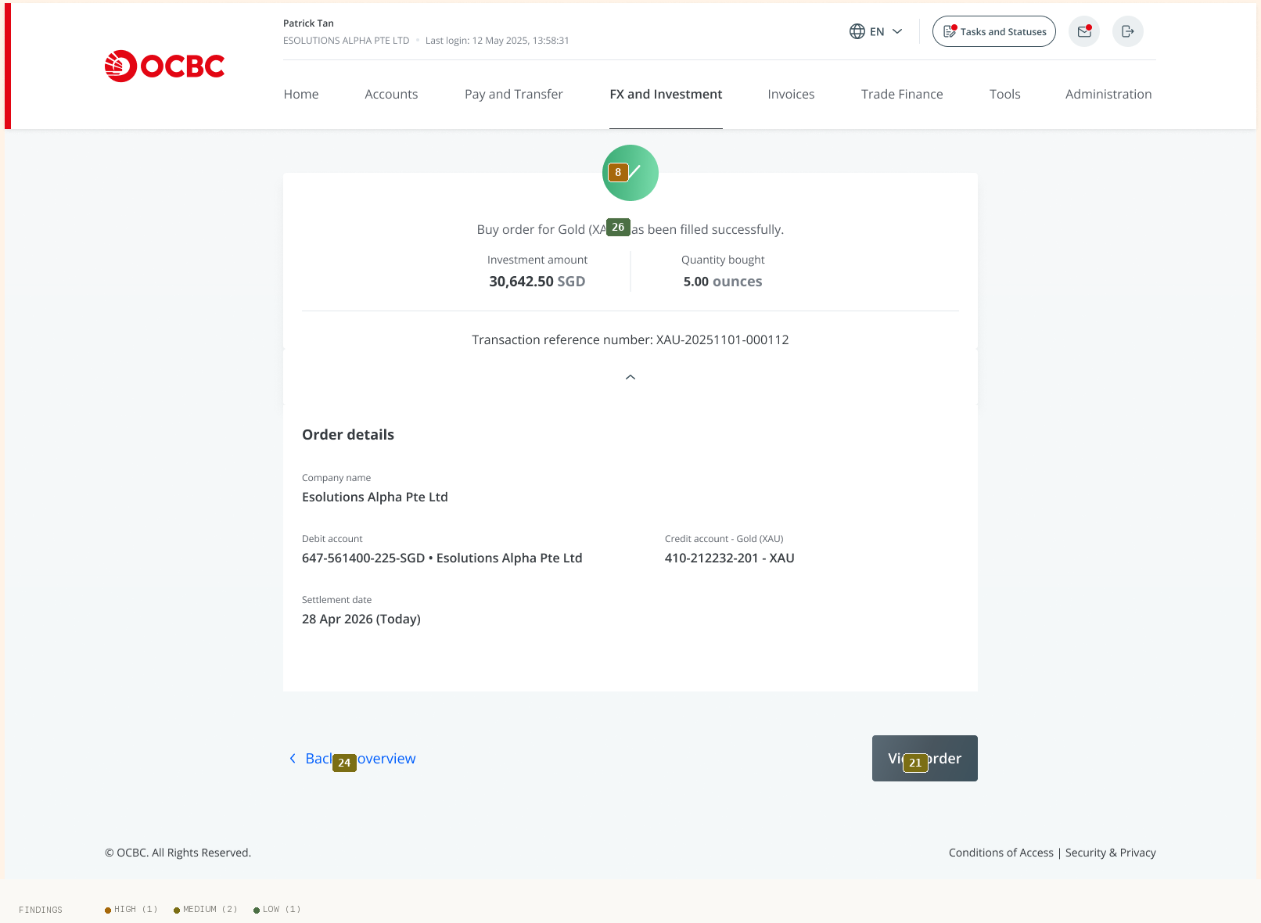
16 Confirmation Success
Findings on this screen:
8
[HIGH] No loading/processing state exists between 'Confirm buy order' and the success screen. Order submission, price lock, and account creation all involve latency, but there is no spinner, skeleton, or 'Submitting order…' state — risking double submission and user uncertainty at the most critical moment.
→ Add an explicit processing state that disables the button, shows progress, and prevents resubmission until the server responds.
24
[MEDIUM] The primary-button system is not systematised: slate-grey is the de-facto primary while OCBC red is never used for a primary action; the same 'Back' action appears as a blue text-link on the success screen but an outlined button on trade-detail and review. Two near-identical confirmation screens also use different backgrounds (grey page + white card vs white page, no card).
→ Define one primary, one secondary, and one tertiary button treatment and apply consistently; unify the two confirmation layouts.
21
[MEDIUM] The trade-detail screen is a dead end (only 'Back'), with no 'Sell this holding', 'Download receipt', or 'Set an alert' — the obvious next actions. The success screen offers only 'Back to overview' and 'View order' with no 'Place another trade', despite this being a repeat-action product.
→ Add contextual next-actions on trade detail (sell, download, set alert) and a 'Place another trade' shortcut on success.
26
[LOW] On the success screen the confirming sentence ('Buy order for Gold (XAU) has been filled successfully') is set in lighter mid-grey, smaller than the figures beneath it; the green check carries all the visual weight. The most important message on a success screen should be its strongest text element.
→ Promote the success sentence to the strongest text on the screen (size/weight/contrast).

Slide 23
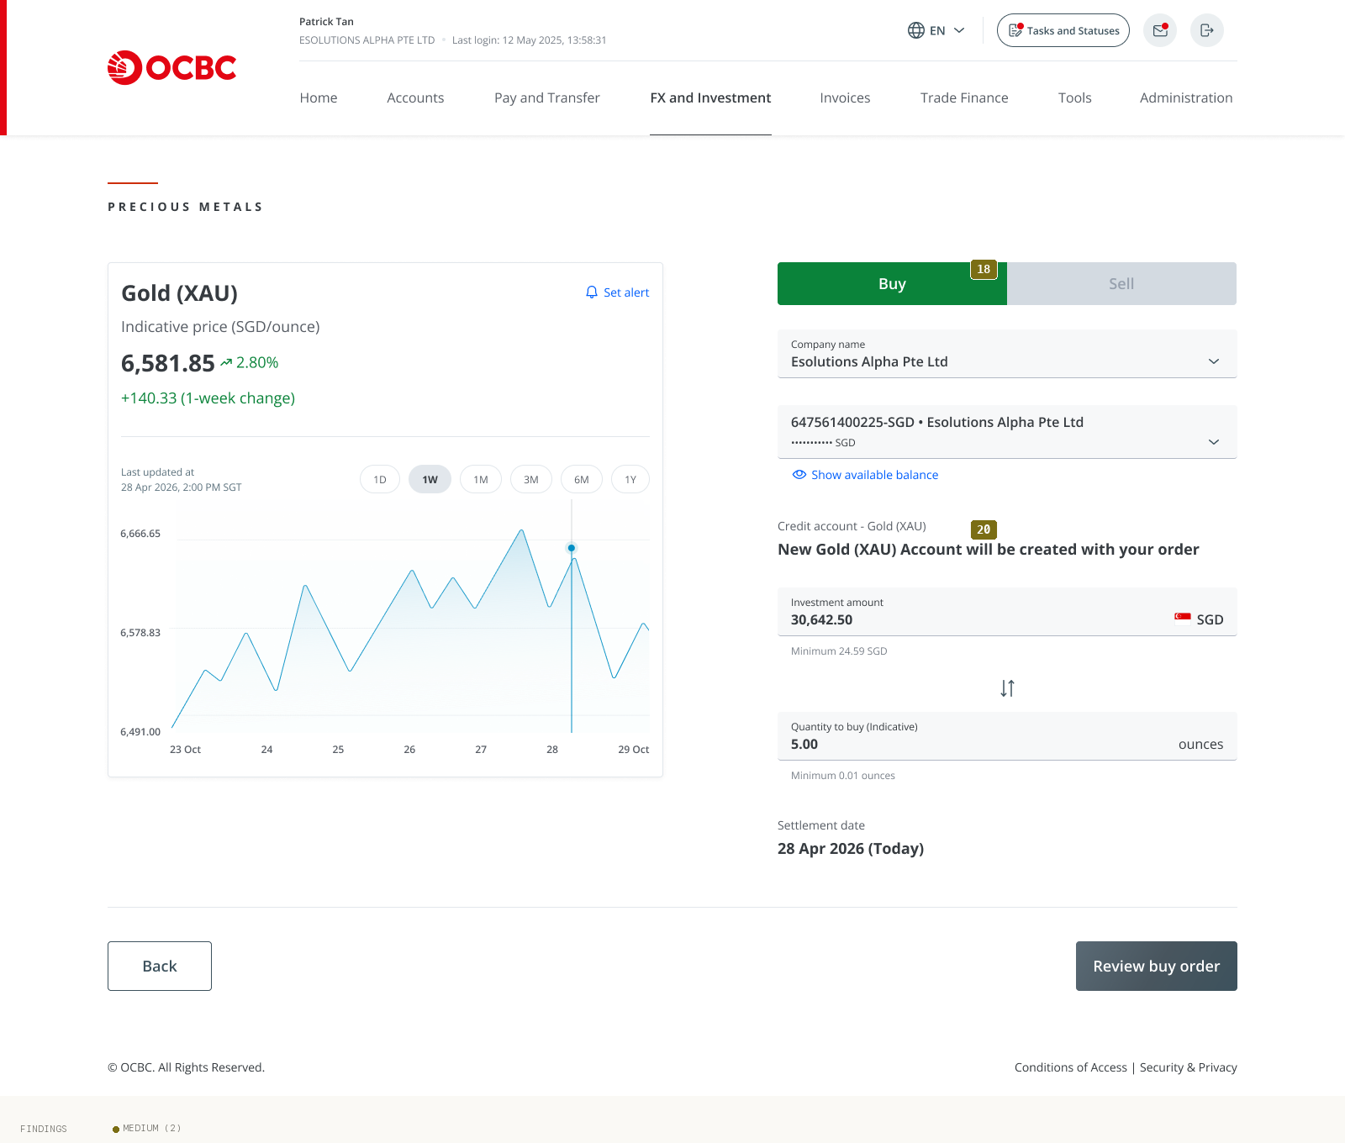
18 Buy Input Filled
Findings on this screen:
18
[MEDIUM] Account creation is messaged twice and inconsistently: the buy input says 'New Gold (XAU) Account will be created with your order', while a separate first-time modal says 'a Gold (XAU) account will be created for you' — leaving it unclear when the account is actually opened.
→ Use one clear, consistent account-creation message at a single, well-defined point in the flow.
20
[MEDIUM] Field labels and helper text ('Investment amount', 'Quantity to buy', 'Minimum 24.59 SGD') are light grey inset on light-grey fills, with borderline contrast likely failing WCAG AA at ~11px. The empty-state '0.00' is rendered in the same dark weight a real value would use, so a placeholder is indistinguishable from an actual entered zero.
→ Raise label/helper contrast to AA and visually distinguish placeholder from entered values (lighter placeholder, clear focus/filled states).

Slide 24
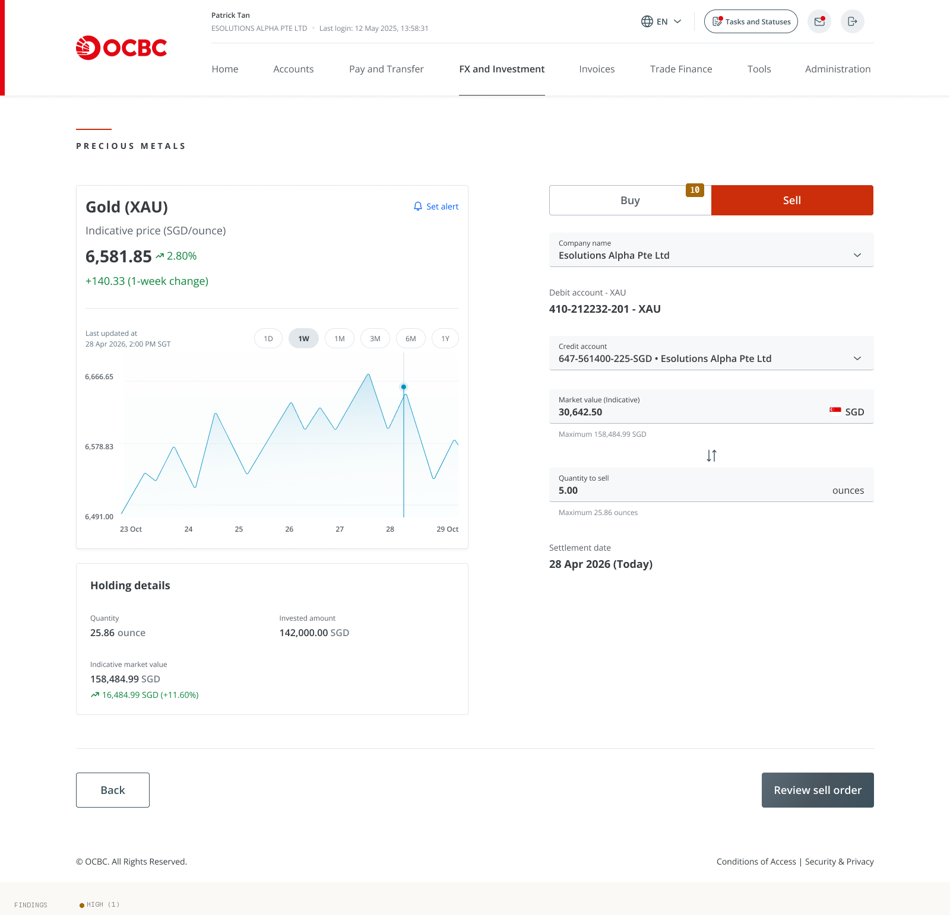
19 Sell Trade Input
Findings on this screen:
10
[HIGH] Buy/Sell is differentiated almost entirely by colour (green Buy / red Sell pill) with no icon, arrow, or shape redundancy, and gain/loss values on the Holding-details card rely on green/red with only a weak '+/-' sign. Brand red is simultaneously used for OCBC branding, the Sell state, and loss values — so the most saturated red on the Sell screen is the toggle, not the primary action.
→ Add non-colour redundancy (directional icons/labels) to Buy/Sell and gain/loss everywhere, and decide a single meaning for red (brand vs action vs sell) so the primary CTA reads unambiguously.

Slide 25
Top 5 Priority Recommendations
1
Add a compliant risk-disclosure step before "Confirm buy order"
Large Effort
What to fix: Insert a Key Fact Sheet / risk-warning statement with an explicit "I understand precious-metal values can fall" acknowledgement, and make the four agreements in the T&C modal genuinely openable (links or expandable text). Separate the customer-facing risk disclosure from the bank's liability declaration. (Resolves #1, #4, #5, #12.) | Why it matters: For a regulated investment product this is the single biggest gap — currently a customer commits a five-figure order with no risk disclosure and agrees to documents they cannot read. It is both a user-protection and a regulatory exposure. | How to fix it: A dedicated step (or expandable panel) before confirm: concise plain-language risks + openable versioned KFS/T&Cs + a required checkbox. Log acknowledgement against the order reference.
2
Make price honesty explicit — indicative vs execution, and freshness
Quick Win (copy/tooltip) + Medium Lift (live refresh)
What to fix: Add an "Indicative price" tooltip and an execution caveat at input and review ("Final price is set at execution and may differ from the indicative price shown"); show the executed price prominently on confirmation; reconcile the conflicting timestamps and add an auto-refresh with a visible countdown/refresh control. (Resolves #3, #7.) | Why it matters: The displayed price silently differs from the charged price and freshness is contradictory — a novice perceives bait-and-switch and an expert cannot trust the quote. | How to fix it: Tooltip component + a live price ticker with "updated Xs ago / refresh" and an expiry on the quote used at confirm.
3
Purge all template artifacts and add the missing submit/loading states
Quick Win (artifacts) + Medium Lift (loading state)
What to fix: Strip/fill every leaked token (`[6:00 AM SGT]`, `<Salutation> <Surname>`, `<Name>/<Designation>/<Department>`, `<7,000.00 SGD/ounce>`), fix "© 2024", and add an explicit processing state between Confirm and success that disables the button and prevents resubmission. (Resolves #6, #8.) | Why it matters: Shipped placeholders read as broken on a bank; the missing loading state risks double-submitting a real order. Both are high-ROI trust fixes. | How to fix it: Wire merge fields to data with safe fallbacks; add a submitting/pending state with optimistic disable + server confirmation.
4
Differentiate pre-commit from completed, and warm up the confirm moment
Medium Lift
What to fix: Visually separate Review (not yet submitted) from Trade-detail (Filled) with distinct headers, a clear status banner, and a step indicator; replace the cold liability-only declaration with plain-language reassurance (debit/settlement timing, security) kept alongside (not instead of) the legal text. (Resolves #9, #12, #16.) | Why it matters: Users currently cannot reliably tell whether money has moved, and the most consequential screen has the coldest copy — a direct hit to novice confidence and a misread risk for experts. | How to fix it: Status banner component ("Review — not yet submitted" vs "Completed · Filled"), a 3-step progress indicator, and a reassurance block above the declaration.
5
Glossed jargon + efficiency shortcuts via progressive disclosure
Medium Lift
What to fix: Add inline tooltips/glosses on first use for novice-hostile terms ("troy ounce", "Filled = completed", define XAU/XAG, clarify Credit/Debit account) and carry FAQ definitions onto transactional screens; add a "Place another trade" shortcut and contextual next-actions (sell/download/set alert) on trade detail; label the swap control. (Resolves #15, #17, #21, #23.) | Why it matters: Closes the novice comprehension gap and the expert efficiency gap simultaneously without sacrificing either — the core dual-persona resolution. | How to fix it: Reusable tooltip/term component (collapsible for experts), labelled swap button, and contextual action bar on detail/success screens.

Slide 26
What's Working Well
Persistent, top-aligned field labels
No placeholder-only labels in the trade panels — every input keeps its label visible, which is exactly right for a high-stakes form.
Non-punitive, specific error-recovery copy
The spec'd errors tell the user *what* and *how to fix* with concrete thresholds ("Increase the investment amount to 24.59 SGD or more to proceed"; three recovery paths for insufficient balance). Once integrated on the live screen, this is exemplary.
Sell-side guardrails
The sell flow pre-fills the XAU account and caps inputs to actual holdings ("Maximum 25.86 ounces / 158,484.99 SGD") — strong error prevention.
The "without holding the physical metal" gloss and the empty holdings state
The one genuinely good plain-language explanation, paired with a proper illustrated zero-state and a clear "Start trading" CTA.
Plain-language confirmation across channels
Success screen, trade detail, and email explain the mechanics in human terms ("the paper gold has been credited… the SGD amount has been debited") and share a consistent transaction reference number — good for trust and traceability. ---

Slide 27
Thank You
Generated by UX Audit Skill · 2026-06-23

