Slide 1
UI/UX AUDIT REPORT: Precious Metals Trading App
Comprehensive UI/UX Audit Report
6.5
AUDIT DATE
2026-03-09
PLATFORM
Web desktop (1280x1080)
UX Health Score / 10
AUDITOR PERSONA
Novice investor, new to precious metals
URL
https://theory-round-48270233.figma.site

Slide 2
Executive Summary
This is a well-structured precious metals trading prototype with a clean visual identity, logical information architecture, and a complete buy/sell flow covering all 4 metals. The app follows modern SaaS conventions (Tailwind + shadcn/ui) and provides a credible trading experience. However, for a financial trading product used by novice investors, there are significant gaps in trust signalling, error prevention, educational scaffolding, and accessibility compliance that would erode confidence and cause drop-off. The biggest risks are: (1) a novice user has no onboarding or guided first-trade experience, (2) critical accessibility failures in contrast, touch targets, and motion, (3) the sell flow allows zero-balance sells to reach the review screen before failing, and (4) currency conversion introduces confusion without adequate explanation.
3
6
7
5
CRITICAL
HIGH
MEDIUM
LOW
Total Findings: 21

Slide 3
Findings (1/5)
#
Screen
Severity
Finding
Recommendation
#1
Trade -- Order Form
CRITICAL
No onboarding or guided first-trade experience for novice investors
Add contextual tooltips, first-visit banner, default to Market + SGD
#2
Trade -- Sell Flow
CRITICAL
Sell toggle accessible with 0 oz holdings -- error only at validation
Disable Sell or show inline message when holdings = 0
#3
Trade -- Order Form
CRITICAL
Currency selector introduces massive cognitive load with no explanation
Default SGD, collapse behind 'Change currency' link
#4
Global
HIGH
No prefers-reduced-motion support despite extensive animations
Add global @media (prefers-reduced-motion: reduce) rule
#5
Global
HIGH
Muted text contrast #717182 on #ececf0 fails WCAG AA at ~3.5:1
Darken muted foreground to at least #5e5e6e

Slide 4
Findings (2/5)
#
Screen
Severity
Finding
Recommendation
#6
Global -- Interactive Elements
HIGH
Button/input height 36px below WCAG 2.2 SC 2.5.8 minimum of 44px
Increase min-heights to 44px for coarse pointers
#7
Dashboard -- Market Overview
HIGH
All 4 metal cards have equal visual weight -- no beginner guidance
Add 'Most Popular' badge to Gold or 'New? Start with Gold' CTA
#8
Trade -- Order Form
HIGH
Amount field label ambiguous -- spend amount vs metal quantity unclear
Rename to 'I want to spend (SGD)' and show computed oz prominently
#9
Order Review
HIGH
No fee disclosure, no spread cost breakdown before confirmation
Add cost breakdown: Metal price, Spread (0.5%), Total, Fees (S$0.00)
#10
Order Review
MEDIUM
Confirm button has no loading state -- direct navigation on click
Add loading spinner with 'Processing...' and disable after first click

Slide 5
Findings (3/5)
#
Screen
Severity
Finding
Recommendation
#11
Dashboard -- Portfolio Holdings
MEDIUM
Empty state CTA 'Start trading to build your portfolio' is vague
Change to 'Buy your first precious metal' button linking to /trade/XAU
#12
Trade -- Price Chart
MEDIUM
Chart has no Y-axis labels, gridlines, or volume data
Add Y-axis price labels, gridlines, label time buttons descriptively
#13
Trade -- Metal Tabs
MEDIUM
Metal tabs use expert codes (XAU, XPT) more prominently than names
Show metal name first, code smaller: 'Gold (XAU)'
#14
Order Confirmation
MEDIUM
Order ID is truncated UUID -- no receipt download option
Display human-readable reference, add Download Receipt button
#15
Navigation
MEDIUM
Trade nav link goes directly to Gold with no intermediate page
Make Trade a dropdown or remember last-traded metal

Slide 6
Findings (4/5)
#
Screen
Severity
Finding
Recommendation
#16
Products Page
MEDIUM
No cross-metal comparison view -- must tab between 4 metals
Add Compare Metals table: Price, Min Qty, Volatility, Best For
#17
Global -- Footer
LOW
Footer only has copyright -- no Help, Terms, Privacy, regulatory links
Add standard footer links including regulatory information
#18
Dashboard -- Recent Orders
LOW
8-row table on dashboard is too dense for novice users
Show 3 simplified cards, reserve full table for Orders page
#19
Trade -- Debit/Credit
LOW
Account dropdown shows full account numbers adding noise
Simplify to 'Current Account -- S$50,000.00'
#20
Global
LOW
No skip-navigation link for keyboard users
Add visually hidden skip link: 'Skip to main content'

Slide 7
Findings (5/5)
#
Screen
Severity
Finding
Recommendation
#21
404 Page
LOW
404 page has no search or suggested links
Add suggested links (Dashboard, Trade, Products)

Slide 8
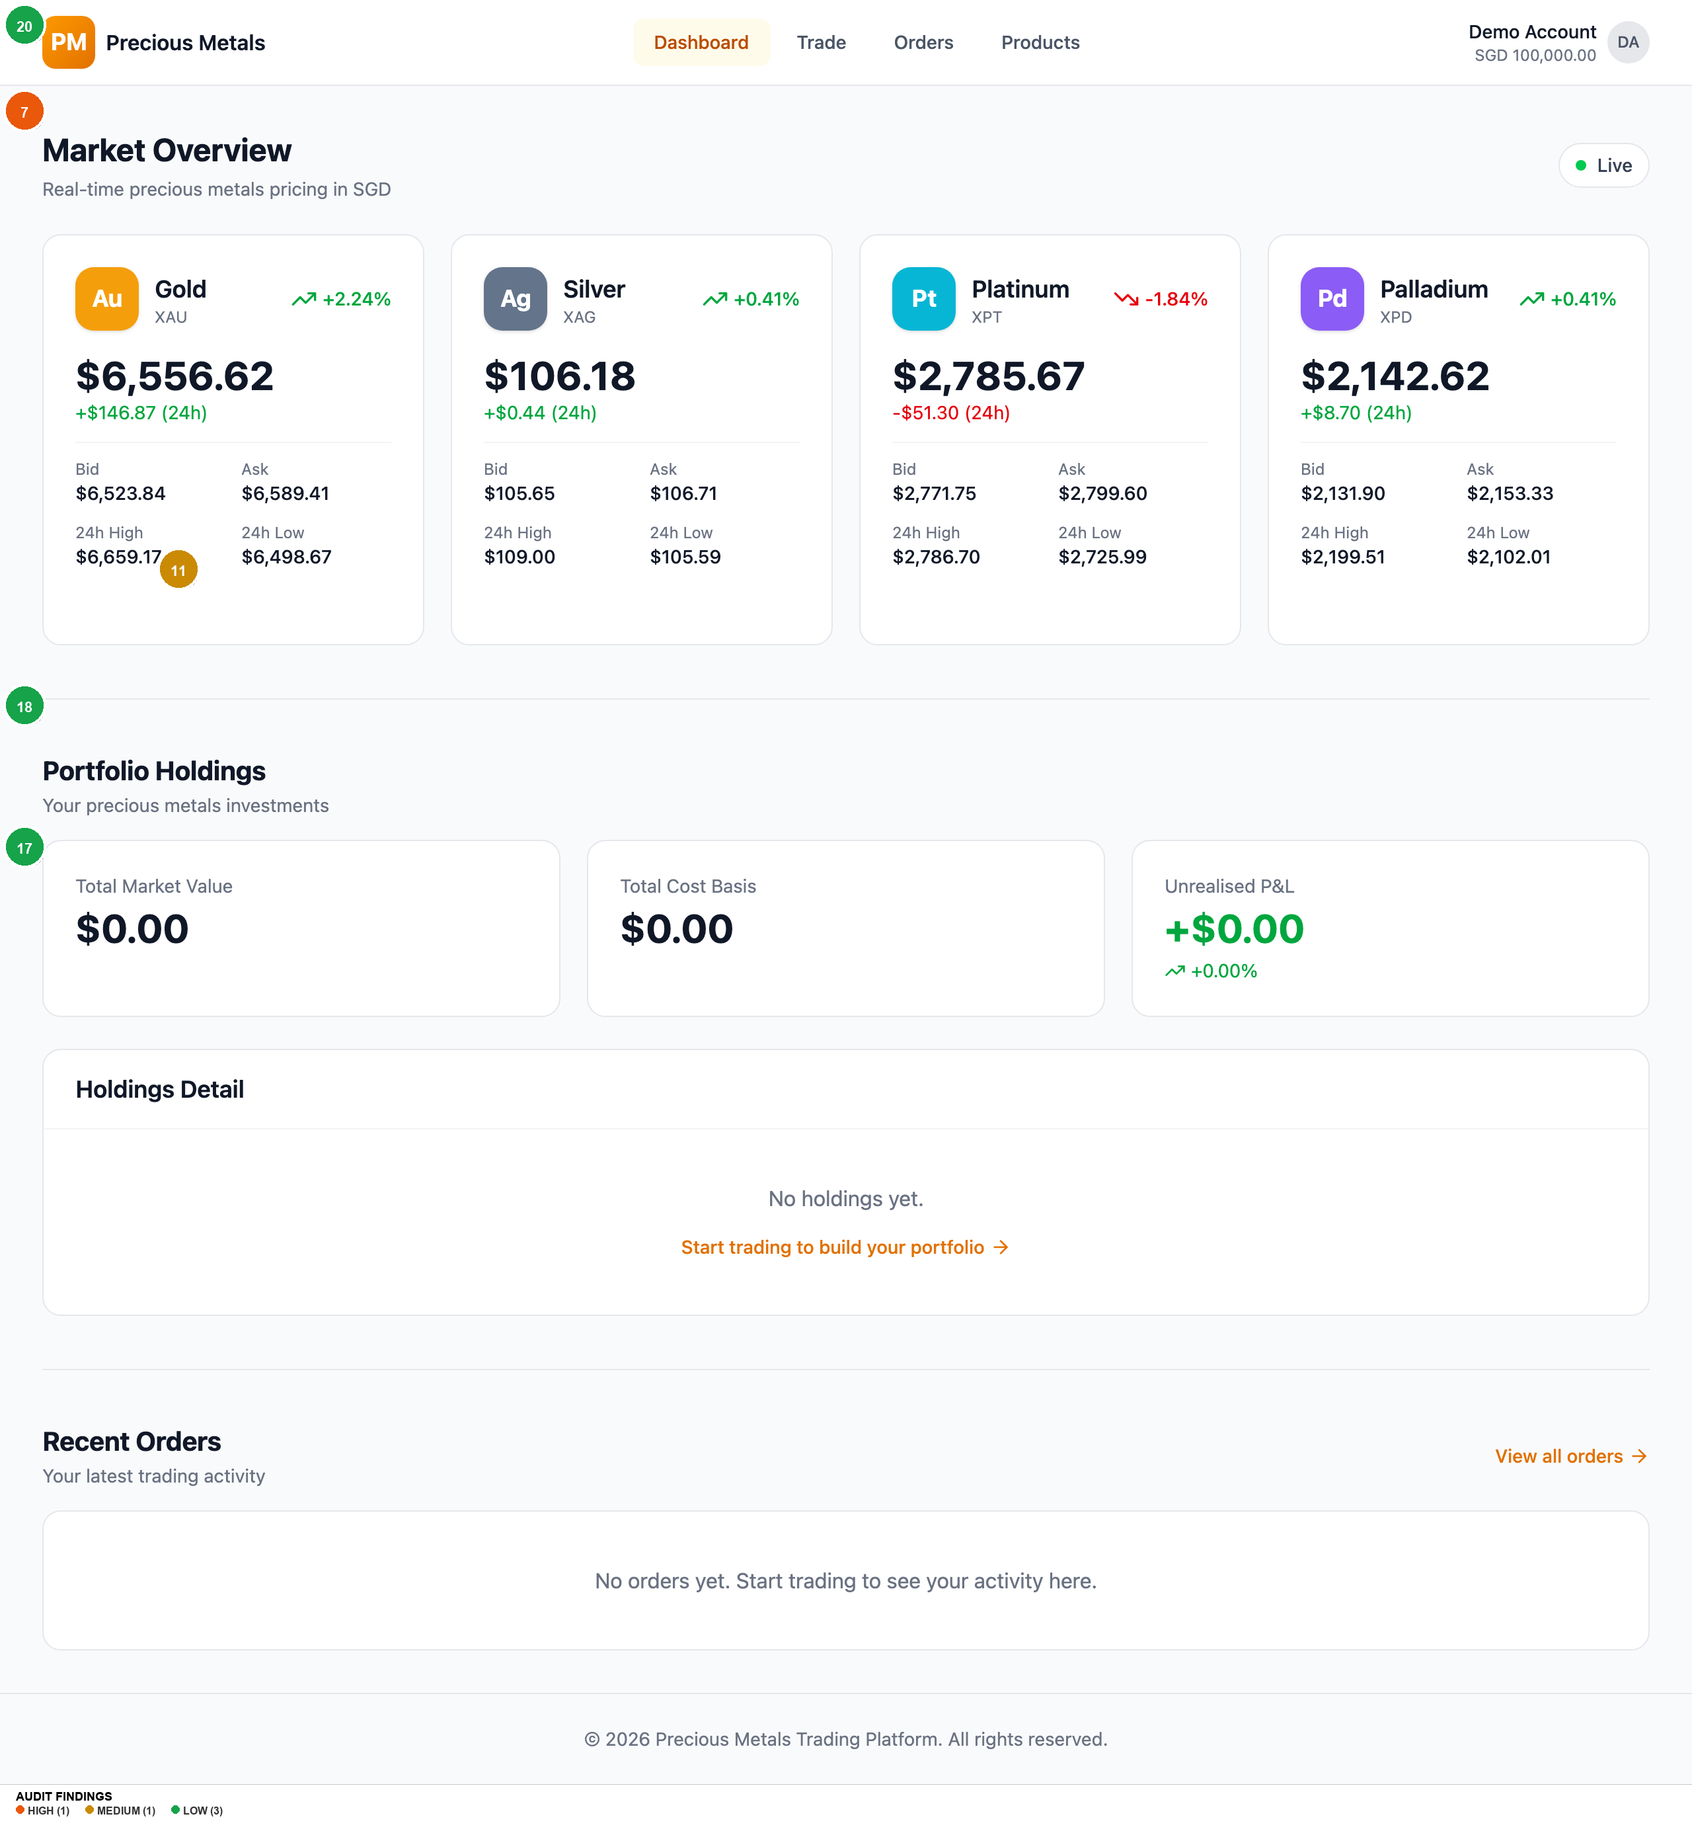
Homepage
Findings on this screen:
7
[HIGH] All 4 metal cards have equal visual weight -- no beginner guidance
→ Add 'Most Popular' badge to Gold or 'New? Start with Gold' CTA
11
[MEDIUM] Empty state CTA 'Start trading to build your portfolio' is vague
→ Change to 'Buy your first precious metal' button linking to /trade/XAU
17
[LOW] Footer only has copyright -- no Help, Terms, Privacy, regulatory links
→ Add standard footer links including regulatory information
18
[LOW] 8-row table on dashboard is too dense for novice users
→ Show 3 simplified cards, reserve full table for Orders page
20
[LOW] No skip-navigation link for keyboard users
→ Add visually hidden skip link: 'Skip to main content'

Slide 9
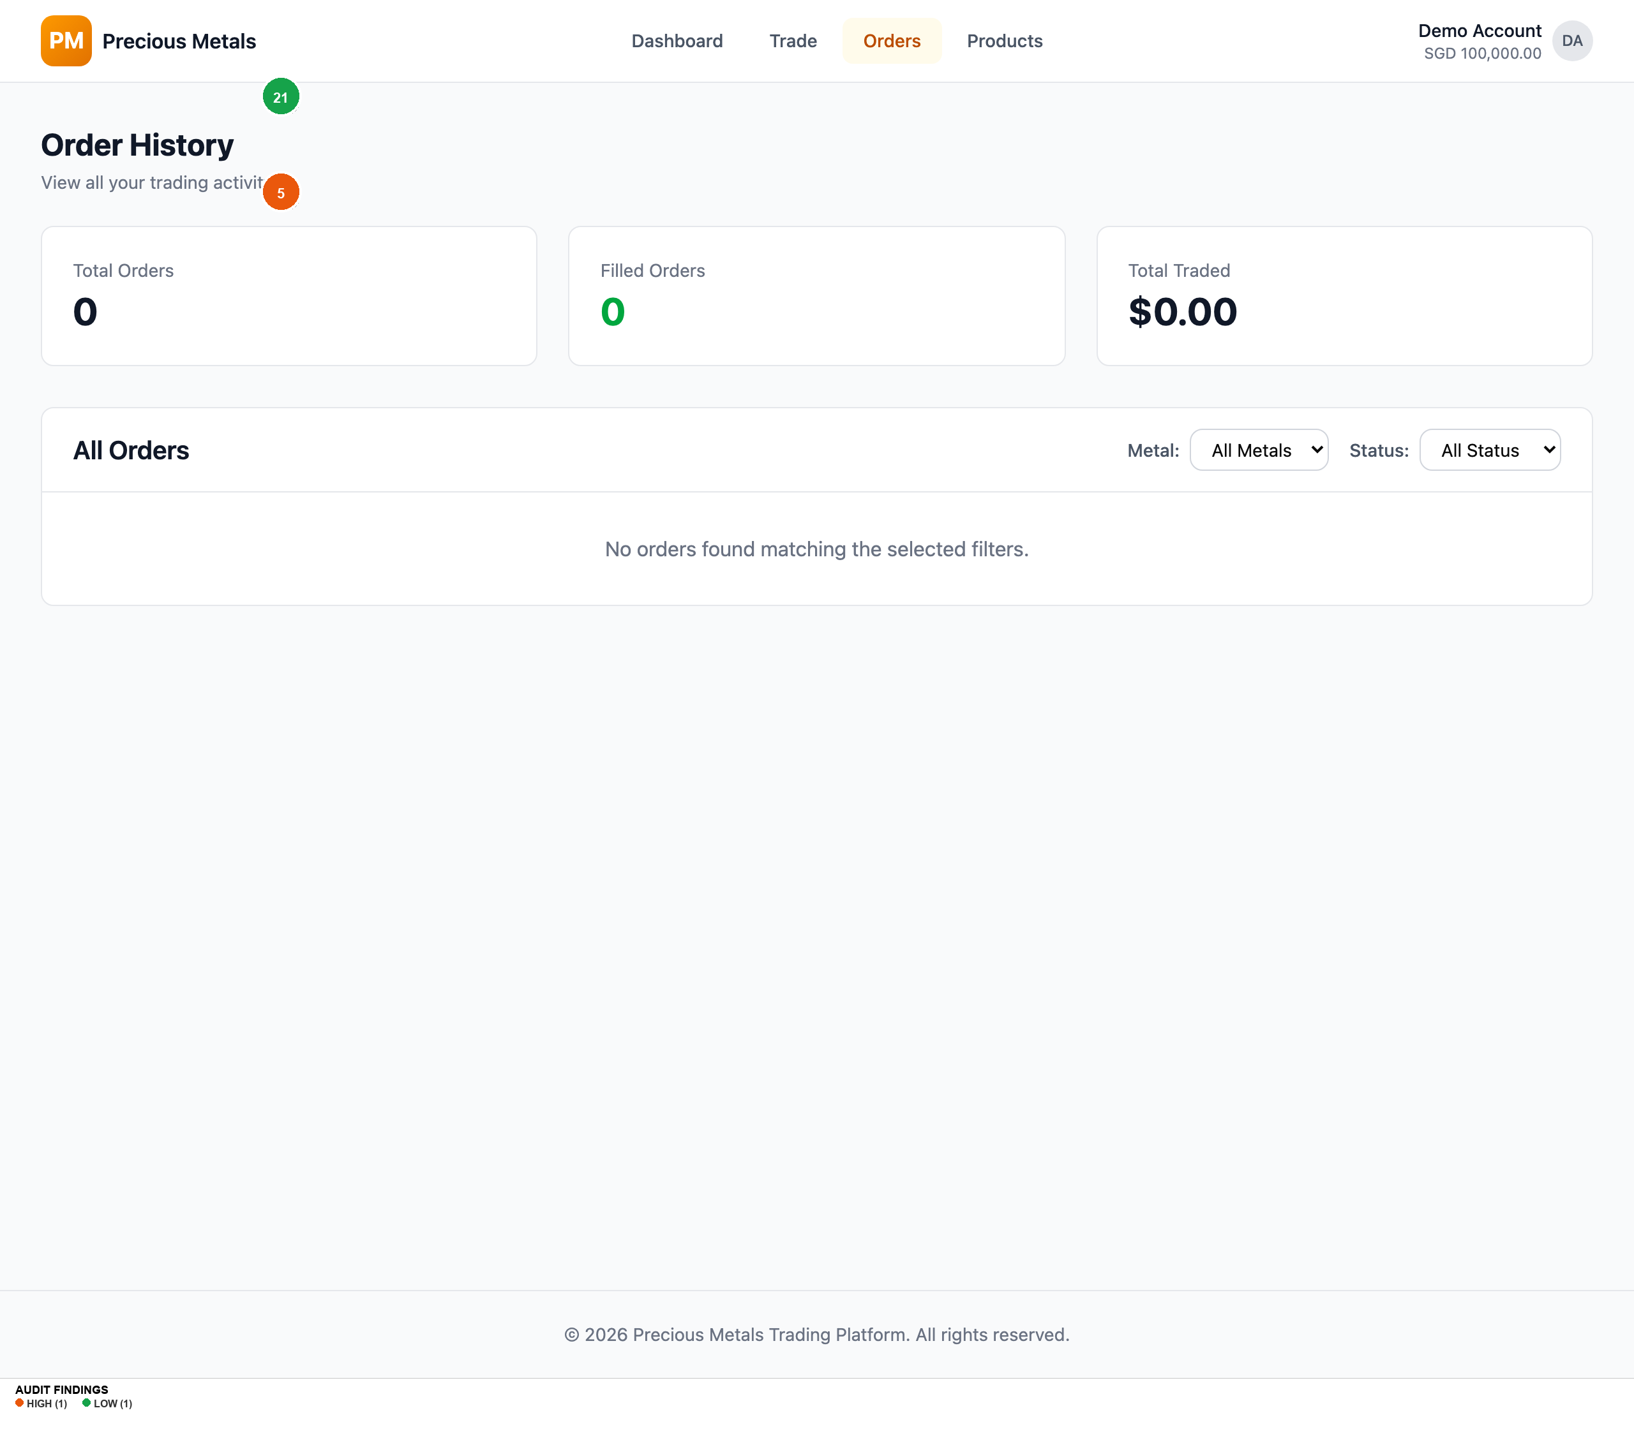
Orders
Findings on this screen:
5
[HIGH] Muted text contrast #717182 on #ececf0 fails WCAG AA at ~3.5:1
→ Darken muted foreground to at least #5e5e6e
21
[LOW] 404 page has no search or suggested links
→ Add suggested links (Dashboard, Trade, Products)

Slide 10
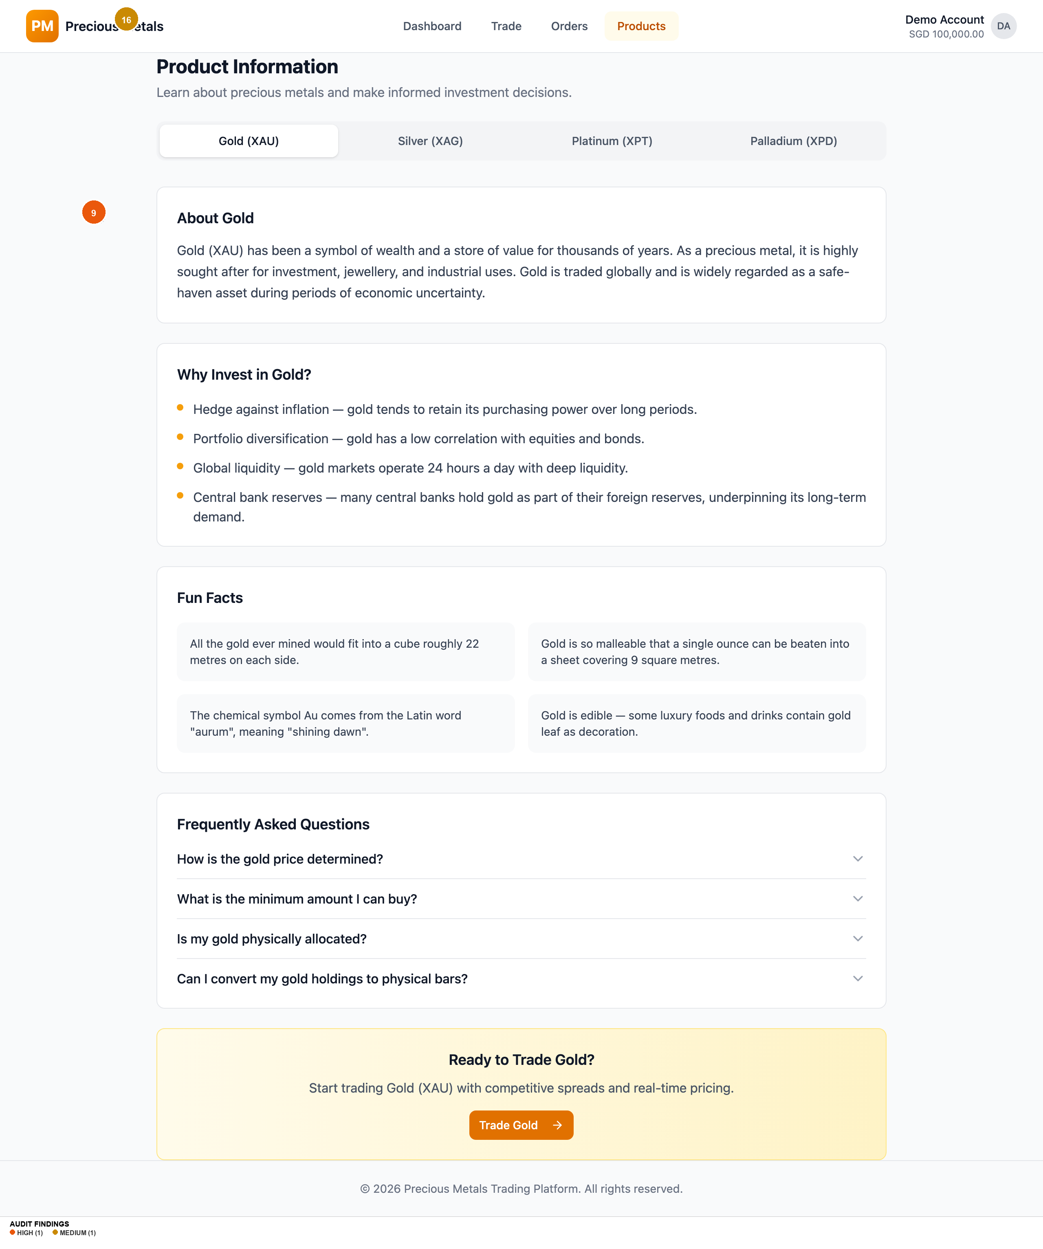
Products
Findings on this screen:
9
[HIGH] No fee disclosure, no spread cost breakdown before confirmation
→ Add cost breakdown: Metal price, Spread (0.5%), Total, Fees (S$0.00)
16
[MEDIUM] No cross-metal comparison view -- must tab between 4 metals
→ Add Compare Metals table: Price, Min Qty, Volatility, Best For

Slide 11
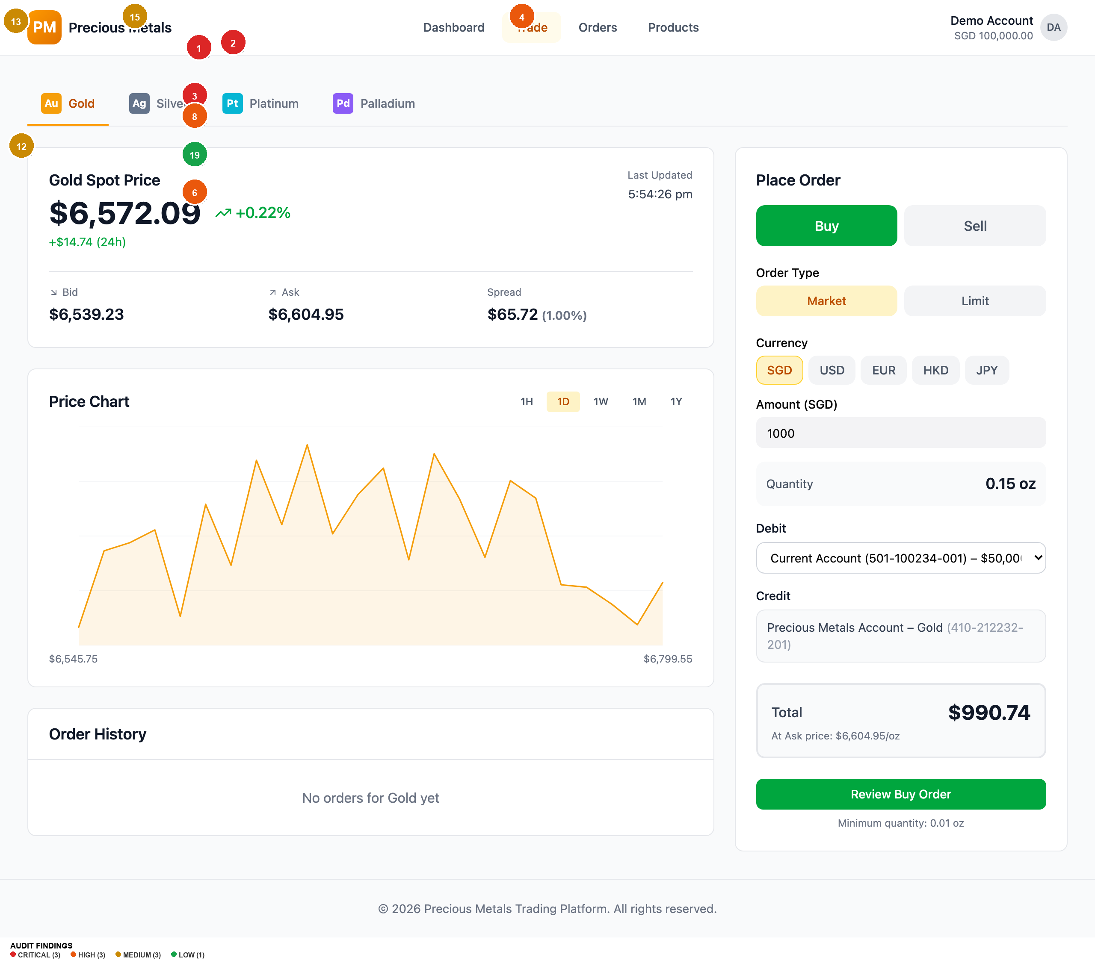
Trade Xau
Findings on this screen:
1
[CRITICAL] No onboarding or guided first-trade experience for novice investors
→ Add contextual tooltips, first-visit banner, default to Market + SGD
2
[CRITICAL] Sell toggle accessible with 0 oz holdings -- error only at validation
→ Disable Sell or show inline message when holdings = 0
3
[CRITICAL] Currency selector introduces massive cognitive load with no explanation
→ Default SGD, collapse behind 'Change currency' link
8
[HIGH] Amount field label ambiguous -- spend amount vs metal quantity unclear
→ Rename to 'I want to spend (SGD)' and show computed oz prominently
4
[HIGH] No prefers-reduced-motion support despite extensive animations
→ Add global @media (prefers-reduced-motion: reduce) rule
6
[HIGH] Button/input height 36px below WCAG 2.2 SC 2.5.8 minimum of 44px
→ Increase min-heights to 44px for coarse pointers
12
[MEDIUM] Chart has no Y-axis labels, gridlines, or volume data
→ Add Y-axis price labels, gridlines, label time buttons descriptively
13
[MEDIUM] Metal tabs use expert codes (XAU, XPT) more prominently than names
→ Show metal name first, code smaller: 'Gold (XAU)'
15
[MEDIUM] Trade nav link goes directly to Gold with no intermediate page
→ Make Trade a dropdown or remember last-traded metal
19
[LOW] Account dropdown shows full account numbers adding noise
→ Simplify to 'Current Account -- S$50,000.00'

Slide 12
Top 5 Priority Recommendations
1
Add Novice Investor Onboarding & Contextual Education
Medium Lift
What to fix: Add tooltips, a first-trade walkthrough, and inline explanations for trading terminology (Market/Limit orders, Bid/Ask/Spread, XAU codes). | Why it matters: The stated user is a novice investor. Every unexplained term is a drop-off point. Financial literacy cannot be assumed. | How to fix it: (a) Add `(?)` tooltip icons next to "Order Type", "Bid", "Ask", "Spread" with 1-sentence definitions. (b) Show dismissible first-visit banner. (c) Default to Market order + SGD to reduce decisions.
2
Fix the Sell Flow for Zero-Balance Holdings
Quick Win
What to fix: Prevent users from entering the sell flow when they hold 0 oz. | Why it matters: Error-provoking design violates Nielsen's Error Prevention heuristic. Users discover they can't sell only after entering data. | How to fix it: When holdings = 0, disable Sell toggle with tooltip or replace form with: "You don't have any Gold to sell. [Buy Gold now]".
3
Add Cost Transparency on Order Review Page
Quick Win
What to fix: Break down total into metal price, spread cost, and fees before confirmation. | Why it matters: Regulatory standards require clear cost disclosure. Hidden spread erodes trust. | How to fix it: Add Cost Breakdown section: Metal Price/oz, Spread (0.5%)/oz, You Pay (Ask)/oz, quantity, total, fees (S$0.00).
4
Fix WCAG Accessibility Failures
Quick Win
What to fix: (a) Muted text contrast, (b) touch targets below 44px, (c) no prefers-reduced-motion. | Why it matters: Three WCAG 2.1/2.2 Level AA violations. Legal liability for a financial product. | How to fix it: (a) Darken --muted-foreground to #5a5a6a. (b) Add min-height: 44px for coarse pointers. (c) Add prefers-reduced-motion media query.
5
Simplify the Order Form for Novice Users
Medium Lift
What to fix: Reduce cognitive load — default Market + SGD, clarify Amount field, collapse advanced options. | Why it matters: 5+ simultaneous decisions paralyse novices. Reducing complexity increases completion by 20-30%. | How to fix it: (a) Rename "Amount" to "I want to spend" + show computed oz. (b) Hide currency selector behind toggle. (c) Hide Limit orders behind "Advanced" toggle.

Slide 13
Accessibility Summary
WCAG Criterion
Level
Status
Details
| 1.4.3 Contrast (Minimum)
AA
FAIL
--muted-foreground on --muted/--accent: ~3.5:1 (needs 4.5:1)
2.3.3 Animation from Interactions
AAA
FAIL
No prefers-reduced-motion; all animations persist
2.5.8 Target Size (Minimum)
AA
FAIL
Interactive elements at 36px, below 44px minimum
2.4.1 Bypass Blocks
A
MISSING
No skip-navigation link
1.3.1 Info and Relationships
A
UNCLEAR
Cannot verify label associations from static analysis
4.1.3 Status Messages
AA
LIKELY PASS
Sonner toasts likely use ARIA live regions
2.1.1 Keyboard
A
PASS
Radix UI provides keyboard support
2.4.7 Focus Visible
AA
PASS
:focus-visible rings with forced-colors fallback
Overall Accessibility Risk Level: HIGH — Three AA failures + missing Level A requirement.

Slide 14
What's Working Well
Logical, complete flow architecture.
The buy flow (Dashboard → Trade → Review → Confirmation) is a well-structured 4-step funnel with clear back paths and 3 next actions on confirmation.
Excellent product information content.
The Products page includes "About", "Why Invest", "Fun Facts", and FAQ for each metal — written in accessible plain English. High-quality educational content.
Real-time price data with smart refresh.
Prices refresh every 5s, holdings every 10s. The "Live" indicator provides system status. Bid/ask/spread display follows financial conventions.
Multi-currency support.
5 currencies with automatic account matching is genuinely useful for Singapore-based international investors.
Modern, credible visual design.
The amber/gold brand identity is appropriate. Clean shadcn/ui aesthetic feels professional and trustworthy. ---

Slide 15
Thank You
Generated by UX Audit Skill · 2026-03-09

