Slide 1
UI/UX AUDIT REPORT: Precious Metals Trading App (Audited Version)
Comprehensive UI/UX Audit Report
7.8
AUDIT DATE
2026-03-10
PLATFORM
Web desktop (1280x1080)
UX Health Score / 10
AUDITOR PERSONA
Novice investor, new to precious metals
URL
https://git-mocha-82857934.figma.site

Slide 2
Executive Summary
This is an significantly improved version of the Precious Metals Trading App. The team has addressed 14 of 21 original findings, including all 3 critical issues. The sell flow now correctly prevents zero-balance sells with an inline message, tooltips provide educational scaffolding for trading terminology (Bid, Ask, Spread, Order Type), the order review page includes a full cost breakdown with explicit fee disclosure, the "Amount to Invest" label is clear with a computed "You'll receive ~X.XX ounce" display, and the Gold card carries a "Most Popular" badge to guide beginners. The muted text contrast has been fixed, a skip-navigation link has been added, and `prefers-reduced-motion` is now supported. However, 4 original issues remain unfixed and several new issues have emerged from the improvements themselves. The most significant remaining gap is that interactive element heights are still 36px (below the WCAG 2.2 44px minimum), the green-600 colour used for positive price changes and buy states fails WCAG AA contrast, and ironically, the new tooltip trigger icons meant to educate novices are themselves too small and low-contrast to be discovered. The currency selector, while now showing conversion rates, still presents all 5 currencies upfront with potential for costly accidental switches.
0
4
6
5
CRITICAL
HIGH
MEDIUM
LOW
Total Findings: 15

Slide 3
Findings (1/3)
#
Screen
Severity
Finding
Recommendation
#1
Global -- Interactive Elements
HIGH
Button/input height still 36px (h-9) -- below WCAG 2.2 SC 2.5.8 minimum of 44px, no @media (pointer: coarse) override
Add min-height: 44px for all interactive elements via @media (pointer: coarse) query
#2
Global -- Price Changes & Buy State
HIGH
green-600 text (#16a34a) on white background fails WCAG AA at 3.30:1 -- used for positive price changes, buy toggle, and status badges
Switch to green-700 (#15803d) which passes at 4.79:1, or use green text on green-50 background only
#3
Trade -- Tooltip Triggers
HIGH
Tooltip trigger icons are gray-400 (#9ca3af) at 14px (w-3.5) -- 2.54:1 contrast fails WCAG AA and size is below WCAG 2.5.8 touch target
Increase icon size to at least 20px (w-5), darken to gray-600 (#4b5563) for 7.23:1 contrast
#4
Trade -- Order Form
HIGH
Currency selector still shows all 5 currencies upfront -- switching from SGD to JPY multiplies amounts ~111x with only a small info box warning
Default to SGD, collapse currency behind 'Change currency' link, add confirmation dialog when switching currencies mid-form
#5
Trade -- Order Form
MEDIUM
No guided first-trade walkthrough -- tooltips added but no dismissible onboarding banner or step-by-step tour for first-time users
Add a dismissible 3-step first-visit banner: 1) Choose metal, 2) Set amount, 3) Review and confirm

Slide 4
Findings (2/3)
#
Screen
Severity
Finding
Recommendation
#6
Global -- Footer
MEDIUM
No footer whatsoever -- no Help, Terms, Privacy, Contact, or regulatory disclosure links
Add standard footer with: Help Centre, Terms of Service, Privacy Policy, Contact Us, MAS regulatory notice
#7
Order Confirmation
MEDIUM
No receipt download option on order confirmation -- order ID is now human-readable but no way to save proof of transaction
Add 'Download Receipt' button generating PDF with order details, timestamp, and reference number
#8
Trade -- Sell Flow
MEDIUM
Sell quantity validation error appears as auto-dismissing toast -- 'Cannot sell more than holdings' disappears after a few seconds
Show persistent inline error below the amount field instead of an auto-dismissing toast for form validation errors
#9
Trade -- Limit Orders
MEDIUM
Limit price field has no guidance -- novice user has no reference for what constitutes a reasonable limit price relative to current market
Show current bid/ask next to limit price input, add helper text: 'Current ask: $X. Set below to wait for a dip.'
#10
Trade -- Price Display
MEDIUM
Live price refreshes every 5 seconds with no visual indicator of update -- prices change silently, user may not notice stale vs fresh data
Add subtle pulse/flash animation on price change, show 'Updated Xs ago' countdown near the timestamp

Slide 5
Findings (3/3)
#
Screen
Severity
Finding
Recommendation
#11
Trade -- Debit Account
LOW
Account dropdown still shows full account numbers (501-100234-001) adding visual noise
Simplify to 'Current Account -- S$50,000.00'. Show account numbers only in account settings.
#12
Trade -- Price Chart
LOW
Chart time interval buttons display abbreviations (1H, 1D, 1W) as primary labels -- tooltips help but novices may not hover
Show full labels on desktop ('1 Hour', '1 Day') or at minimum on first visit
#13
Global
LOW
No responsive font scaling -- base font-size is fixed at 16px with no breakpoint adjustments for larger/smaller screens
Use fluid typography: clamp(14px, 1vw + 0.5rem, 18px) for base, or add media query adjustments at sm/lg breakpoints
#14
Products Page
LOW
Compare All Metals table requires explicit toggle -- users must discover and click 'Compare All Metals' link, defaults to hidden
Show comparison table by default on desktop, collapse to toggle on mobile only
#15
Trade -- Order Form
LOW
Order form shows 'Minimum quantity: X ounce' at bottom of form -- easy to miss, only discovered after validation failure
Move minimum quantity notice next to the 'You'll receive' display where quantity context is visible

Slide 6
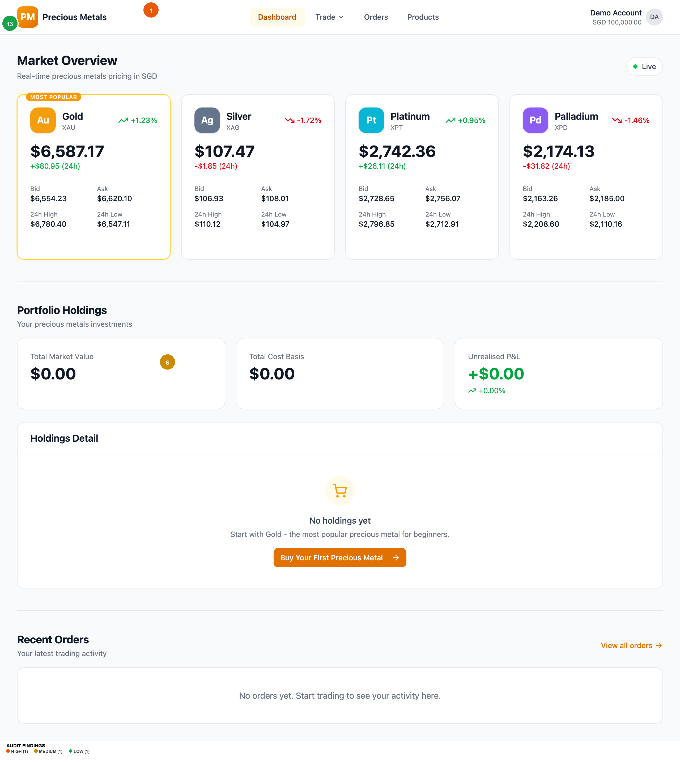
Homepage
Findings on this screen:
1
[HIGH] Button/input height still 36px (h-9) -- below WCAG 2.2 SC 2.5.8 minimum of 44px, no @media (pointer: coarse) override
→ Add min-height: 44px for all interactive elements via @media (pointer: coarse) query
6
[MEDIUM] No footer whatsoever -- no Help, Terms, Privacy, Contact, or regulatory disclosure links
→ Add standard footer with: Help Centre, Terms of Service, Privacy Policy, Contact Us, MAS regulatory notice
13
[LOW] No responsive font scaling -- base font-size is fixed at 16px with no breakpoint adjustments for larger/smaller screens
→ Use fluid typography: clamp(14px, 1vw + 0.5rem, 18px) for base, or add media query adjustments at sm/lg breakpoints

Slide 7
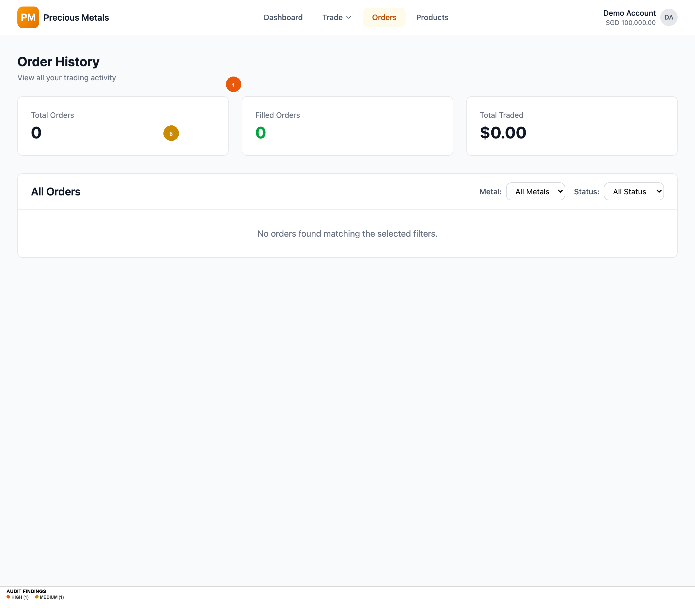
Orders
Findings on this screen:
1
[HIGH] Button/input height still 36px (h-9) -- below WCAG 2.2 SC 2.5.8 minimum of 44px, no @media (pointer: coarse) override
→ Add min-height: 44px for all interactive elements via @media (pointer: coarse) query
6
[MEDIUM] No footer whatsoever -- no Help, Terms, Privacy, Contact, or regulatory disclosure links
→ Add standard footer with: Help Centre, Terms of Service, Privacy Policy, Contact Us, MAS regulatory notice

Slide 8

Products
Findings on this screen:
14
[LOW] Compare All Metals table requires explicit toggle -- users must discover and click 'Compare All Metals' link, defaults to hidden
→ Show comparison table by default on desktop, collapse to toggle on mobile only

Slide 9
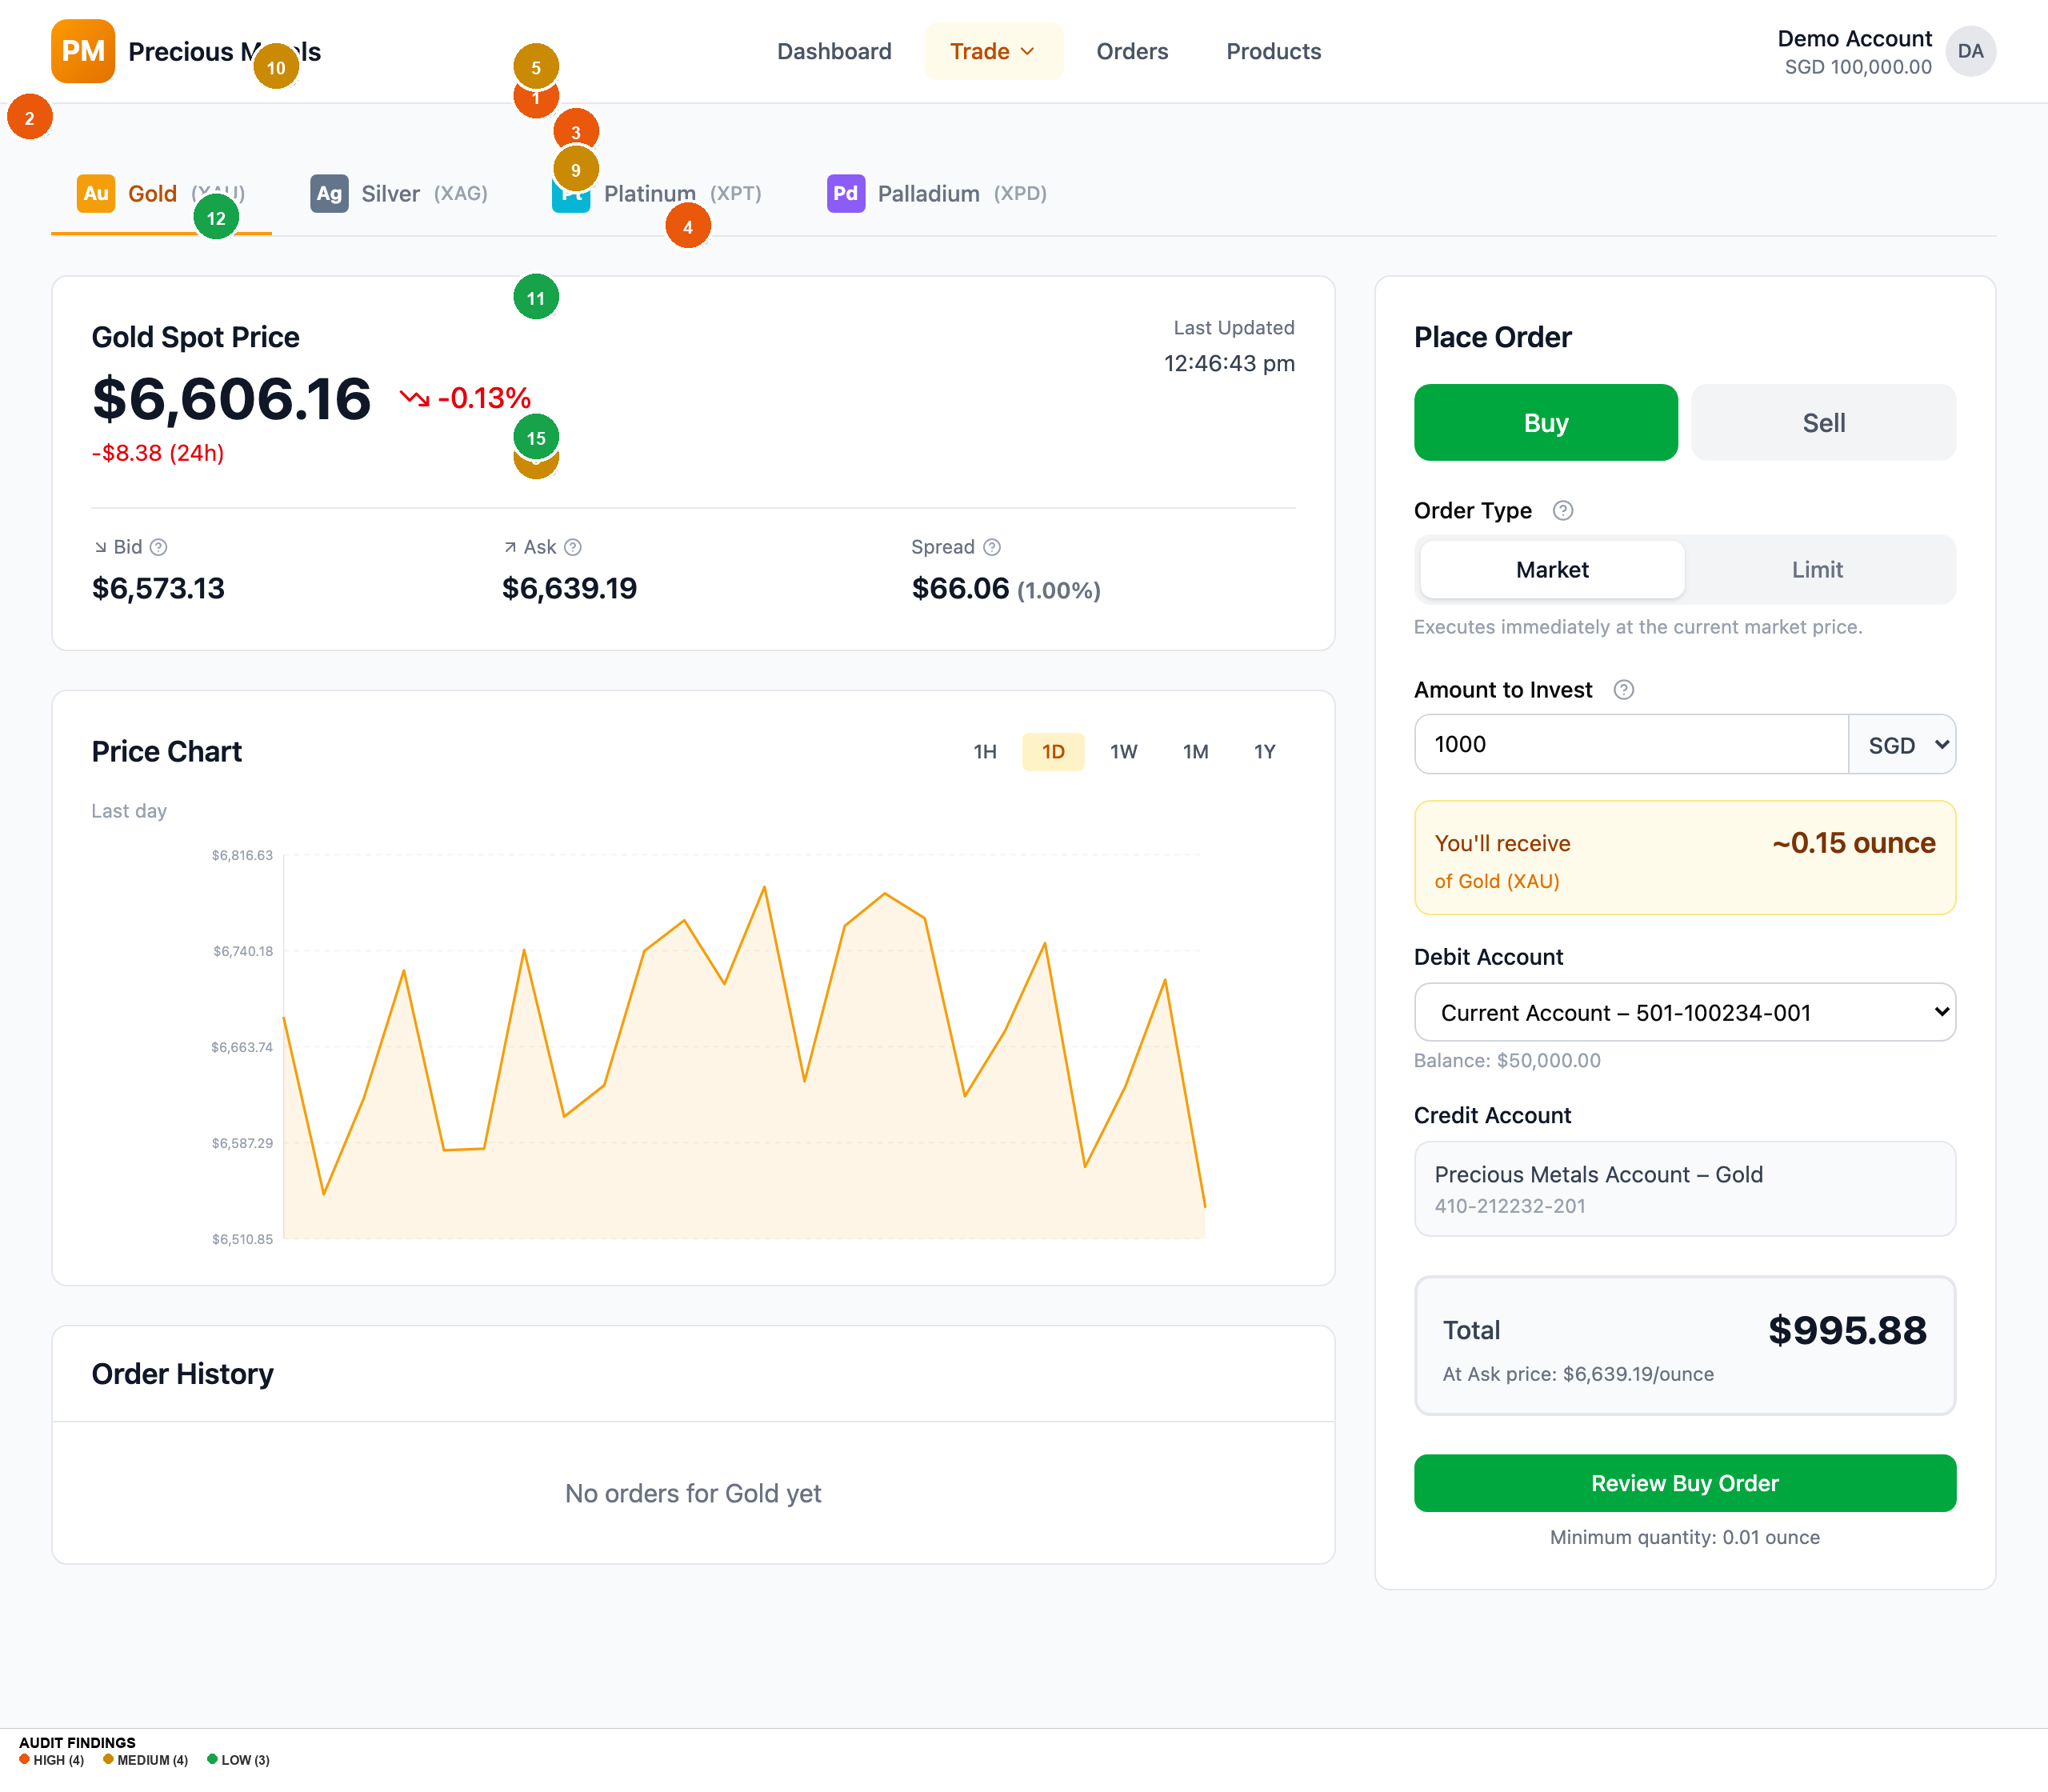
Trade Xau
Findings on this screen:
2
[HIGH] green-600 text (#16a34a) on white background fails WCAG AA at 3.30:1 -- used for positive price changes, buy toggle, and status badges
→ Switch to green-700 (#15803d) which passes at 4.79:1, or use green text on green-50 background only
3
[HIGH] Tooltip trigger icons are gray-400 (#9ca3af) at 14px (w-3.5) -- 2.54:1 contrast fails WCAG AA and size is below WCAG 2.5.8 touch target
→ Increase icon size to at least 20px (w-5), darken to gray-600 (#4b5563) for 7.23:1 contrast
4
[HIGH] Currency selector still shows all 5 currencies upfront -- switching from SGD to JPY multiplies amounts ~111x with only a small info box warning
→ Default to SGD, collapse currency behind 'Change currency' link, add confirmation dialog when switching currencies mid-form
1
[HIGH] Button/input height still 36px (h-9) -- below WCAG 2.2 SC 2.5.8 minimum of 44px, no @media (pointer: coarse) override
→ Add min-height: 44px for all interactive elements via @media (pointer: coarse) query
5
[MEDIUM] No guided first-trade walkthrough -- tooltips added but no dismissible onboarding banner or step-by-step tour for first-time users
→ Add a dismissible 3-step first-visit banner: 1) Choose metal, 2) Set amount, 3) Review and confirm
8
[MEDIUM] Sell quantity validation error appears as auto-dismissing toast -- 'Cannot sell more than holdings' disappears after a few seconds
→ Show persistent inline error below the amount field instead of an auto-dismissing toast for form validation errors
9
[MEDIUM] Limit price field has no guidance -- novice user has no reference for what constitutes a reasonable limit price relative to current market
→ Show current bid/ask next to limit price input, add helper text: 'Current ask: $X. Set below to wait for a dip.'
10
[MEDIUM] Live price refreshes every 5 seconds with no visual indicator of update -- prices change silently, user may not notice stale vs fresh data
→ Add subtle pulse/flash animation on price change, show 'Updated Xs ago' countdown near the timestamp
11
[LOW] Account dropdown still shows full account numbers (501-100234-001) adding visual noise
→ Simplify to 'Current Account -- S$50,000.00'. Show account numbers only in account settings.
12
[LOW] Chart time interval buttons display abbreviations (1H, 1D, 1W) as primary labels -- tooltips help but novices may not hover
→ Show full labels on desktop ('1 Hour', '1 Day') or at minimum on first visit
15
[LOW] Order form shows 'Minimum quantity: X ounce' at bottom of form -- easy to miss, only discovered after validation failure
→ Move minimum quantity notice next to the 'You'll receive' display where quantity context is visible

Slide 10
Top 5 Priority Recommendations
1
Fix WCAG 2.2 Touch Target Compliance
Quick Win
What to fix: Interactive element heights (buttons, inputs, selects) are 36px, below the 44px minimum. | Why it matters: WCAG 2.2 SC 2.5.8 failure. Legal compliance risk for a financial product. Touch users on tablets/touchscreens will struggle. | How to fix it: Add `@media (pointer: coarse) { button, input, select, [role="button"] { min-height: 44px; } }`. Consider increasing default height to h-10 (40px) for all pointers.
2
Fix Green Text Contrast for Price Changes
Quick Win
What to fix: green-600 (#16a34a) on white background fails WCAG AA at 3.30:1. Used extensively for positive price movements and buy state. | Why it matters: Price direction (up/down) is critical information in a trading app. Low-vision users literally cannot distinguish positive from negative prices. | How to fix it: Replace green-600 with green-700 (#15803d) which passes at 4.79:1. Or always pair green text with green-50 background for 4.79:1.
3
Make Tooltip Triggers Discoverable
Quick Win
What to fix: The educational tooltip icons (ⓘ) are 14px with 2.54:1 contrast. They're the gateway to all novice-friendly content but nearly invisible. | Why it matters: The team invested in excellent tooltip content (Bid, Ask, Spread, Order Type explanations) but the entry point is hidden in plain sight. Novice users -- the exact target audience -- will never discover them. | How to fix it: (a) Increase to 20px (w-5 h-5). (b) Darken to gray-600. (c) On first visit, auto-open one tooltip to teach the pattern. (d) Consider using text labels "What's this?" instead of icon-only triggers.
4
Collapse Currency Selector with Confirmation
Medium Lift
What to fix: 5 currencies shown upfront in dropdown. Switching from SGD to JPY changes the entire form with a ~111x multiplier. | Why it matters: A novice investor in Singapore trading in SGD has no reason to see JPY/EUR/HKD options. Accidental switches cause confusion and potential financial mistakes. | How to fix it: (a) Default to SGD, show "Change currency" link. (b) When clicked, show currency options. (c) On selection, show a confirmation: "Switch to Japanese Yen? Your amount will be converted at 1 SGD = 111.11 JPY."
5
Add Regulatory Footer and Receipt Downloads
Medium Lift
What to fix: No footer with regulatory links. No receipt download on order confirmation. | Why it matters: A financial trading product requires Terms, Privacy, and regulatory disclosure (MAS in Singapore). Users need transaction records for tax and disputes. | How to fix it: (a) Add footer: Help, Terms, Privacy, Contact, "Regulated by MAS" notice. (b) Add "Download Receipt" on confirmation page generating PDF.

Slide 11
Accessibility Summary
WCAG Criterion
Level
Status
Details
| 1.4.3 Contrast (Minimum)
AA
PARTIAL FAIL
green-600 on white: 3.30:1, gray-400 icons on white: 2.54:1. Muted-foreground now PASSES at 6.76:1.
2.3.3 Animation from Interactions
AAA
PASS
`prefers-reduced-motion: reduce` now implemented
2.5.8 Target Size (Minimum)
AA
FAIL
Default button height h-9 = 36px, below 44px minimum. No coarse pointer override.
2.4.1 Bypass Blocks
A
PASS
Skip-navigation link "Skip to main content" implemented with focus styling
1.3.1 Info and Relationships
A
LIKELY PASS
Semantic headings, table structure, labelled inputs. Tooltip triggers have aria-label.
4.1.3 Status Messages
AA
LIKELY PASS
Sonner toasts likely use ARIA live regions. Inline messages present for sell-zero-holdings.
2.1.1 Keyboard
A
PASS
Radix UI provides keyboard support. Focus rings visible.
2.4.7 Focus Visible
AA
PASS
:focus-visible rings with forced-colors fallback
1.4.12 Text Spacing
AA
PASS
Tailwind line-height 1.5, standard spacing, no fixed containers
Overall Accessibility Risk Level: HIGH — Three AA failures + missing Level A requirement.

Slide 12
What's Working Well
Excellent educational tooltip content.
The Bid/Ask/Spread/Order Type tooltips are well-written, concise, and genuinely helpful. The tooltip architecture (va/wa components) with hover+click triggers is thoughtful. The content quality is first-rate -- just needs more visible trigger icons.
Cost transparency on order review.
The cost breakdown (mid price, spread 0.5%, effective ask/bid price, quantity, total, explicit "No additional fees") is exactly what a financial product needs. This builds trust and meets regulatory standards.
Intelligent sell-flow error prevention.
The sell toggle now shows an inline message ("You don't have any Gold to sell. Buy some first to start selling.") with a direct "Buy Gold" CTA. This is textbook error prevention -- the user never enters a dead-end.
Strong beginner guidance architecture.
"Most Popular" badge on Gold, "Buy Your First Precious Metal" CTA in empty holdings, metal-specific "Best For" labels (Beginners, Growth-oriented, Experienced), Compare All Metals table with volatility ratings -- the information architecture now actively guides novice investors rather than treating all users as experts.
Improved navigation and information architecture.
Trade dropdown with all 4 metals, "Gold (XAU)" tab format (name-first, code-second), human-readable order IDs (PM-2026-XXXX), and a comprehensive 404 page with suggested links. Navigation now serves both discovery and direct access patterns. ---

Slide 13
Thank You
Generated by UX Audit Skill · 2026-03-10

