Slide 1
UI/UX Audit Report: OCBC Dual Currency Investment (DCI)
Comprehensive UI/UX Audit Report
N/A
AUDIT DATE
13 March 2026
PLATFORM
Web Desktop (1280px+)
UX Health Score / 10
AUDITOR PERSONA
N/A
URL
N/A

Slide 2
Executive Summary
5
9
8
2
CRITICAL
HIGH
MEDIUM
LOW
Total Findings: 24

Slide 3
Findings (1/5)
#
Screen
Severity
Finding
Recommendation
#1
Reinvest Step 1 (Strike Not Met)
CRITICAL
Silent currency pair swap on reinvestment. When strike price is NOT met, the reinvestment screen swaps the currency pair (e.g., USD/SGD becomes SGD/EUR) without any banner, warning, or explanation.
Add a prominent banner: 'Your settlement was in [SGD]. Your new investment will use [SGD] as the base currency. This differs from your original pair [USD/SGD].' Offer choice between same pair or settlement-based pair.
#2
Investment Parameters / Review
CRITICAL
Scenario B does not show base-currency equivalent value. User sees '258,392.17 SGD' but cannot assess whether this represents a gain or loss relative to their 200,000 USD investment without mental FX arithmetic.
Add a line below Scenario B settlement: 'Equivalent to approximately ~USD [X] at current spot rate.' Flag in red if the equivalent is below original investment.
#3
Investment Parameters / Review
CRITICAL
Green/red color coding on scenario badges biases perception. 'Base Currency' badge is green (positive connotation), 'Alternate Currency' badge is red/coral (negative connotation). Both scenarios produce positive yield; the color coding creates an unfair implicit hierarchy.
Use neutral colors for both scenario badges (e.g., both navy/dark grey). Reserve green/red exclusively for gain/loss indicators in settlement breakdowns.
#4
Review
CRITICAL
No explicit risk statement or acknowledgment before Submit. The only pre-commitment safeguard is a single-line T&C link. No standalone risk disclosure, no plain-language summary of 'what could happen,' no friction step like a checkbox.
Add a risk summary box above Submit: 'Important: If the strike price is not met, your principal will be converted to [alternate currency] at the strike rate.' Require checkbox: 'I understand my investment may be settled in [alternate currency].'
#5
All Form Screens
CRITICAL
No error states, validation feedback, or loading states designed across any screen. No inline field validation errors, submission failures, network timeout states, processing indicators, or session expiry warnings.
Design inline validation (min/max amount, numeric format), processing overlay for submission, error states with retry, session timeout warning, insufficient funds error.

Slide 4
Findings (2/5)
#
Screen
Severity
Finding
Recommendation
#6
Investment Parameters
HIGH
Strike price presented without any plain-language definition or explanation. Five radio options show values, '% from spot,' and 'Indicative yield' but never explain what strike price is, what 'from spot' means, or why higher strike reduces yield.
Add contextual tooltip: 'The strike price determines the exchange rate threshold. If the market rate is above/below this at expiry, you receive base/alternate currency. Further from spot = higher yield but higher conversion probability.'
#7
Investment Parameters
HIGH
Yield visually dominates risk in the strike price selector. Bold red yield percentages (right-aligned) draw the eye first; risk parameters ('% from spot') are in smaller grey text (left-aligned). Visual hierarchy inverts appropriate weighting for a risk-bearing product.
Give 'from spot' percentage equal visual weight (same font size and weight). Consider reframing as 'conversion probability: higher/lower' to make risk tangible.
#8
Investment Parameters / Landing
HIGH
Green overloaded with 5+ distinct meanings: success checkmark, 'Base Currency' badge, 'Strike Price Met' banner, positive yield amount, 'Active' status, and OCBC logo. Creates ambiguity between 'good for you' and 'base currency.'
Reserve green for explicit gain/positive indicators only. Use navy or brand colors for currency badges and neutral blue for informational status badges.
#9
Investment Parameters / Review
HIGH
Yield shown as annualized rate ('6.50% p.a.') without period return. For a 1-month tenor, actual return is ~0.54% (~USD 1,083 on USD 200,000). Users may expect 6.5% total return.
Show both: '6.50% p.a. (~0.54% for 1 month)' on strike price selectors. In Potential Outcomes, add: 'Estimated return: USD 1,083.33 (0.54% of principal).'
#10
Landing (Active Investments)
HIGH
Action-critical settlement notifications buried as inline banners within dense table. Strike Price Met/Not Met banners appear between table rows, competing visually with dense data. Most time-sensitive items are not visually prioritized.
Create a 'Requires Action' card section at the top of the Active Investments view with prominent Reinvest/View Details CTAs. Keep the full table below for monitoring.

Slide 5
Findings (3/5)
#
Screen
Severity
Finding
Recommendation
#11
Investment Details (Strike Not Met)
HIGH
Warning triangle icon on 'Strike Price Not Met' implies error/problem when it is a normal, expected product outcome. For users who placed DCI for currency conversion purposes, alternate-currency settlement may be the desired outcome.
Use a neutral blue information icon instead of warning triangle. Change banner to outcome-neutral: 'Your investment will be settled in [alternate currency] at the strike rate.'
#12
Multi-Currency Account Gate
HIGH
Account gate uses completely different nav bar configuration ('FX and treasury' lowercase, 'Trade finance' active) and is a dead end with no timeline, alternatives, or back navigation. Different nav config from all other DCI screens.
Use same nav bar config as rest of DCI flow. Add estimated processing time, required documents, 'Learn More' link, and back navigation.
#13
Investment Parameters
HIGH
'$0,000.00 USD' minimum amount is a formatting bug/template error. In a financial product, displaying a malformed monetary value undermines trust at the very first input field.
Fix data binding to display actual minimum (e.g., 'Minimum amount: 50,000.00 USD'). Ensure currency format consistency.
#14
All Screens
HIGH
Navigation label inconsistency: 'FX and Investment' (most screens) vs 'FX and Treasury' (details screens) vs 'FX and treasury' (MCA gate). Three different nav bar configurations within the same product flow.
Standardize to 'FX and Investment' across all DCI screens. Audit all screens against a single nav component.
#15
All Flow Screens
MEDIUM
No step indicator or progress bar across the multi-step placement flow. User moves through Parameters > Account Selection > Review > Confirmation with no visual indication of position or steps remaining.
Add horizontal step indicator: 'Step 1 of 3: Investment Parameters > Step 2 of 3: Account Selection > Step 3 of 3: Review & Submit.'

Slide 6
Findings (4/5)
#
Screen
Severity
Finding
Recommendation
#16
Confirmation
MEDIUM
Confirmation is a dead end. Only CTA is 'Place Another Investment.' No link to view the investment in portfolio, view investment details, or return to DCI landing page.
Add 'View Investment Details' (primary) and 'Return to DCI Portfolio' (link) alongside existing 'Place Another Investment.'
#17
Review vs Parameters
MEDIUM
Scenario condition language differs between screens. Parameters: 'If fixing rate is >= 1.2850 on expiry.' Review: 'If spot rate >= 1.2850 at maturity.' Different rate names and time references for the same condition.
Standardize: 'If the market exchange rate is at or above [strike price] on the Expiry Date ([date])' across all screens.
#18
Confirmation
MEDIUM
Collapsed confirmation lacks key parameter summary. User sees success message and reference number but must expand to verify investment details (amount, currency pair, strike, yield).
Show brief summary above timeline: 'USD 200,000.00 | USD/SGD | Strike: 1.2850 | Yield: 6.50% p.a. | Maturity: 19 Dec 2025.'
#19
Landing (Active)
MEDIUM
Cross-currency KPI aggregation unclear. 'Total Invested Amount: 1,500,000.00 SGD' aggregates USD, EUR, and AUD investments into SGD equivalent without disclosing the conversion basis.
Label as 'Total Invested (SGD equivalent)' or show separate totals per base currency.
#20
Review / Parameters
MEDIUM
Potential Outcomes visual treatment changes between Parameters and Review screens. Parameters uses white cards with colored badges; Review uses full-width cards with colored backgrounds. Layout shifts from two-column to single-column.
Maintain consistent visual treatment for Potential Outcomes cards across all screens.

Slide 7
Findings (5/5)
#
Screen
Severity
Finding
Recommendation
#21
Landing (Active)
MEDIUM
Status badges use inconsistent visual treatments: 'Active' is text-only, 'Expiring Soon' is orange text, 'Awaiting Settlement' is green outline pill. No unified badge component.
Standardize all status badges to use the same shape and size, varying only in color. All should be pill badges.
#22
Landing (Active)
MEDIUM
'Expiring Soon' status in table provides no urgency context — no expiry date inline, no countdown, no indication of required action.
Add expiry date inline or as tooltip: 'Expires 10 Nov 2025 (2 days).'
#23
Landing (Empty)
LOW
Filter controls (All Currencies, Status, Tenor, Search) visible on empty state when there is no data to filter.
Hide filter controls when there are no investments.
#24
Landing (Empty)
LOW
Landing page value propositions are generic and marketing-heavy. 'Maximise your investment returns' and 'Great for currency conversion needs' don't differentiate DCI from a deposit or FX forward.
Replace with specific value props: 'Earn yields of X-Y% p.a. on your idle foreign currency' and 'Choose your preferred conversion rate while earning returns.'

Slide 8
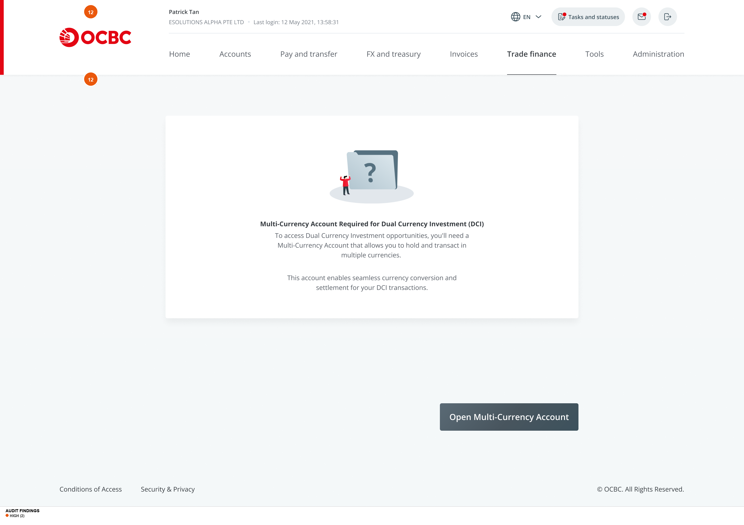
Confirm Omc
Findings on this screen:
12
[HIGH] Account gate uses completely different nav bar configuration ('FX and treasury' lowercase, 'Trade finance' active) and is a dead end with no timeline, alternatives, or back navigation. Different nav config from all other DCI screens.
→ Use same nav bar config as rest of DCI flow. Add estimated processing time, required documents, 'Learn More' link, and back navigation.
12
[HIGH] Account gate uses completely different nav bar configuration ('FX and treasury' lowercase, 'Trade finance' active) and is a dead end with no timeline, alternatives, or back navigation. Different nav config from all other DCI screens.
→ Use same nav bar config as rest of DCI flow. Add estimated processing time, required documents, 'Learn More' link, and back navigation.

Slide 9
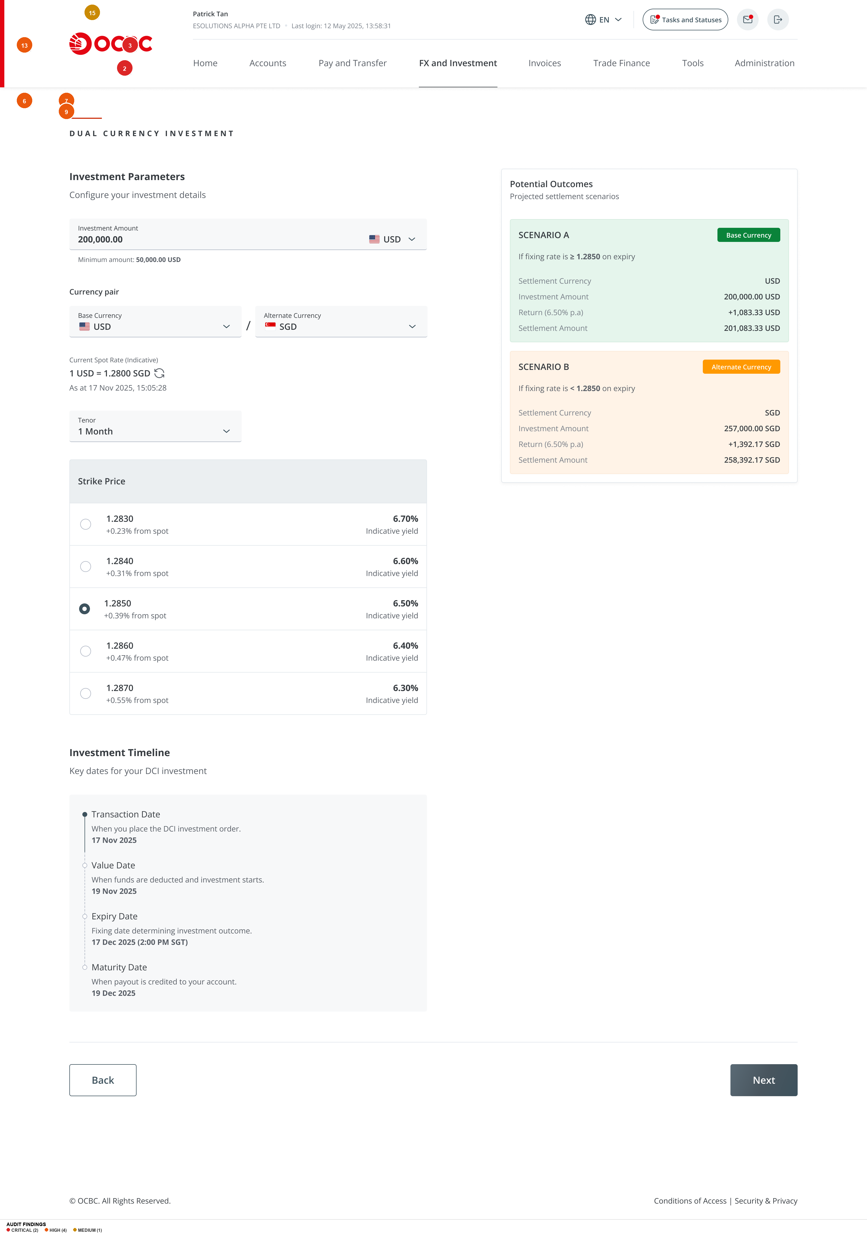
Day 1 Add Delete Users 3
Findings on this screen:
2
[CRITICAL] Scenario B does not show base-currency equivalent value. User sees '258,392.17 SGD' but cannot assess whether this represents a gain or loss relative to their 200,000 USD investment without mental FX arithmetic.
→ Add a line below Scenario B settlement: 'Equivalent to approximately ~USD [X] at current spot rate.' Flag in red if the equivalent is below original investment.
3
[CRITICAL] Green/red color coding on scenario badges biases perception. 'Base Currency' badge is green (positive connotation), 'Alternate Currency' badge is red/coral (negative connotation). Both scenarios produce positive yield; the color coding creates an unfair implicit hierarchy.
→ Use neutral colors for both scenario badges (e.g., both navy/dark grey). Reserve green/red exclusively for gain/loss indicators in settlement breakdowns.
6
[HIGH] Strike price presented without any plain-language definition or explanation. Five radio options show values, '% from spot,' and 'Indicative yield' but never explain what strike price is, what 'from spot' means, or why higher strike reduces yield.
→ Add contextual tooltip: 'The strike price determines the exchange rate threshold. If the market rate is above/below this at expiry, you receive base/alternate currency. Further from spot = higher yield but higher conversion probability.'
7
[HIGH] Yield visually dominates risk in the strike price selector. Bold red yield percentages (right-aligned) draw the eye first; risk parameters ('% from spot') are in smaller grey text (left-aligned). Visual hierarchy inverts appropriate weighting for a risk-bearing product.
→ Give 'from spot' percentage equal visual weight (same font size and weight). Consider reframing as 'conversion probability: higher/lower' to make risk tangible.
9
[HIGH] Yield shown as annualized rate ('6.50% p.a.') without period return. For a 1-month tenor, actual return is ~0.54% (~USD 1,083 on USD 200,000). Users may expect 6.5% total return.
→ Show both: '6.50% p.a. (~0.54% for 1 month)' on strike price selectors. In Potential Outcomes, add: 'Estimated return: USD 1,083.33 (0.54% of principal).'
13
[HIGH] '$0,000.00 USD' minimum amount is a formatting bug/template error. In a financial product, displaying a malformed monetary value undermines trust at the very first input field.
→ Fix data binding to display actual minimum (e.g., 'Minimum amount: 50,000.00 USD'). Ensure currency format consistency.
15
[MEDIUM] No step indicator or progress bar across the multi-step placement flow. User moves through Parameters > Account Selection > Review > Confirmation with no visual indication of position or steps remaining.
→ Add horizontal step indicator: 'Step 1 of 3: Investment Parameters > Step 2 of 3: Account Selection > Step 3 of 3: Review & Submit.'

Slide 10
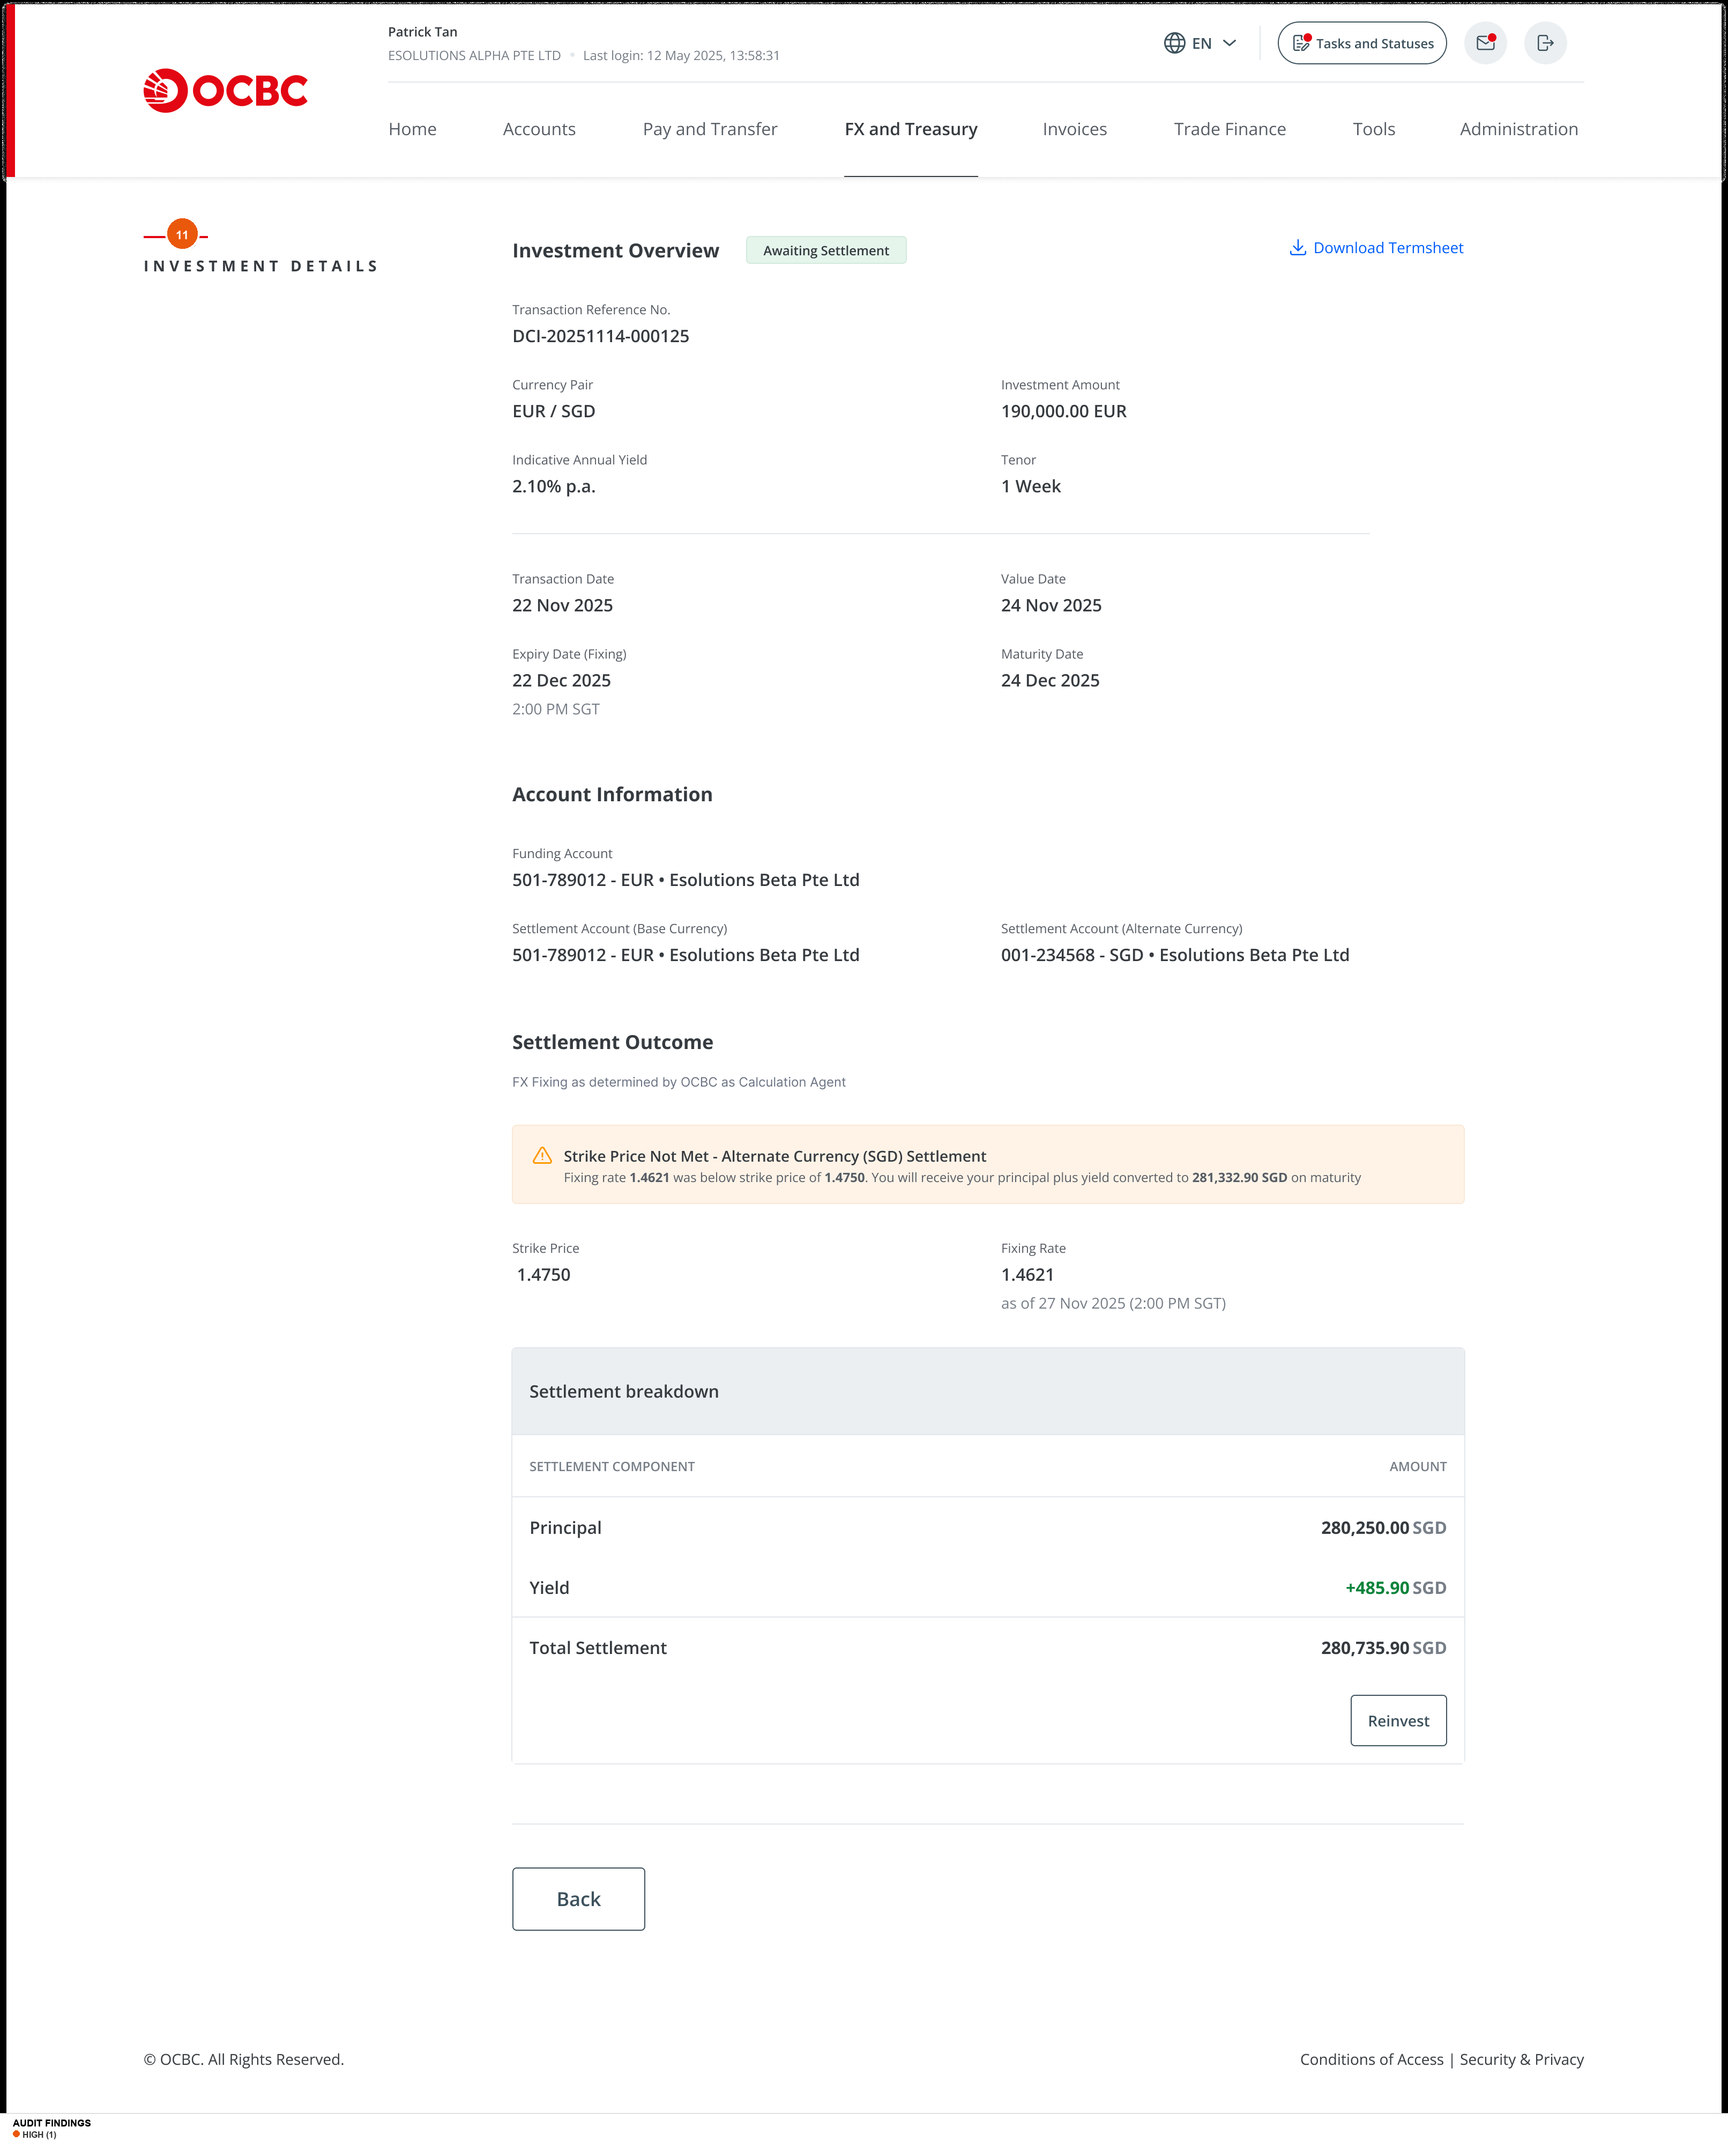
Investment Details Awaiting Settlement Strike Price Not Met
Findings on this screen:
11
[HIGH] Warning triangle icon on 'Strike Price Not Met' implies error/problem when it is a normal, expected product outcome. For users who placed DCI for currency conversion purposes, alternate-currency settlement may be the desired outcome.
→ Use a neutral blue information icon instead of warning triangle. Change banner to outcome-neutral: 'Your investment will be settled in [alternate currency] at the strike rate.'

Slide 11
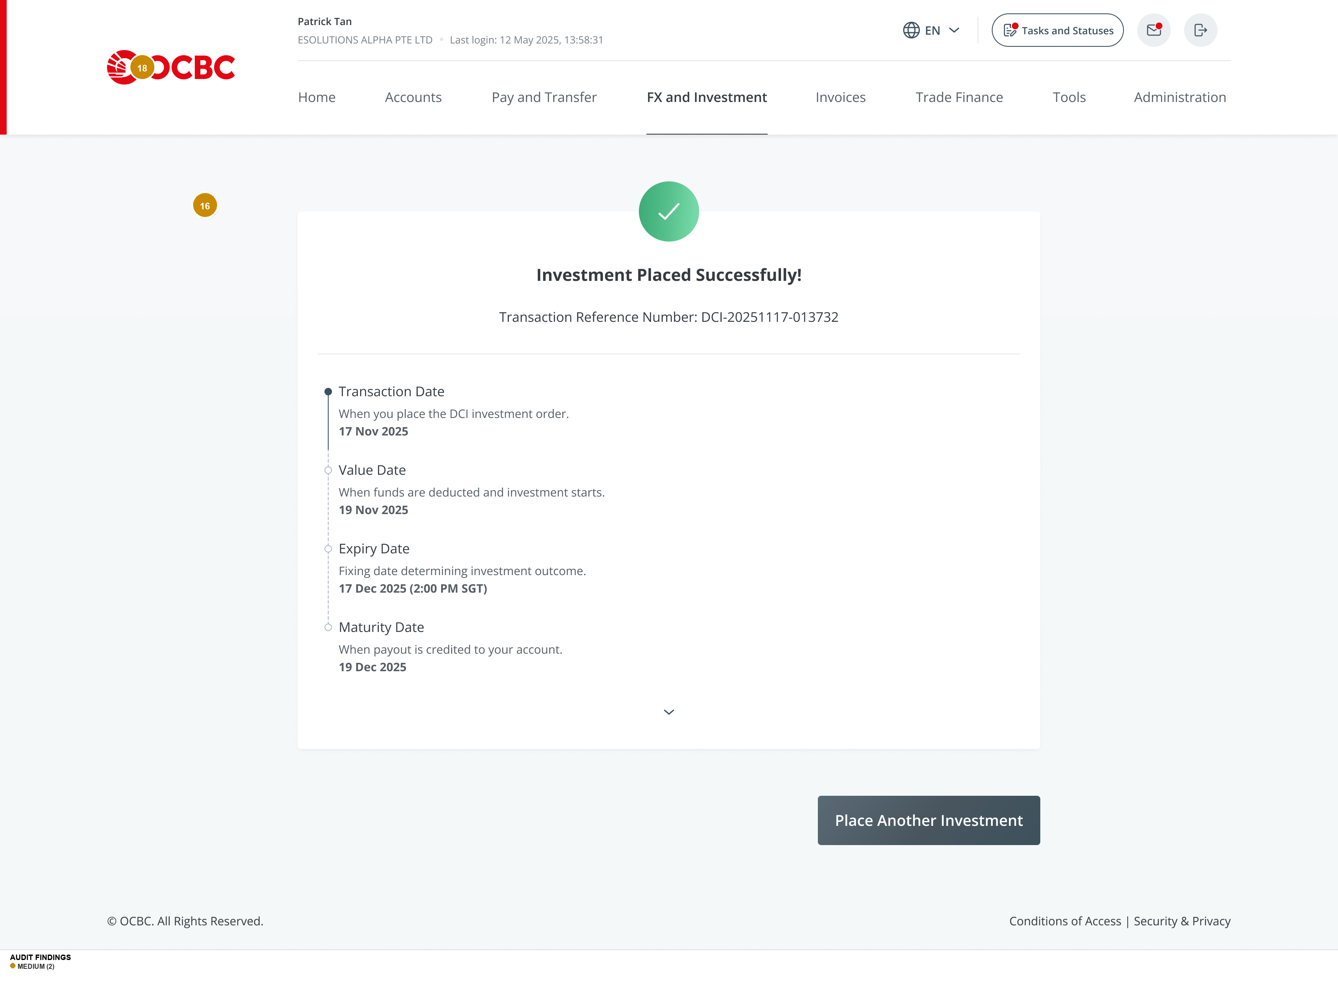
Overseas Confirmation Maker Collapsed
Findings on this screen:
16
[MEDIUM] Confirmation is a dead end. Only CTA is 'Place Another Investment.' No link to view the investment in portfolio, view investment details, or return to DCI landing page.
→ Add 'View Investment Details' (primary) and 'Return to DCI Portfolio' (link) alongside existing 'Place Another Investment.'
18
[MEDIUM] Collapsed confirmation lacks key parameter summary. User sees success message and reference number but must expand to verify investment details (amount, currency pair, strike, yield).
→ Show brief summary above timeline: 'USD 200,000.00 | USD/SGD | Strike: 1.2850 | Yield: 6.50% p.a. | Maturity: 19 Dec 2025.'

Slide 12
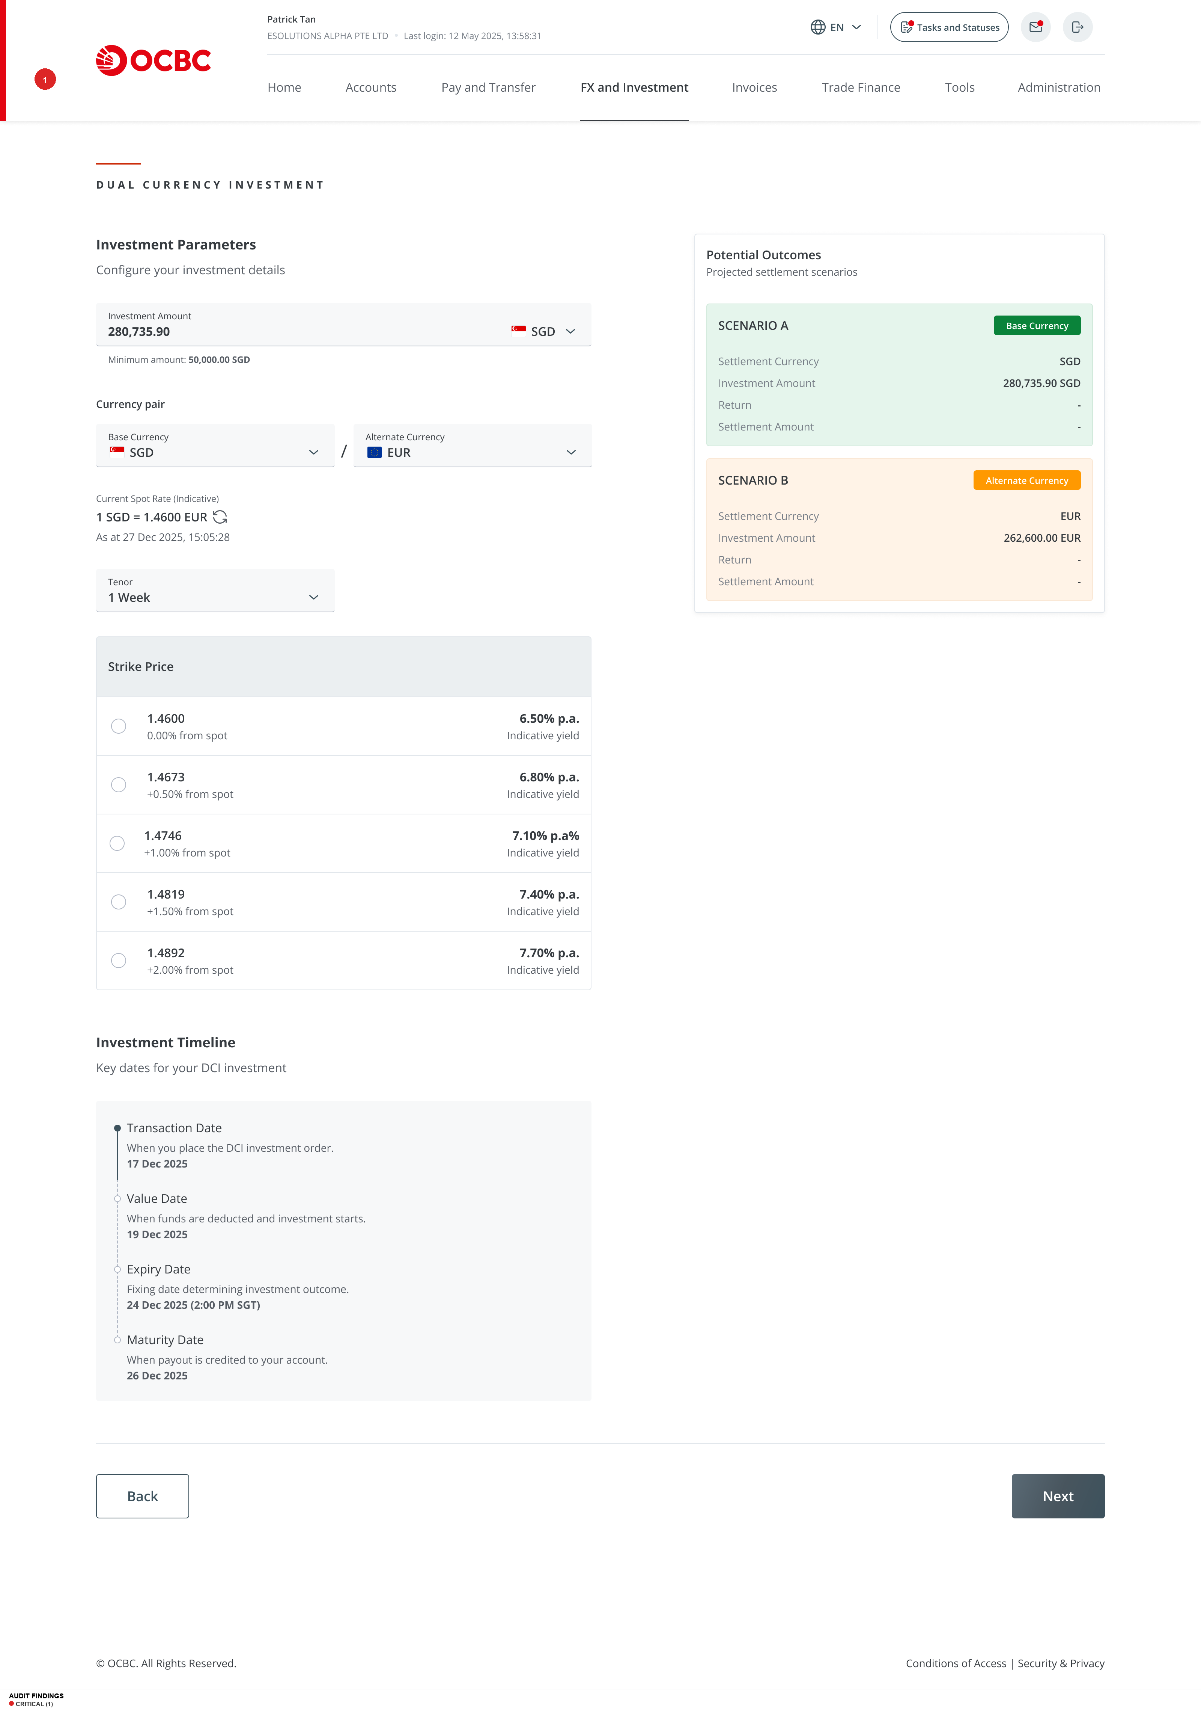
Reinvest Step 1 Strike Price Not Met
Findings on this screen:
1
[CRITICAL] Silent currency pair swap on reinvestment. When strike price is NOT met, the reinvestment screen swaps the currency pair (e.g., USD/SGD becomes SGD/EUR) without any banner, warning, or explanation.
→ Add a prominent banner: 'Your settlement was in [SGD]. Your new investment will use [SGD] as the base currency. This differs from your original pair [USD/SGD].' Offer choice between same pair or settlement-based pair.

Slide 13
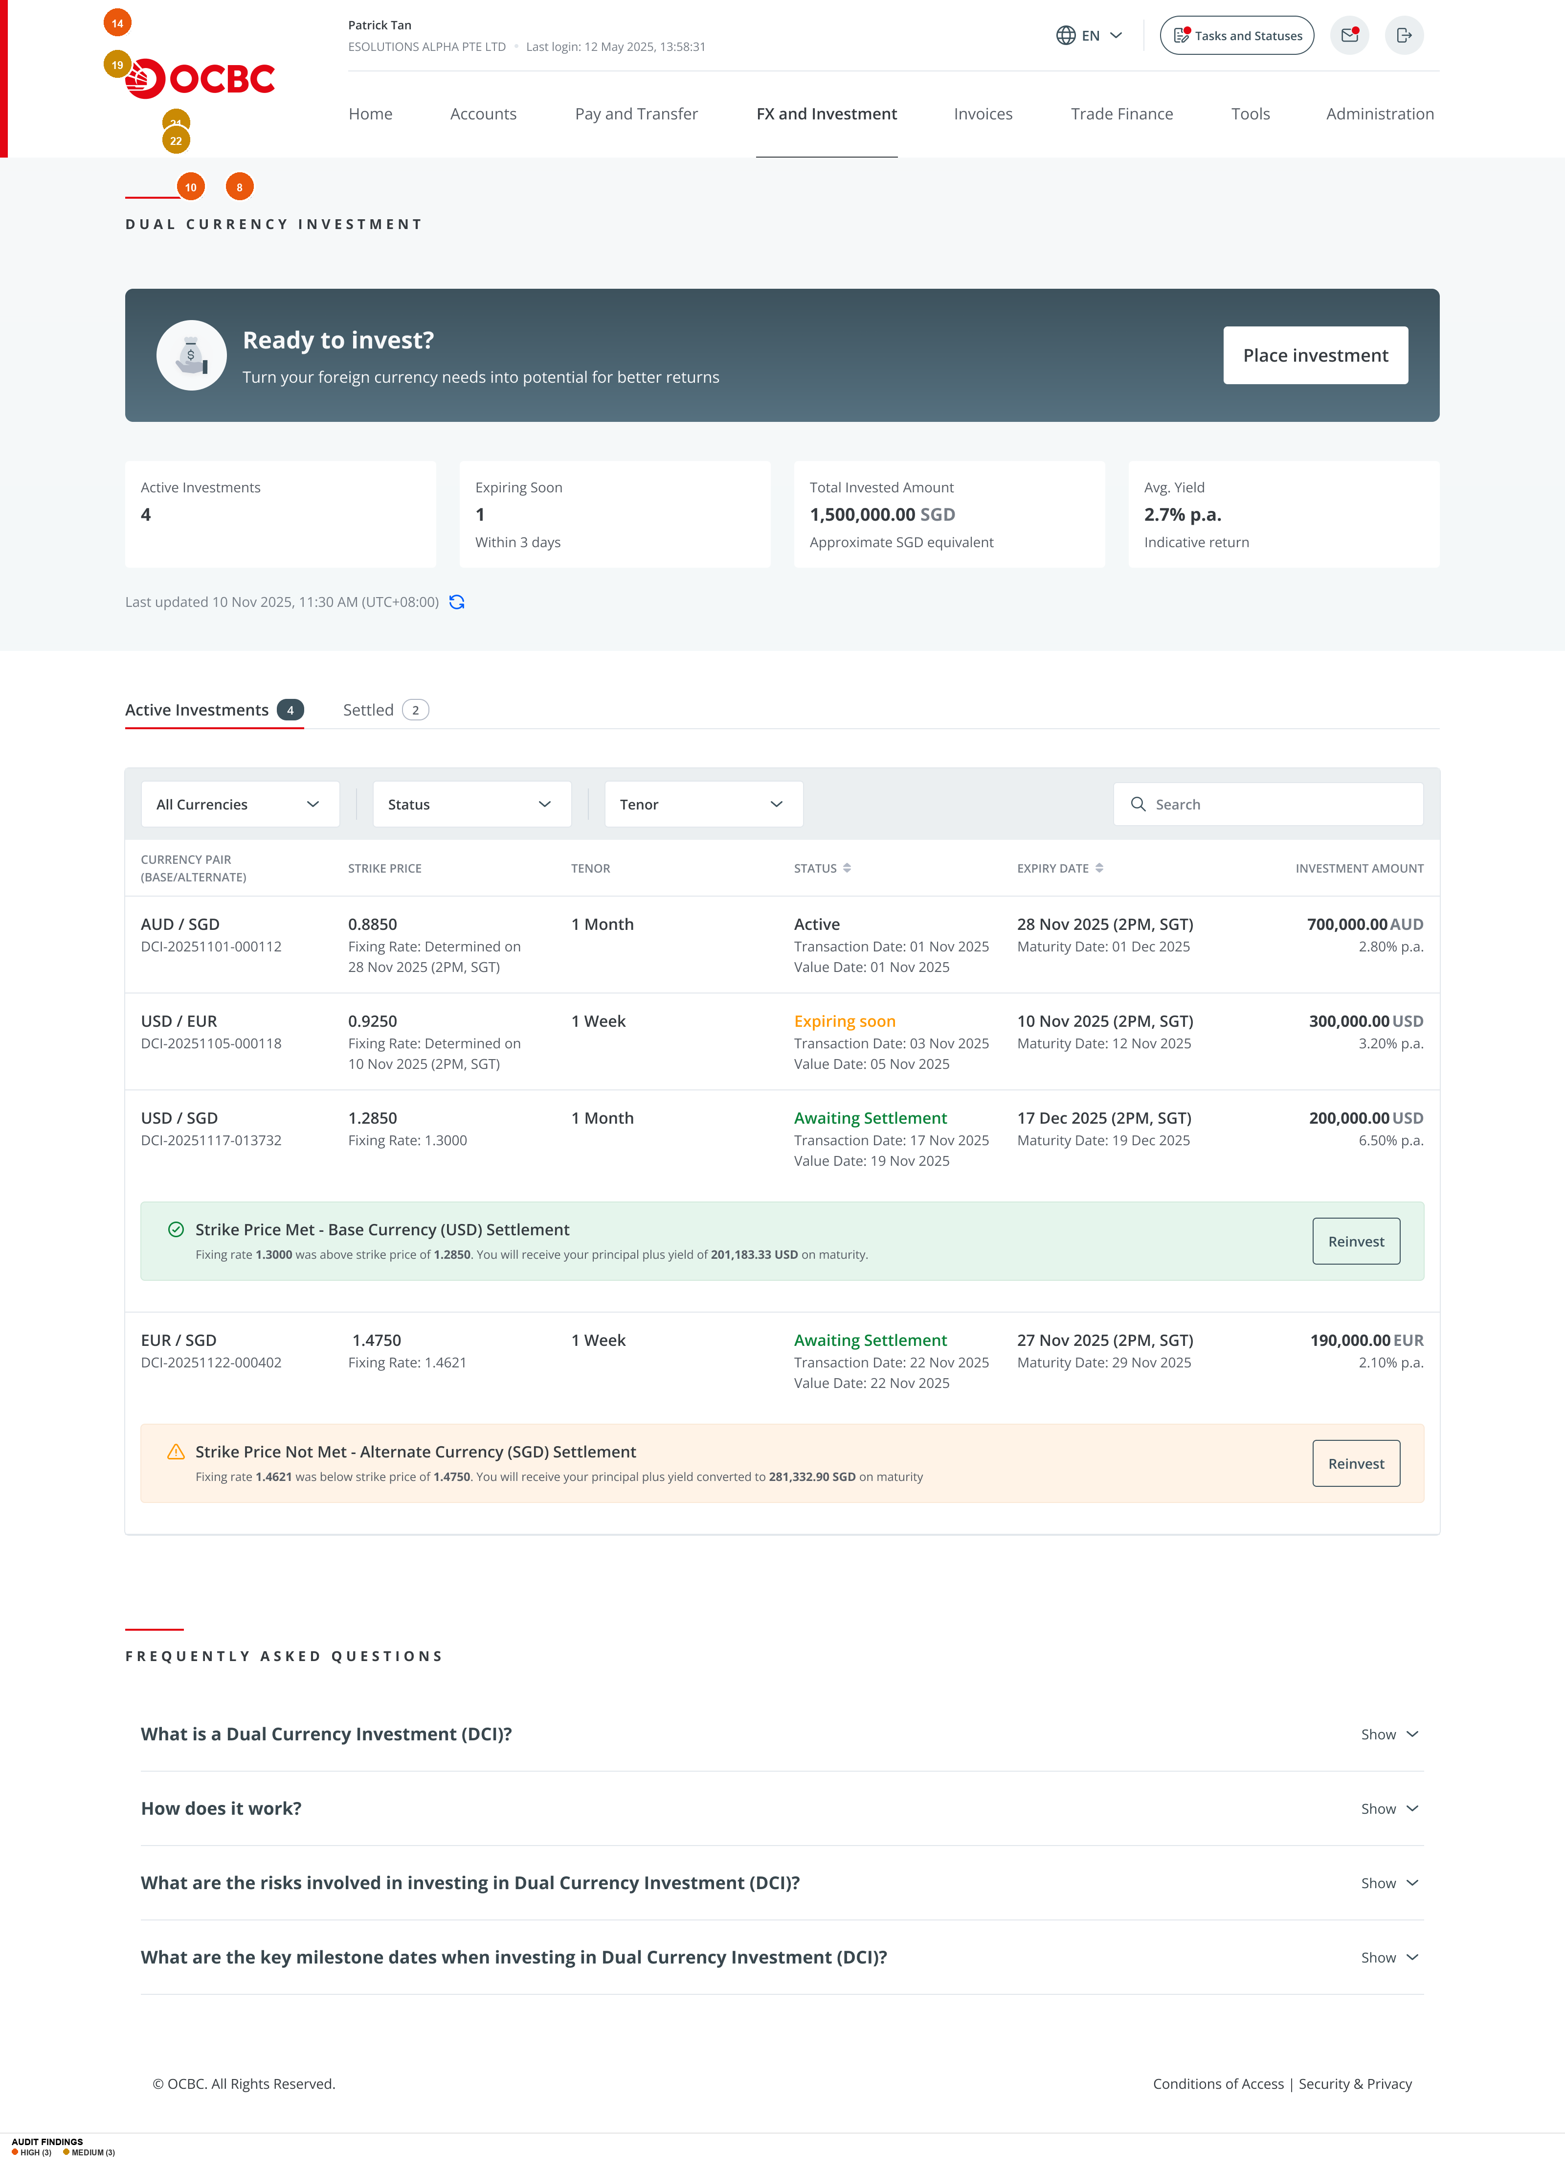
Renew Landing Uploaded File 3
Findings on this screen:
10
[HIGH] Action-critical settlement notifications buried as inline banners within dense table. Strike Price Met/Not Met banners appear between table rows, competing visually with dense data. Most time-sensitive items are not visually prioritized.
→ Create a 'Requires Action' card section at the top of the Active Investments view with prominent Reinvest/View Details CTAs. Keep the full table below for monitoring.
8
[HIGH] Green overloaded with 5+ distinct meanings: success checkmark, 'Base Currency' badge, 'Strike Price Met' banner, positive yield amount, 'Active' status, and OCBC logo. Creates ambiguity between 'good for you' and 'base currency.'
→ Reserve green for explicit gain/positive indicators only. Use navy or brand colors for currency badges and neutral blue for informational status badges.
14
[HIGH] Navigation label inconsistency: 'FX and Investment' (most screens) vs 'FX and Treasury' (details screens) vs 'FX and treasury' (MCA gate). Three different nav bar configurations within the same product flow.
→ Standardize to 'FX and Investment' across all DCI screens. Audit all screens against a single nav component.
19
[MEDIUM] Cross-currency KPI aggregation unclear. 'Total Invested Amount: 1,500,000.00 SGD' aggregates USD, EUR, and AUD investments into SGD equivalent without disclosing the conversion basis.
→ Label as 'Total Invested (SGD equivalent)' or show separate totals per base currency.
21
[MEDIUM] Status badges use inconsistent visual treatments: 'Active' is text-only, 'Expiring Soon' is orange text, 'Awaiting Settlement' is green outline pill. No unified badge component.
→ Standardize all status badges to use the same shape and size, varying only in color. All should be pill badges.
22
[MEDIUM] 'Expiring Soon' status in table provides no urgency context — no expiry date inline, no countdown, no indication of required action.
→ Add expiry date inline or as tooltip: 'Expires 10 Nov 2025 (2 days).'

Slide 14
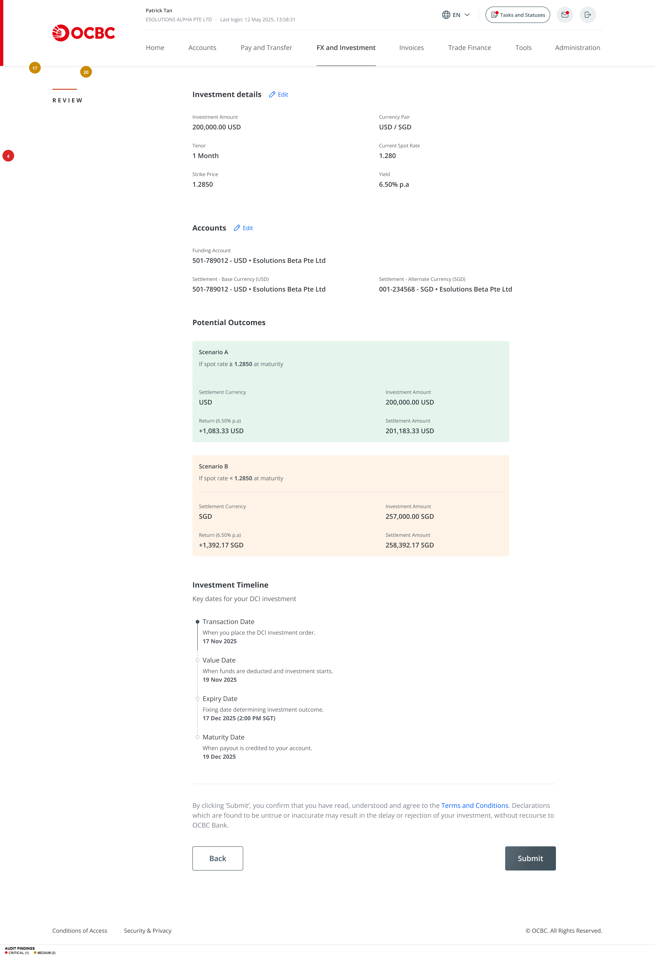
Review
Findings on this screen:
4
[CRITICAL] No explicit risk statement or acknowledgment before Submit. The only pre-commitment safeguard is a single-line T&C link. No standalone risk disclosure, no plain-language summary of 'what could happen,' no friction step like a checkbox.
→ Add a risk summary box above Submit: 'Important: If the strike price is not met, your principal will be converted to [alternate currency] at the strike rate.' Require checkbox: 'I understand my investment may be settled in [alternate currency].'
17
[MEDIUM] Scenario condition language differs between screens. Parameters: 'If fixing rate is >= 1.2850 on expiry.' Review: 'If spot rate >= 1.2850 at maturity.' Different rate names and time references for the same condition.
→ Standardize: 'If the market exchange rate is at or above [strike price] on the Expiry Date ([date])' across all screens.
20
[MEDIUM] Potential Outcomes visual treatment changes between Parameters and Review screens. Parameters uses white cards with colored badges; Review uses full-width cards with colored backgrounds. Layout shifts from two-column to single-column.
→ Maintain consistent visual treatment for Potential Outcomes cards across all screens.

Slide 15
Thank You
Generated by UX Audit Skill · 13 March 2026

