Slide 1
Combined UI/UX Audit: Precious Metals Trading App
Comparative UI/UX Audit Report
6.5
7.8
AUDIT DATES
2026-03-09 vs 2026-03-10
PLATFORM
Original
Re-audit
Web desktop (1280x1080)
AUDITOR PERSONA
Novice investor, new to precious metals
AUDITS COMPARED
2 audits

Slide 2
Score Improvement
6.5
7.8
→
2026-03-09 (Original)
2026-03-10 (Re-audit)
21 findings
15 findings
+1.3
Score Improvement
Original: 21 findings (3 critical, 6 high) → Re-audit: 15 findings (0 critical, 4 high)

Slide 3
Severity Breakdown Comparison
2026-03-09 (Original) — 21 findings
2026-03-10 (Re-audit) — 15 findings
3
6
7
5
0
4
6
5
CRITICAL
HIGH
MEDIUM
LOW
CRITICAL
HIGH
MEDIUM
LOW

Slide 4
Finding Resolution Status
Cross-reference of original findings against the audited version
FIXED: 15
PARTIALLY FIXED: 3
NOT FIXED: 2
WORSE: 1
#
Original Finding
Status
Notes
#1
No onboarding or guided first-trade experience
PARTIALLY FIXED
Tooltips added, but no walkthrough banner. See new #5.
#2
Sell toggle accessible with 0 oz holdings
FIXED
Inline message + "Buy [Metal]" CTA.
#3
Currency selector cognitive load
PARTIALLY FIXED
Conversion info added, but still upfront. See new #4.
#4
No prefers-reduced-motion
FIXED
Global media query added.
#5
Muted text contrast ~3.5:1
FIXED
Now 6.76:1 on white, 5.74:1 on muted.
#6
Button/input height 36px
NOT FIXED
Still h-9 (36px). See new #1.
#7
All metal cards equal weight
FIXED
"Most Popular" badge on Gold.
#8
Amount field label ambiguous
FIXED
"Amount to Invest" + "You'll receive ~X.XX ounce".

Slide 5
Finding Resolution Status (cont.)
#
Original Finding
Status
Notes
#9
No fee disclosure on review
FIXED
Full cost breakdown with explicit "No additional fees".
#10
Confirm button no loading state
FIXED
"Processing..." spinner added, button disabled.
#11
Empty state CTA vague
FIXED
"Buy Your First Precious Metal" with direct link.
#12
Chart no Y-axis labels
FIXED
Y-axis price labels and gridlines added.
#13
Metal tabs use expert codes
FIXED
"Gold (XAU)" format, name-first.
#14
Order ID truncated UUID
PARTIALLY FIXED
Human-readable PM-2026-XXXX, but no download receipt. See new #7.
#15
Trade nav goes to Gold directly
FIXED
Dropdown with all 4 metals.
#16
No cross-metal comparison
FIXED
"Compare All Metals" table added.

Slide 6
Finding Resolution Status (cont.)
#
Original Finding
Status
Notes
#17
Footer only copyright
WORSE
No footer at all now. See new #6.
#18
8-row dense dashboard table
FIXED
Shows 3 most recent orders.
#19
Account dropdown full numbers
NOT FIXED
Still shows 501-100234-001. See new #11.
#20
No skip-navigation link
FIXED
Skip link "Skip to main content" added.
#21
404 page no suggestions
FIXED
Dashboard, Trade Gold, Products links added.

Slide 7
2026-03-09 (Original) — Executive Summary
This is a well-structured precious metals trading prototype with a clean visual identity, logical information architecture, and a complete buy/sell flow covering all 4 metals. The app follows modern SaaS conventions (Tailwind + shadcn/ui) and provides a credible trading experience. However, for a financial trading product used by novice investors, there are significant gaps in trust signalling, error prevention, educational scaffolding, and accessibility compliance that would erode confidence and cause drop-off. The biggest risks are: (1) a novice user has no onboarding or guided first-trade experience, (2) critical accessibility failures in contrast, touch targets, and motion, (3) the sell flow allows zero-balance sells to reach the review screen before failing, and (4) currency conversion introduces confusion without adequate explanation. -- Solid foundation, but unshipped for production without fixing trust, accessibility, and novice-friendliness gaps.

Slide 8
2026-03-09 (Original) — Findings (1/5)
#
Screen
Severity
Finding
Recommendation
#1
Trade -- Order Form
CRITICAL
No onboarding or guided first-trade experience for novice investors
Add contextual tooltips, first-visit banner, default to Market + SGD
#2
Trade -- Sell Flow
CRITICAL
Sell toggle accessible with 0 oz holdings -- error only at validation
Disable Sell or show inline message when holdings = 0
#3
Trade -- Order Form
CRITICAL
Currency selector introduces massive cognitive load with no explanation
Default SGD, collapse behind 'Change currency' link
#4
Global
HIGH
No prefers-reduced-motion support despite extensive animations
Add global @media (prefers-reduced-motion: reduce) rule
#5
Global
HIGH
Muted text contrast #717182 on #ececf0 fails WCAG AA at ~3.5:1
Darken muted foreground to at least #5e5e6e

Slide 9
2026-03-09 (Original) — Findings (2/5)
#
Screen
Severity
Finding
Recommendation
#6
Global -- Interactive Elements
HIGH
Button/input height 36px below WCAG 2.2 SC 2.5.8 minimum of 44px
Increase min-heights to 44px for coarse pointers
#7
Dashboard -- Market Overview
HIGH
All 4 metal cards have equal visual weight -- no beginner guidance
Add 'Most Popular' badge to Gold or 'New? Start with Gold' CTA
#8
Trade -- Order Form
HIGH
Amount field label ambiguous -- spend amount vs metal quantity unclear
Rename to 'I want to spend (SGD)' and show computed oz prominently
#9
Order Review
HIGH
No fee disclosure, no spread cost breakdown before confirmation
Add cost breakdown: Metal price, Spread (0.5%), Total, Fees (S$0.00)
#10
Order Review
MEDIUM
Confirm button has no loading state -- direct navigation on click
Add loading spinner with 'Processing...' and disable after first click

Slide 10
2026-03-09 (Original) — Findings (3/5)
#
Screen
Severity
Finding
Recommendation
#11
Dashboard -- Portfolio Holdings
MEDIUM
Empty state CTA 'Start trading to build your portfolio' is vague
Change to 'Buy your first precious metal' button linking to /trade/XAU
#12
Trade -- Price Chart
MEDIUM
Chart has no Y-axis labels, gridlines, or volume data
Add Y-axis price labels, gridlines, label time buttons descriptively
#13
Trade -- Metal Tabs
MEDIUM
Metal tabs use expert codes (XAU, XPT) more prominently than names
Show metal name first, code smaller: 'Gold (XAU)'
#14
Order Confirmation
MEDIUM
Order ID is truncated UUID -- no receipt download option
Display human-readable reference, add Download Receipt button
#15
Navigation
MEDIUM
Trade nav link goes directly to Gold with no intermediate page
Make Trade a dropdown or remember last-traded metal

Slide 11
2026-03-09 (Original) — Findings (4/5)
#
Screen
Severity
Finding
Recommendation
#16
Products Page
MEDIUM
No cross-metal comparison view -- must tab between 4 metals
Add Compare Metals table: Price, Min Qty, Volatility, Best For
#17
Global -- Footer
LOW
Footer only has copyright -- no Help, Terms, Privacy, regulatory links
Add standard footer links including regulatory information
#18
Dashboard -- Recent Orders
LOW
8-row table on dashboard is too dense for novice users
Show 3 simplified cards, reserve full table for Orders page
#19
Trade -- Debit/Credit
LOW
Account dropdown shows full account numbers adding noise
Simplify to 'Current Account -- S$50,000.00'
#20
Global
LOW
No skip-navigation link for keyboard users
Add visually hidden skip link: 'Skip to main content'

Slide 12
2026-03-09 (Original) — Findings (5/5)
#
Screen
Severity
Finding
Recommendation
#21
404 Page
LOW
404 page has no search or suggested links
Add suggested links (Dashboard, Trade, Products)

Slide 13
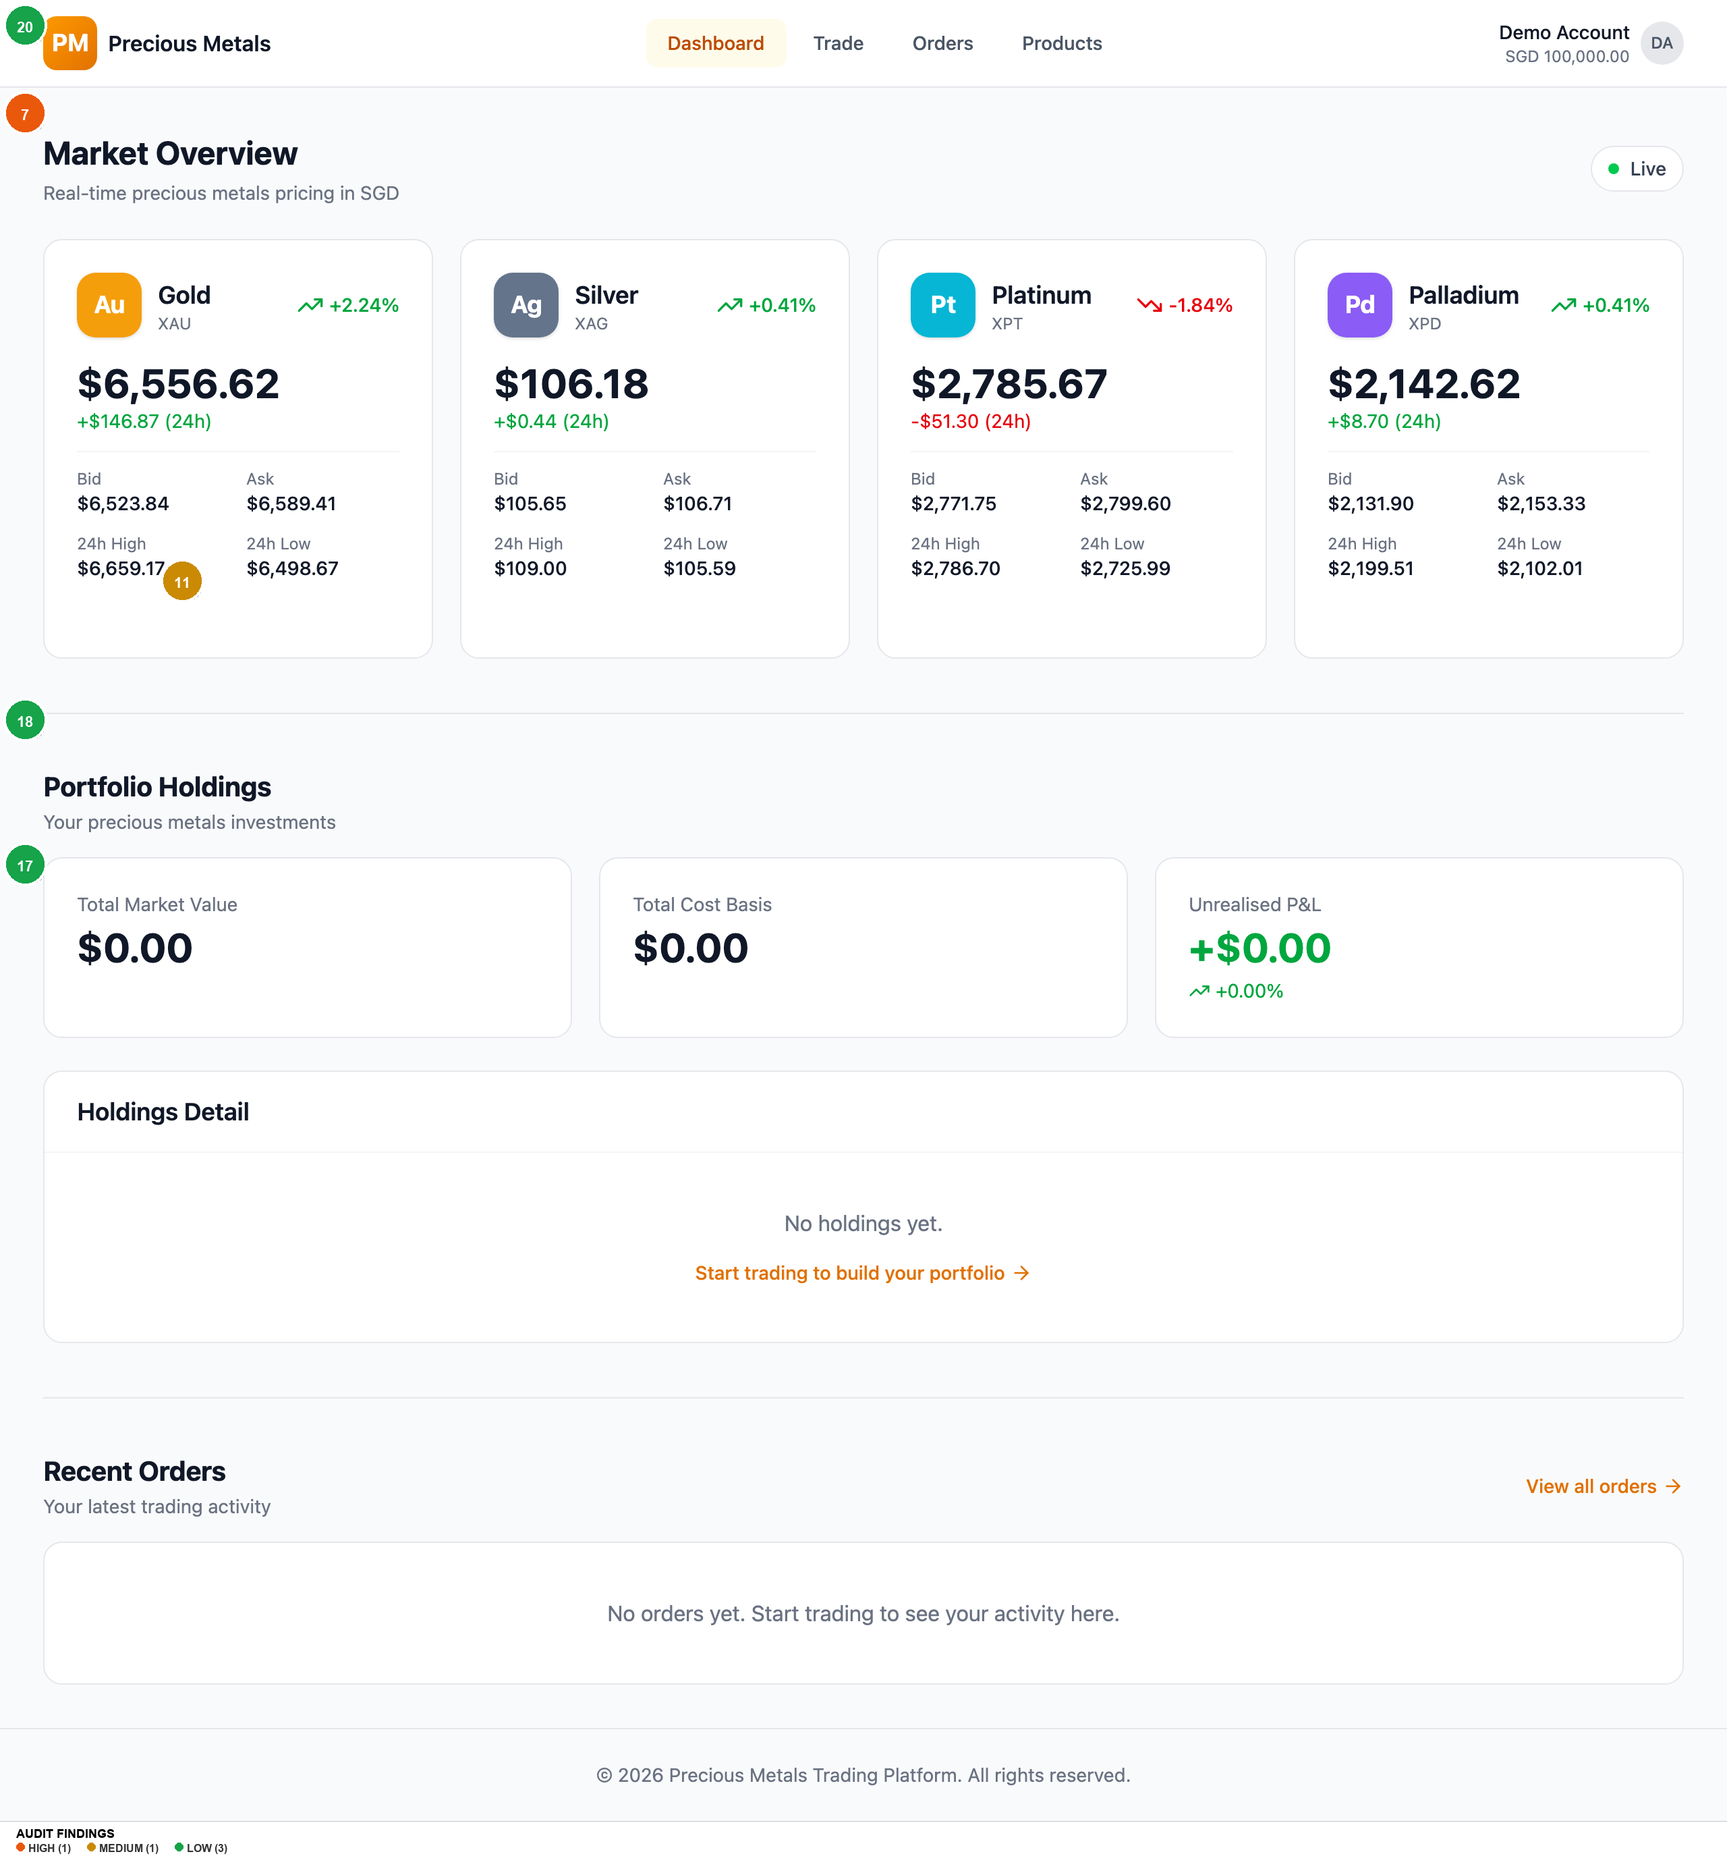
2026-03-09 (Original) — Homepage
Findings on this screen:
7
[HIGH] All 4 metal cards have equal visual weight -- no beginner guidance
→ Add 'Most Popular' badge to Gold or 'New? Start with Gold' CTA
11
[MEDIUM] Empty state CTA 'Start trading to build your portfolio' is vague
→ Change to 'Buy your first precious metal' button linking to /trade/XAU
17
[LOW] Footer only has copyright -- no Help, Terms, Privacy, regulatory links
→ Add standard footer links including regulatory information
18
[LOW] 8-row table on dashboard is too dense for novice users
→ Show 3 simplified cards, reserve full table for Orders page
20
[LOW] No skip-navigation link for keyboard users
→ Add visually hidden skip link: 'Skip to main content'

Slide 14
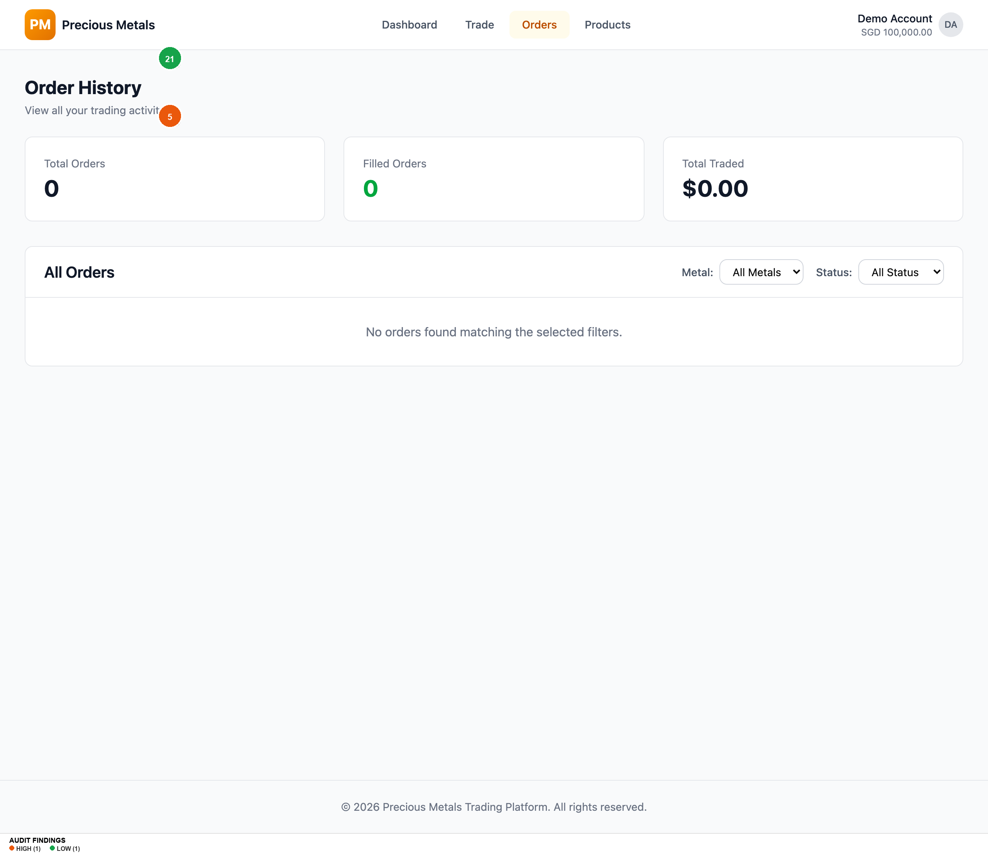
2026-03-09 (Original) — Orders
Findings on this screen:
5
[HIGH] Muted text contrast #717182 on #ececf0 fails WCAG AA at ~3.5:1
→ Darken muted foreground to at least #5e5e6e
21
[LOW] 404 page has no search or suggested links
→ Add suggested links (Dashboard, Trade, Products)

Slide 15
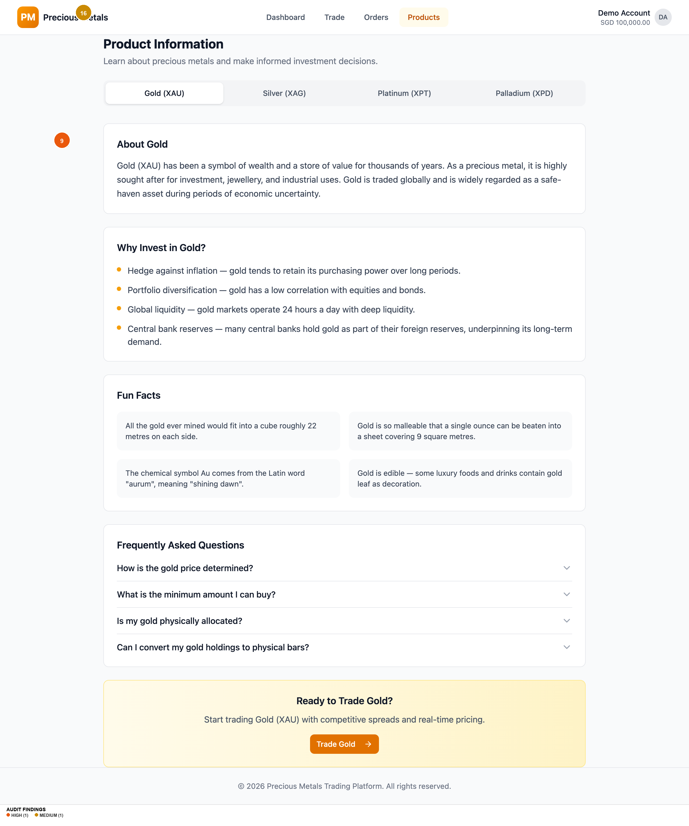
2026-03-09 (Original) — Products
Findings on this screen:
9
[HIGH] No fee disclosure, no spread cost breakdown before confirmation
→ Add cost breakdown: Metal price, Spread (0.5%), Total, Fees (S$0.00)
16
[MEDIUM] No cross-metal comparison view -- must tab between 4 metals
→ Add Compare Metals table: Price, Min Qty, Volatility, Best For

Slide 16
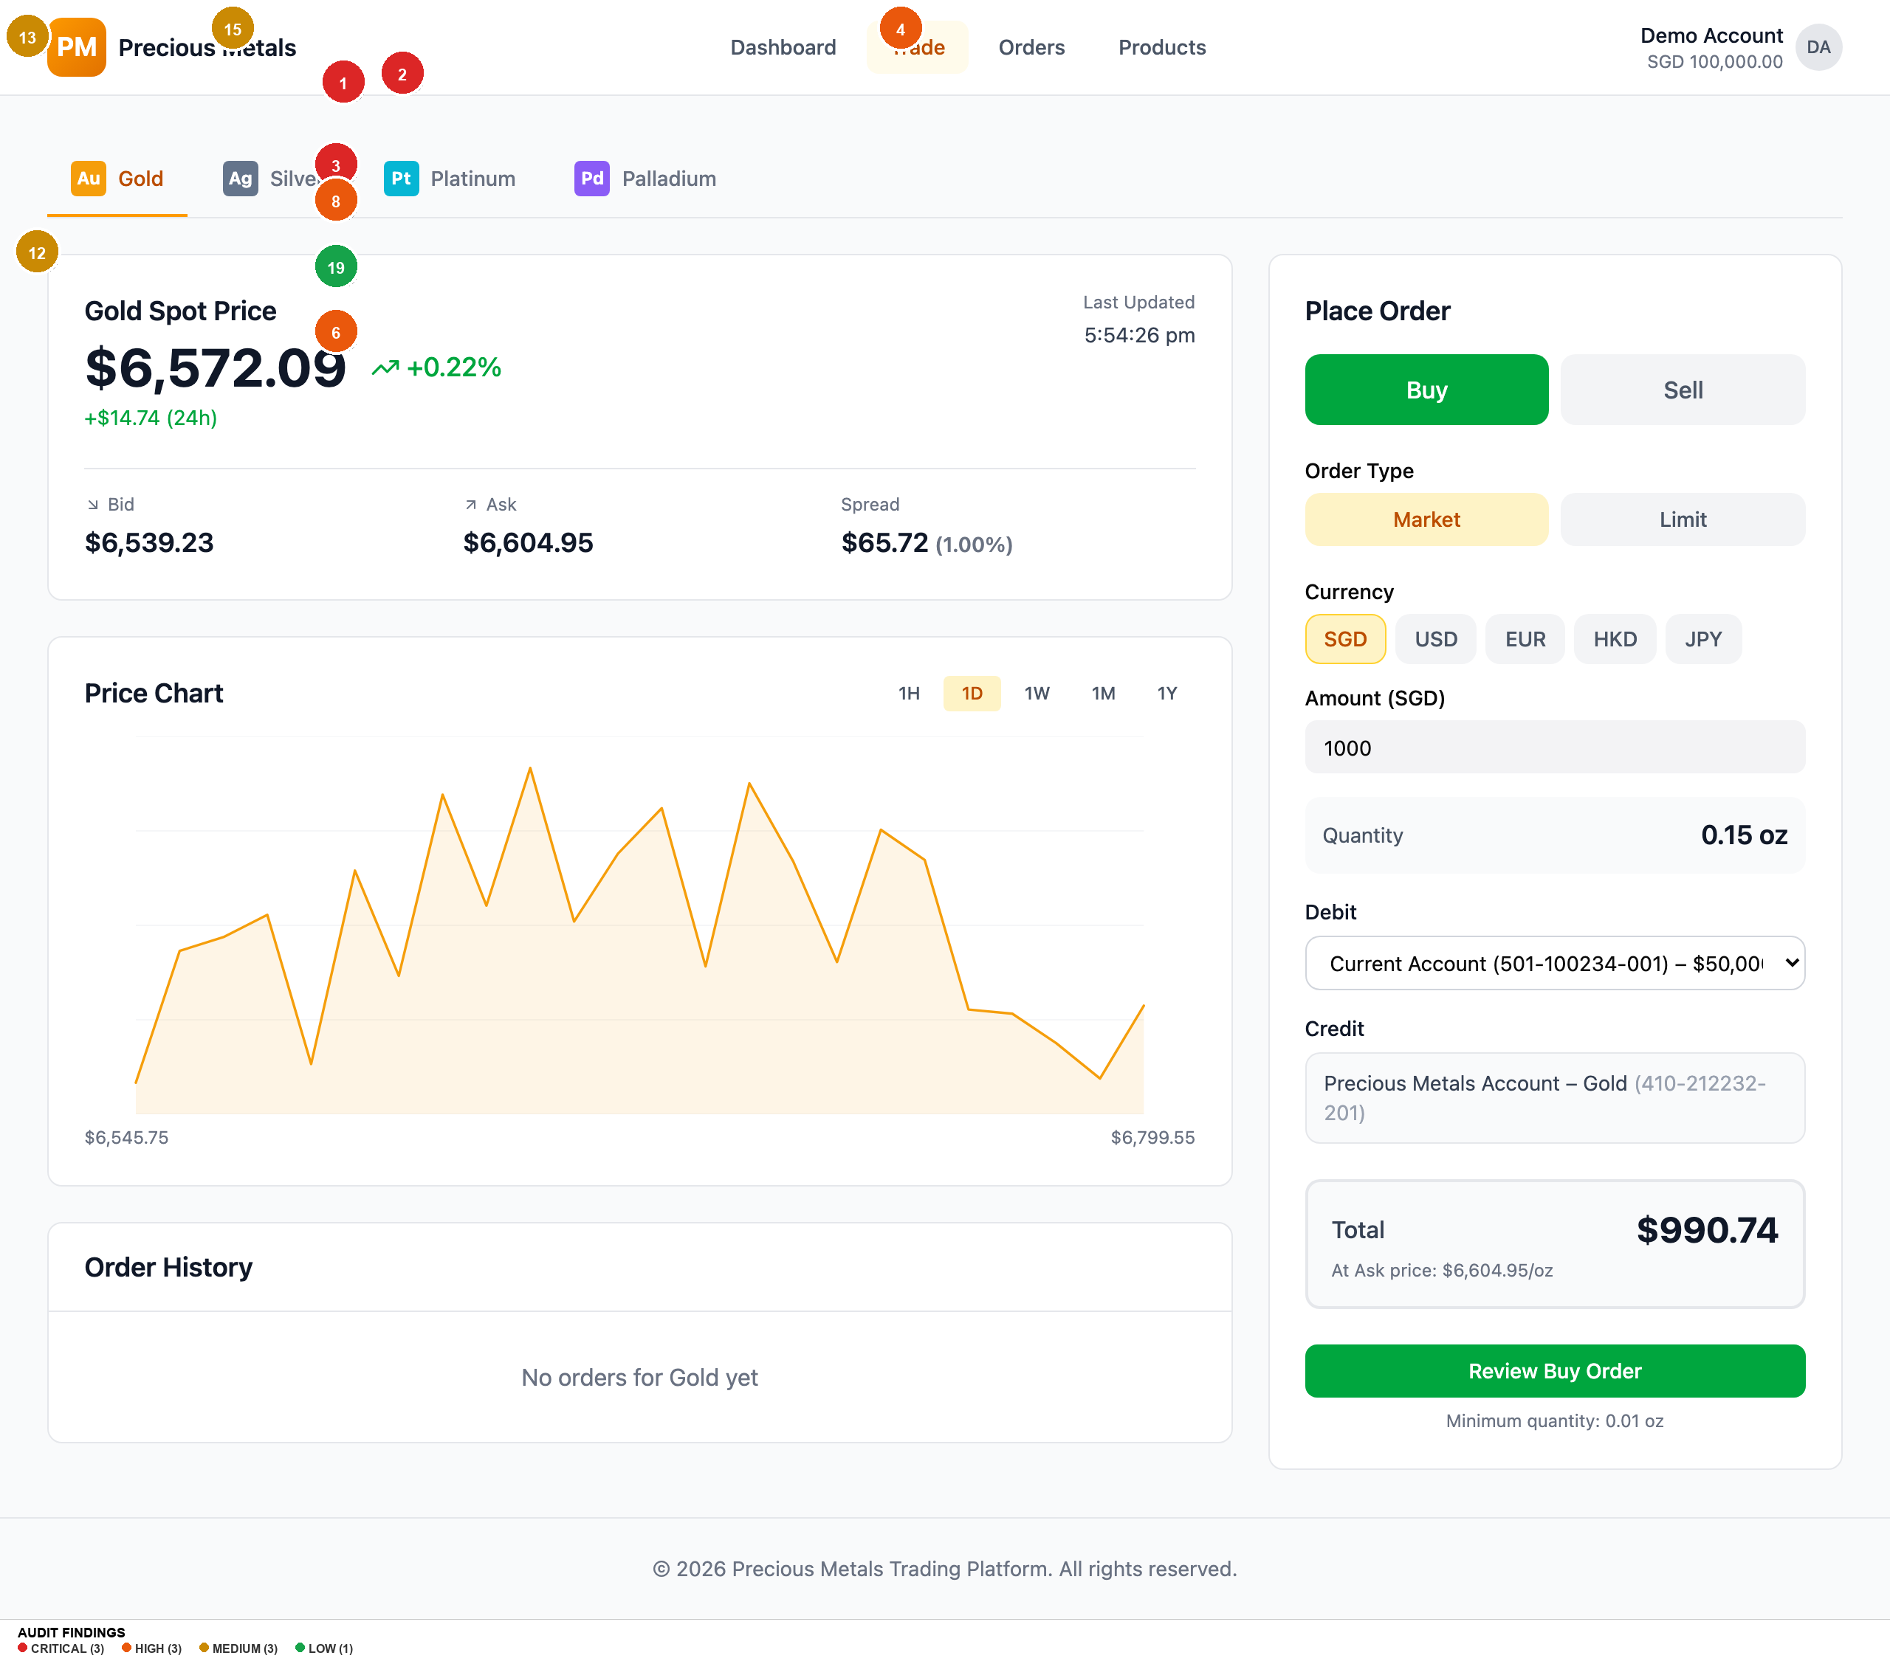
2026-03-09 (Original) — Trade Xau
Findings on this screen:
1
[CRITICAL] No onboarding or guided first-trade experience for novice investors
→ Add contextual tooltips, first-visit banner, default to Market + SGD
2
[CRITICAL] Sell toggle accessible with 0 oz holdings -- error only at validation
→ Disable Sell or show inline message when holdings = 0
3
[CRITICAL] Currency selector introduces massive cognitive load with no explanation
→ Default SGD, collapse behind 'Change currency' link
8
[HIGH] Amount field label ambiguous -- spend amount vs metal quantity unclear
→ Rename to 'I want to spend (SGD)' and show computed oz prominently
4
[HIGH] No prefers-reduced-motion support despite extensive animations
→ Add global @media (prefers-reduced-motion: reduce) rule
6
[HIGH] Button/input height 36px below WCAG 2.2 SC 2.5.8 minimum of 44px
→ Increase min-heights to 44px for coarse pointers
12
[MEDIUM] Chart has no Y-axis labels, gridlines, or volume data
→ Add Y-axis price labels, gridlines, label time buttons descriptively
13
[MEDIUM] Metal tabs use expert codes (XAU, XPT) more prominently than names
→ Show metal name first, code smaller: 'Gold (XAU)'
15
[MEDIUM] Trade nav link goes directly to Gold with no intermediate page
→ Make Trade a dropdown or remember last-traded metal
19
[LOW] Account dropdown shows full account numbers adding noise
→ Simplify to 'Current Account -- S$50,000.00'

Slide 17
2026-03-10 (Re-audit) — Executive Summary
This is an significantly improved version of the Precious Metals Trading App. The team has addressed 14 of 21 original findings, including all 3 critical issues. The sell flow now correctly prevents zero-balance sells with an inline message, tooltips provide educational scaffolding for trading terminology (Bid, Ask, Spread, Order Type), the order review page includes a full cost breakdown with explicit fee disclosure, the "Amount to Invest" label is clear with a computed "You'll receive ~X.XX ounce" display, and the Gold card carries a "Most Popular" badge to guide beginners. The muted text contrast has been fixed, a skip-navigation link has been added, and `prefers-reduced-motion` is now supported. However, 4 original issues remain unfixed and several new issues have emerged from the improvements themselves. The most significant remaining gap is that interactive element heights are still 36px (below the WCAG 2.2 44px minimum), the green-600 colour used for positive price changes and buy states fails WCAG AA contrast, and ironically, the new tooltip trigger icons meant to educate novices are themselves too small and low-contrast to be discovered. The currency selector, while now showing conversion rates, still presents all 5 currencies upfront with potential for costly accidental switches. -- Strong improvement from 6.5. Remaining issues are mostly accessibility hardening and polish rather than fundamental UX failures.

Slide 18
2026-03-10 (Re-audit) — Findings (1/3)
#
Screen
Severity
Finding
Recommendation
#1
Global -- Interactive Elements
HIGH
Button/input height still 36px (h-9) -- below WCAG 2.2 SC 2.5.8 minimum of 44px, no @media (pointer: coarse) override
Add min-height: 44px for all interactive elements via @media (pointer: coarse) query
#2
Global -- Price Changes & Buy State
HIGH
green-600 text (#16a34a) on white background fails WCAG AA at 3.30:1 -- used for positive price changes, buy toggle, and status badges
Switch to green-700 (#15803d) which passes at 4.79:1, or use green text on green-50 background only
#3
Trade -- Tooltip Triggers
HIGH
Tooltip trigger icons are gray-400 (#9ca3af) at 14px (w-3.5) -- 2.54:1 contrast fails WCAG AA and size is below WCAG 2.5.8 touch target
Increase icon size to at least 20px (w-5), darken to gray-600 (#4b5563) for 7.23:1 contrast
#4
Trade -- Order Form
HIGH
Currency selector still shows all 5 currencies upfront -- switching from SGD to JPY multiplies amounts ~111x with only a small info box warning
Default to SGD, collapse currency behind 'Change currency' link, add confirmation dialog when switching currencies mid-form
#5
Trade -- Order Form
MEDIUM
No guided first-trade walkthrough -- tooltips added but no dismissible onboarding banner or step-by-step tour for first-time users
Add a dismissible 3-step first-visit banner: 1) Choose metal, 2) Set amount, 3) Review and confirm

Slide 19
2026-03-10 (Re-audit) — Findings (2/3)
#
Screen
Severity
Finding
Recommendation
#6
Global -- Footer
MEDIUM
No footer whatsoever -- no Help, Terms, Privacy, Contact, or regulatory disclosure links
Add standard footer with: Help Centre, Terms of Service, Privacy Policy, Contact Us, MAS regulatory notice
#7
Order Confirmation
MEDIUM
No receipt download option on order confirmation -- order ID is now human-readable but no way to save proof of transaction
Add 'Download Receipt' button generating PDF with order details, timestamp, and reference number
#8
Trade -- Sell Flow
MEDIUM
Sell quantity validation error appears as auto-dismissing toast -- 'Cannot sell more than holdings' disappears after a few seconds
Show persistent inline error below the amount field instead of an auto-dismissing toast for form validation errors
#9
Trade -- Limit Orders
MEDIUM
Limit price field has no guidance -- novice user has no reference for what constitutes a reasonable limit price relative to current market
Show current bid/ask next to limit price input, add helper text: 'Current ask: $X. Set below to wait for a dip.'
#10
Trade -- Price Display
MEDIUM
Live price refreshes every 5 seconds with no visual indicator of update -- prices change silently, user may not notice stale vs fresh data
Add subtle pulse/flash animation on price change, show 'Updated Xs ago' countdown near the timestamp

Slide 20
2026-03-10 (Re-audit) — Findings (3/3)
#
Screen
Severity
Finding
Recommendation
#11
Trade -- Debit Account
LOW
Account dropdown still shows full account numbers (501-100234-001) adding visual noise
Simplify to 'Current Account -- S$50,000.00'. Show account numbers only in account settings.
#12
Trade -- Price Chart
LOW
Chart time interval buttons display abbreviations (1H, 1D, 1W) as primary labels -- tooltips help but novices may not hover
Show full labels on desktop ('1 Hour', '1 Day') or at minimum on first visit
#13
Global
LOW
No responsive font scaling -- base font-size is fixed at 16px with no breakpoint adjustments for larger/smaller screens
Use fluid typography: clamp(14px, 1vw + 0.5rem, 18px) for base, or add media query adjustments at sm/lg breakpoints
#14
Products Page
LOW
Compare All Metals table requires explicit toggle -- users must discover and click 'Compare All Metals' link, defaults to hidden
Show comparison table by default on desktop, collapse to toggle on mobile only
#15
Trade -- Order Form
LOW
Order form shows 'Minimum quantity: X ounce' at bottom of form -- easy to miss, only discovered after validation failure
Move minimum quantity notice next to the 'You'll receive' display where quantity context is visible

Slide 21
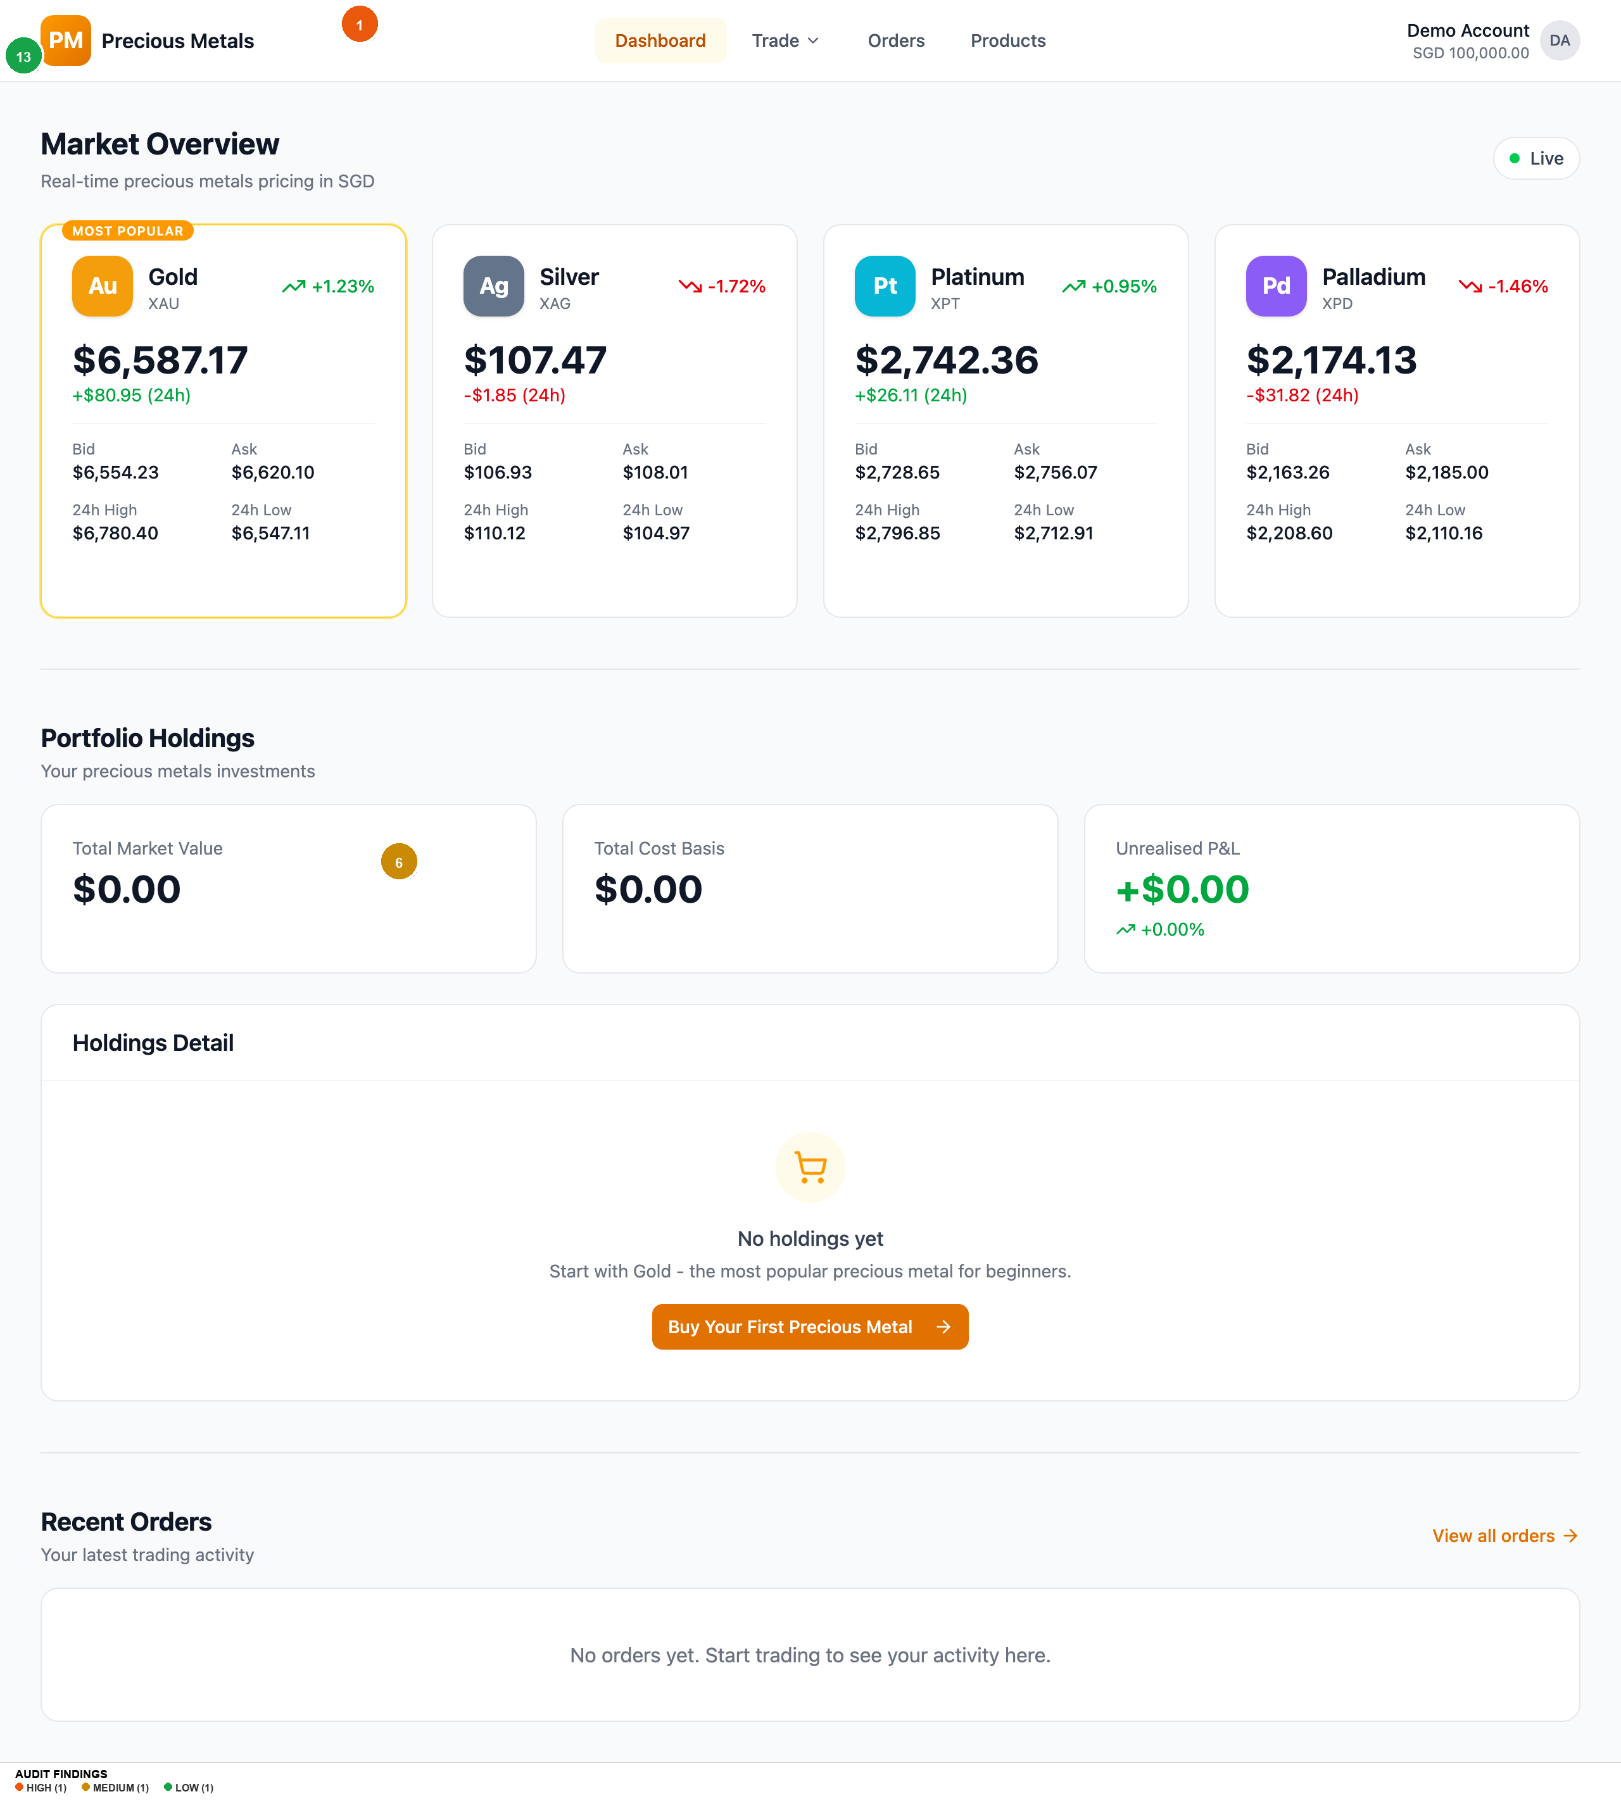
2026-03-10 (Re-audit) — Homepage
Findings on this screen:
1
[HIGH] Button/input height still 36px (h-9) -- below WCAG 2.2 SC 2.5.8 minimum of 44px, no @media (pointer: coarse) override
→ Add min-height: 44px for all interactive elements via @media (pointer: coarse) query
6
[MEDIUM] No footer whatsoever -- no Help, Terms, Privacy, Contact, or regulatory disclosure links
→ Add standard footer with: Help Centre, Terms of Service, Privacy Policy, Contact Us, MAS regulatory notice
13
[LOW] No responsive font scaling -- base font-size is fixed at 16px with no breakpoint adjustments for larger/smaller screens
→ Use fluid typography: clamp(14px, 1vw + 0.5rem, 18px) for base, or add media query adjustments at sm/lg breakpoints

Slide 22
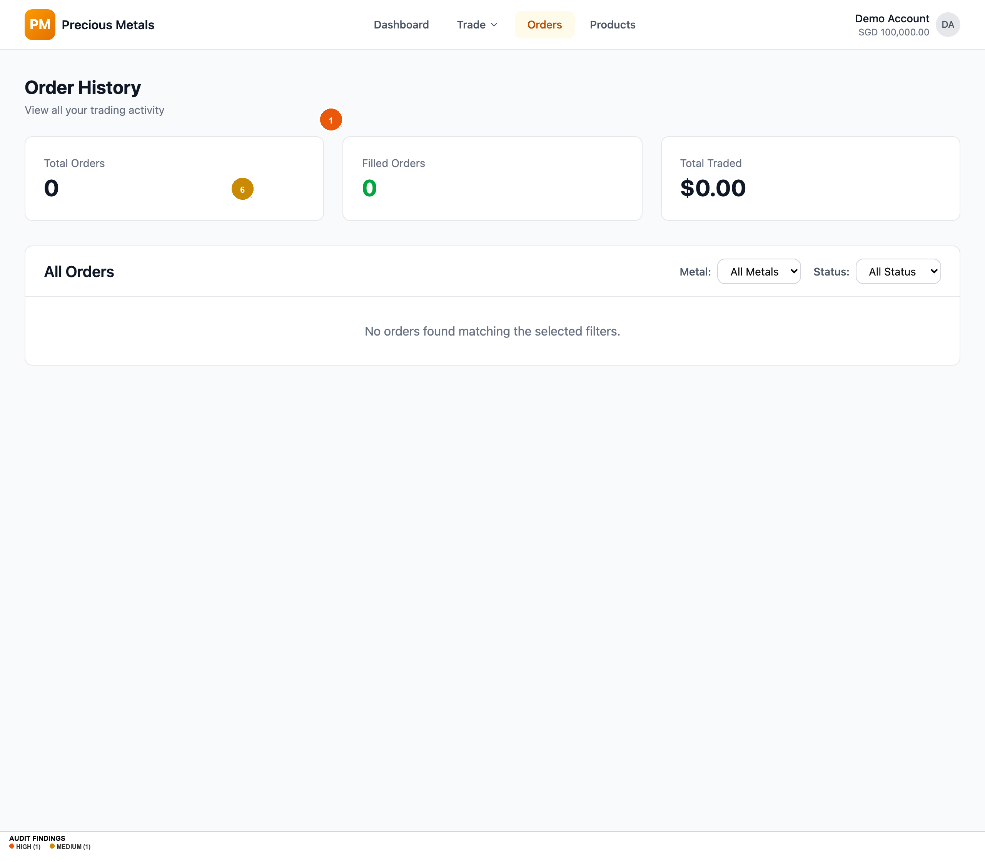
2026-03-10 (Re-audit) — Orders
Findings on this screen:
1
[HIGH] Button/input height still 36px (h-9) -- below WCAG 2.2 SC 2.5.8 minimum of 44px, no @media (pointer: coarse) override
→ Add min-height: 44px for all interactive elements via @media (pointer: coarse) query
6
[MEDIUM] No footer whatsoever -- no Help, Terms, Privacy, Contact, or regulatory disclosure links
→ Add standard footer with: Help Centre, Terms of Service, Privacy Policy, Contact Us, MAS regulatory notice

Slide 23

2026-03-10 (Re-audit) — Products
Findings on this screen:
14
[LOW] Compare All Metals table requires explicit toggle -- users must discover and click 'Compare All Metals' link, defaults to hidden
→ Show comparison table by default on desktop, collapse to toggle on mobile only

Slide 24
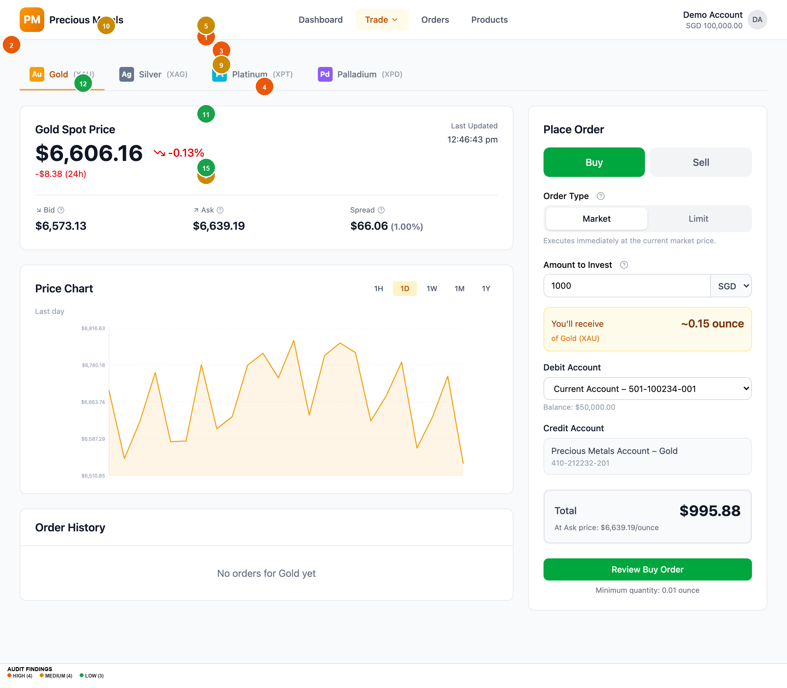
2026-03-10 (Re-audit) — Trade Xau
Findings on this screen:
2
[HIGH] green-600 text (#16a34a) on white background fails WCAG AA at 3.30:1 -- used for positive price changes, buy toggle, and status badges
→ Switch to green-700 (#15803d) which passes at 4.79:1, or use green text on green-50 background only
3
[HIGH] Tooltip trigger icons are gray-400 (#9ca3af) at 14px (w-3.5) -- 2.54:1 contrast fails WCAG AA and size is below WCAG 2.5.8 touch target
→ Increase icon size to at least 20px (w-5), darken to gray-600 (#4b5563) for 7.23:1 contrast
4
[HIGH] Currency selector still shows all 5 currencies upfront -- switching from SGD to JPY multiplies amounts ~111x with only a small info box warning
→ Default to SGD, collapse currency behind 'Change currency' link, add confirmation dialog when switching currencies mid-form
1
[HIGH] Button/input height still 36px (h-9) -- below WCAG 2.2 SC 2.5.8 minimum of 44px, no @media (pointer: coarse) override
→ Add min-height: 44px for all interactive elements via @media (pointer: coarse) query
5
[MEDIUM] No guided first-trade walkthrough -- tooltips added but no dismissible onboarding banner or step-by-step tour for first-time users
→ Add a dismissible 3-step first-visit banner: 1) Choose metal, 2) Set amount, 3) Review and confirm
8
[MEDIUM] Sell quantity validation error appears as auto-dismissing toast -- 'Cannot sell more than holdings' disappears after a few seconds
→ Show persistent inline error below the amount field instead of an auto-dismissing toast for form validation errors
9
[MEDIUM] Limit price field has no guidance -- novice user has no reference for what constitutes a reasonable limit price relative to current market
→ Show current bid/ask next to limit price input, add helper text: 'Current ask: $X. Set below to wait for a dip.'
10
[MEDIUM] Live price refreshes every 5 seconds with no visual indicator of update -- prices change silently, user may not notice stale vs fresh data
→ Add subtle pulse/flash animation on price change, show 'Updated Xs ago' countdown near the timestamp
11
[LOW] Account dropdown still shows full account numbers (501-100234-001) adding visual noise
→ Simplify to 'Current Account -- S$50,000.00'. Show account numbers only in account settings.
12
[LOW] Chart time interval buttons display abbreviations (1H, 1D, 1W) as primary labels -- tooltips help but novices may not hover
→ Show full labels on desktop ('1 Hour', '1 Day') or at minimum on first visit
15
[LOW] Order form shows 'Minimum quantity: X ounce' at bottom of form -- easy to miss, only discovered after validation failure
→ Move minimum quantity notice next to the 'You'll receive' display where quantity context is visible

Slide 25
Top 5 Priority Recommendations (Current)
1
Fix WCAG 2.2 Touch Target Compliance
Quick Win
What to fix: Interactive element heights (buttons, inputs, selects) are 36px, below the 44px minimum. | Why it matters: WCAG 2.2 SC 2.5.8 failure. Legal compliance risk for a financial product. Touch users on tablets/touchscreens will struggle. | How to fix it: Add `@media (pointer: coarse) { button, input, select, [role="button"] { min-height: 44px; } }`. Consider increasing default height to h-10 (40px) for all pointers.
2
Fix Green Text Contrast for Price Changes
Quick Win
What to fix: green-600 (#16a34a) on white background fails WCAG AA at 3.30:1. Used extensively for positive price movements and buy state. | Why it matters: Price direction (up/down) is critical information in a trading app. Low-vision users literally cannot distinguish positive from negative prices. | How to fix it: Replace green-600 with green-700 (#15803d) which passes at 4.79:1. Or always pair green text with green-50 background for 4.79:1.
3
Make Tooltip Triggers Discoverable
Quick Win
What to fix: The educational tooltip icons (ⓘ) are 14px with 2.54:1 contrast. They're the gateway to all novice-friendly content but nearly invisible. | Why it matters: The team invested in excellent tooltip content (Bid, Ask, Spread, Order Type explanations) but the entry point is hidden in plain sight. Novice users -- the exact target audience -- will never discover them. | How to fix it: (a) Increase to 20px (w-5 h-5). (b) Darken to gray-600. (c) On first visit, auto-open one tooltip to teach the pattern. (d) Consider using text labels "What's this?" instead of icon-only triggers.
4
Collapse Currency Selector with Confirmation
Medium Lift
What to fix: 5 currencies shown upfront in dropdown. Switching from SGD to JPY changes the entire form with a ~111x multiplier. | Why it matters: A novice investor in Singapore trading in SGD has no reason to see JPY/EUR/HKD options. Accidental switches cause confusion and potential financial mistakes. | How to fix it: (a) Default to SGD, show "Change currency" link. (b) When clicked, show currency options. (c) On selection, show a confirmation: "Switch to Japanese Yen? Your amount will be converted at 1 SGD = 111.11 JPY."
5
Add Regulatory Footer and Receipt Downloads
Medium Lift
What to fix: No footer with regulatory links. No receipt download on order confirmation. | Why it matters: A financial trading product requires Terms, Privacy, and regulatory disclosure (MAS in Singapore). Users need transaction records for tax and disputes. | How to fix it: (a) Add footer: Help, Terms, Privacy, Contact, "Regulated by MAS" notice. (b) Add "Download Receipt" on confirmation page generating PDF.

Slide 26
What's Working Well
Excellent educational tooltip content.
The Bid/Ask/Spread/Order Type tooltips are well-written, concise, and genuinely helpful. The tooltip architecture (va/wa components) with hover+click triggers is thoughtful. The content quality is first-rate -- just needs more visible trigger icons.
Cost transparency on order review.
The cost breakdown (mid price, spread 0.5%, effective ask/bid price, quantity, total, explicit "No additional fees") is exactly what a financial product needs. This builds trust and meets regulatory standards.
Intelligent sell-flow error prevention.
The sell toggle now shows an inline message ("You don't have any Gold to sell. Buy some first to start selling.") with a direct "Buy Gold" CTA. This is textbook error prevention -- the user never enters a dead-end.
Strong beginner guidance architecture.
"Most Popular" badge on Gold, "Buy Your First Precious Metal" CTA in empty holdings, metal-specific "Best For" labels (Beginners, Growth-oriented, Experienced), Compare All Metals table with volatility ratings -- the information architecture now actively guides novice investors rather than treating all users as experts.
Improved navigation and information architecture.
Trade dropdown with all 4 metals, "Gold (XAU)" tab format (name-first, code-second), human-readable order IDs (PM-2026-XXXX), and a comprehensive 404 page with suggested links. Navigation now serves both discovery and direct access patterns. ---

Slide 27
Thank You
Generated by UX Audit Skill · Comparative Audit

