Slide 1
Transformer and BERT based Automatic COVID-19 Fake News Detection System
Xinchi Shi

Slide 2
Pipeline
Freeze Parameters
BiLSTM
Dataset description
Words Pre-processing
Pre-trained BERT
Model
Evaluation
Freeze Parameters
BiLSTM

Slide 3
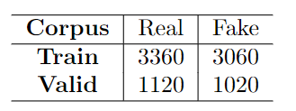
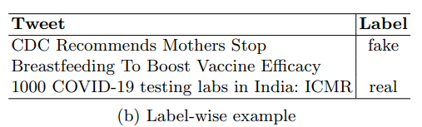
Dataset Description
containing 8,560 data points collected from various online social networks such as Twitter, Facebook, and Instagram, etc
Each data contains social media data points and their corresponding labels, either real or fake.
(a) Dataset Statistics

Slide 4
Dataset split
We combine those two datasets together and randomly split data into training set (90%) and test set (10%) using the set seed method.
7,704 Training set (90%)
856 Test set (10%)

Slide 5
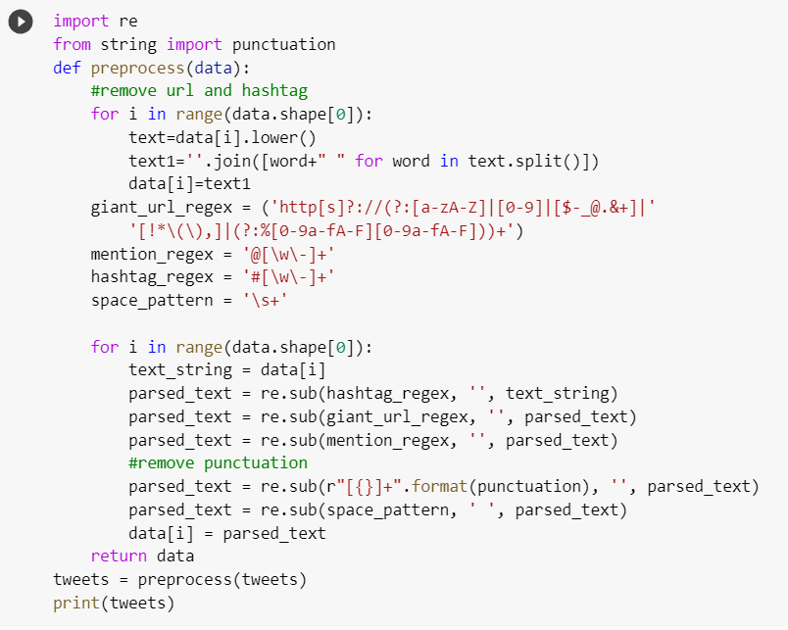
Data Pre-processing
1) Text cleaning
Remove URL
Remove hashtag #
Remove parenthesis ()
Remove punctutaion
Convert to lower case

Slide 6
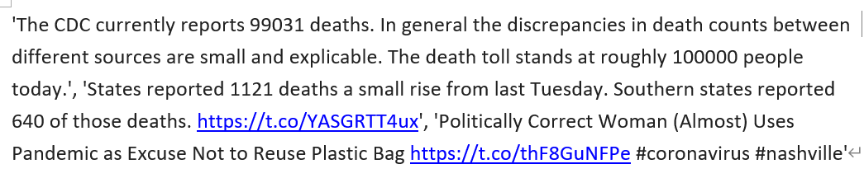
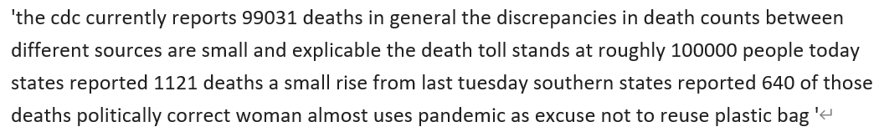
1) Text cleaning

Slide 7
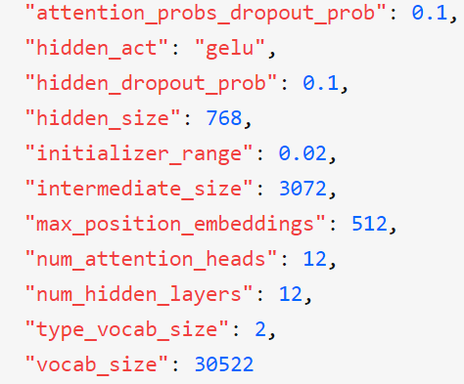
2) Tokenize
bert-base-uncased:

Slide 8
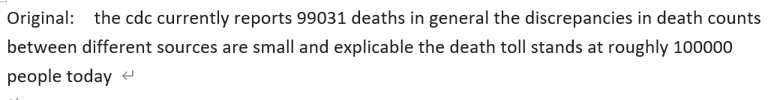
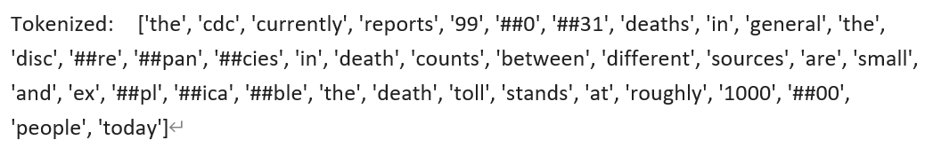
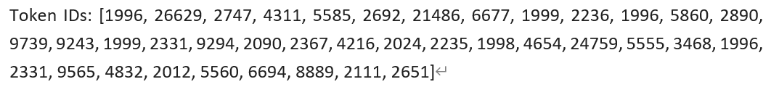
2) Example of tokenize

Slide 9
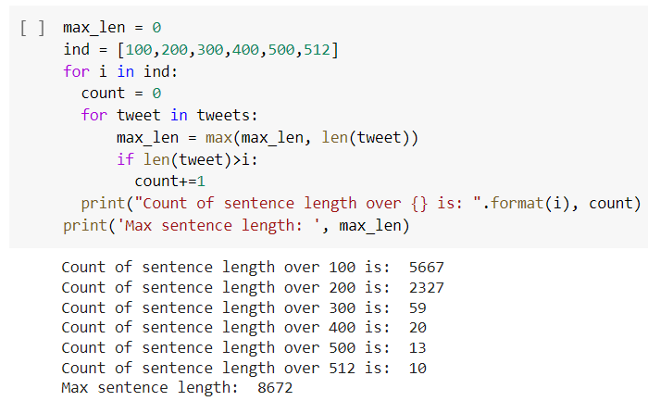
3) Encode (Padding and trunction)
BERT requires that all sentences must have the same fixed length and the max length of 512 tokens per setence.
We found out that only 10 out of 8560 rows has length that is over 512. Hence, we set up our max length to 512.

Slide 10
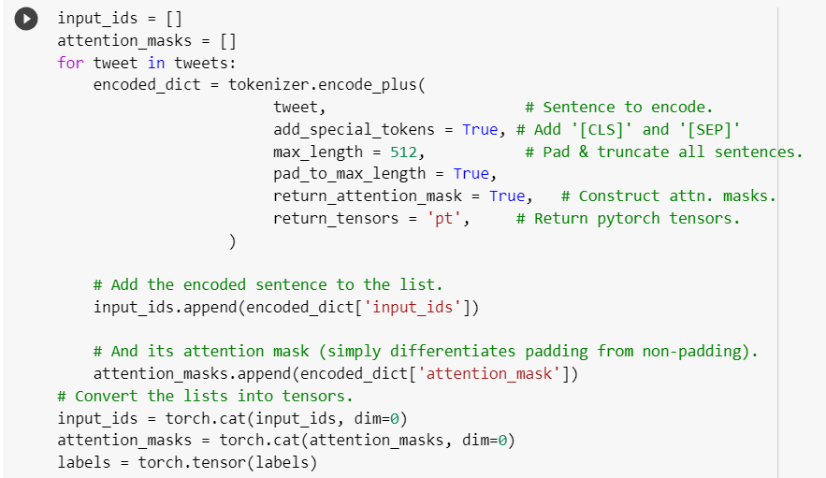
3) Encode (Padding and trunction)
We also use Attention Masks. The purpose of adding the masks is to ensure not incorporate the padded tokens into the interpretation of the sentences

Slide 11
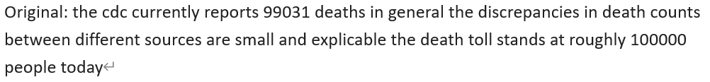
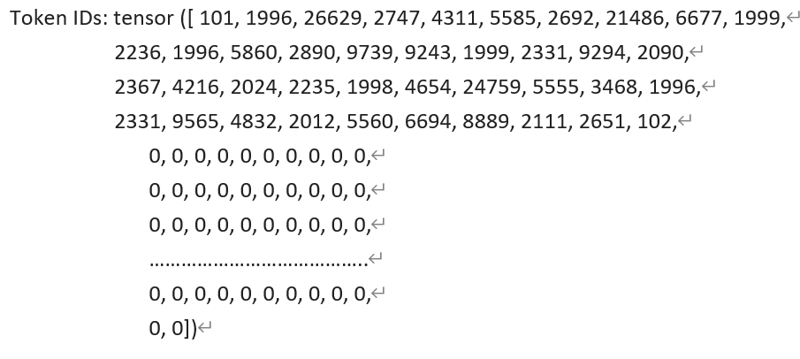
3) Example of encode

Slide 12
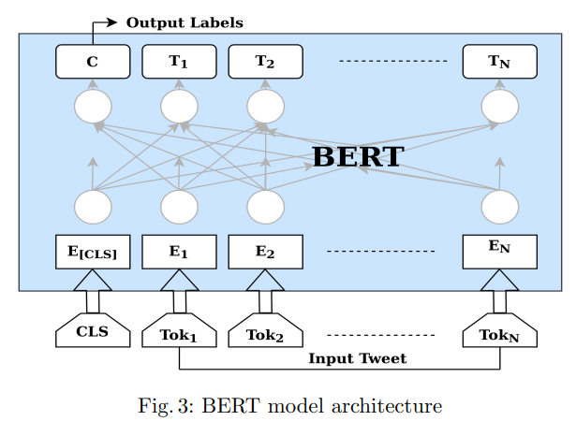
BERT
BERT implementation has two steps
Pre-training: the model is trained on unseen data over various pretraining problems using a dataset in a particular language or in increases data with multiple languages
Fine-tuning: all the initialized parameters are fine-tuned using the labeled data from certain tasks

Slide 13
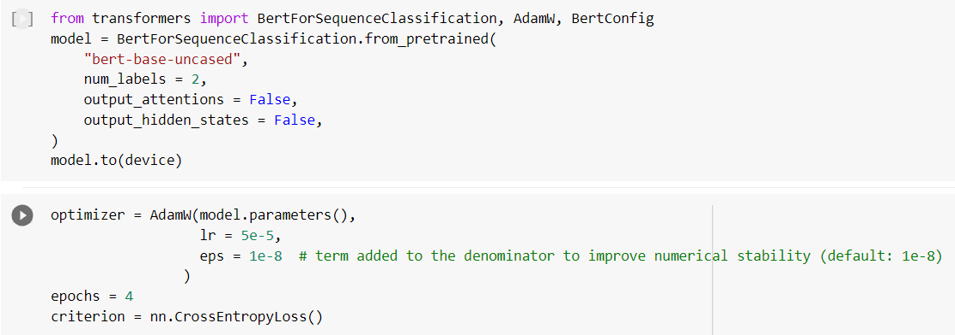
BERT Fine-tuning
First, we apply the BertForSequenceClassification model.
Second, we use 4 epochs to fine-tune the BERT model.

Slide 14
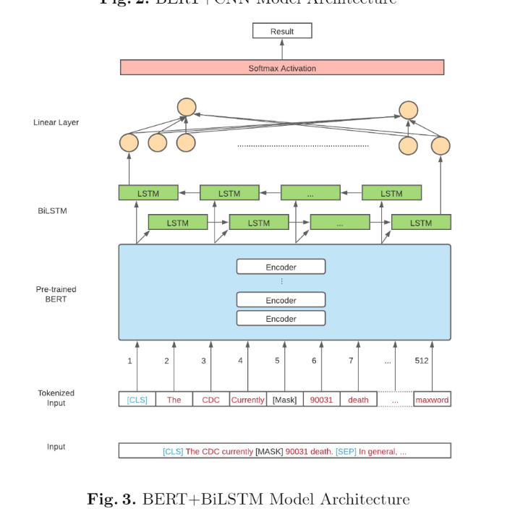
BERT + BiLSTM

Slide 15
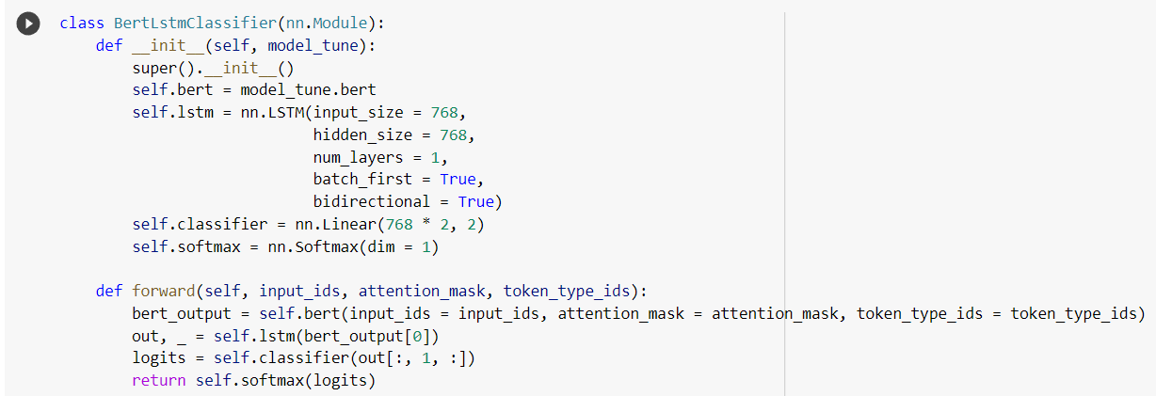
Build the model of BERT-BiLSTM

Slide 16
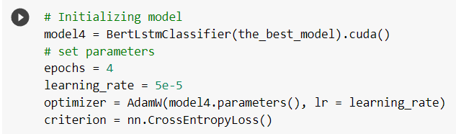
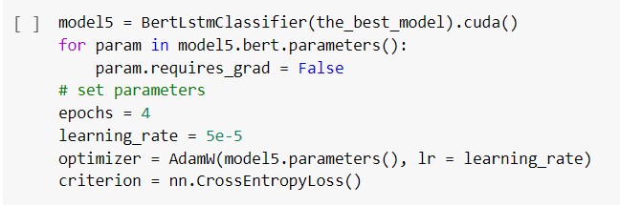
Initialize the model and parameters
Frozen parameters
Without frozen parameters

Slide 17
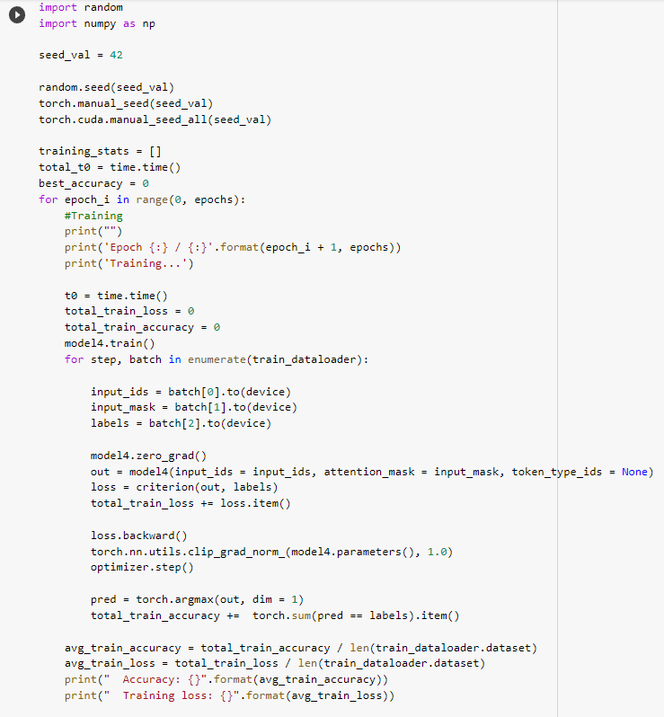
Training the model

Slide 18
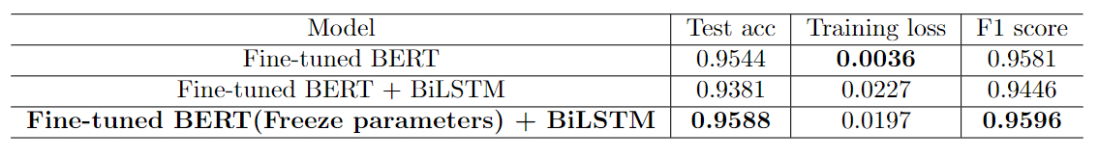
Results and Evaluation
Table: Model Evaluation
Fine-tuned BERT (Freeze parameters) + BiLSTM has the highest Test accuracy and F1 score
Fine-tuned BERT has minimum Training loss

Slide 19
Discussions
Limitations:
One possible reason for unsatisfactory performances of the model with unfrozen parameters could be that the scale of the dataset is unable to support to train such large models.
The reason why the performance of BERT (Freeze parameters) + BiLSTM model improves little compared to Fine-tuned BERT may be the small number of epochs
We may need to use other methods such as cross-validation to achieve a stronger convincing conclusion

Slide 20
Conclusion and Future work
We adopt three BERT-based deep learning models for the CVOID-19 fake news detection task.
The Fine-tuned BERT model is our base model and we add additional layers (BiLSTM) at the top of the based model with and without frozen parameters approaches.
It shows that combining BERT with BiLSTM using freezing parameters yields better performance than other models.
For our future work, we should enlarge our training dataset size, increase the number of training epochs and use different hyper-parameters in the model. Also, we can try to apply a variety of additional layers besides BiLSTM.

Slide 21
References
Gundapu, S. and Mamidi, R., 2021. Transformer based automatic COVID-19 fake news detection system. arXiv preprint arXiv:2101.00180.
Wang, Y., Zhang, Y., Li, X. and Yu, X., 2021. COVID-19 Fake News Detection Using Bidirectional Encoder Representations from Transformers Based Models. arXiv preprint arXiv:2109.14816.

Slide 22

THANKS!

