Slide 1


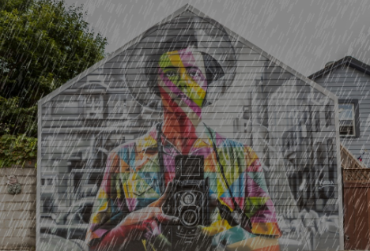





Please think with the image, identify the distortions, and decide which tools can be used for restoration.
This image contains rain, noise, and blur. The most suitable task to restore the image is Deraining, and the recommended tool is MPRNet.
Instruction
🚀
🚩
RestoraMind
Response
$$I^{LQ}$$
$${\hat{I_{1}}}^{HQ}$$
{Noise Sigma: 0.12
Edge Density: 0.08
Color Bias: 4.1 …}
{Noise Sigma: 0.12
Edge Density: 0.08
Color Bias: 4.1 …}
Image Statistics
ToolBox
Image Statistics
Input
Reasoning
Output
Notes:
User instruction

